Slide 1


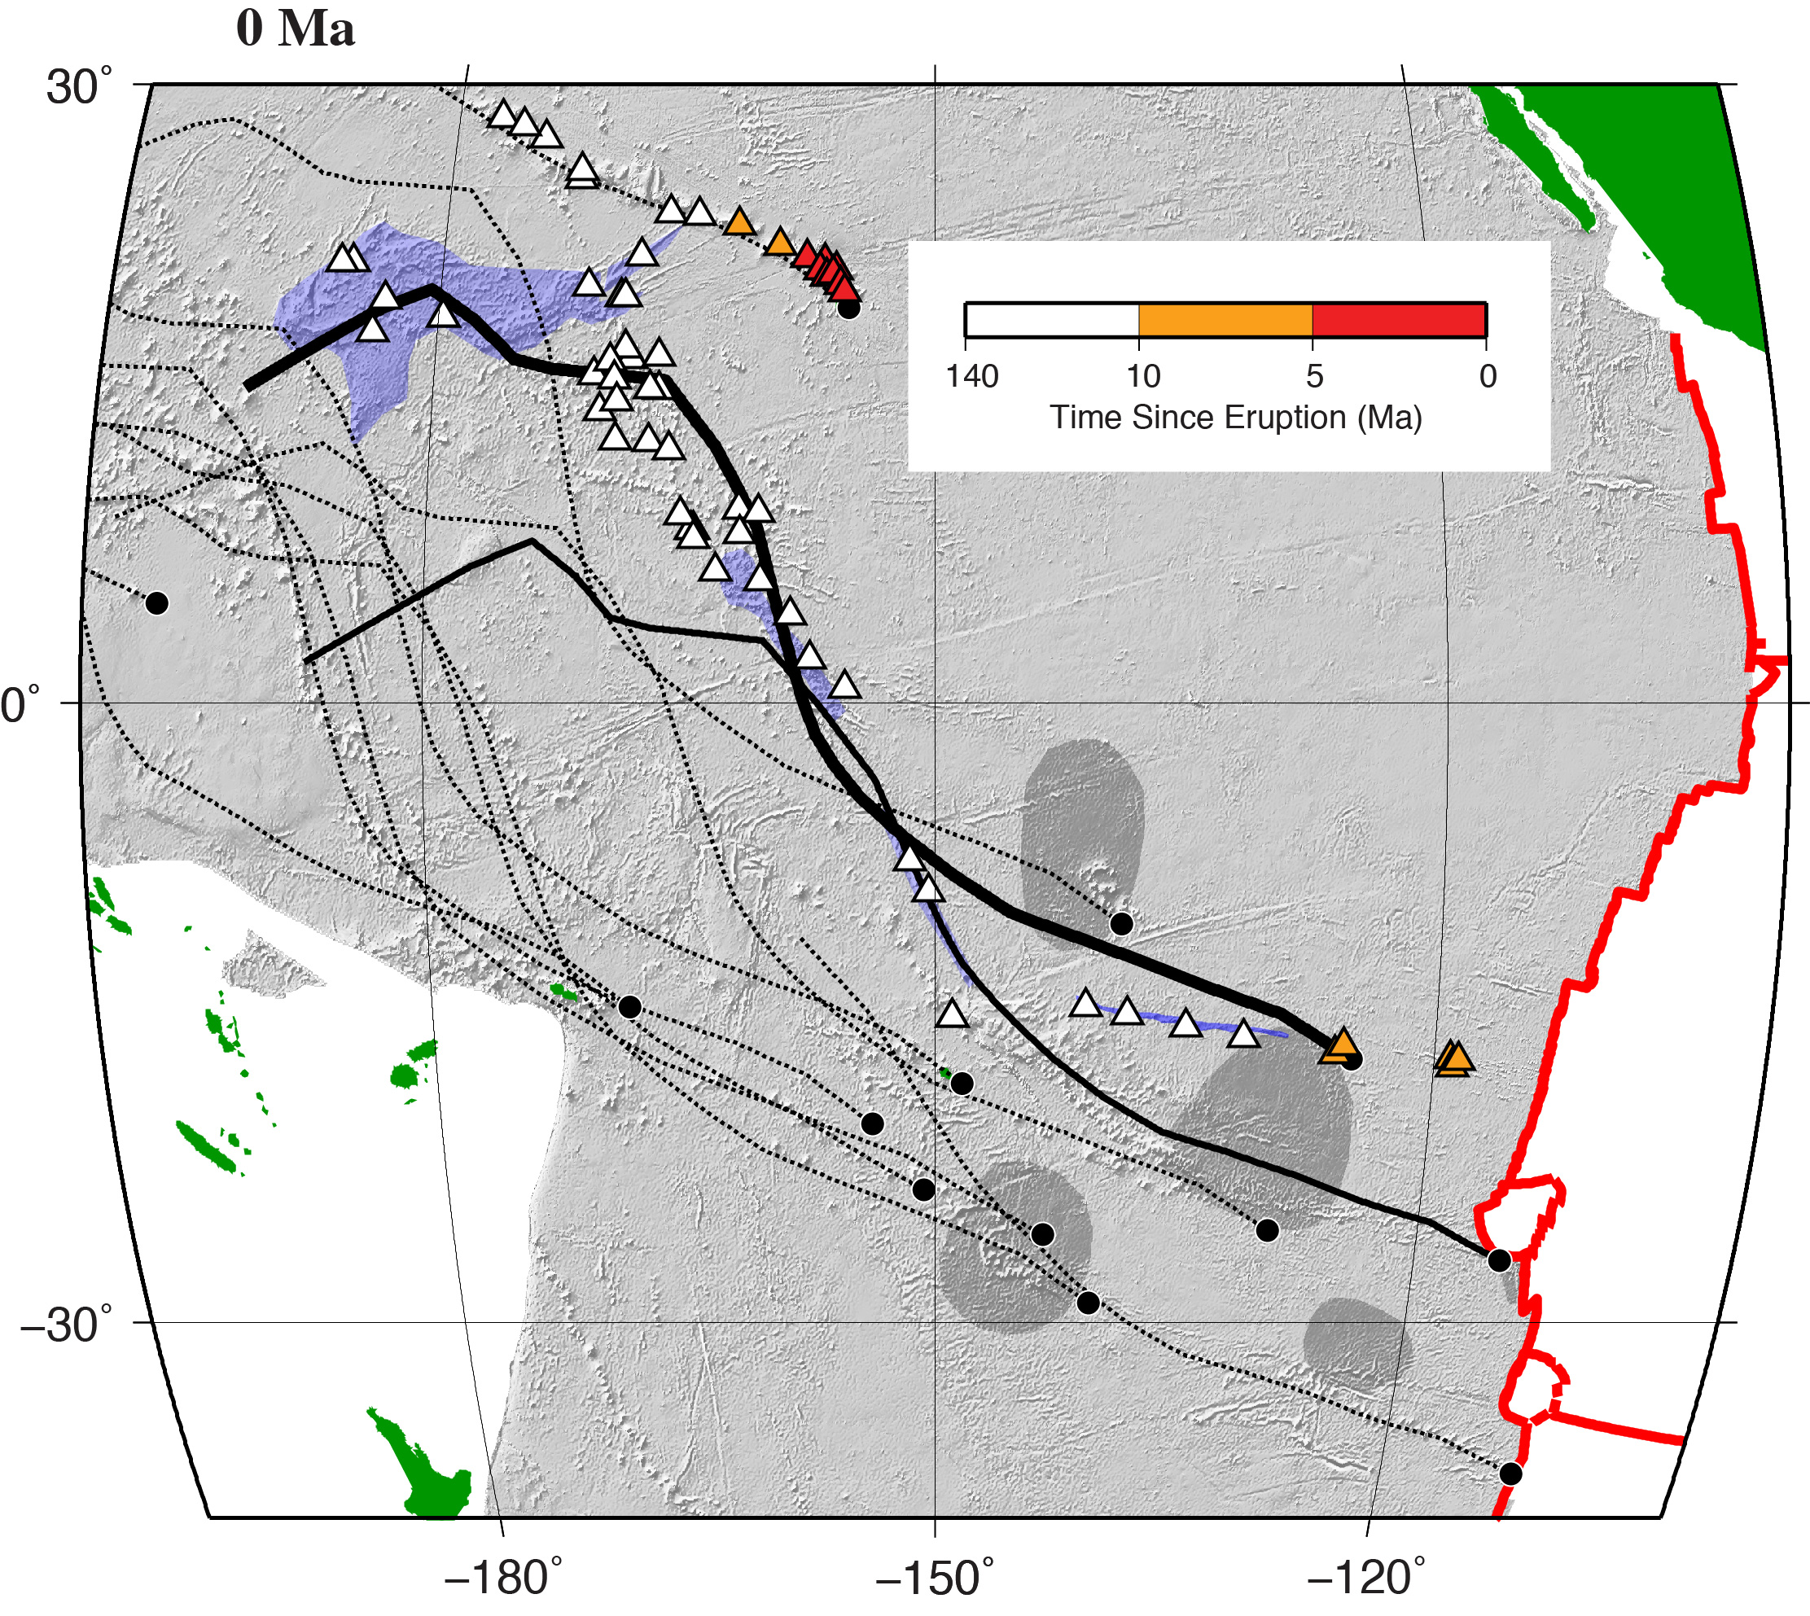
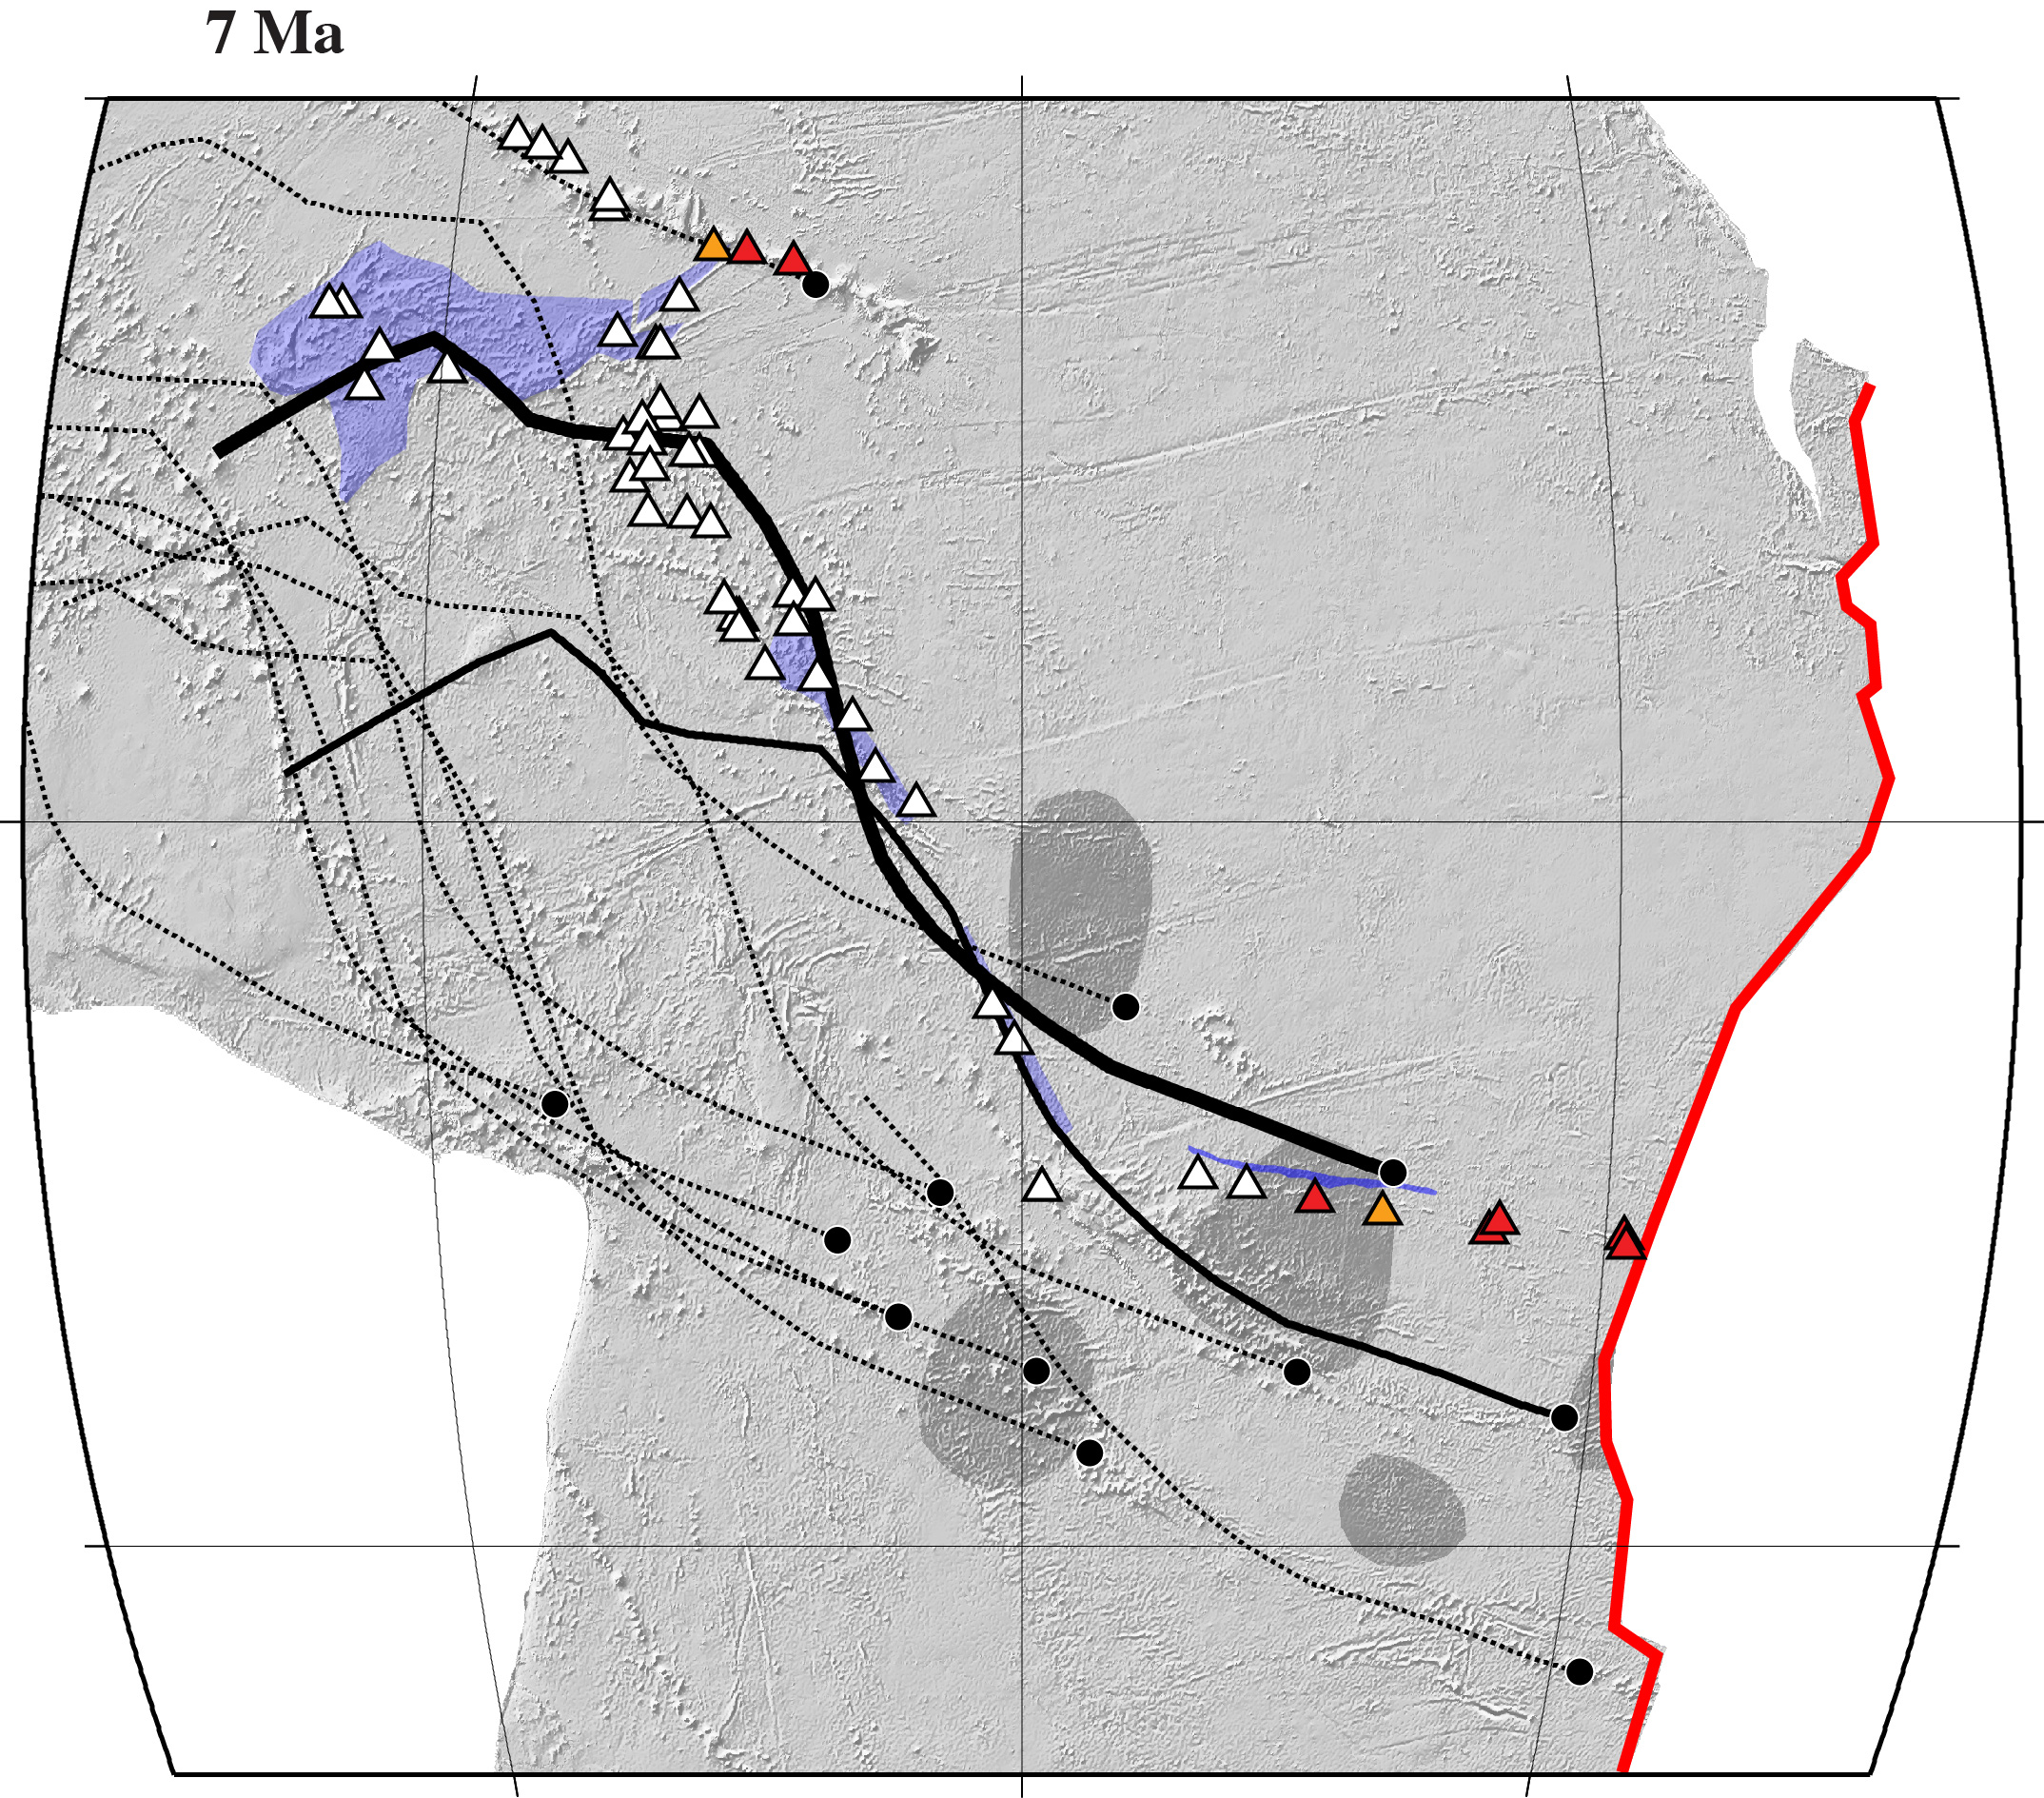
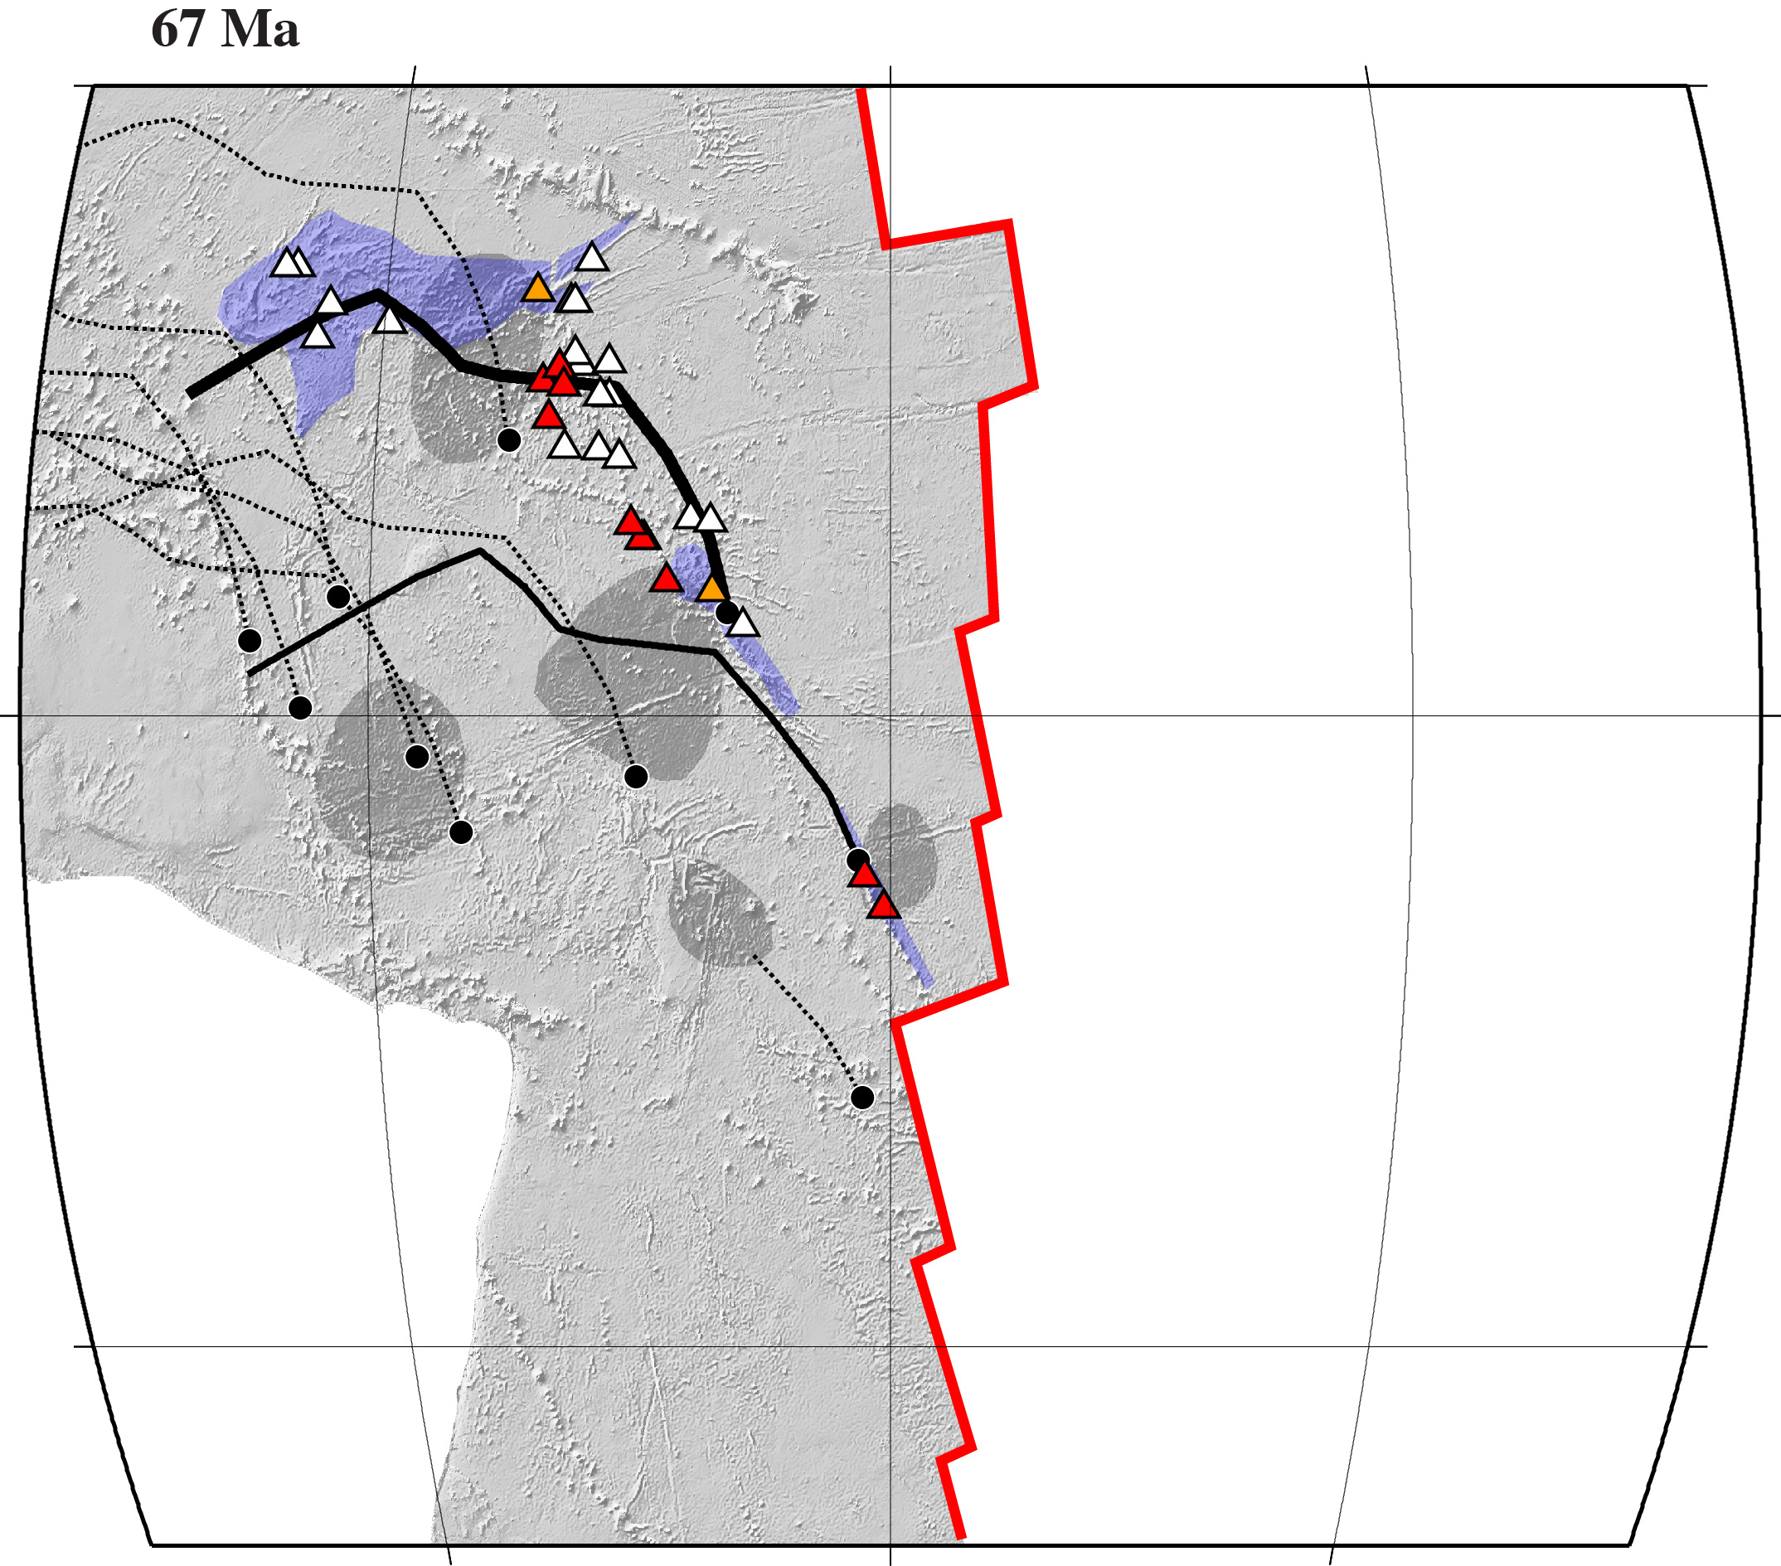
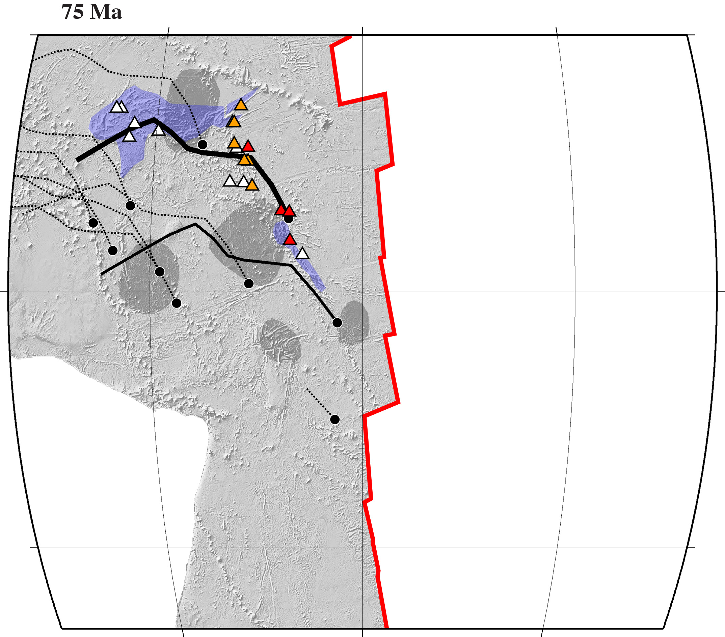
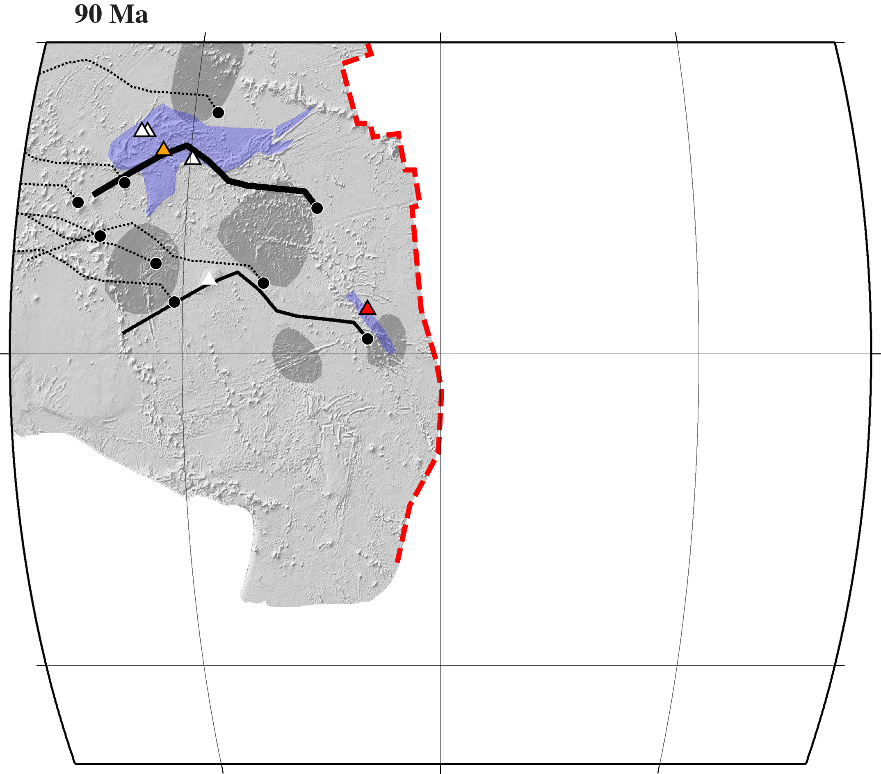
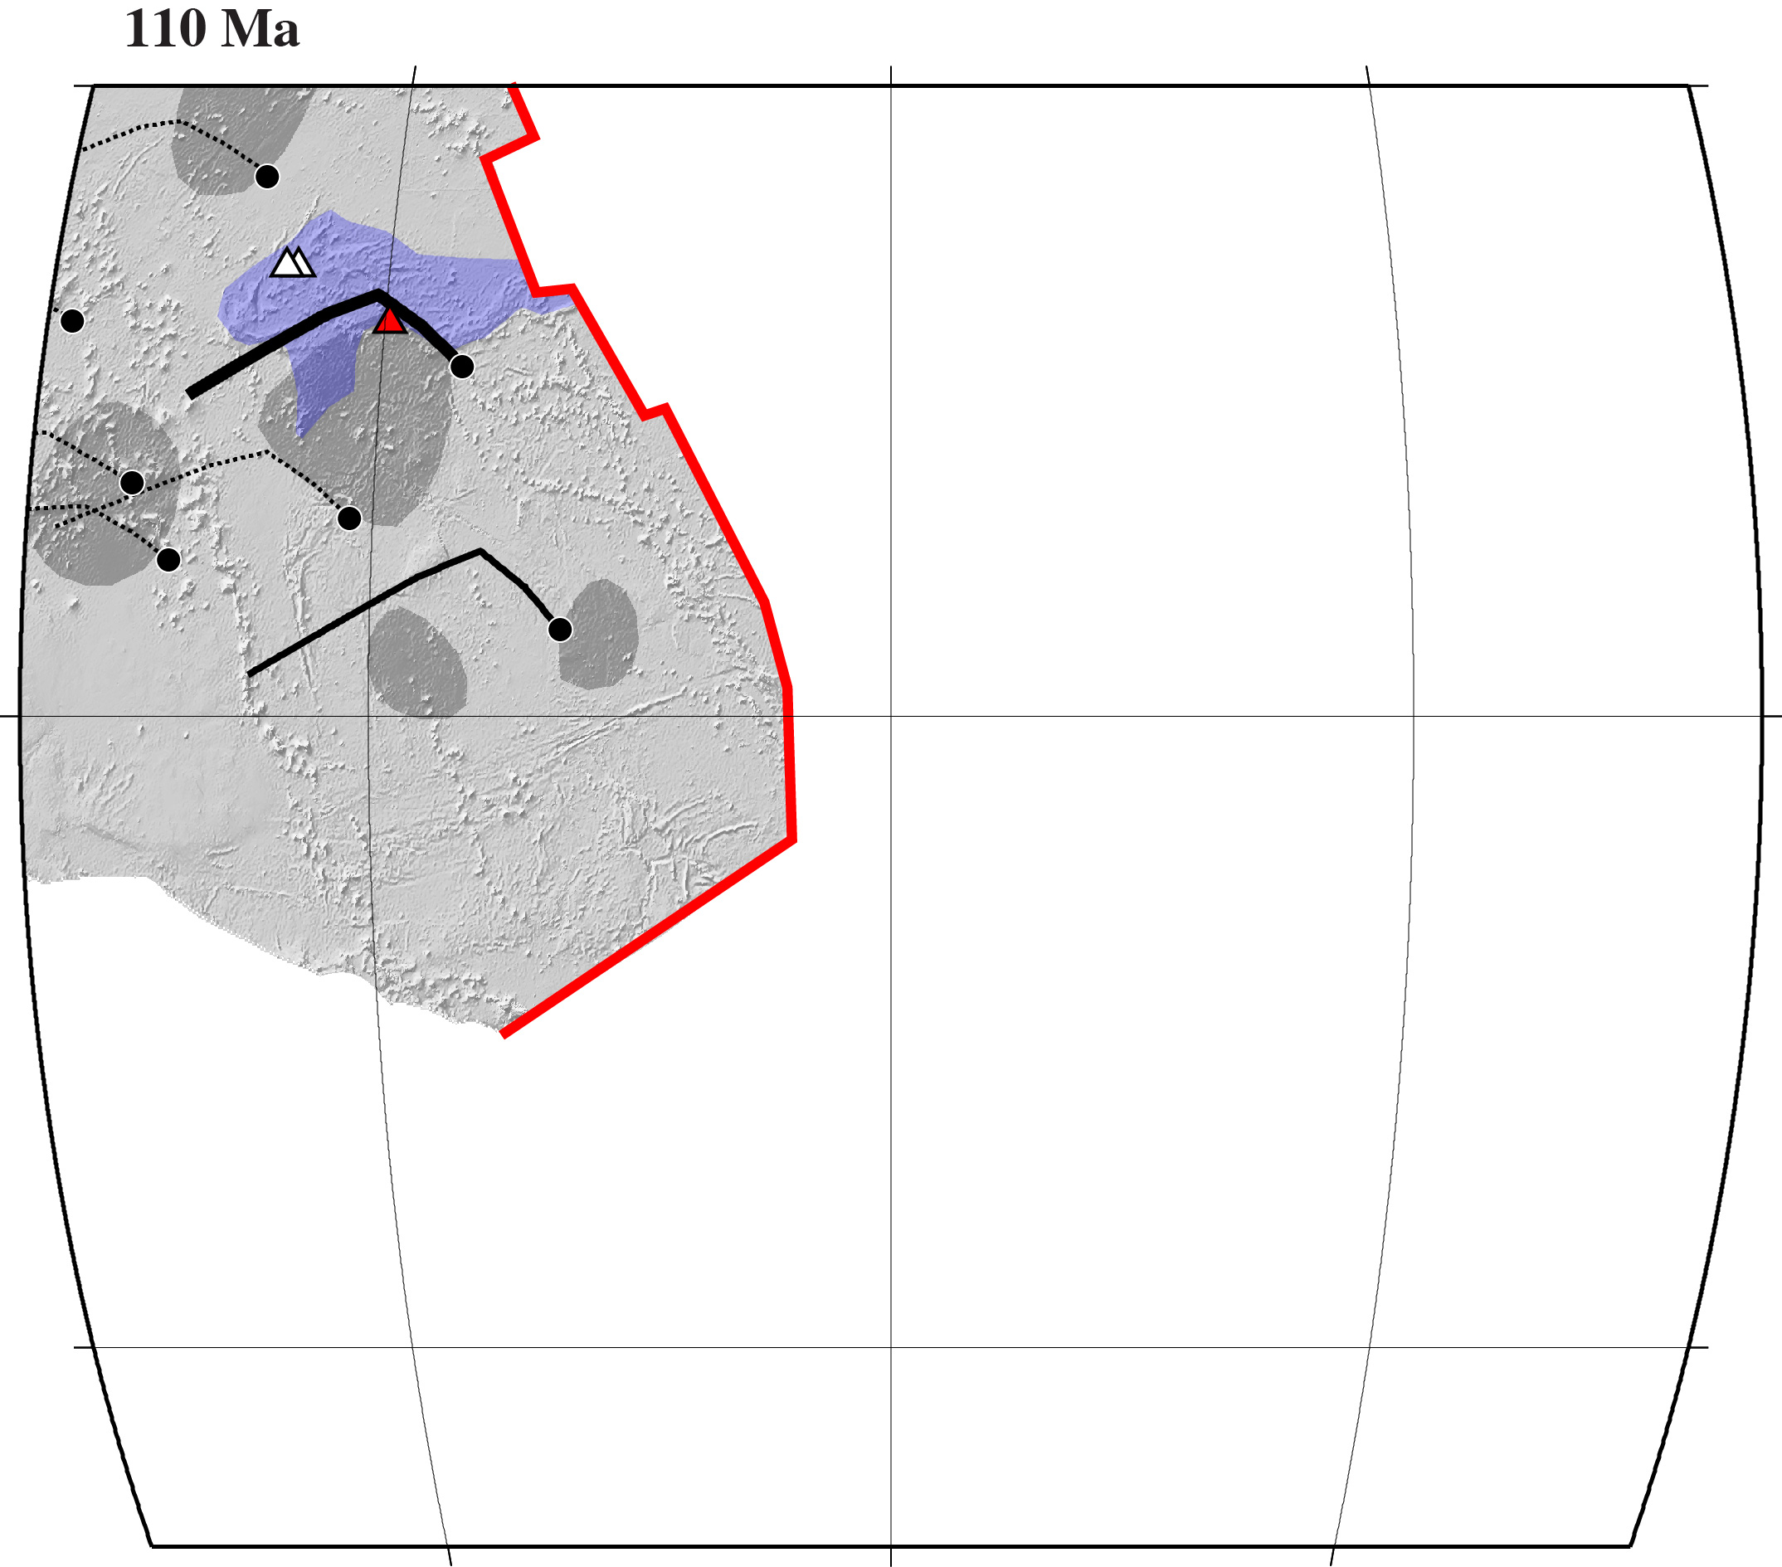
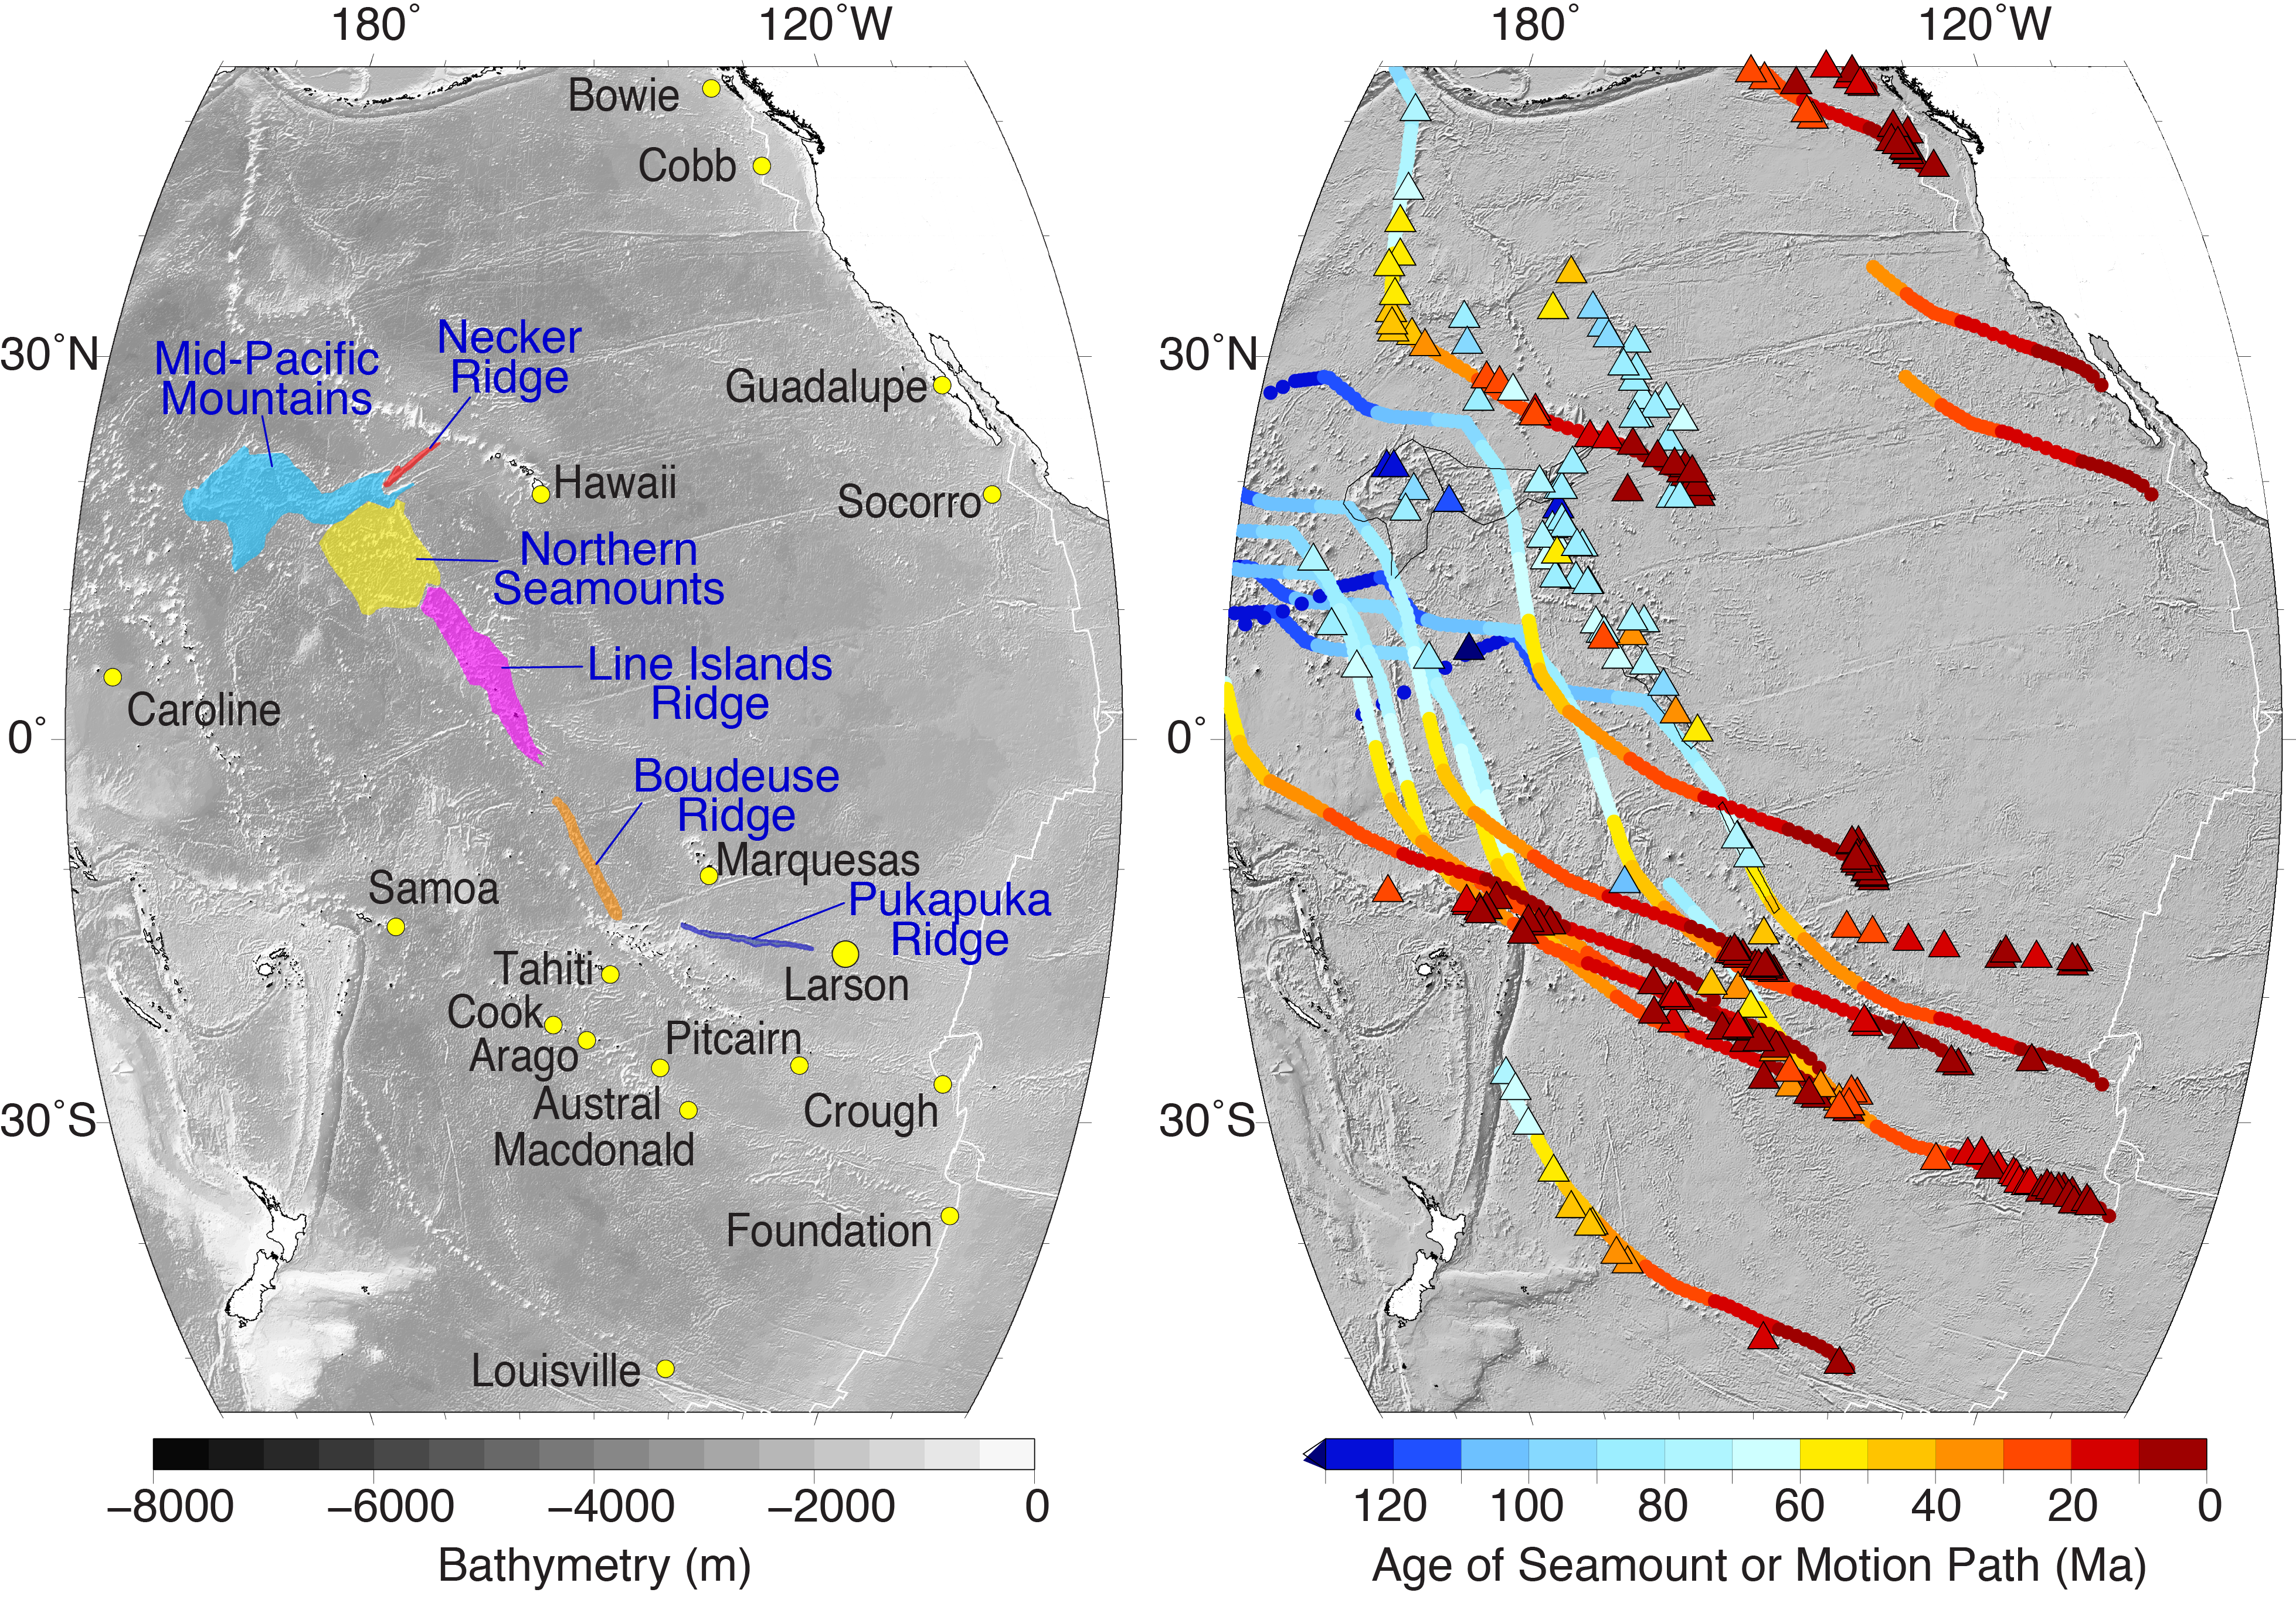
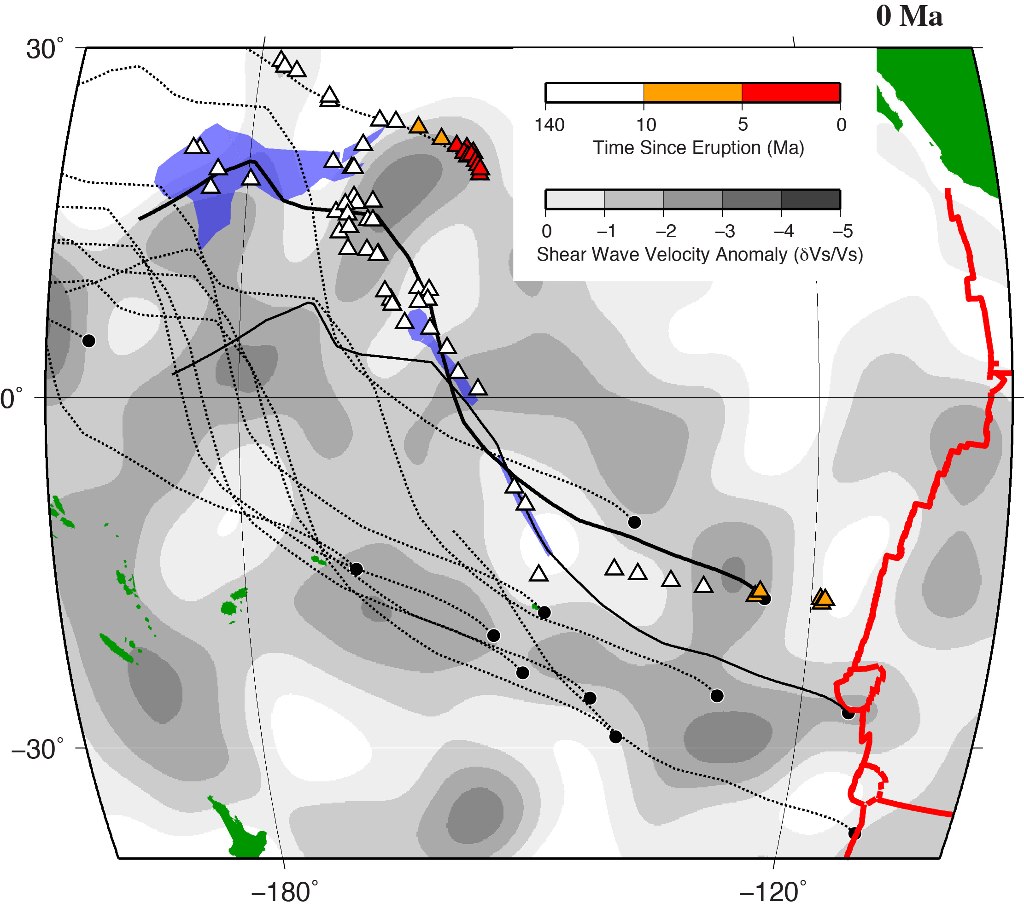
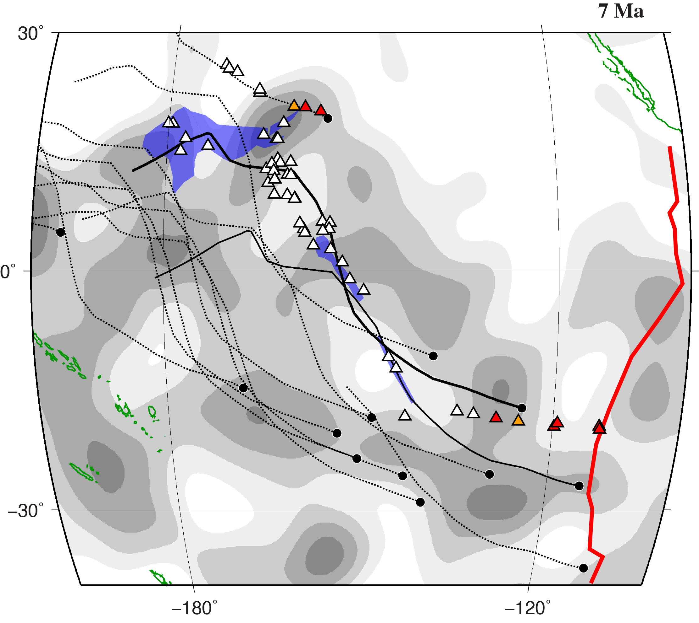
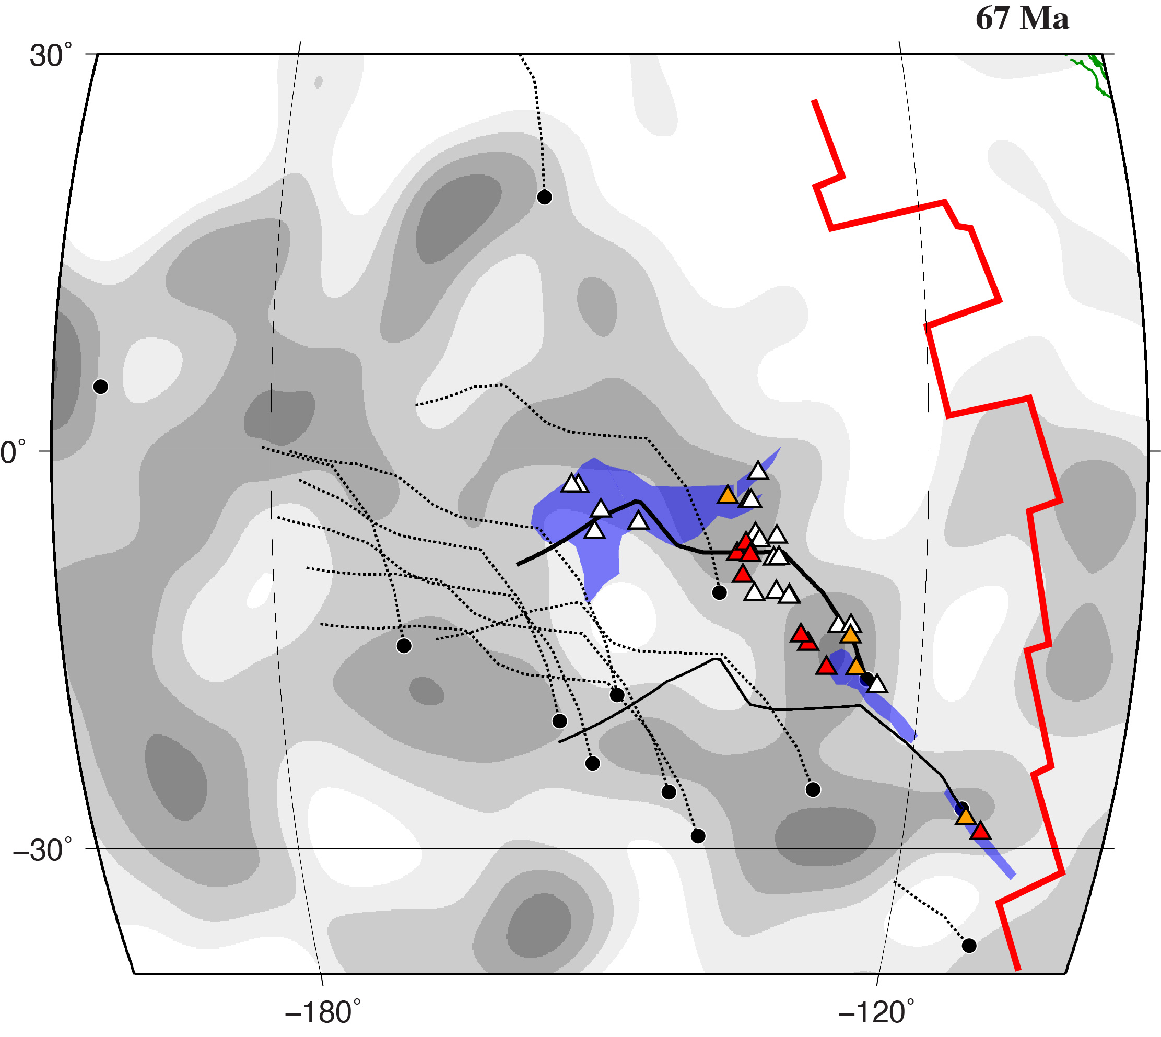
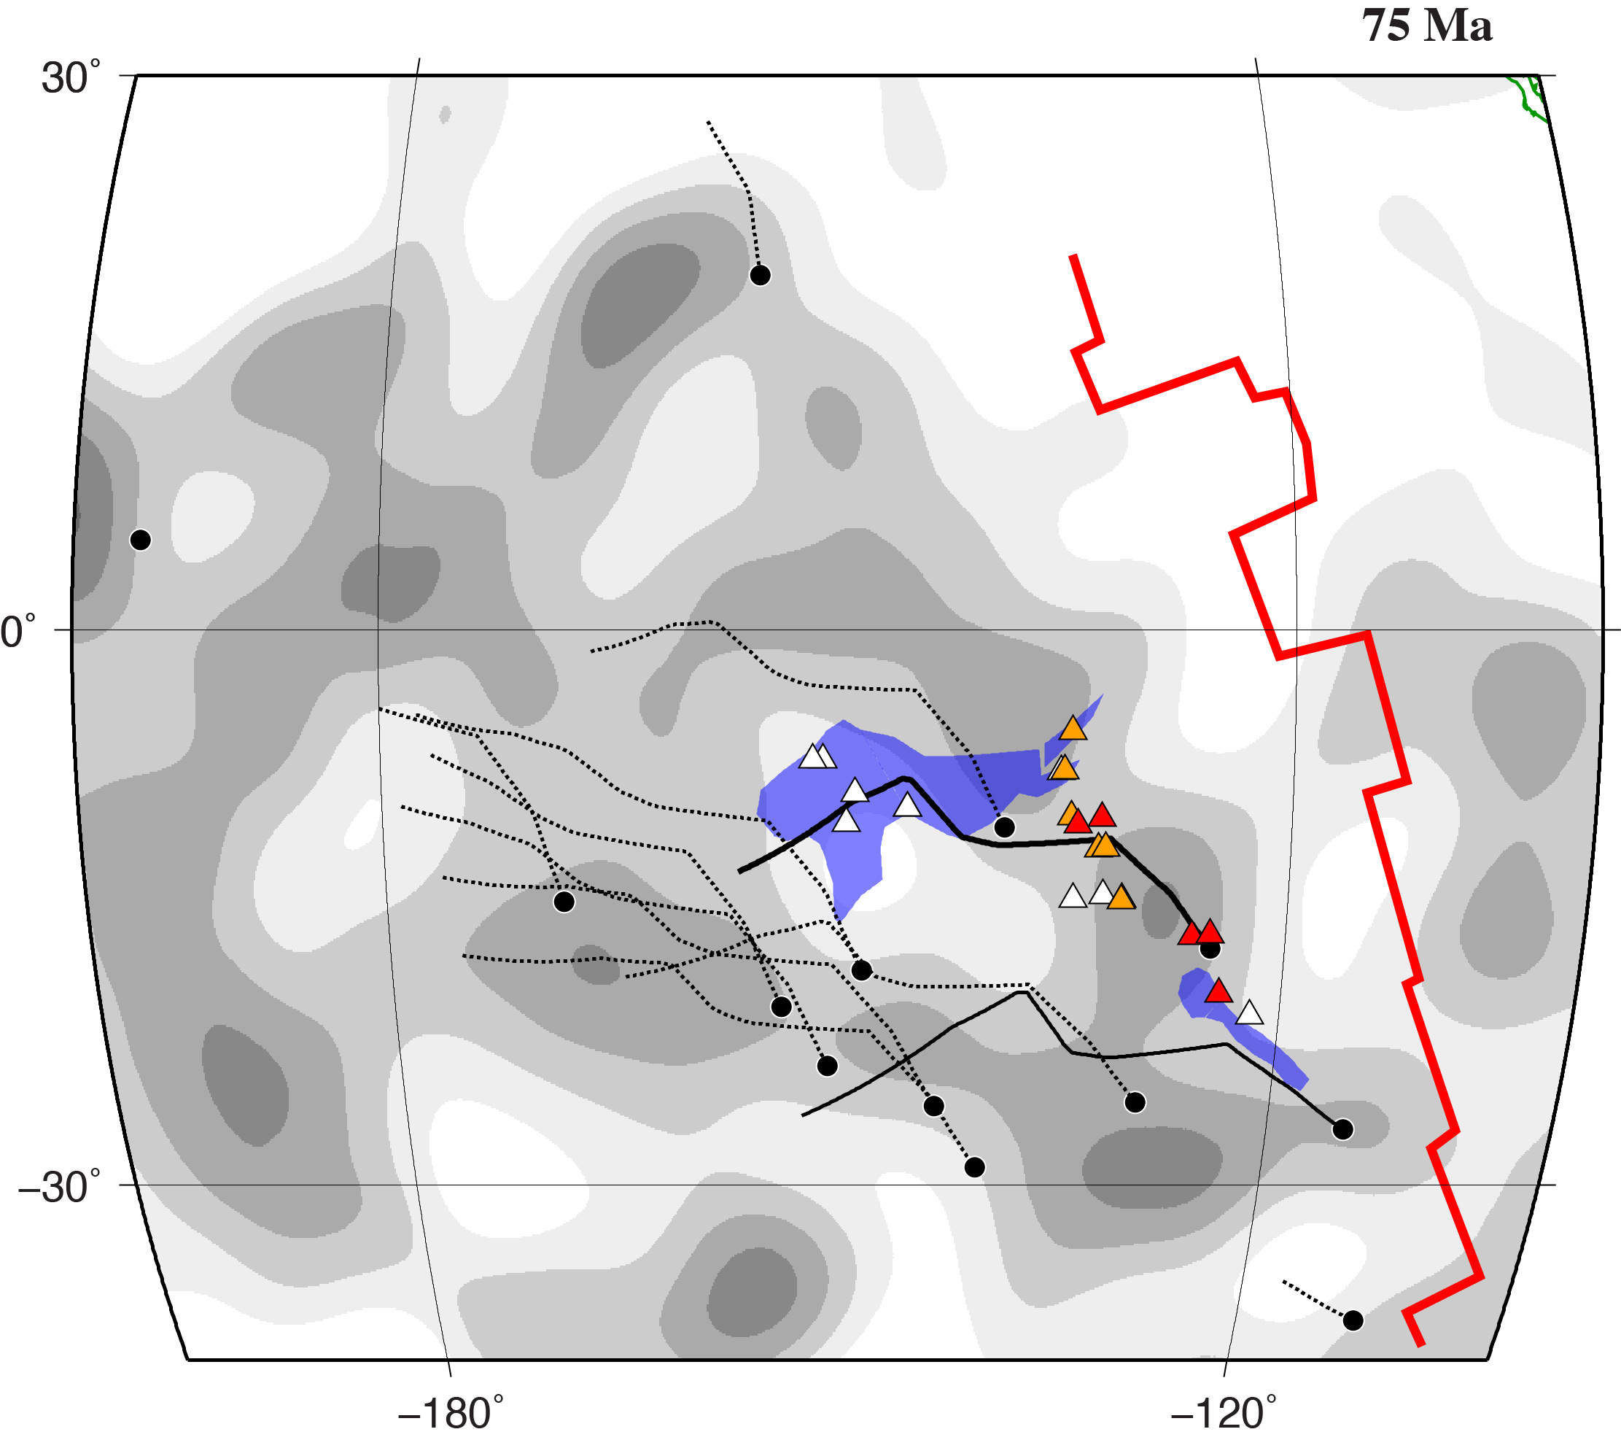
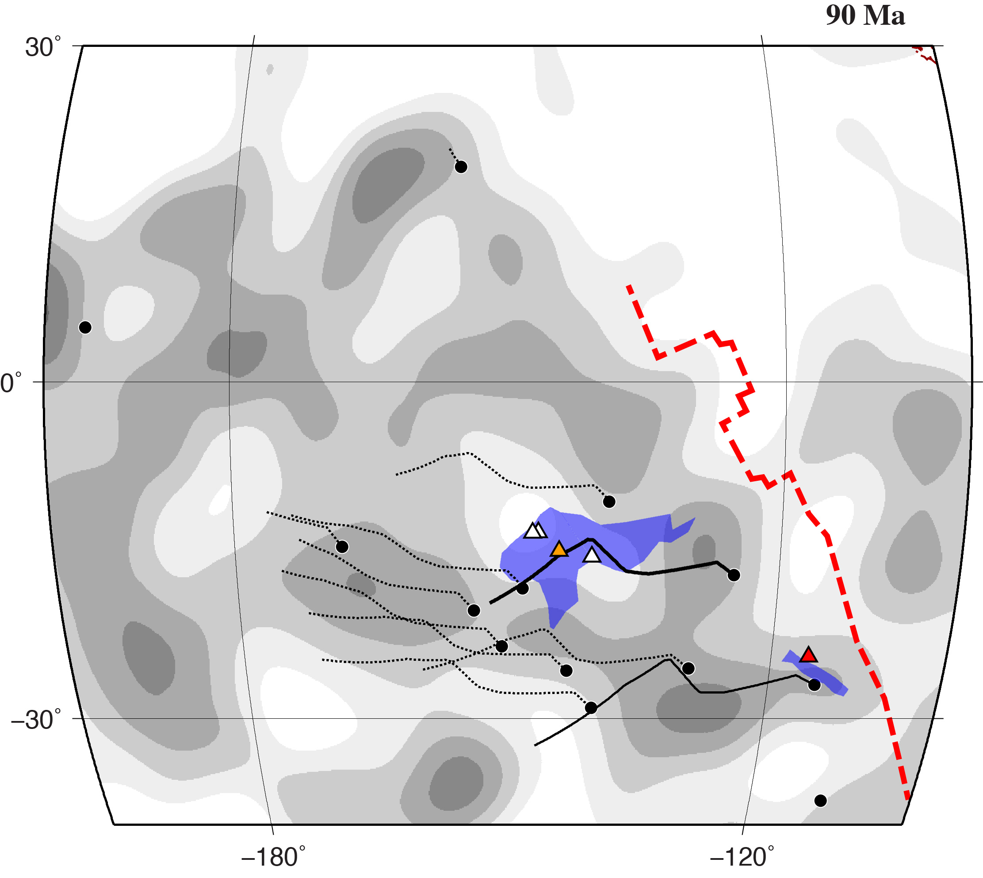
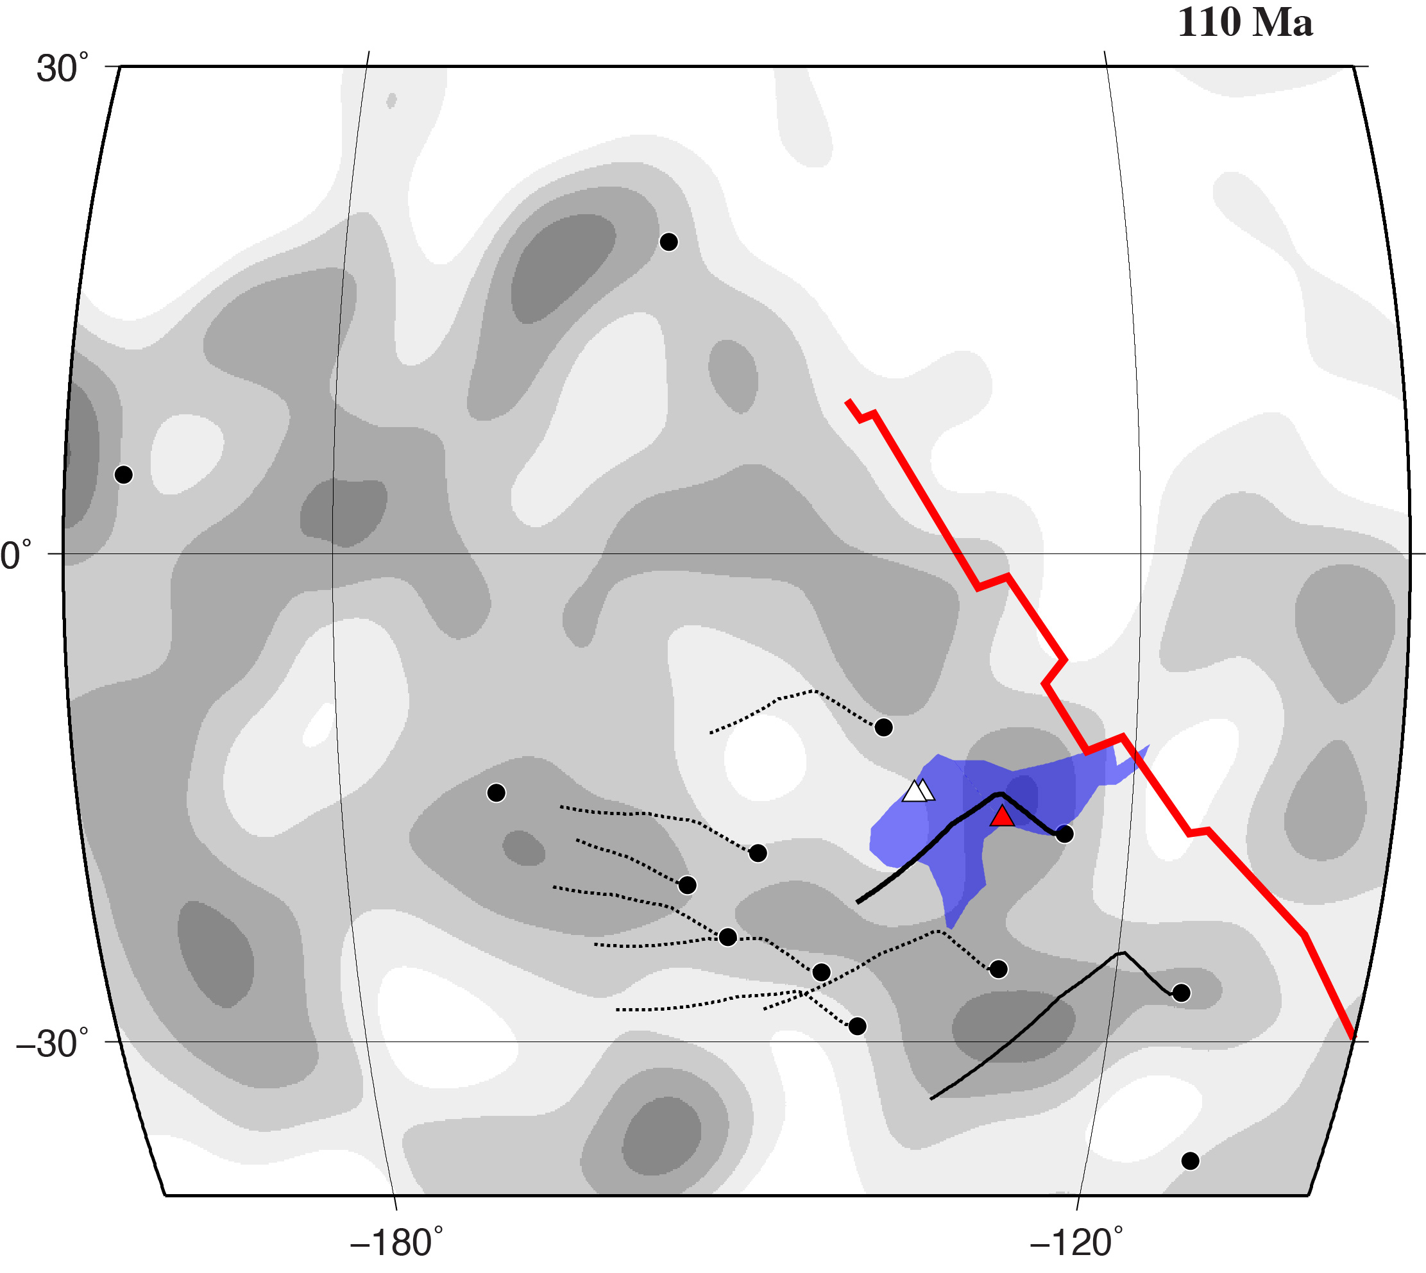
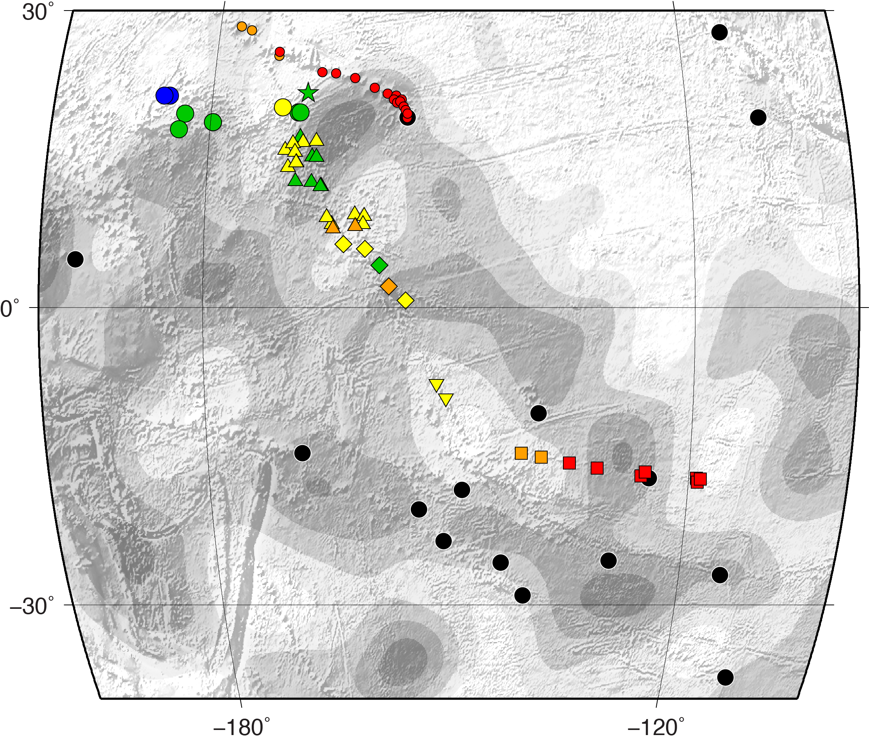
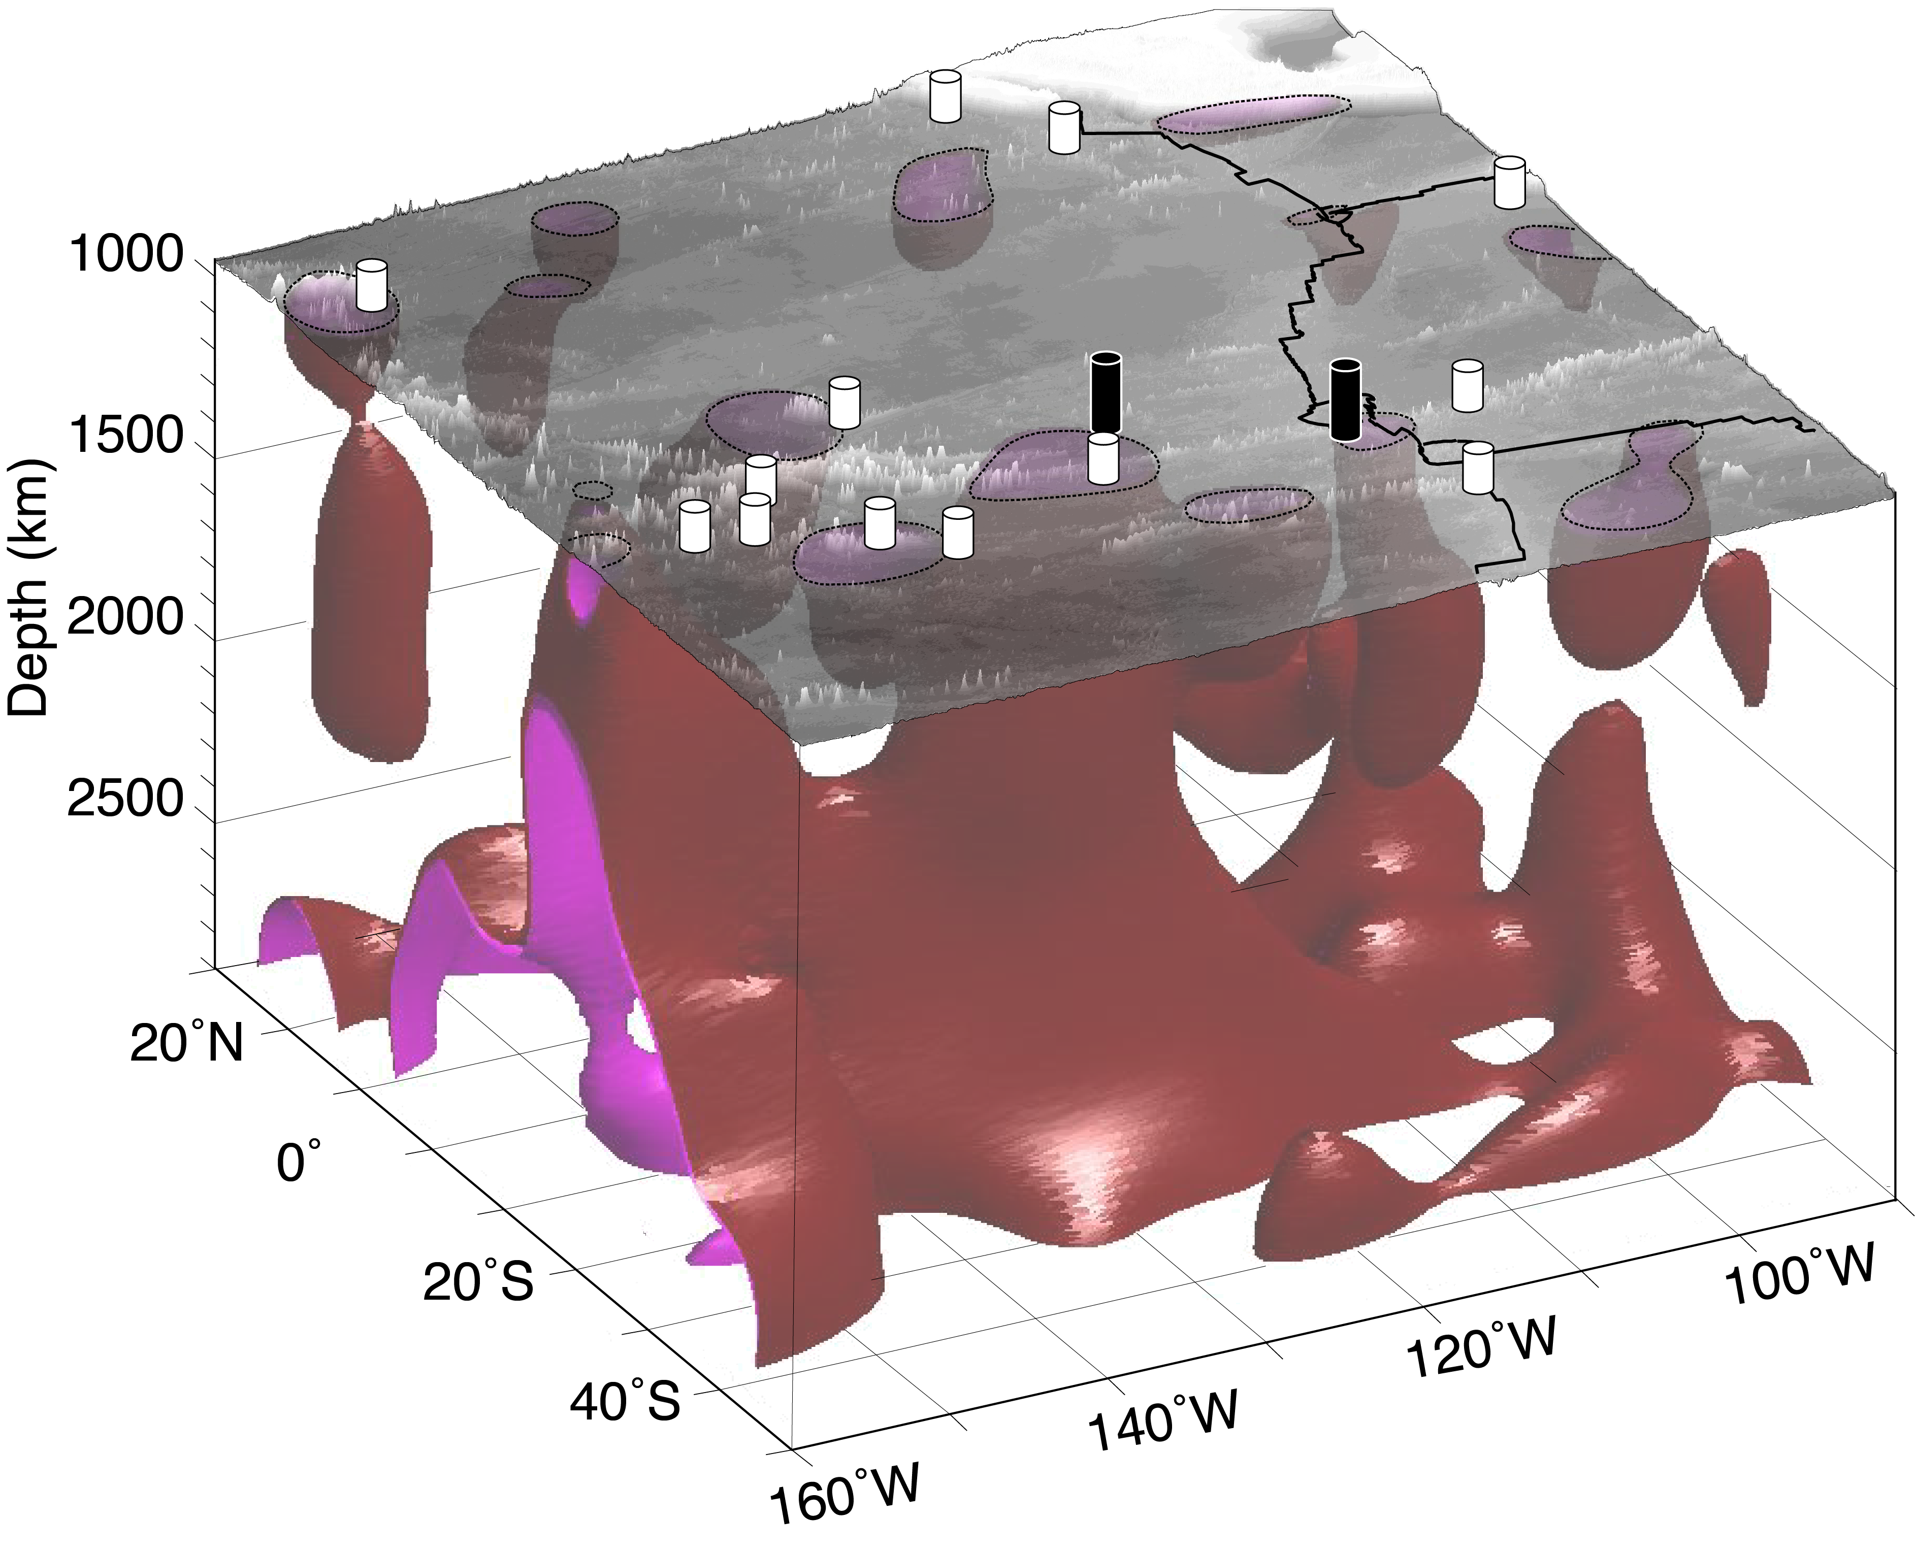
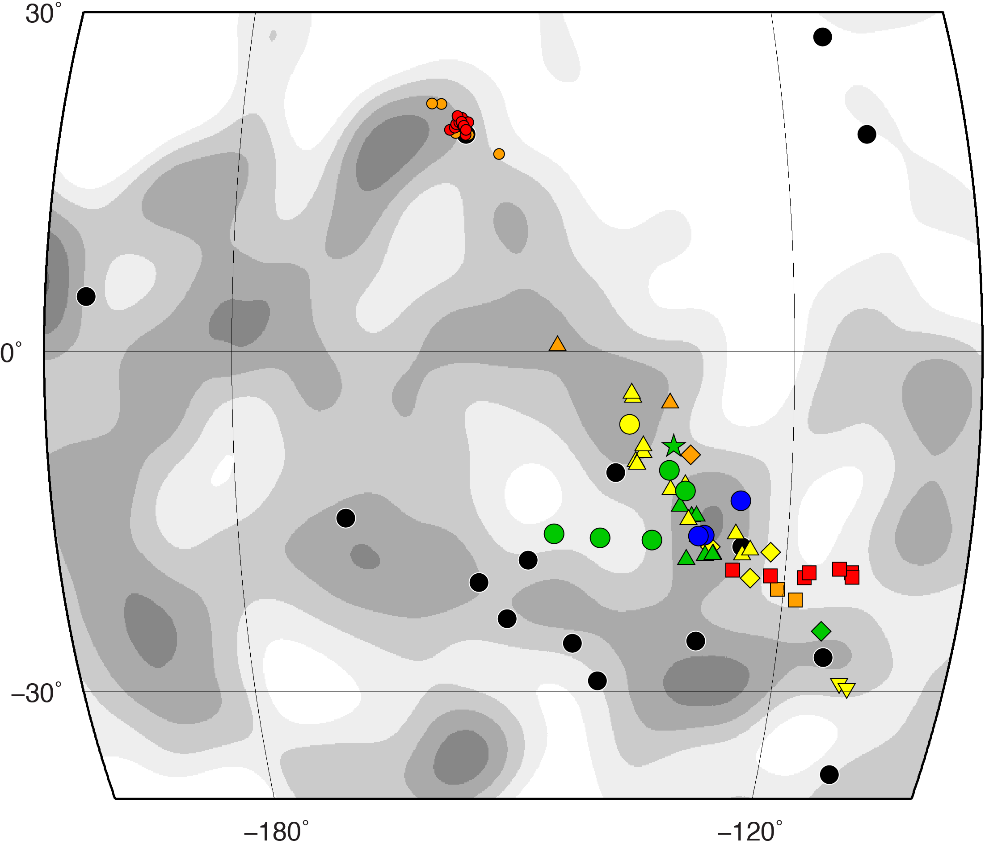

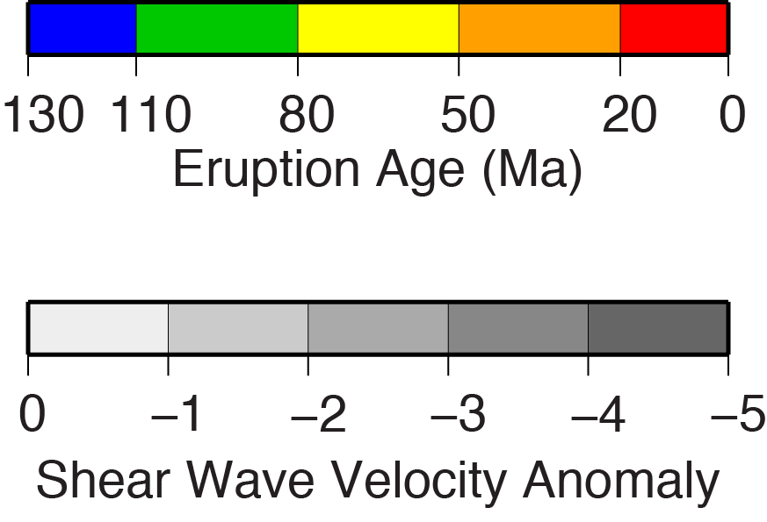
V23B
-3141
A Double Hotspot Model for the Origin of Line Islands Ridge
Robert A. Pockalny Graduate School of Oceanography, U. Rhode Island, Narragansett, RI (robp@gso.uri.edu)
Ginger Barth U.S. Geological Survey, Menlo Park, California
Christina Wertman Graduate School of Oceanography, U. Rhode Island, Narragansett, RI
MOTIVATION
  Explore Origin of Enigmatic Line Islands Ridge
  Path of volcanism follows a general absolute plate motion trend
  Lacks classic age-progressive volcanism pattern along Line Islands Ridge
  Propose a Double Hotspot Model of Line Islands Ridge
    Southern Line Islands Ridge
    Crough Hotspot (80 – 100 Ma)
    Larson Hotspot (50 – 65 Ma)
    Northern Line Islands Ridge
      Larson Hotspot (65 – 85 Ma)
RECONSTRUCTION (Fixed Pacific Plate)
Pukapuka Ridge
- Larson or Crough Hotspot (0 – 30 Ma)
Boudeuse Ridge
- Crough Hotspot (45 – 75 Ma)
Line Islands Ridge (North)
- Larson Hotspot (65 – 80 Ma)
Line Islands Ridge (South)
- Crough Hotspot (80 – 100 Ma)
- Larson Hotspot (50 – 65 Ma
Mid-Pacific Mountains
- Larson Hotspot prior to 110 Ma
LIP and/or
Plume-Ridge
Interaction
Lithosphere
Extension
Melt Conduit?
Melt Conduit?
Larson
Melt Conduit
Eruption Style
Interpolated
Ridge Location
Crough
0 Ma
7 Ma
67 Ma
75 Ma
90 Ma
110 Ma
RECONSTRUCTION (Fixed Mantle)
Pukapuka Ridge
- Larson or Crough Hotspot (0 – 30 Ma)
Boudeuse Ridge
- Crough Hotspot (45 – 75 Ma)
Line Islands Ridge (North)
- Larson Hotspot (65 – 80 Ma)
Line Islands Ridge (South)
- Crough Hotspot (80 – 100 Ma)
- Larson Hotspot (50 – 65 Ma
Mid-Pacific Mountains
- Larson Hotspot prior to 110 Ma
0 Ma
7 Ma
67 Ma
75 Ma
90 Ma
110 Ma
  Pacific Plate hotspot (yellow dots) and related features of the Line Islands.
  Dated seamounts (triangles) and plate motion paths (lines) colored coded for age.
Larson
PREVIOUS MODELS
Crough
  Age Progressive Single Hotspot Track
    Morgan [1972]
    Duncan and Clague [1985]
  Multiple Hotspots
    Crough and Jarrad [1981]
    Henderson and Gordon [1982]
LARSON HOTSPOT JUSTIFICATION
Present-day
Dated Seamount Locations
References
Cannon, J., Lau, E. and Müller, R. D. 2014, Solid Earth Discussions, 6, 793-830.
Clouard, V. and Bonneville, A. 2005, GSA Special Papers, 388, 71-90.
Courtillot, V., Davaille, A., Besse, J. and Stock, J. 2003. Earth Planet. Sci. Lett,, 205, 295-308.
  Crough, S. T., and Jarrad, R. D. 1981Journal of Geophysical Research, 86, 11,763–11,771.
  Davis, A. S., Gray, L. B., Clague, D. A. and Hein, J. R. 2002, Geochemistry, Geophysics, Geosystems, 3, 1-28.
Duncan, R. A. and Clague, D. A. 1985, The ocean basins and margins (pp. 89-121). Springer US, doi 10.1007/978-1-4613-2351-8_3.
Earth Reference Data and Models, 2015, Seamount Catalog: http:// http://earthref.org/SC/ (accessed Sept., 2015).
French, S. W. and Romanowicz, B. 2015, Nature, 525, 95-99.
  Henderson, L. J., and Gordon, R. G. 1982. GSA Abstr. Programs, 14, 513, 1982.
  Morgan, W. J., 1972. Am. Assoc. Petrol. Geol. Bull., 56, 203–213.
  Morgan, W. J. and Morgan, J. P. 2007, GSA Special Papers, 430, 65-78.
Sandwell, D. T., Winterer, E. L., Mammerickx, J., Duncan, R. A., Lynch, M. A., Levitt, D. A. and Johnson, C. L. 1995, J. Geophys. Res., 100, 15087-15099.
Seton, M., Müller, R. D., Zahirovic, S., Gaina, C., Torsvik, T., Shephard, G., Talsma, A., Gurnis, M., Turner, M., Maush, S. and Chandler, M. 2012, Earth-Science Reviews, 113, 212-270.
Smith, W. H., and Sandwell, D. T. 1997, Science, 277, 1956-1962.
Winterer, E. L. and Metzler, C. V. 1984, J. Geophys. Res., 89, 9969-9979.
Larson hotspot is coincident with a deep mantle plume source
Eruptive sites of seamounts along
Line Islands are clustered around
Larson Hotspot and along a trend
to Marquesas Hotspot
  Lithosphere Extension
    Winterer [1976]
    Davis et al. [2002]
Larson
Reconstructed
Eruption Sites
DATA & METHODS
Crough
  Tectonic Reconstruction Software
    GPlates, Cannon et al [2014]
Larson
  Plate Motion Model
    Seton et al. [2012]
Crough
  Seamount Ages
    Clouard and Bonneville [2005]
    Earth Reference Data and Models [2015]
Marquesas
Larson
  Hotspot Locations
    Courtillot et al. [2003]
    Morgan and Morgan [2007]
Crough
Acknowledgments
This research was partially funded by the U.S. Geological Survey (#G13AC00351) and the National Science Foundation (OCE-1158994).
  Mantle Shear Wave Anomalies
    French and Romanowicz [2015]
Shear Wave Velocity Anomaly
Isosurfaces (-0.7 – -0.8)

