Slide 1


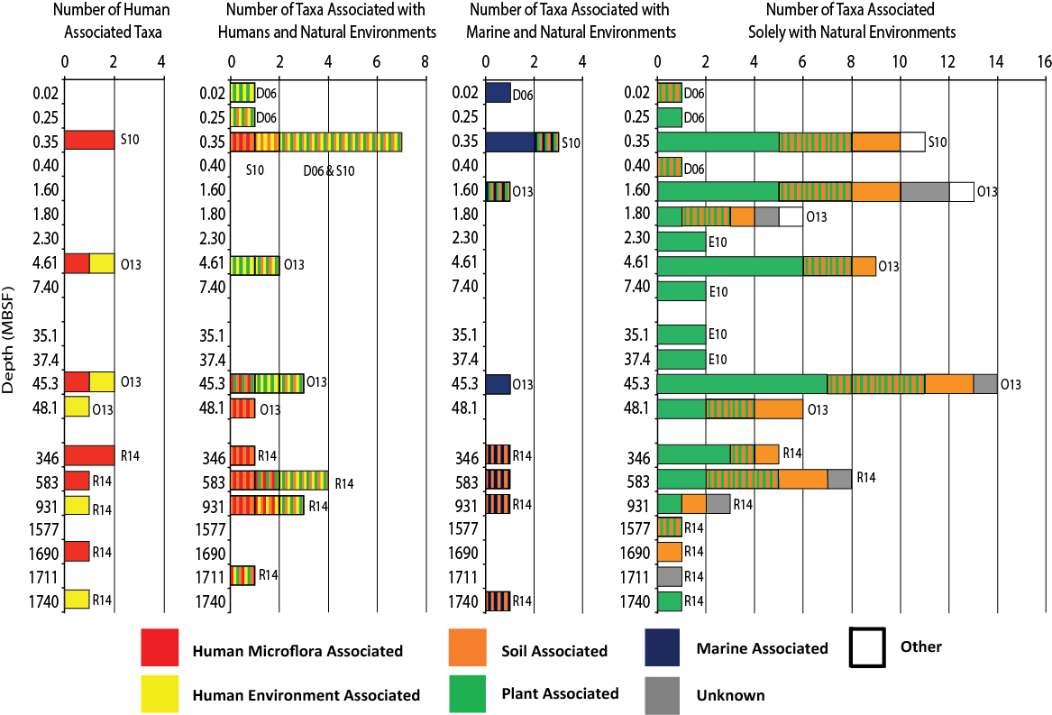
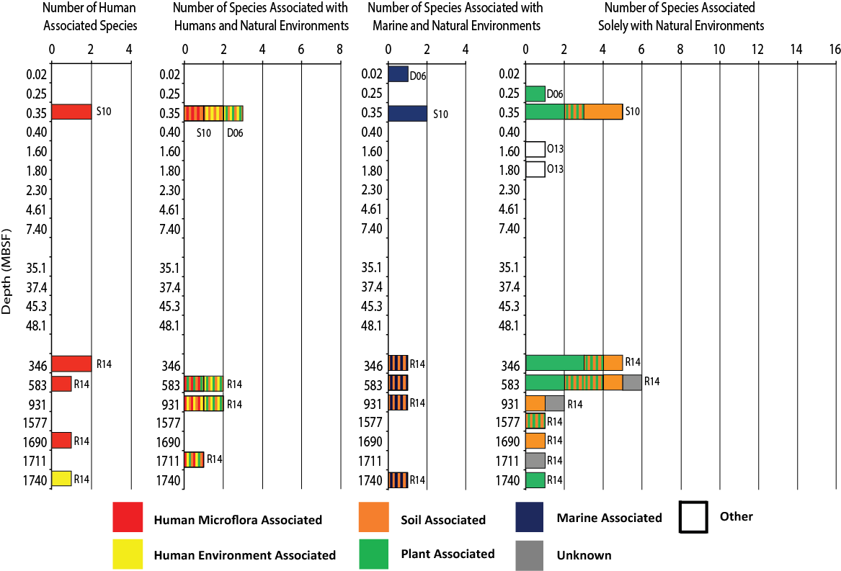
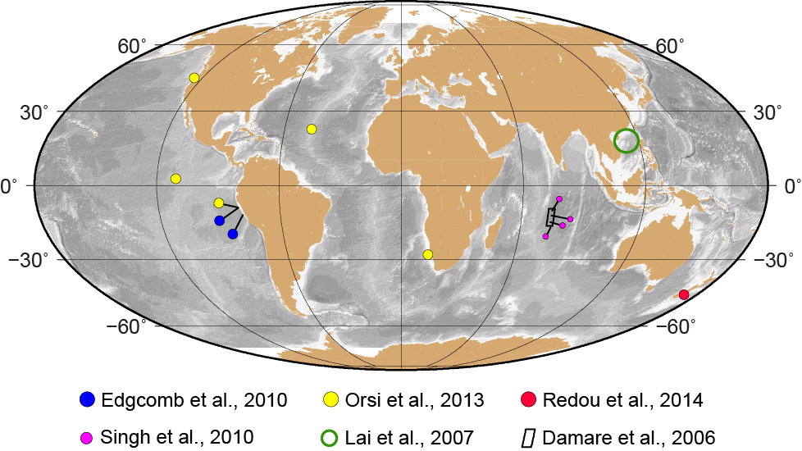
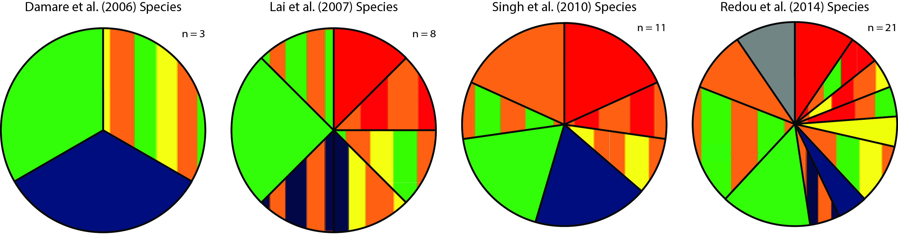
PP43A
-2247
Human-Associated Fungi in Deep Subseafloor Sediment?
Victoria M. Fulfer Graduate School of Oceanography, U. Rhode Island, Narragansett, RI (vmf713@my.uri.edu)
John B. Kirkpatrick Graduate School of Oceanography, U. Rhode Island, Narragansett, RI
Steven D’Hondt Graduate School of Oceanography, U. Rhode Island, Narragansett, RI
Victoria M. Fulfer, John B. Kirkpatrick and Steven L. D’Hondt
Graduate School of Oceanography, U. Rhode Island, Narragansett, RI
(vmf713@my.uri.edu)
Motivation
  Investigate Findings of Fungi in Deep Subseafloor Sediment
  Recent studies identify nearly 100 different fungal taxa from subseafloor sediment worldwide, with the deepest findings at 1740 mbsf in sediment as old as the early Miocene (17 Ma).
  Implications of these findings include:
  - the extension of the third domain of life into the subseafloor realm
  - the suggestion that some Eukarya have survived for millions of
  years separated from the surface world
  - the possibility that fungi could enhance cycling of carbon and
  nutrients in subseafloor sediment
  Our objective was to investigate the environments with which these fungi have been previously associated, with the goal of assessing the extent to which the reported fungi are human-associated or marine-associated.
Results
All Fungal Taxa
At Species Level
Victoria M. Fulfer All at
Graduate School of Oceanography,
John B. Kirkpatrick U. Rhode Island, Narragansett, RI
Steven D’Hondt (vmf713@my.uri.edu)
a
Previous Work
  Analyses of Fungi in Subseafloor Sediments
  Benguela Upwelling Canterbury Basin
  Central Indian Basin Eastern Equatorial Pacific
  Hydrate Ridge North Pond
  Peru Margin South China Sea
Human-Associated Fungi are Ubiquitous
Fungal taxa associated with human microflora and/or the human environment make up 1/3 of the taxa identified.
Rédou et al. (2014) reported fungi in the deepest sediment samples (346 to 1740 mbsf), but almost 40% are human-associated.
Marine-Associated Fungi are Infrequently Reported
Previously identified marine taxa make up only 10% of all taxa reported (10 of 98).
Of the marine-associated taxa, half (5 of 10) have also been associated with soil, the human-environment, and plants.
Focusing on Taxonomic Specificity
41 of the 98 reported fungi were reported to the species level.
15 of the 41 species have been previously associated with human microflora and/or human environments.
    6 of the 41 are associated with both plants and humans
    12 of the 41 are associated with both plants and soil
Of soil-associated species, almost half are also human-associated.
One-third of the fungi identified to the species level found in deep-sea sediment from deeper than 40 meters were human-associated.
At Species Level
Data & Methods
  Compiled a complete list of fungal taxa identified by each study
  98 taxa total from six studies:
  - Species: 41
  - Genus: 55
  - Class: 1
  - Phylum: 1
  Recorded the depth of each sample (0.02 – 1740 mbsf)
  Researched each taxa and determined previous associations
  Marine environments
  Human environments (ex: indoor air)
  Human microflora (ex: on skin)
  Soil
  Plants
  Compared the results within and between each study
  Compiled the results and compared previous associations with respect to the depth of the sample
  Deconstructed individual studies based on the previous associations of their reported fungi, both at any taxonomic level and solely at the species level.
Conclusions
  Each study had a considerable amount of human-associated fungi, and a much lower number of marine-associated fungal taxa.
  Between 16% and 55% of the taxa identified by each study at the genus and species levels are human-associated, while only between 5% and 22% have been previously reported as marine-associated.
  The prevalence of human-associated fungi suggests that many, perhaps all, of the fungal taxa reported from deep subseafloor sediment were introduced by sample-handling contamination and/or analytical contamination.
References
Damare, S., Raghukumar, C., & Raghukumar, S. (2006). Deep-sea Research Part I 53:14-27.
Edgcomb, V. P., Beaudoin, D., Gast, R., Biddle, J. F., & Teske, A. (2010). Environmental Microbiology 13(1):172-183.
Lai, X., Cao, L., Tan, H., Fang, S., Huang, Y., Zhou, S., & Zhou, S. (2007). ISME Journal 1:756-762.
Orsi, W., Biddle, J. F., & Edgcomb, V. (2013). PLoS ONE 8(2):e56335.
Rédou, V., Ciobanu, M. C., Pachiadaki, M. G., Edgcomb, V., Alain, K., Barbier, G., & Burgaud, G. (2014). FEMS Microbiology Ecology 90:908-921.
Singh, P., Raghukumar, C., Verma, P., & Shouche, Y. (2010). Fungal Diversity 40:89-102.
Acknowledgments
This research was funded by the NSF-funded Center for Dark Energy Biosphere Investigations (C-DEBI).

