Slide 1






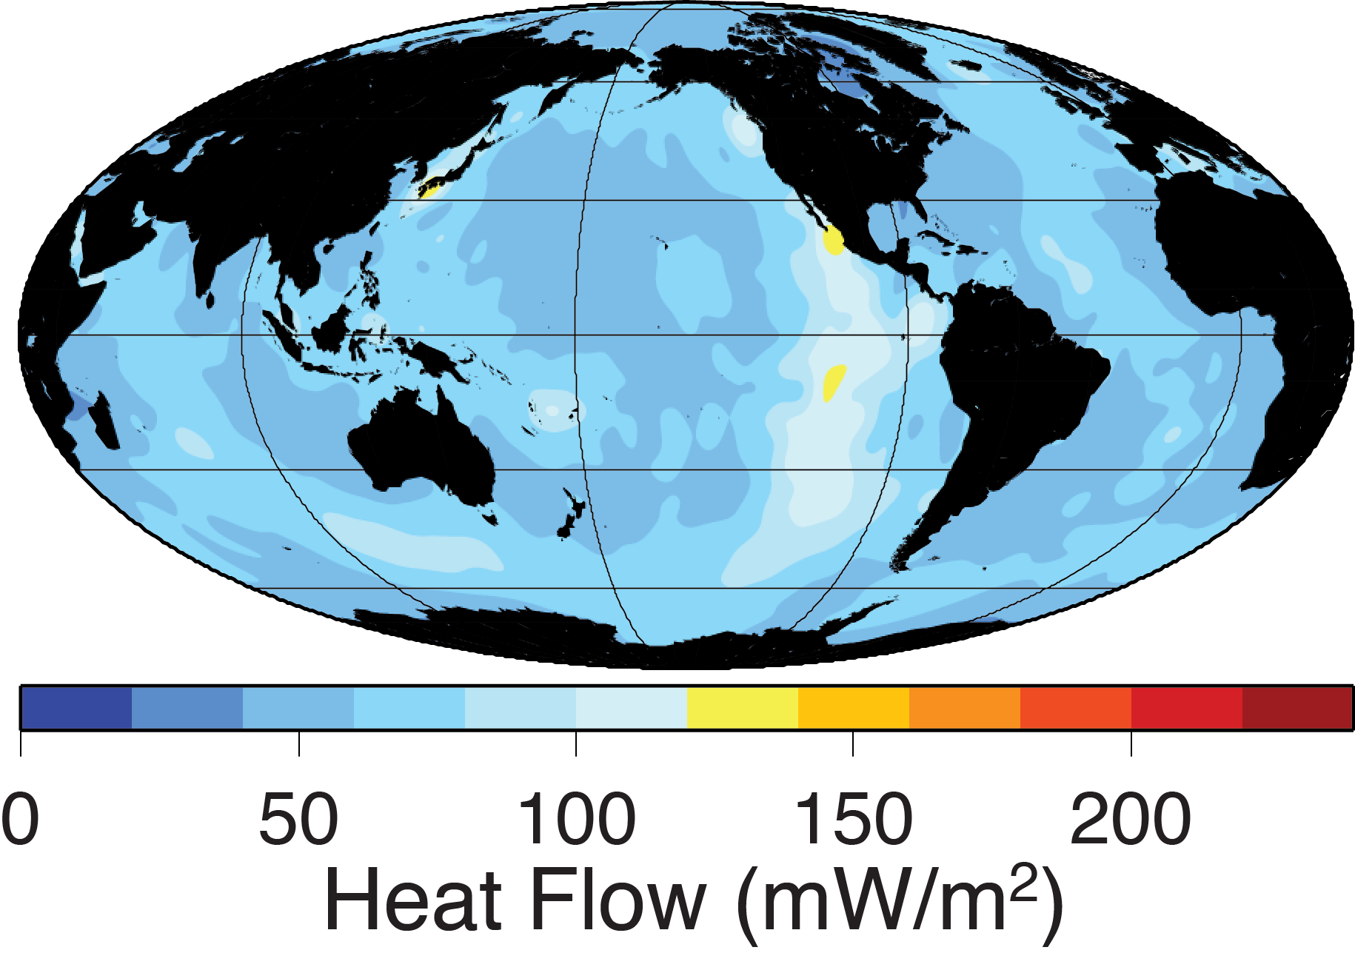
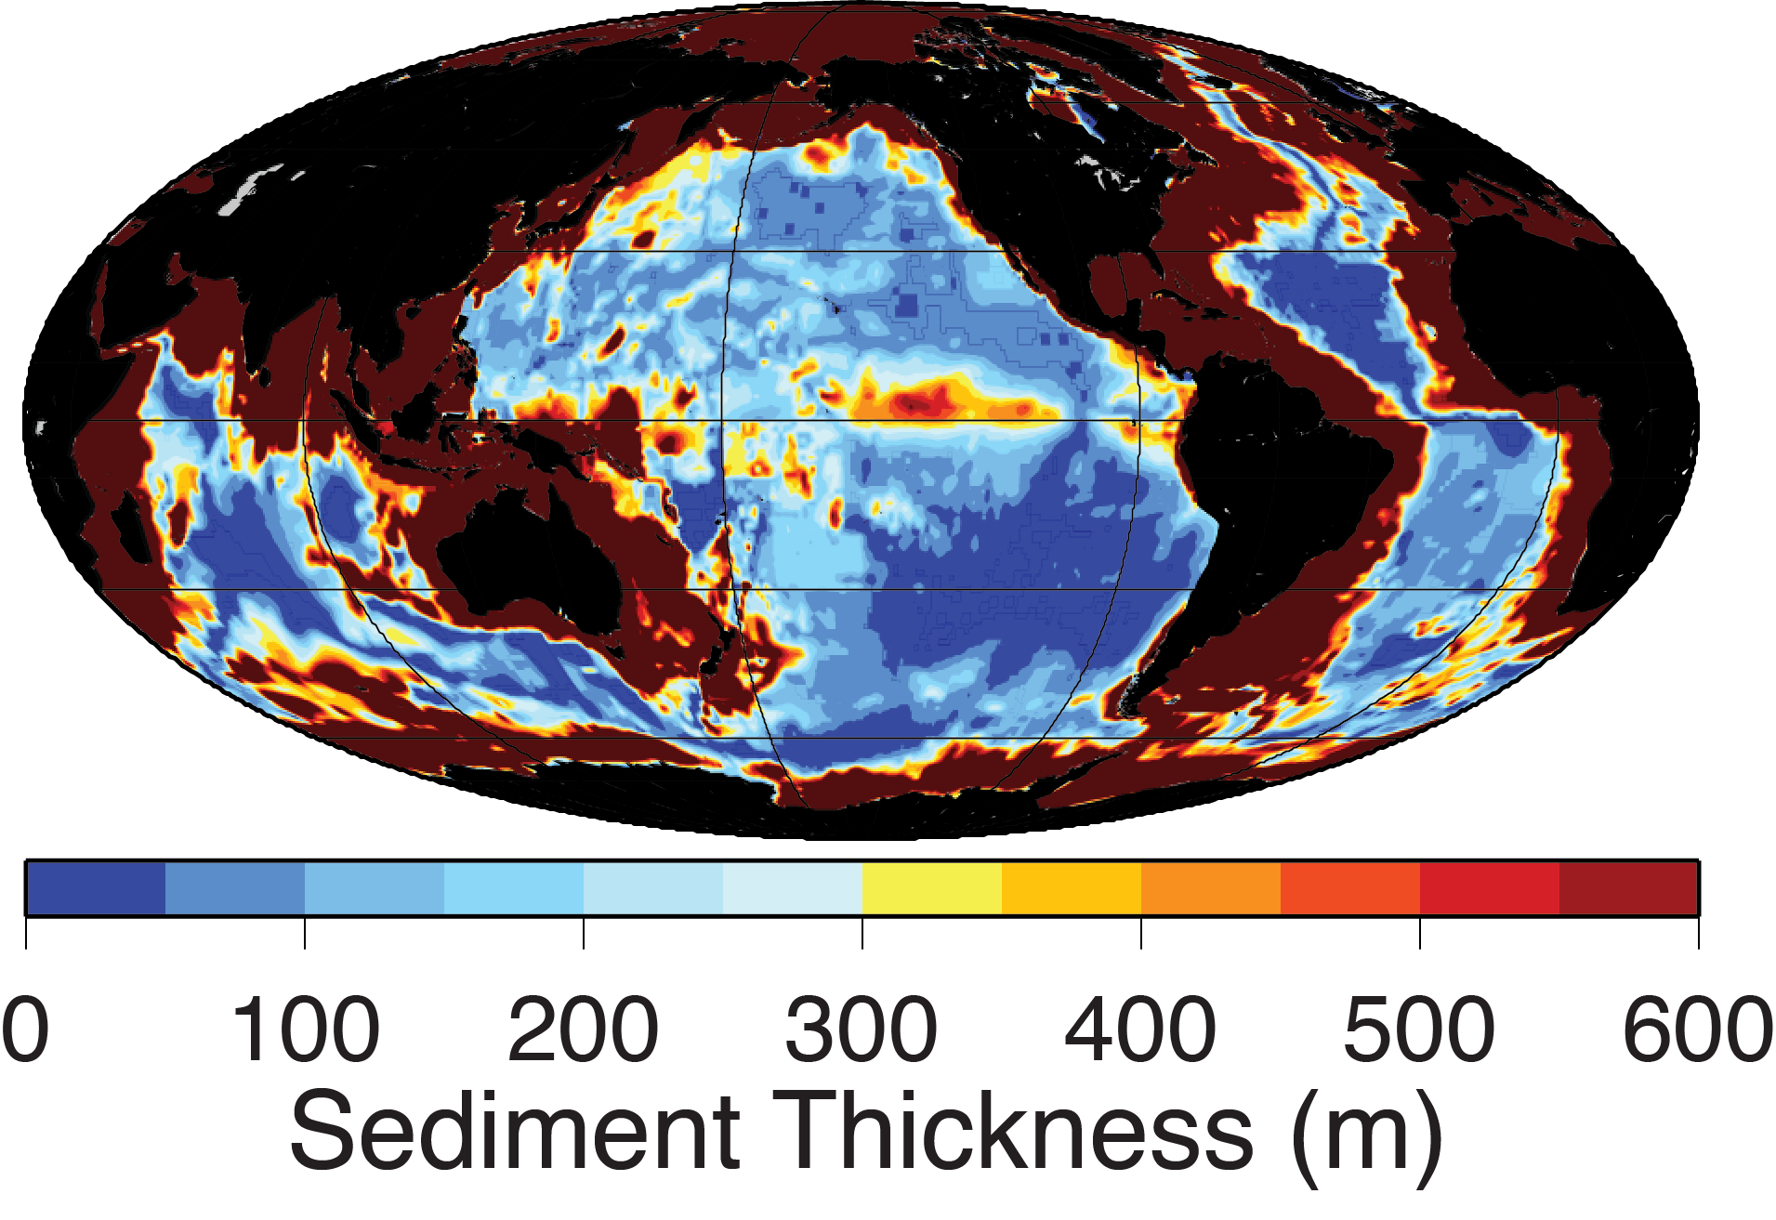
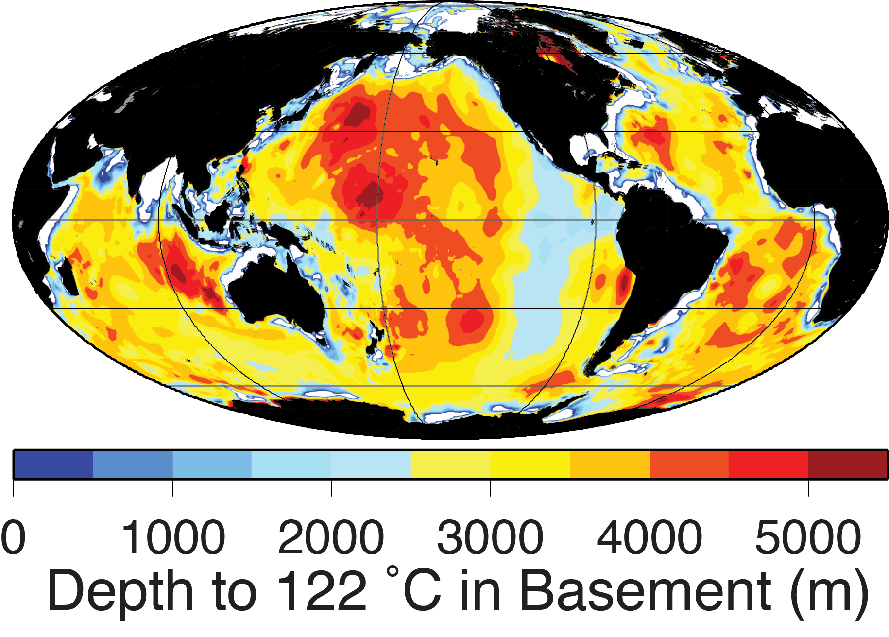
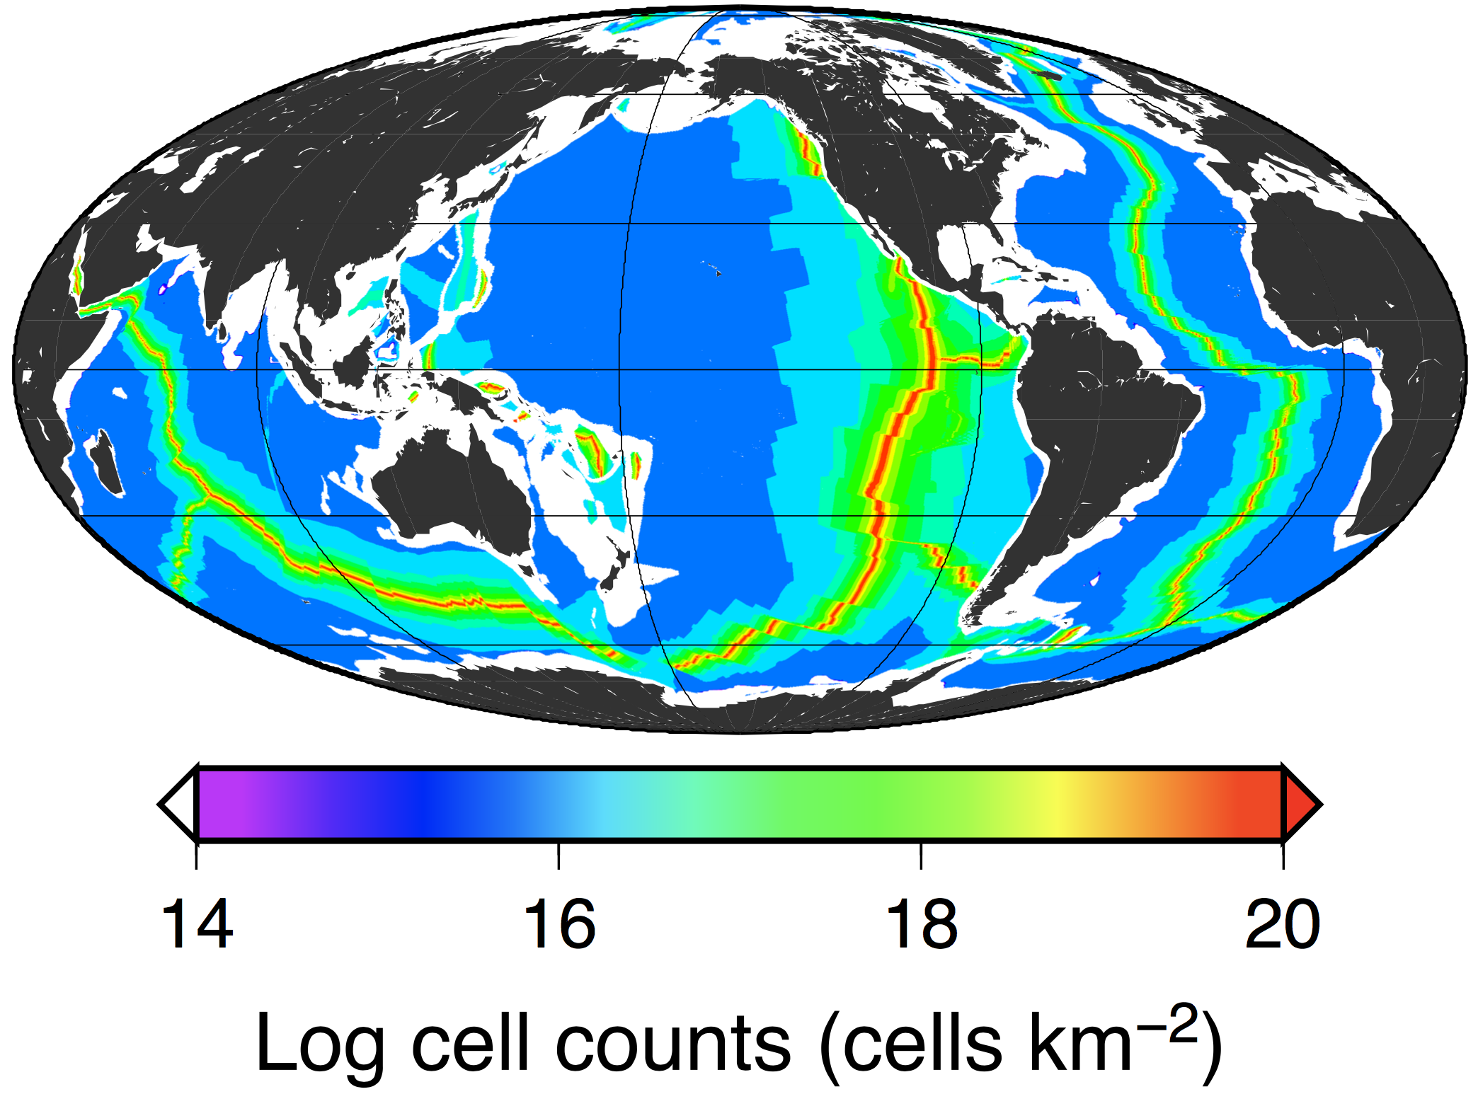
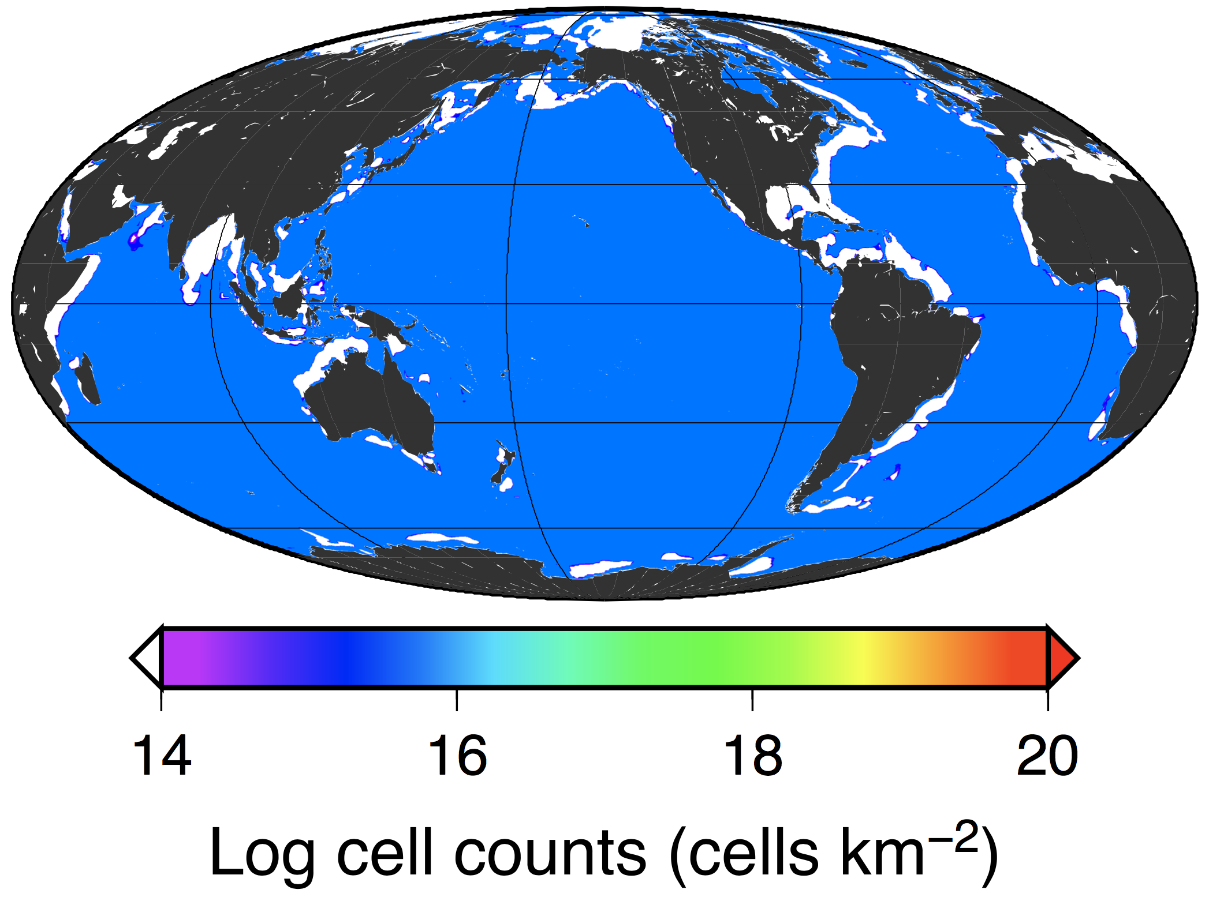
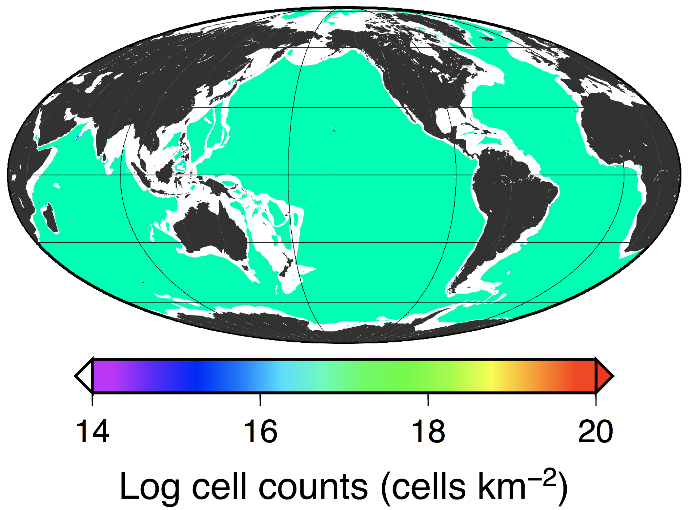
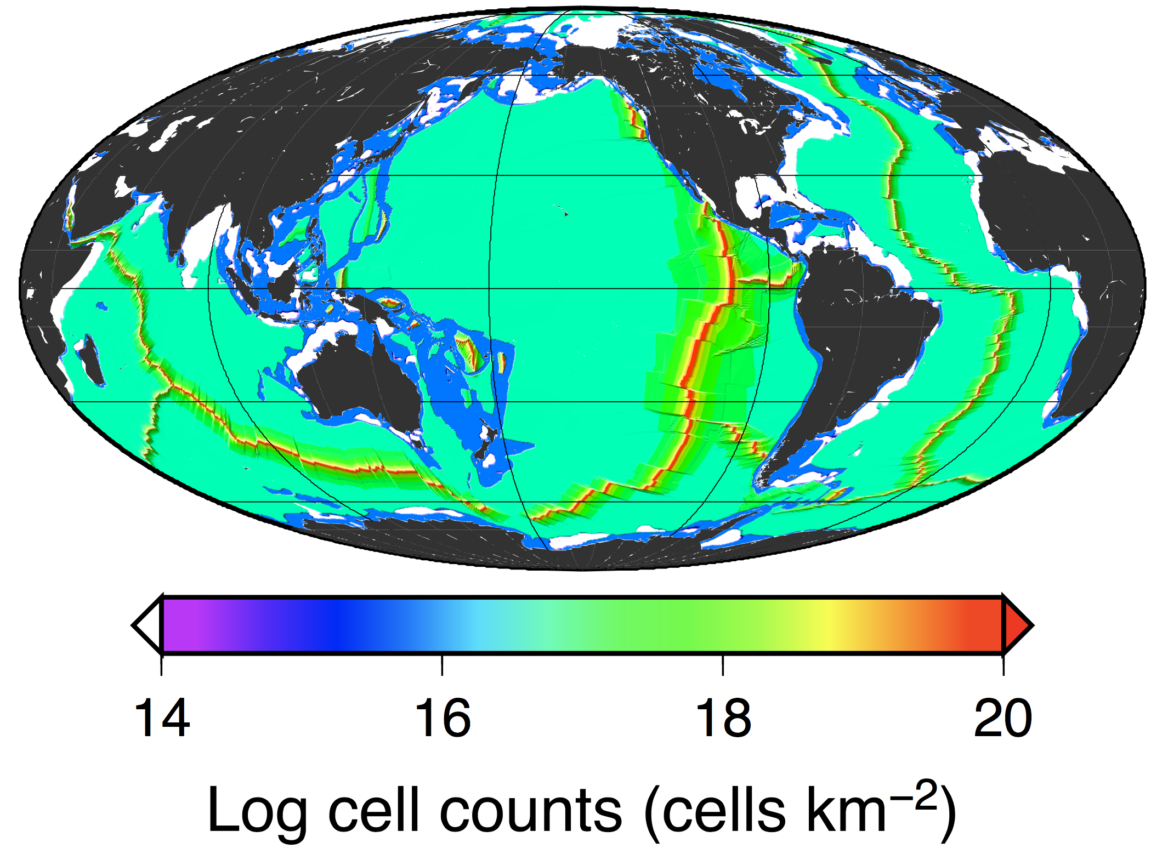

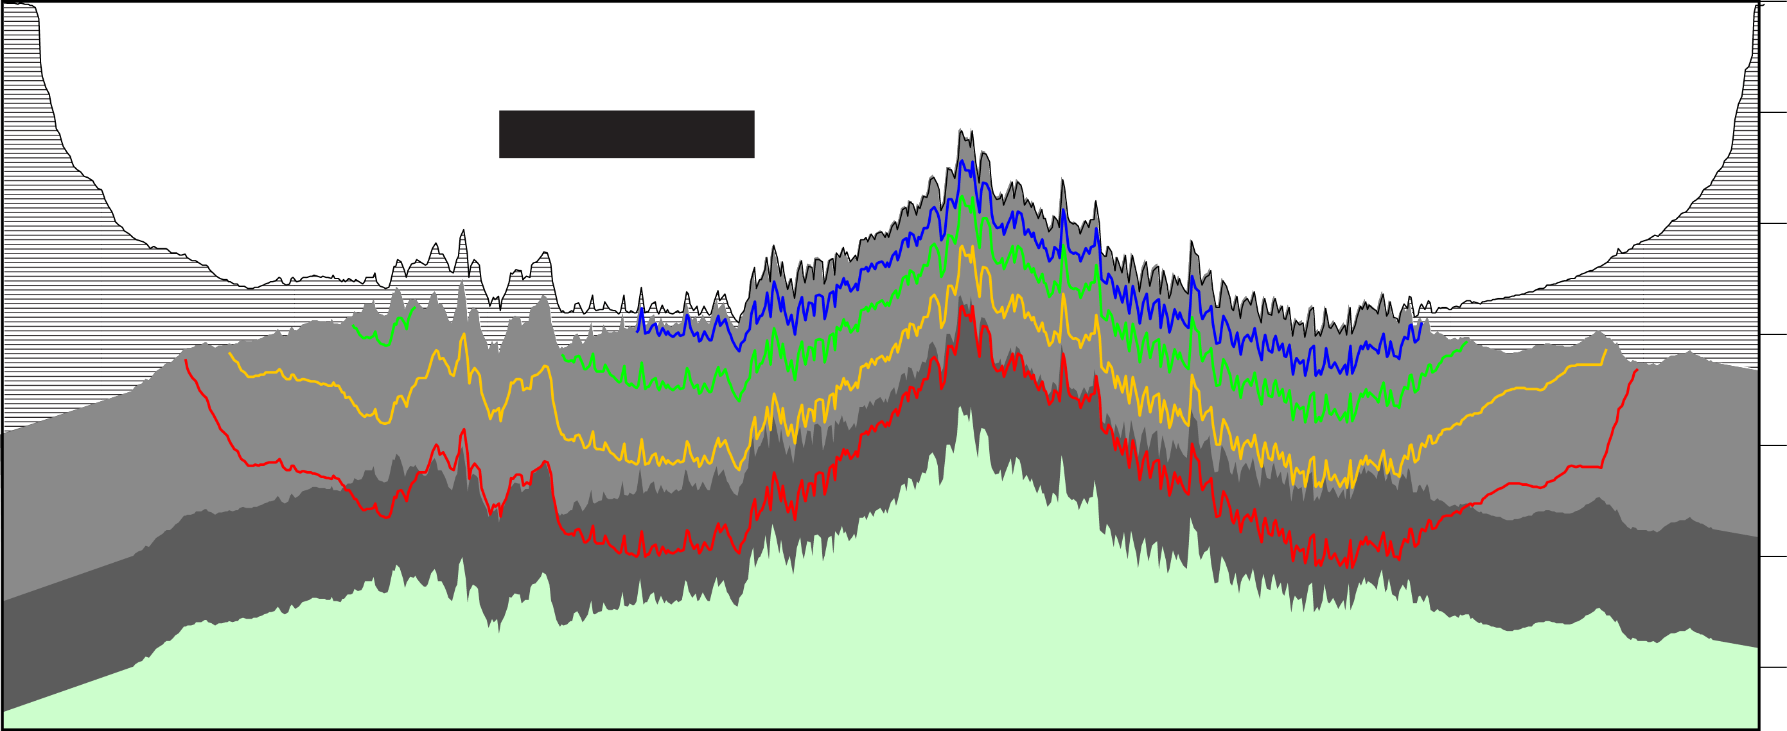
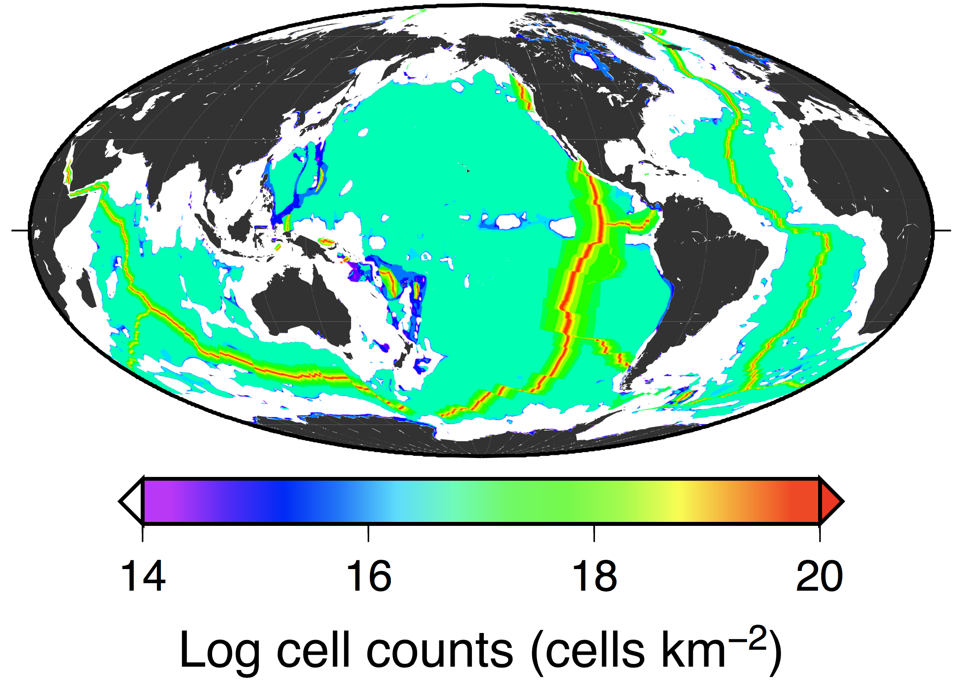
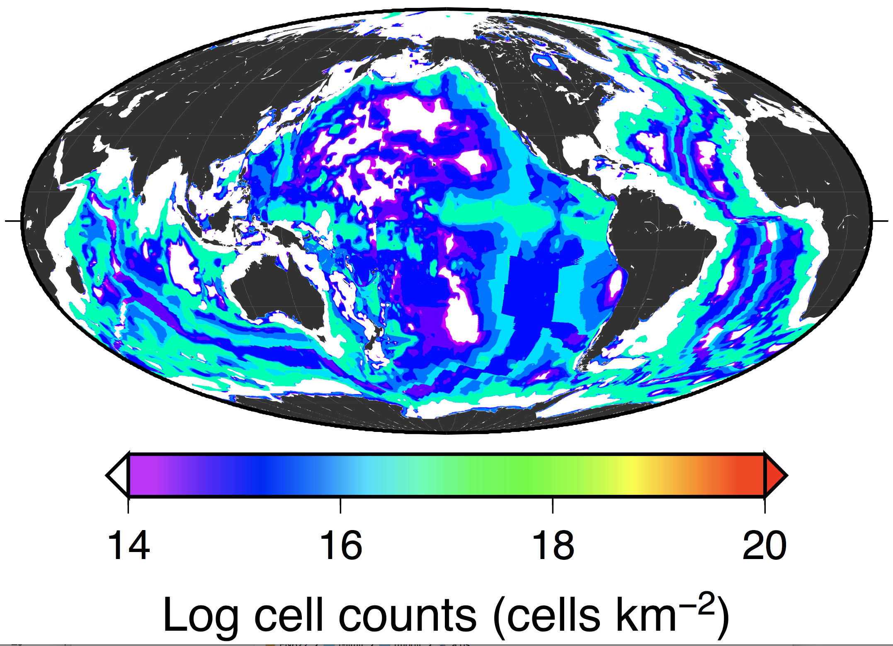
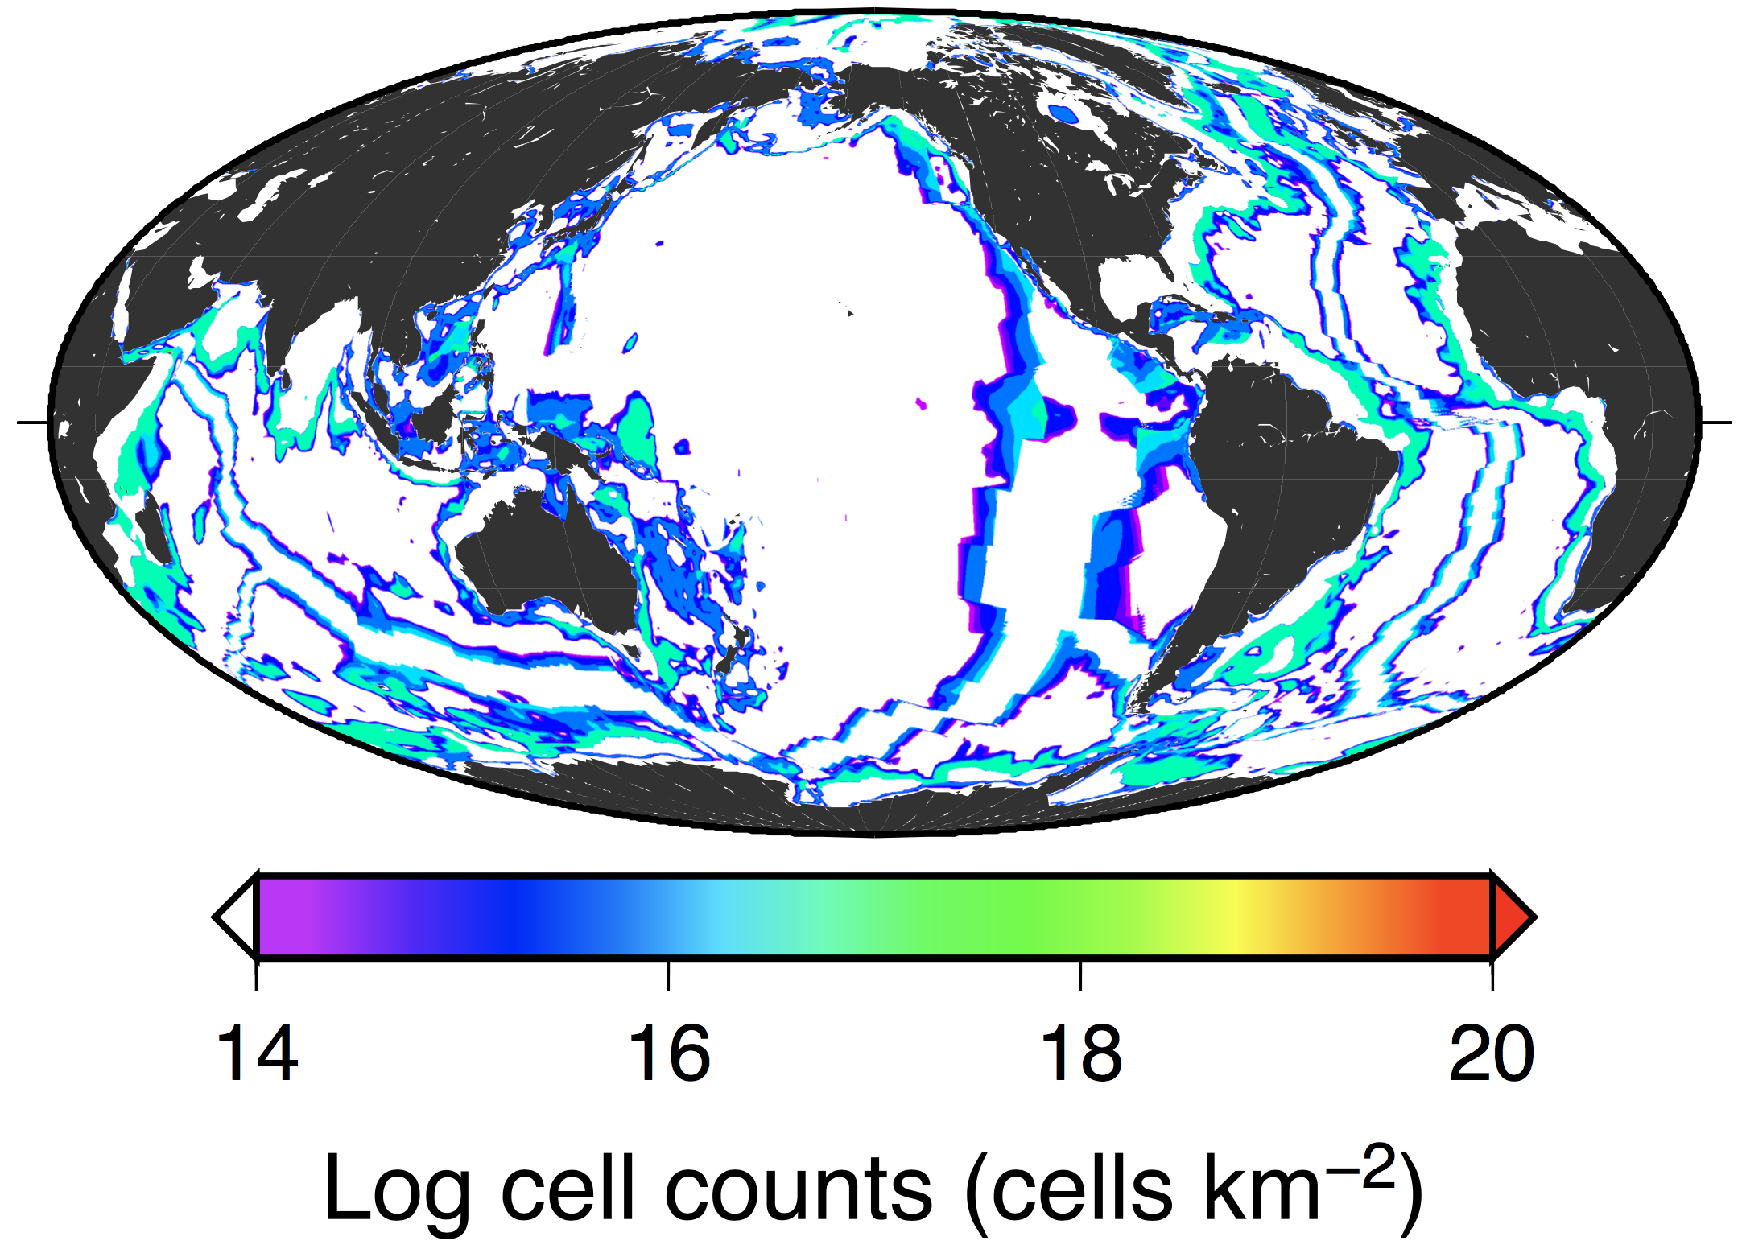
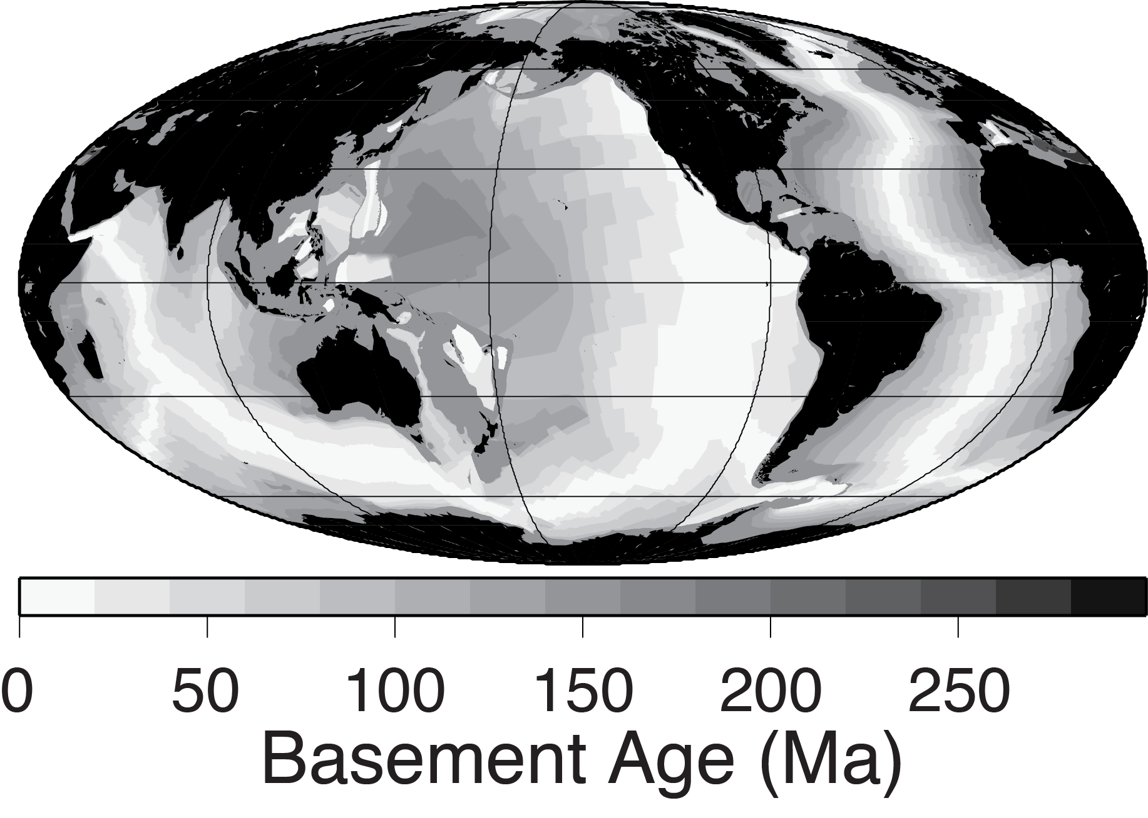
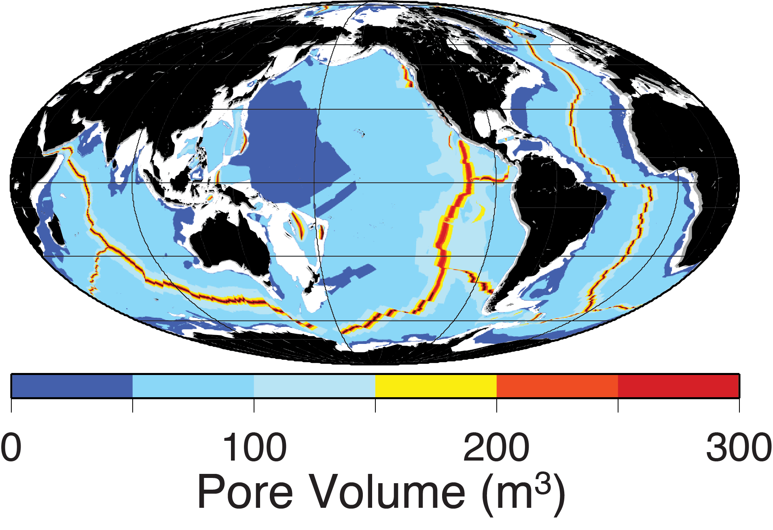
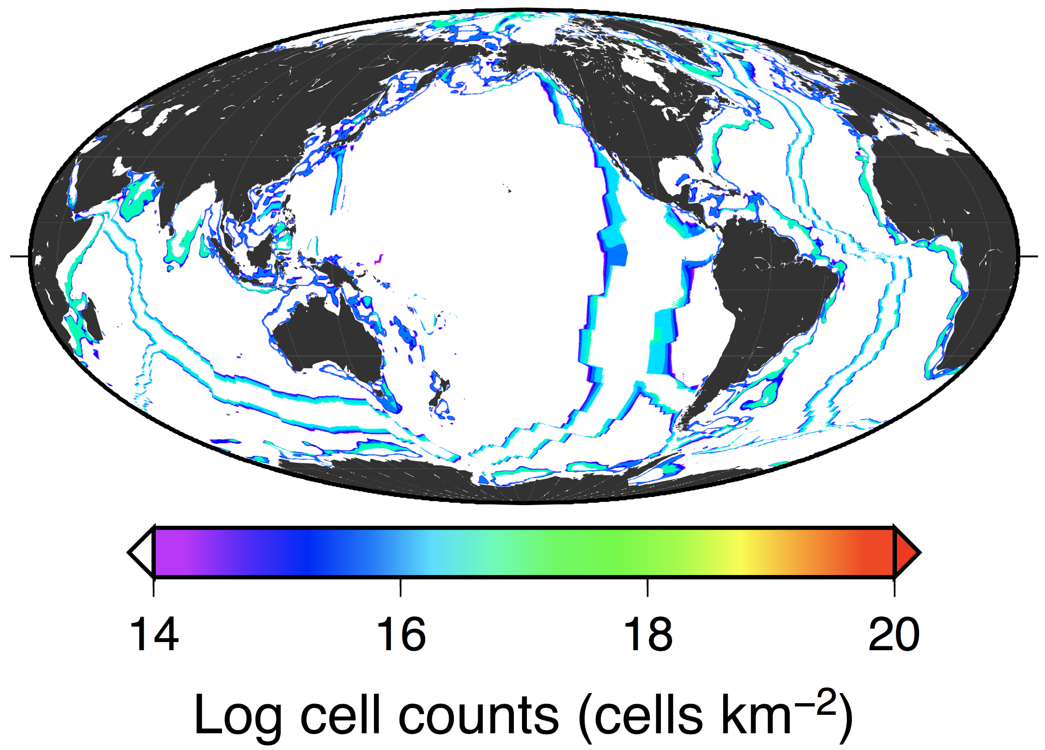
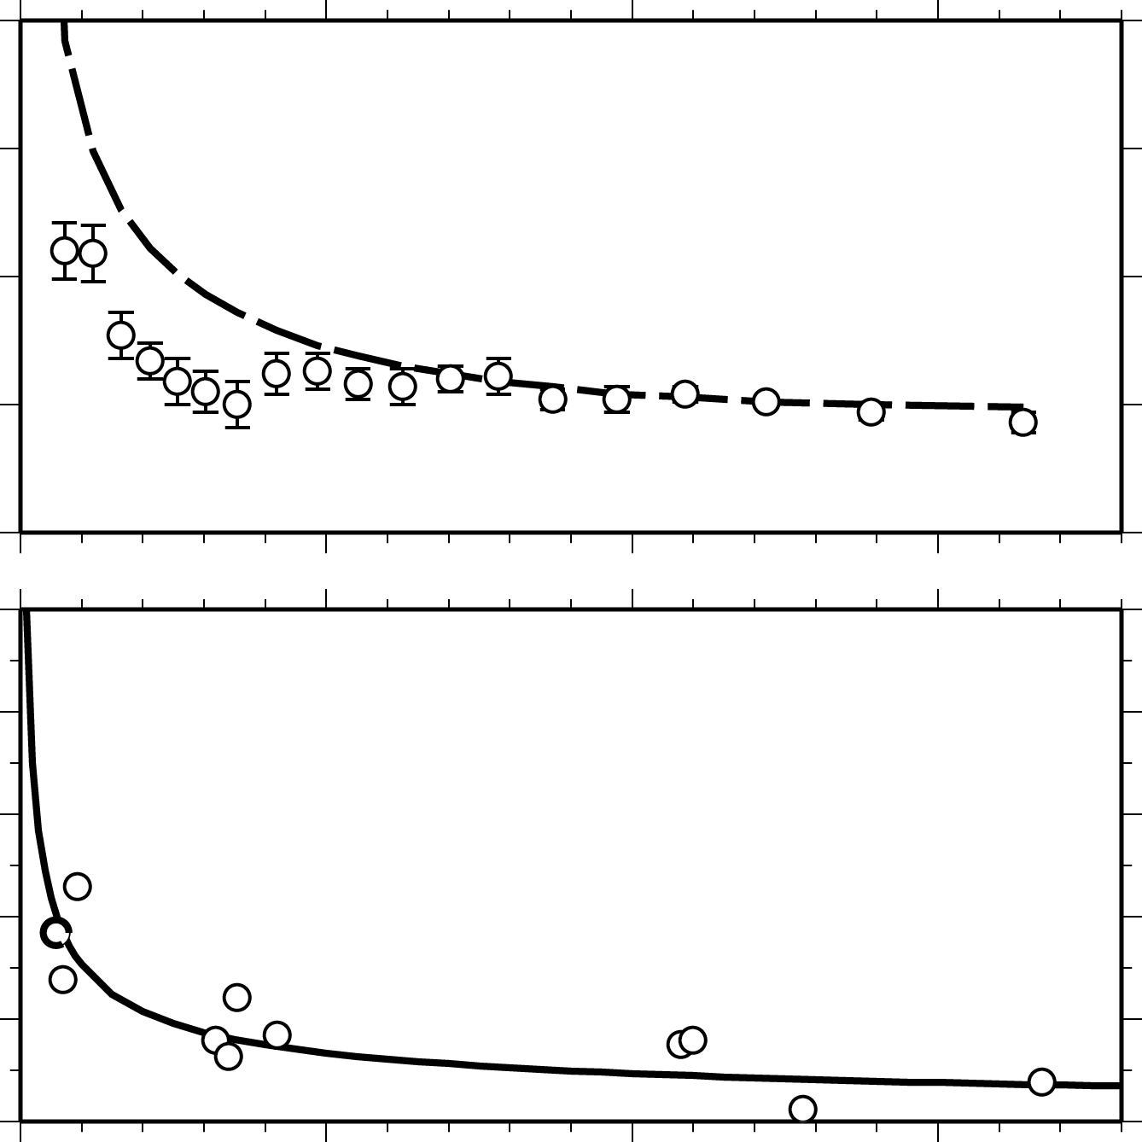
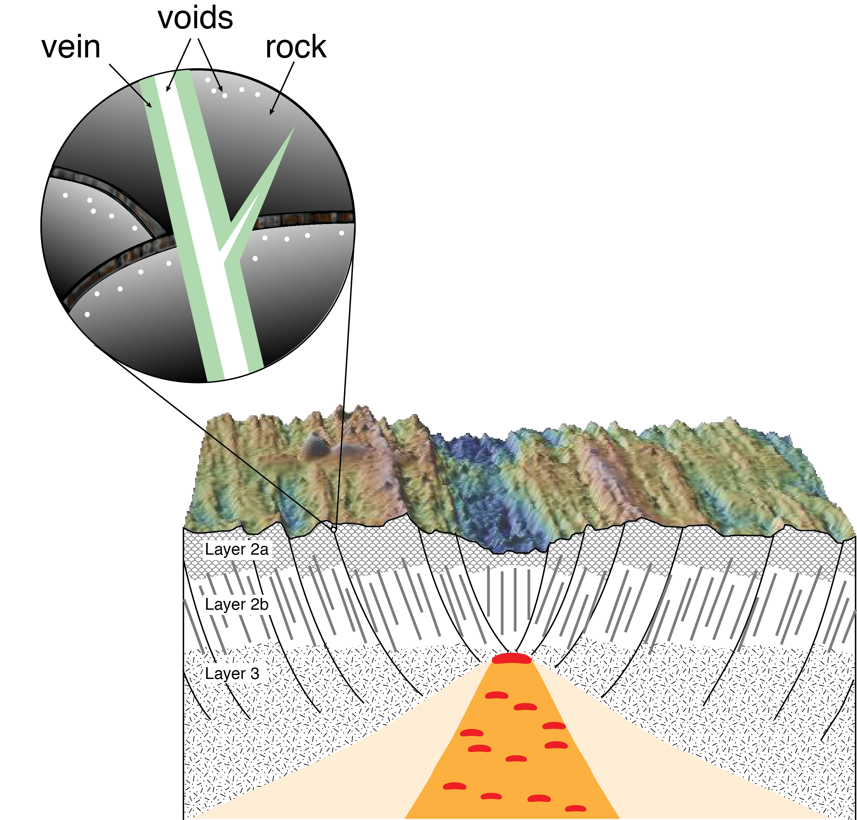
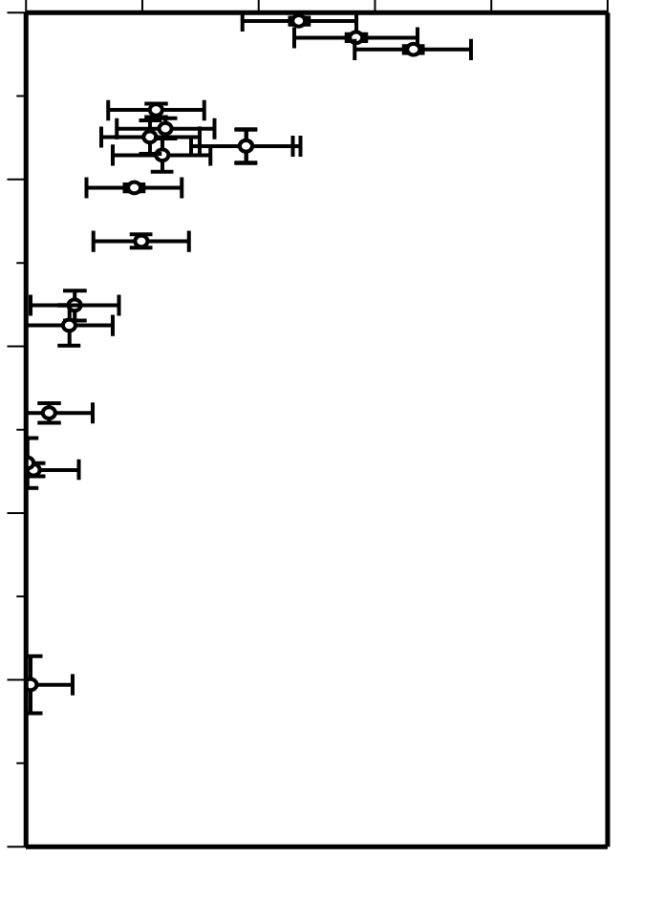
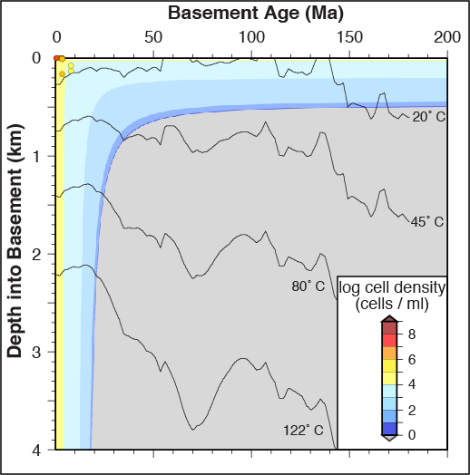
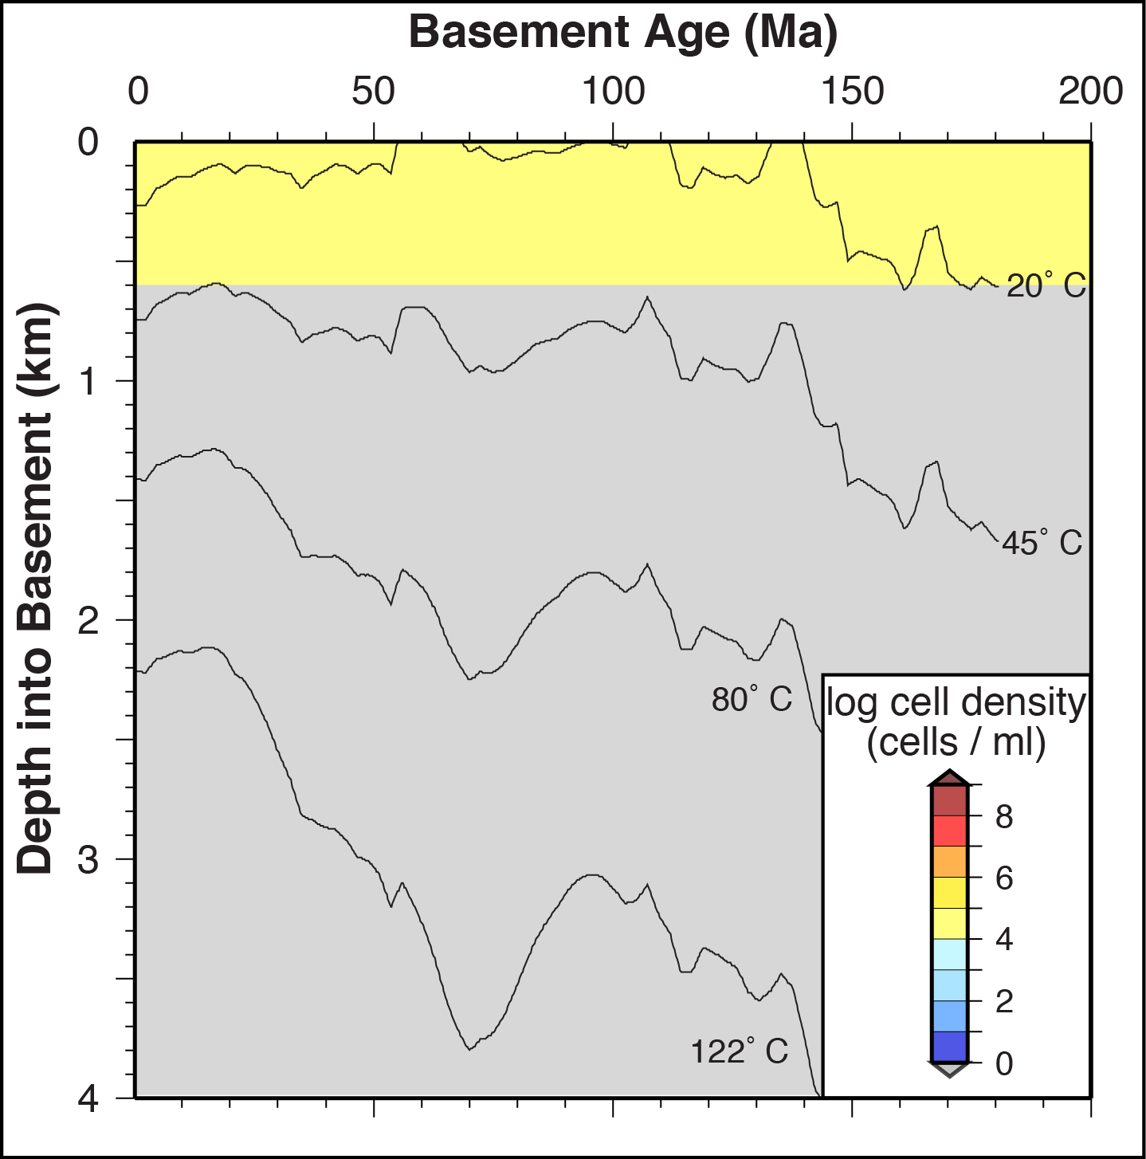
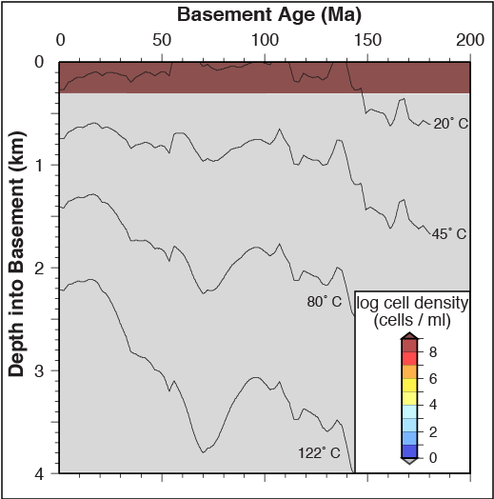
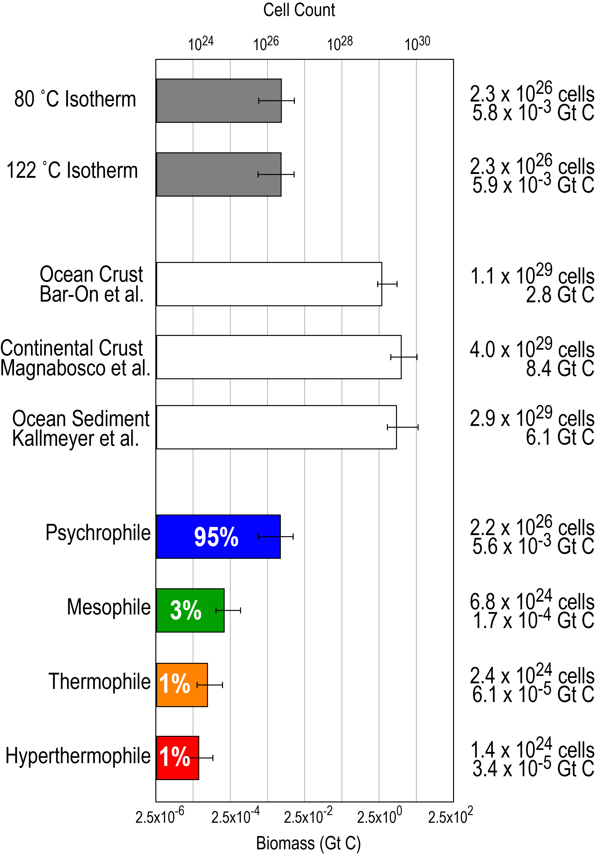
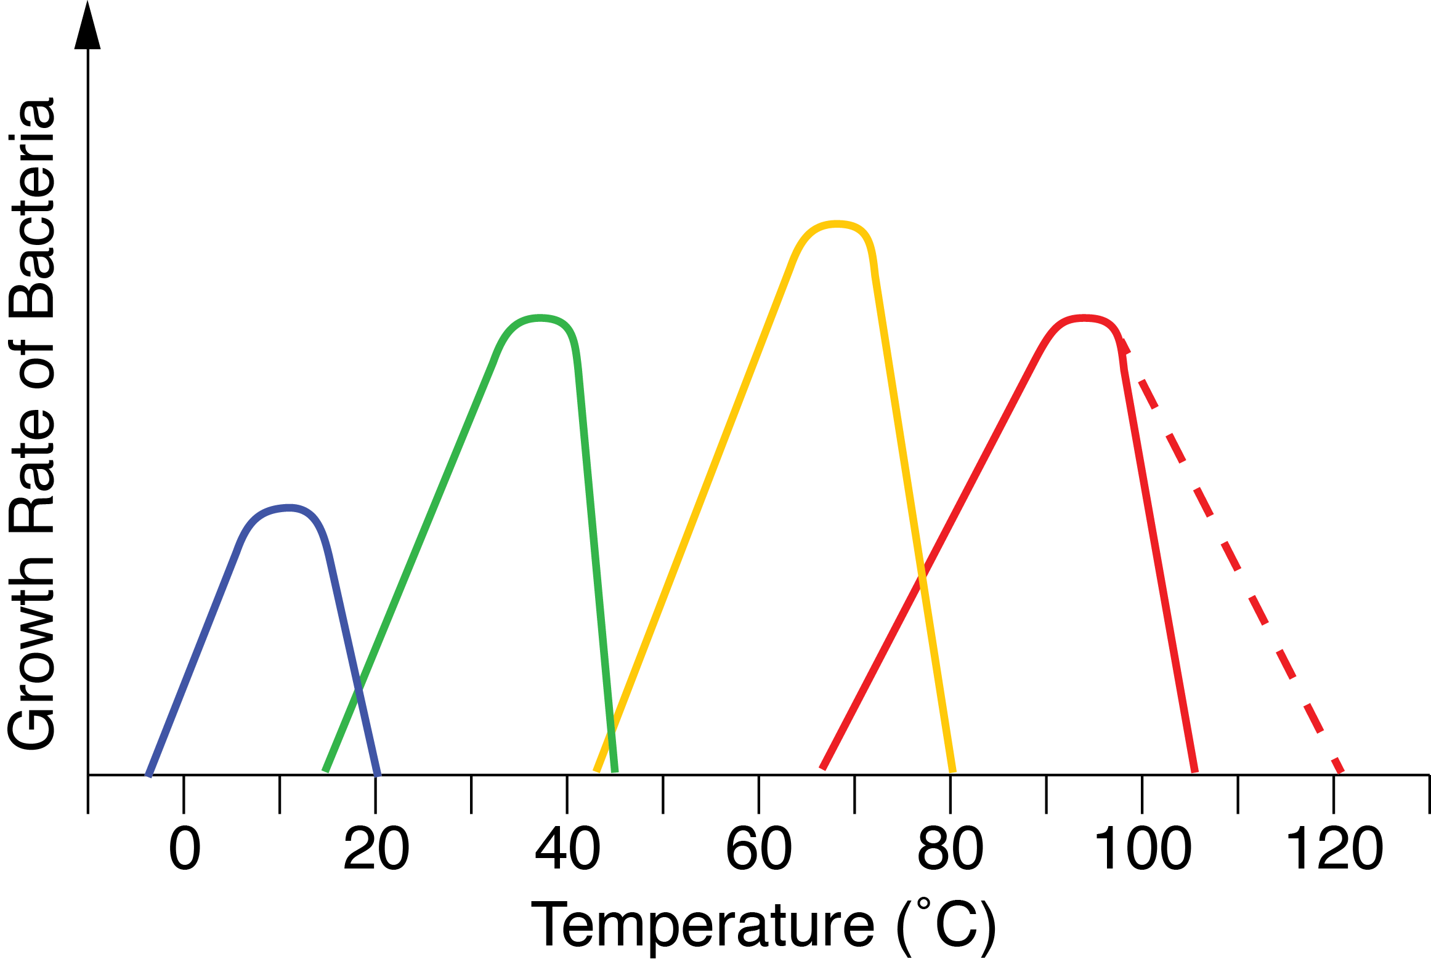
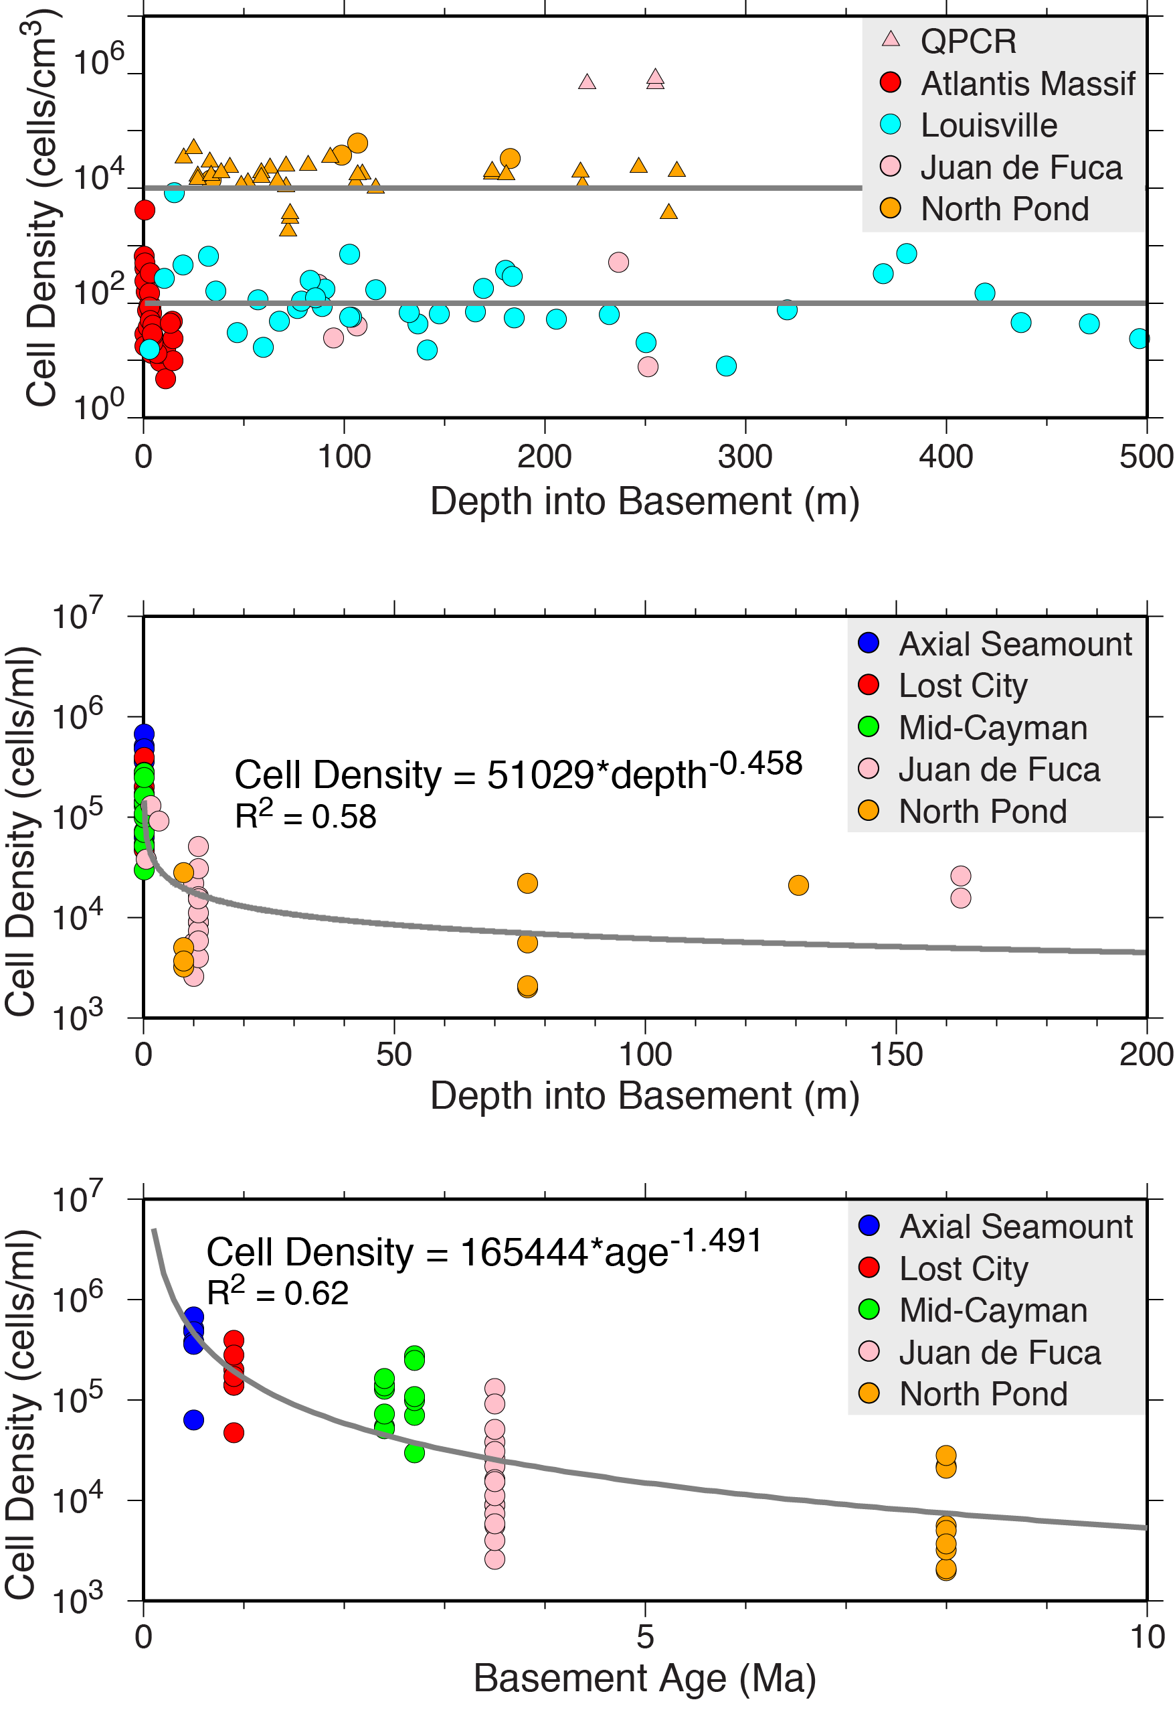
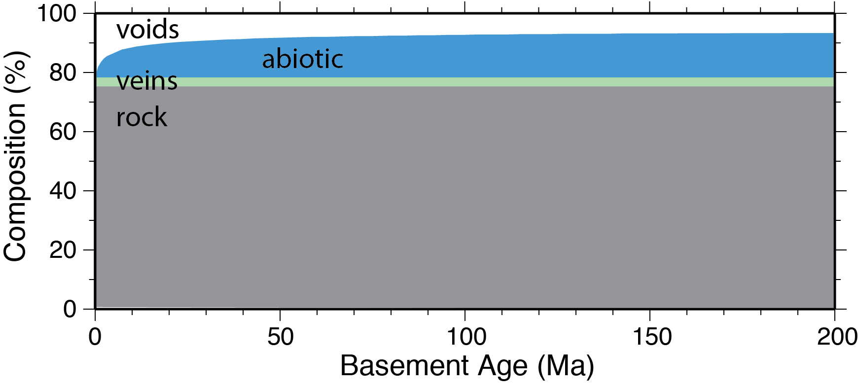
Habitability and Distribution of Subseafloor Life in Oceanic Basement
Rob Pockalny, Steven D'Hondt & Gustavo Ramirez, Graduate School of Oceanography, U. of Rhode Island, Narragansett, RI
Julie A Huber, Woods Hole Oceanographic Institution, Woods Hole, MA
Beth Orcutt, Bigelow Laboratory for Ocean Science, East Boothbay, M
Jason B Sylvan, Texas A&M University, Oceanography, College Station, TX
Motivation & Goals
Data & Methods
Observations
Previous estimates of the biomass contained within the ocean basement differ by two orders of magnitude
1.5 Gt C (Bar-On et al., 2018)
200 Gt C (Heberling et al., 2010)
We combine global maps of heat flow and sediment thickness with models of ocean porosity and microbial abundances (e.g., planktonic and biofilm) to assess the previous biomass estimates and predict the habitability and distribution of microbes associated with various thermal regimes.
Depth to Isotherms (heat flow, sediment thickness)
Habitat Distribution (void, rock, vein)
Hamza et al. (2008)
Laske et al. (2013)
Voids
2.2 x 10²⁶ cells
~51% of total
Rock
1.6 x 10²⁴ cells
~8% of total
Veins
1.7 x 10²⁵ cells
~41% of total
Totoal
2.3 x 10²⁶ cells
after Heberling et al. (2010)
Marine
(6 Gt C)
Illustration of the relative contribution of microbes in various environments, modified from Bar-On et al. (2018).
Global heat flow and sediment thickness grids are used to calculate depth to a particular isotherm in the ocean basement.
Terrestrial
(470 Gt C)
1000 km
Basement
Isotherms
0 km
Deep
Subsurface
(72 Gt C)
20 ˚C
Example of global distributions of microbes in ocean crust defined by presence in voids, on rocks, or in veins. This example is for a 122˚C isotherm with intermediate porosity model assumptions.
45 ˚C
80 ˚C
4
Ocean
Basement
(1.5 Gt C)
Ocean
Sediments
(10 Gt C)
Continent
Basement
(8 - 60 Gt C)
Sediment
122 ˚C
Thermal Regime Distribution
Porous Ocean
Crust
3 km
8
Psychrophiles
(0 – 20 ˚C)
Background
Lower Crust
Mesophiles
(20 – 45 ˚C)
Increasing Depth into Basement
Basic Assumptions
microbial habitability requires open spaces or surfaces
  - voids (fractures & pores) => planktonic microbes
  - rock surfaces => biofilms
  - veins => biofilms
microbes prefer certain temperature ranges
porosity decreases with depth and age of ocean crust
porosity negligible below 3 km in basement
heat flow decreases as a function ocean crust age
temperature gradient in the ocean crust varies as a function of heat flow and sediment thickness
Mantle
12
Representative cross-section of North Atlantic Ocean illustrating the location of basement isotherms relative to seafloor depth, sediment thickness, and the porous upper 3 km of ocean crust.
Thermophiles
(45 – 80 ˚C)
Basement Porosity (age, depth)
Hyperthermophiles
(80 – 122 ˚C)
Müller et al. (2016)
Ocean Crust
Porosity Models
Porosity Age
Dependence
200
Stein and Stein (1994)
Heat Flow
(mW/m²)
0
Becker et al (1982)
Johnson et al. (2000)
Jarrard et al. (2003)
Whitmarsh (1978)
1
Jarrard et al. (2003)
Basement age grids with 4 porosity models and 3 porosity age-dependent models are used to calculate 12 different 3D porosity models of the ocean basement.
Global distributions of microbes in ocean crust defined by preferred temperature ranges.
Normalized
Porosity
0
0
50
100
150
Cell Density
Summary
Porosity (%)
Basement Age (Ma)
Voids
Rock
Veins
Our biomass estimate of ocean crust (~6 x 10⁻³ Gt C) is
3 orders of magnitude below previous estimates (2.8 Gt C)
3 orders of magnitude below continent estimates (8.4 Gt C)
3 orders of magnitude below ocean sediments (6.1 Gt C)
Microbial abundance decreases with increasing temperature, basement age, and depth into basement
Microbial abundance estimates are greatest in voids (51%) and veins (41%) and much lower on solid rock (8%)
Microbial abundance is greatest in the shallowest crust within lower temperature environments (<20˚C) inhabitated by psychrophiles (95%).
0
0
50
Pillows
1
Dikes
2
Basement Depth (km)
Gabbro
3
4
Brittle-Ductile Transition
5
Jarrard et al. (2003)
Representative cross-section of upper oceanic crust illustrating the various layers and the general changes in properties (e.g., porosity, heat flow, composition), as a function of basement age and depth into basement. The expanded region illustrates the various habitats (e.g., voids, rock, vein) assumed in this study.
A 2D linear regression is used to calculate a “best-fit plane” to predict cell density as a function of basement age and depth into basement.
No apparent change in cell density as a function of age or depth, so uniform values of cell density (e.g., 10² and 10⁴ cells/cm³ are used in calculations to a maximum depth of 0.6 km).
No apparent change in cell density as a function of age or depth, so uniform values of cell density reported by Yohey et al. (in prep.) are used in calculations to a maximum depth of 0.3 km.
mesophiles
thermophiles
hyperthermophiles
2% veins
5% celadonite + FeO
psychrophiles
Graph of growth rate as a function of temperature for various classes of microbes (Brock, 1985).
1.0x10² to 1.0x10⁴ cells/cm³
6.6x10⁹ to 46.6x10⁹ cells/cm³
Total cell counts are calculated by,
- depth integration for the various habitats (voids, rock, veins)
with depth limits determined by isotherm depths or pre-set maximums (e.g., 3 km, 0.6 km and 0.3 km, respectively)
over a global grid with and spatial interval of 0.1˚ x 0.1˚
then summed and scaled for the ocean basin where ocean basement age data exist (e.g., 3 x 10⁸ km²).
Acknowledgments
Cell Density = 1.2x10⁵ * age^{-1.5}
+ 3.2x10⁴ * depth^{-0.46}
– 1.9x10³
assuming 25 fg C/cell
Support for this project is partially funded by the Sloan Foundation as part of the Deep Carbon Observatory (DCO)and the National Science Foundation as part of the Center for Dark Energy Biosphere Investigations (C-DEBI).

