Slide 1
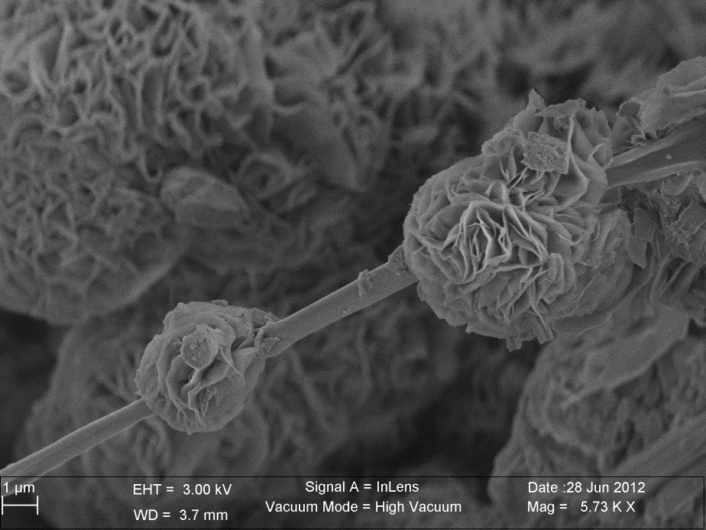
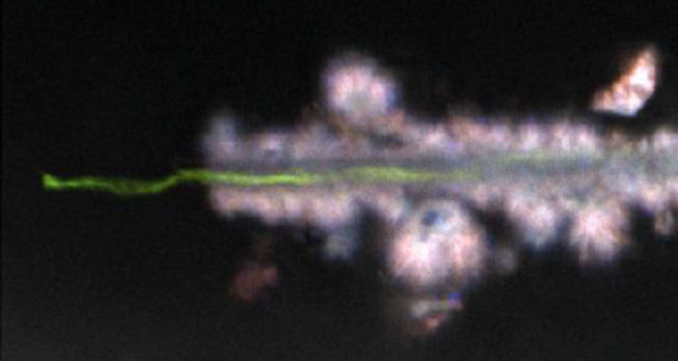
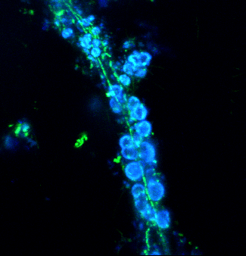
Mg-hydrocarb
C-rich filament
1 µm
5 µm
10 µm

Slide 2
