Slide 1
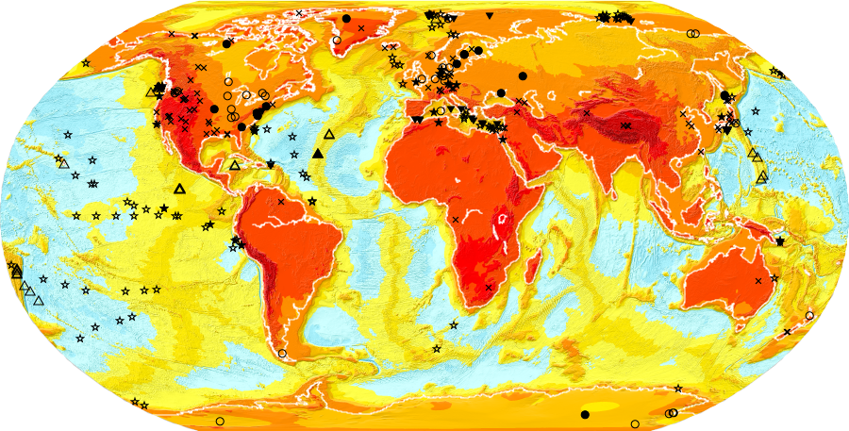
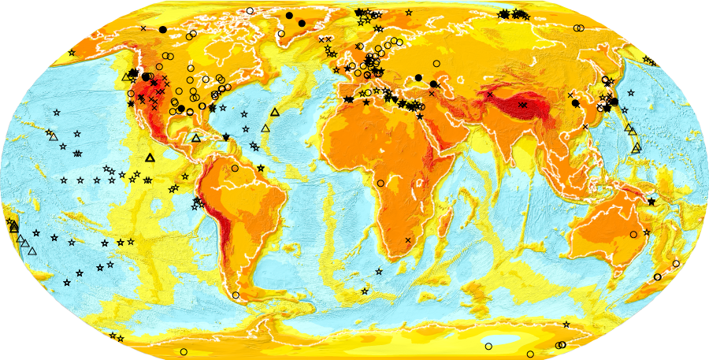
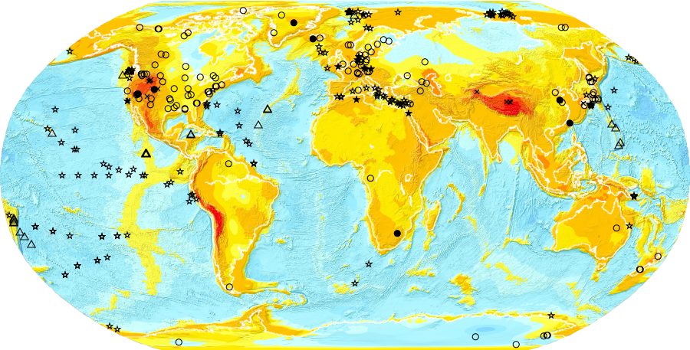
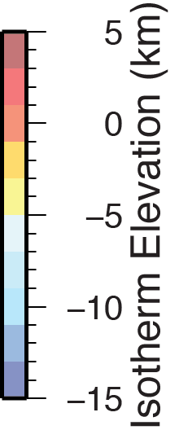
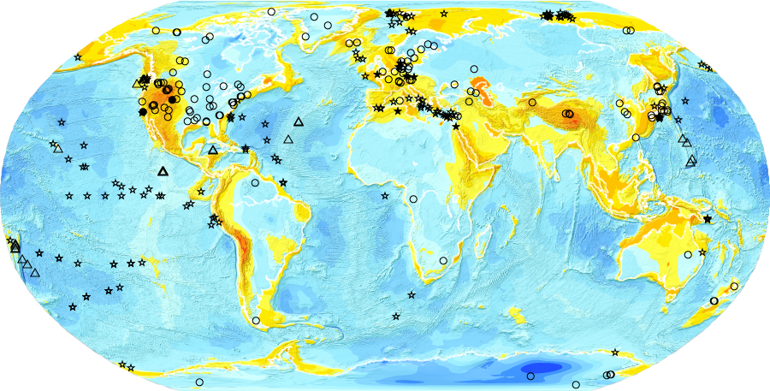
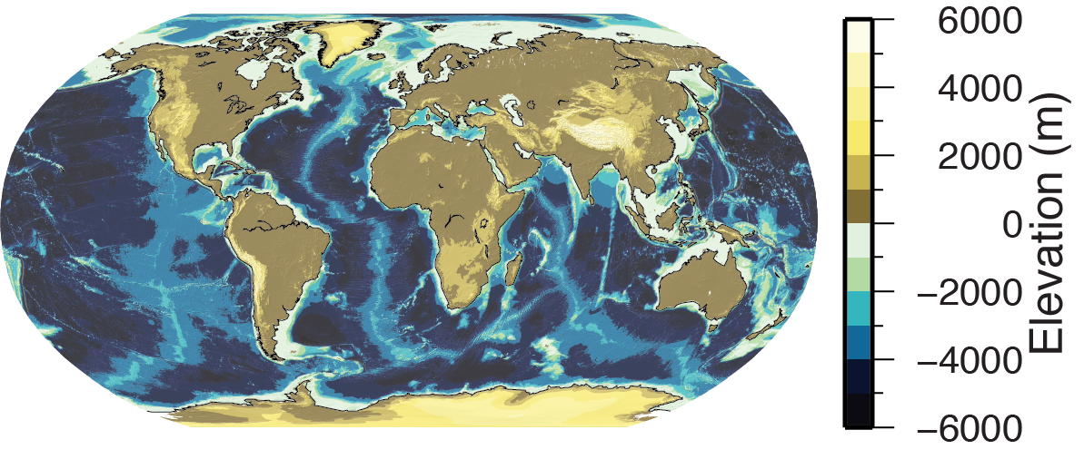
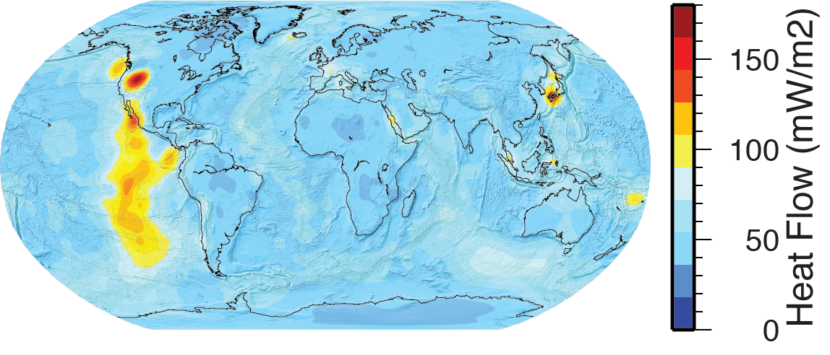
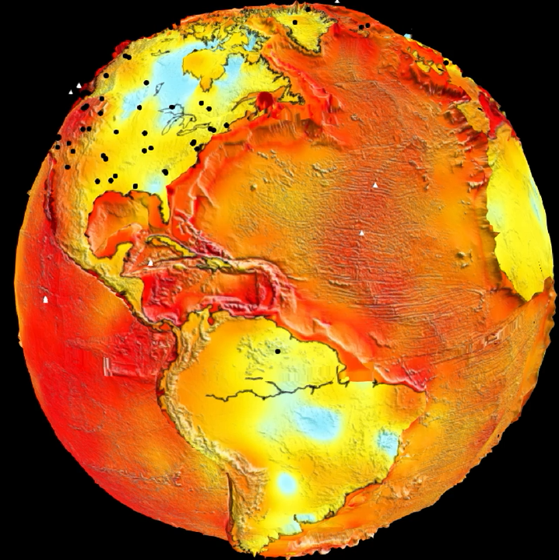
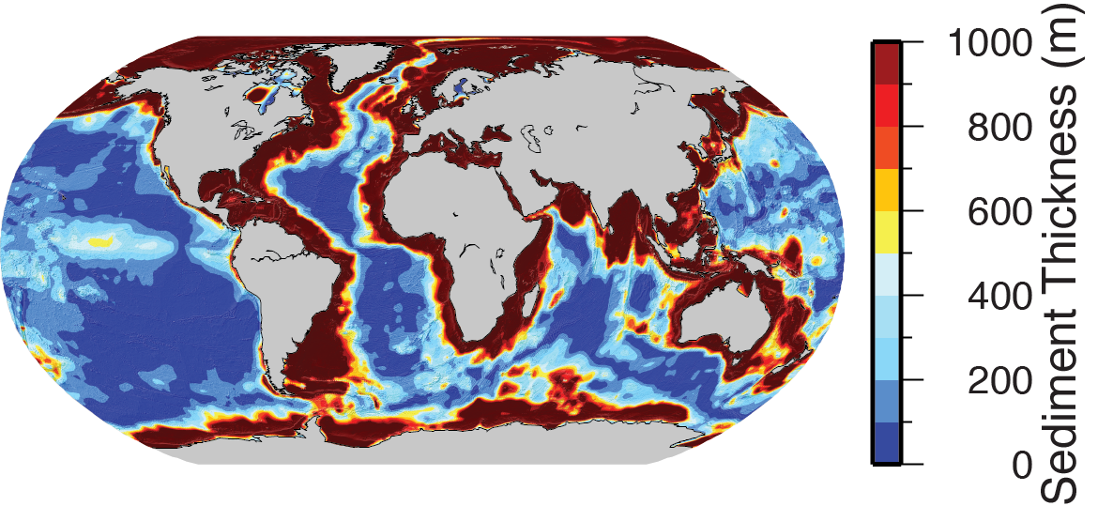
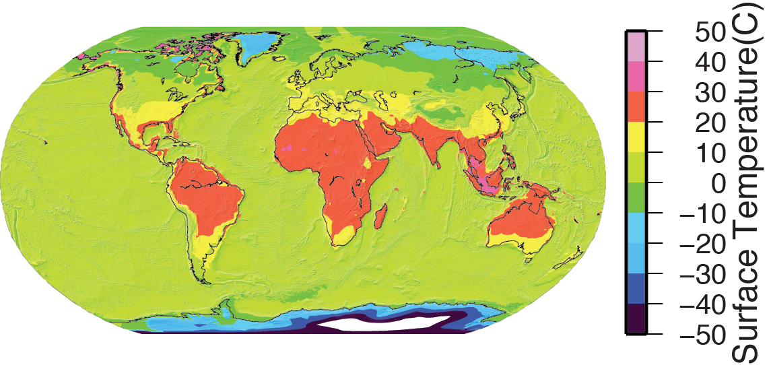

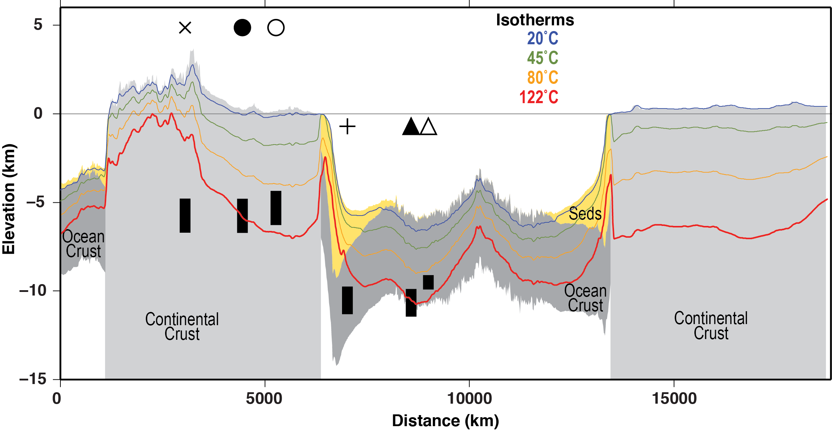
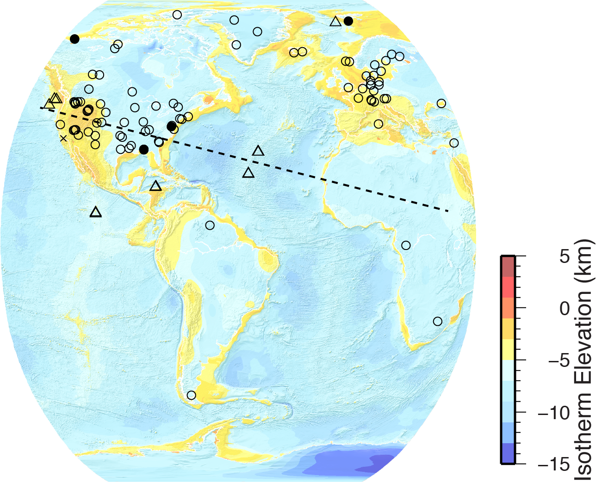
Mapping the Deep Subsurface Biosphere on a Sphere
¹Pockalny, R., ²Zahirovic, S., ²Qin X., ¹Pratt. K., ¹Trew Crist, D., ¹Wood, J., ³Colwell, F.
¹DCO Engagement Team, , University of Rhode Island, Graduate School of Oceanography, Narragansett, RI, USA
²The University of Sydney, School of Geosciences, Sydney, AU
³Oregon State University, College of Earth, Ocean and Atmospheric Sciences, Corvallis, OR, USA
Motivation
Methods
Results
The depth to a chosen isotherm (Z_{t}) at given geographic location (x, y) is calculated for continental crust, ocean crust, and ocean sediments, as shown by the equations below. The depths for the various regions are merged to create anisotherm surface. This isotherm surface is combined with surface elevation and sediment thickness data to create an “elevation” map of the chosen isotherm. We then place the location of deep-life samples and use various symbols to indicate whether the data are located above, below or intersect the isotherm.
20˚C
We wanted to develop an user-friendy interface to assist researchers with future deep-life research. Our goals include,
- cataloging basic metadata for existing deep-life samples in continental crust, ocean crust, and ocean sediments,
- calculating the depth to key isotherm limits for psychrophiles (20˚C), mesophiles (45˚C), thermophiles (80˚C), and hyperthermophiles (122˚C),
- showing the location of these deep-life samples on various map projections, and
- indicating whether the deep-life samples for each site are located above, across or below a chosen isotherm.
45˚C
80˚C
Continental Crust (after Magnabosco et al., 2018)
Z_{t} = depth to isotherm T at given x, y location
T_{surf} = land surface temperature at given x, y location
Q = heat flow at given x, y location
Z_{sed} = sediment thickness at given x,y location
λ_{rock} = thermal conductivity of continental rock (3.0 mW/m)
λ_{bas} = thermal conductivity of ocean basement (2.0 mW/m)
λ_{sed} = thermal conductivity of ocean sediments (0.8 mW/m)
λ_{grains} = thermal conductivity of ocean sediment grains (porosity dependent)
λ_{pores} = thermal conductivity of ocean sediment pores (porosity dependent)
122˚C
Data
Continental
Crust
Ocean
Crust
Ocean
Sediments
Ocean Crust (after Heberling et al., 2010)
Above
Topography
Heat Flow
Intersects
Below
Ocean Sediments (after LaRowe et al., 2017)
^{(1-φ)}
Deep Biosphere Cesium Globe
http://portal.gplates.org/
cesium/?view=Biosphere
ETOPO1, 2018
Hamza et al., 2006
^{(φ)}
Sediment Thickness
Surface Temperature
122°C isotherm
Laske, et al., 2012
Willmott & Matsuura, 2001
HYCOM, 2018
References
Acknowledgments
ETOPO1 Global Relief Model. Retrieved from https://www.ngdc.noaa.gov/mgg/global/, March, 2018.
Hamza, V. M., R. R. Cardoso, and CF Ponte Neto. "Spherical harmonic analysis of earth’s conductive heat flow." International Journal of Earth Sciences 97.2 (2008): 205-226.
Heberling, Cara, et al. "Extent of the microbial biosphere in the oceanic crust." Geochemistry, Geophysics, Geosystems 11.8 (2010).
HYCOM Global Ocean Model. Retrieved from https://www.hycom.org/dataserver July, 2018.
LaRowe, Douglas E., et al. "Temperature and volume of global marine sediments." Geology 45.3 (2017): 275-278.
Laske, G., et al. "CRUST1. 0: An updated global model of Earth’s crust." Geophys Res Abs 14 (2012): 3743.
Magnabosco, C., et al. "The biomass and biodiversity of the continental subsurface." Nature Geoscience 11.10 (2018): 707-717.Sandwell ETOPO
Willmott, Cort J., and Kenji Matsuura. "Terrestrial air temperature and precipitation: Monthly and annual time series (1950–1999) Version 1.02." Center for Climatic Research, University of Delaware, Newark (2001).
We thank Julie Huber, Jens Kallmeyer, Beth Orcutt, and Jason Sylvan for providing metadata information of various deep-life samples. Research activities were partially supported by C-DEBI and DCO.
Representative cross section of isotherm elevations superimposed on simple geology. The location of the cross section is indicated on the map of the 122˚C isotherm elevation map with the description of the various symbols indicated.

