Slide 1
Traditional Knowledge & Climate Change:
Sustainable Land Management Practices from
the Past for
the Future

Slide 2
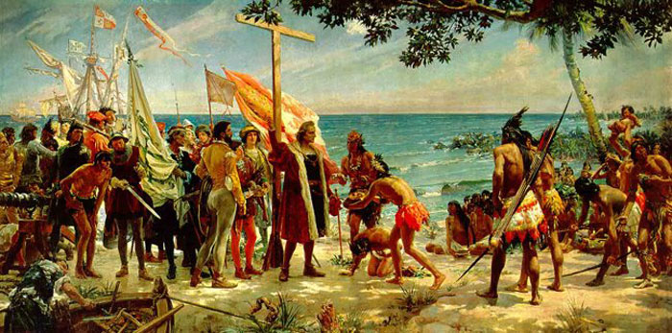
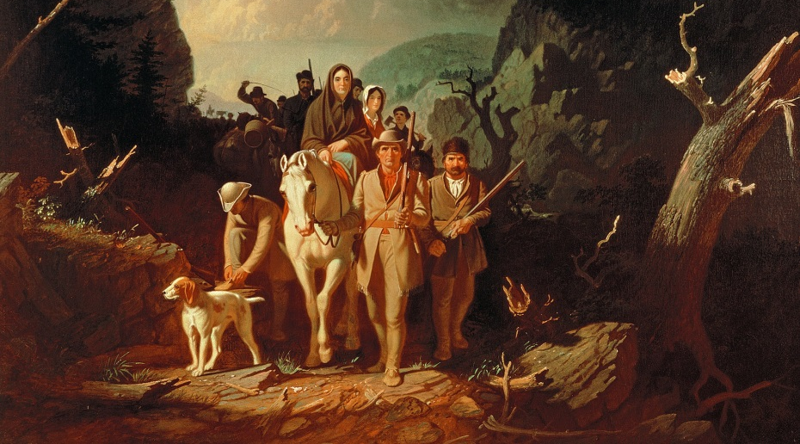
The “American Wilderness” Myth
Two primary competing Euro-American views of the “New World’s” wilderness:
Early Euro-American settlers in the regarded the land as a spiritual and physical void which had to be conquered and civilized in the name of Christianity and progress
contained savagery and temptation that threatened authority of the European-based community; or
2) represented a new “Garden” that could flourish with “proper” cultivation by European settlers

Slide 3
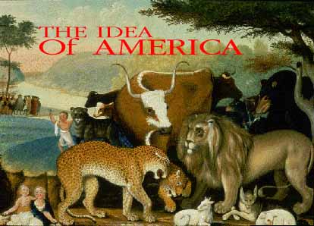
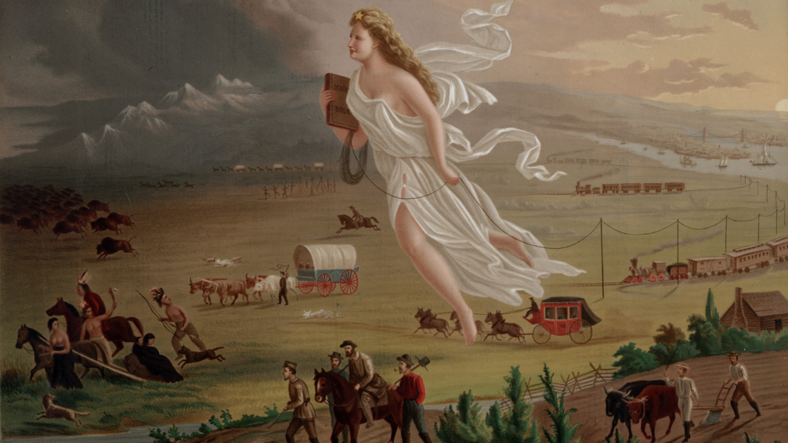
The “American Wilderness” Myth
An unknown entity with bizarre animals, unusual topography, and strange indigenous inhabitants, the wilderness represented a place where community and consensus would be put in peril by the total absence of European law, religion, and civilization
Land supplied the raw materials for building a society, and nature was to be used, not feared
Despite the different outlooks, the goal was the same: to destroy the savage wilderness and its indigenous inhabitants and make it bloom with European civilization

Slide 4
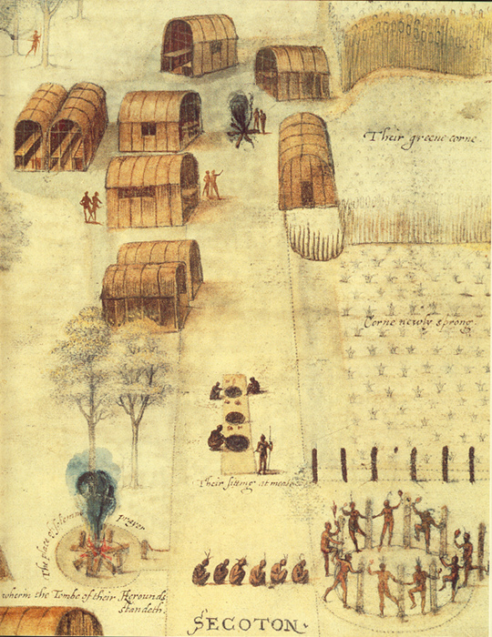
The Reality
Many of the pre-European contact landscapes were not "wild" or untouched by humans
They were instead shaped using a broad range of indigenous, land management techniques (e.g., regular burning)
One of the most sophisticated, wide-spread and sustainable forms of land management ever practiced
Now sustainable agriculture proponents are seeking to revive and reapply traditional knowledge
Village of the Secotan Indians in North Carolina, by John White (1585)

Slide 5
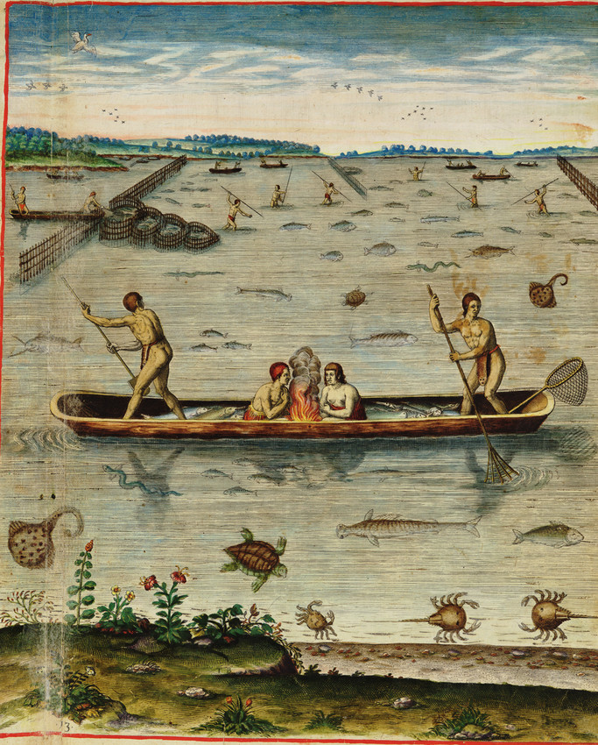
Sustainability
What does it mean to be sustainable?
Renewing resources at rate equal to or greater than the rate at which they are consumed
Living within the resources that are available without damaging the environment
Community resembles a living system where all resources are renewed and in balance always
Economic system that provides a high quality of life while renewing the environment and its resources
Commonality — a respect for the earth, for natural resources and a stewardship mindset
Native Fishing Techniques (John White 1585)

Slide 6
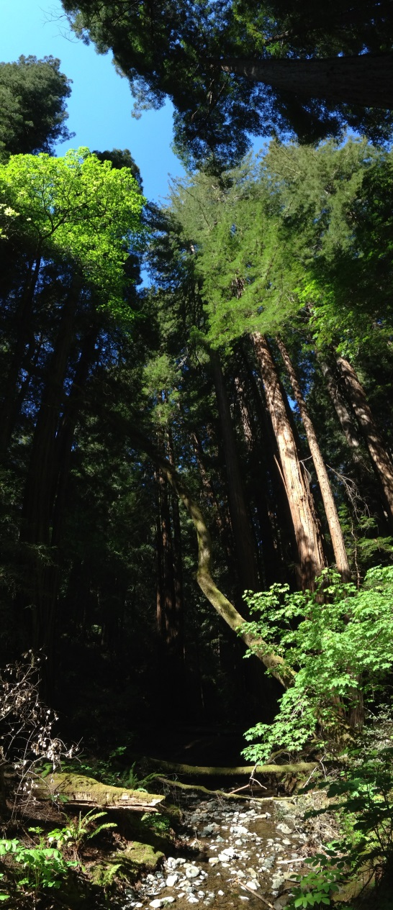
Sustainability
John Muir commented in the late 1800s:
“Indians walk softly and hurt the landscape hardly more than birds or squirrels.”
As a result, the land before the Europeans arrived was rich and fertile, organized and well-tended
Native Americans were not in a power struggle against nature, but rather worked within the set boundaries before them and out of a spirit of respect came to know how the resources could be used for their survival.
They took no more than they could use and used all they could from what they took, being sure to put the time and energy into the land so that it would continue to yield and continue to produce for generations to come.
Redwoods in the Muir Woods National Park

Slide 7
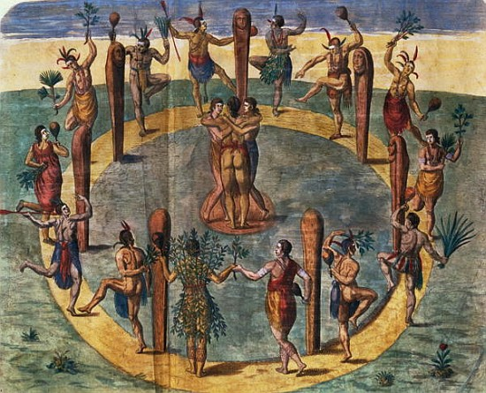
Sustainability
Historically, Native American people understood that nature was to be tended, carefully and lovingly maintained, and respected - not dominated
They understood the natural resources on the earth would continue to produce year after year – to provide the things needed for survival when steps were light and hearts were right
This is what it means to be sustainable

Slide 8
Contrast Native American Resource Management with Modern Agricultural Practices:
Dominated by industrial agriculture - chemically intensive food production developed in the decades after World War II featuring enormous single-crop farms and animal production facilities
Once hailed as a technological triumph that would enable a skyrocketing world population to feed itself
Industrial agriculture’s impacts on the environment, public health, and rural communities make it an unsustainable way to grow our food over the long term
Today, increasingly seen as a dead end, a mistaken application to living systems of approaches better suited for making jet fighters and refrigerators.

Slide 9
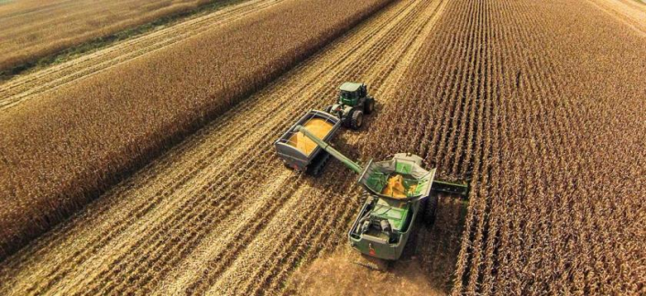
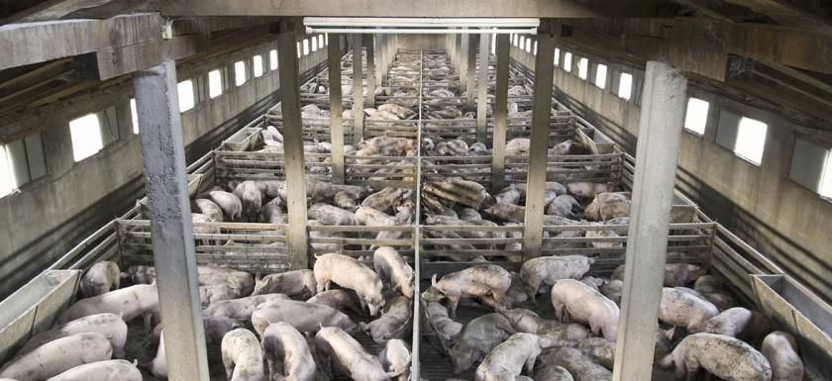
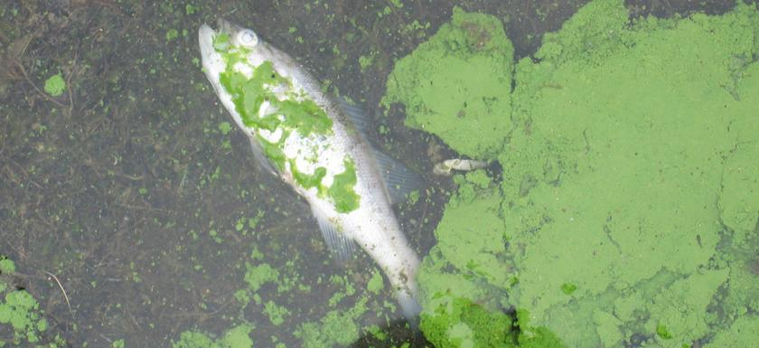
Industrial Agriculture Practices
Monoculture - single crops grown intensively on a very large scale (corn, wheat, soybeans, cotton, rice), with a heavy reliance on chemicals - synthetic fertilizers and pesticides that quickly depletes soil’s nutrients and attractive to certain weeds and insect pests
Industrial Meat Production - large-scale CAFOs (confined animal feeding operations) in which animals fed high-calorie, grain-based diet supplemented with antibiotics and hormones to maximize weight with waste concentrated in one place making it an environmental problem –
Chemical fertilizer runoff and CAFO wastes add to global warming emissions & create oxygen-deprived "dead zones" at the mouths of major waterways
Herbicides & insecticides harm wildlife and pose human health risks

Slide 10
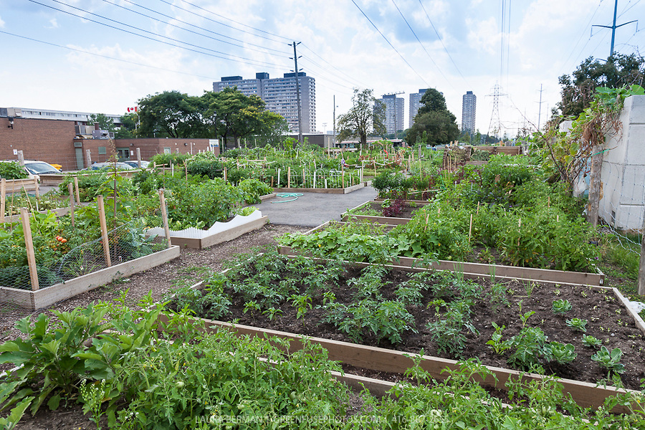
Sustainable Agriculture Practices
Return to Small-Scale Organic Farming & Community-Based Gardens (rural and urban settings)

