Slide 1
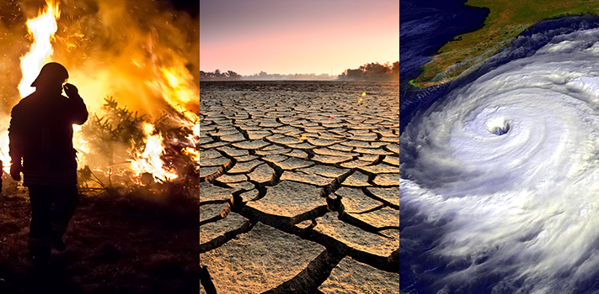
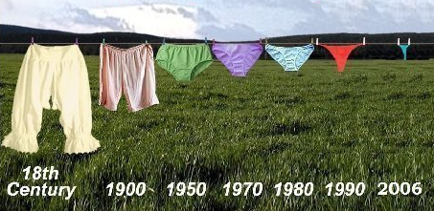
CLIMATE CHANGE’S EFFECT ON PEOPLE:
PAST & PRESENT

Slide 2
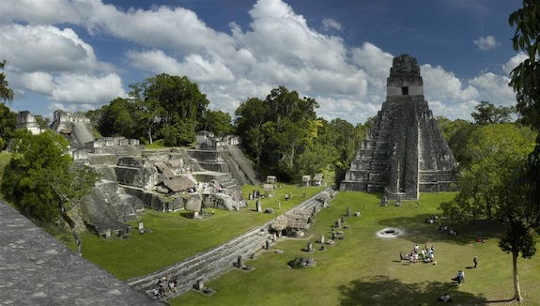
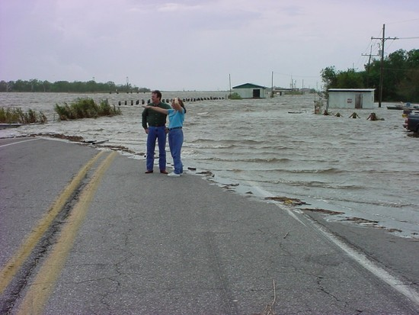
CLIMATE CHANGE’S EFFECT ON PEOPLE:
PAST & PRESENT
Topics for Discussion
How Does Climate Change Effect Us?
Climate Change in the Past:
  Impact on the Mayan Civilization
Climate Change in the Present:
  Impacts on Louisiana’s Isle de Jean Charles Band of Biloxi-Chitimacha Indians – America’s First ‘Climate Change Refugees’

Slide 3
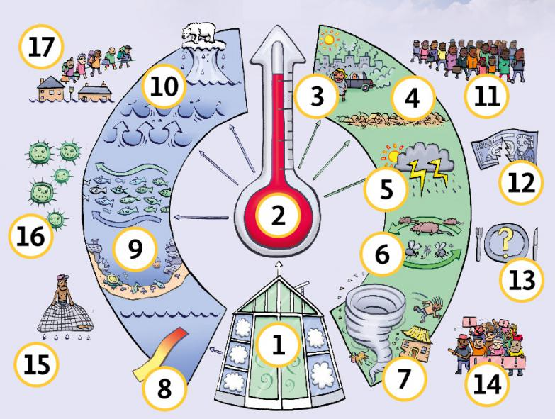
CLIMATE CHANGE’S EFFECT ON PEOPLE
How Does Climate Change Effect People?
(think-pair-share)

Slide 4
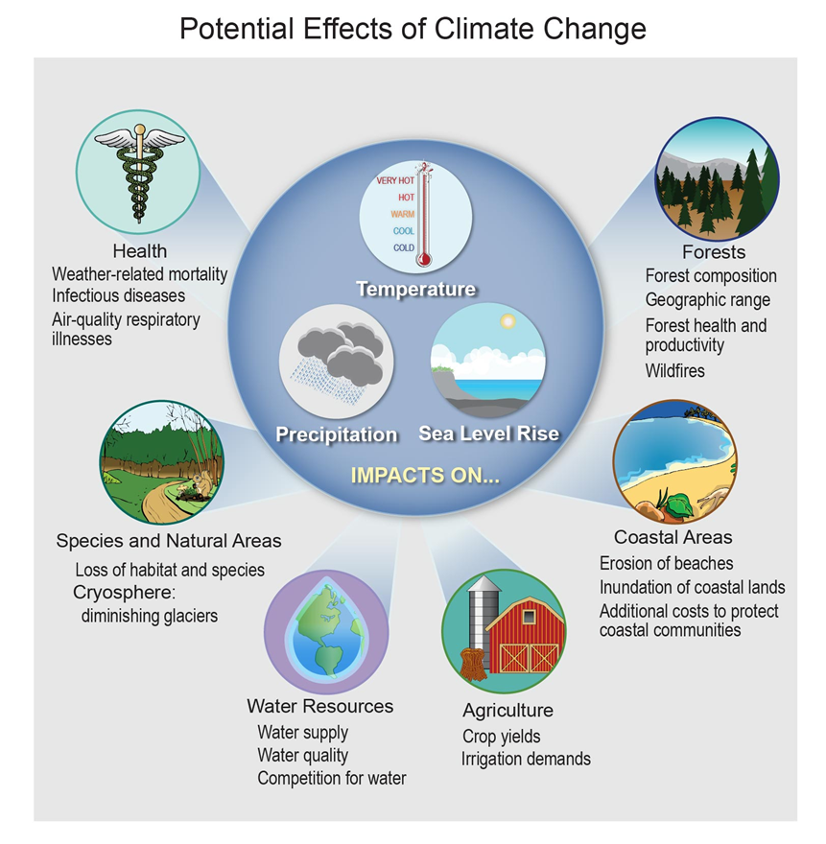
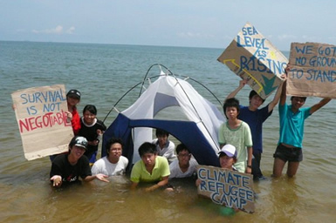
CLIMATE CHANGE’S EFFECT ON PEOPLE
How Does Climate Change Effect People?
  Health
  Agriculture/Fisheries
  Energy
  Water
  Ecosystems
  Forests
  Coastal Areas
  Recreation

Slide 5
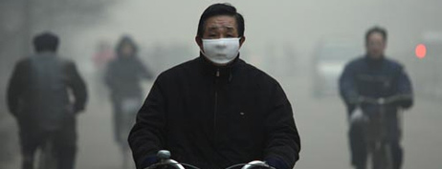
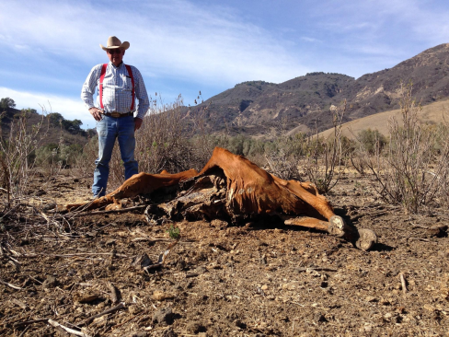
CLIMATE CHANGE’S EFFECT ON PEOPLE
How Does Climate Change Effect People?
  Health
    Temperature-Related Illnesses
    Air Quality-Related Illnesses
    Spreading Diseases
  Agriculture/Fisheries
    Crop & Species Losses = Food Shortages
  Energy
    Increased Demand = Energy Shortages
  Water
    Low or Dried-Out Streams, Rivers, Ponds, Lakes (reservoirs)
    Public Water Supply Shortages, Irrigation Restrictions, Reduced Hydropower, Transportation Disruptions

Slide 6
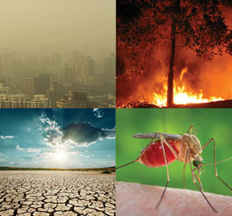
CLIMATE CHANGE’S EFFECT ON PEOPLE
How Does Climate Change Effect People?
  Ecosystems (plants and animals)
    Altered/Diminished Habitat
  Forests
    Spread of Pests
    Increased Wildfires
  Coastal Areas
    Coastal Cities Flooded
    Coastal Wetlands Destroyed
  Recreation
    No Snow = No Skiing/Snowboarding
    Beach Erosion = No Beach

Slide 7
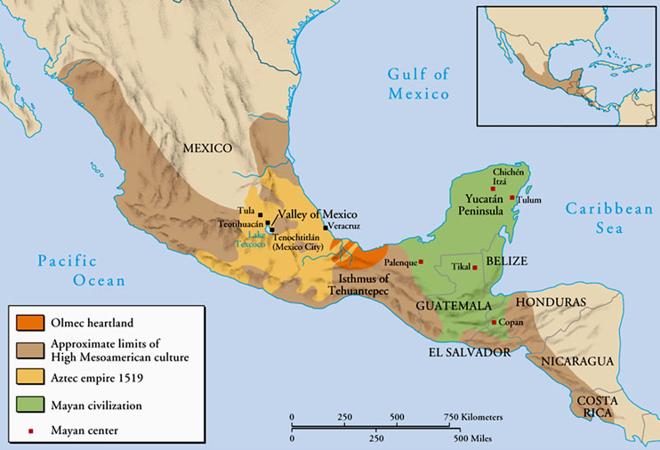
CLIMATE CHANGE’S EFFECT ON PEOPLE
Impact of Climate Change on the Maya Civilization
Maya civilization – one of the most dominant indigenous societies of Mesoamerica (Mexico and Central America) before the 16th-century Spanish invasion. Experienced growth over 2,700 years between 3,800-1,100 years before present (B.P.), followed by collapse @ 1,100 B.P., and a 600-yr transition to villages
Maya culture centered in one area (shown in green) – Yucatan Peninsula (in modern-day Guatemala, Belize, parts of Mexican states Tabasco and Chiapas, and western parts of Honduras and El Salvador)
Tikal (Classical Maya’s capital city)

Slide 8
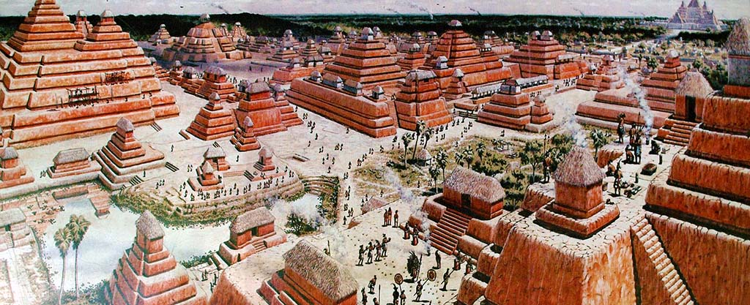
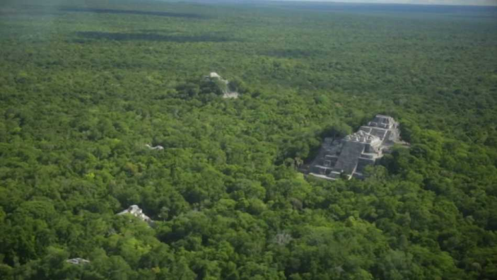
CLIMATE CHANGE’S EFFECT ON PEOPLE
EARLY MAYA PERIOD (3,800-2,250 B.P.)
  Agricultural culture (corn [maize], beans, squash and cassava [manioc])
  City and pyramid-builders - Mirador – one of the greatest cities ever built
CLASSIC MAYA PERIOD (2,250-1,100 B.P.)
  40 cities with plazas, palaces, temples and pyramids, and ball-courts
  Each city @ 5-50,000 people; total est. population ca. 2 million
  Cities surrounded/supported by large population of farmers
  Farming = primitive “slash-and-burn” agriculture; also irrigation, and terracing
  “Collapse” @ ca. 1,100 B.P. – Why?!?
    Possible causes: 1) exhausted environment; 2) constant warfare - led to
    broken trade alliances, politics, and religion; or 3) climate change (drought)
Early Maya city of Mirador

Slide 9
CLIMATE CHANGE’S EFFECT ON PEOPLE
Collapse of Maya Civilization (ca. 1,300-1,100 B.P.)
  Evidence of climate change (ca. 200 yr-long period of intense drought) found in
  sediment samples taken from two lakes (north and south)
  Examined ratio of heavy & light oxygen isotopes found in fossilized shell and
  sedimentary rock, and hydrogen isotopes in the acid found in the waxy coatings of
  Land plants
  Lighter isotopes of oxygen evaporate more readily – times of greater evaporation
  and lower precipitation = a greater amount of heavy isotopes in the water, which
  end up in the fossilized shell and sedimentary rock
  Also looked at growth rates of stalagmites – they grow quicker during wet months
  Mayan culture founded on anomalous high rainfall patterns. Drought found to be
  worse in the southern region –where the civilization’s collapse was more rapid)
  Possible result of shift in the Intertropical Convergence Zone or El Nino – similar
  effect on several ancient societies (e.g., Teotihuacan and Akkadian Empires)

Slide 10
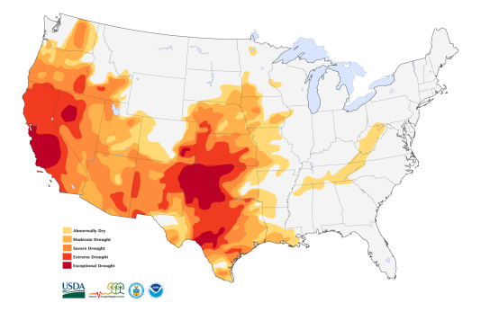
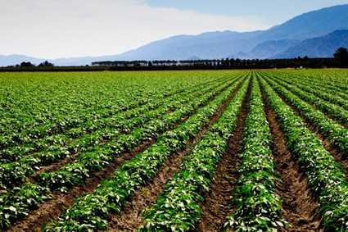
CLIMATE CHANGE’S EFFECT ON PEOPLE
Extreme Drought Conditions in California and the Midwest Since 2000
The chances of a 35-year or longer "megadrought" striking the Southwest and central Great Plains by 2100 are above 80 percent if the world stays on its current trajectory of greenhouse gas emissions, according to scientists from NASA, Columbia University, and Cornell University.
California has been the #1 food & agricultural producer in the United States for more than 50 consecutive years.
A nearly $44 billion dollar industry that generates over $100 billion in related economic activity in the United States every year.
Any Similarities Between Ancient Mayan Situation and Ours Today?
(think-pair-share)

Slide 11
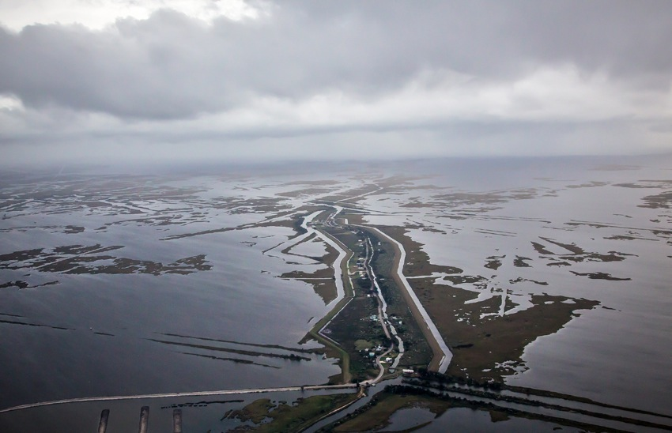
CLIMATE CHANGE’S EFFECT ON PEOPLE
Impact of Sea Level Rise on the Islands and Wetlands of South Louisiana
Since 1930, the Louisiana coast has lost about 190,000 square miles of land = an area the size of Rhode Island
USGS: Over the last 25 yrs – losing 16.57 sq mi/year (= football field of coast every hour)
Isle de Jean Charles Band of the Biloxi-Chitimacha Indians will be America’s First “Climate Change Refugees”
Island population is about 70 people, down from a peak of about 350, with only 25 homes full-time residences. Rising waters are now threatening the very existence of the Tribe and its homeland
“It ain’t they-uh no maw.”

Slide 12
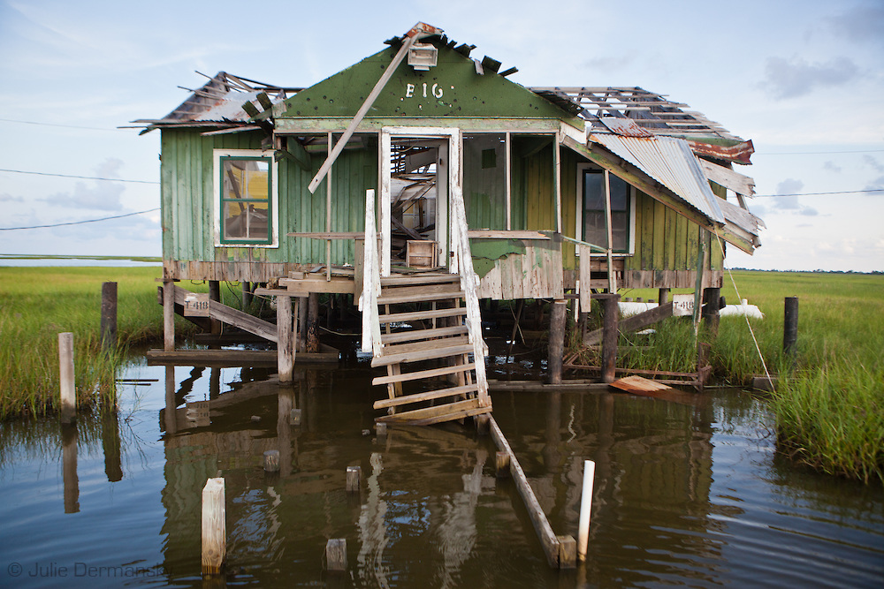
CLIMATE CHANGE’S EFFECT ON PEOPLE
Impact of Sea Level Rise on the Islands and Wetlands of Southern Louisiana
50 yrs ago, Isle de Jean Charles was 11 miles long-x-5 miles wide. It is now 2 miles long-x-0.5 miles wide and shrinking rapidly
Louisiana’s $50-billion “Comprehensive Master Plan for a Sustainable Coast” released in 2012 does not include any measure to rebuild or protect the Isle de Jean Charles
Chief Albert Naquin hoped to relocate the Tribe, but dropped idea because some determined to stay
Tribe faces not only the disappearing land of their ancestors, but also the disappearance of their island-based culture

Slide 13
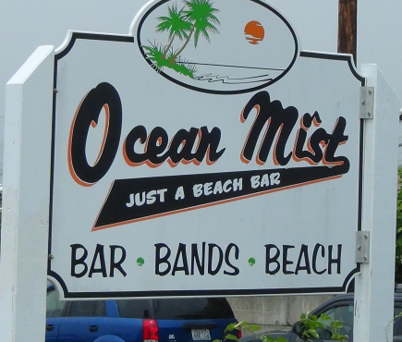
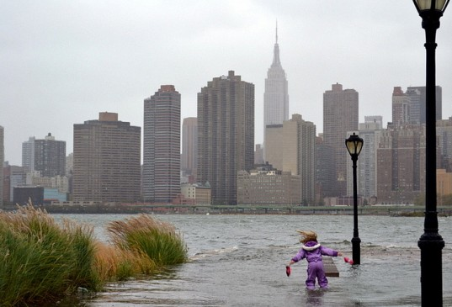
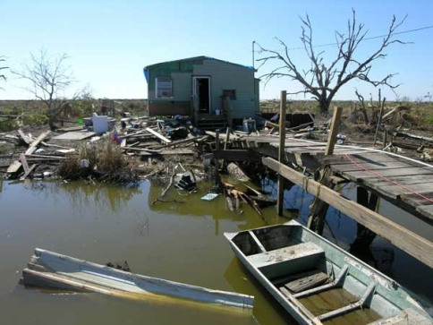
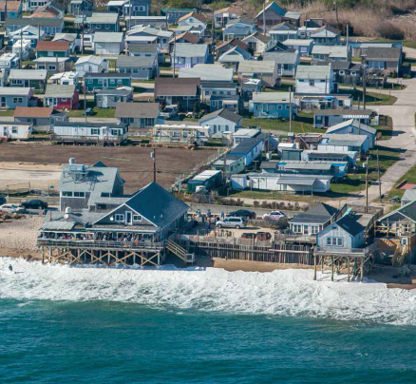
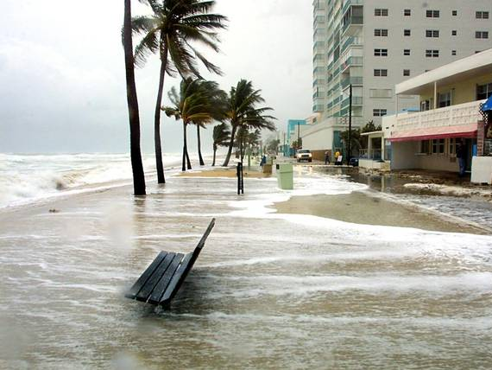
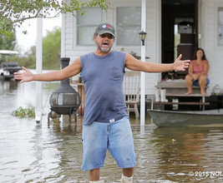
CLIMATE CHANGE’S EFFECT ON PEOPLE
Social Justice Question: Who will be the “Winners” and “Losers”? Why?
(think-pair-share)
E. Matunuck, RI
Manhattan, NY &
Miami Beach, FL
Isle de Jean Charles
Southeastern ,LA

