Slide 1
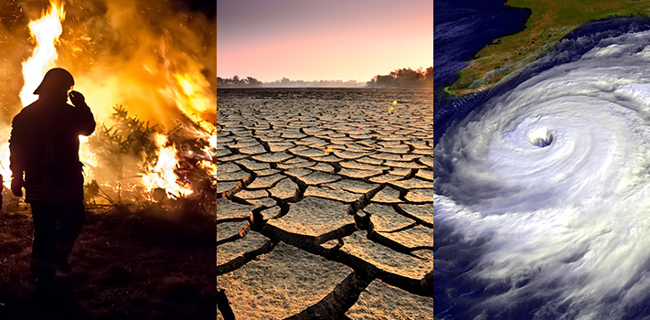
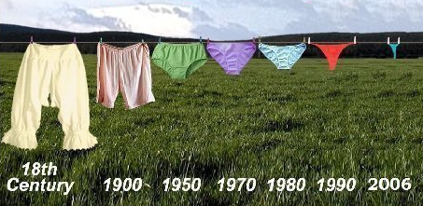
CLIMATE CHANGE’S EFFECT ON PEOPLE: PAST & PRESENT

Slide 2
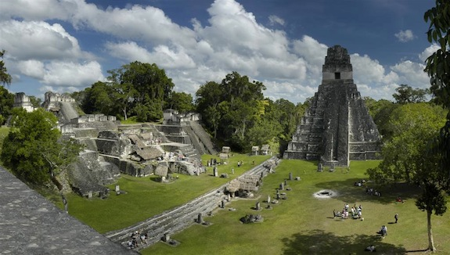
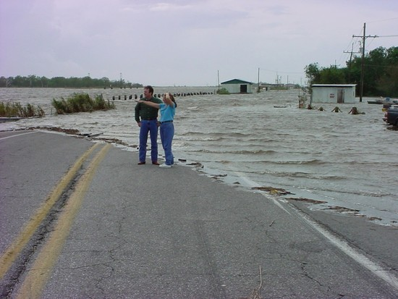
CLIMATE CHANGE’S EFFECT ON PEOPLE: PAST & PRESENT
Topics for Discussion
How Does Climate Change Effect Us?
Climate Change in the Past:
Impact on the Mayan Civilization
Climate Change in the Present:
Impacts on Louisiana’s Isle de Jean Charles Band of Biloxi-Chitimacha Indians – America’s First ‘Climate Change Refugees’

Slide 3
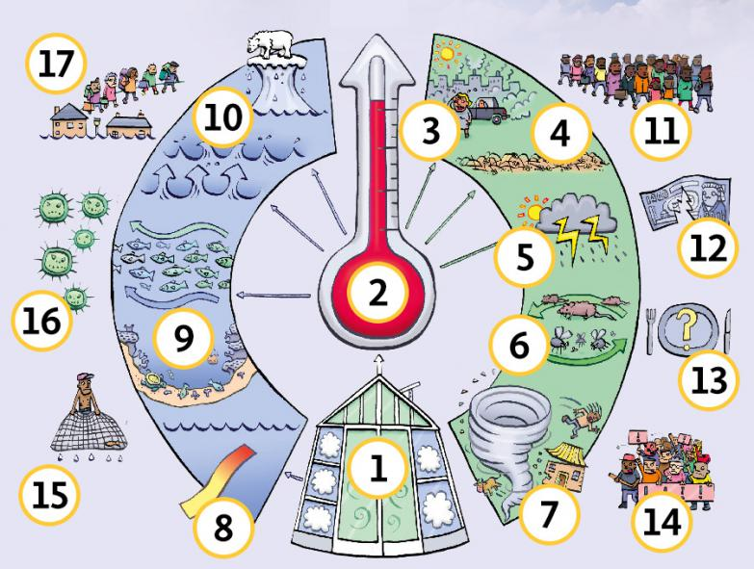
CLIMATE CHANGE’S EFFECT ON PEOPLE
How Does Climate Change Effect People?
(think-pair-share)

Slide 4
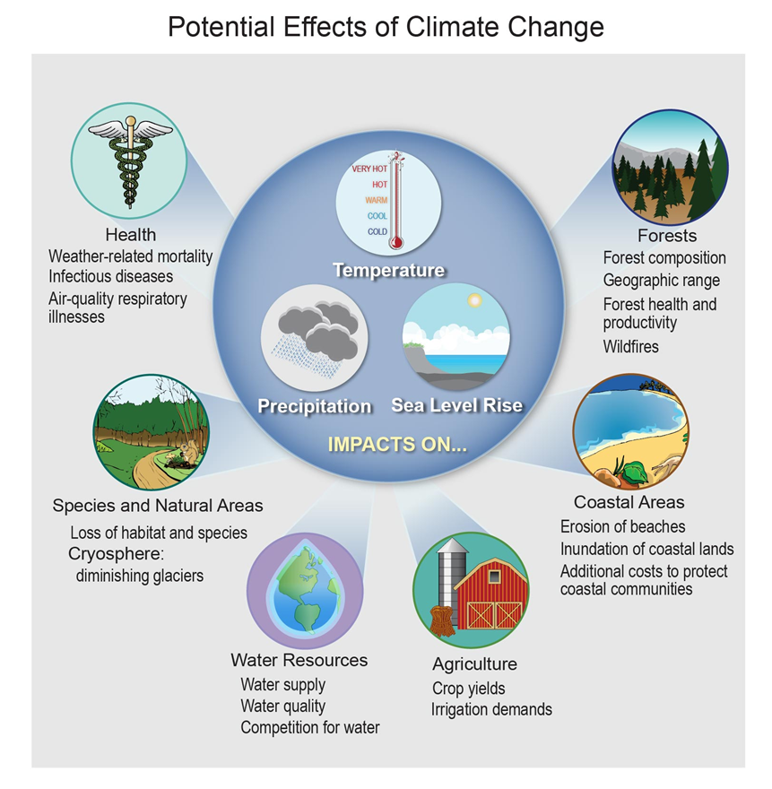
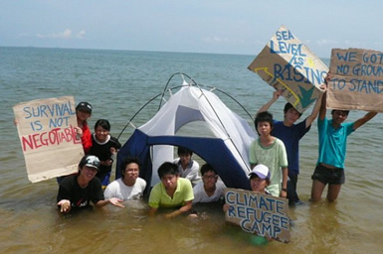
CLIMATE CHANGE’S EFFECT ON PEOPLE
How Does Climate Change Effect People?
Health
Agriculture/Fisheries
Energy
Water
Ecosystems
Forests
Coastal Areas
Recreation

Slide 5
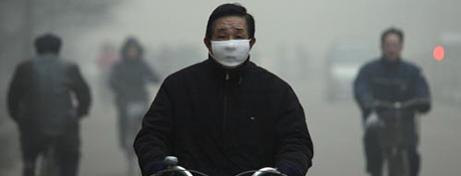
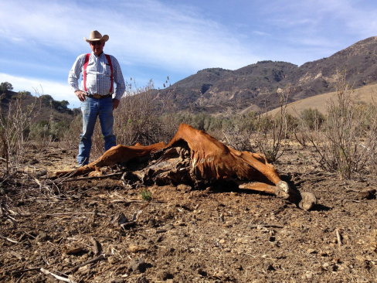
CLIMATE CHANGE’S EFFECT ON PEOPLE
How Does Climate Change Effect People?
Health
Temperature-Related Illnesses
Air Quality-Related Illnesses
Spreading Diseases
Agriculture/Fisheries
Crop & Species Losses = Food Shortages
Energy
Increased Demand = Energy Shortages
Water
Low or Dried-Out Streams, Rivers, Ponds, Lakes (reservoirs)
Public Water Supply Shortages, Irrigation Restrictions, Reduced Hydropower, Transportation Disruptions

Slide 6
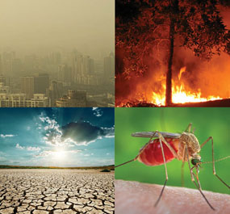
CLIMATE CHANGE’S EFFECT ON PEOPLE
How Does Climate Change Effect People?
Ecosystems (plants and animals)
Altered/Diminished Habitat
Forests
Spread of Pests
Increased Wildfires
Coastal Areas
Coastal Cities Flooded
Coastal Wetlands Destroyed
Recreation
No Snow = No Skiing/Snowboarding
Beach Erosion = No Beach

Slide 7
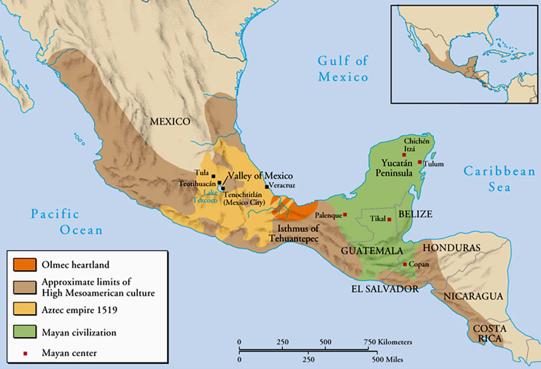
CLIMATE CHANGE’S EFFECT ON PEOPLE
Impact of Climate Change on the Maya Civilization
Maya civilization – one of the most dominant indigenous societies of Mesoamerica (Mexico and Central America) before the 16th-century Spanish invasion. Experienced growth over 2,700 years between 3,800-1,100 years before present (B.P.), followed by collapse @ 1,100 B.P., and a 600-yr transition to villages
Maya culture centered in one area (shown in green) – Yucatan Peninsula (in modern-day Guatemala, Belize, parts of Mexican states Tabasco and Chiapas, and western parts of Honduras and El Salvador)
Tikal (Classical Maya’s capital city)

Slide 8
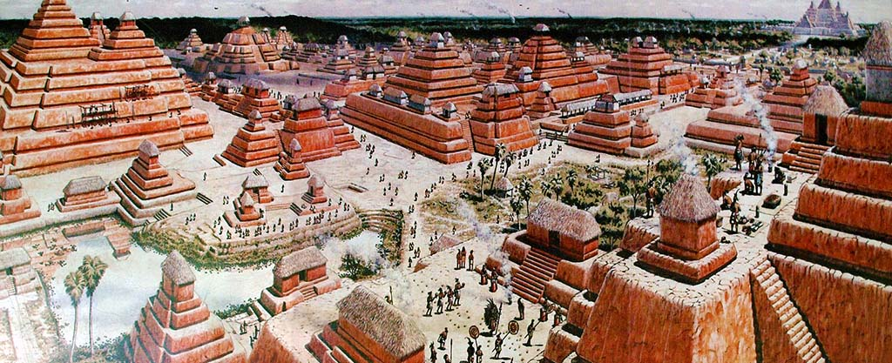
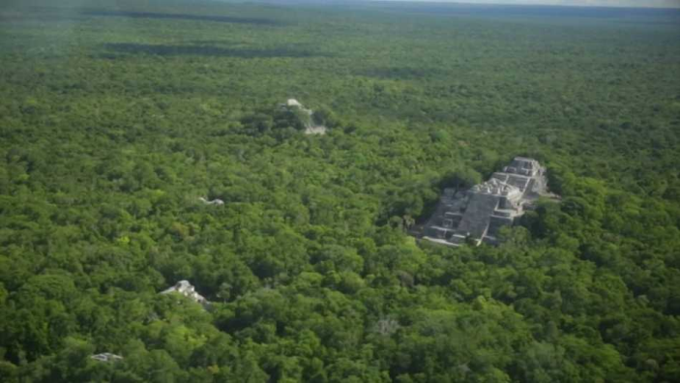
CLIMATE CHANGE’S EFFECT ON PEOPLE
EARLY MAYA PERIOD (3,800-2,250 B.P.)
Agricultural culture (corn [maize], beans, squash and cassava [manioc])
City and pyramid-builders - Mirador – one of the greatest cities ever built
CLASSIC MAYA PERIOD (2,250-1,100 B.P.)
40 cities with plazas, palaces, temples and pyramids, and ball-courts
Each city @ 5-50,000 people; total est. population ca. 2 million
Cities surrounded/supported by large population of farmers
Farming = primitive “slash-and-burn” agriculture; also irrigation, and terracing
“Collapse” @ ca. 1,100 B.P. – Why?!?
Possible causes: 1) exhausted environment; 2) constant warfare - led to
broken trade alliances, politics, and religion; or 3) climate change (drought)
Early Maya city of Mirador

Slide 9
CLIMATE CHANGE’S EFFECT ON PEOPLE
Collapse of Maya Civilization (ca. 1,300-1,100 B.P.)
Evidence of climate change (ca. 200 yr-long period of intense drought) found in
sediment samples taken from two lakes (north and south)
Examined ratio of heavy & light oxygen isotopes found in fossilized shell and
sedimentary rock, and hydrogen isotopes in the acid found in the waxy coatings of
Land plants
Lighter isotopes of oxygen evaporate more readily – times of greater evaporation
and lower precipitation = a greater amount of heavy isotopes in the water, which
end up in the fossilized shell and sedimentary rock
Also looked at growth rates of stalagmites – they grow quicker during wet months
Mayan culture founded on anomalous high rainfall patterns. Drought found to be
worse in the southern region –where the civilization’s collapse was more rapid)
Possible result of shift in the Intertropical Convergence Zone or El Nino – similar
effect on several ancient societies (e.g., Teotihuacan and Akkadian Empires)

Slide 10
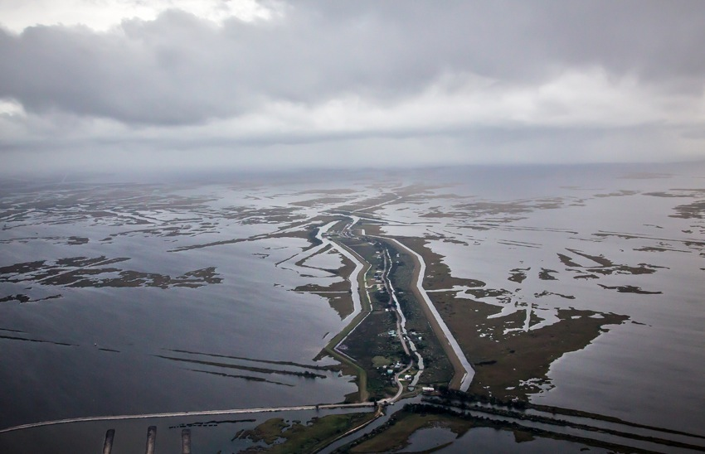
CLIMATE CHANGE’S EFFECT ON PEOPLE
Impact of Sea Level Rise on the Islands and Wetlands of South Louisiana
Since 1930, the Louisiana coast has lost about 190,000 square miles of land = an area the size of Rhode Island
USGS: Over the last 25 yrs – losing 16.57 sq mi/year (= football field of coast every hour)
Isle de Jean Charles Band of the Biloxi-Chitimacha Indians will be America’s First “Climate Change Refugees”
Island population is about 70 people, down from a peak of about 350, with only 25 homes full-time residences. Rising waters are now threatening the very existence of the Tribe and its homeland
“It ain’t they-uh no maw.”

Slide 11
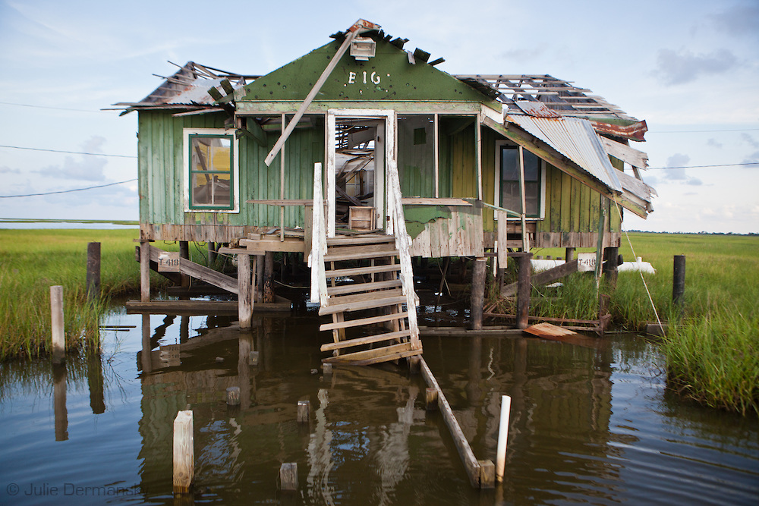
CLIMATE CHANGE’S EFFECT ON PEOPLE
Impact of Sea Level Rise on the Islands and Wetlands of Southern Louisiana
Isle de Jean Charles was once 11 miles long-x-5 miles wide. It is now 2 miles long-x-0.5 miles wide.
“Louisiana’s Comprehensive Master Plan for a Sustainable Coast” released in 2012. The $50-billion plan does not include any measure to rebuild or protect the Isle de Jean Charles
Chief Albert Naquin hoped to relocate the Tribe, but dropped idea because some determined to stay
Tribe faces not only the disappearing land of their ancestors, but also the disappearance of their island-based culture

