Slide 1
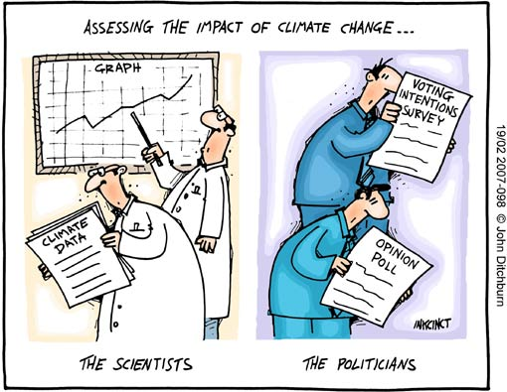
Climate Box Review & Greenhouse Gases
What the heck did we just do?
Black & White
- Results
- Implications
Separate & Mixed
- Results
- Implications
Greenhouse effect?
Greenhouse gases

Slide 2
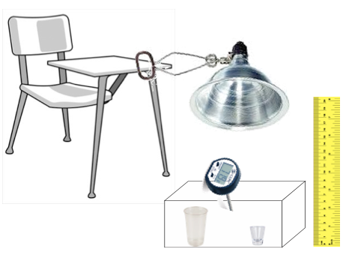
Climate Box Review - What the heck did we just do?
Review Procedure
Materials
Plastic Bin
Thermometer (˚F)
Lamp
Light Bulb (100 W)
Ruler
Plastic Cup
Plastic Shot
Black Plastic
White Plastic
Vinegar (50 ml)
Baking Soda (15 g)

Slide 3

Climate Box Review – Overview
Results
Black + Fizz
Jenna, Joe, Emily, Matt, Alec, Stephanie
Isaiah, Caroline, Betsy, Kara, Z
White + Fizz
Black
White
Stephanie, Matt, Caitlyn, Wesley, Jacqueline, Emily
Luke, Adam, Norm

Slide 4
Climate Box Review – Black & White
Results
Separate
Mixed
What patterns do you see?
Think-Pair-Share

Slide 5
Climate Box Review
Key Relationship
Temperature & Reflectivity
- darker background => increase air temperature
Warm
Air Temperature
Cool
Black
White
Albedo or Surface Reflectivity

Slide 6
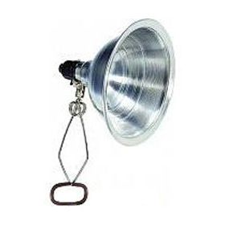
Climate Box Review – Black & White
What’s Happening
Incoming
Energy
Reflected
Energy
Incoming
Energy
Reflected
Energy
More
Energy
Absorbed
Less
Energy
Absorbed
More
Energy
Absorbed
Plastic
Warms
Faster
Adjacent Air
Warmed
Faster & More
Less
Energy
Absorbed
Plastic
Warms
Slower
Adjacent Air
Warmed
Slower & Less

Slide 7
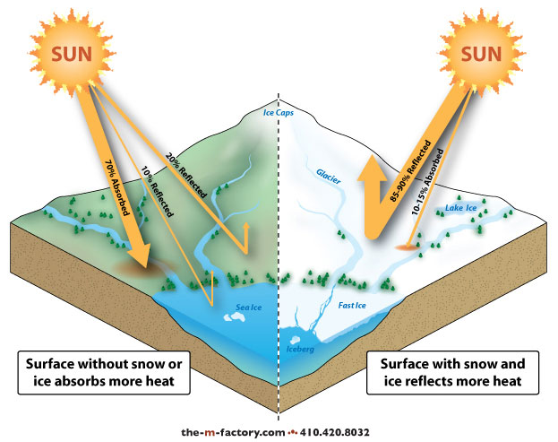
Climate Box Review – Black & White
Implications
Low
Albedo
High
Albedo
Asphalt => Black => Low Albedo
Snow => White => High Albedo

Slide 8
?
Climate Box Review – Pre & Post Fizz
?
Results
White
Black
What patterns do you see?
Think-Pair-Share

Slide 9
Climate Box Review – Pre & Post Fizz
Results
White
Kristen Chelsea Nicolette Emily
Black
What patterns do you see?
Think-Pair-Share

Slide 10
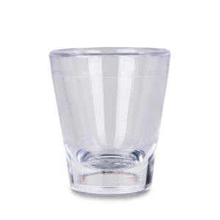

Climate Box Review
What’s Happening ?
Carbon Dioxide
Vinegar
Baking Soda
Antacid
Water
HC₂H₃O₂ + NaHCO₃ ➔ NaC₂H₃O₂ + H₂O + CO₂
Carbon Dioxide (gas)
Water (liquid)
Antacid (solid)

Slide 11
Climate Box Review
Key Relationship
Temperature & CO₂ Correlation
- increase in atmospheric CO₂ => increase air temperature
Warm
Air Temperature
Cool
Low
High
CO₂ Concentration in Air

Slide 12
Climate Box Review – Multiple Factors
Implications
Warm
Factor 1 ➔ Albedo
Factor 2 ➔ Carbon Dioxide (CO₂)
Air Temperature
Cool
Black
White
Albedo or Surface Reflectivity
Warm
Air Temperature
Cool
Low
High
CO₂ Concentration in Air

Slide 13
Climate Box Review – Summary
Key Points
Surface Reflectivity (Albedo) is an important factor in the Earth’s temperature
Carbon Dioxide (CO₂) and other greenhouse gases are also important factor in the Earth’s temperature
High reflectivity and Low CO₂ => cooler temperatures
Low reflectivity and High CO₂ => warmer temperatures

Slide 14
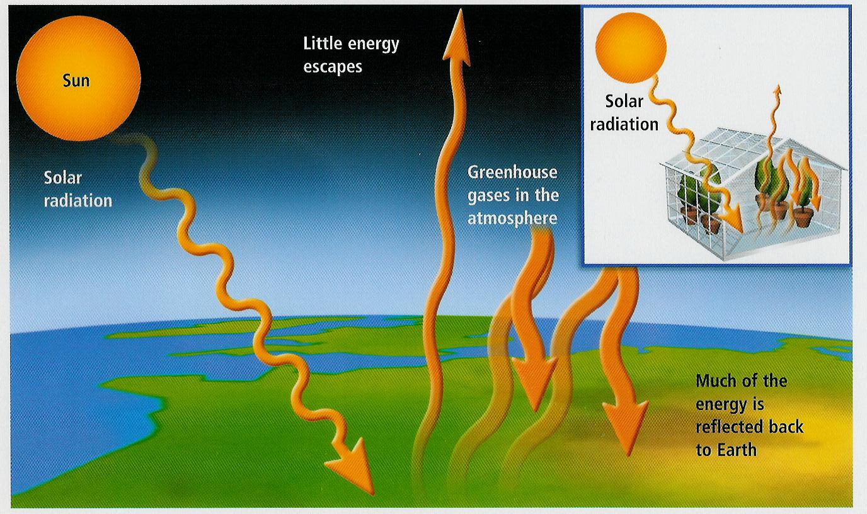
Greenhouse Effect
What is the greenhouse effect?

Slide 15
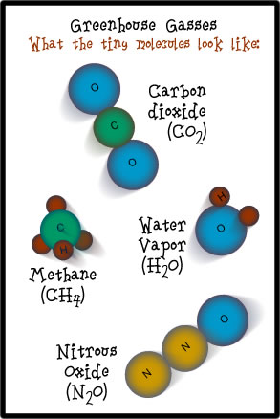
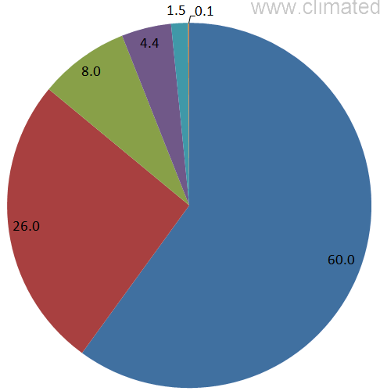
Greenhouse Effect
Greenhouse Gases (GHG)
Water Vapor (H₂O)
Carbon Dioxide (CO₂)
Nitrous Oxide (N₂O)
Methane (CH₄)
Ozone (O₃)
N₂O
CH₄
O₃
CO₂
H₂O
Contribution to Greenhouse Effect

Slide 16
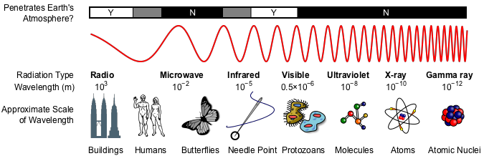
Greenhouse Effect – How does it work?
Electromagnetic Radiation Spectrum
?
?
Radio Waves
Infrared
Visible Light
Ultraviolet
Penetrate Earth’s Atmosphere

Slide 17
Greenhouse Effect
Greenhouse Gases
Visible
IR
UV
IR warms up CO₂
Re-radiates heat
O-C-O
Incoming
Sunlight
O-C-O
O-C-O
UV & Visible
No effect
Heats up Earth
“Converts” UV & Vis to IR

Slide 18
Greenhouse Effect
Greenhouse Gases
Visible
IR
UV
IR warms up CO₂
Re-radiates heat
O-C-O
IR heats up CO₂
Re-radiates heat
Incoming
Sunlight
O-C-O
O-C-O
O-C-O
UV & Visible
No effect
Radiated IR
Heats up Earth
“Converts” UV & Vis to IR

Slide 19
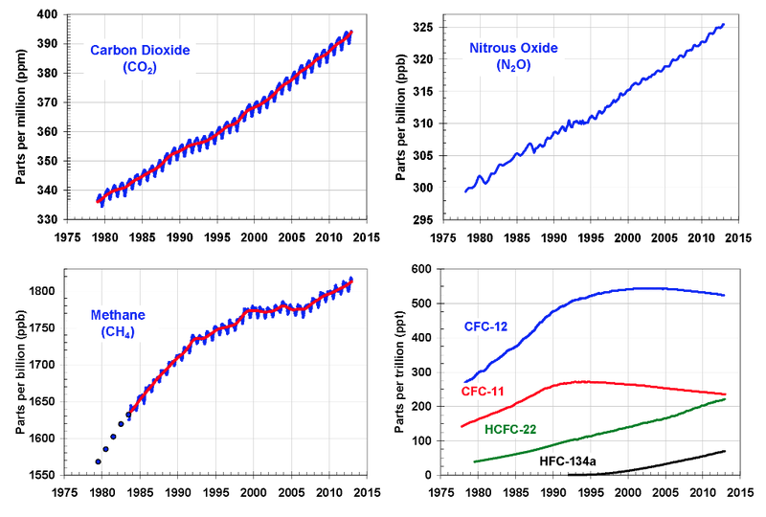
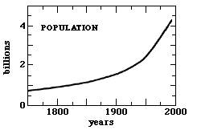
Greenhouse Effect - Trends
Greenhouse Gases (GHG)
Water Vapor (H₂O)
Carbon Dioxide (CO₂)
Nitrous Oxide (N₂O)
Methane (CH₄)
Ozone (O₃)

Slide 20
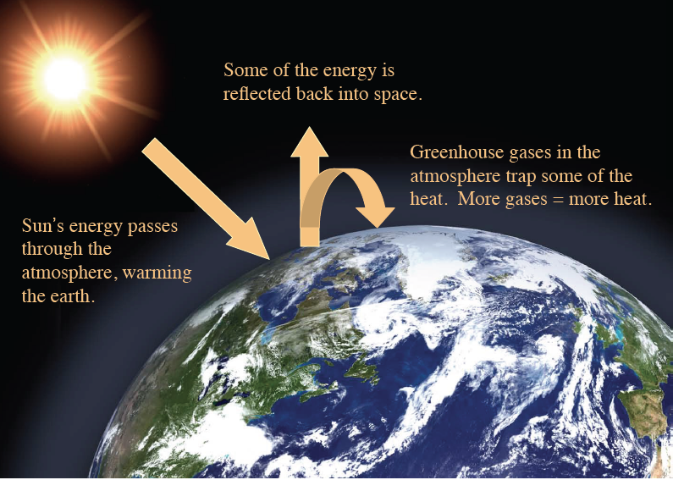
Greenhouse Effect
Greenhouse Gases (GHG)
Water Vapor (H₂O)
Carbon Dioxide (CO₂)
Nitrous Oxide (N₂O)
Methane (CH₄)
Ozone (O₃)
Greenhouse Effect
No Atmosphere
Sun In =>Sun Out
Atmosphere w/ some GHG
Sun In =>warm air =>Sun Out
Atmosphere w/ more GHG
Sun In =>warmer air =>Sun Out

Slide 21
Video – Questions
I still do not understand how CO₂ can create such a temperature change.
One thing that I still don't understand from the greenhouse gas video is how
exactly greenhouse gases trap heat.
If our planet's atmosphere is 99% nitrogen, which said it doesn’t absorb heat well,
how does the carbon dioxide and water vapor contain enough heat to keep the
planet warm?
IR radiation
C
O
O
Carbon Dioxide
Molecule
Incoming energy
“excites” the molecule
Molecule slowly “relaxes”
& releases heat (IR radiation)

Slide 22
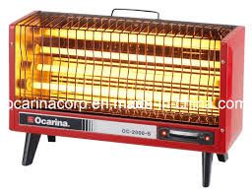
Video – Questions
Why do the radiation wavelengths change from short to long?
Electrical
Current
Electrical heater “converts” electric waves to heat (IR radiation)

Slide 23
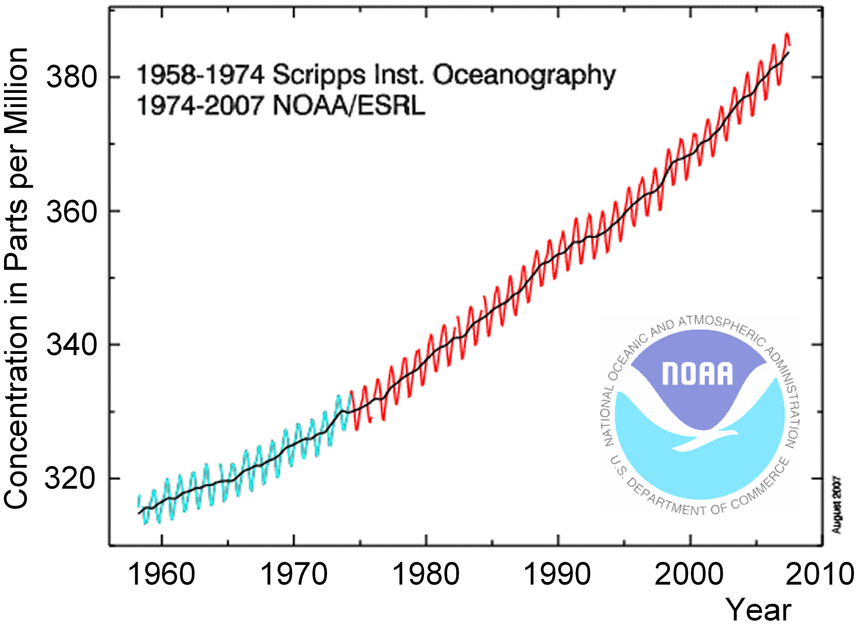
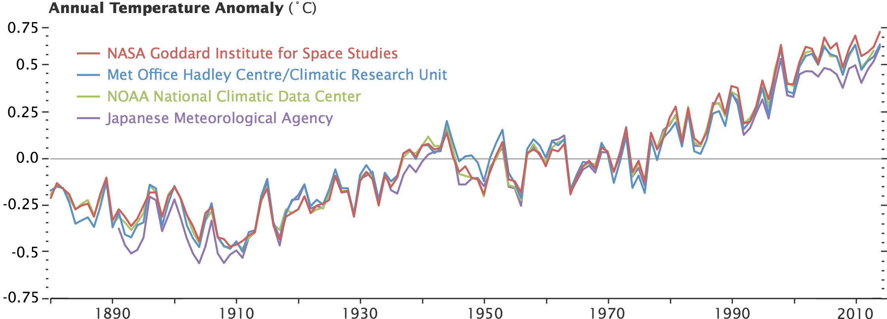
Greenhouse Effect - Trends
Greenhouse Gases (GHG)
Water Vapor (H₂O)
Carbon Dioxide (CO₂)
Nitrous Oxide (N₂O)
Methane (CH₄)
Ozone (O₃)

