Slide 1
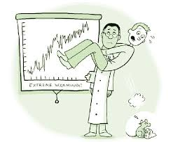
Climate Prediction
Climate Change Factors (quick review)
Climate Prediction
Feedback Mechanisms
Climate Simulations
- net logo

Slide 2
Climate Prediction
Climate Change Factors
External
Internal
Solar Variations
- Orbital Patterns
- Sunspots
Solid Earth Variations
- Position of Plates
- Spreading Rates
- Volcanism
Atmosphere Variations
- Clouds
- Winds
- Composition
Ocean Variations
- Ocean Circulation
- Composition
- Ice Cover
Land Variations
- Land use
- Sea Level
- Vegetation

Slide 3
Conceptual Climate Model
How will an increase in clouds impact global climate ????
Think-Pair-Share
Create causal chain (e.g., clouds increase => cause A => cause B => cause C)
Hint: think temperature & evaporation
Clouds Increase
=> Earth cooler during day
=> Less evaporation
=> Clouds decrease
=> Earth warms
=> More evaporation
=> Clouds increase
Clouds Increase
=> Earth warmer at night
=> More evaporation
=> Clouds increase
=> Earth warmer at night
=> More evaporation
=> Clouds increase
Negative Feedback
Positive Feedback

Slide 4
Feedback Mechanisms
Activity
Model Earth
Step 1
Place yellow post-its (i.e., daisies) on any grid cell
Repeat Step 2
Repeat Step 2
Step 2
Count no. of daisies & record on graph
If no. daisies < 10
If no. daisies >= 10
X
X
X
X
X
X
X
X
X
Step 3a
Place new daisies next to existing daisies
Step 3b
Remove daisies adjacent to gray grid

Slide 5
1 Daisy (Yellow Post-it) anywhere
5 Daisies (Yellow Post-it) anywhere

Slide 6
Feedback Mechanisms
Daisies Increase
=> Increase Albedo (reflectivity)
=> Earth cools
=> Temp. still good for daisies, so daisies increase
=> Increase Albedo
=> Earth cools
=> Temp. bad for daisies, so daisies decrease
=> Decrease Albedo
=> Earth warms
=> Temp. good for daisies, so daisies increase
Credit Card Charge
Don’t
Pay Bill
Clouds Increase
=> Earth cooler during day
=> Less evaporation
=> Clouds decrease
=> Earth warms
=> More evaporation
=> Clouds increase
Clouds Increase
=> Earth warmer at night
=> More evaporation
=> Clouds increase
=> Earth warmer at night
=> More evaporation
=> Clouds increase
Owe
More
$$$
Apply
Interest
& Penalty
Negative
supply & demand
Price of gas & RIPTA
Clouds
- warm days
- more water vapor
- more clouds
Positive
savings interest
Credit card interest
Clouds
More clouds
Warmer nights
More water vapor
More clouds

Slide 7
Feedback Mechanisms
Activity
Model Earth
Step 1
Place 5 blue post-its (i.e., glaciers) on any grid cell
Repeat Step 2
Repeat Step 2
Step 2
Count no. of glaciers, negate & record on graph
If -glaciers < minimum T (-2)
If –glaciers >= minimum T (-2)
X
X
Step 3a
Place new glaciers next to existing glaciers
Step 3b
Remove glaciers adjacent to gray grid

Slide 8
1 Daisy (Yellow Post-it) anywhere
1 Glacier (Blue Post-it) anywhere
1 Daisy (anywhere)
Max limit 10
15 Daisies (anywhere)
Max limit 10
5 Daisies (Yellow Post-it) anywhere
5 Glaciers (Blue Post-it) anywhere
15 Daisies (col 1,3,5)
Max limit 10

Slide 9
Feedback Mechanisms
Glaciers increase
=> Increase Albedo (reflectivity)
=> Earth cools
=> More ice formation, glaciers decrease
=> Increase Albedo
=> Earth cools
=> More ice formation, glaciers decrease
=> Increase Albedo
=> Earth cools
=> More ice ice formation, glaciers decrease
Credit Card Charge
Don’t
Pay Bill
Clouds Increase
=> Earth cooler during day
=> Less evaporation
=> Clouds decrease
=> Earth warms
=> More evaporation
=> Clouds increase
Clouds Increase
=> Earth warmer at night
=> More evaporation
=> Clouds increase
=> Earth warmer at night
=> More evaporation
=> Clouds increase
Owe
More
$$$
Apply
Interest
& Penalty
Negative
supply & demand
Price of gas & RIPTA
Clouds
- warm days
- more water vapor
- more clouds
Positive
savings interest
Credit card interest
Clouds
More clouds
Warmer nights
More water vapor
More clouds

Slide 10
Feedback Mechanisms
Feedback Mechanisms
Impact of present actions on future conditions
Causal Chains
1) Gas Prices
2) Interest on Savings
3) Not Paying Credit Card Bills
Credit Card Charge
Don’t
Pay Bill
Owe
More
$$$
Apply
Interest
& Penalty
Negative
supply & demand
Price of gas & RIPTA
Clouds
- warm days
- more water vapor
- more clouds
Positive
savings interest
Credit card interest
Clouds
More clouds
Warmer nights
More water vapor
More clouds

Slide 11
Feedback Mechanisms
Feedback Mechanisms
Impact of present actions on future conditions
Positive => amplifies change
(e.g., interest rates)
Negative => minimizes change
(e.g., supply & demand)
$ in Savings
Gas $$ Rises
Take
RIPTA
Put
In Bank
Save
More
$$
Apply
Interest
Rate
Gas
Demand
Decreases
Cost of
Gas Drops
Credit Card Charge
Don’t
Pay Bill
Leave
In Bank
Gas $$ Drops
Drive
Car
Owe
More
$$$
Apply
Interest
& Penalty
Save
More
$$$
Apply
Interest
Rate
Gas
Demand
Increases
Cost of
Gas Increases
Negative
supply & demand
Price of gas & RIPTA
Clouds
- warm days
- more water vapor
- more clouds
Positive
savings interest
Credit card interest
Clouds
More clouds
Warmer nights
More water vapor
More clouds

Slide 12
Feedback Mechanisms
Feedback Mechanisms
Impact of present actions on future conditions
Positive => amplifies change
(e.g., interest rates)
Negative => minimizes change
(e.g., supply & demand)
After Interest
Money in Bank
Credit Card Charge
Don’t
Pay Bill
Drivers
Owe
More
$$$
Apply
Interest
& Penalty
Cost of Gas
Negative
supply & demand
Price of gas & RIPTA
Clouds
- warm days
- more water vapor
- more clouds
Positive
savings interest
Credit card interest
Clouds
More clouds
Warmer nights
More water vapor
More clouds

Slide 13
Feedback Mechanisms
Feedback Mechanisms
(+) Water Vapor (Greenhouse Gas)
H₂O increases
in atmosphere
Earth
Warms
H₂O increases
in atmosphere
Earth
Warms
More H₂O (atm)
More H₂O (atm)
More
Evaporation
More
Evaporation
(-) Water Vapor (Increase Albedo)
Clouds
increase
Earth
Cools
Clouds
Decrease
Earth
Warms
Clouds
Decrease
Clouds
Increase
Less
Evaporation
More
Evaporation

Slide 14
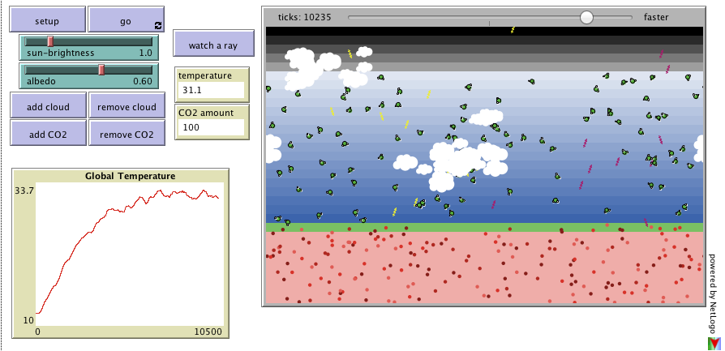
Climate Simulations
Climate Simulations
http://ccl.northwestern.edu/netlogo/models/run.cgi?ClimateChange.892.454

Slide 15
Climate Prediction
Climate Change Factors
- External (solar radiation, plate tectonics)
- Internal (atmosphere, ocean & land interactions)
Feedback Mechanisms
- Positive => amplify process (interest rates, microphone feedback)
- Negative => mitigates process (supply & demand)

