Slide 1
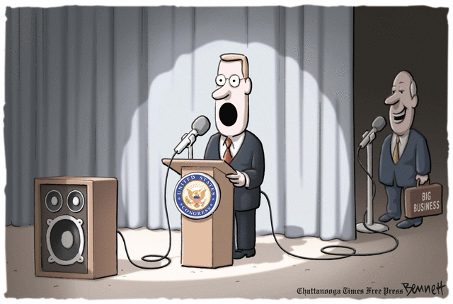
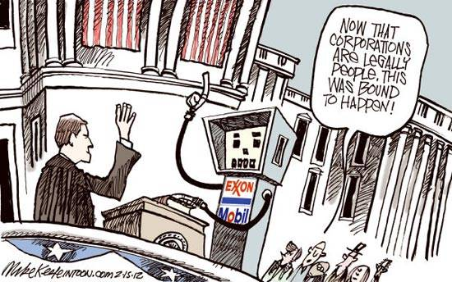
GCH103 - Impact of Global Change on NE’s Coastal Environment
Todays’s Topics
Corporations
What is a Corporation?
What is a legal “person”
What are externalities
“Citizens” United

Slide 2
Class Review
Societal Institutions – Personal Relative Importance
Economy
Education
Family
Political
Religion
Philosophies of a Good Society
Emphasis on individual initiative
Gov’t causes more problems than is solves
“Pull yourself up by your bootstraps”
A
B
Emphasis on collective or group initiative
Gov’t can solve many problems that individuals cannot
“We are all in this thing together”

Slide 3
Corporations
What is a Corporation?
What is a legal “person?”
What is an Externality?

Slide 4
Corporations
http://cdebi.gso.uri.edu/GCH103/videos/Corporation.mp4
What is a Corporation?

Slide 5
Corporations
What is a legal “person?”
http://cdebi.gso.uri.edu/GCH103/videos/Legal_Person.mp4

Slide 6
Corporations
What is an Externality?
http://cdebi.gso.uri.edu/GCH103/videos/Externalities.mp4

Slide 7
Corporations
What is a Corporation?
Large, growing, sustained, legal returns for people that own the business
maximize profit for shareholders
What is a legal “person?”
an individual, company, or other entity that has legal rights and is subject to obligation
What is an Externality
cost or benefit that results from an activity and affects an otherwise uninvolved party who did not choose to incur that cost or benefit

Slide 8
What is “Citizens United?”
A political action committee
Major funding from the Koch Brothers,
owners of the 2nd-largest privately owned
company in the U.S.
It sued the Federal Election Commission in 2009 to eliminate restrictions on campaign financing by corporations and Unions.

Slide 9
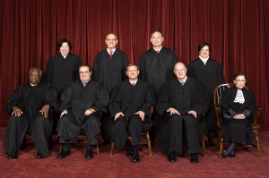
What is “Citizens United?”
A Supreme Court case: Citizens United vs. FEC
Decided 5:4 in favor of Citizens United
Affirms concept of corporate personhood and First Amendment Rights (free speech) of corporations and Unions.
Allows unlimited political donations to campaigns and political action committees by corporations, Unions, and individuals.

Slide 10
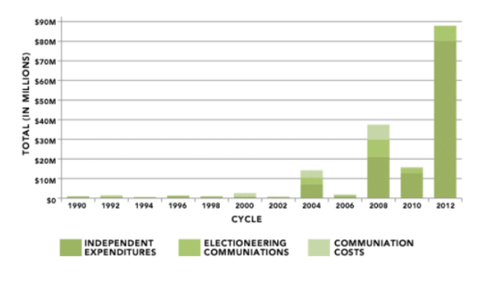
Impact of “Citizens United”
The major impact is the huge increase in the cost of elections.
One perspective is that people can now buy elections in the U.S.

Slide 11
Summary of Key Points
Corporations
- What is a Corporation
maximize profit for shareholders
- A legal “person”
an individual, company, or other entity that has legal rights and is subject to obligation
- Externalities
cost or benefit that results from an activity and affects an otherwise uninvolved party who did not choose to incur that cost or benefit
Citizens United
- Affirms concept of corporate personhood
A political action committee
Eliminate restrictions on campaign financing by corporations & unions

