Slide 1
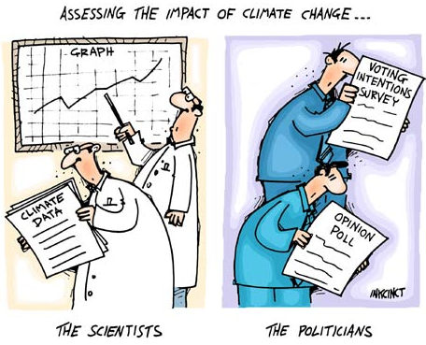
Responding to Climate Change
Gloom & Doom of Climate Change
What Can Be Done?
Final Project Stuff.

Slide 2
Global Warming – What Can Be Done?
Hypothetical….
Rob could lose a few pounds.
Possible Solutions? (good points & bad points)
Change Habits
- no more NYS Wieners
Medical Procedures
- Lipo-suck 4000
What can we do about Global Environmental Change?
Change Habits
- Reduce emissions
Geo-Engineering
- Human ingenuity

Slide 3
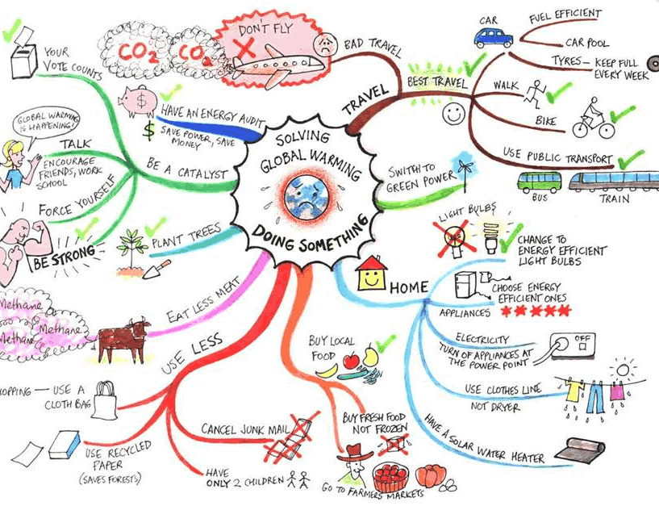
Global Warming – What Can Be Done?
Change Habits

Slide 4
Global Warming – What Can Be Done?
Geo-Engineering

Slide 5
Global Warming – What Can Be Done?

Slide 6
Global Warming – What Can Be Done?

Slide 7
Global Warming – What Can Be Done?

Slide 8
Global Warming – What Can Be Done?

Slide 9
Modeling & Responding to Climate Change
Gloom & Doom of Climate Change
- sea level rise, drought, floods, severe weather, disease
What Can Be Done?
- change behavior
- geo-engineering

Slide 10
Modeling & Responding to Climate Change
Gloom & Doom of Climate Change
- sea level rise, drought, floods, severe weather, disease
What Can Be Done?
- change behavior
- geo-engineering

Slide 11
Project Topics
Global Warming
Insect-Borne Infectious Diseases
Declining Winter Sports
Recreation Changes
Heat Waves
Energy Demands
Sea Level Rise
Beach Replenishment
National Flood Insurance Program
Business & Gov’t Infrastructure
Extreme Weather
Beach Replenishment
National Flood Insurance Program
Drought/Floods/Tornados/Hurricanes
Corporate Globalization
Aquaculture?
Ecosystem Disruption
Insect-Borne Infectious Diseases
Invasive Species
Fish & Shellfish
Maple Syrup
Societal Institutions
Economy
Education
Family
Government/Politics
Religion
Geography
Rhode Island
New England
East Coast
U.S.
Global

