Slide 1
Global Warming – Final Thoughts
Data “Tinkering”
Group Projects
Make-Up Field Trip
- Saturday , 10-Noon?

Slide 2
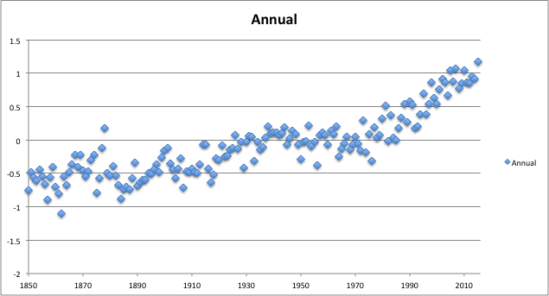
Data Tinkering
Cherry Picking
http://http://berkeleyearth.org/data/

Slide 3
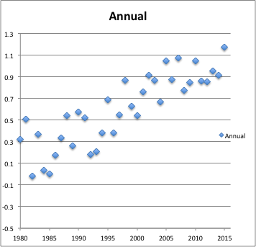
Data Tinkering
Cherry Picking
http://http://berkeleyearth.org/data/

Slide 4
Data Tinkering
Cherry Picking
http://http://berkeleyearth.org/data/

Slide 5
Data Tinkering
Cherry Picking
Axis Manipulation
http://www.ncdc.noaa.gov/temp-and-precip/msu/

Slide 6
Data Tinkering
Cherry Picking
Axis Manipulation
Inappropriate Data
http://www.ncdc.noaa.gov/temp-and-precip/msu/

Slide 7
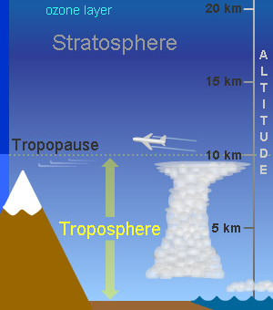
Who to Believe – Critical Thinking
El Chichon
Pinatubo

Slide 8
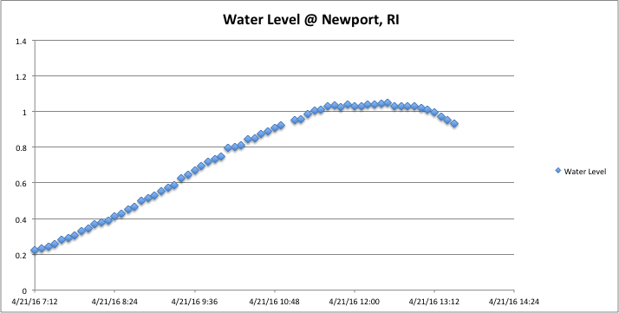
https://noaa.gov/waterlevels.html

Slide 9
Effects of Increased CO₂ : Ocean Water Acidification
Ocean water acidification threatens shellfishing in the Bay
CO₂
pH
As CO₂ in the
atmosphere
is increasing…..
ocean water is becoming more acidic.
Acidic water can:
dissolve shells
make it hard for
shellfish to create
their skeletons

Slide 10
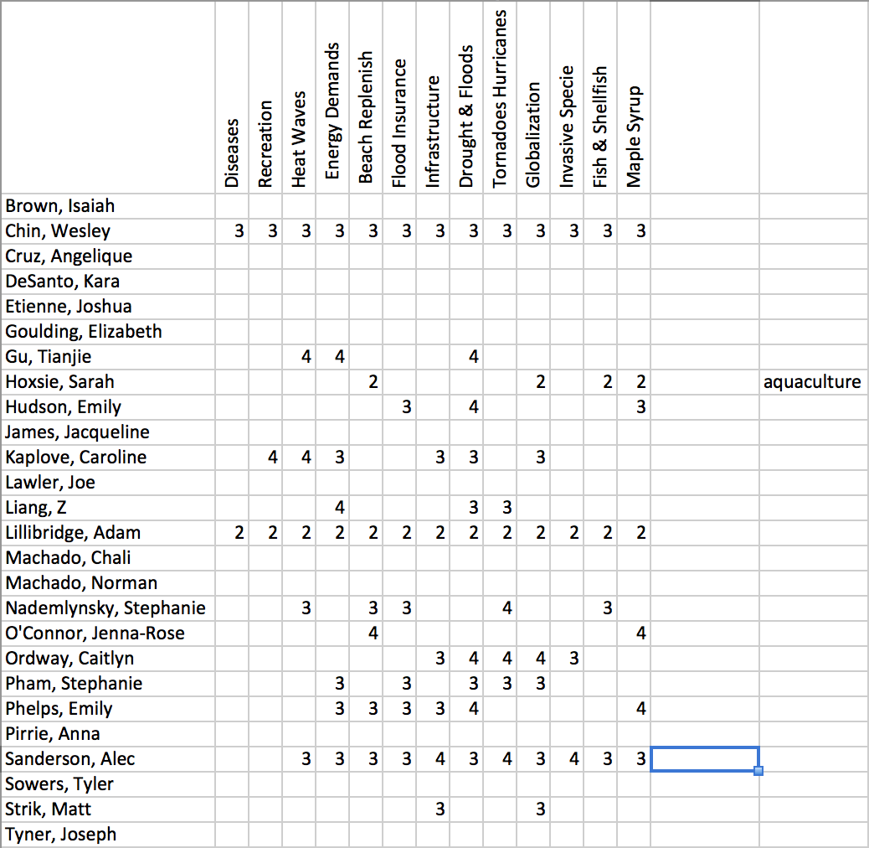
Higher number more interest

Slide 11
Content | Did the presentation provide useful information? Were appropriate graphics/data used and referenced?
3 | Presentation had significant useful information and appropriate graphics/references.
2 | Presentation had modest useful information and/or appropriate graphics/references.
1 | Presentation was lacking in useful information and appropriate graphics/references.
Organization | Was the presentation well organized and easy to follow? Were transitions and proposed format followed?
3 | The presentation was well organized and followed proposed format
2 | The presentation was sufficiently organized and somewhat followed the proposed format.
1 | The presentation was poorly organized and did not follow the proposed format.
Discussion | How well did the group handle the questions and discussion period ?
3 | The questions and discussion period were handled very well.
2 | The questions and discussion period were handled adequately.
1 | The questions and discussion period were handled “not so good.”
Collaboration | Did everyone contribute to the presentation? Did everyone seem well versed in the material?
3 | Everyone contributed and were knowledgeable of the material.
2 | Only some of the group contributed and were knowledgeable of the material.
1 | Group had poor coordination and lacked sufficient knowledge of the material.

Slide 12
Contribution | How much did each partner contribute to the group project | You __________ | Name _________ | Name ________ | Name ________
3 | Above Expectations – Did most of the work
2 | Met Expectations – Did their fair share
1 | Below Expectations - Slacker

