Slide 1
Climate, Glaciers, Sea Level & Paleocultures
Focus Question:
How did climate, glaciers, and sea level change
impact paleocultures in “coastal New England?”
Glacier Primer
Climate, Glaciers and Sea Level Change
Regional/Local Impacts

Slide 2
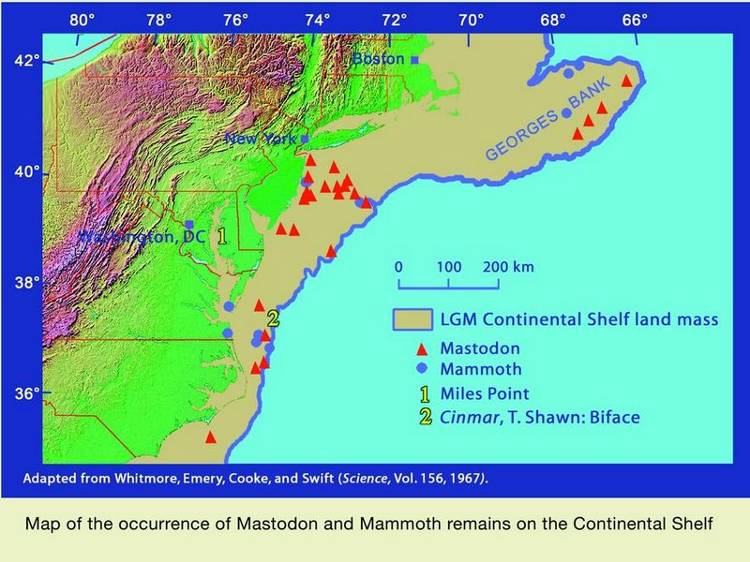
Paleoculture Refresher
Who
When
Where
What is missing?
Shoreline
~20,000 BP
19,000 BP
23,000 BP
22,000 BP
20,000 BP

Slide 3
Cliff Notes
1
3
Warmer
Present Temperature
Temperature
2
Colder
In the Past
Today
Snowfall
Evaporation
Melt Water
Glacier
Land
Ocean
1
2
Sea Level
Falls
3
Sea Level
Rises

Slide 4
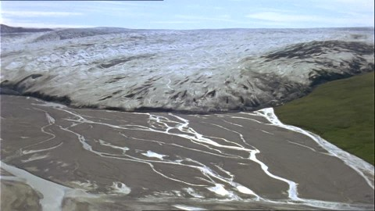
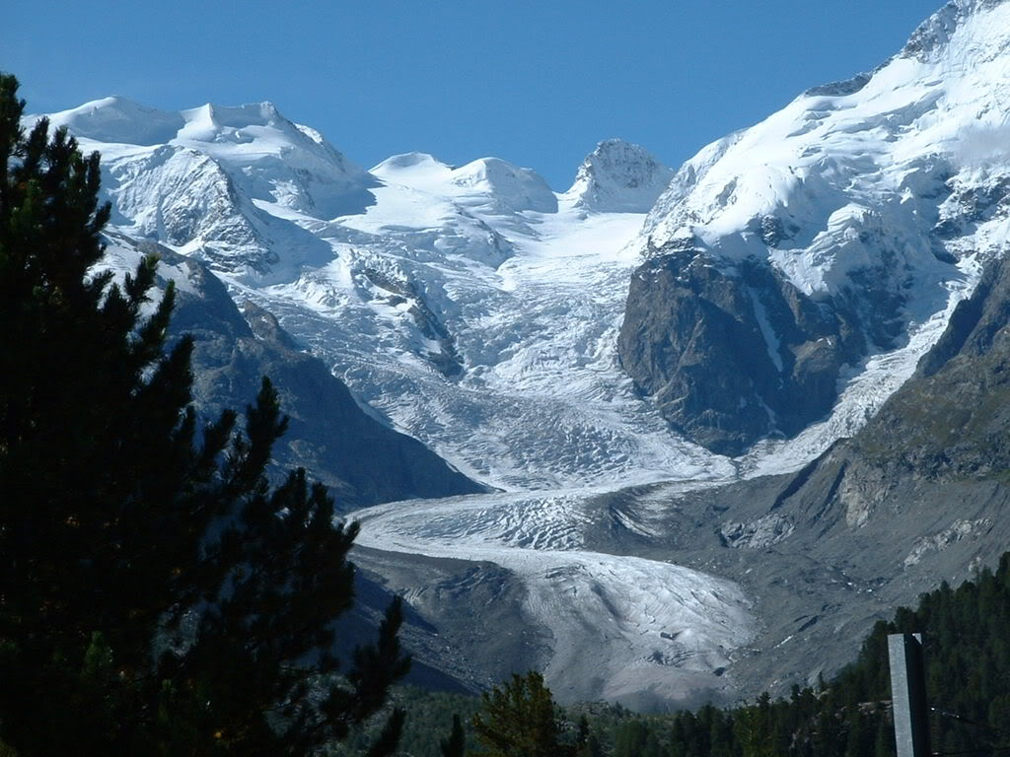
Glacier Primer
2 Types of Glaciers
Mountain or
Alpine Glaciers
Continental Glaciers
or Ice Sheets

Slide 5
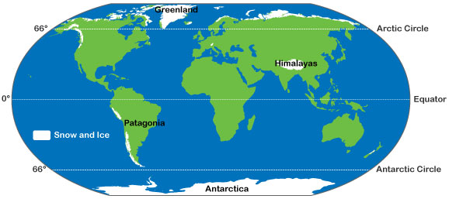
Glacier Primer
Mountain or
Alpine Glaciers
Continental Glaciers
or Ice Sheets
High Altitudes
High Latitudes

Slide 6
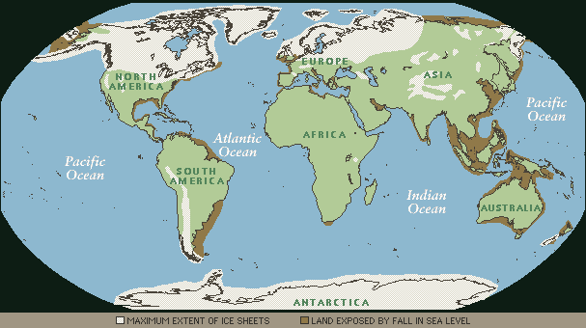
Glaciers Today
3.1 % of Earth’s surface,
10.7 % of Earth’s land area
Glaciers 20 kybp
8 % of Earth’s surface
25 % of Earth’s land area

Slide 7
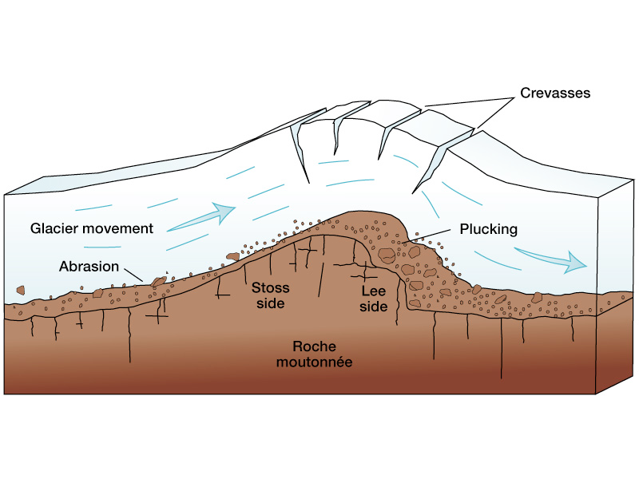
Glacier Primer
Movement of a Glacier
- typically 1 to 2 meters/day
- up to 50 meters/day
Glacial Erosion
- think potholes gone crazy

Slide 8
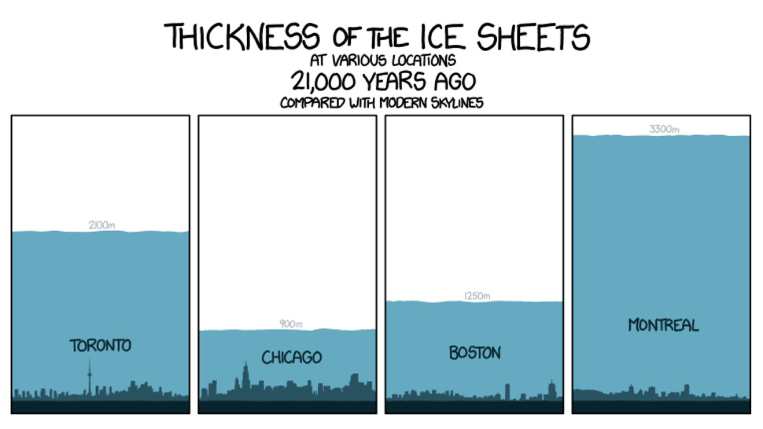
Glacier Primer
3300 m
2000 m
1200 m
900 m

Slide 9
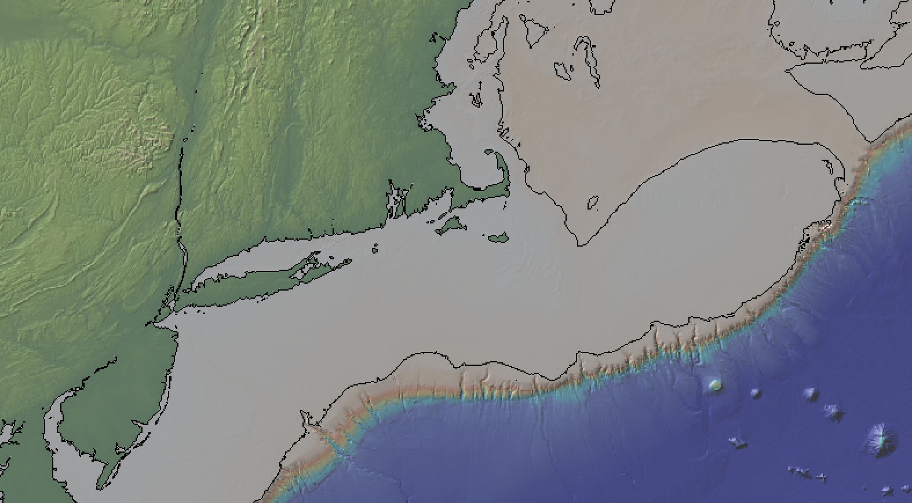
Sooooo………..
How do climate, glaciers, and sea level change
impact paleocultures in “coastal New England?”
20,000 years ago
Ice Sheet
Exposed Land
Shoreline
Where do you think people lived ?
Over what time span?

Slide 10
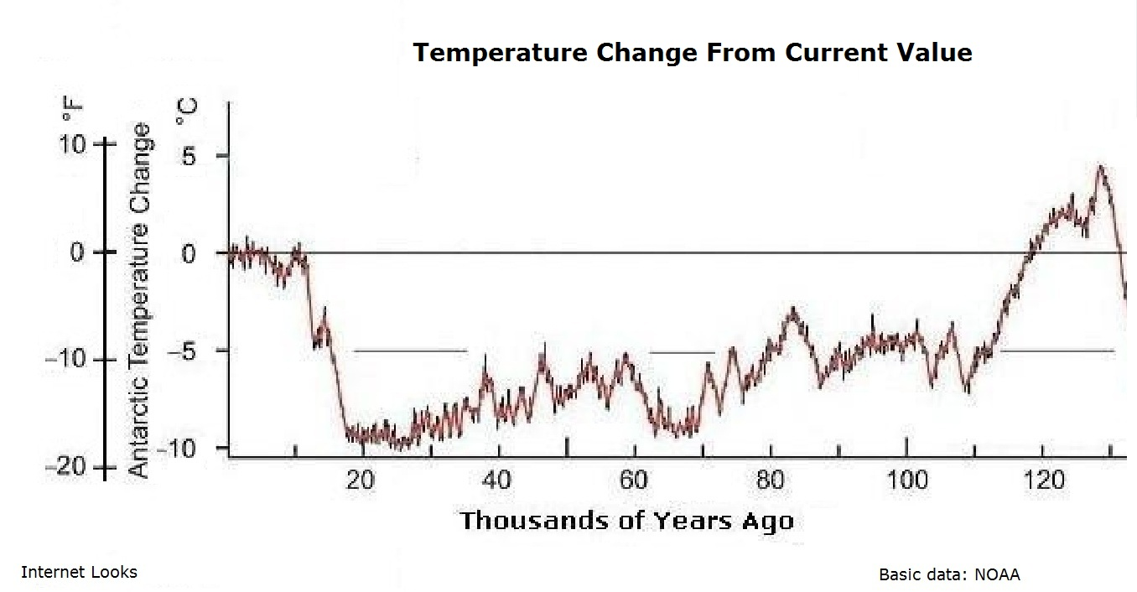
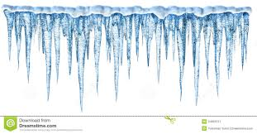
Paleo-Temperature Record
Today
Glacial
Retreat
Last
Glacial
Maximum
5˚C
0˚
Glaciers Form & Advance
Temperature Change
-5˚
-10˚
100
50
0
Thousands of Years Before Present (KYBP)
8˚C increase in 10,000 years
0.5˚C increase in 100 years

Slide 11
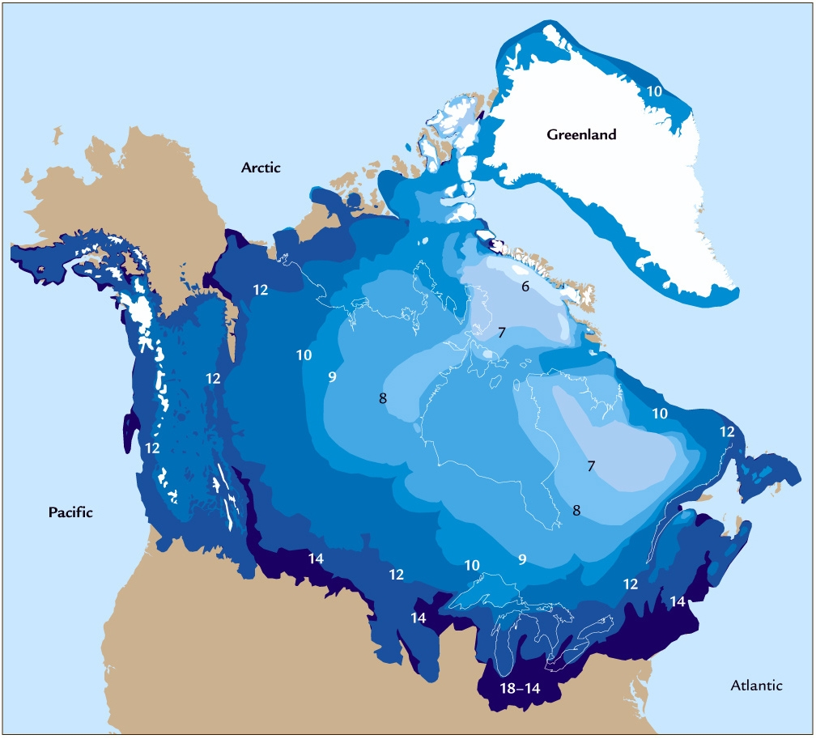
Laurentide Ice Sheet

Slide 12
History of Laurentide Ice Sheet in New England
http://cdebi.gso.uri.edu/GCH103/videos/glaciers.mov

Slide 13
East Coast Sea Level Rise Movie
http://cdebi.gso.uri.edu/GCH103/videos/east_coast.mp4

Slide 14
Sea Level Change in Coastal Rhode Island
http://cdebi.gso.uri.edu/GCH103/videos/movie_nbay2.mp4

Slide 15
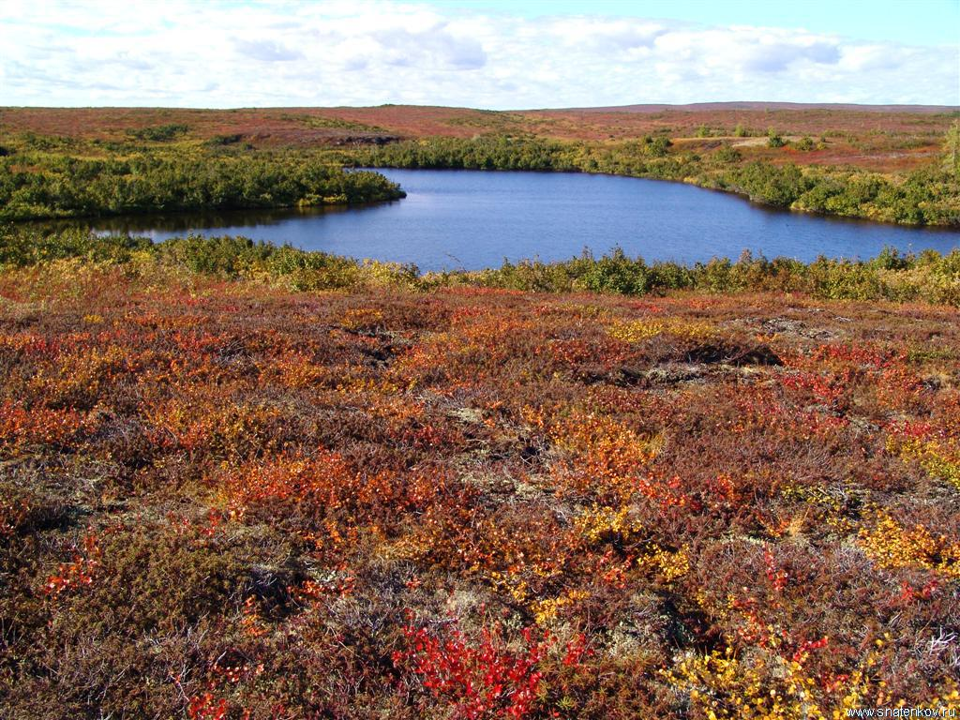
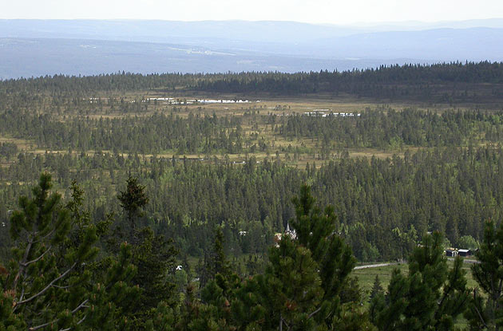
Paleo-Landscapes
Tundra
18,000 years ago
Ice
Open Boreal Woodland
http://www.esd.ornl.gov/projects/qen/new_na.html

Slide 16
Paleo-Landscapes
Tundra
13,000 years ago
Ice
Open Boreal Woodland

Slide 17
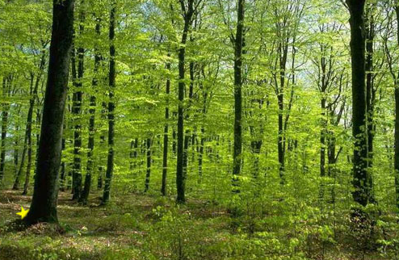
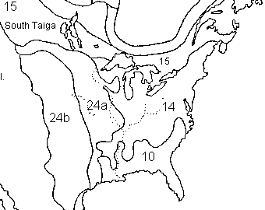
Paleo-Landscapes
8,000 years ago
Temperate Forest
Ice

Slide 18
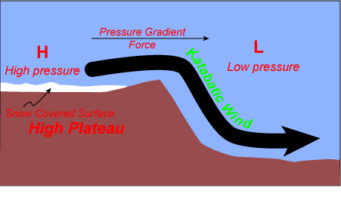
Paleo-Weather
Katabatic WInds
Continental
Margin
Ice Sheet
Cold/Dry
Air
Warm/Dry
Air
Antarctica &
Greenland
> 100 mph

Slide 19
Where do you think people lived ?
Over what time span?
20,000 years ago
Ice Sheet
Exposed Land
Shoreline

Slide 20
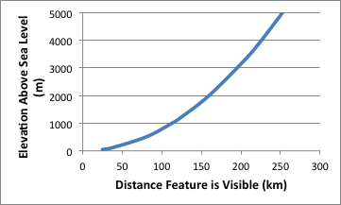
Mt. Washington
Elevation => 1900 m
Distance => 300 km from Kingston
Glaciers ~20,000 years ago
Elevation => ? m
Distance => 120 km Cont. Margin to Block Island
Visible
Not Visible

