Slide 1
Group Jigsaw
4 Groups of 5-6 people
Select a Topic/Question
Discuss for 15 minutes
Report out group discussion (each person in the group presents a topic below)
1) Statement of the problem/issue.
2) How the issue was addressed or solved
3) What are the positive aspects to the solution
or things you are certain about
4) What are the negative aspects to the solution
or things you are uncertain about
5) Any outstanding questions
Use any of your class notes

Slide 2
1) The oral history of the Narragansett’s does not include any mention of glaciers.
From the material we have covered in class, provide an argument for or against this claim.
2) Some people in class have expressed concern over the sea level rise and their homes.
Do you think the people that inhabited the region within the past 20,000 years had similar
concerns?
a. Calculate the rate of sea level rise since the Last Glacial Maximum.
b. Calculate the rate at which the shoreline would have advanced across the continental margin during this time of sea level rise.
3) Discuss what items/resources would be essential for humans to survive 15,000 years ago.
Based on these items/resources and knowledge of paleolandscapes, where do you think
the people along the U.S. East Coast lived at that time.
4) What is meant by the term Community-Based Participatory Research (CBPR). What are some pros and cons of this approach versus an “Indian Jones” approach.

Slide 3
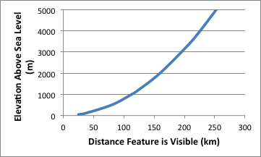
The oral history of the Narragansett’s does not include any mention of glaciers.
From the material we have covered in class, provide an argument for or against this claim.
Visible
Not Visible

Slide 4
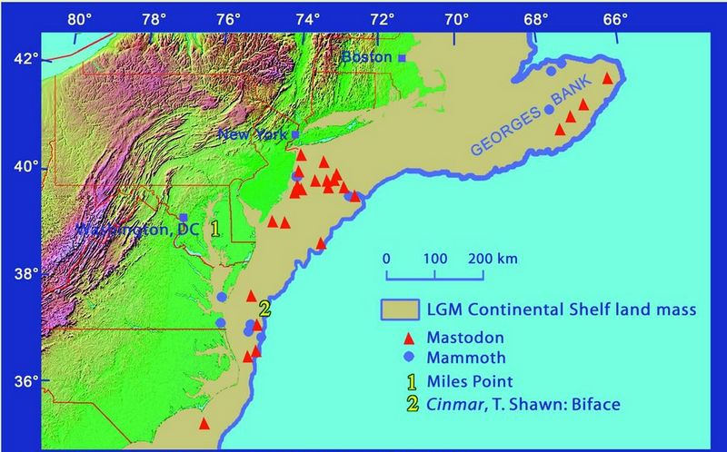
1˚ of latitude ~100 km
Shoreline
~20,000 BP

Slide 5
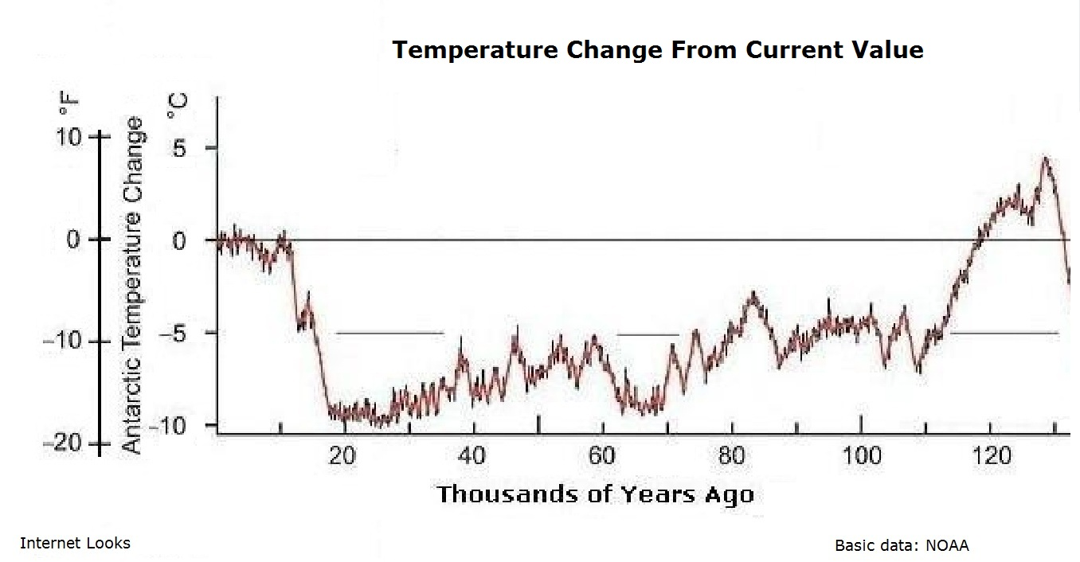
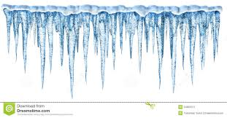
Today
Glacial
Retreat
Last
Glacial
Maximum
5˚C
0˚
Glaciers Form & Advance
Temperature Change
-5˚
-10˚
100
50
0
Thousands of Years Before Present (KYBP)
8˚C increase in 10,000 years
0.5˚C increase in 100 years

Slide 6
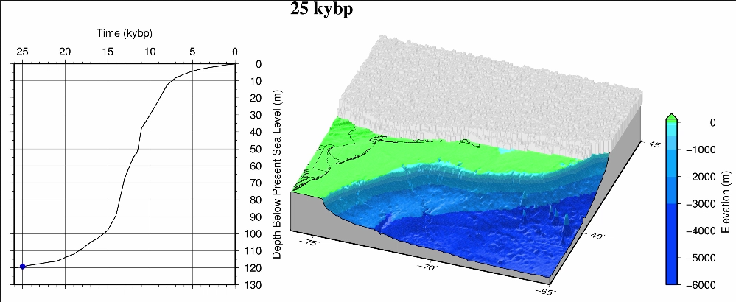

Slide 7
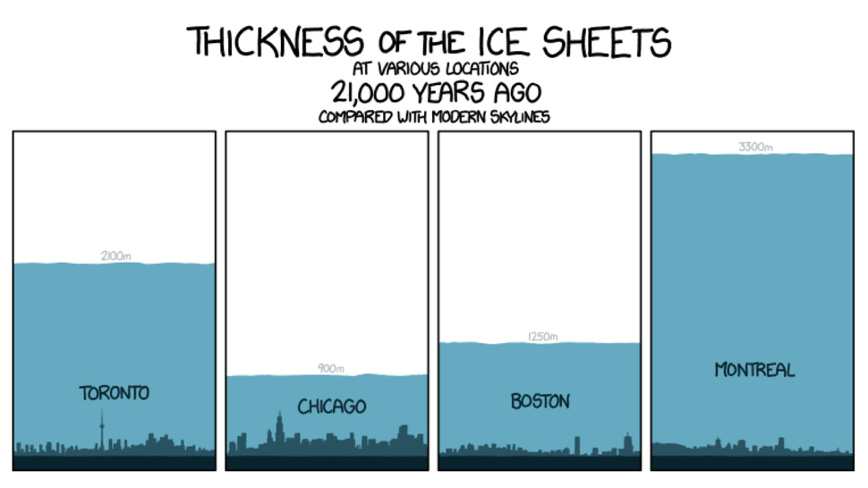
3300 m
2000 m
1200 m
900 m

Slide 8
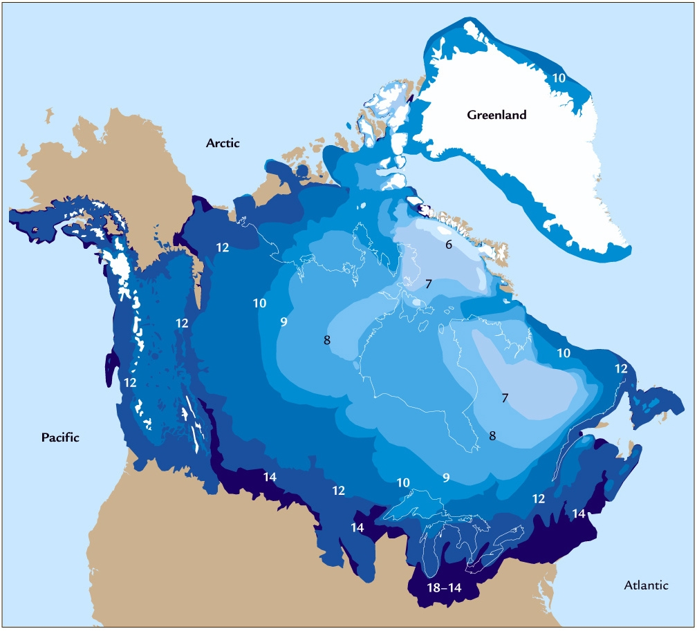
Laurentide Ice Sheet

Slide 9
History of Laurentide Ice Sheet in New England
http://cdebi.gso.uri.edu/GCH103/videos/glaciers.mov

Slide 10
East Coast Sea Level Rise Movie
http://cdebi.gso.uri.edu/GCH103/videos/east_coast.mp4

Slide 11
Sea Level Change in Coastal Rhode Island
http://cdebi.gso.uri.edu/GCH103/videos/movie_nbay2.mp4

Slide 12
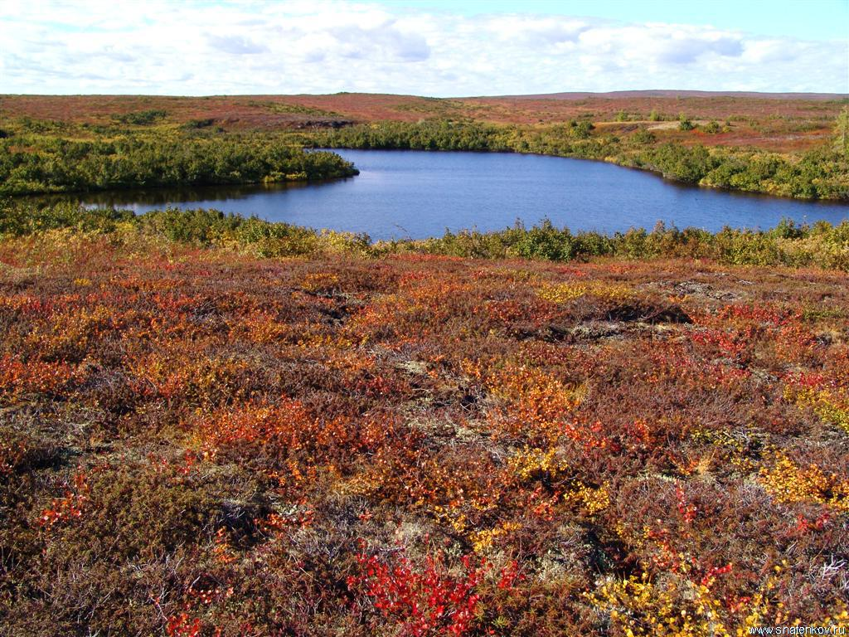
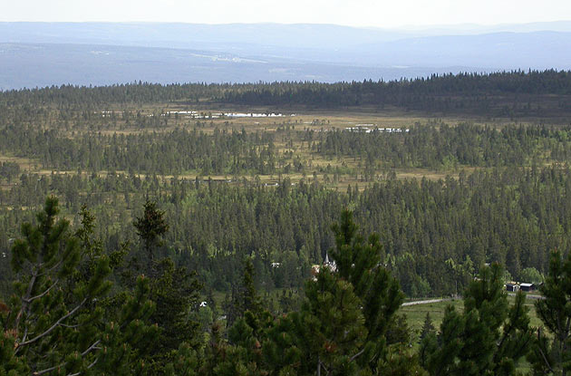
Paleo-Landscapes
Tundra
18,000 years ago
Ice
Open Boreal Woodland
http://www.esd.ornl.gov/projects/qen/new_na.html

Slide 13
Paleo-Landscapes
Tundra
13,000 years ago
Ice
Open Boreal Woodland

Slide 14
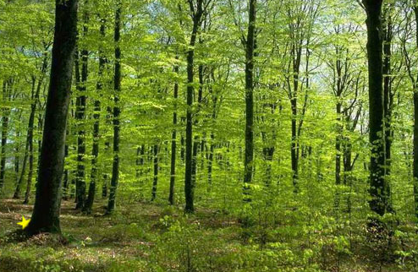
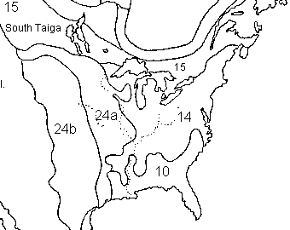
Paleo-Landscapes
8,000 years ago
Temperate Forest
Ice

Slide 15
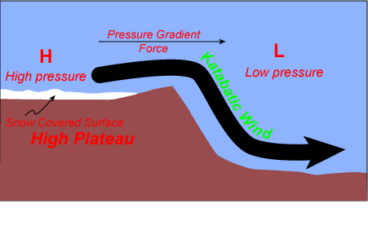
Paleo-Weather
Katabatic WInds
Continental
Margin
Ice Sheet
Cold/Dry
Air
Warm/Dry
Air
Antarctica &
Greenland
> 100 mph

Slide 16
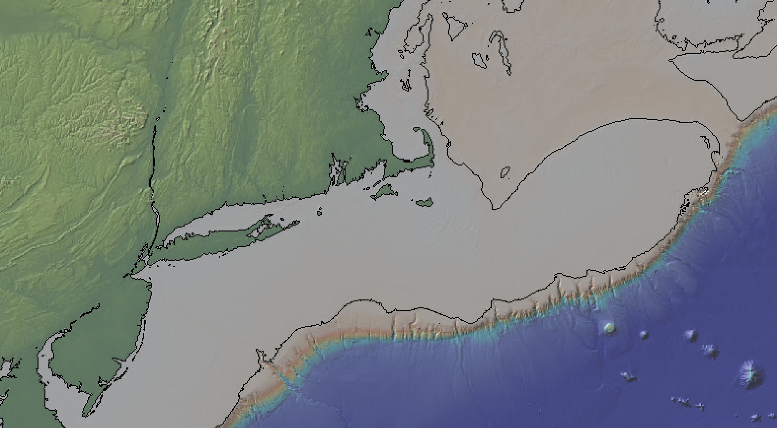
20,000 years ago
Ice Sheet
Exposed Land
Shoreline

