Slide 1
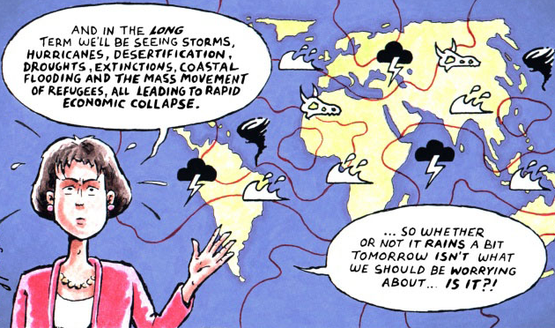
GCH103 - Impact of Global Change on NE’s Coastal Environment
Think-Pair-Share
1) What does this cartoon represent?
2) How are climate and society linked?

Slide 2
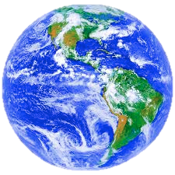
Global Environmental Change
Potential Solutions
Nature
Biological
Chemical
Physical
Changes
Atmosphere
Ocean
Societal
Institutions
Land
Quality
of Life
Humans
Definition:
The set of biological, chemical and physical changes to land, ocean and atmosphere, which are driven by an interwoven system of human and natural processes.
These changes are intimately connected with processes
of socio-economic and cultural globalization.
Potential Topics
Climate
Population Trends
Ocean Acidification
Pollution
Critters

Slide 3
Weather & Climate
Weather vs Climate
Weather
- day-to-day state of the atmosphere in a region
(e.g., sunny, cloudy, rain, snow, hot, cold)
- short-term
Climate
- average weather pattern(s) in a region
(e.g., tropical, temperate, polar, dry, wet)
- longer-term (~30 years of observations)

Slide 4
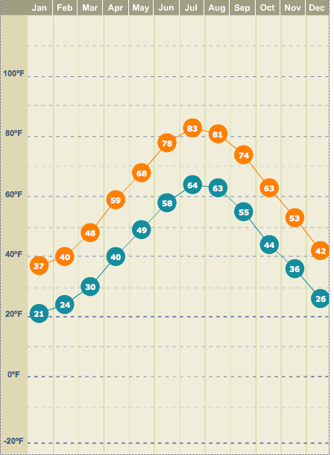
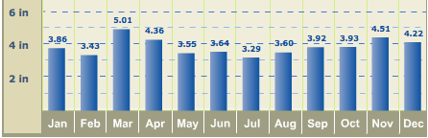
Weather & Climate – Local Examples
Local RI Weather
Local RI Climate
Winds
NW
SW
NW

Slide 5
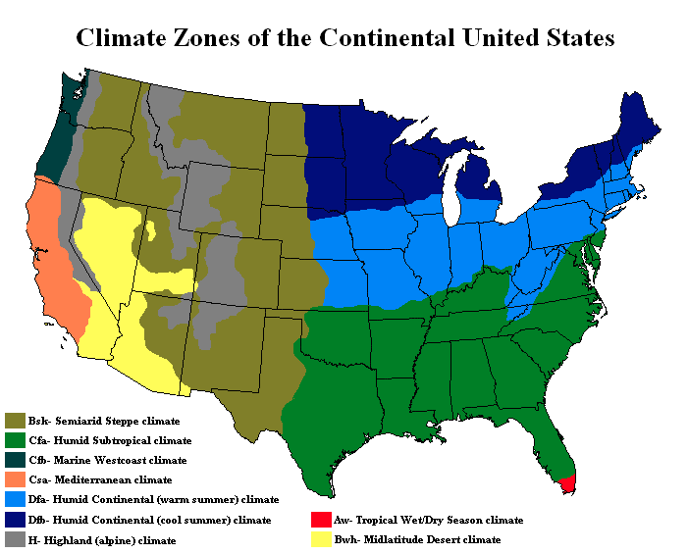
Weather & Climate – U.S. Climate Zones
Think-Pair-Share
What patterns do you notice?
What are the cause(s) of these patterns?

Slide 6
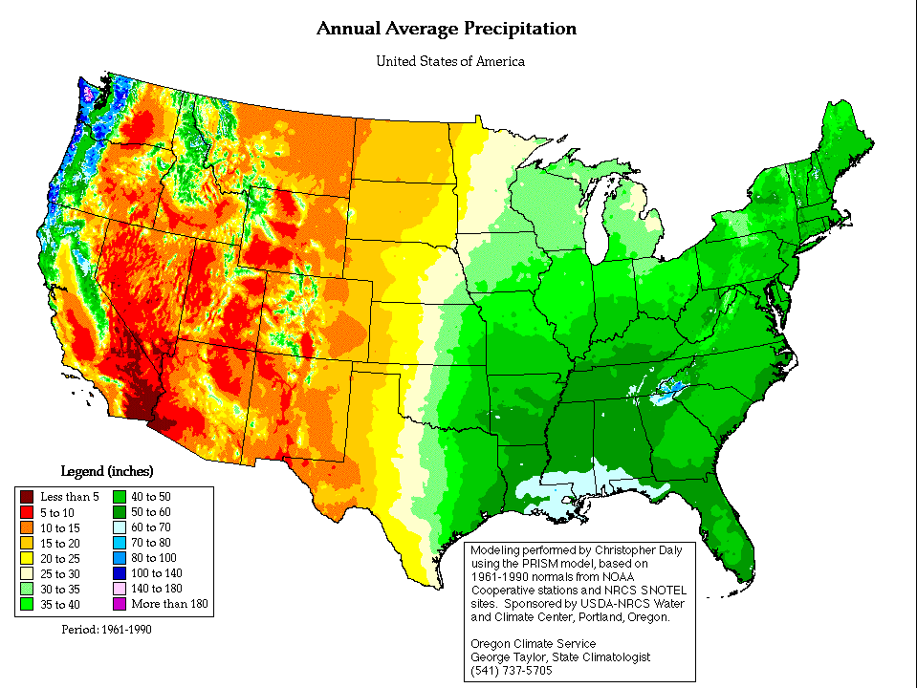
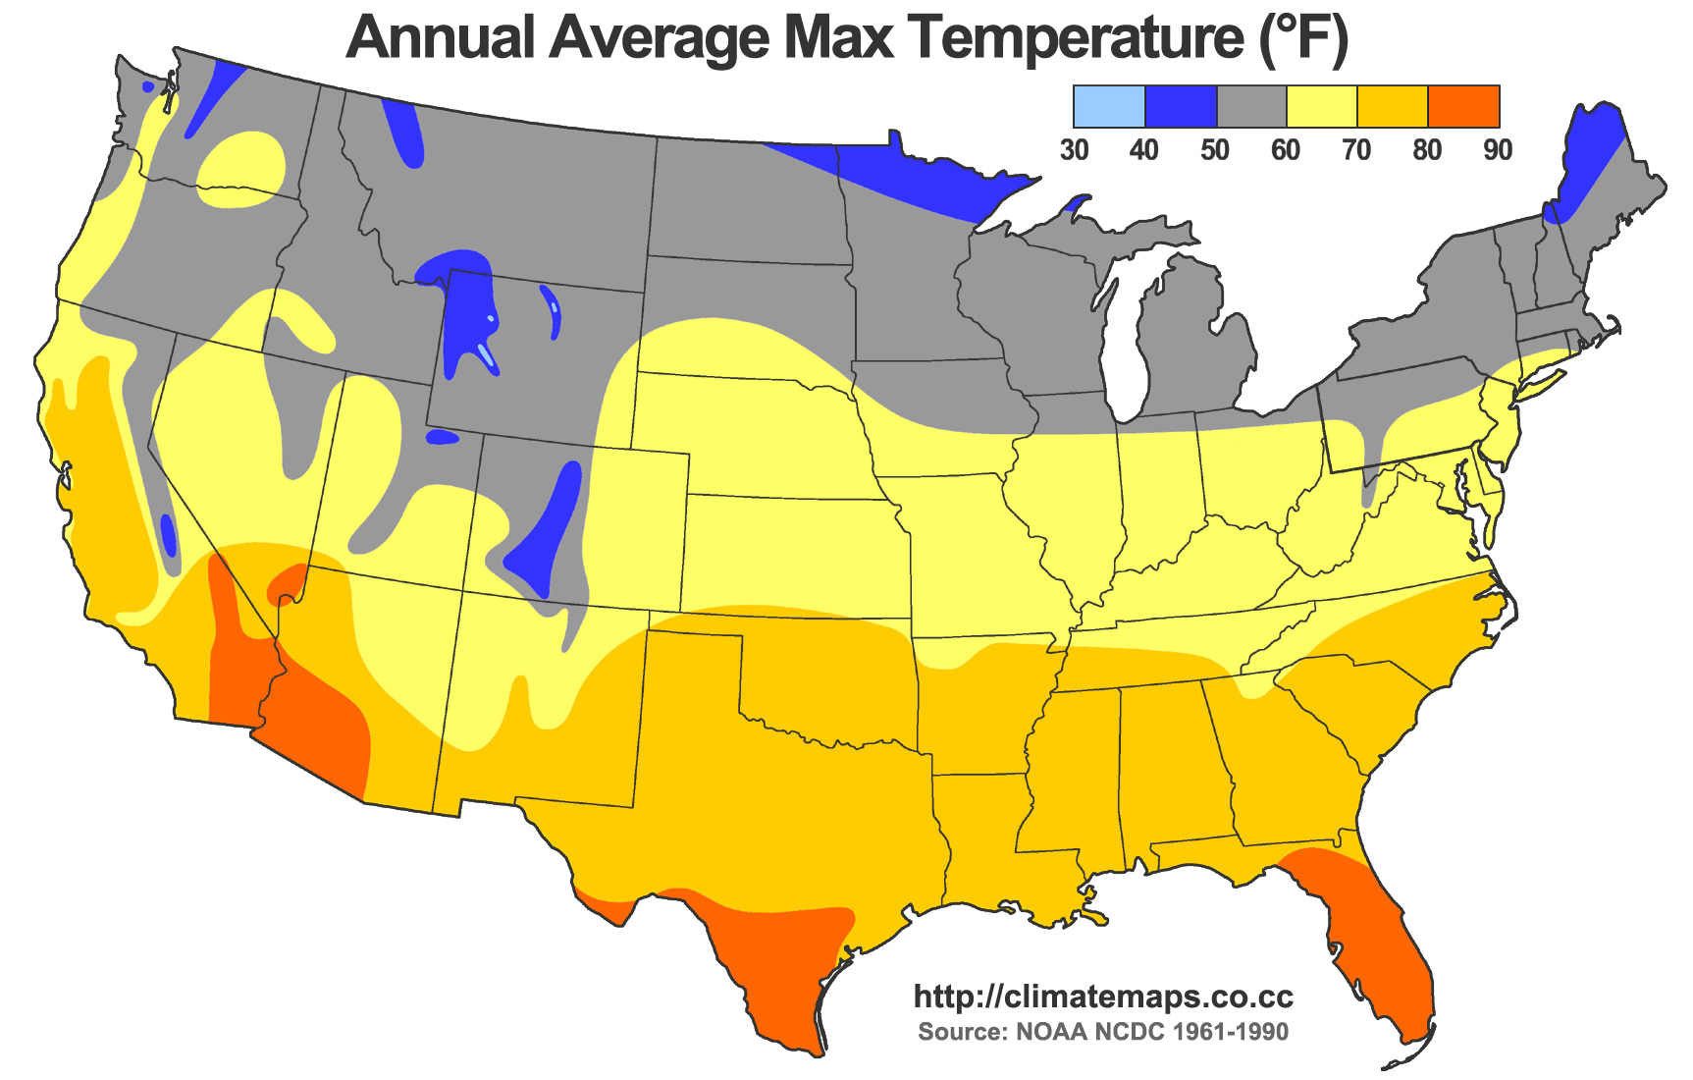
Weather & Climate – U.S. Climate Zones
Very
Wet
Annual Average Precipitation
Cool
Dry
Wet
Warm

Slide 7
Weather & Climate – U.S. Climate Zones
Alpine
Humid Continental (cool)
Marine West Coast
Humid Continental (warm)
Mediterranean
Humid Subtropical
Mid-latitude Desert
Semi-arid Steppe
Tropical Wet/Dry Season

Slide 8
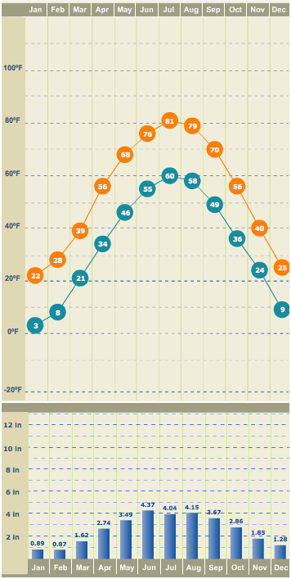
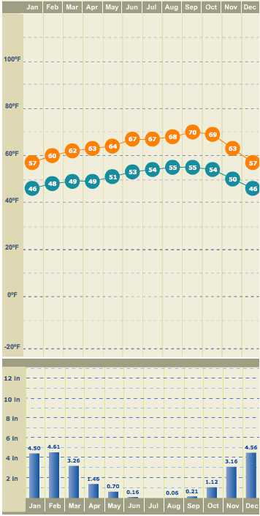
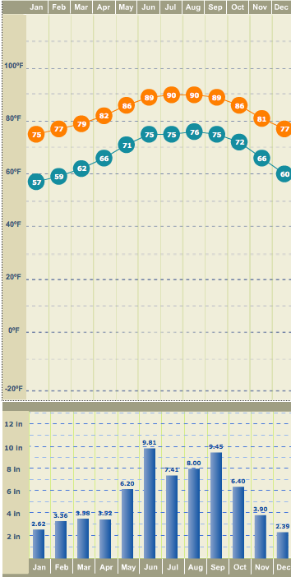
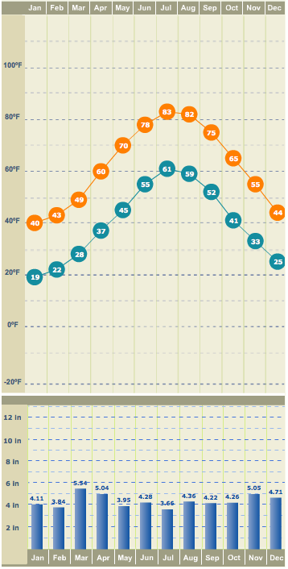
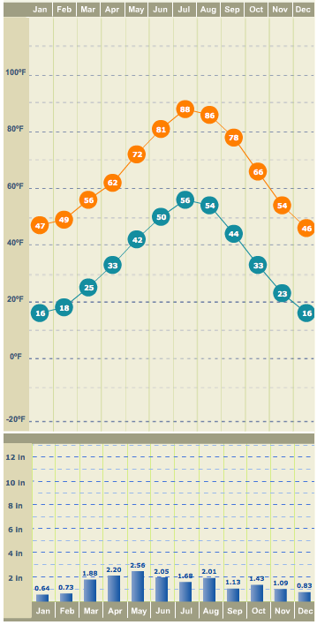
Weather & Climate – Climate Comparisons
San Francisco, CA
Ft. Lauderdale, FL
Kingston, RI
Denver, CO

Slide 9
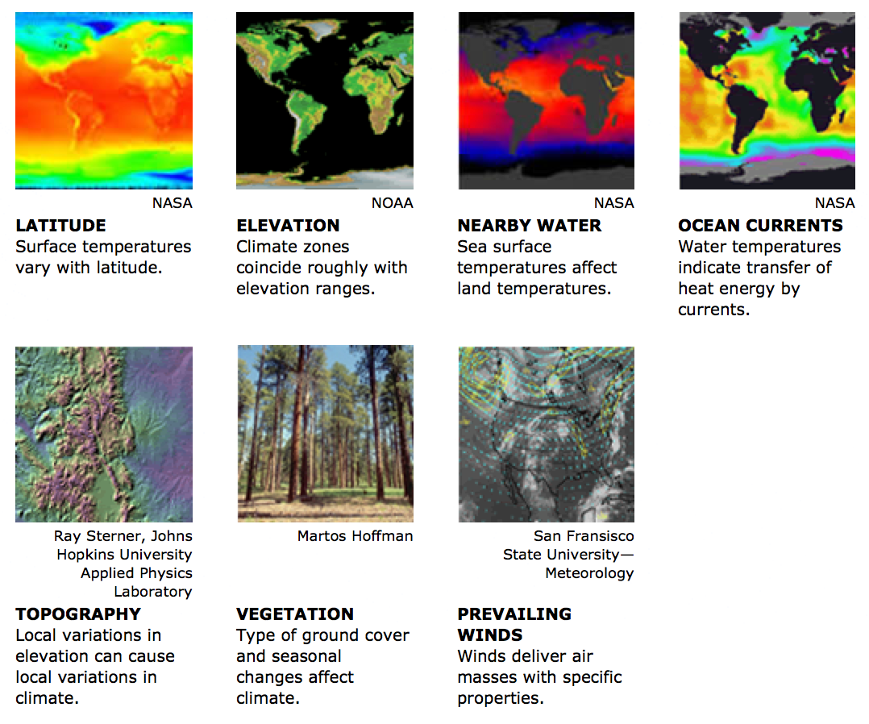
Other Factors

Slide 10
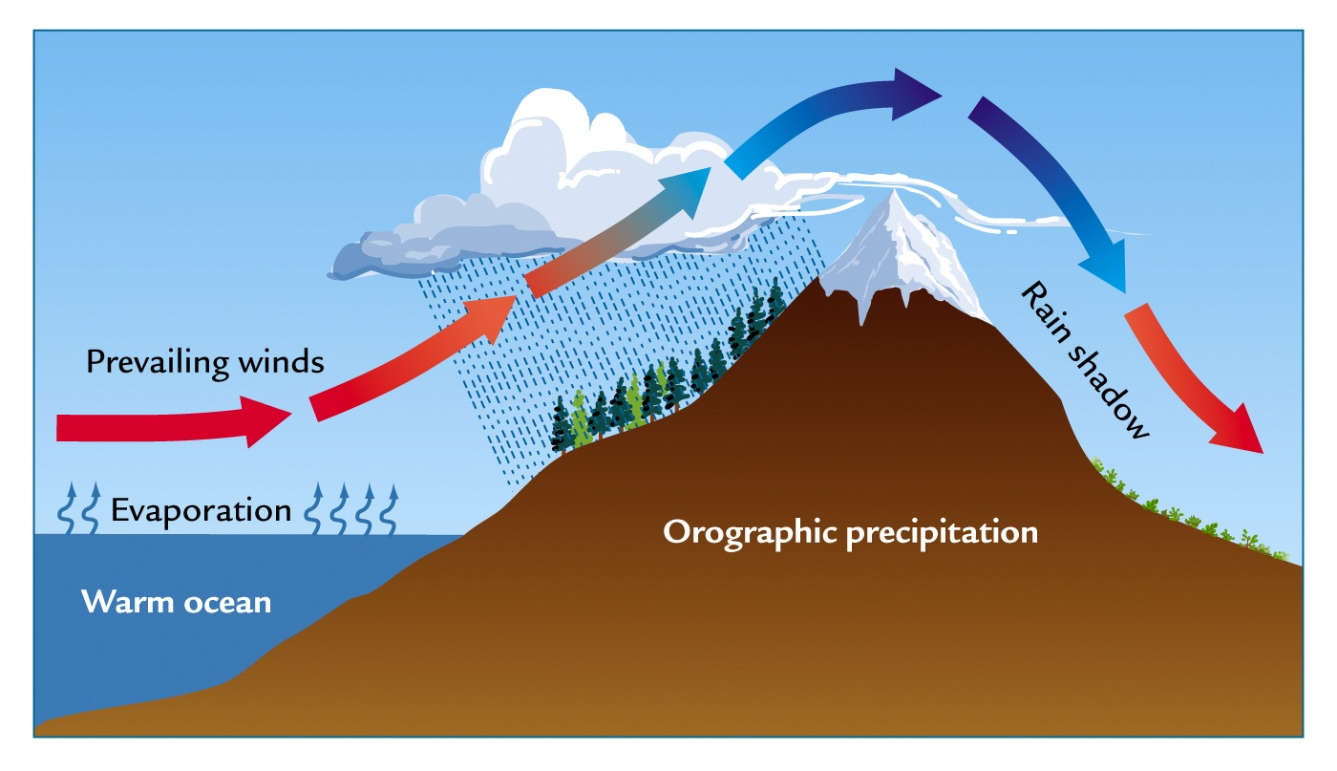
Other Factors – Orographic (Mountain) Effect

Slide 11
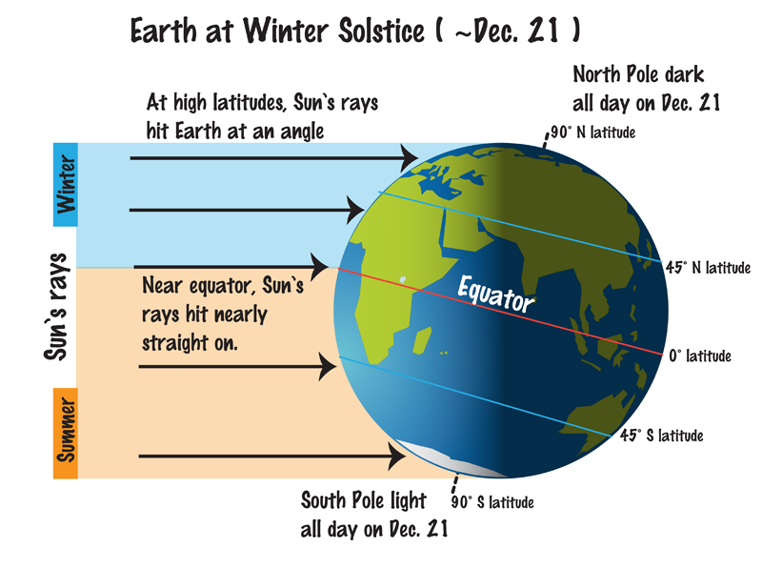
Other Factors – Latitude

Slide 12
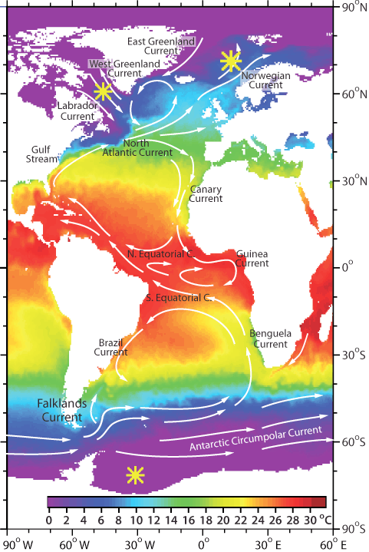
Other Factors – Ocean Currents
Impact of Ocean Currents
Do you think England would be
1) warmer
2) colder
3) about the same
without ocean currents?

Slide 13
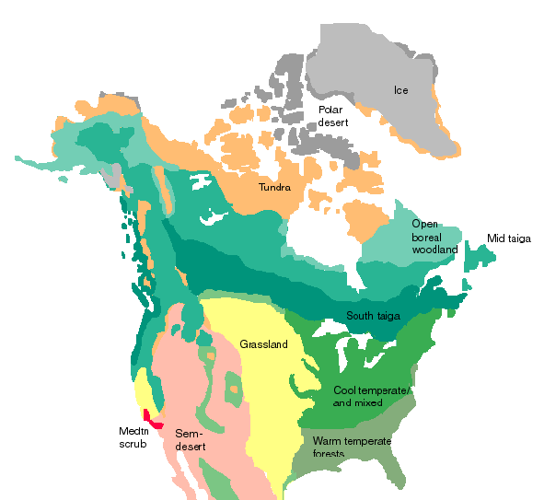
Other Factors - Vegetation
Today, if no agriculture
~25, kybp

Slide 14
Summary
Global Environmental Change
- Natural & human impacts
- Bio, chem & phys. changes
- Atmosphere, oceans & land
- Impacts on society
For more information
Weather and Climate Basics
http://www.eo.ucar.edu/basics/
Weather vs Climate
- Weather is short term conditions
- Climate is longer term (~30 years)
Indicators of Climate
- Primarily Temperature & Precipitation
U.S. Climate Zones
- Eastern Half => temperature gradient from N to S
- Western Half => amount of precipitation & elevation
Factors Controlling Climate
- Latitude - Elevation/Topography
- Vegetation - Nearby Water/Currents
- Prevailing Winds

