Slide 1
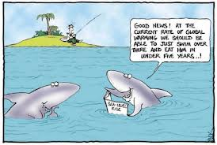
Global Warming
History of Climate/Temperature Change
Causes of Climate Change
How Do We Know?........ Temperature Proxies

Slide 2
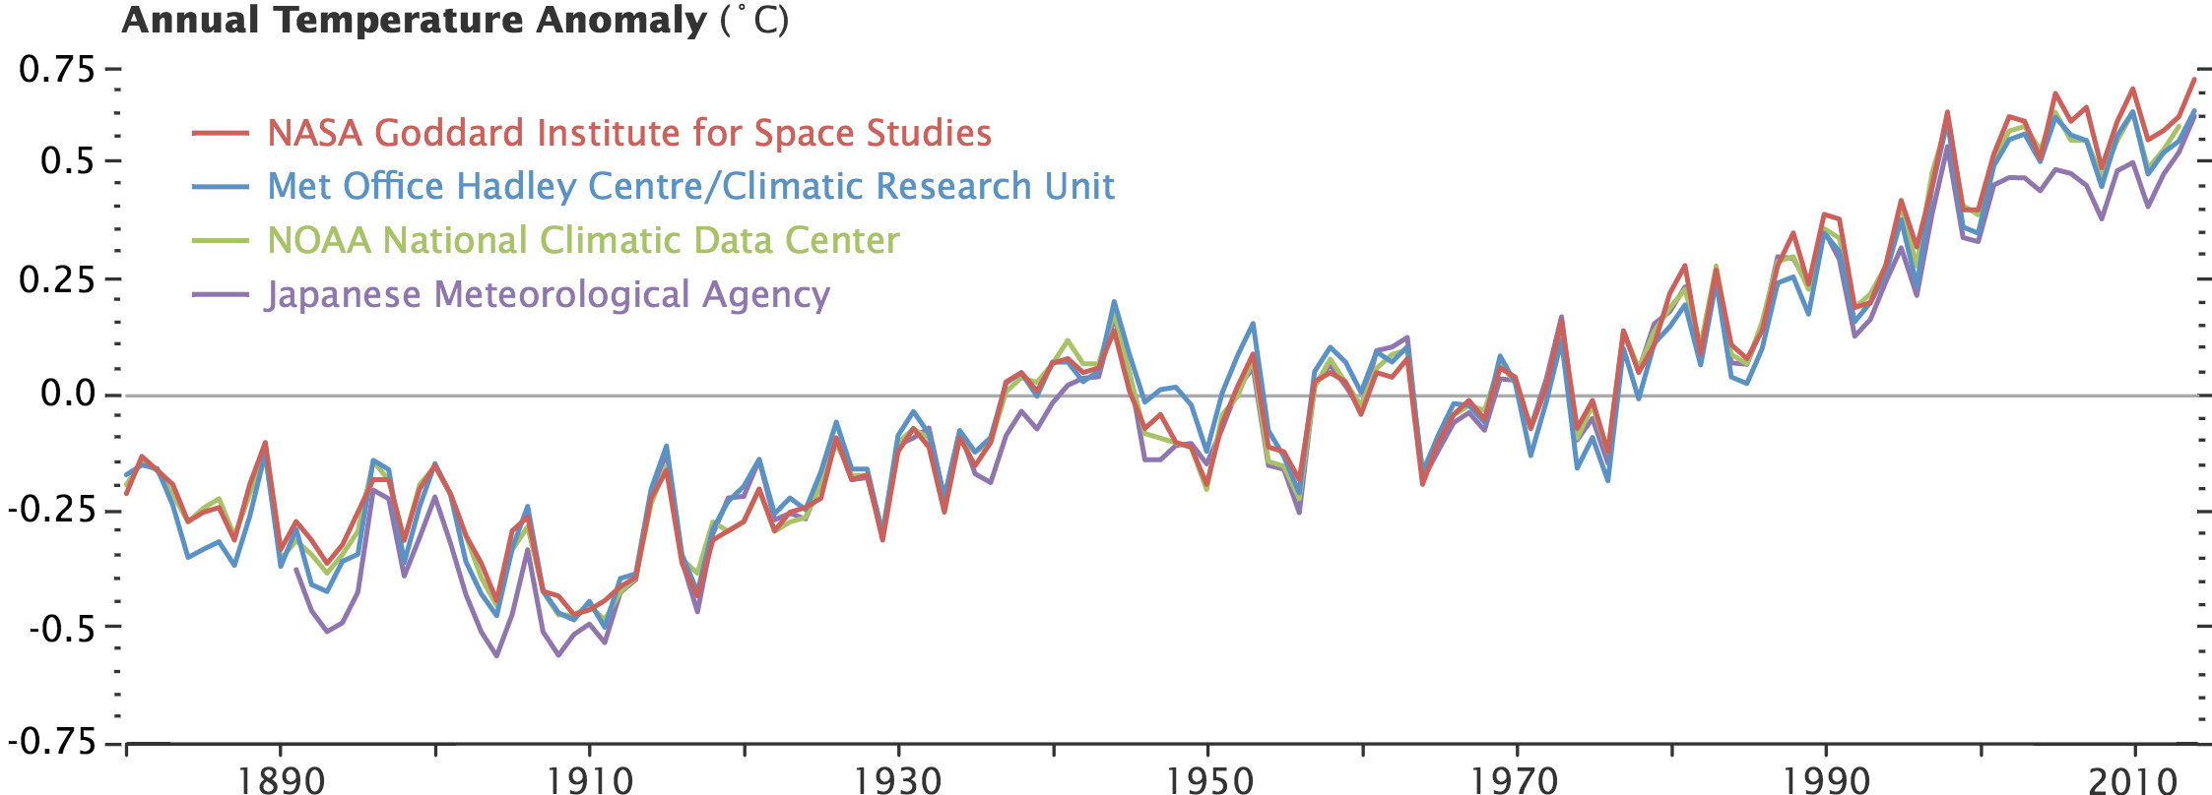
Global Warming – The Big Aha !!!!
Recent Temperature Change (Past 135 years)
15˚C
14˚C

Slide 3
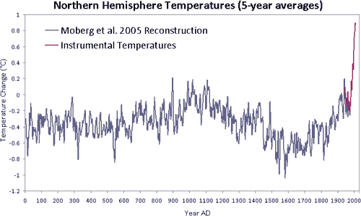
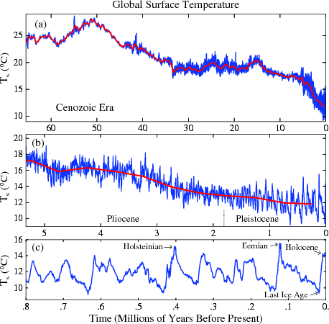
Global Warming – Temperature History
Millennial Time Scales – Past 2,000 Years
15
Medieval
Warm
Period
14
Little
Ice Age
13

Slide 4
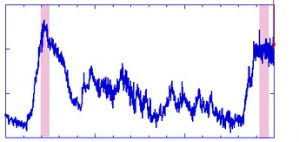
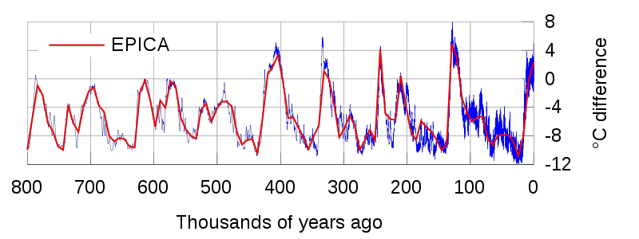
Global Warming – Temperature History
Millennial Time Scales – Glaciers
Interglacial
Interglacial
15
Glacial
10
5
150
100
50
0
15
10
5

Slide 5
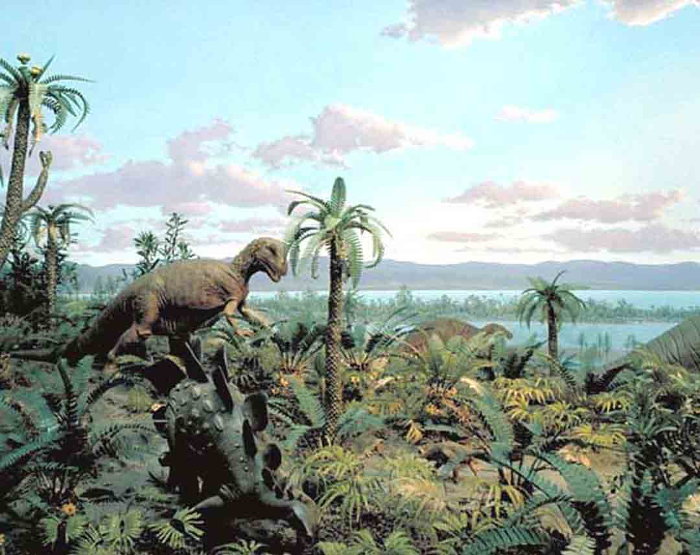
Global Warming – Temperature History
Geologic Time Scales – Since the Dinosaurs
30

Slide 6
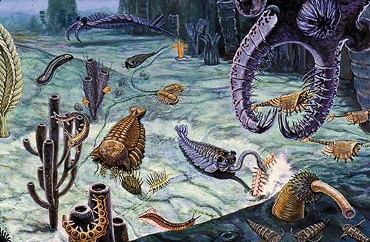
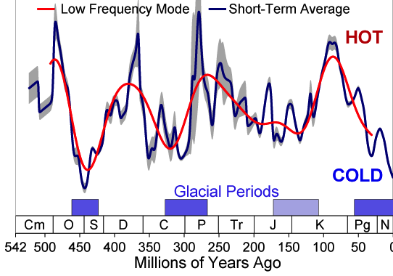
Global Warming – Temperature History
Geologic Time Scales – Since Complex Animals
40
30
Temperature (˚C)
20
10

Slide 7
Global Warming – Temperature History
40
30
Temperature (˚C)
20
10
Group Discussion
The present-day temperature is up to 20˚C cooler than in the past,
so why are we worried about global warming?

Slide 8
Hints…..
10˚C change in 10,000 years
15
10
5
150
100
50
0
1˚C change in 100 years

Slide 9
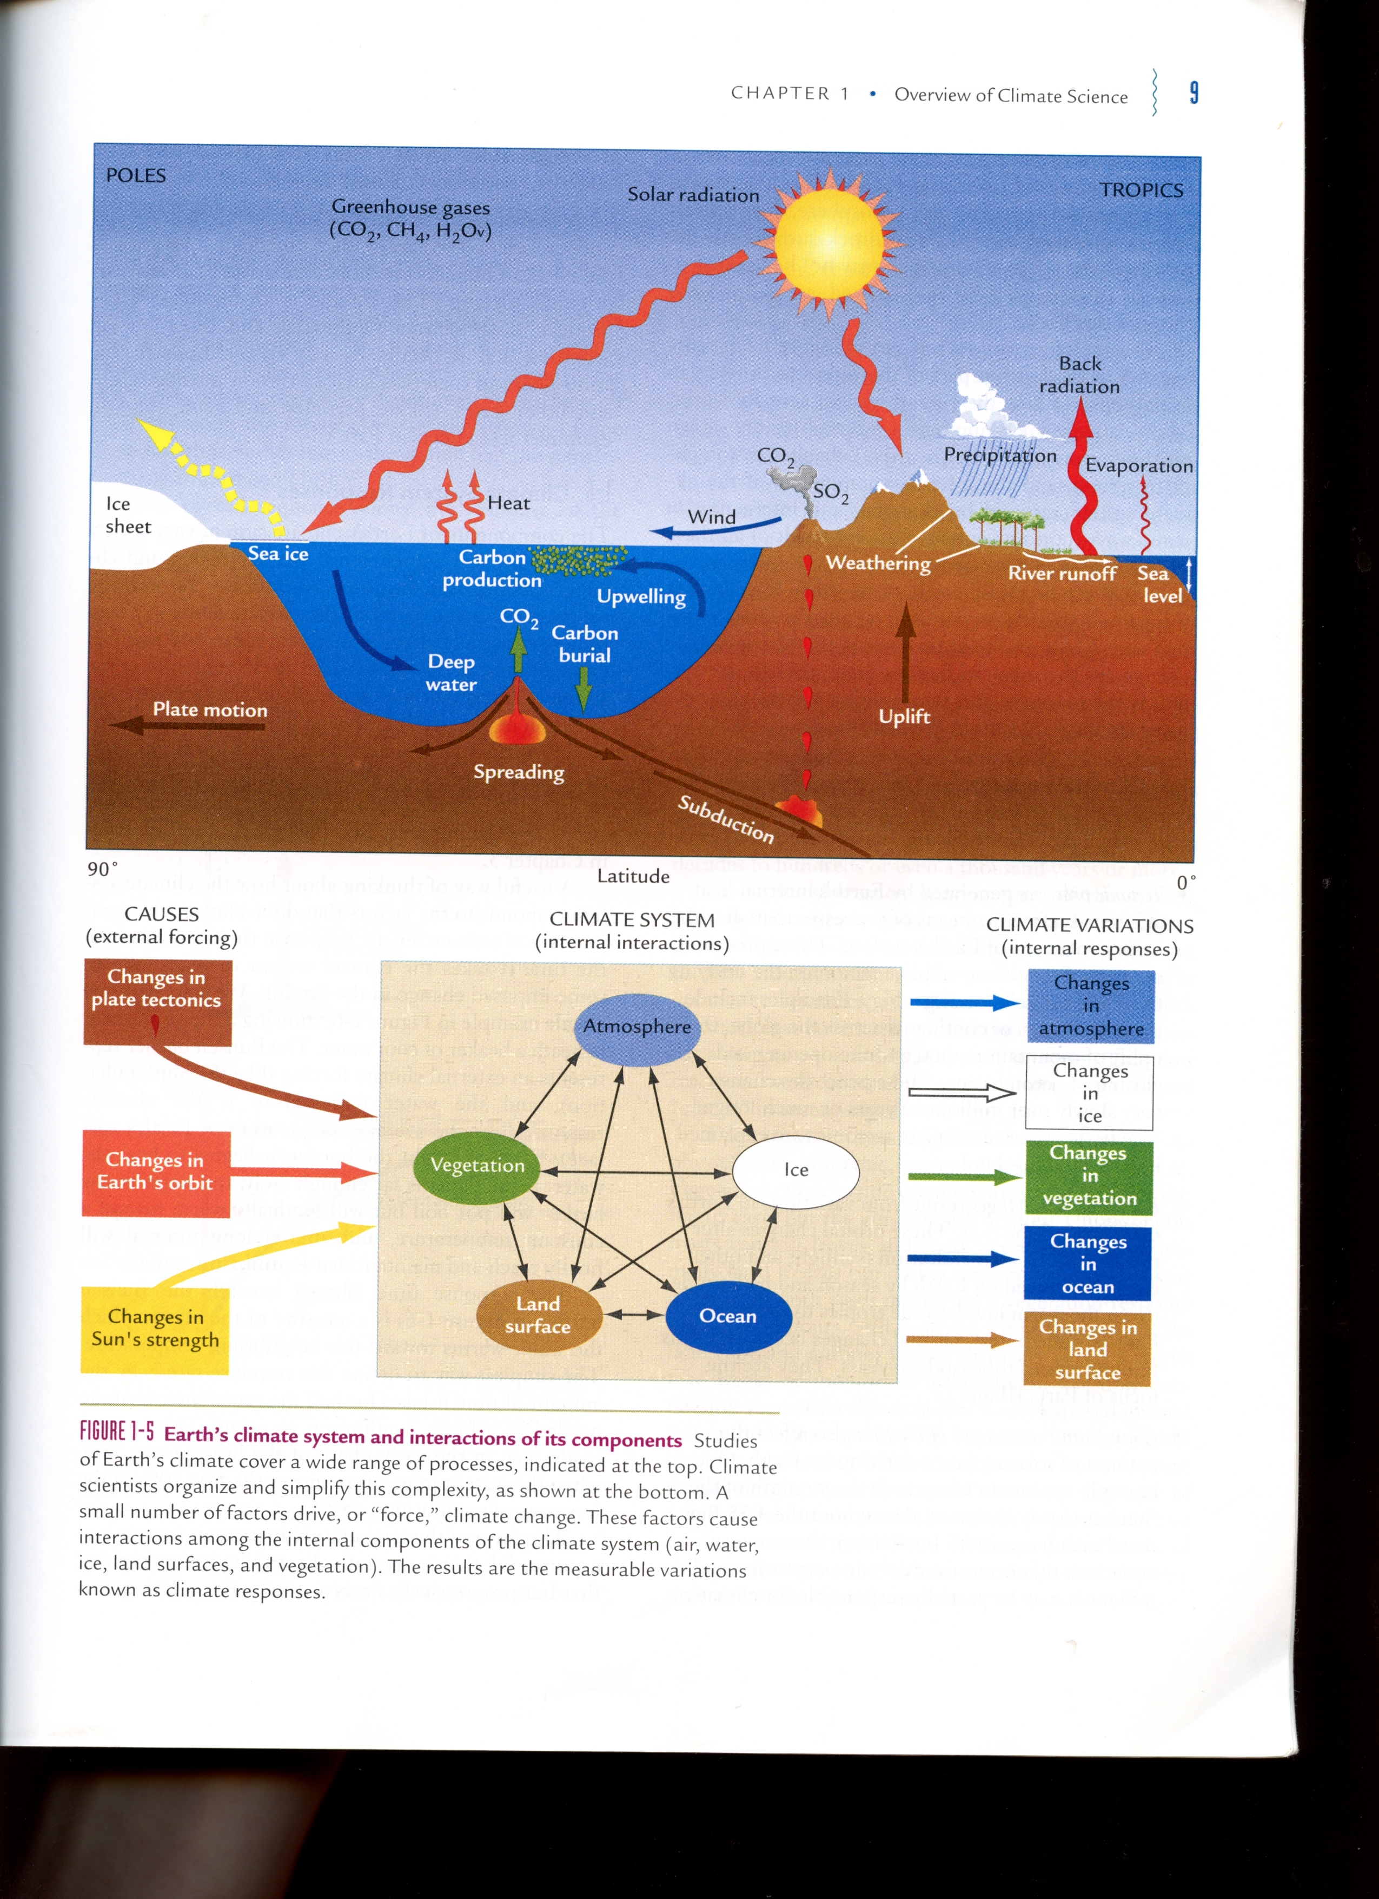
Climate System
Complex System
External forcings have varied responses

Slide 10
Climate Change Factors
100
10
Temperature Change (˚C)
Orbital Patterns
Plate Tectonics
Albedo
Green House Gases
1
Volcanoes
Sunspots
0.1
1
10
10²
10³
10⁶
10⁹
Time Span (Years)

Slide 11
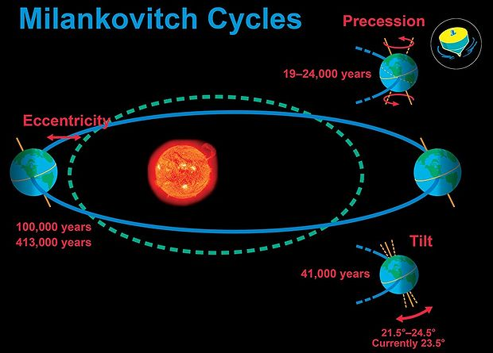
External Forcings – Changes in Earth’s Orbit
Orbital Patterns
Eccentricity – elliptical orbit (100,000 & 400,000 years)
Obliquity – variable tilt (~40,000 years)
Precessions – wobbly top (~20,000 years)

Slide 12
Heavenly Bodies Demonstration

Slide 13
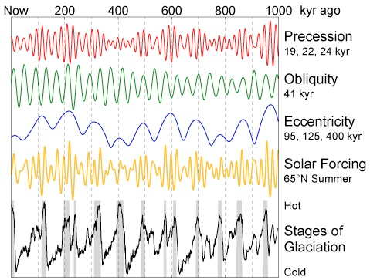
External Forcings – Changes in Earth’s Orbit
Orbital Patterns Through Time
+
+
+
Solar Variability

Slide 14
External Forcings – Changes in Earth’s Orbit
Orbital Patterns
Eccentricity – elliptical orbit (100,000 & 400,000 years)
Obliquity – variable tilt (~40,000 years)
Precessions – wobbly top (~20,000 years)
Think-Pair-Share
What will happen to global temperatures with no tilt of the Earth?

Slide 15
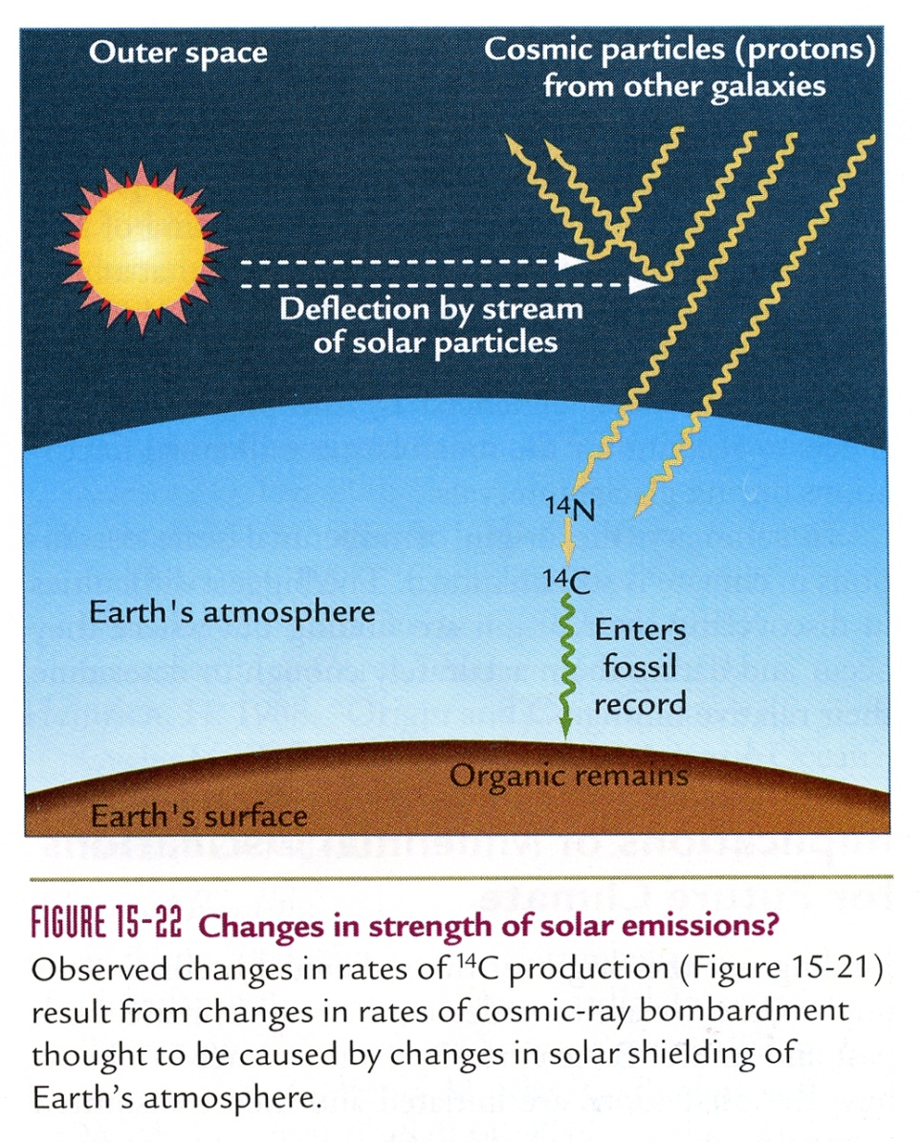

External Forcings – Changes in Sun’s Strength

Slide 16
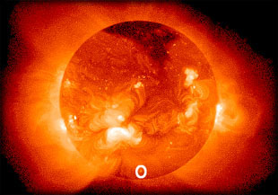
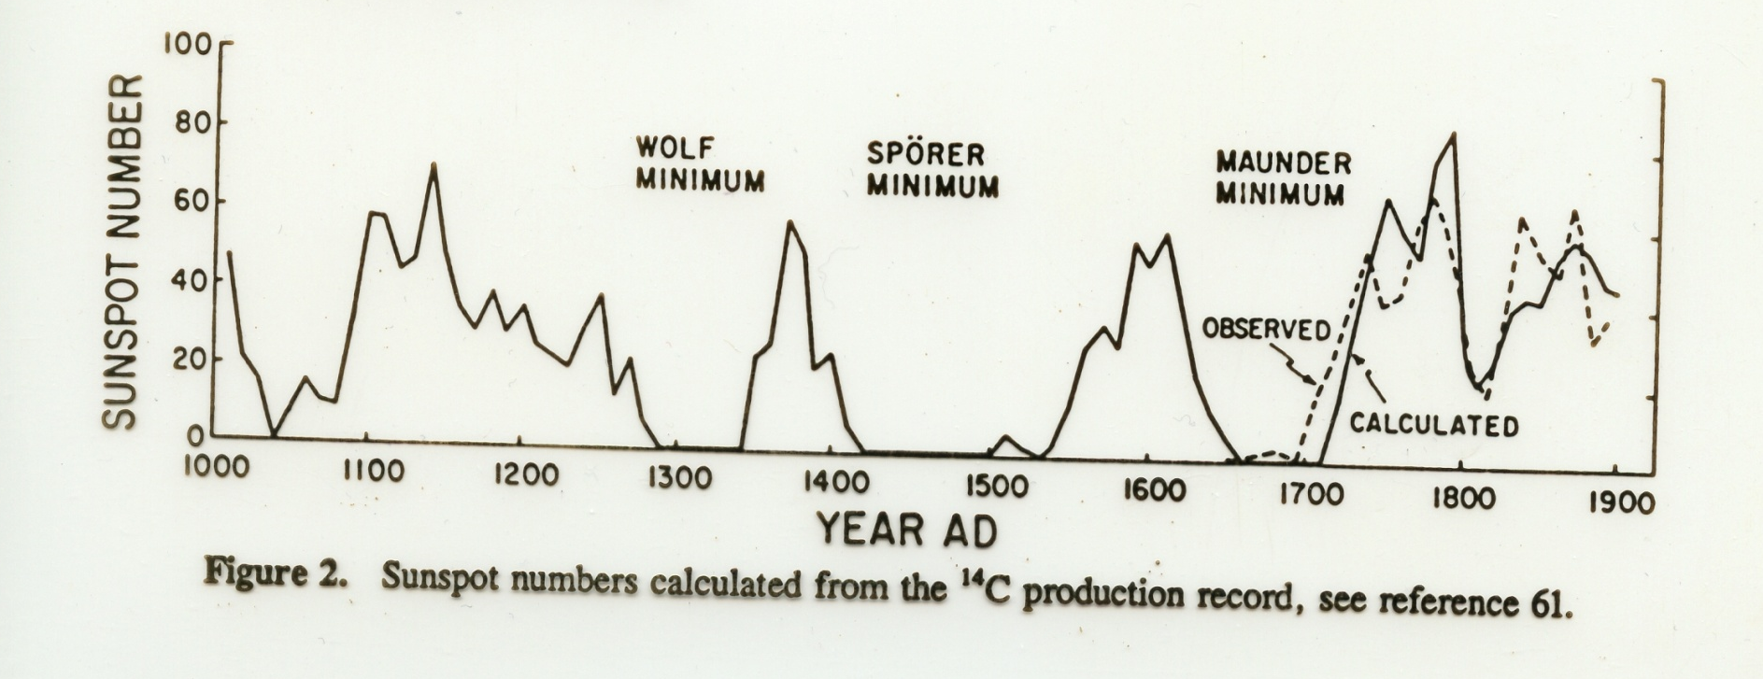
External Forcings – Changes in Sun’s Strength
Sunspot Numbers

Slide 17
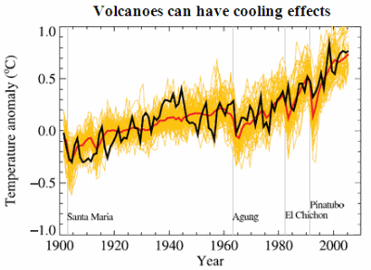
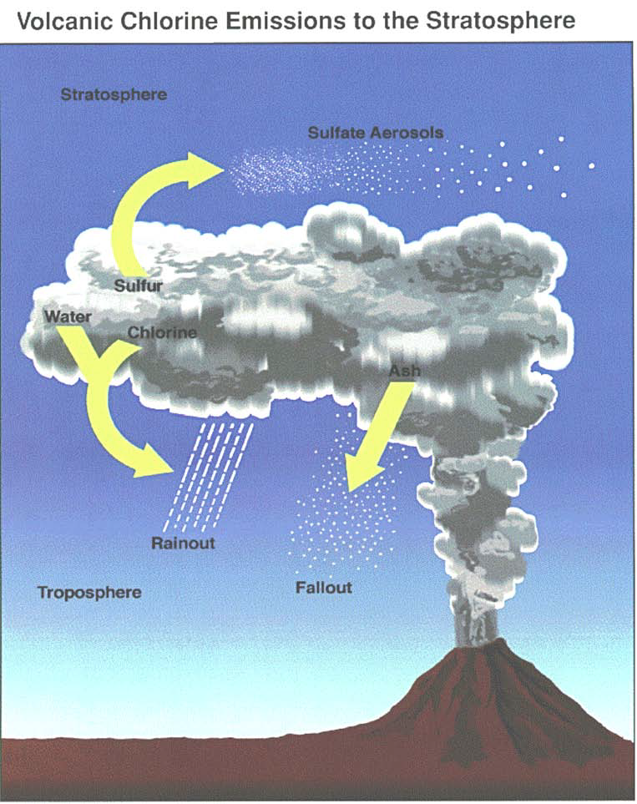
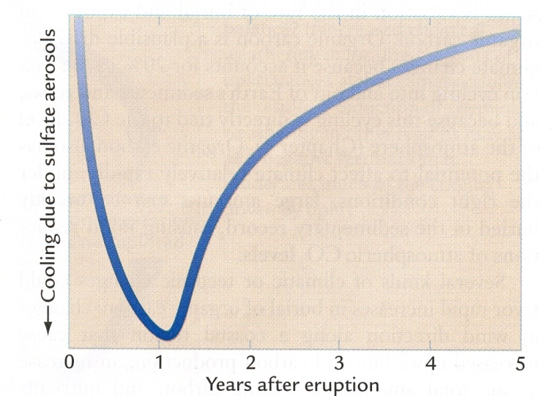
External Forcings – Volcanic Eruptions
Climate Change Factors

Slide 18
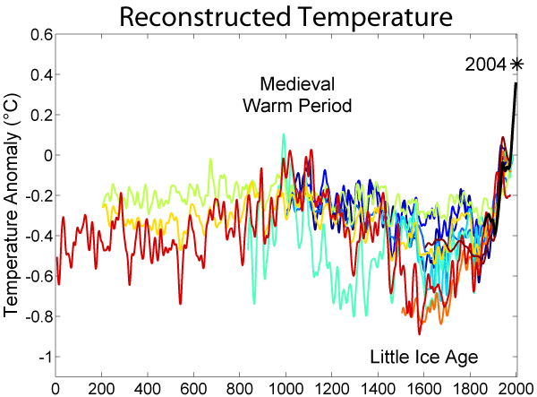
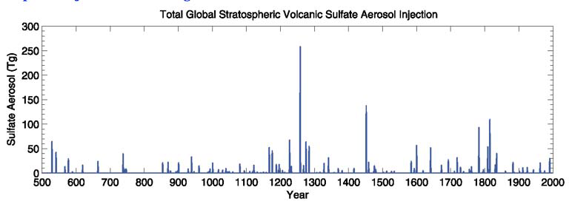
External Forcings – Volcanic Eruptions
Climate Change Factors
Volcanic
Eruptions
Sulfate Aerosol
500
1000
1500
2000
Year

Slide 19
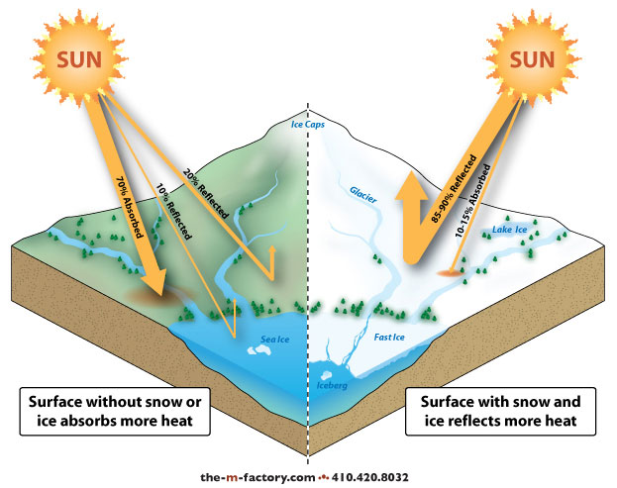
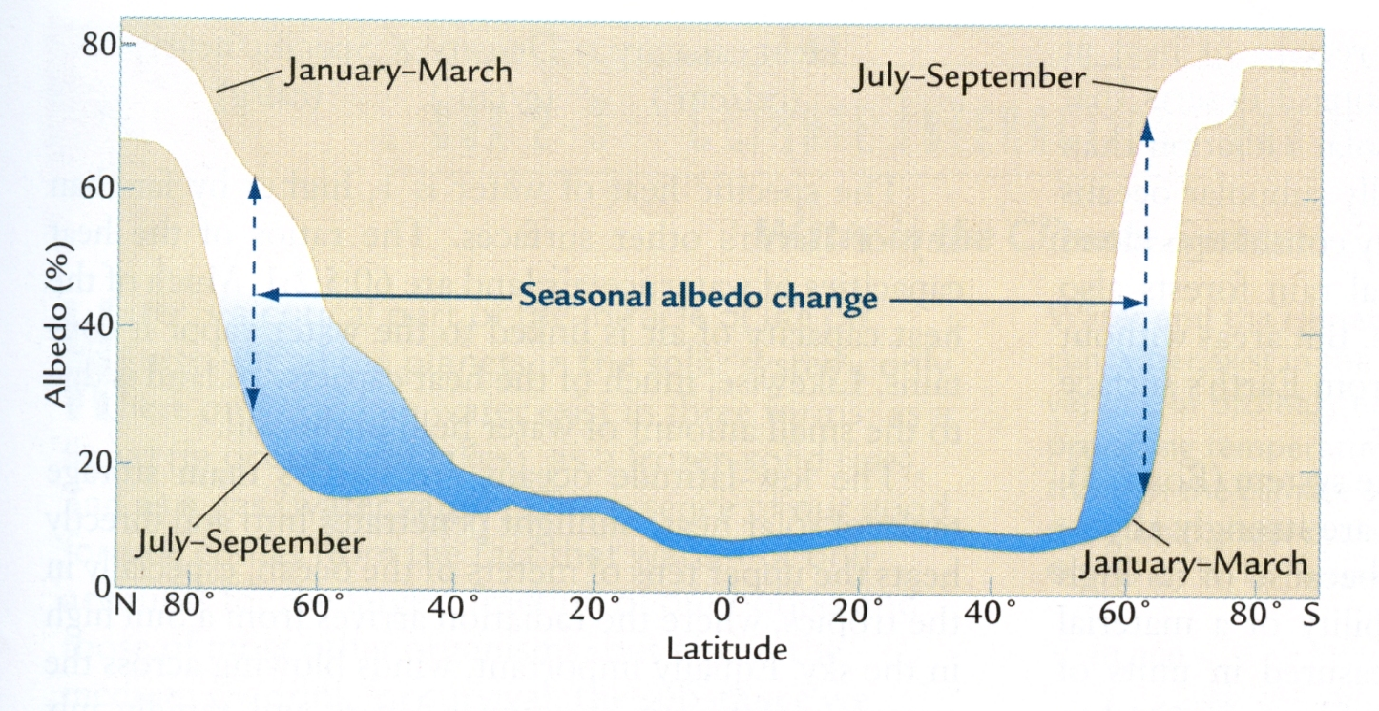
Climate Change Factors - Albedo Effects
Increased ice and snow cover will lead to cooling
Reduced ice and snow cover will lead to warming

Slide 20
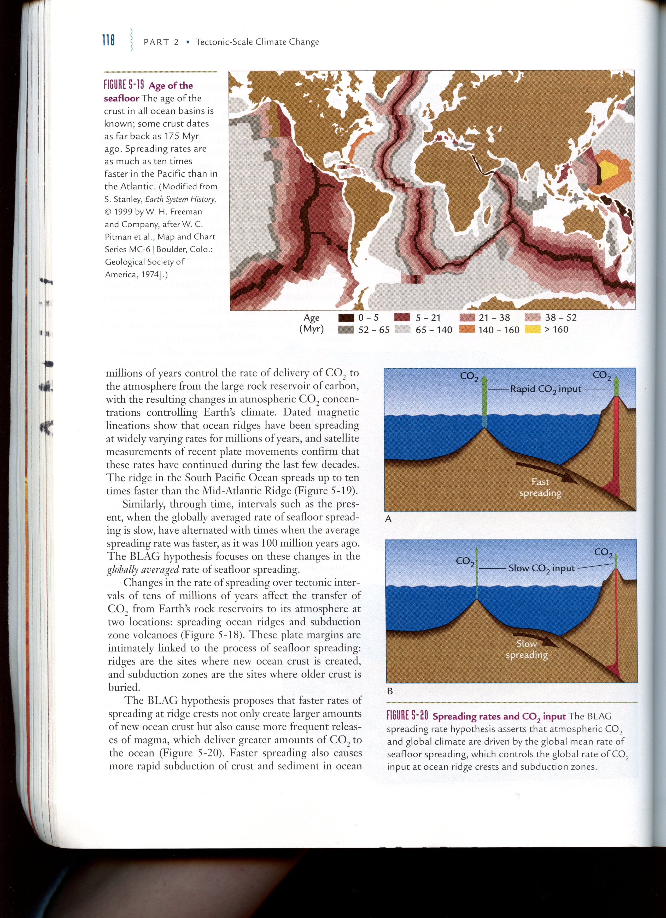
External Forcings - Plate Tectonics
BLAG (Berner, Lasaga & Garrels) Hypothesis
  Faster spreading increases rate of CO₂ input to the atmosphere
  Slower spreading decreases rate of CO₂ input to the atmosphere

Slide 21
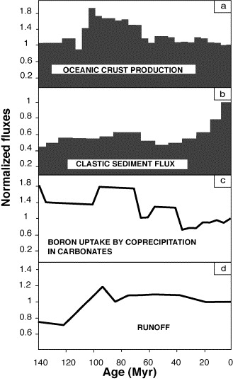
External Forcings - Plate Tectonics
Faster
Slower
Seafloor spreading rates
Think-Pair-Share
Would you predict the atmospheric CO₂ concentration to be higher, lower, or about the same ~100 Million years ago?
Would you expect the climate to be warmer, cooler, or about the same?

Slide 22
Global Warming – The Big Aha !!!!
What do you think is causing this recent change?
15˚C
14˚C

