Slide 1
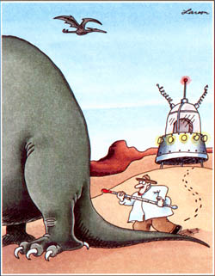
Earth’s Temperature History – How do we know?
Climate System Review
Temperature History Review
Temperature Proxies
Ice Core Activity

Slide 2
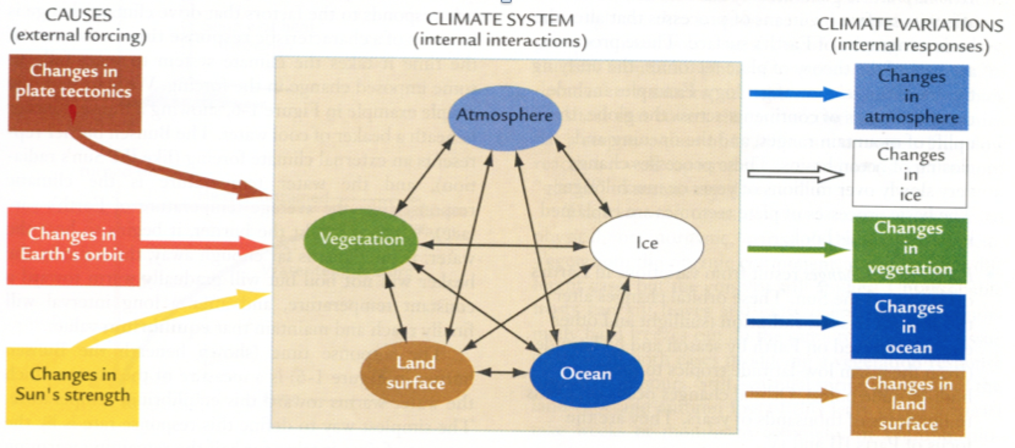
Climate Change
Climate System
- external forcings (plate tectonics, orbit, solar input, volcanoes & man)
- internal interactions (air, sea, land, ice, vegetation)
- internal responses (changes in climate system)
Causal Chains
More sunspots => global warming => melts ice => sea level rises => land area decreases
=> less room for land plants ………

Slide 3
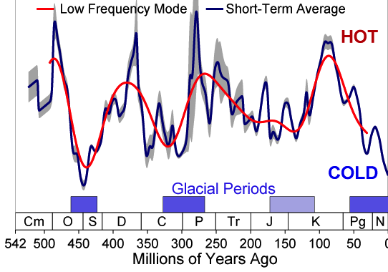
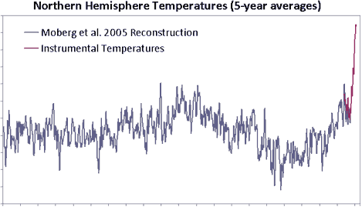
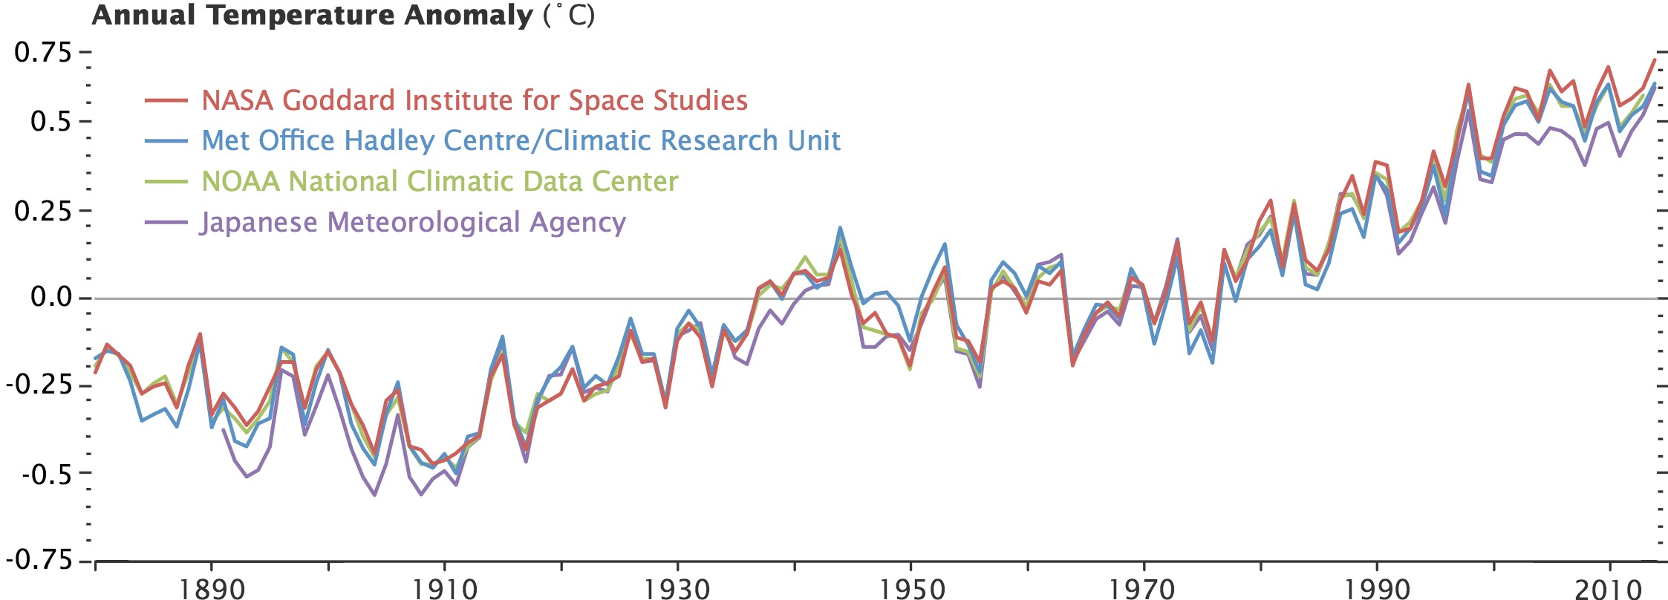
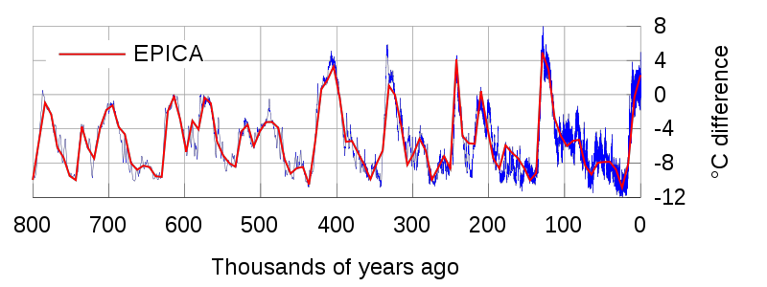
Temperature History Review
Plate Tectonics (Millions of Years)
Sunspots/Volcanoes (10-100s of Years)
0.5
Proxies
Temp. Anomaly (C)
0
Instruments
-0.5
0
Year (AD)
1000
2000
Which time-frame do you believe is the most accurate?
? (Decades)
Orbital Patterns (Thousands of Years)
5
0
Temp. Anomaly (C)
-5
Thousands of Years Ago

Slide 4
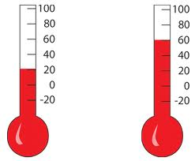
Temperature Proxy
Temperature Proxy –
- preserved physical characteristic (e.g., tree ring)
- that can be used as a measure of past temperature
- if properly calibrated.
4
150
4
3
100
3
Height of Fluid
2
50
2
1
0
1
0
50
100
150
Temperature

Slide 5
Temperature Proxy – Tree Rings
Tree Rings
Tree Ring Age
1937
1942
1947
1952
1957
1962
1967
1972
1977
1982
1987
1992
1997
2002
2007
2012
Growing Conditions?

Slide 6
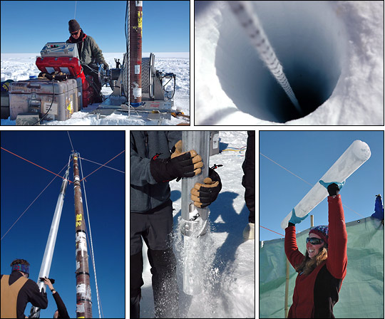
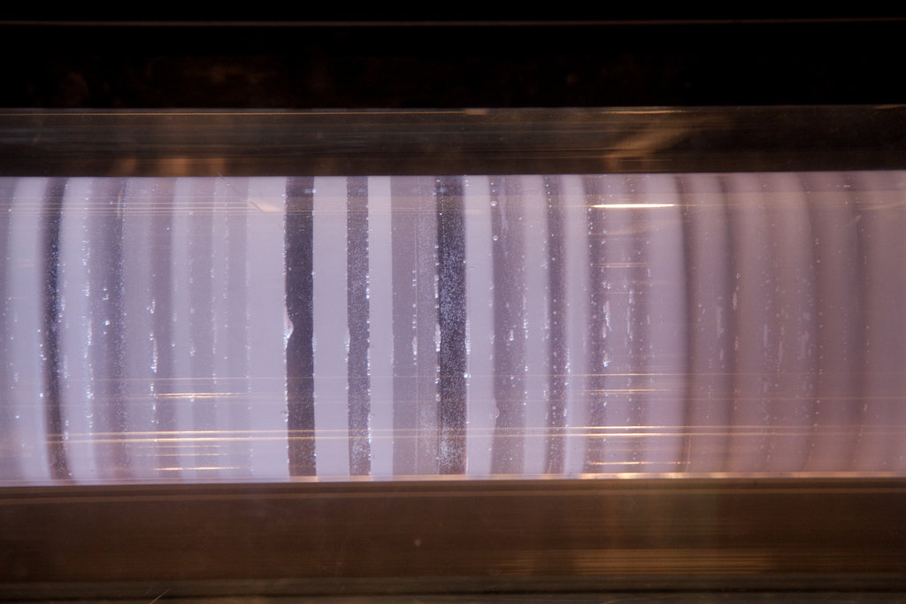
Temperature Proxy – Ice Cores
Annual
Rings

Slide 7
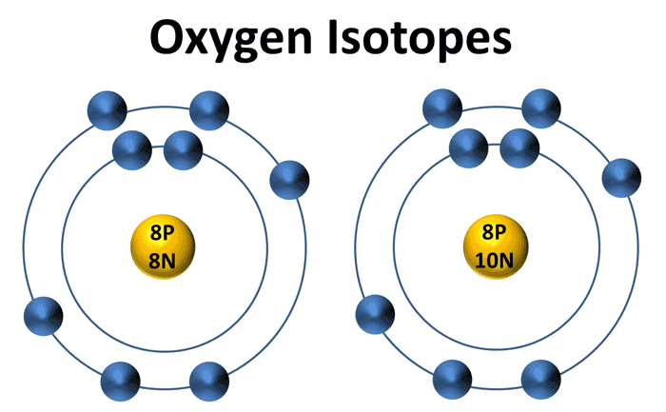
Temperature Proxy – Ice Cores
Warmer Temps.
Ice enriched in ¹⁸O
Ice depleted in ¹⁶O
¹⁸O/¹⁶O increases
¹⁶O
¹⁸O
Lighter
Heavier
Cooler Temps.
Ice depleted in ¹⁸O
Ice enriched in ¹⁶O
¹⁸O/¹⁶O decreases
Water Molecules
¹⁶O
¹⁸O
H
H
H
H
Lighter
Heavier

Slide 8
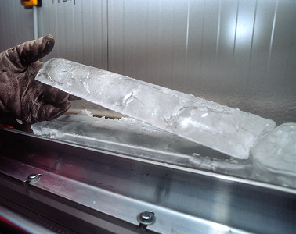
Split Ice Cores
Split Ice Tray
Archive
Working
1
2
3
4
5
6
7
8

Slide 9
ABCDEFGH
Top
Big Green Beads (¹⁸O) | Small Black Beads (¹⁶O) | Green:Black Ratio | Temperature
A
B
C
18
D
17
16
15
E
14
13
12
F
0:6
1:5
1:2
1:1
2:1
5:1
6:0
G
H

Slide 10
ABCDEFGH
Top
A
B
C
D
E
Volcanic Eruptions
1720
1760
F
G
H

Slide 11
ABCDEFGH
Top
A
B
C
D
E
F
G
H

Slide 12
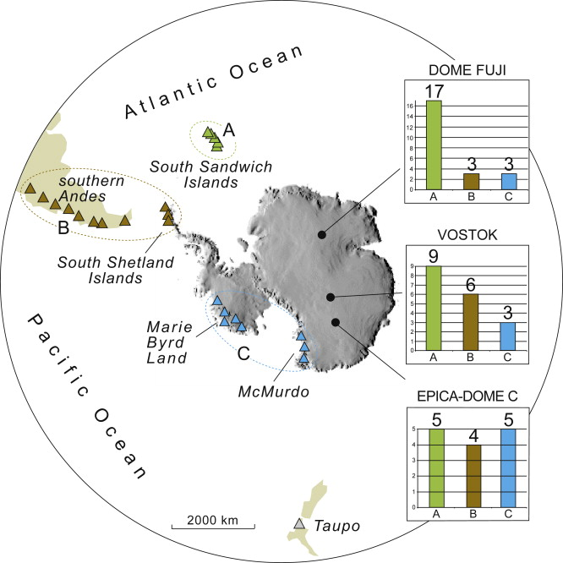
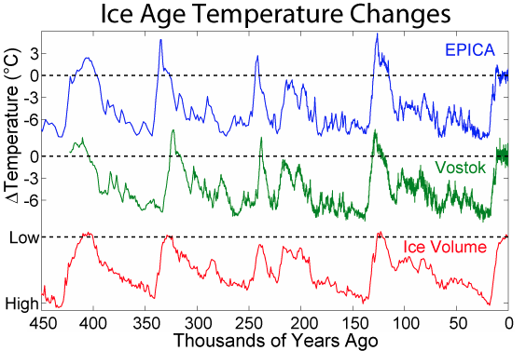
Ice Core Results

