Slide 1
Loose Ends
Exam Review
Causal Chains
Milankovitch Cycles… redux

Slide 2
Exam Review
100223655 | 25
100247722 | 24
100421704 | 27
100480280 | 22
100489736 | 28
100507390 | 24
100532725 | 24
100533896 | 11
100539025 | 29
100544908 | 26
100562316 | 28
100563329 | 21
100563641 | 12
100564307 | 24
100567738 | 27
100567742 | 23
100572022 | 30
100572790 | 24
100579094 | 25
100583957 | 29
100586488 | 29
100592491 | 25
100597249 | 24
F
C
(21-23)
B
(24-26)
A
(27+)

Slide 3
Exam Review
Short Answers – Answer all Questions (1 to 2 sentences).
1) What is the difference between weather and climate?
2) What do Long Island, Block Island, Martha’s Vineyard and Nantucket represent with respect to recent climate history?
3) What are the 2 primary factors that define a climate zone?
4) What are two sources of information used to understand past Native American culture?
5) What is a shortcoming or source of potential misinterpretation of “modern” archaeology?

Slide 4
Exam Review

Slide 5
Exam Review
3) Describe the relationships between global temperatures, glaciers and sea level. Please provide rough numbers (time, temperature change, glacial coverage and sea level changes) in your answer.
4) How is the 1940s-era “archaeology” of Indiana Jones different from the new “Community-Based Archaeology” of today? Which do you think is the better approach and why?
5) It’s nine months before the 2016 US Presidential and national election. Candidates from one political party agree with the vast majority of the scientific community that climate change is a real and growing problem that needs to be addressed immediately, while the other party’s candidates do not. At the moment you’re still unsure which party is right and who to vote for on the basis of that issue alone. What do you need to do to make an informed decision about which side of the argument to believe and who to vote for?

Slide 6
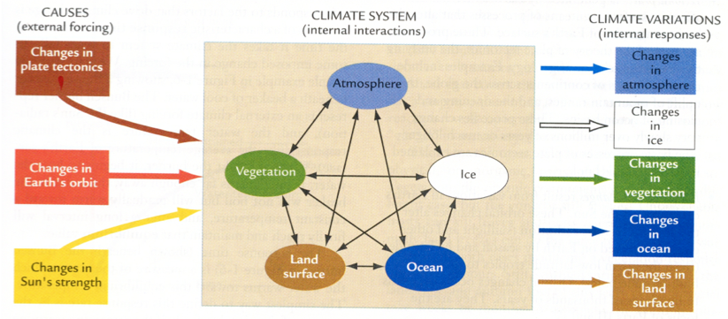
Causal Chains
Change in External Forcing
- causes atmosphere to change …. How/effect?
- causes cryosphere (ice) to change…. How/effect?
- causes hydrosphere (ocean) to change…. How/effect?
- causes geosphere (land) to change…. How/effect?
- causes biosphere (vegetation) to change…. How/effect?
Greenhouse Gas => warmer
Melts ice => more liquid water
Sea level rise => reduce land area
More land for plants => more plants
More plants => reduce CO₂ in air

Slide 7
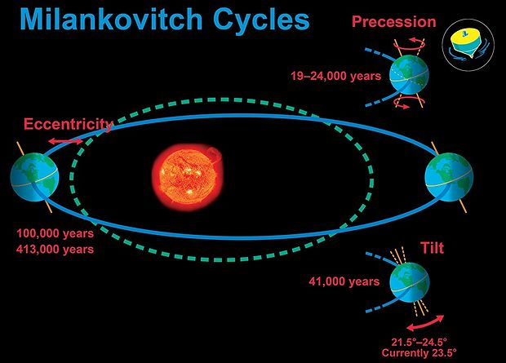
External Forcings – Changes in Earth’s Orbit
Orbital Patterns
Eccentricity – elliptical orbit (100,000 & 400,000 years)
Obliquity – variable tilt (~40,000 years)
Precessions – wobbly top (~20,000 years)

Slide 8
Heavenly Bodies Demonstration

Slide 9
External Forcings – Changes in Earth’s Orbit
+
+
+
Solar Variability

Slide 10
External Forcings – Changes in Earth’s Orbit
More
Tilt
Present
Tilt
Less
Tilt
+
+
+
Solar Variability

Slide 11
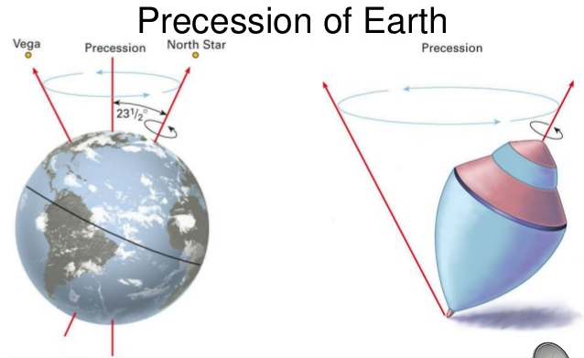
External Forcings – Changes in Earth’s Orbit
More
Tilt
Present
Tilt
Less
Tilt
+
+
+
Solar Variability

Slide 12
External Forcings – Changes in Earth’s Orbit
20,000
More
Tilt
Present
Tilt
Less
Tilt
+
40,000
+
400,000
100,000
+
Solar Variability

Slide 13
External Forcings – Changes in Earth’s Orbit
Orbital Patterns
Eccentricity – elliptical orbit (100,000 & 400,000 years)
Obliquity – variable tilt (~40,000 years)
Precessions – wobbly top (~20,000 years)
Think-Pair-Share
What will happen to global temperatures with no tilt of the Earth?

