Slide 1
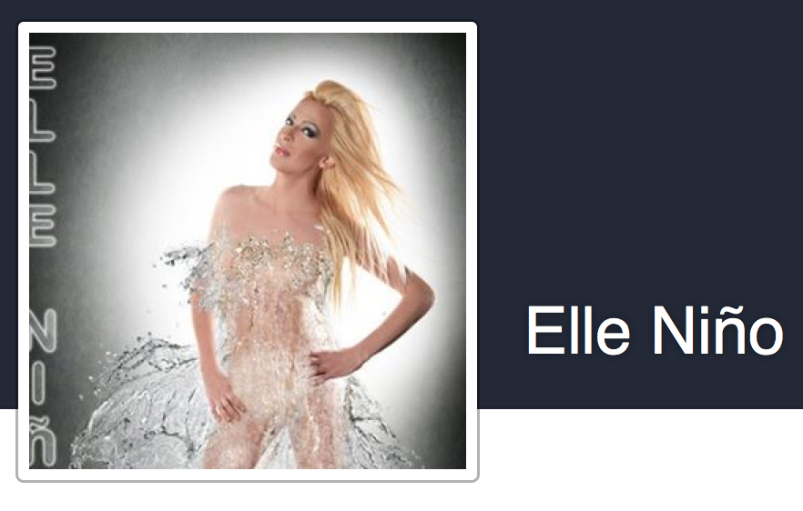
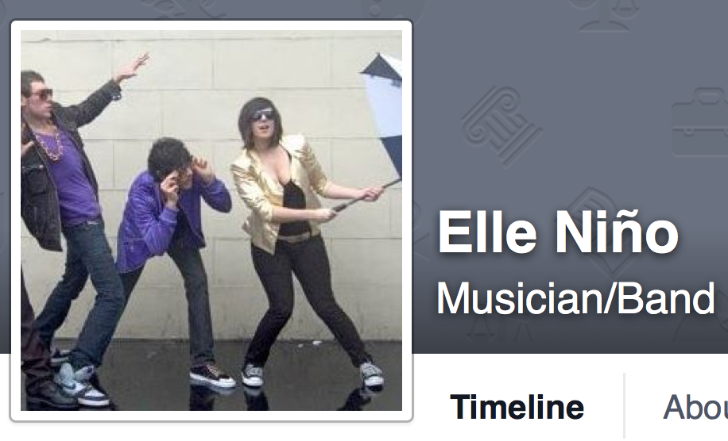

Slide 2
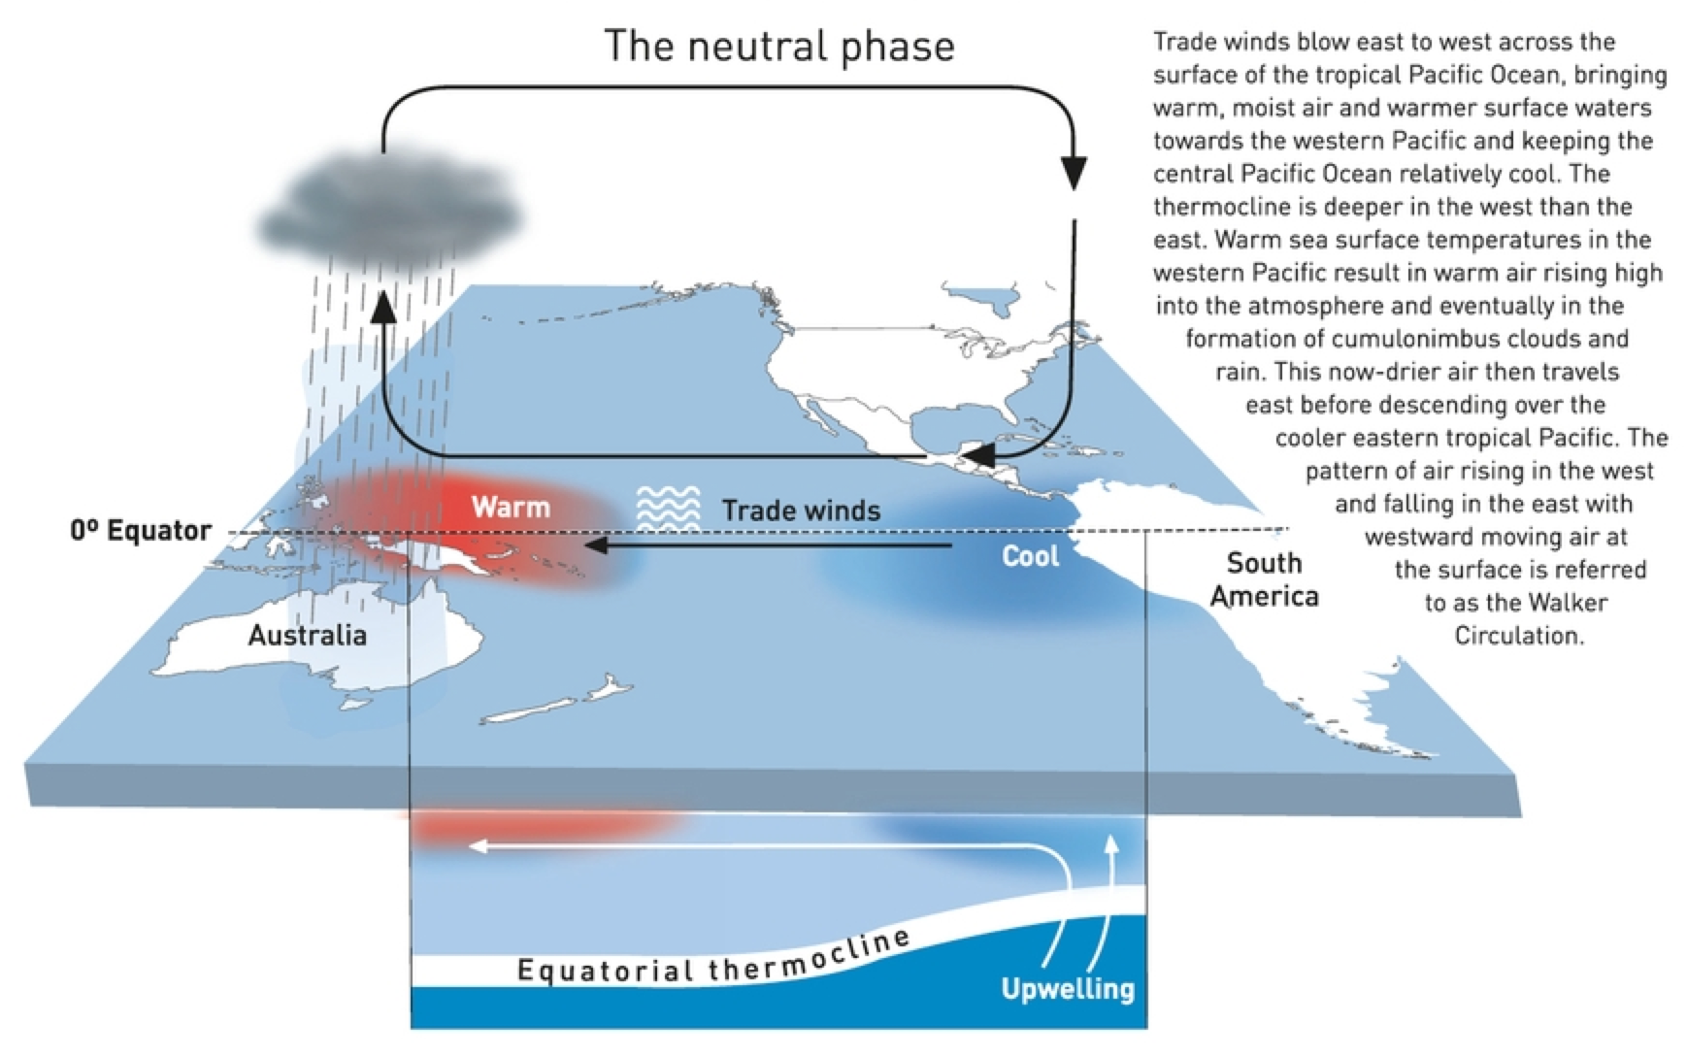
El Nino Southern Oscillation (ENSO)
Trade Winds Strength
- ”normal”

Slide 3
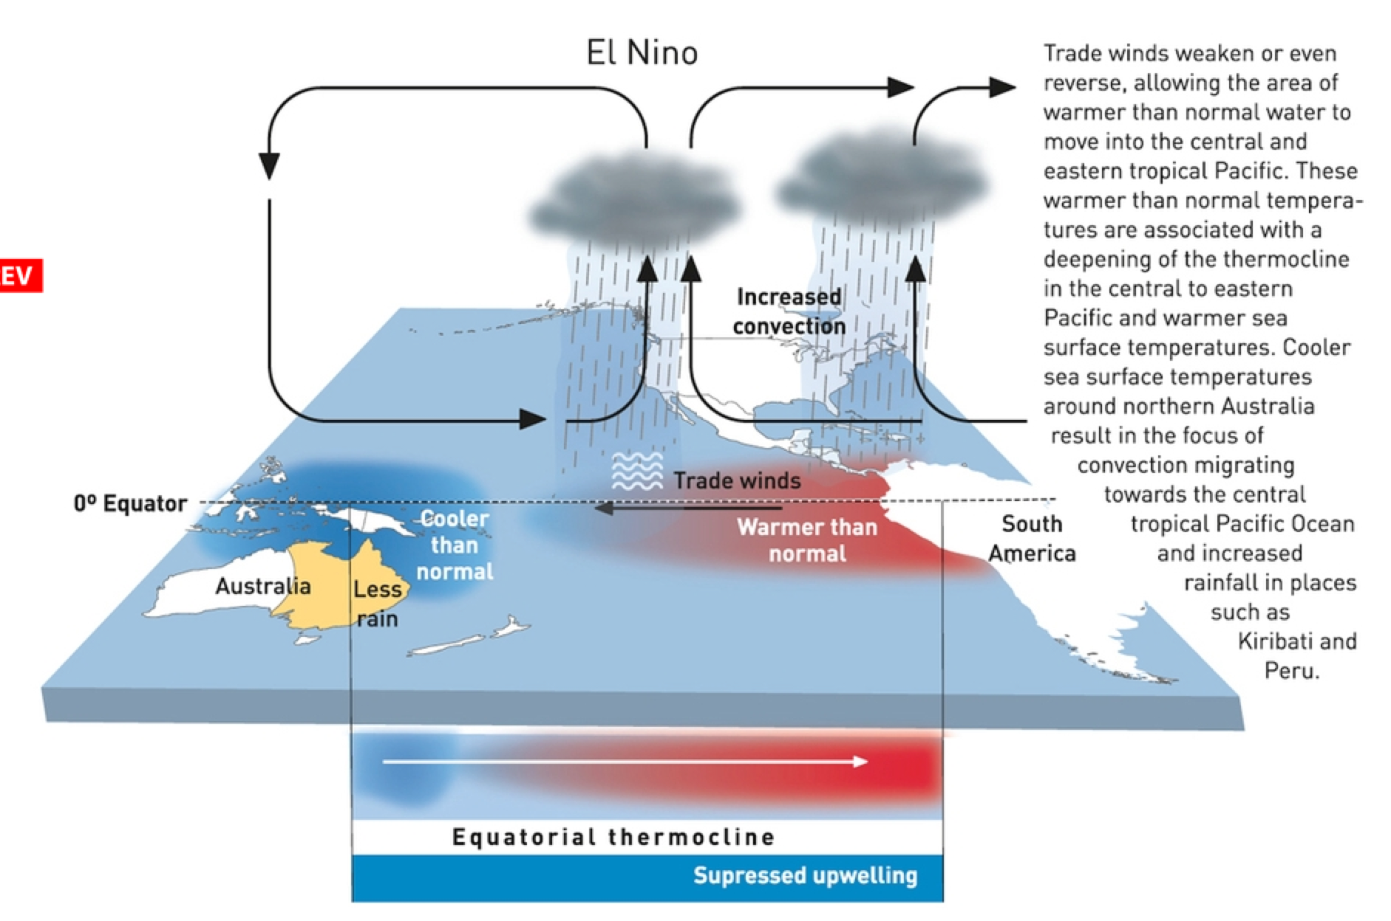
El Nino Southern Oscillation (ENSO)
Trade Winds Strength
- ”weaker”

Slide 4
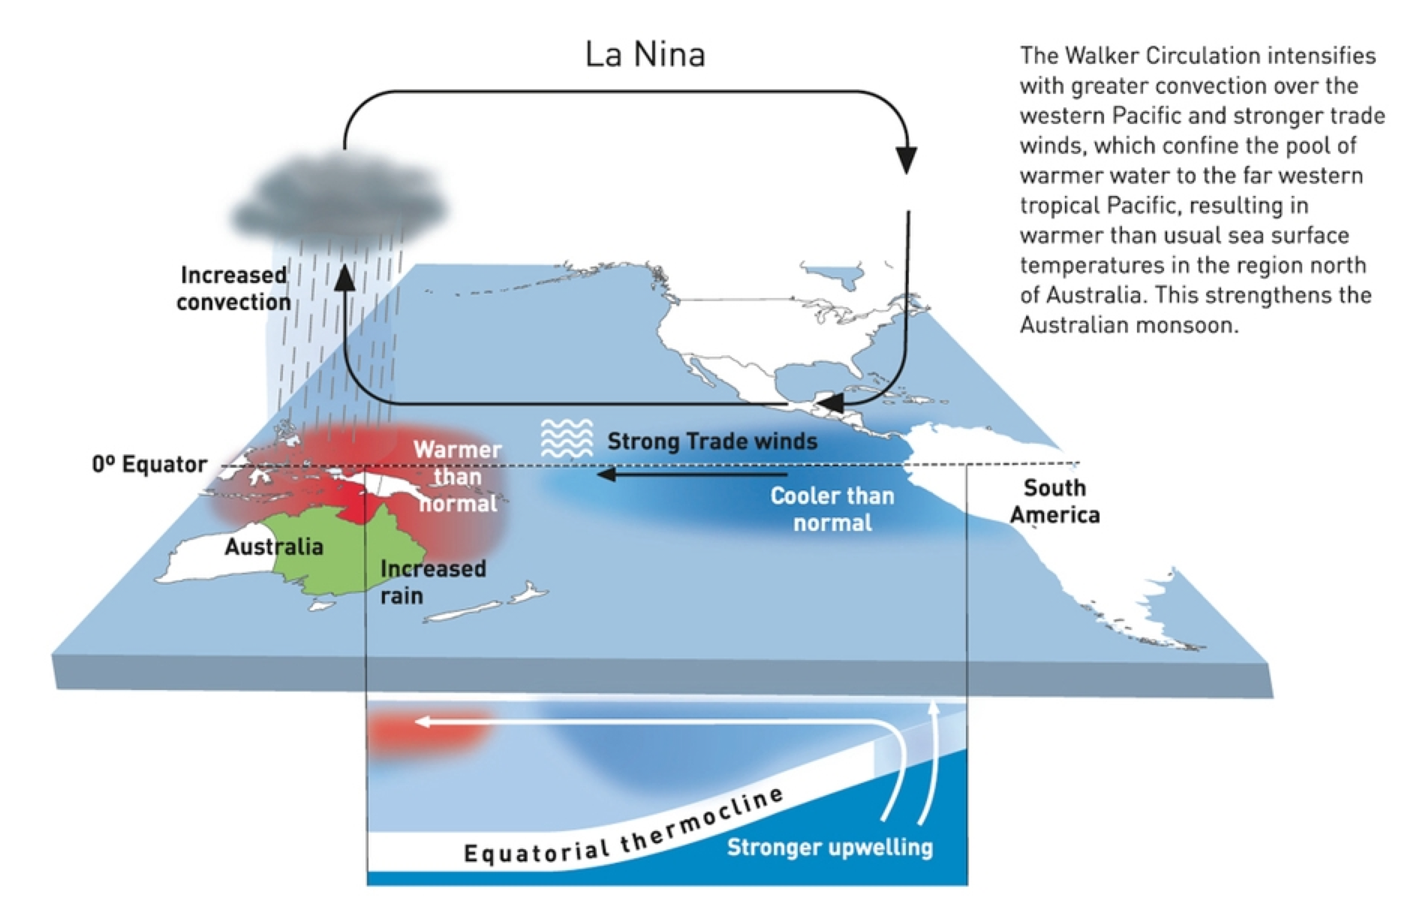
El Nino Southern Oscillation (ENSO)
Trade Winds Strength
- ”strongerl”

Slide 5
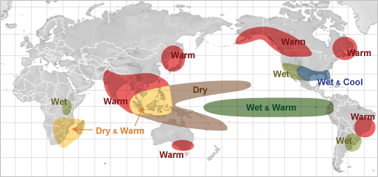
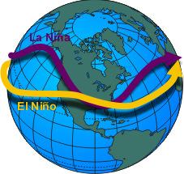
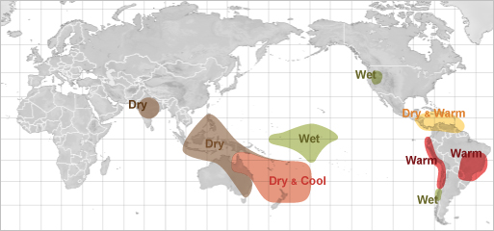
ENSO Weather Impacts
El Nino
Winter
Jetstream
Path
Summer

Slide 6
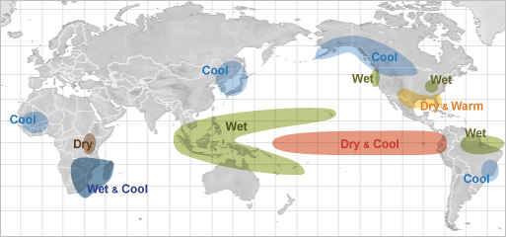
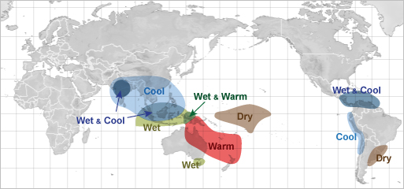
ENSO Weather Impacts
La Nina
Winter
Jetstream
Path
Summer

Slide 7
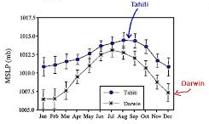
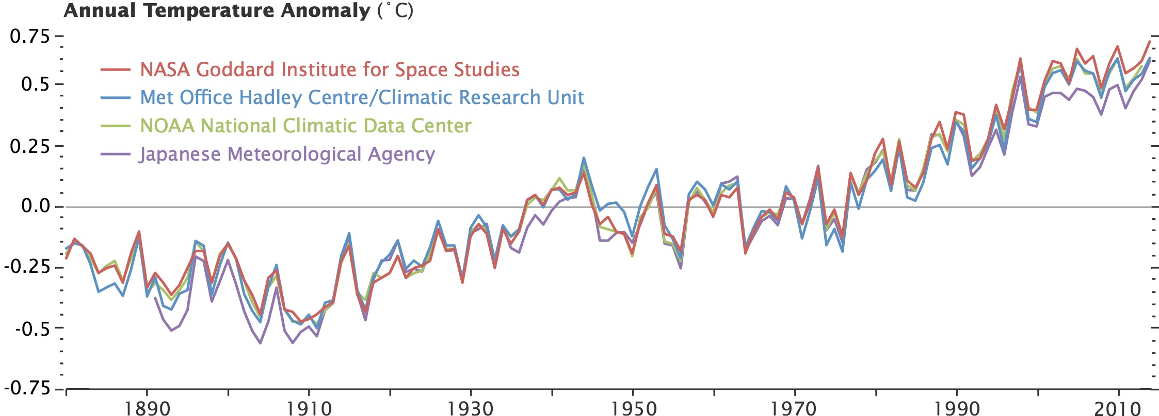
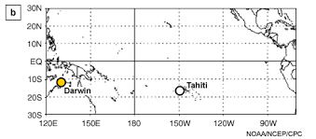
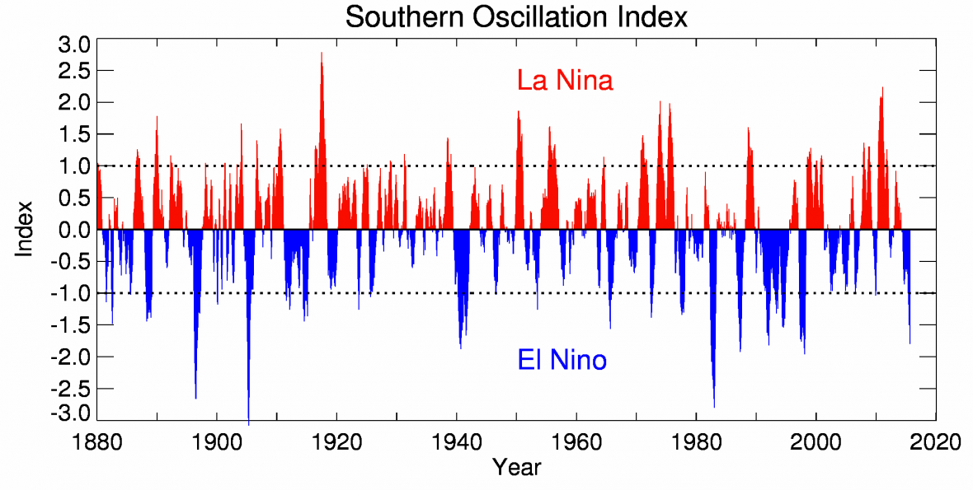
ENSO Recent History
2 to 7 year frequency

Slide 8
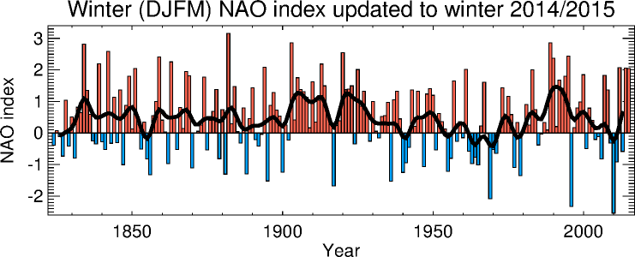
North Atlantic Oscillation (NAO)
Positive Mode
Negative Mode
Strong pressure systems (H & L) over Atlantic
- “Guide” Jetstream between systems
Weak pressure systems (H & L) over Atlantic
- Allow Jetstream to meander

Slide 9
ENSO NAO Comparison
2 to 7 year frequency

Slide 10
Why on earth is it called el nino? What does El Nino mean?
I still don't understand what La Niña is or how that works.
How long of a period of time El Nino affects the weather?
Is this a normal climate change that happens or is this rare?
When were the first affects of El Nino felt?
Does El Nino and La Nina cause the temperature to oscillate in an unstable way?
I still don't understand the rising of the cool water and how this has to do with el nino.
How much is the temperature difference between the east and west side of the ocean?
How much does it have to be to cause a significant variation in weather?
Why el nino always related to Indonesia??
Given the above, does climate change have the ability to dramatically change the currents and normal winds of Earth?
"Jet Streams" and what they refer to.
The jet stream and how it affects weather.
I don't understand why there are wetter than normal conditions in the middle of the country but drier than normal conditions surrounding it.
Why do trade winds move toward the East rather than the West?

Slide 11
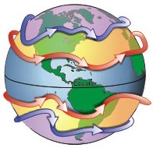
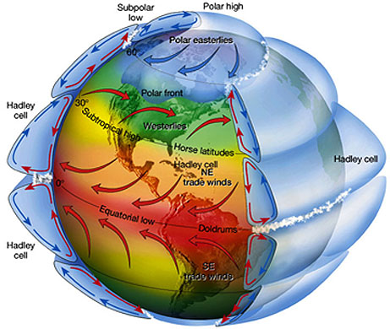
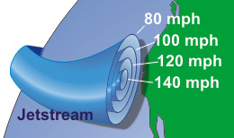
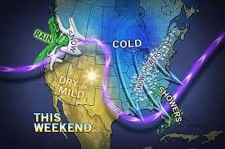
Jet Streams
Polar
Sub-Tropical
H
L

Slide 12
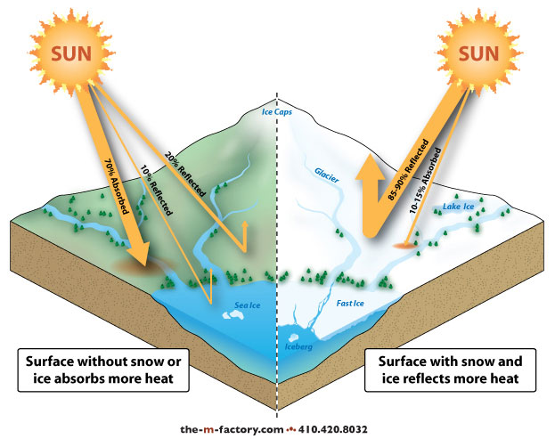
Climate Change Factors - Albedo Effects
Increased ice and snow cover will lead to cooling
Reduced ice and snow cover will lead to warming

Slide 13
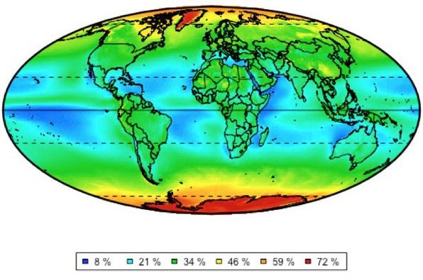
Albedo & Causal Chains
What if Climate Cools? What Happens to Albedo?
Case 1: Start with Glaciers
Case 2: Start with Vegetation
Average Annual Albedo (Reflectivity)

Slide 14
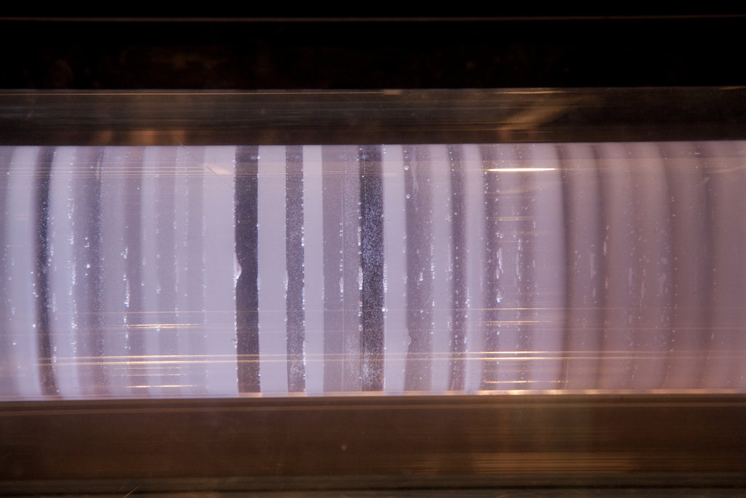
18
A
17
16
15
14
B
13
Annual
Rings
12
C
0:6
1:5
1:2
1:1
2:1
5:1
6:0
D
E
F
G
H

Slide 15
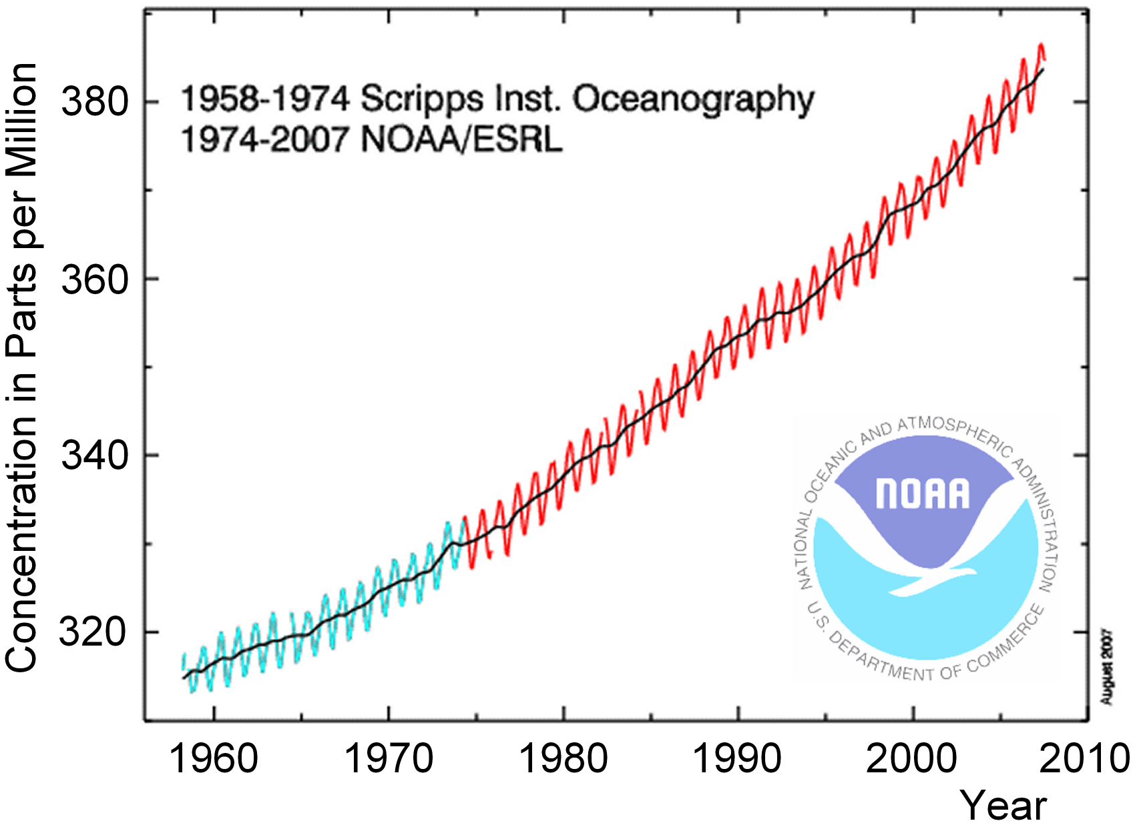
Greenhouse Effect - Trends
Greenhouse Gases (GHG)
Water Vapor (H₂O)
Carbon Dioxide (CO₂)
Nitrous Oxide (N₂O)
Methane (CH₄)
Ozone (O₃)

Slide 16
