Slide 1
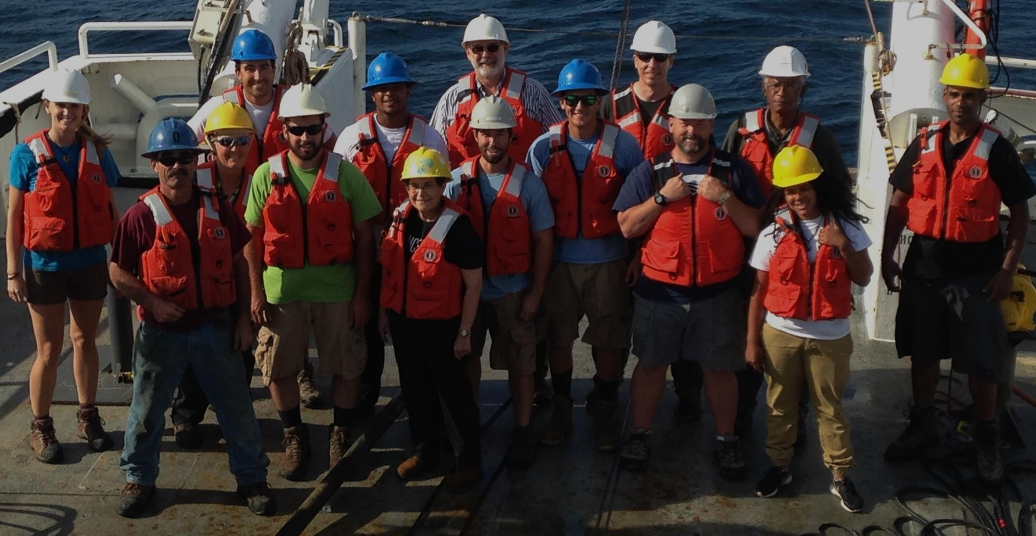
WEEK 2 – CLASS 2:
COMMUNITY-BASED ARCHAEOLOGY –
THE ARCHAEOLOGY OF THE 21st CENTURY
Topics for Today’s Discussion
The need for community-based archaeology
What is community-based archaeology?
Examples: Atalay’s Çatalhöyük Project and
the URI-GSO and NITHPO’s Project

Slide 2
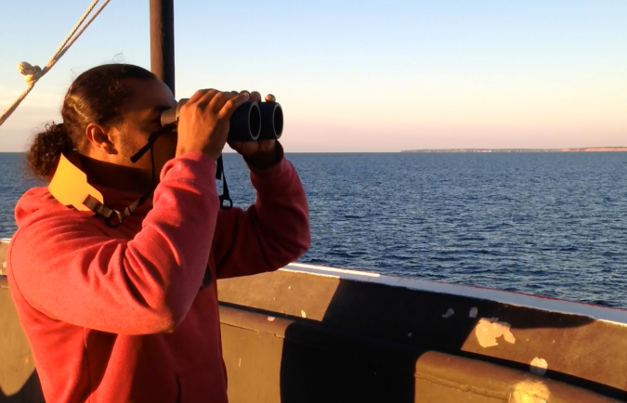
Last Class…
Archaeology as a “Lens” for Viewing the Past
Archaeology’s Downsides:
Western-culture bias
De-emphasis on humanity
Difficult to integrate with Tribal oral history

Slide 3
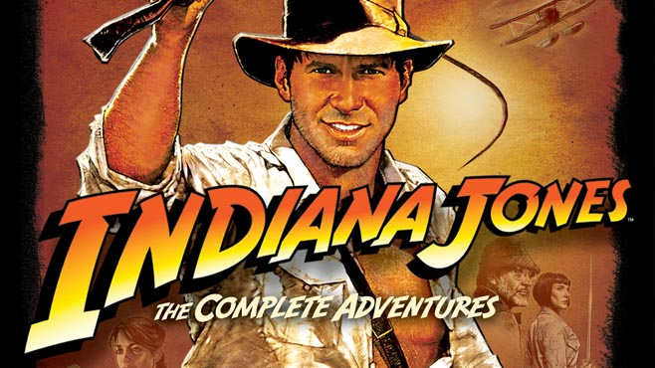
“You Don’t Know the Half of it…”

Slide 4
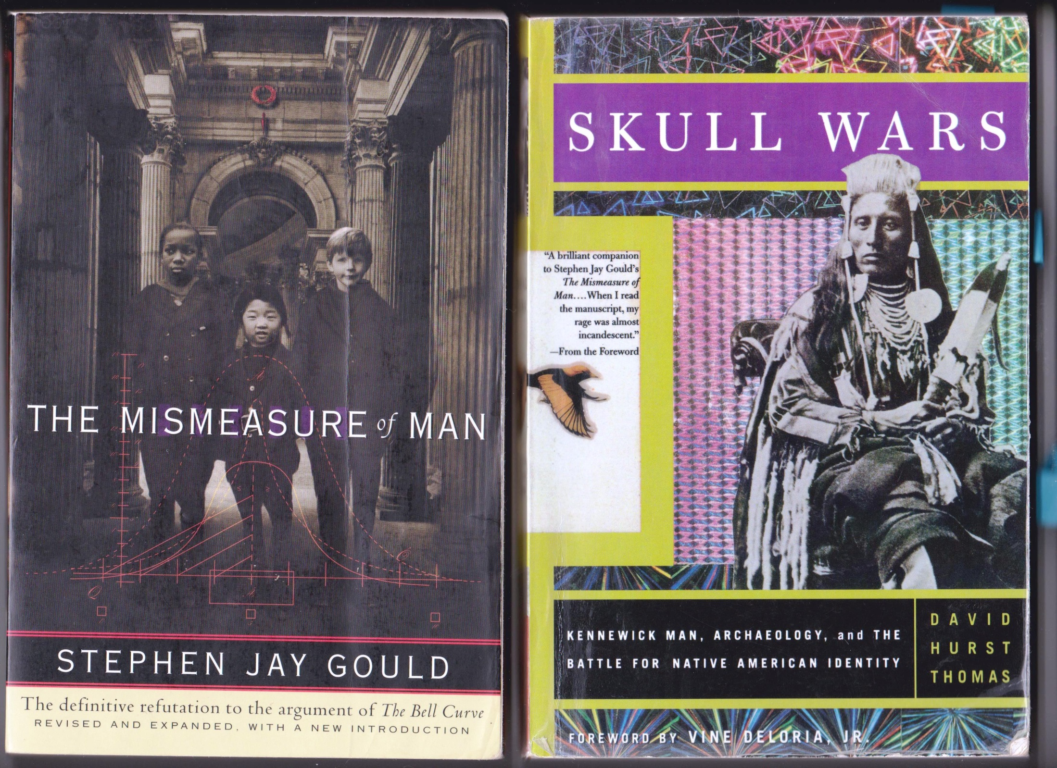
Questions, Discussion & Cell Phone Break

Slide 5
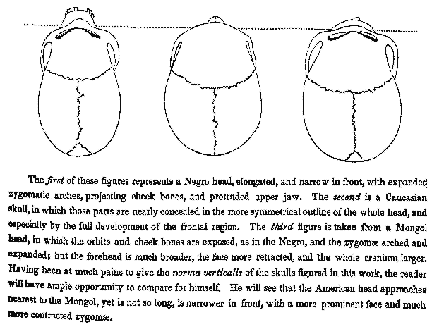
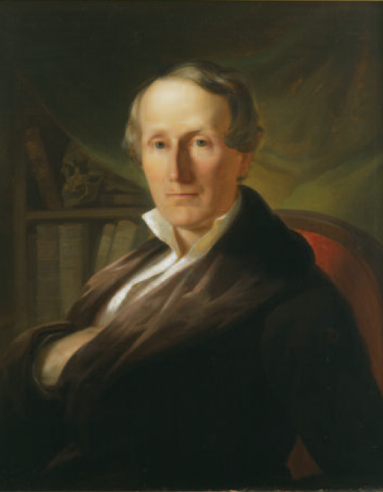
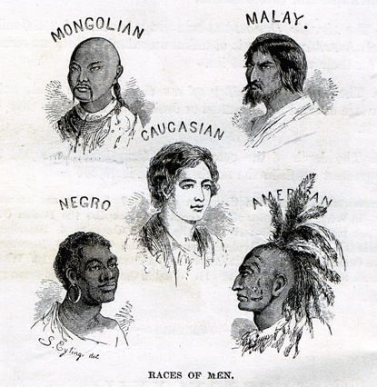
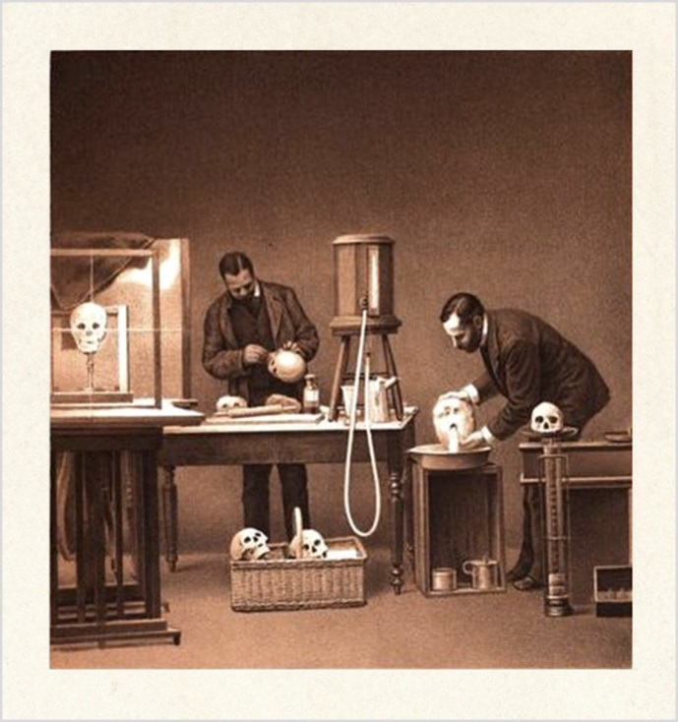
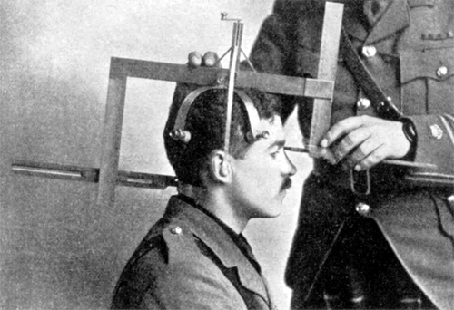

Slide 6
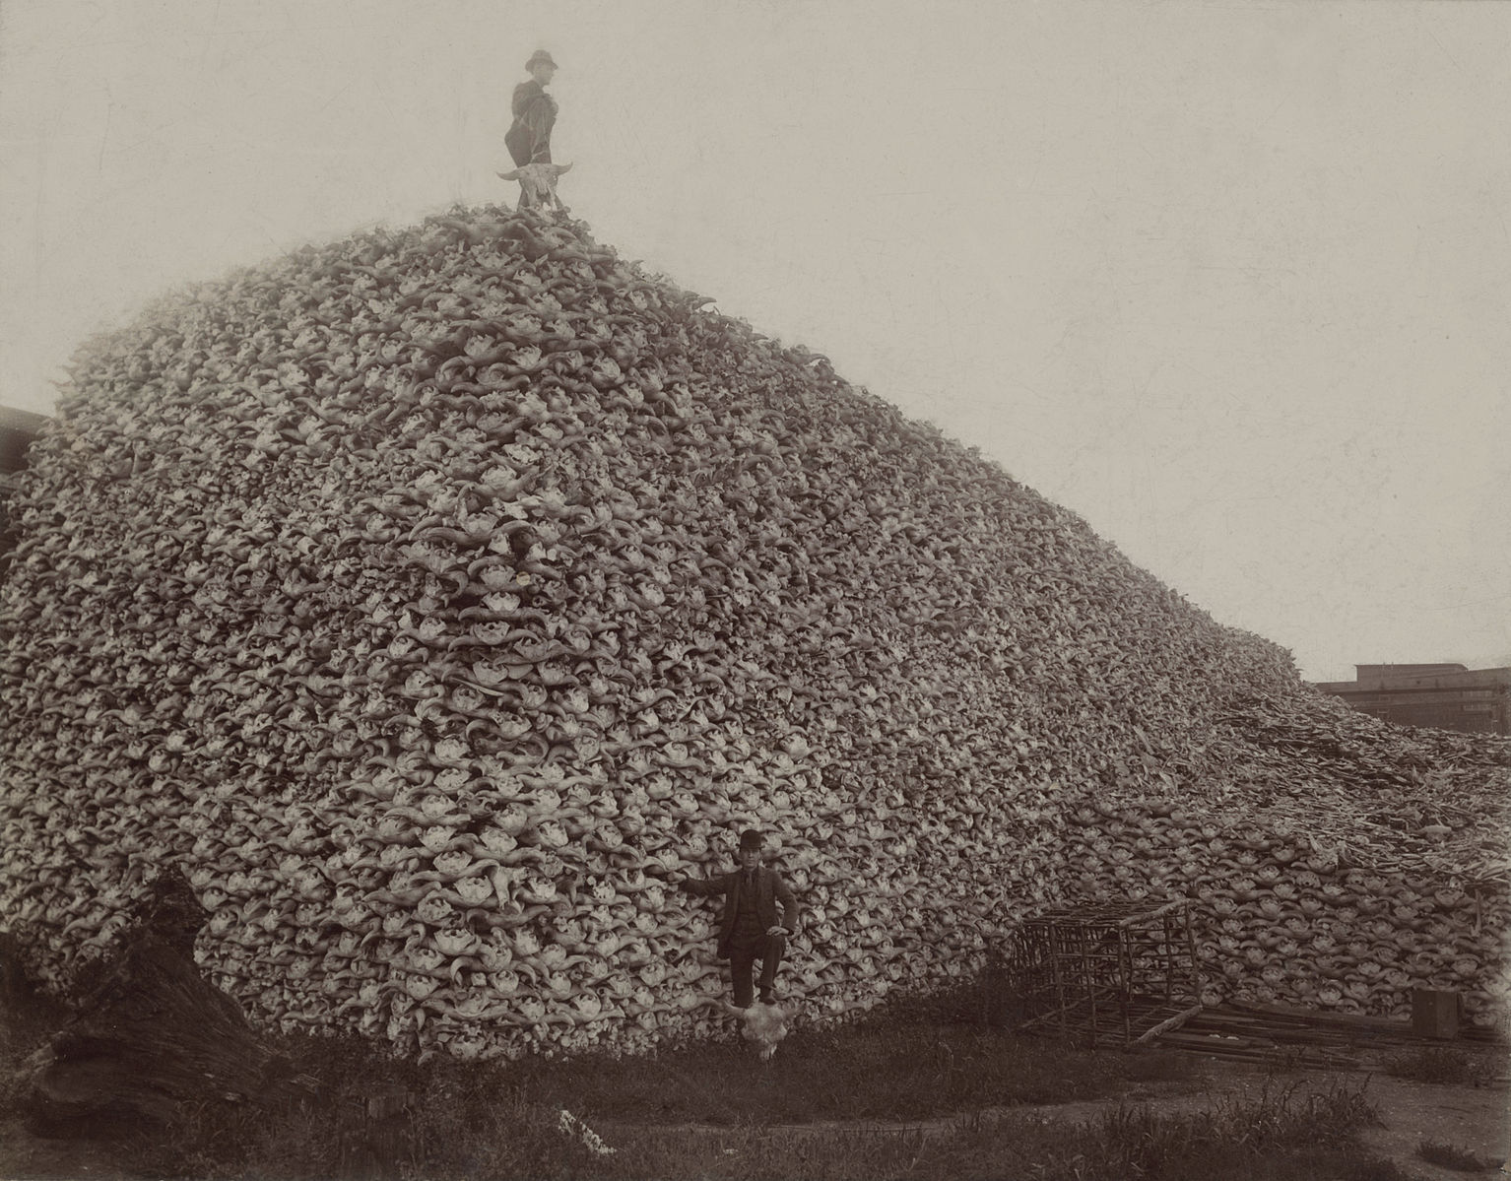
In 1990, when the Native American Graves Protection and Repatriation Act (NAGPRA) was passed, the skeletal remains of nearly 200,000 individual Native Americans were stored in collections of 700 museum and federal agency repositories across the United States.
As of 2000, only 10% of these remains had been repatriated.
As of 2014, the remains of over 50,000 individuals were still awaiting repatriation.
(Mid-1870s photo of a pile of American bison skulls waiting to be ground for fertilizer).

Slide 7



Slide 8
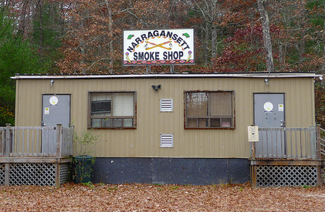
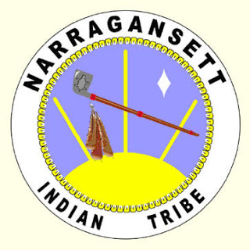
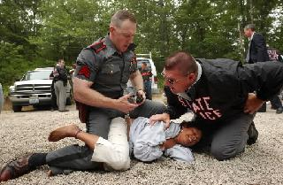
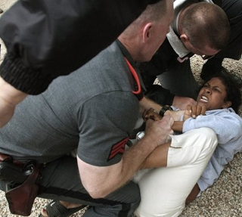
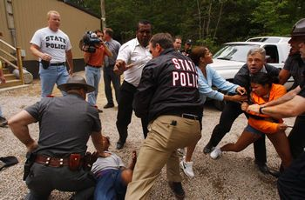
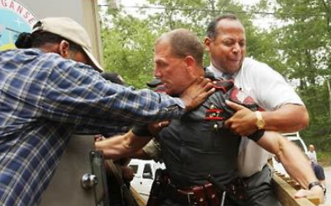
Narragansett Indian Tribe Smoke-Shop Raid
Charlestown, RI
July 14, 2003

Slide 10
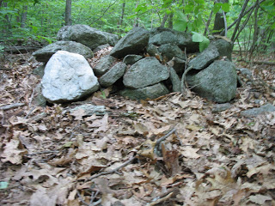
Nipsachuck Hill & Swamp, North Smithfield, RI
Nearly 150 two- to three-foot-high piles over a two-acre area
Site is location of two “battles” of the 17th century King Philip's War, a bloody conflict between New England's colonists and the Wampanoag tribe and its allies, as well as an ancient ceremonial place.
"It's a very, very sensitive area for us."
- Doug Harris, NITHPO

Slide 12
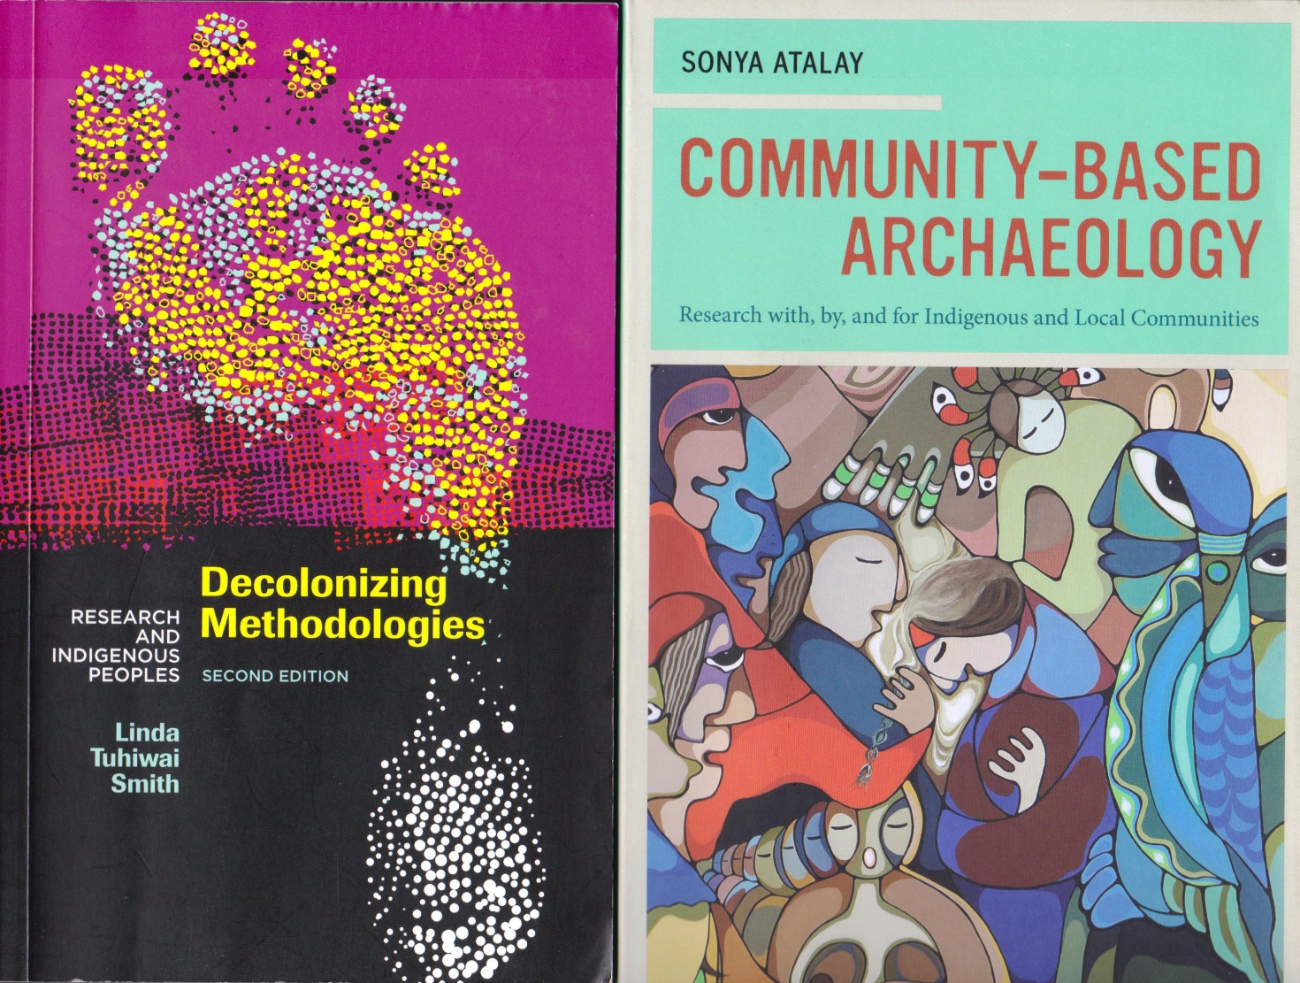
COMMUNITY-BASED ARCHAEOLOGY
(Community-Based Participatory Research – CBPR)

Slide 13
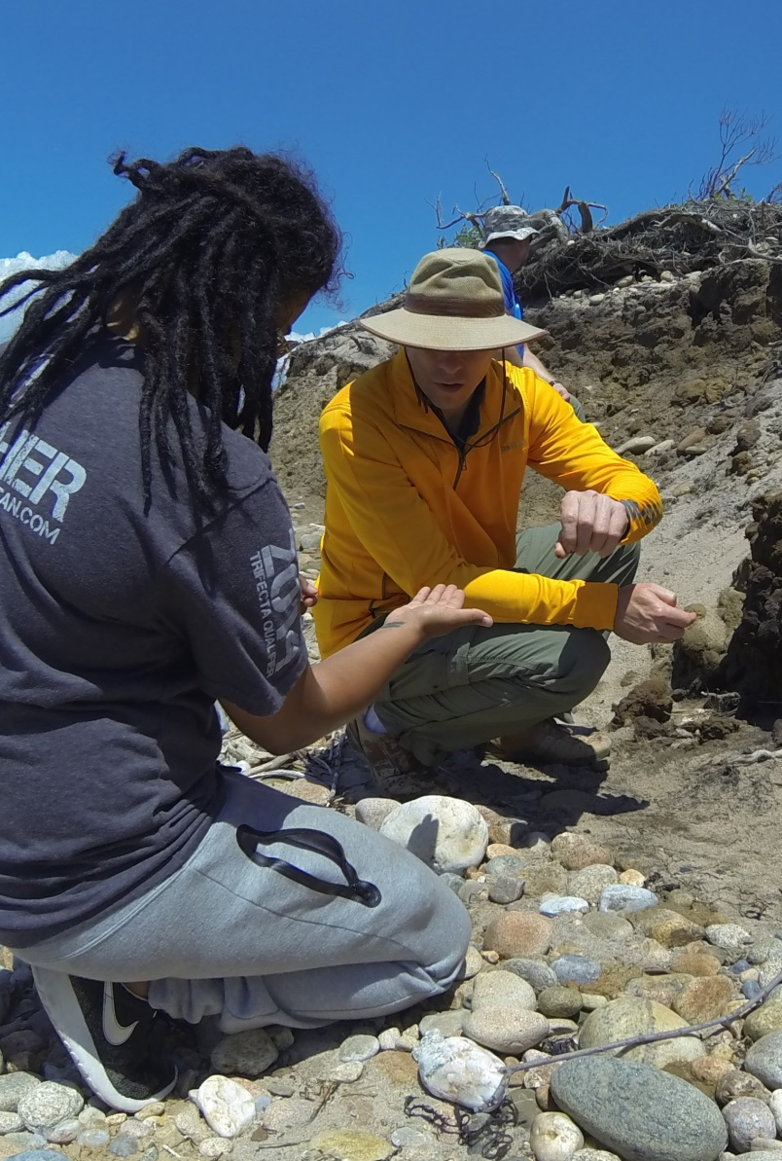
COMMUNITY-BASED ARCHAEOLOGY
(Community-Based Participatory Research – CBPR)
Science and community work together as equal partners & participants in all aspects of project
Ethical, rigorous research conducted in harmony with core Tribal values & with Tribal and science research goals given equal priority
Fosters shared decision-making, frequent communication, open & respectful dialog, and long-term community research capacity
Data interpreted from a “braided knowledge” perspective with community knowledge intertwined with archaeological data to create new, richly-textured interpretations of the past

Slide 14
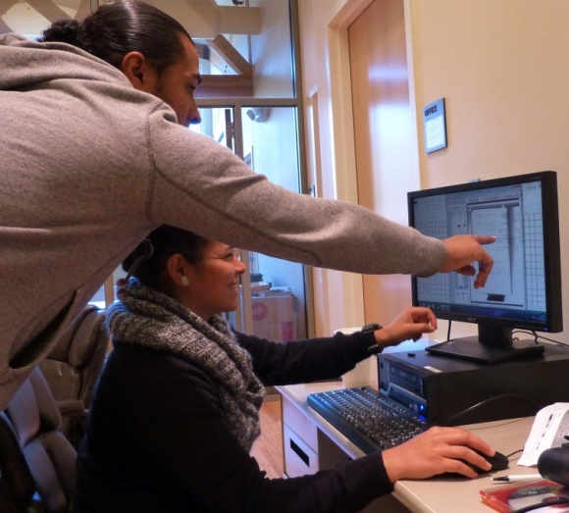
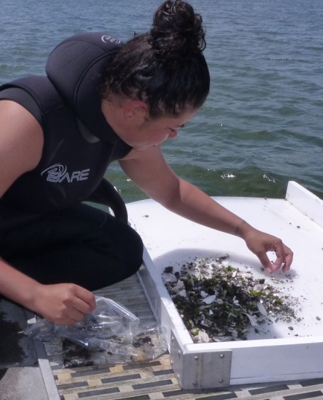
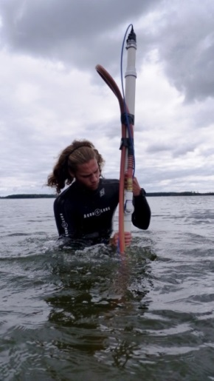
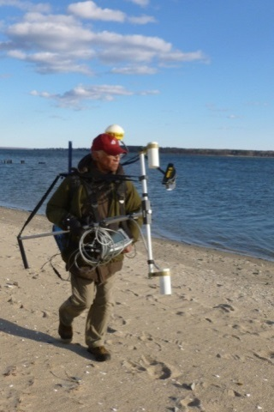
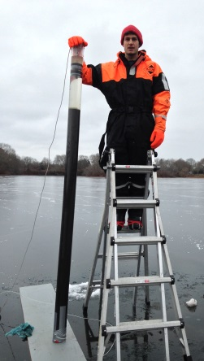
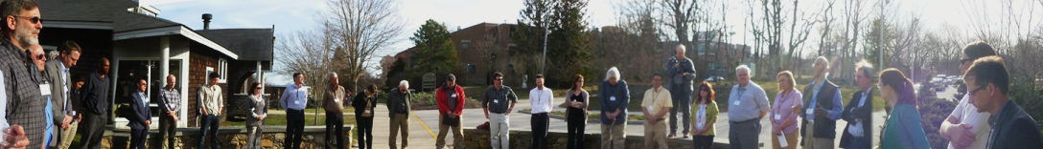
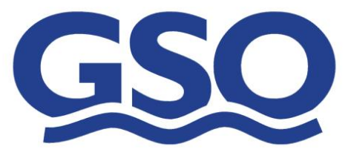
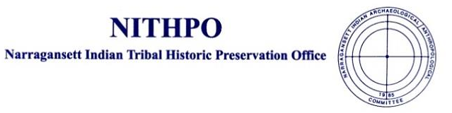
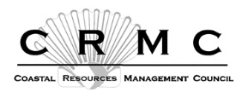
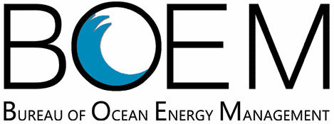
BOEM - URI-GSO - NITHPO
Submerged Paleocultural Landscapes Project
A Collaborative Approach
“May our work succeed, because all of our hearts and spirits request it to be so.”
-Doug Harris (NITHPO)

Slide 15
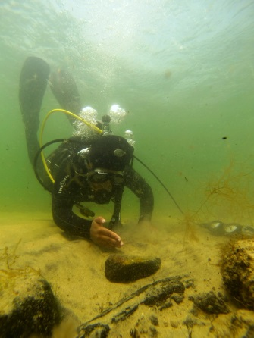
BOEM-URI-NITHPO Submerged Paleo-Cultural Landscapes Project
Create opportunity for respectful dialog & collaboration between agency-science-Tribal research partners
Develop a geospatial predictive model combining science and Tribal oral history to assist in locating submerged Native American sites
Develop “Best Practices” protocols for a collaborative approach to identifying and protecting submerged ancient Native American cultural sites
Foster and enhance capacity for agency-science-Tribal partners to work together more effectively

