Slide 1
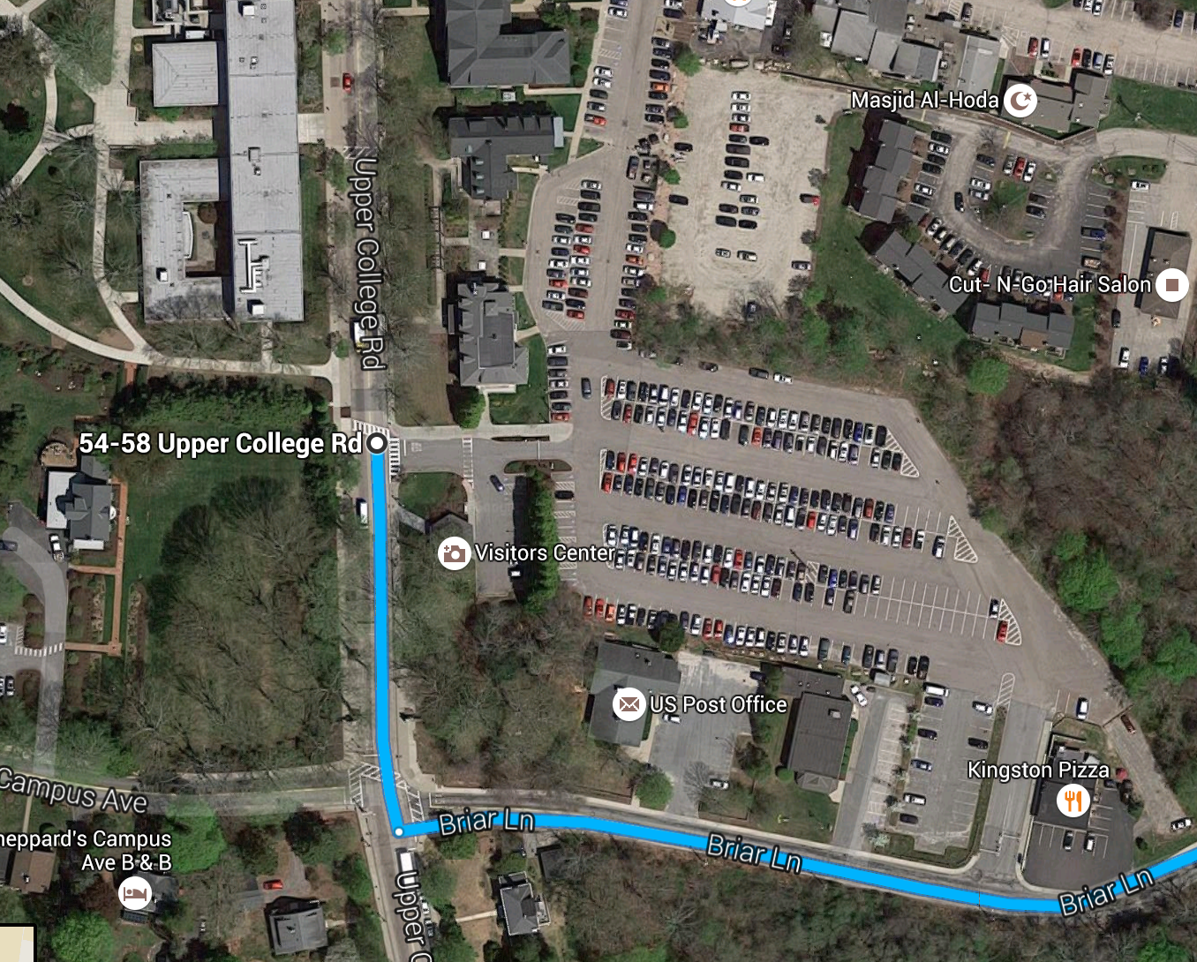
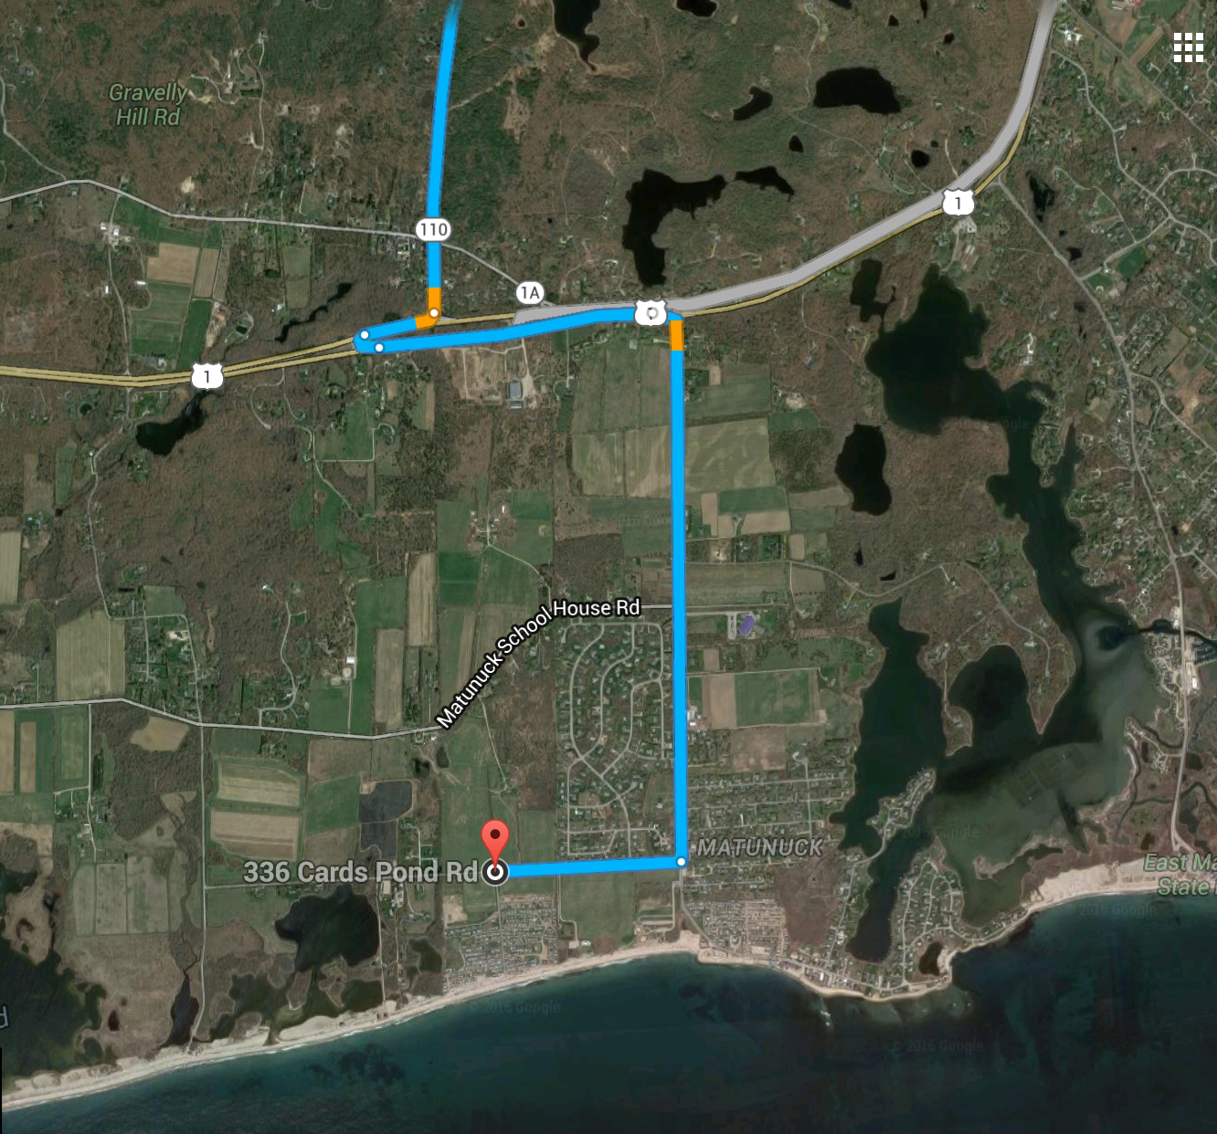
If you need a ride or are driving others:
Meet at URI Visitor’s Center
at 9:45 AM
If you are driving only yourself:
Meet here at 10:15 AM
336 Cards Pond Rd
South Kingstown, RI

