Slide 1
Blake Nose Subseafloor Life
Proposal Number: 929
Overview
  Overview of proposed scientific program
  Status of site survey information
  Proposed drilling program
    number of sites
    types of coring
    logging program
  Description of Key Safety and Environmental Issues
Site-by-Site Review
  Reasons for Selection of Site Location
  Planned Types of Coring, Sampling, and Logging
    depths of penetration including rat-hole for logging
    nature of section to be penetrated (hydrocarbon potential & seals)
    degree of confidence in velocity control and proposed lith. column
    possibility of thermally mature hydrocarbons & effective pathways
    previous drilling results
    likelihood of abnormal pressure or sub-surface flow
    environmental and safety issues specific to leg
      how sites located
      crossing lines
      order of drilling

Slide 2

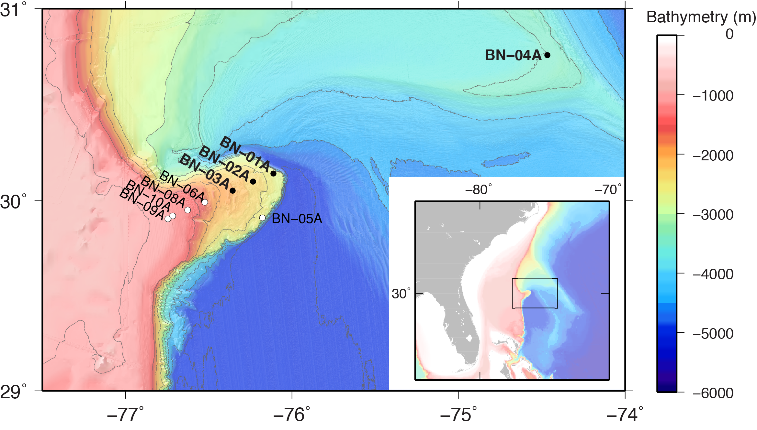
Proposal Number: 929
Blake Nose Drilling:
Effects on Subseafloor Life of a Major Lithologic Unconformity and Past Oceanic Events
Steven D’Hondt - Science Lead
Rob Pockalny - Data Lead
EPSP Meeting – September 4-6, 2019
Texas A&M University

Slide 3
Blake Nose Subseafloor Life
Proposal Number: 929
Co-Proponents:
Steven D'Hondt - University of Rhode Island (USA)
Robert Pockalny - University of Rhode Island (USA)
Valier Galy - Woods Hole Oceanographic Institution (USA)
Leila Hamdan - University of Southern Mississippi (USA)
Andrew Henderson - Newcastle University (UK)
Fumio Inagaki - JAMSTEC (Japan)
R. Mark Leckie - University of Massachusetts, Amherst (USA)
Yuki Morono - JAMSTEC (Japan)
Richard Murray - Woods Hole Oceanographic Institution (USA)
William Orsi - Ludwig-Maximilians-University Munich (Germany)
Richard Pancost - University of Bristol (UK)
Gustavo Ramírez - University of North Carolina, Chapel Hill (USA)
Ana Christina Ravelo - University of California, Santa Cruz (USA)
Tina Treude - University of California, Los Angeles (USA)
Laura Wehrmann - Stony Brook University (USA)
EPSP Meeting – September 4-6, 2019
Texas A&M University

Slide 4
Presentation Outline
Blake Nose Subseafloor Life (Proposal 929)
Overview
  Science Objectives
  Relationship to IODP Science Plan
  Why Blake Nose? (unconformities, previous drilling, sampled ages)
  Drilling Plan
Site-by-Site Review
  Site survey Status (overview)
    seismic survey data
    prior drilling
    velocity data
  Potential Hazards
  methane
  currents
  weather
  Site-by Site
    Form 6’s
EPSP Meeting – September 4-6, 2019
Texas A&M University

Slide 5
Science Objectives
Blake Nose Subseafloor Life (Proposal 929)
1. Determine the extent to which subseafloor microbes vertically migrate through sediment
2. Discover how chemical diffusion across a major unconformity affects microbial communities in ancient sediment
3. Test the influence of major ocean historical events on present-day subseafloor communities
- PETM
- K/Pg impact
- OAE 2
- OAE 1d
- OAE 1b
4. Comparison of deep water site (BN-04A) to Blake Nose sites
Hypothesis 1. Microorganisms do not migrate across the unconformity, but remain
where they were buried.
Hypothesis 2. The lithologic unconformity is a biological unconformity.
Hypothesis 3. Past major changes in deep-sea oxygen content and organic flux to the
seafloor continue to influence present-day sub-seafloor communities.
EPSP Meeting – September 4-6, 2019
Texas A&M University

Slide 6
Relationship to IODP Science Plan
Blake Nose Subseafloor Life (Proposal 929)
Directly addresses all 3 Deep Life Challenges of the IODP Science Plan 2013-2023:
  1. What are the origin, composition, and global significance of subseafloor communities?
  2. What are the limits of life in the subseafloor?
extent to which composition of subseafloor communities is set at the time of sediment deposition
extent to which community composition is altered over time by microbial migration through the sediment.
  3. How sensitive are ecosystems and biodiversity to environmental change?
documenting the influence, if any, of past major oceanic events on present communities in sediment deposited before, during, or after those events.
EPSP Meeting – September 4-6, 2019
Texas A&M University

Slide 7
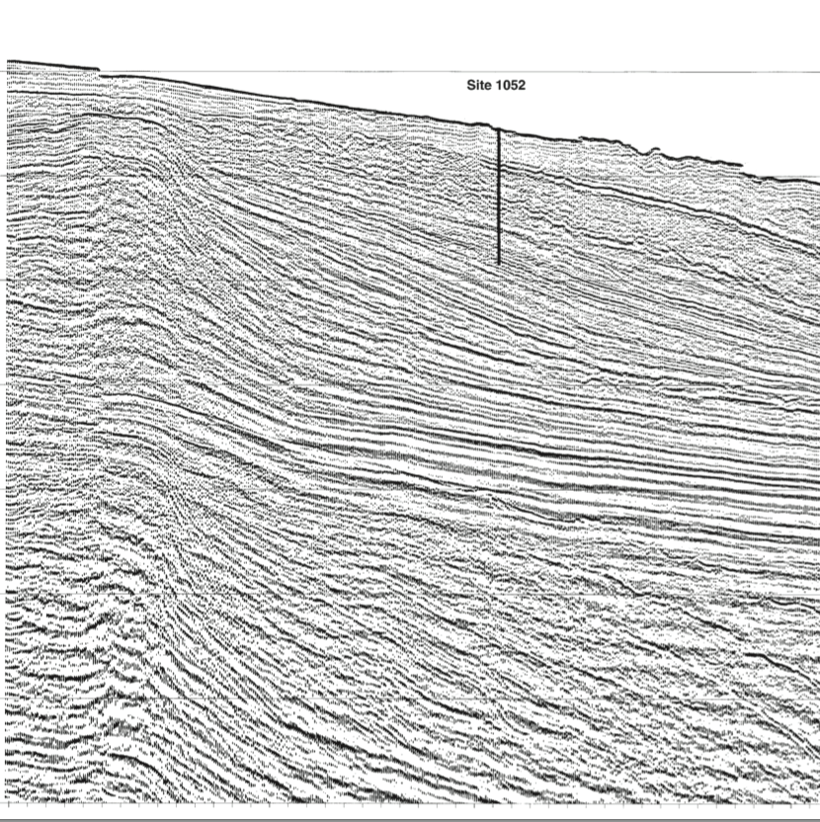
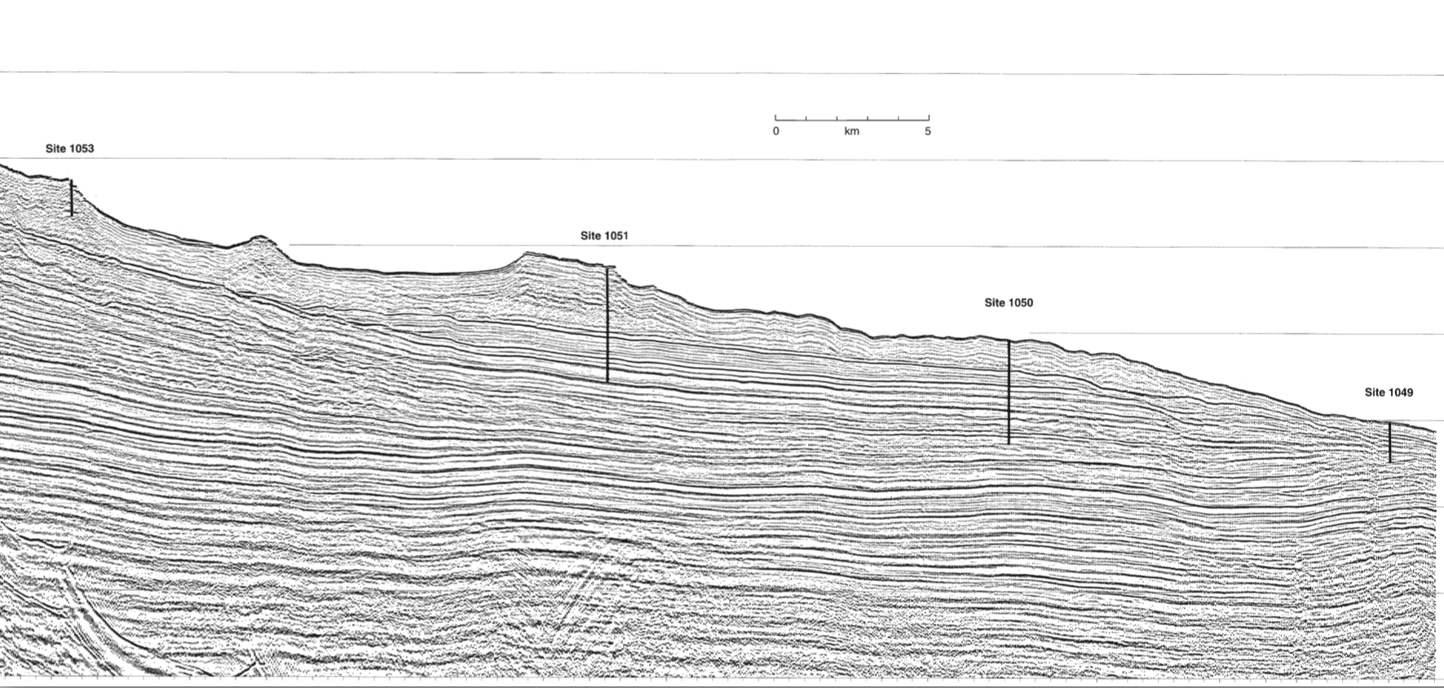
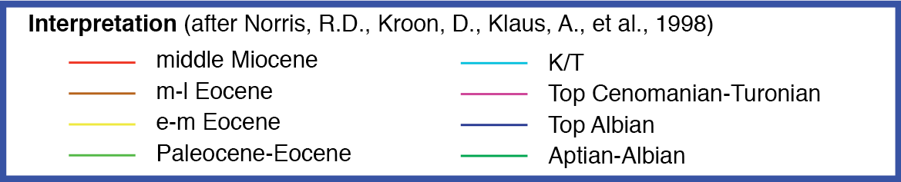
Why Blake Nose?
Blake Nose Subseafloor Life (Proposal 929)
Documented unconformities and ages from prior DSDP and IODP drilling results
BN-09A
ODP 1052
BN-08A
BN-10A
ODP 1053
BN-06A
ODP 1051
BN-03A
ODP 1050
BN-02A
ODP 1049
BN-01A
EPSP Meeting – September 4-6, 2019
Texas A&M University

Slide 8
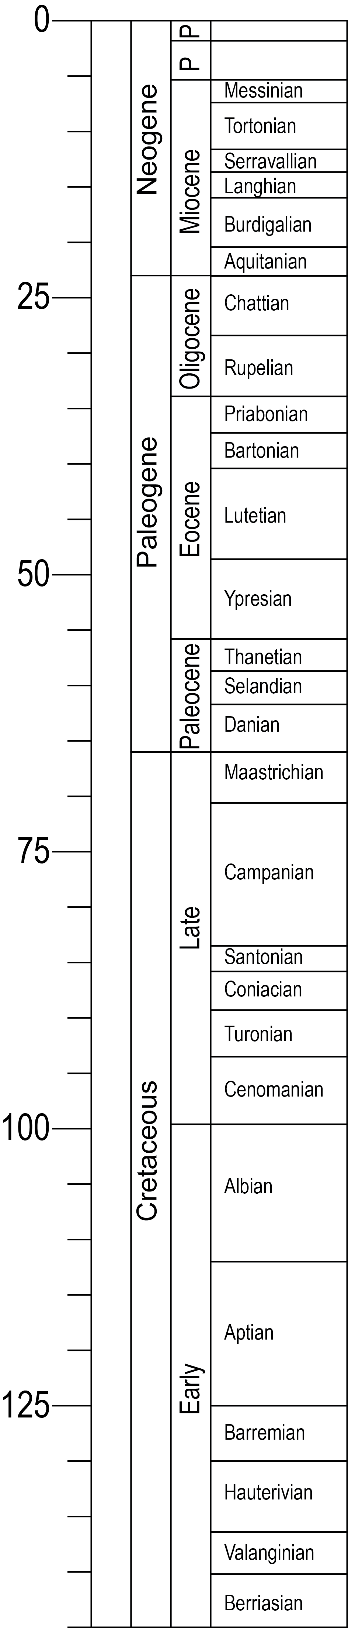
Why Blake Nose?
Blake Nose Subseafloor Life (Proposal 929)
Documented unconformities and ages from prior DSDP and IODP drilling results
Alternate Sites
Primary Sites
BN-09A
BN-10A
BN-06A (ODP 1053)
BN-03A (ODP 1051)
BN-08A (ODP 1052)
BN-01A (ODP 1049)
BN-05A (DSDP 392)
BN-02A (ODP 1050)
BN-04A (ODP 1060)
PETM
K/Pg
OAE 2
OAE 1d
OAE 1b
EPSP Meeting – September 4-6, 2019
Texas A&M University

Slide 9
Proposed Drilling/Logging Plan
Blake Nose Subseafloor Life (Proposal 929)
 | Site | Penetration (m) | ªMudline | ^{b}APC | ^{c}RCB | ^{d}XCB | Logging
Primary | BN-01A | 210 | multiple | 3 | 3 | X | WL Porosity Density Gamma Ray Resistivity Sonic Formation Image VSP Formation Temp. & Pressure Borehole Temp.
 | BN-02A | 610 | multiple | 3 | 2 3
 | BN-03A | 650 | multiple | 3 3 | 2 3 | X
 | BN-04A | 175 | multiple | 3
Alternate | BN-05A | 350 | multiple | 3 | 3
 | BN-06A | 200 | multiple | 3 | 3
 | BN-08A | 700 | multiple | 3 | 3 | X
 | BN-09A | 330 | multiple | 3 | 3 | X
 | BN-10A | 330 | multiple | 3 | 3 | X
ª to target unconformity
^{b} to refusal (half-length)
^{c} if needed to reach target depth
^{d} if needed to drill through chert or porcellanite
EPSP Meeting – September 4-6, 2019
Texas A&M University

Slide 11
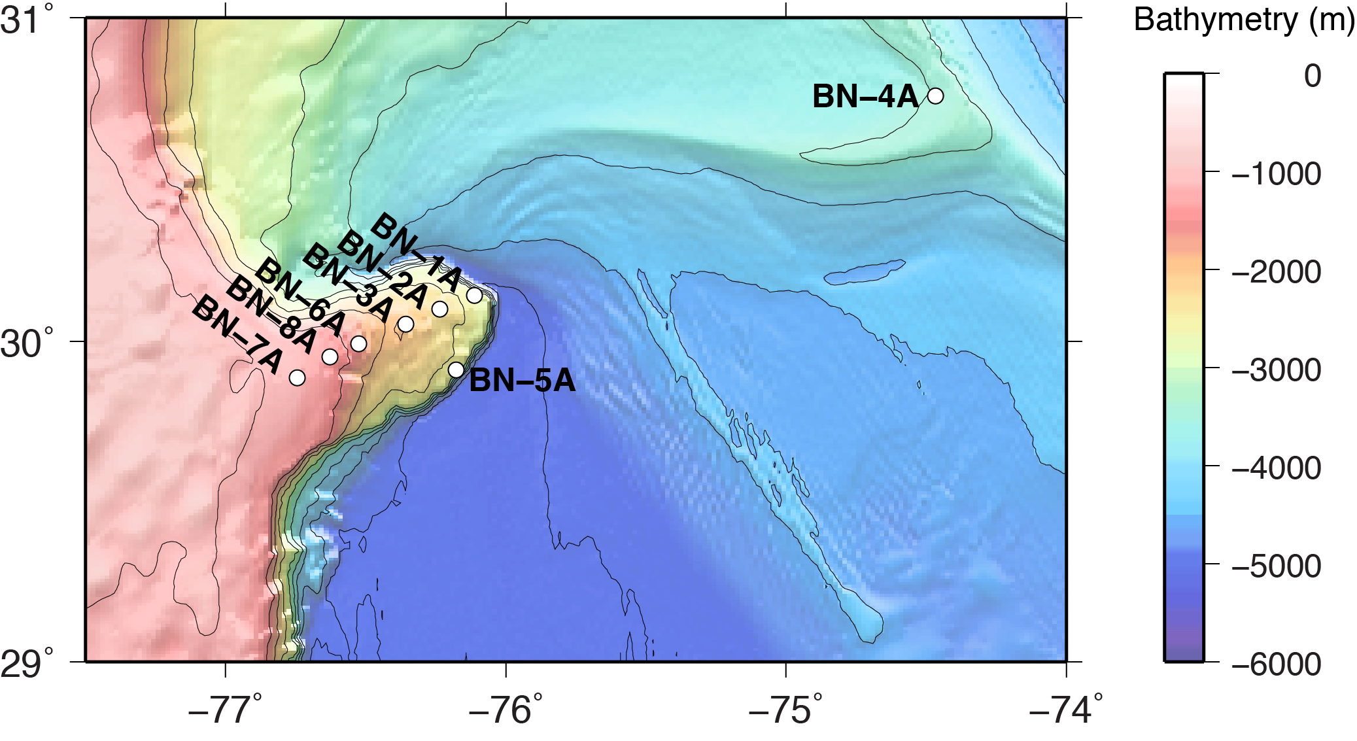
Blake Nose Subseafloor Life
Proposal Number: 929
Overview
  Overview of proposed scientific program
    sites (Primary/Alternate)
    objectives
1. Determine the extent to which subseafloor microbes vertically migrate through sediment
2. Discover how chemical diffusion across a major unconformity affects microbial communities in ancient sediment
3. Test the influence of major ocean historical events on present-day subseafloor communities
- K/Pg impact, OAE 1b (BN-01A)
- OAE 2 and OAE 1d (BN-02A)
- PETM (BN-03A)
- OAE 1d (BN-08A)
4. Comparison of deep water site (BN-04A) to Blake Nose sites
EPSP Meeting – September 4-6, 2019
Texas A&M University
Notes:
Overview
Overview of proposed scientific program
sites (Primary/Alternate)
objectives
K/Pg (K/T) 66 Ma
OAE 1b Oceanic Anoxic Event (early Albian) ~111 Ma
OAE 1d Oceanic Anoxic Event (late Albian) ~102 Ma
OAE 2 Oceanic Anoxic Event (late Cenomanian) ~94 Ma
PETM Paleocene-Eocene Thermal Maximum

Slide 12
BN-04A (ODP 1060)
Blake Nose Subseafloor Life
Proposal Number: 929
BN-09A
BN-10A
BN-03A (ODP 1051)
BN-06A (ODP 1053)
BN-08A (ODP 1052)
BN-01A (ODP 1049)
BN-05A (DSDP 392)
BN-02A (ODP 1050)
PETM
K/Pg
OAE 2
OAE 1d
OAE 1b
EPSP Meeting – September 4-6, 2019
Texas A&M University
Notes:
Overview
Overview of proposed scientific program
sites (Primary/Alternate)
objectives
K/Pg (K/T) 66 Ma
OAE 1b Oceanic Anoxic Event (early Albian) ~111 Ma
OAE 1d Oceanic Anoxic Event (late Albian) ~102 Ma
OAE 2 Oceanic Anoxic Event (late Cenomanian) ~94 Ma
PETM Paleocene-Eocene Thermal Maximum

Slide 13
Blake Nose Subseafloor Life
Proposal Number: 929
Overview
  Status of site survey information
Classification from SEP1906 Review
Definition of “2” Classification
Data reviewed by SEP are sufficient to support the scientific objectives of the drilling effort, but minor concerns require follow-up by proponents.
Site | Type | Classification
BN-01A | Primary | 2
BN-02A | Primary | 2
BN-03A | Primary | 2
BN-04A | Primary | 2
BN-05A | Alternate | 2
BN-06A | Alternate | 2
BN-07A | Alternate | 3
BN-08A | Alternate | 2
BN-09A | Alternate | 2
BN-10A | Alternate | 2
Remedied Comments from SEP1906 Review
Navigation data is currently in files that relate to several lines from the same survey, or several segments of the same line.
  - data parsed into separate navigation files
File labeled “BP-138G_stk.segy” contains SEG-Y data for line BP-138F_stk.segy, an d vice versa.
  - seismic data checked and renamed
  - site forms relabeled accordingly
EPSP Meeting – September 4-6, 2019
Texas A&M University

Slide 14
Blake Nose Subseafloor Life
Proposal Number: 929
Overview
  Key Safety and Environmental Issues
 | Site | Methane (PPM) | Weather
Primary | BN-01A | <50 | Hurricane Season (May through November)
 | BN-02A | <1000
 | BN-03A | <250
 | BN-04A | up to 57,000 gas voids in cores > 60 MBSF
Alternate | BN-05A | No gas detected
 | BN-06A | <20
 | BN-08A | <20
 | BN-09A | No measurements Nearby sites <20
 | BN-10A | No measurements Nearby sites <20
EPSP Meeting – September 4-6, 2019
Texas A&M University

Slide 15
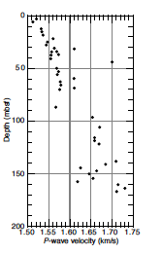
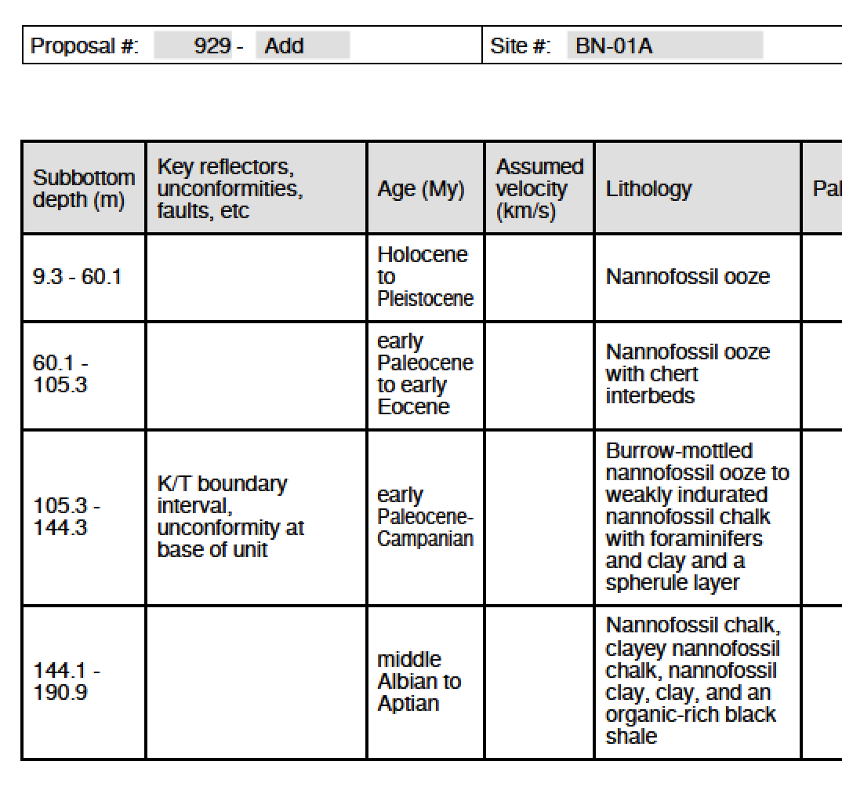
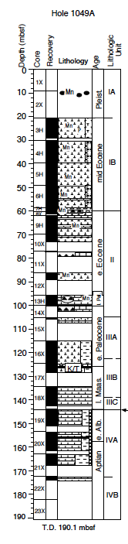
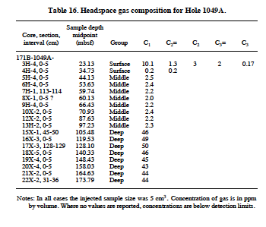
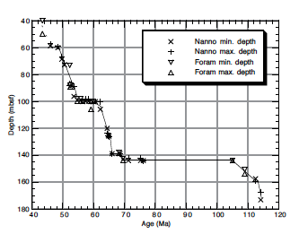
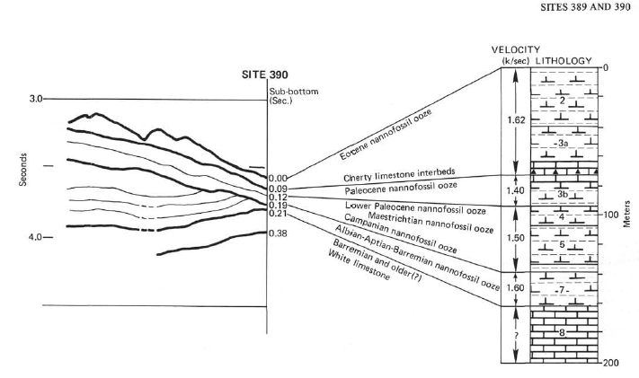
Blake Nose Subseafloor Life
Proposal Number: 929
ODP 1049 (191 total)
DSDP390 (225 total)
BN-01A
Site-by-Site Review
  Reasons for Selection of Site Location
  Planned Types of Coring, Sampling, and Logging
    depths of penetration including rat-hole for logging
    nature of section to be penetrated (hydrocarbon potential & seals)
    degree of confidence in velocity control and proposed lith. column
    possibility of thermally mature hydrocarbons & effective pathways
    previous drilling results
    likelihood of abnormal pressure or sub-surface flow
    environmental and safety issues specific to leg
      how sites located
      crossing lines
      order of drilling
EPSP Meeting – September 4-6, 2019
Texas A&M University

Slide 16
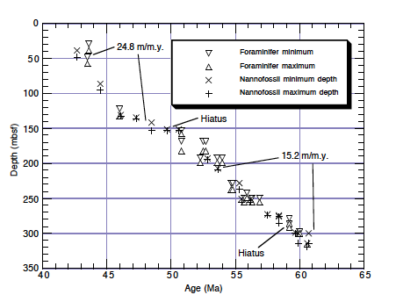
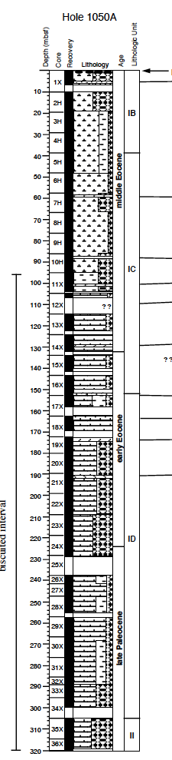
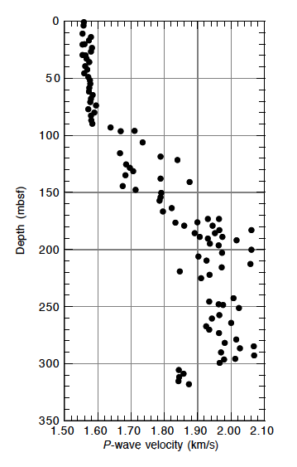
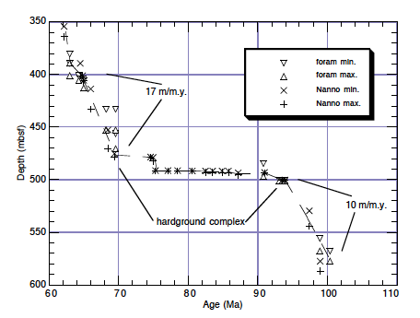
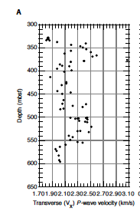
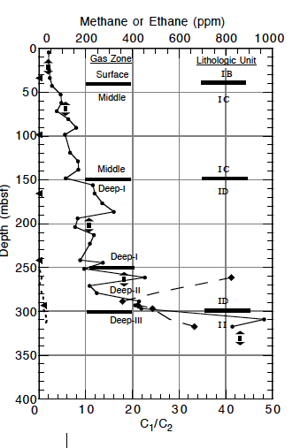
Blake Nose Subseafloor Life
Proposal Number: 929
ODP1050 (606 mbsf total)
BN-02A
Site-by-Site Review
  Reasons for Selection of Site Location
  Planned Types of Coring, Sampling, and Logging
    depths of penetration including rat-hole for logging
    nature of section to be penetrated (hydrocarbon potential & seals)
    degree of confidence in velocity control and proposed lith. column
    possibility of thermally mature hydrocarbons & effective pathways
    previous drilling results
    likelihood of abnormal pressure or sub-surface flow
    environmental and safety issues specific to leg
      how sites located
      crossing lines
      order of drilling
EPSP Meeting – September 4-6, 2019
Texas A&M University

Slide 17
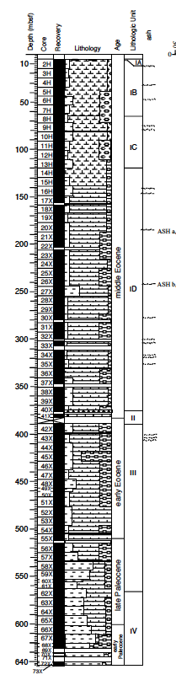
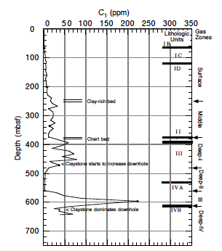
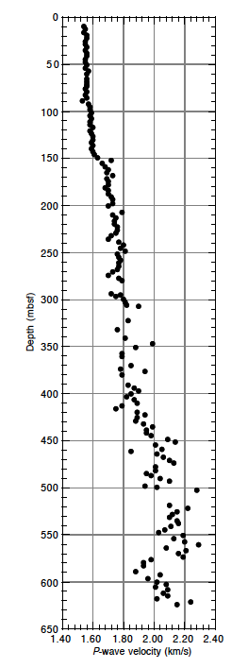
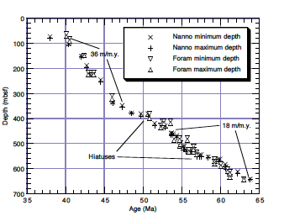
Blake Nose Subseafloor Life
Proposal Number: 929
ODP1051 (644 total)
BN-03A
Site-by-Site Review
  Reasons for Selection of Site Location
  Planned Types of Coring, Sampling, and Logging
    depths of penetration including rat-hole for logging
    nature of section to be penetrated (hydrocarbon potential & seals)
    degree of confidence in velocity control and proposed lith. column
    possibility of thermally mature hydrocarbons & effective pathways
    previous drilling results
    likelihood of abnormal pressure or sub-surface flow
    environmental and safety issues specific to leg
      how sites located
      crossing lines
      order of drilling
EPSP Meeting – September 4-6, 2019
Texas A&M University

Slide 18
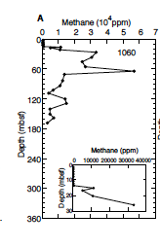
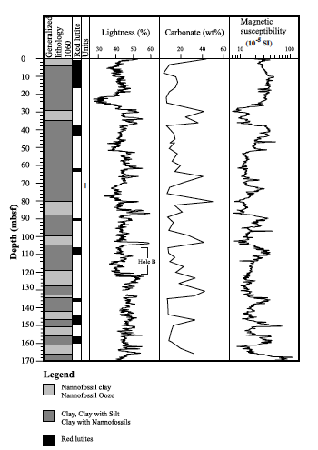
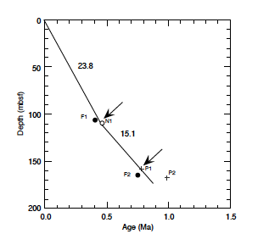
Blake Nose Subseafloor Life
Proposal Number: 929
ODP1060 (177 total)
BN-04A
Site-by-Site Review
  Reasons for Selection of Site Location
  Planned Types of Coring, Sampling, and Logging
    depths of penetration including rat-hole for logging
    nature of section to be penetrated (hydrocarbon potential & seals)
    degree of confidence in velocity control and proposed lith. column
    possibility of thermally mature hydrocarbons & effective pathways
    previous drilling results
    likelihood of abnormal pressure or sub-surface flow
    environmental and safety issues specific to leg
      how sites located
      crossing lines
      order of drilling
EPSP Meeting – September 4-6, 2019
Texas A&M University

Slide 19
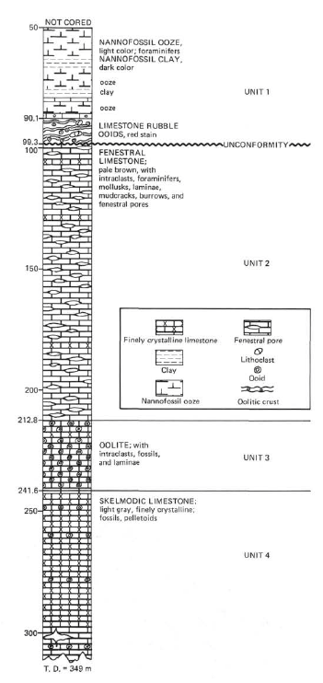
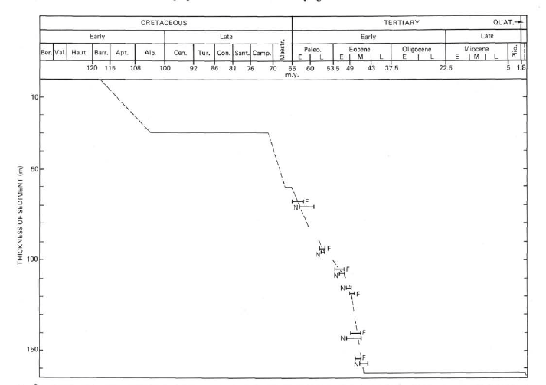
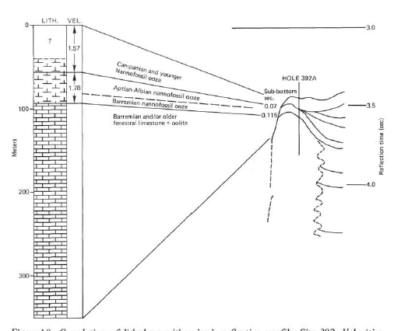
Blake Nose Subseafloor Life
Proposal Number: 929
BN-05A
DSDP392 (349 total)
Site-by-Site Review
  Reasons for Selection of Site Location
  Planned Types of Coring, Sampling, and Logging
    depths of penetration including rat-hole for logging
    nature of section to be penetrated (hydrocarbon potential & seals)
    degree of confidence in velocity control and proposed lith. column
    possibility of thermally mature hydrocarbons & effective pathways
    previous drilling results
    likelihood of abnormal pressure or sub-surface flow
    environmental and safety issues specific to leg
      how sites located
      crossing lines
      order of drilling
EPSP Meeting – September 4-6, 2019
Texas A&M University

Slide 20
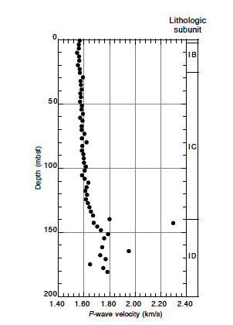
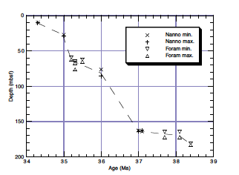
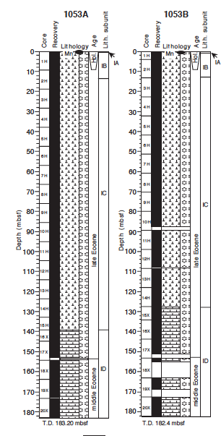
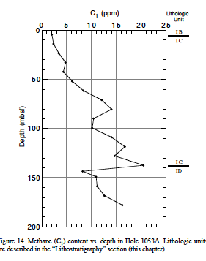
Blake Nose Subseafloor Life
Proposal Number: 929
BN-06A
ODP 1053 (183 total)
Site-by-Site Review
  Reasons for Selection of Site Location
  Planned Types of Coring, Sampling, and Logging
    depths of penetration including rat-hole for logging
    nature of section to be penetrated (hydrocarbon potential & seals)
    degree of confidence in velocity control and proposed lith. column
    possibility of thermally mature hydrocarbons & effective pathways
    previous drilling results
    likelihood of abnormal pressure or sub-surface flow
    environmental and safety issues specific to leg
      how sites located
      crossing lines
      order of drilling
EPSP Meeting – September 4-6, 2019
Texas A&M University

Slide 21
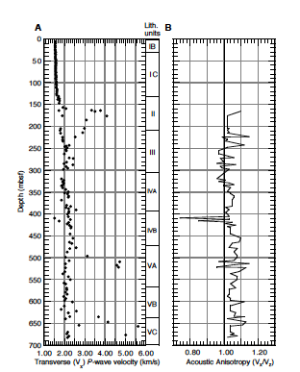
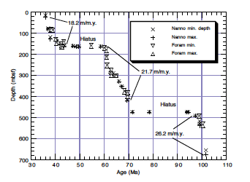
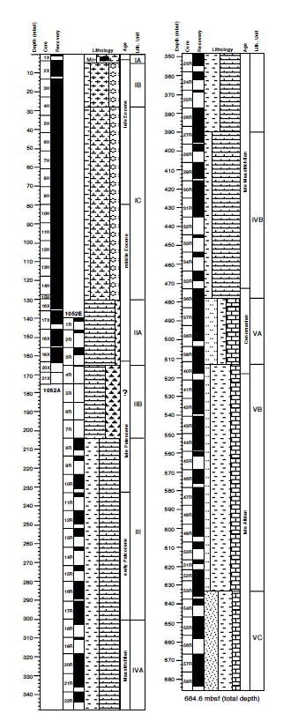
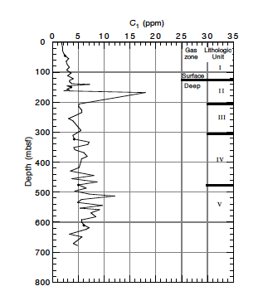
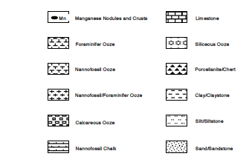
Blake Nose Subseafloor Life
Proposal Number: 929
ODP 1052 (684 total)
BN-08A
Site-by-Site Review
  Reasons for Selection of Site Location
  Planned Types of Coring, Sampling, and Logging
    depths of penetration including rat-hole for logging
    nature of section to be penetrated (hydrocarbon potential & seals)
    degree of confidence in velocity control and proposed lith. column
    possibility of thermally mature hydrocarbons & effective pathways
    previous drilling results
    likelihood of abnormal pressure or sub-surface flow
    environmental and safety issues specific to leg
      how sites located
      crossing lines
      order of drilling
EPSP Meeting – September 4-6, 2019
Texas A&M University

Slide 22
Blake Nose Subseafloor Life
Proposal Number: 929
BN-09A
Site-by-Site Review
  Reasons for Selection of Site Location
  Planned Types of Coring, Sampling, and Logging
    depths of penetration including rat-hole for logging
    nature of section to be penetrated (hydrocarbon potential & seals)
    degree of confidence in velocity control and proposed lith. column
    possibility of thermally mature hydrocarbons & effective pathways
    previous drilling results
    likelihood of abnormal pressure or sub-surface flow
    environmental and safety issues specific to leg
      how sites located
      crossing lines
      order of drilling
EPSP Meeting – September 4-6, 2019
Texas A&M University

Slide 23
Blake Nose Subseafloor Life
Proposal Number: 929
BN-10A
Site-by-Site Review
  Reasons for Selection of Site Location
  Planned Types of Coring, Sampling, and Logging
    depths of penetration including rat-hole for logging
    nature of section to be penetrated (hydrocarbon potential & seals)
    degree of confidence in velocity control and proposed lith. column
    possibility of thermally mature hydrocarbons & effective pathways
    previous drilling results
    likelihood of abnormal pressure or sub-surface flow
    environmental and safety issues specific to leg
      how sites located
      crossing lines
      order of drilling
EPSP Meeting – September 4-6, 2019
Texas A&M University

