Slide 1

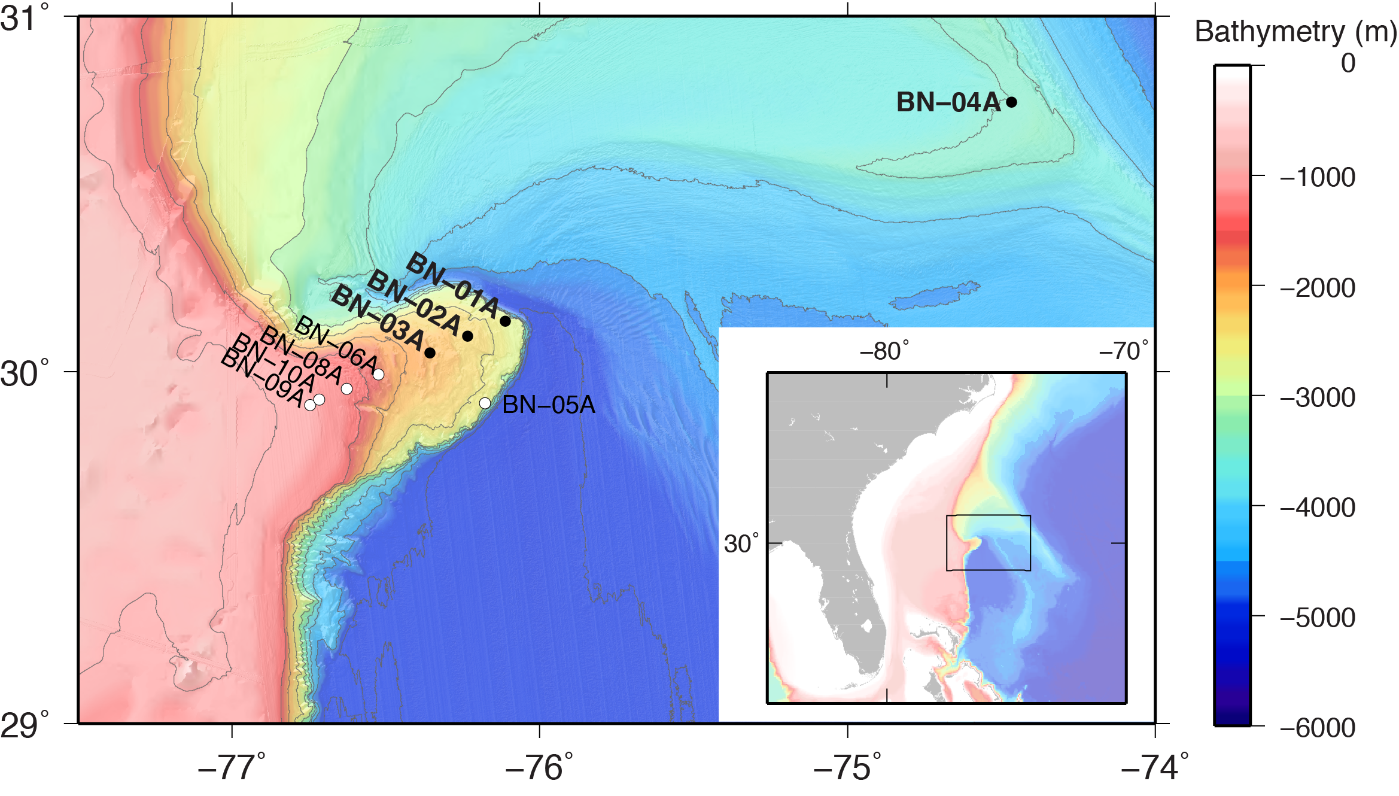
Proposal Number: 929
Blake Nose Drilling:
Effects on Subseafloor Life of a Major Lithologic Unconformity and Past Oceanic Events
Steven D’Hondt - Science Lead
Rob Pockalny - Data Lead
EPSP Meeting – September 4-6, 2019
Texas A&M University

Slide 2
Blake Nose Subseafloor Life
Proposal Number: 929
Co-Proponents:
Steven D'Hondt - University of Rhode Island (USA)
Robert Pockalny - University of Rhode Island (USA)
Valier Galy - Woods Hole Oceanographic Institution (USA)
Leila Hamdan - University of Southern Mississippi (USA)
Andrew Henderson - Newcastle University (UK)
Fumio Inagaki - JAMSTEC (Japan)
R. Mark Leckie - University of Massachusetts, Amherst (USA)
Yuki Morono - JAMSTEC (Japan)
Richard Murray - Woods Hole Oceanographic Institution (USA)
William Orsi - Ludwig-Maximilians-University Munich (Germany)
Richard Pancost - University of Bristol (UK)
Gustavo Ramírez - University of North Carolina, Chapel Hill (USA)
Ana Christina Ravelo - University of California, Santa Cruz (USA)
Tina Treude - University of California, Los Angeles (USA)
Laura Wehrmann - Stony Brook University (USA)
EPSP Meeting – September 4-6, 2019
Texas A&M University

Slide 3
Presentation Outline
Blake Nose Subseafloor Life (Proposal 929)
Overview
  Science Objectives
  Relationship to IODP Science Plan
  Why Blake Nose? (unconformities, previous drilling, sampled ages)
  Drilling Plan
Site-by-Site Review
  Site survey Status (overview)
    seismic survey data
    prior drilling
    velocity data
  Potential Hazards
  methane
  currents
  weather
  Site-by Site
    Form 6’s
EPSP Meeting – September 4-6, 2019
Texas A&M University

Slide 4
Science Objectives
Blake Nose Subseafloor Life (Proposal 929)
1. Determine the extent to which subseafloor microbes vertically migrate through sediment
2. Discover how chemical diffusion across a major unconformity affects microbial communities in ancient sediment
3. Test the influence of major ocean historical events on present-day subseafloor communities
- PETM
- K/Pg impact
- OAE 2
- OAE 1d
- OAE 1b
4. A control for comparison of deep water site (BN-04A) to Blake Nose sites
Hypothesis 1. Microorganisms do not migrate across the unconformity, but remain
where they were buried.
Hypothesis 2. The lithologic unconformity is a biological unconformity.
Hypothesis 3. Past major changes in deep-sea oxygen content and organic flux to the
seafloor continue to influence present-day sub-seafloor communities.
EPSP Meeting – September 4-6, 2019
Texas A&M University

Slide 5
Relationship to IODP Science Plan
Blake Nose Subseafloor Life (Proposal 929)
Directly addresses all 3 Deep Life Challenges of the IODP Science Plan 2013-2023:
  1. What are the origin, composition, and global significance of subseafloor communities?
  2. What are the limits of life in the subseafloor?
extent to which composition of subseafloor communities is set at the time of sediment deposition
extent to which community composition is altered over time by microbial migration through the sediment.
  3. How sensitive are ecosystems and biodiversity to environmental change?
documenting the influence, if any, of past major oceanic events on present communities in sediment deposited before, during, or after those events.
EPSP Meeting – September 4-6, 2019
Texas A&M University

Slide 6
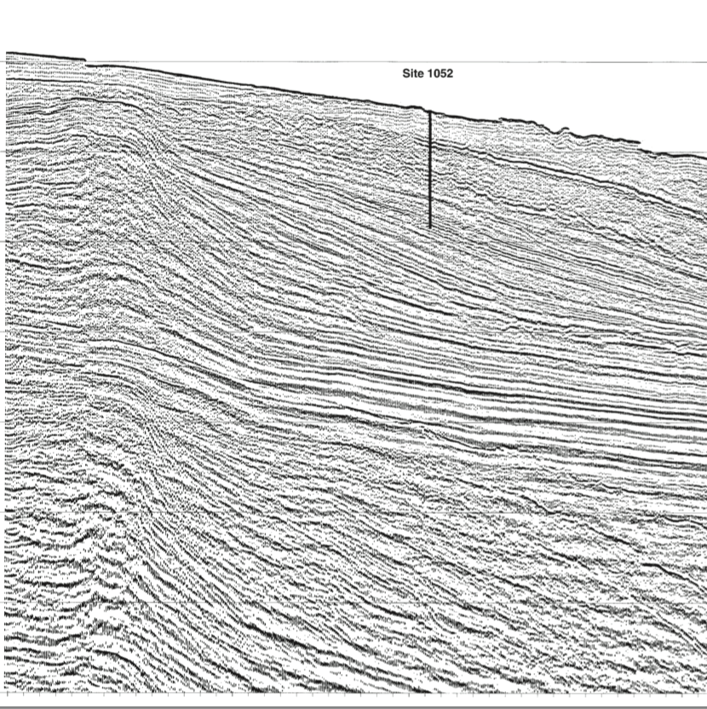
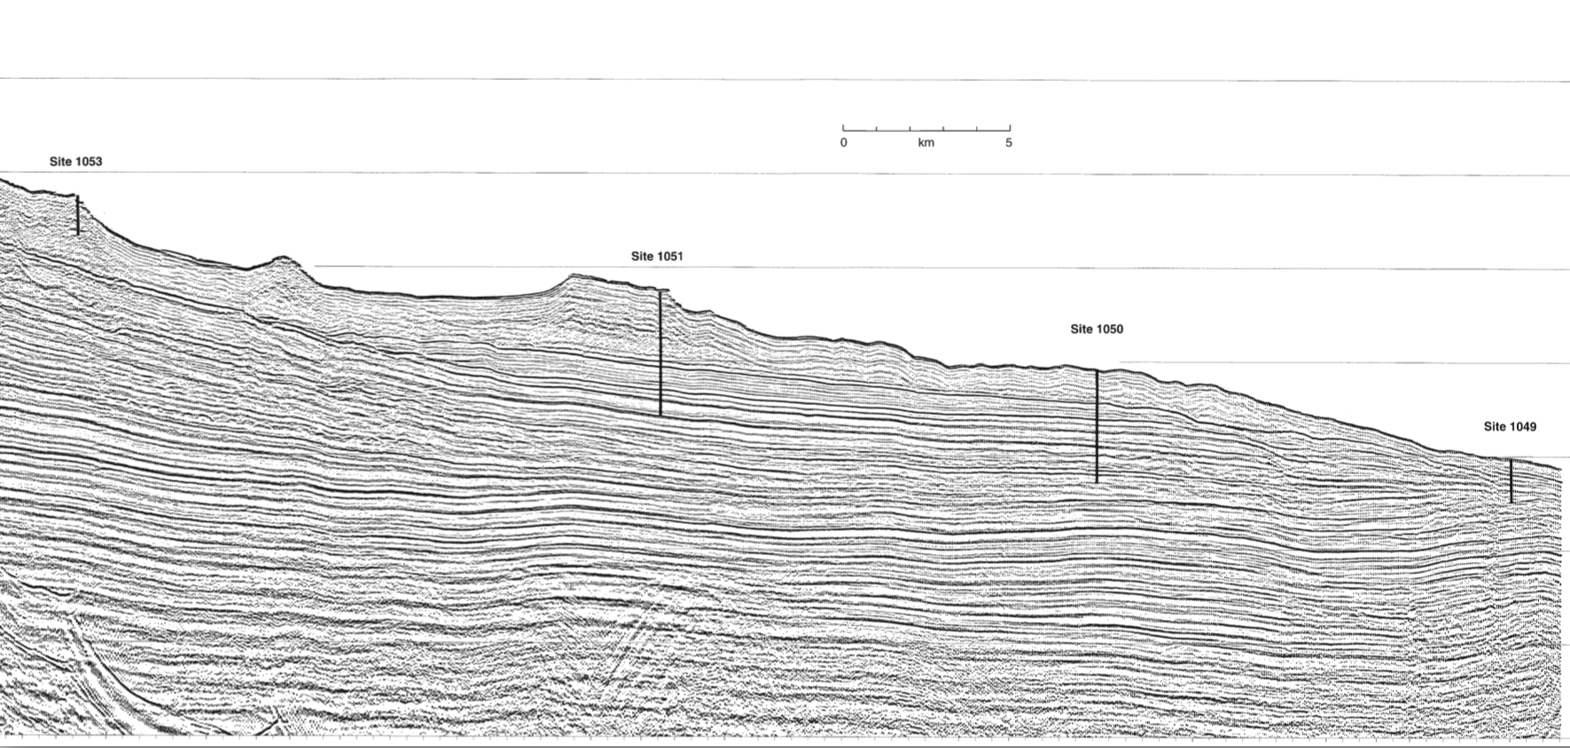
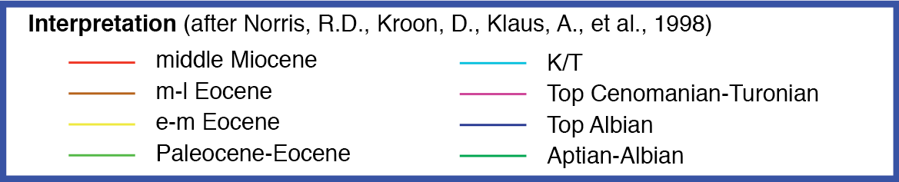
Why Blake Nose?
Blake Nose Subseafloor Life (Proposal 929)
Documented unconformities and ages from prior DSDP and IODP drilling results
BN-09A
ODP 1052
BN-08A
BN-10A
ODP 1053
BN-06A
ODP 1051
BN-03A
ODP 1050
BN-02A
ODP 1049
BN-01A
EPSP Meeting – September 4-6, 2019
Texas A&M University

Slide 7
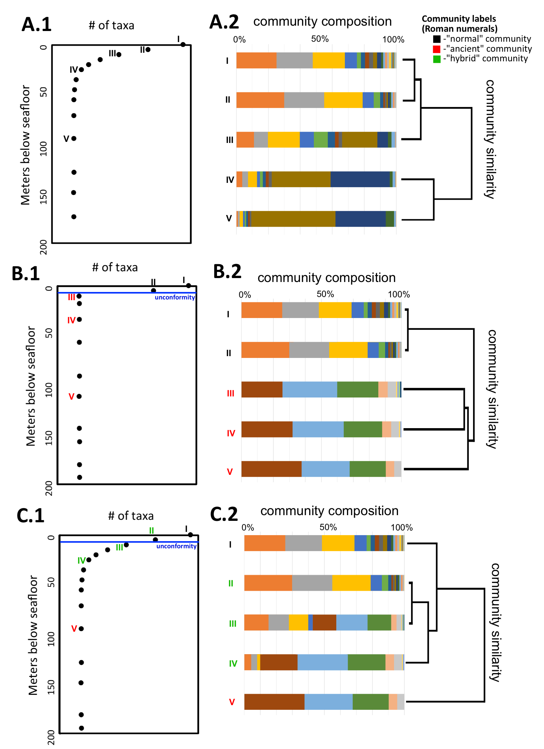
Unconformity Hypotheses
Blake Nose Subseafloor Life (Proposal 929)
Hypothesis 1. Microorganisms do not migrate across the unconformity, but remain
where they were buried.
Hypothesis 2. The lithologic unconformity is a biological unconformity.
Conceptual graphic similar to proposal, but simpler
EPSP Meeting – September 4-6, 2019
Texas A&M University

Slide 8
Past Major Change Hypotheses
Blake Nose Subseafloor Life (Proposal 929)
Hypothesis 3. Past major changes in deep-sea oxygen content and organic flux to the
seafloor continue to influence present-day sub-seafloor communities.
Conceptual graphic
EPSP Meeting – September 4-6, 2019
Texas A&M University

Slide 9
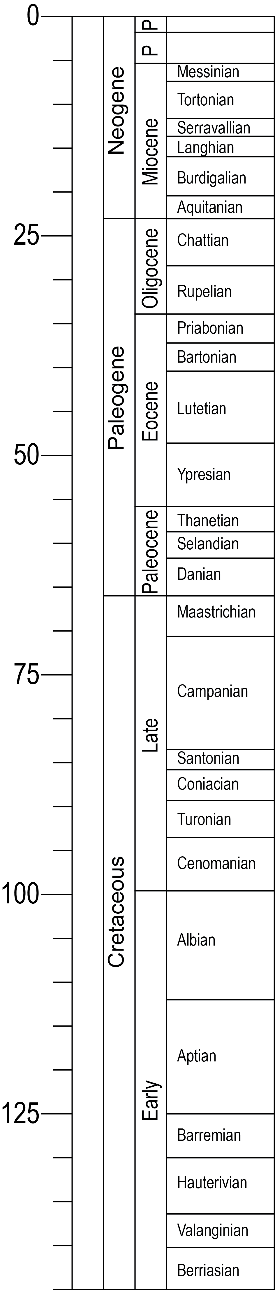
Why Blake Nose?
Blake Nose Subseafloor Life (Proposal 929)
Documented unconformities and ages from prior DSDP and IODP drilling results
Alternate Sites
Primary Sites
BN-09A
BN-10A
BN-06A (ODP 1053)
BN-03A (ODP 1051)
BN-08A (ODP 1052)
BN-01A (ODP 1049)
BN-05A (DSDP 392)
BN-02A (ODP 1050)
BN-04A (ODP 1060)
PETM
K/Pg
OAE 2
OAE 1d
OAE 1b
EPSP Meeting – September 4-6, 2019
Texas A&M University

Slide 10
Proposed Drilling/Logging Plan
Blake Nose Subseafloor Life (Proposal 929)
 | Site | Penetration (m) | ªMudline | ^{b}APC | ^{c}RCB | ^{d}XCB | Logging
Primary | BN-01A | 210 | multiple | 3 | 3 | X | WL Porosity Density Gamma Ray Resistivity Sonic Formation Image VSP Formation Temp. & Pressure Borehole Temp.
 | BN-02A | 610 | multiple | 3 | 2 3
 | BN-03A | 650 | multiple | 3 3 | 2 3 | X
 | BN-04A | 175 | multiple | 3
Alternate | BN-05A | 350 | multiple | 3 | 3
 | BN-06A | 200 | multiple | 3 | 3
 | BN-08A | 700 | multiple | 3 | 3 | X
 | BN-09A | 330 | multiple | 3 | 3 | X
 | BN-10A | 330 | multiple | 3 | 3 | X
ª to target unconformity
^{b} to refusal (half-length)
^{c} if needed to reach target depth
^{d} if needed to drill through chert or porcellanite
EPSP Meeting – September 4-6, 2019
Texas A&M University

Slide 11
Site Survey Status
Blake Nose Subseafloor Life (Proposal 929)
Classification from SEP1906 Review
Definition of “2” Classification
Data reviewed by SEP are sufficient to support the scientific objectives of the drilling effort, but minor concerns require follow-up by proponents.
Site | Type | Classification
BN-01A* | Primary | 2
BN-02A* | Primary | 2
BN-03A* | Primary | 2
BN-04A* | Primary | 2
BN-05A* | Alternate | 2
BN-06A | Alternate | 2
BN-07A | Alternate | 3
BN-08A* | Alternate | 2
BN-09A | Alternate | 2
BN-10A | Alternate | 2
Remedied Comments from SEP1906 Review
Navigation data is currently in files that relate to several lines from the same survey, or several segments of the same line.
  - data parsed into separate navigation files
File labeled “BP-138G_stk.segy” contains SEG-Y data for line BP-138F_stk.segy, and vice versa.
  - seismic data checked and renamed
  - site forms relabeled accordingly
EPSP Meeting – September 4-6, 2019
Texas A&M University

Slide 12
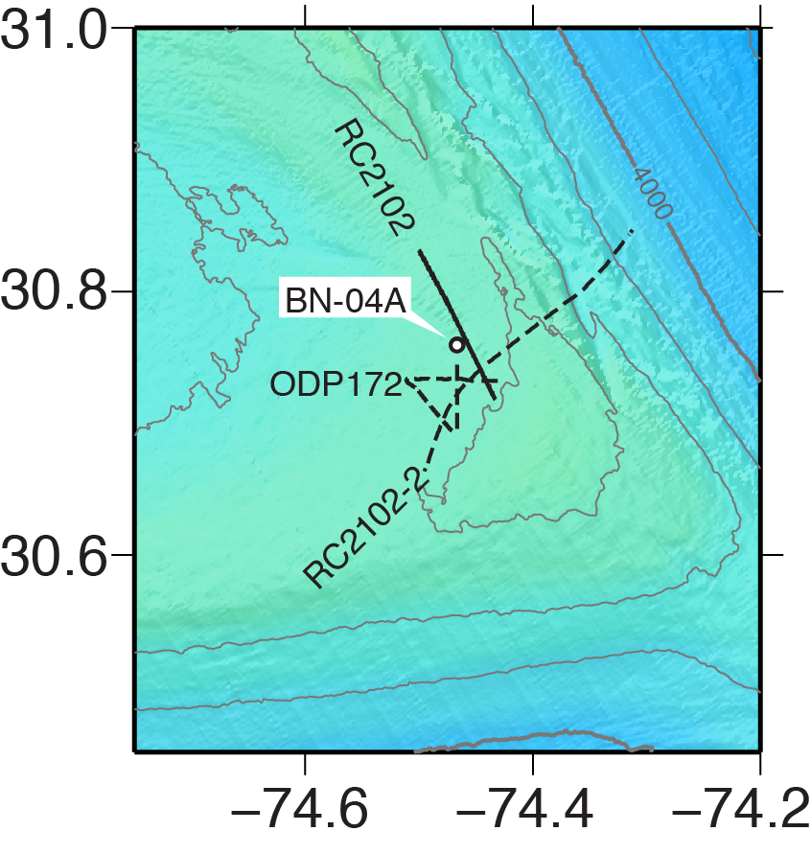
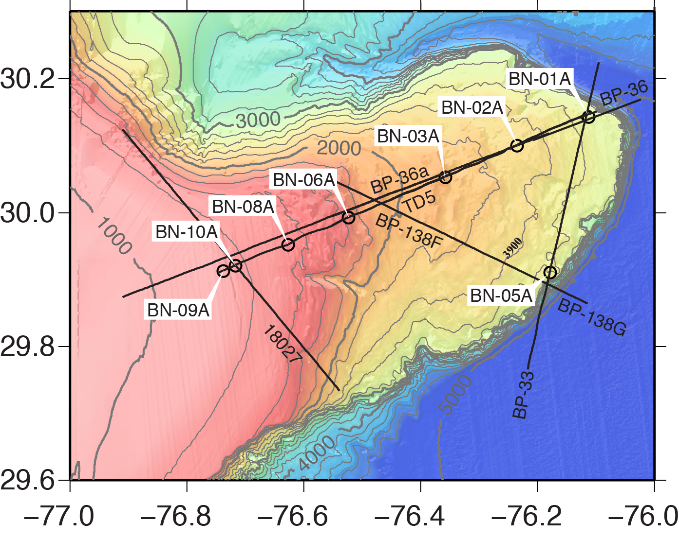
Seismic Surveys
Blake Nose Subseafloor Life (Proposal 929)
EPSP Meeting – September 4-6, 2019
Texas A&M University

Slide 13
Seismic Surveys
Blake Nose Subseafloor Life (Proposal 929)
Line | Sites | Type | Cruise | Acquisition | Sample Rate/Record Length | Channels | Fold | Processing
TD5 | BN-01A BN-02A BN-03A BN-06A BN-08A BN-09A BN-10A | Multichannel | M/V Coral Sea | 1977 Bolt Airgun (4) 2160 in³ | 1 ms/ 2s | 48 | 48 | 48-fold CDP stack poststack decon.
BP-33 | BN-01A BN-05A | Multichannel | Gulf Seal | 1975 Airgun 1700 in³ | 0.4ms/11.3s | - | - | Depth Migration, Migration, Stack
BP-36 | BN-01A BN-03A | Multichannel | Gulf Seal | 1975 Airgun 1700 in³ | 0.4ms/11.3s | - | - | Depth Migration, Migration, Stack
BP-36A | BN-02A | Multichannel | Gulf Seal | 1975 Airgun 1700 in³ | 0.4ms/11.3s | - | - | Depth Migration, Migration, Stack
BP-138F | BN-03A BN-06A | Multichannel | Gulf Seal | 1975 Airgun 1700 in³ | 0.4ms/11.3s | - | - | Depth Migration, Migration, Stack
BP-138G | BN-03A BN-06A | Multichannel | Gulf Seal | 1975 Airgun 1700 in³ | 0.4ms/11.3s | - | - | Depth Migration, Migration, Stack
18027 | BN-09A BN-10A | Multichannel | - | 1982 | 0.4ms/10.5s | - | - | Depth Migration, Migration
RC2102 | BN-04A | Multichannel | R/V Conrad | 1977 | 0.4ms/12.3s | - | - | LNMO, Filtered, Stacked
EPSP Meeting – September 4-6, 2019
Texas A&M University

Slide 14
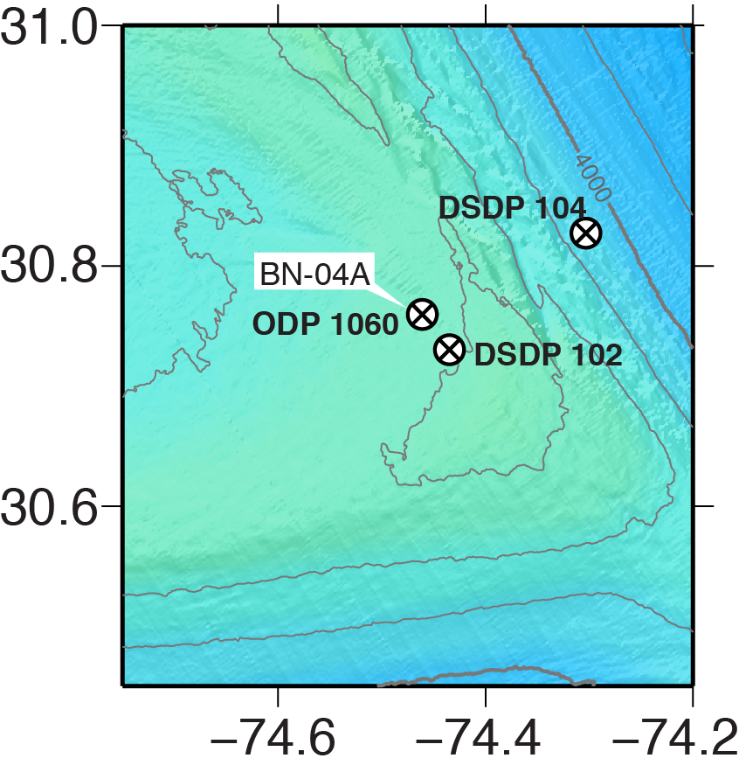
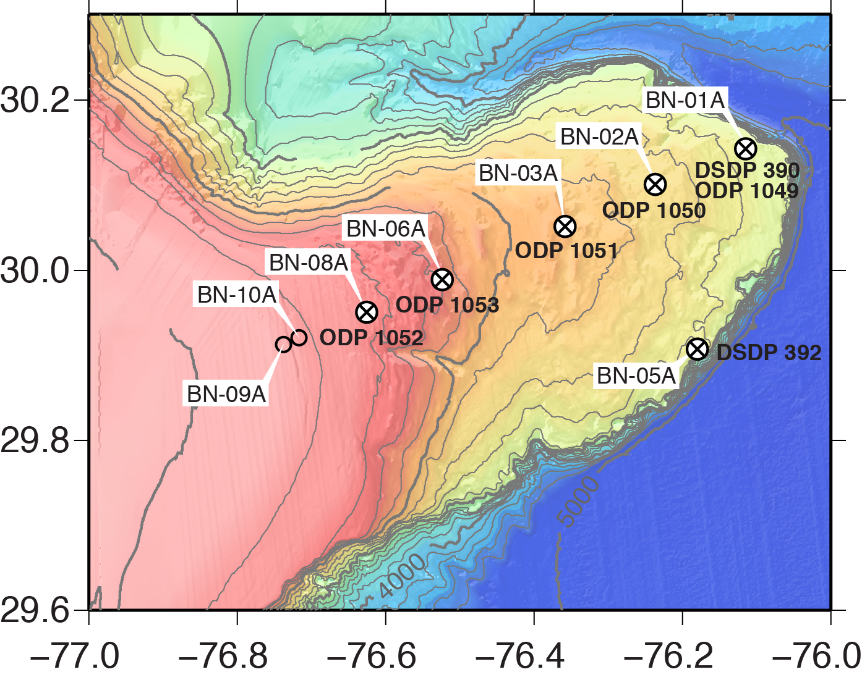
Prior Drilling
Blake Nose Subseafloor Life (Proposal 929)
EPSP Meeting – September 4-6, 2019
Texas A&M University

Slide 15
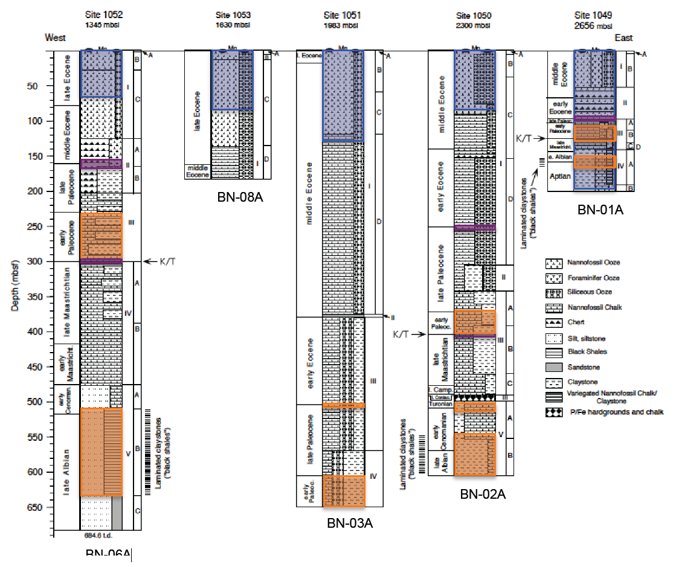
Prior Drilling
Blake Nose Subseafloor Life (Proposal 929)
Site 1052
BN-08A
1344 mbsl
685 mbsf
Site 1053
BN-06A
1630 mbsl
183 mbsf
Site 1051
BN-03A
1983 mbsl
644 mbsf
Site 1050
BN-02A
2300 mbsl
606 mbsf
Site 1049
BN-01A
2656 mbsl
197 mbsf
Unconformity Targets
Major Oceanic Events
EPSP Meeting – September 4-6, 2019
Texas A&M University

Slide 16
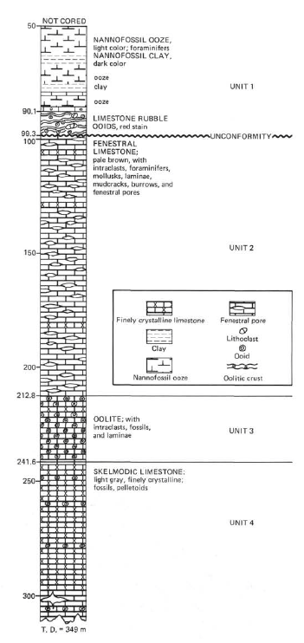
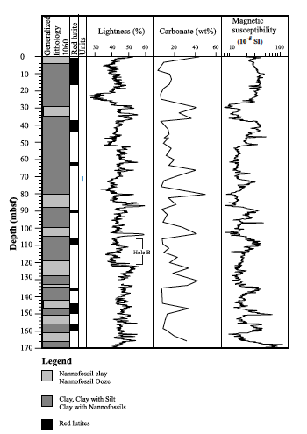
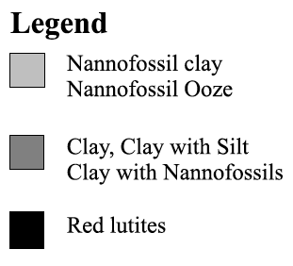
Prior Drilling
Blake Nose Subseafloor Life (Proposal 929)
Site 392
BN-05A
2601 mbsl
349 mbsf
Site 1060
BN-04A
3481 mbsl
170 mbsf
50
100
200
300
EPSP Meeting – September 4-6, 2019
Texas A&M University

Slide 17
Seismic Velocities
Blake Nose Subseafloor Life (Proposal 929)
 | Site | Previous Site | Depth Range Target Depth | Quality
Primary | BN-01A | ODP1049 | 0-170 210 | fair
 | BN-02A | ODP1050 | 0-320 610 | good
 | BN-03A | ODP1051 | 5-630 650 | good
 | BN-04A | ODP1060 | 0-30 175 | fair
Alternate | BN-05A | DSDP392 | 50-250 350 | good
 | BN-06A | ODP1053 | 0-180 200 | good
 | BN-08A | ODP1052 | 0-680 700 | ?
 | BN-09A | - | - 330 | -
 | BN-10A | - | - 330 | -
EPSP Meeting – September 4-6, 2019
Texas A&M University

Slide 18
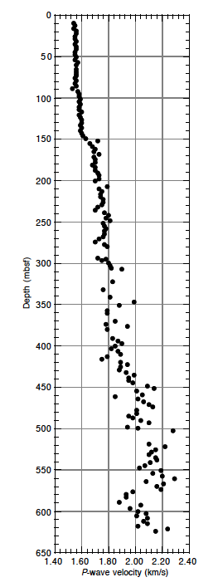
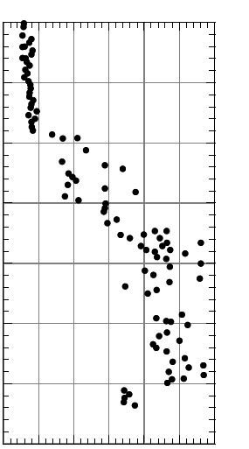
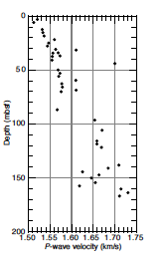
Seismic Velocities
Blake Nose Subseafloor Life (Proposal 929)
Site 1051
BN-03A
1983 mbsl
644 mbsf
Site 1050
BN-02A
2300 mbsl
606 mbsf
Site 1049
BN-01A
2656 mbsl
197 mbsf
km/s
km/s
km/s
1.4
2.4
1.5
2.1
1.5
1.75
EPSP Meeting – September 4-6, 2019
Texas A&M University

Slide 19
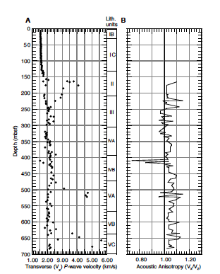
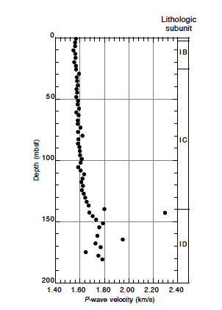
Seismic Velocities
Blake Nose Subseafloor Life (Proposal 929)
Site 1052
BN-08A
1344 mbsl
685 mbsf
Site 1053
BN-06A
1630 mbsl
183 mbsf
Site 392
BN-05A
2601 mbsl
349 mbsf
km/s
km/s
km/s
1.0
6.0
1.4
2.4
1.0
7.0
EPSP Meeting – September 4-6, 2019
Texas A&M University

Slide 20
Seismic Velocities
Blake Nose Subseafloor Life (Proposal 929)
Site 1060
BN-04A
3481 mbsl
170 mbsf
km/s
1.0
1.6
EPSP Meeting – September 4-6, 2019
Texas A&M University

Slide 21
Potential Hazards
Blake Nose Subseafloor Life (Proposal 929)
 | Site | Methane (PPM) | Abyssal Currents | Surface Currents | Weather
Primary | BN-01A | <50 | < 0.15 m/s < 0.3 kts | East of Gulf Stream | Hurricane Season (May through November)
 | BN-02A | <1000
 | BN-03A | <250
 | BN-04A | up to 57,000 gas voids in cores > 60 MBSF
Alternate | BN-05A | No gas detected
 | BN-06A | <20
 | BN-08A | <20
 | BN-09A | No measurements Nearby sites <20
 | BN-10A | No measurements Nearby sites <20
EPSP Meeting – September 4-6, 2019
Texas A&M University

Slide 22
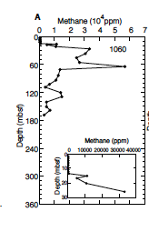
Potential Hazards
Blake Nose Subseafloor Life (Proposal 929)
Methane Concentrations (ppm)
57,000
<50
<1000
<250
<20
<20
0
EPSP Meeting – September 4-6, 2019
Texas A&M University

Slide 23
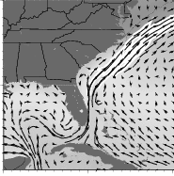
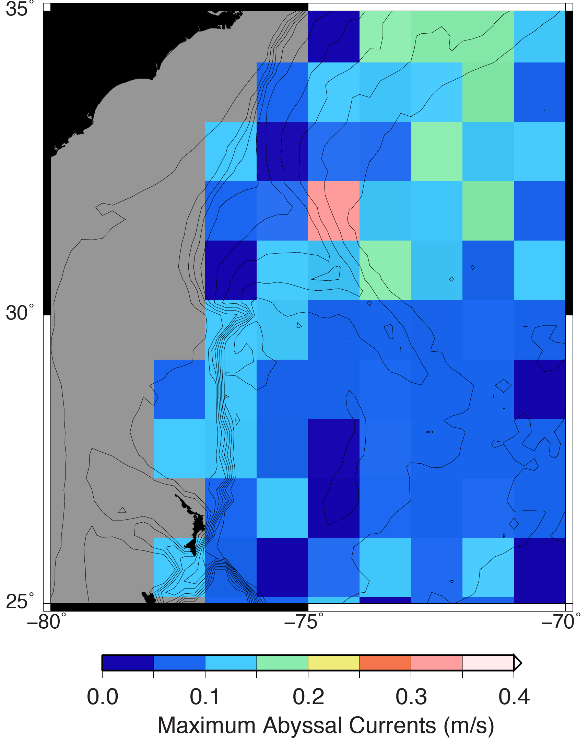
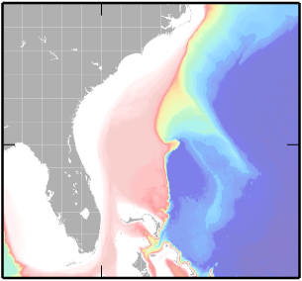
Potential Hazards
Blake Nose Subseafloor Life (Proposal 929)
Ocean Currents
40˚
30˚
Blake Ridge
Blake Nose
-90˚
-80˚
-70˚
Mariano Global Surface Velocity Analysis
HYCOM
EPSP Meeting – September 4-6, 2019
Texas A&M University

Slide 24
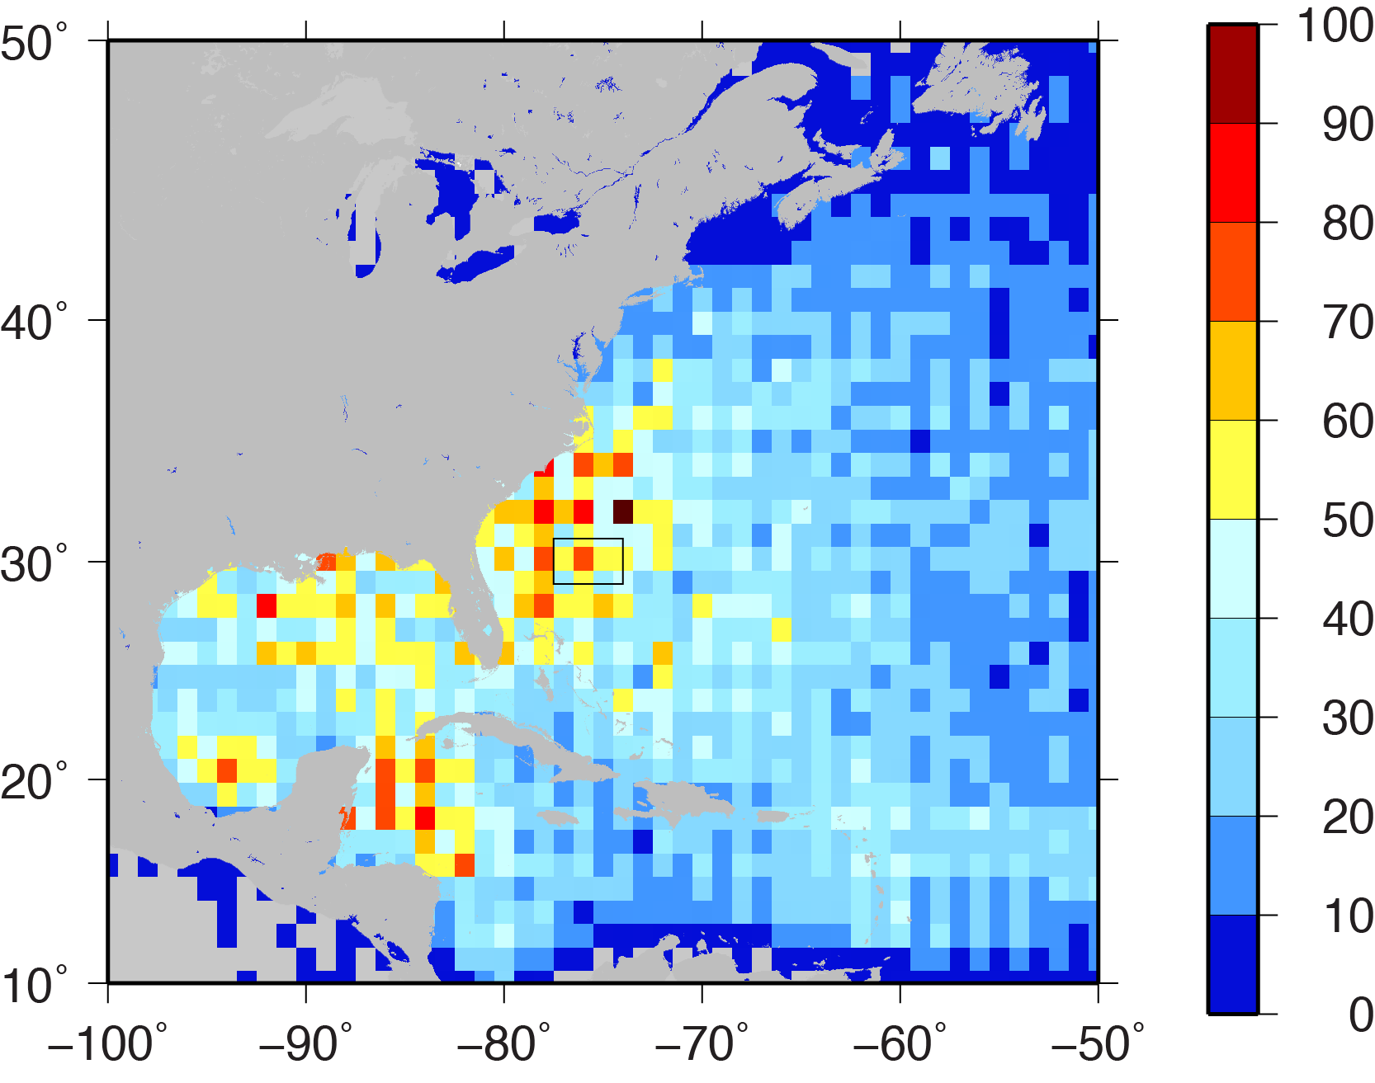
Potential Hazards
Blake Nose Subseafloor Life (Proposal 929)
Hurricanes
Number of days
a hurricane has been
in the region.
(1851-2018)
Atlantic hurricane database (HURDAT2) 1851-2018
EPSP Meeting – September 4-6, 2019
Texas A&M University

Slide 25
Potential Hazards
Blake Nose Subseafloor Life (Proposal 929)
Cables & Ordinance
PLACE Holder for Cables and Ordinance
EPSP Meeting – September 4-6, 2019
Texas A&M University

Slide 26
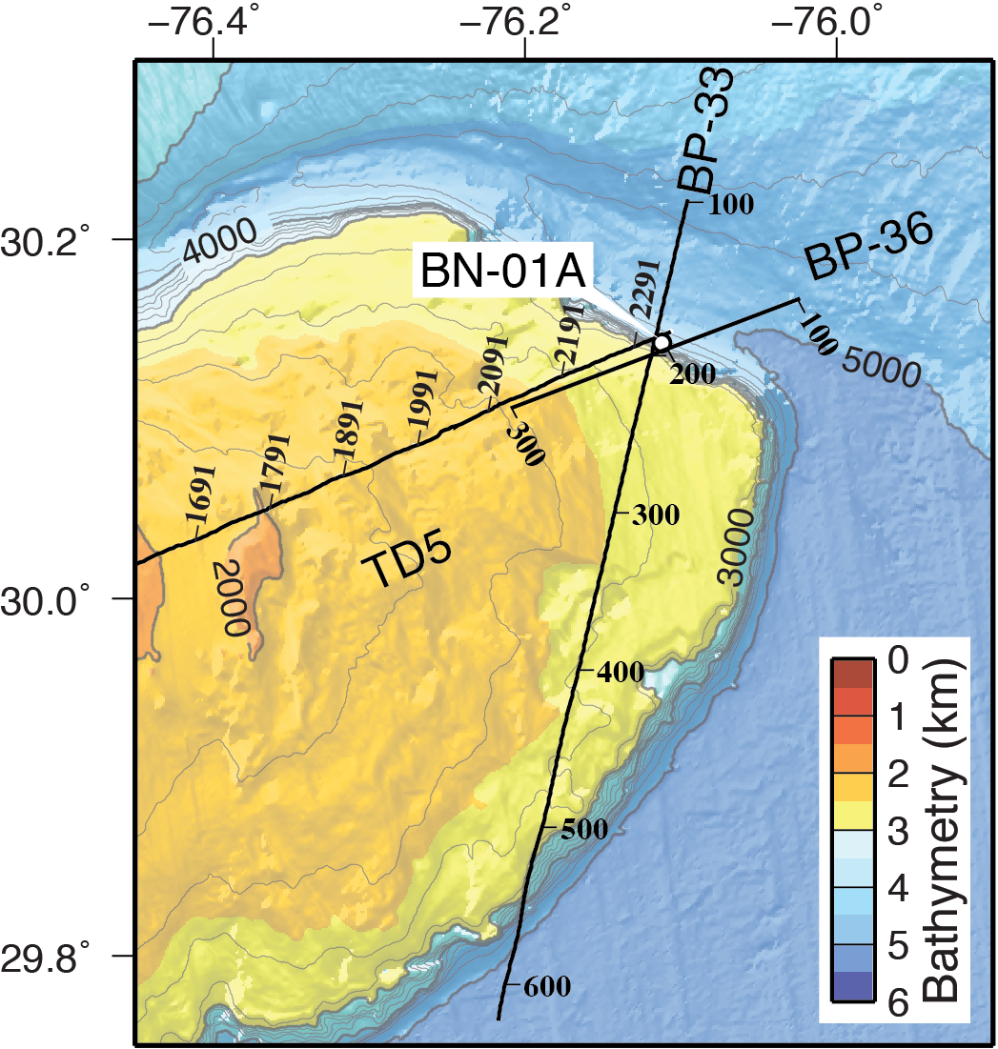
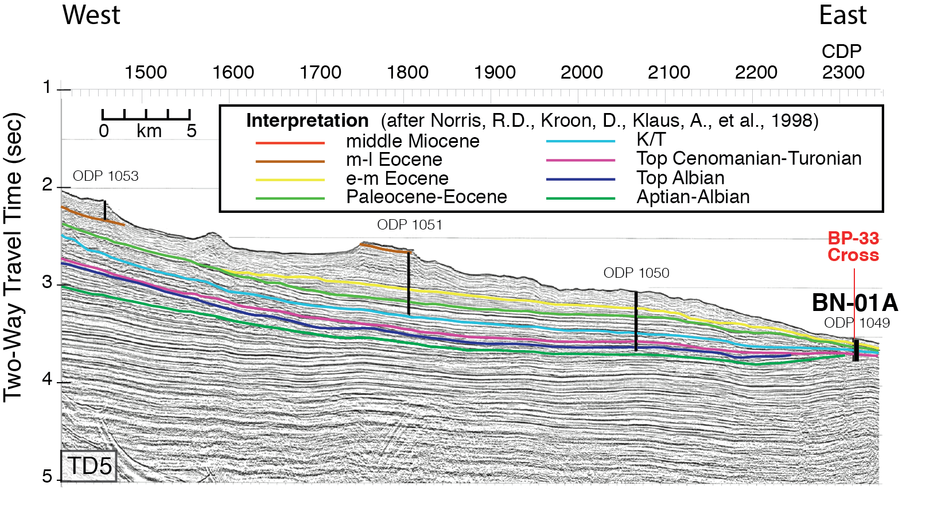
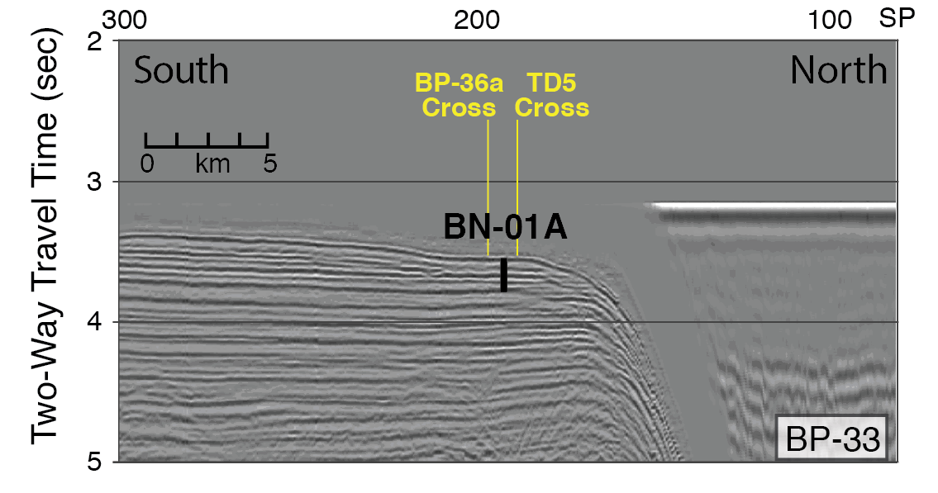
Site BN-01A
Blake Nose Subseafloor Life (Proposal 929)
Location 30.1424N 76.1122W
Water Depth 2656
Target Depth 210
Target Age Barremian
Objectives 1,2,3 (PETM/OAE1b)
EPSP Meeting – September 4-6, 2019
Texas A&M University

Slide 27
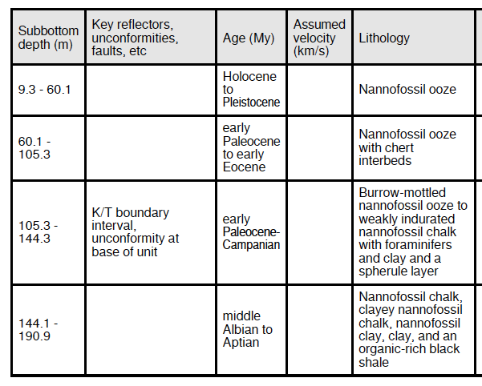
Site BN-01A
Blake Nose Subseafloor Life (Proposal 929)
Site 1049
2656 mbsl
197 mbsf
I
II
MBSF
III
IV
210
EPSP Meeting – September 4-6, 2019
Texas A&M University

Slide 28
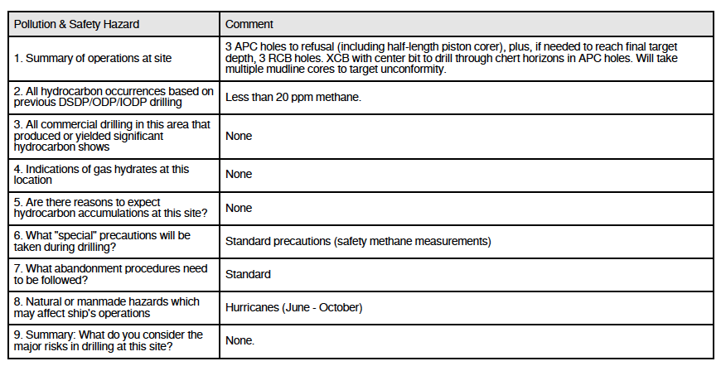
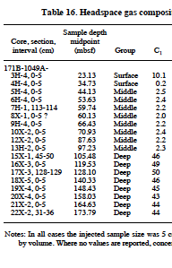
Site BN-01A
Blake Nose Subseafloor Life (Proposal 929)
ª to target unconformity
^{b} to refusal (half-length)
^{c} if needed to reach target depth
^{d} if needed to drill through chert
Site | Penetration (m) | ªMudline | ^{b}APC | ^{c}RCB | ^{d}XCB
BN-01A | 210 | multiple | 3 | 3 | X
50
EPSP Meeting – September 4-6, 2019
Texas A&M University

Slide 29
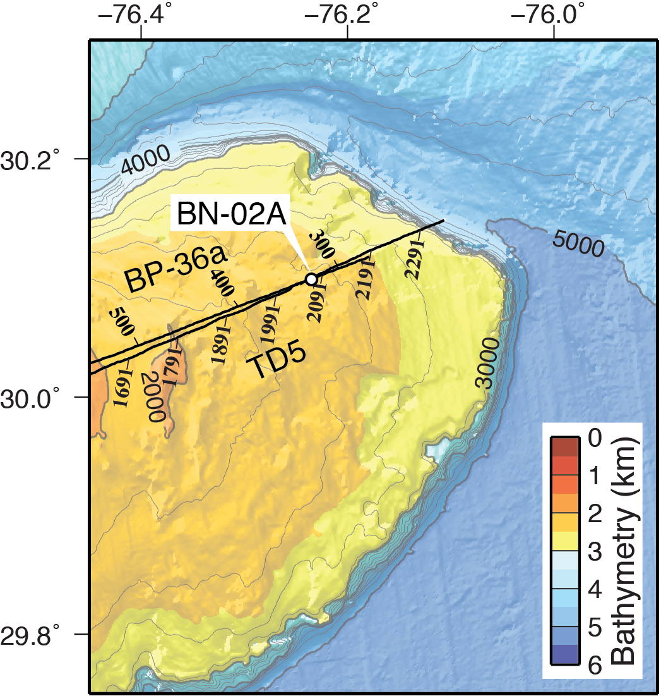
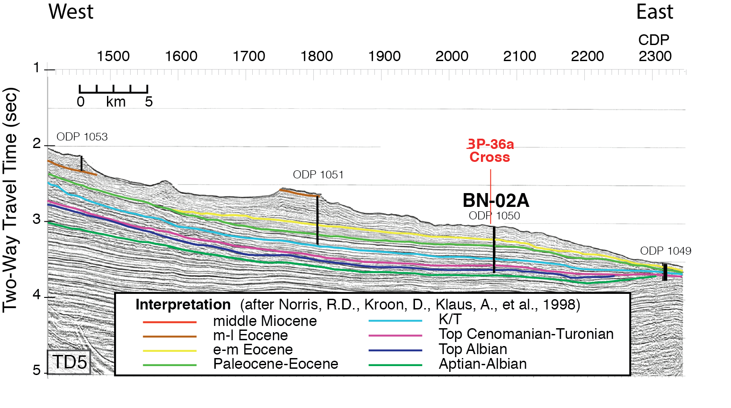
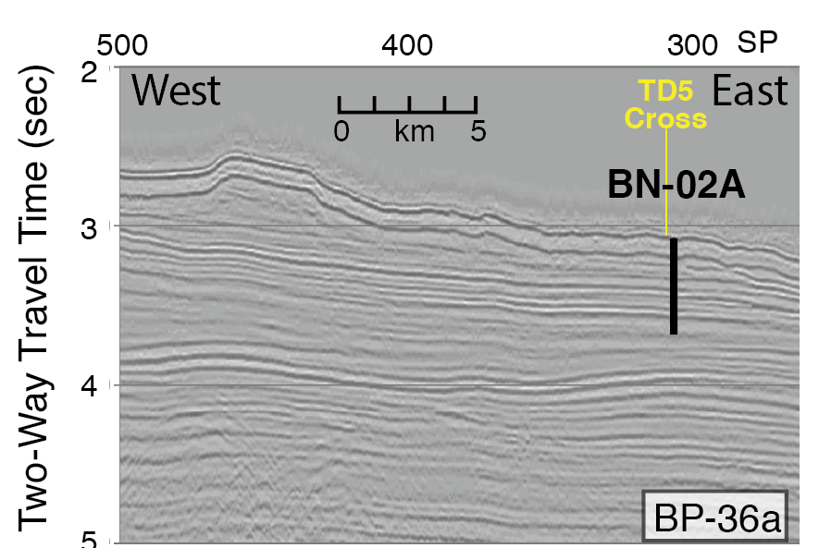
Site BN-02A
Blake Nose Subseafloor Life (Proposal 929)
Location 30.1000N 76.2350W
Water Depth 2300
Target Depth 610
Target Age late Albian
Objectives 1,2,3 (PETM, K/Pg, OAE1d)
EPSP Meeting – September 4-6, 2019
Texas A&M University

Slide 30
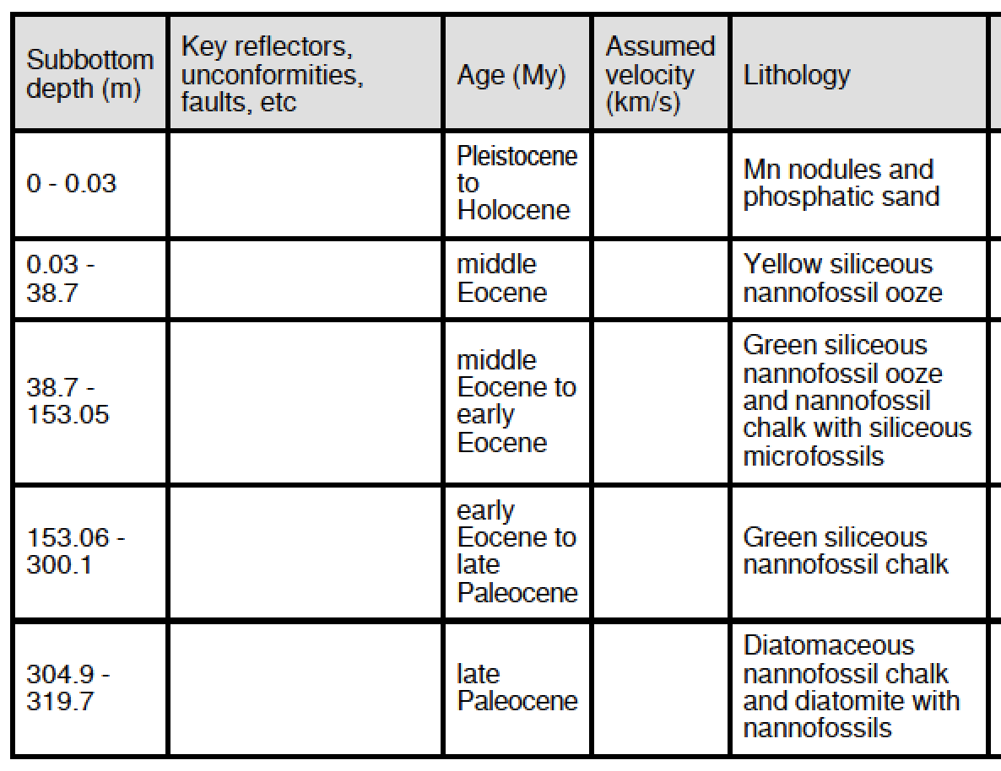
Site BN-02A
Blake Nose Subseafloor Life (Proposal 929)
Site 1050
2300 mbsl
606 mbsf
I
II
III
MBSF
IV
V
610
EPSP Meeting – September 4-6, 2019
Texas A&M University

Slide 31
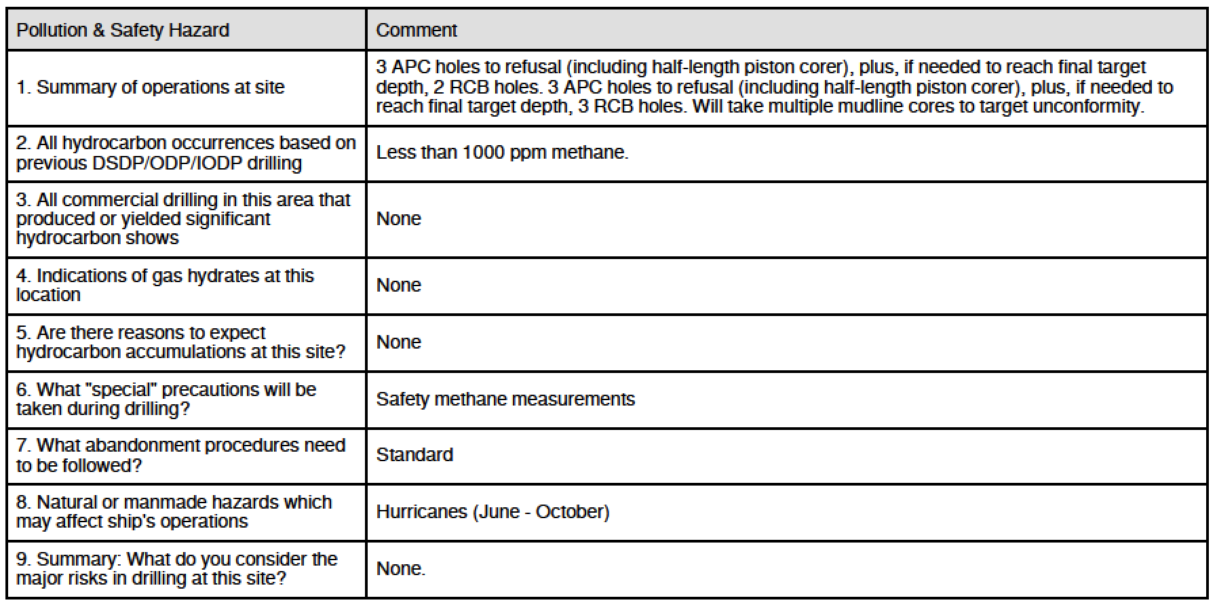
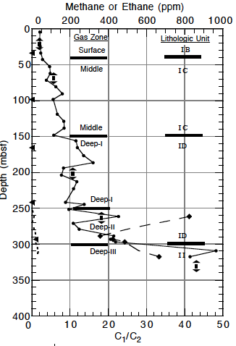
Site BN-02A
Blake Nose Subseafloor Life (Proposal 929)
Site | Penetration (m) | ªMudline | ^{b}APC | ^{c}RCB | ^{d}XCB
BN-02A | 610 | multiple | 3 | 2 3
ª to target unconformity
^{b} to refusal (half-length)
^{c} if needed to reach target depth
^{d} if needed to drill through chert
EPSP Meeting – September 4-6, 2019
Texas A&M University

Slide 32
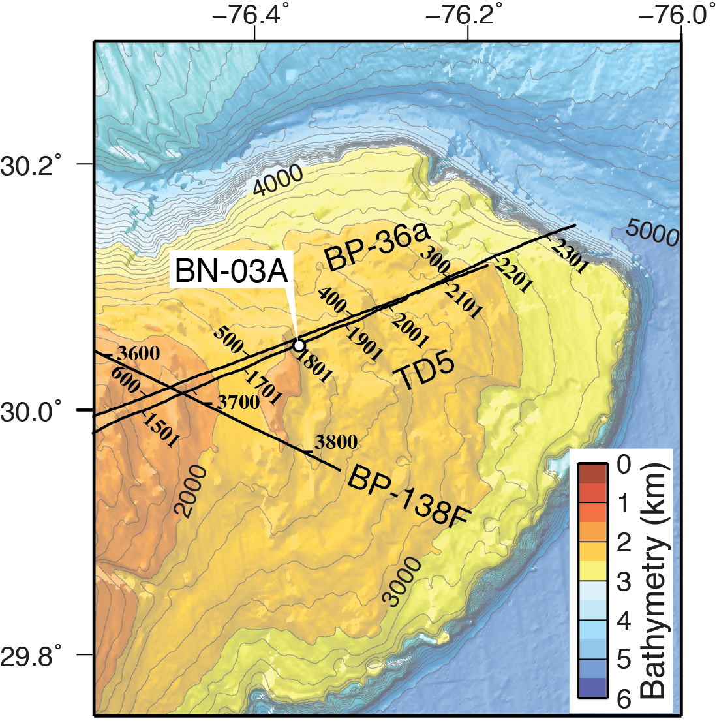
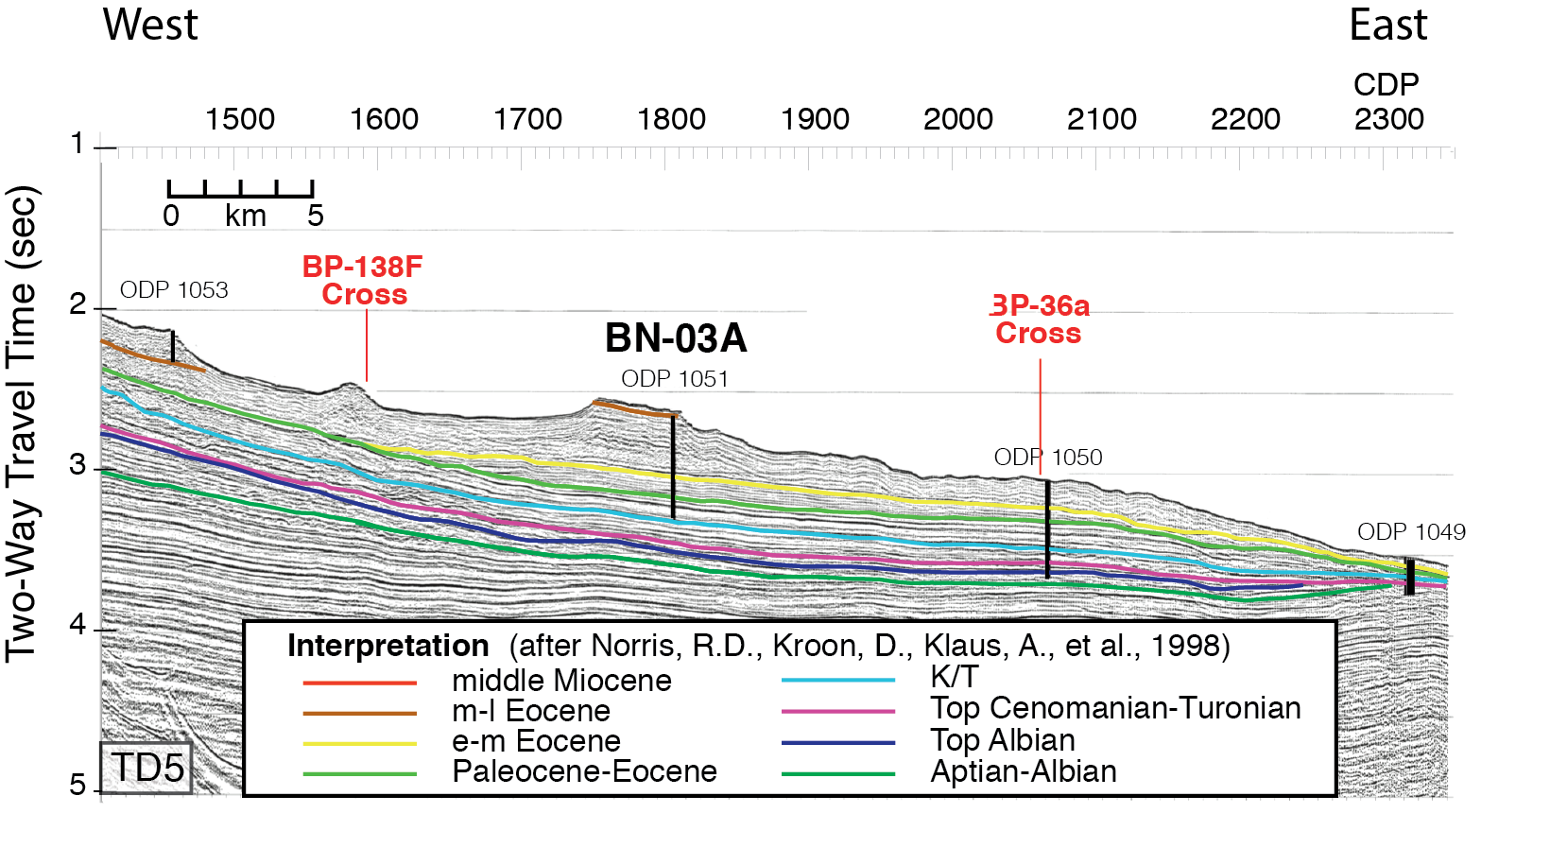
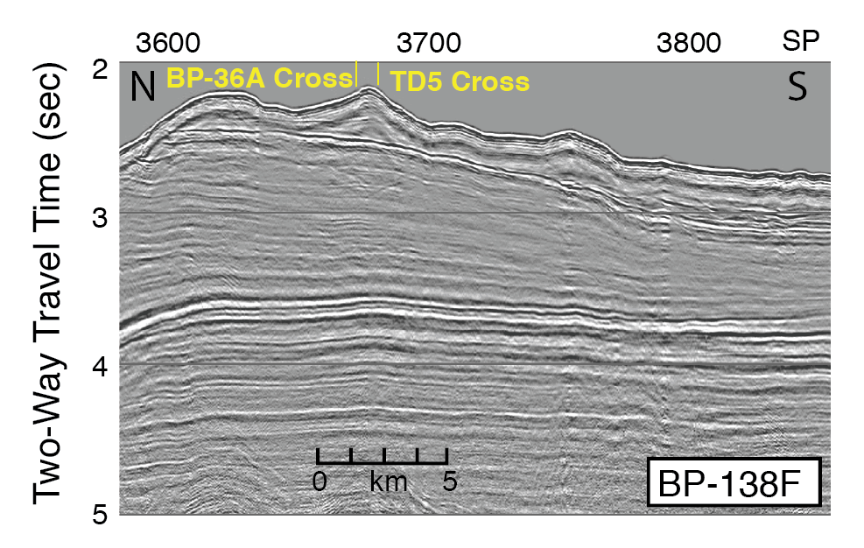
Site BN-03A
Blake Nose Subseafloor Life (Proposal 929)
Location 30.0529N 76.3576W
Water Depth 1983
Target Depth 650
Target Age late Paleocene
Objectives 1,2,3 (PETM)
EPSP Meeting – September 4-6, 2019
Texas A&M University

Slide 33
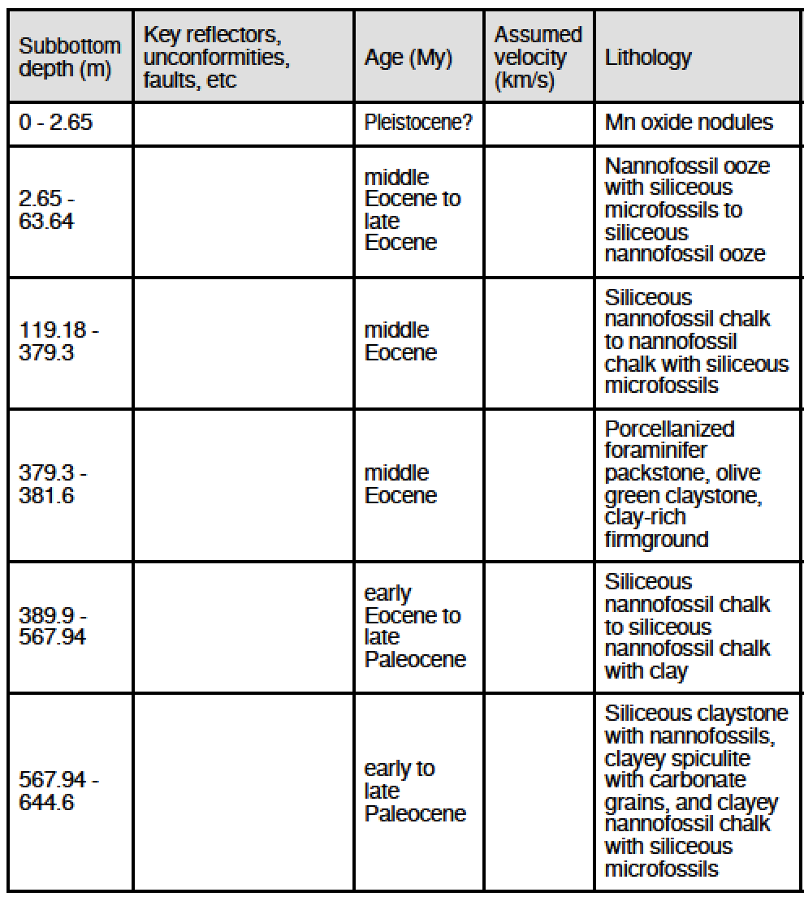
Site BN-03A
Blake Nose Subseafloor Life (Proposal 929)
Site 1051
1983 mbsl
644 mbsf
I
II
III
MBSF
IV
V
VI
650
EPSP Meeting – September 4-6, 2019
Texas A&M University

Slide 34
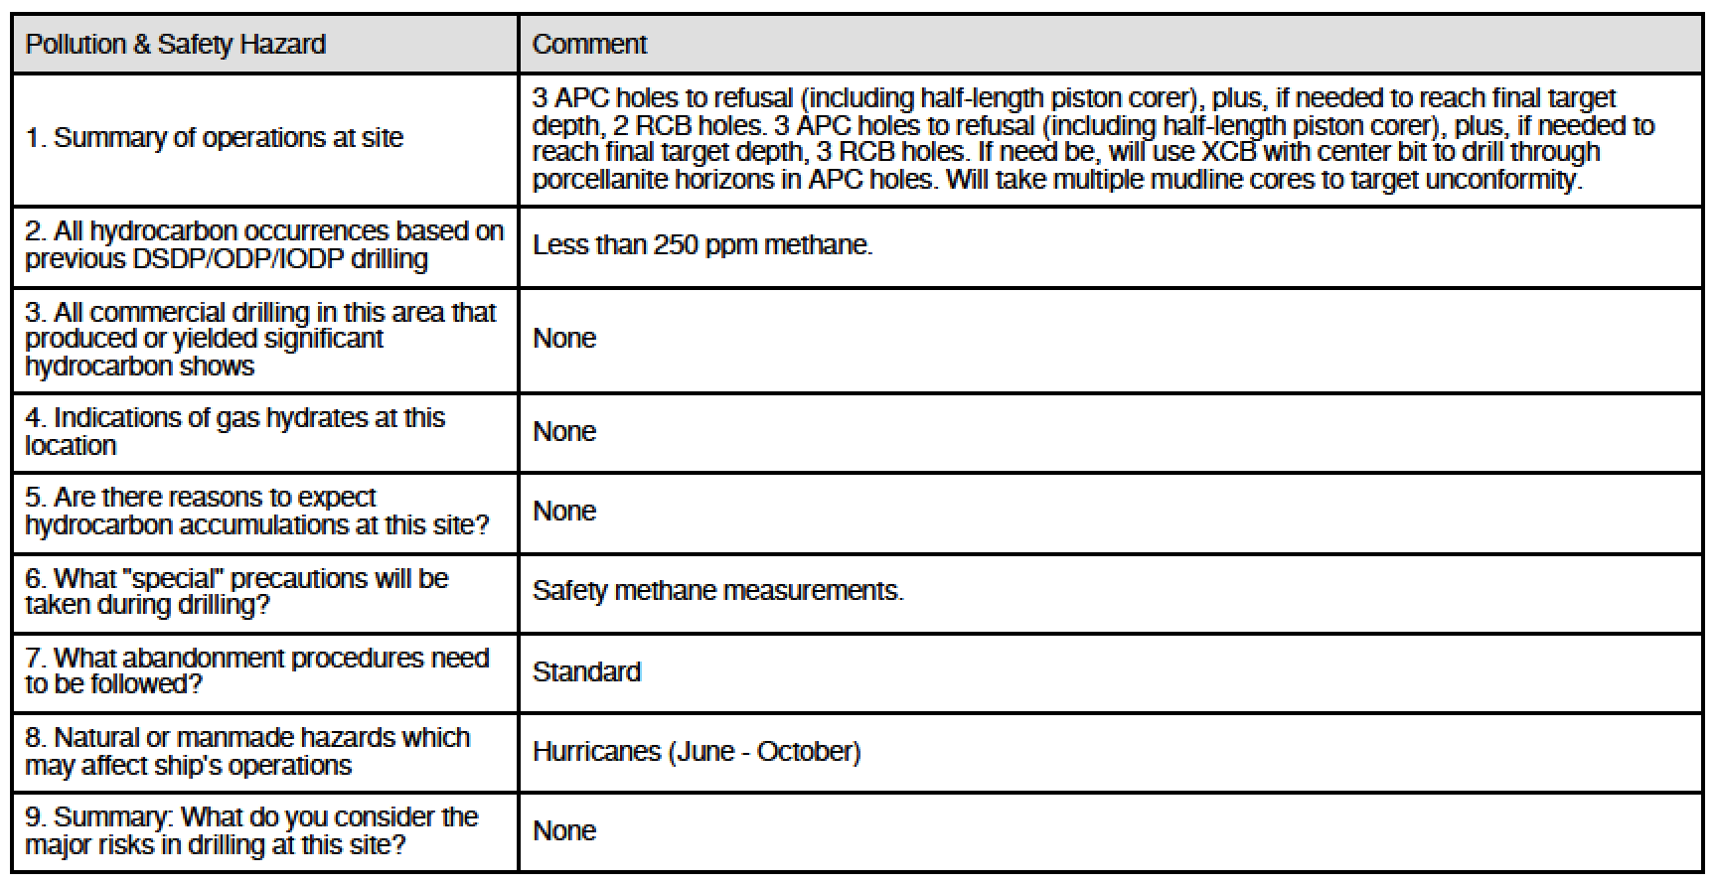
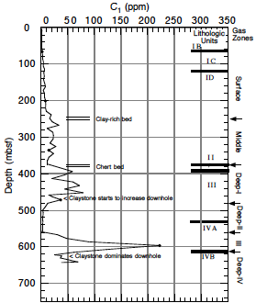
Site BN-03A
Blake Nose Subseafloor Life (Proposal 929)
Site | Penetration (m) | ªMudline | ^{b}APC | ^{c}RCB | ^{d}XCB
BN-03A | 650 | multiple | 3 3 | 2 3 | X
ª to target unconformity
^{b} to refusal (half-length)
^{c} if needed to reach target depth
^{d} if needed to drill through chert
EPSP Meeting – September 4-6, 2019
Texas A&M University

Slide 35
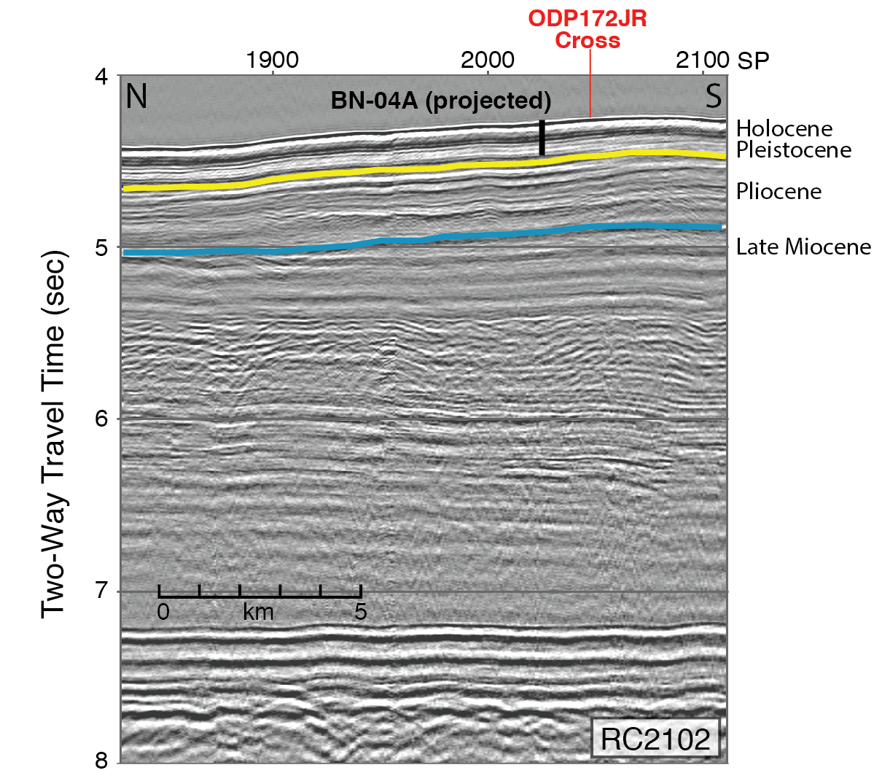
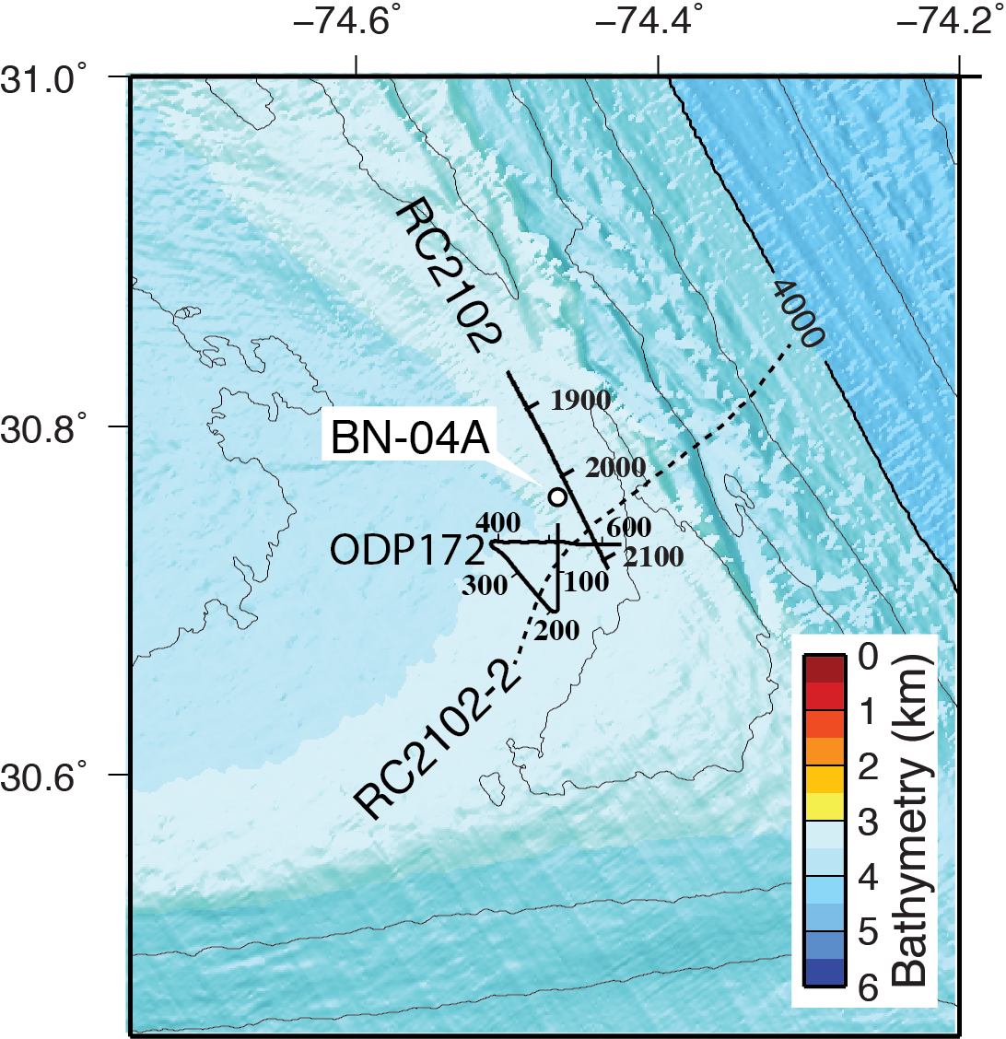
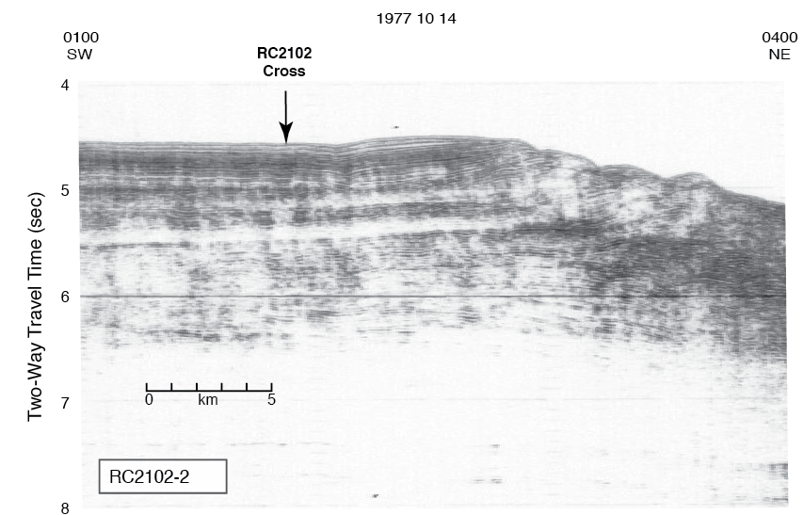
Site BN-04A
Blake Nose Subseafloor Life (Proposal 929)
Location 30.7595N 74.4665W
Water Depth 3481
Target Depth 175
Target Age early Pleistocene
Objectives 1,2
EPSP Meeting – September 4-6, 2019
Texas A&M University

Slide 36
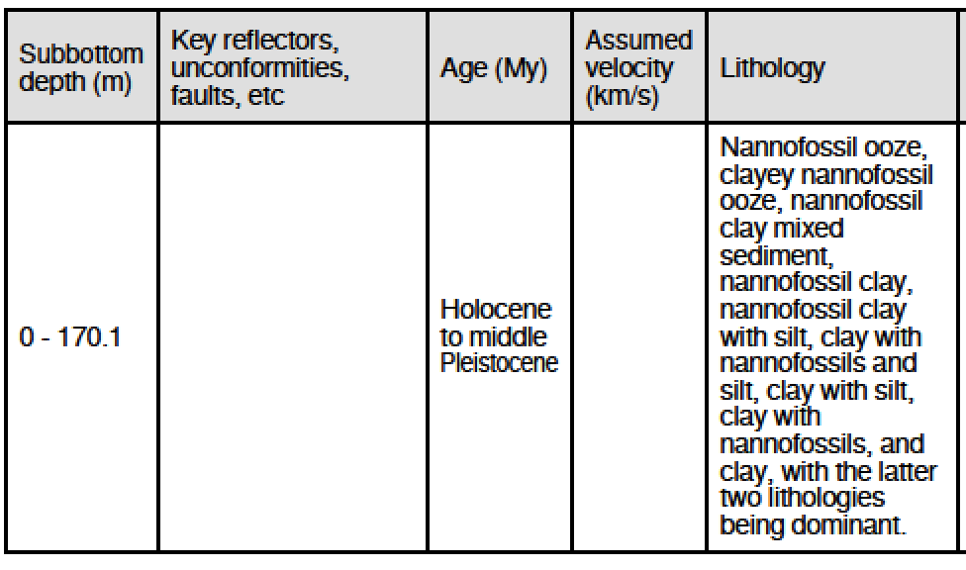
Site BN-04A
Blake Nose Subseafloor Life (Proposal 929)
Site 1060
3481 mbsl
170 mbsf
I
175
EPSP Meeting – September 4-6, 2019
Texas A&M University

Slide 37
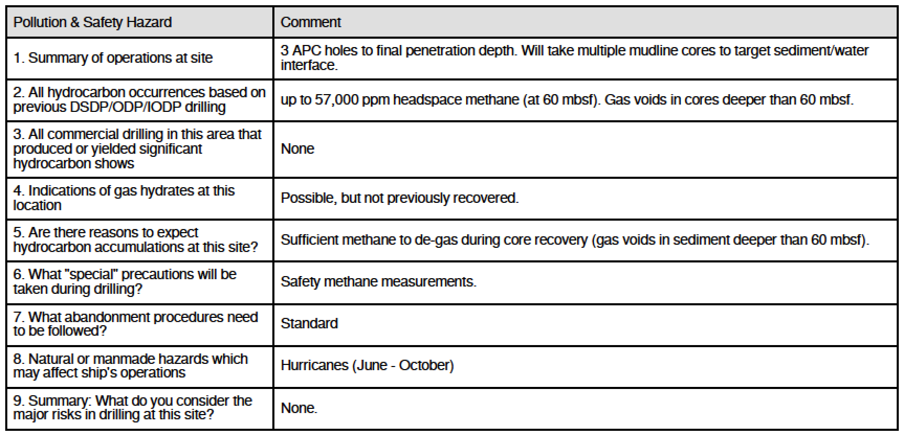
Site BN-04A
Blake Nose Subseafloor Life (Proposal 929)
Site | Penetration (m) | ªMudline | ^{b}APC | ^{c}RCB | ^{d}XCB
BN-04A | 175 | multiple | 3
ª to target unconformity
^{b} to refusal (half-length)
^{c} if needed to reach target depth
^{d} if needed to drill through chert
EPSP Meeting – September 4-6, 2019
Texas A&M University

Slide 38
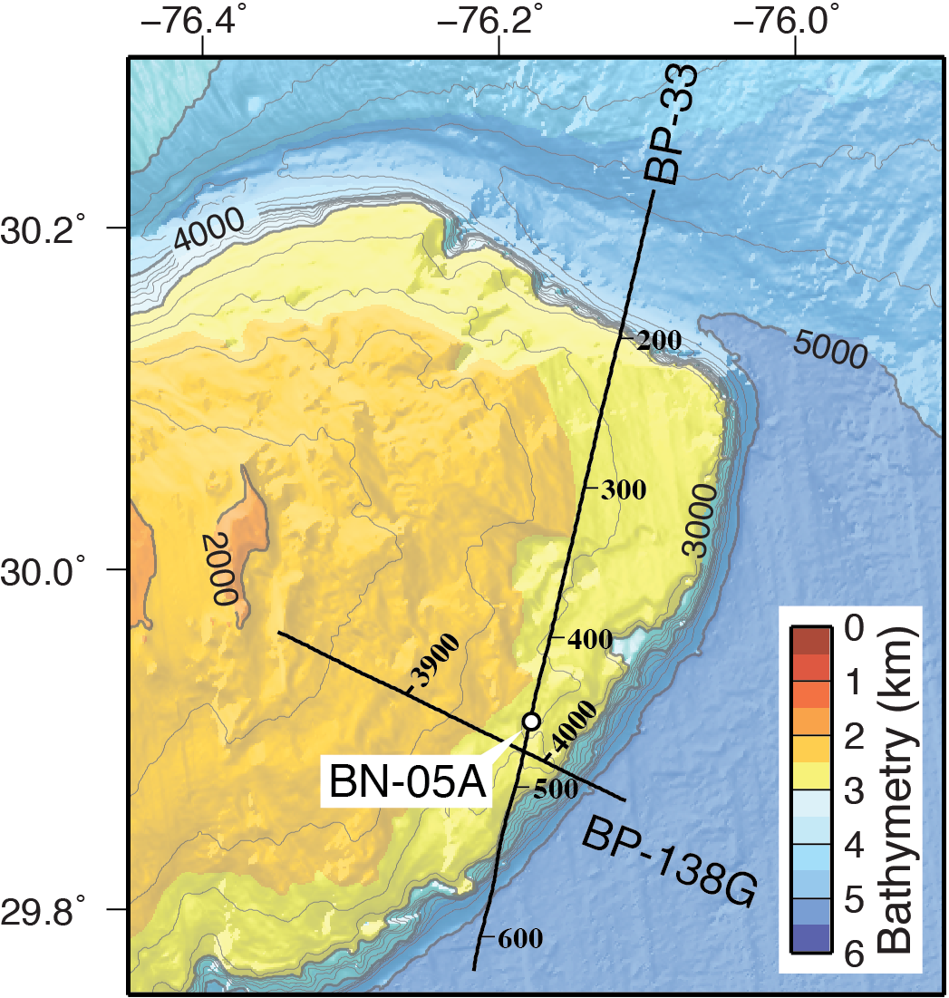
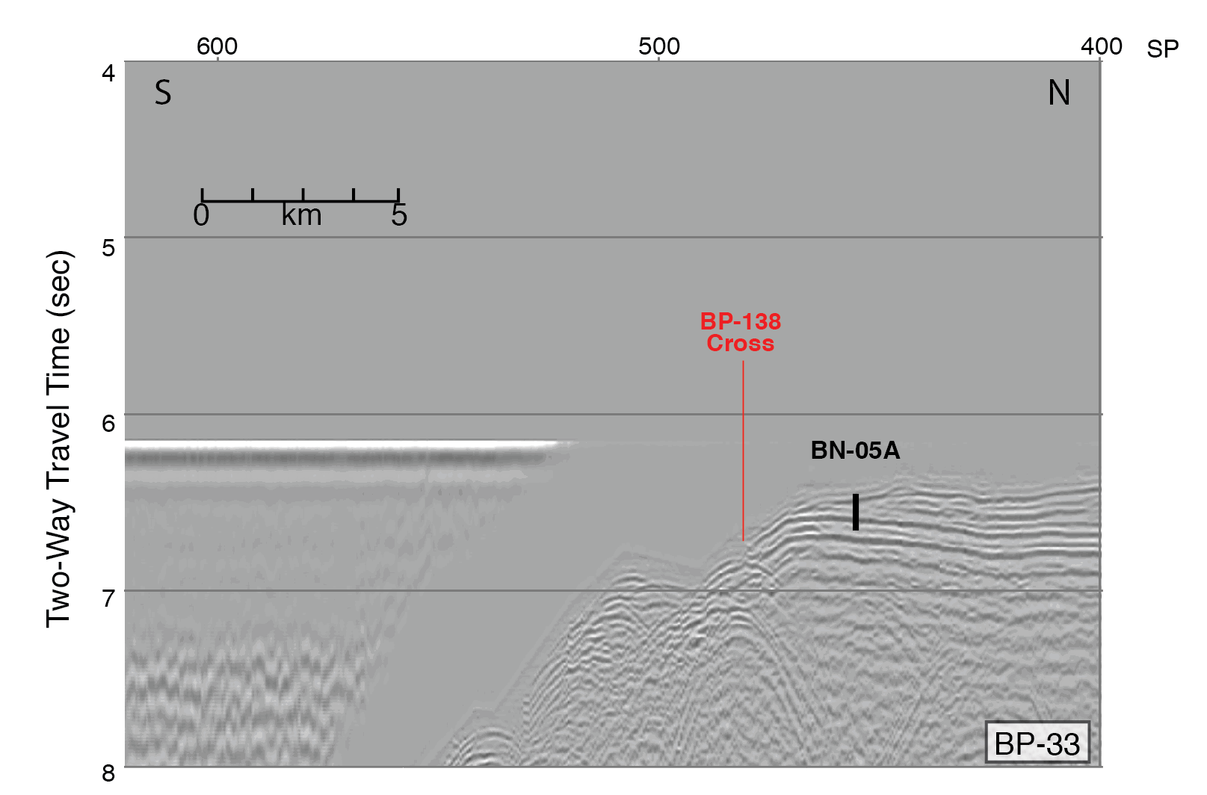
Site BN-05A
Blake Nose Subseafloor Life (Proposal 929)
Location 29.9105N 76.1780W
Water Depth 2601
Target Depth 350
Target Age Neocomian
Objectives 1,2
EPSP Meeting – September 4-6, 2019
Texas A&M University

Slide 39
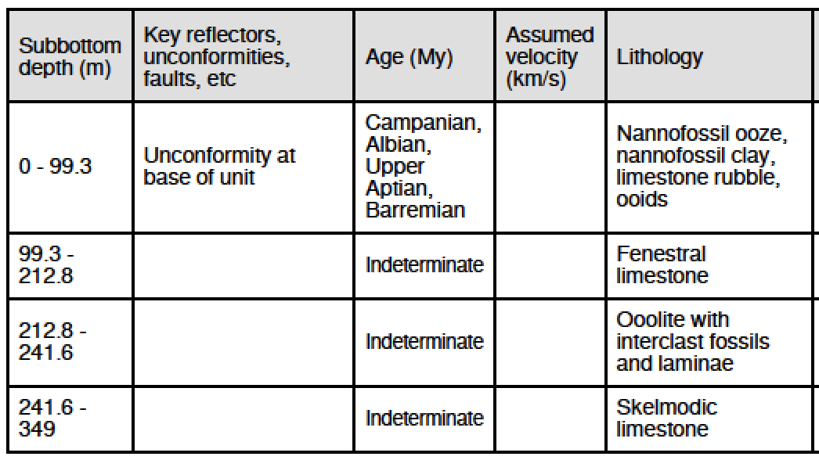
Site BN-05A
Blake Nose Subseafloor Life (Proposal 929)
Site 392
2601 mbsl
349 mbsf
50
I
I
100
II
II
III
MBSF
200
IV
III
IV
300
350
EPSP Meeting – September 4-6, 2019
Texas A&M University

Slide 40

Site BN-05A
Blake Nose Subseafloor Life (Proposal 929)
Site | Penetration (m) | ªMudline | ^{b}APC | ^{c}RCB | ^{d}XCB
BN-05A | 350 | multiple | 3 | 3
ª to target unconformity
^{b} to refusal (half-length)
^{c} if needed to reach target depth
^{d} if needed to drill through chert
EPSP Meeting – September 4-6, 2019
Texas A&M University

Slide 41



Site BN-06A
Blake Nose Subseafloor Life (Proposal 929)
Location 29.9923N 76.5236W
Water Depth 1630
Target Depth 610
Target Age early(?) Eocene
Objectives 1,2
EPSP Meeting – September 4-6, 2019
Texas A&M University

Slide 42

Site BN-06A
Blake Nose Subseafloor Life (Proposal 929)
Site 1050
2300 mbsl
606 mbsf
A
MBSF
B
C
200
D
EPSP Meeting – September 4-6, 2019
Texas A&M University

Slide 43


Site BN-06A
Blake Nose Subseafloor Life (Proposal 929)
Site | Penetration (m) | ªMudline | ^{b}APC | ^{c}RCB | ^{d}XCB
BN-06A | 200 | multiple | 3 | 3
ª to target unconformity
^{b} to refusal (half-length)
^{c} if needed to reach target depth
^{d} if needed to drill through chert
EPSP Meeting – September 4-6, 2019
Texas A&M University

Slide 44



Site BN-08A
Blake Nose Subseafloor Life (Proposal 929)
Location 29.9515N 76.6266W
Water Depth 1344
Target Depth 700
Target Age Albian
Objectives 1,2,3 (K/Pg, OAE 1d)
EPSP Meeting – September 4-6, 2019
Texas A&M University

Slide 45

Site BN-08A
Blake Nose Subseafloor Life (Proposal 929)
Site 1052
1344 mbsl
685 mbsf
IA
IB
IC
IIA
IIB
III
IVA
IVB
VA
VB
700
VC
EPSP Meeting – September 4-6, 2019
Texas A&M University

Slide 46


Site BN-08A
Blake Nose Subseafloor Life (Proposal 929)
Site | Penetration (m) | ªMudline | ^{b}APC | ^{c}RCB | ^{d}XCB
BN-08A | 700 | multiple | 3 | 3 | X
ª to target unconformity
^{b} to refusal (half-length)
^{c} if needed to reach target depth
^{d} if needed to drill through chert
EPSP Meeting – September 4-6, 2019
Texas A&M University

Slide 47



Site BN-09A
Blake Nose Subseafloor Life (Proposal 929)
Location 29.95129N 76.7372W
Water Depth 1125
Target Depth 330
Target Age Albian
Objectives 1,2
EPSP Meeting – September 4-6, 2019
Texas A&M University

Slide 48

Site BN-09A
Blake Nose Subseafloor Life (Proposal 929)
No prior drilling
EPSP Meeting – September 4-6, 2019
Texas A&M University

Slide 49

Site BN-09A
Blake Nose Subseafloor Life (Proposal 929)
Site | Penetration (m) | ªMudline | ^{b}APC | ^{c}RCB | ^{d}XCB
BN-09A | 330 | multiple | 3 | 3 | X
ª to target unconformity
^{b} to refusal (half-length)
^{c} if needed to reach target depth
^{d} if needed to drill through chert
EPSP Meeting – September 4-6, 2019
Texas A&M University

Slide 50



Site BN-10A
Blake Nose Subseafloor Life (Proposal 929)
Location 29.9207N 76.7165W
Water Depth 1167
Target Depth 330
Target Age Aptian-Albian?
Objectives 1,2
EPSP Meeting – September 4-6, 2019
Texas A&M University

Slide 51

Site BN-10A
Blake Nose Subseafloor Life (Proposal 929)
No prior drilling
EPSP Meeting – September 4-6, 2019
Texas A&M University

Slide 52
Site BN-10A
Blake Nose Subseafloor Life (Proposal 929)
Site | Penetration (m) | ªMudline | ^{b}APC | ^{c}RCB | ^{d}XCB
BN-10A | 330 | multiple | 3 | 3 | X
ª to target unconformity
^{b} to refusal (half-length)
^{c} if needed to reach target depth
^{d} if needed to drill through chert
EPSP Meeting – September 4-6, 2019
Texas A&M University

