Slide 1
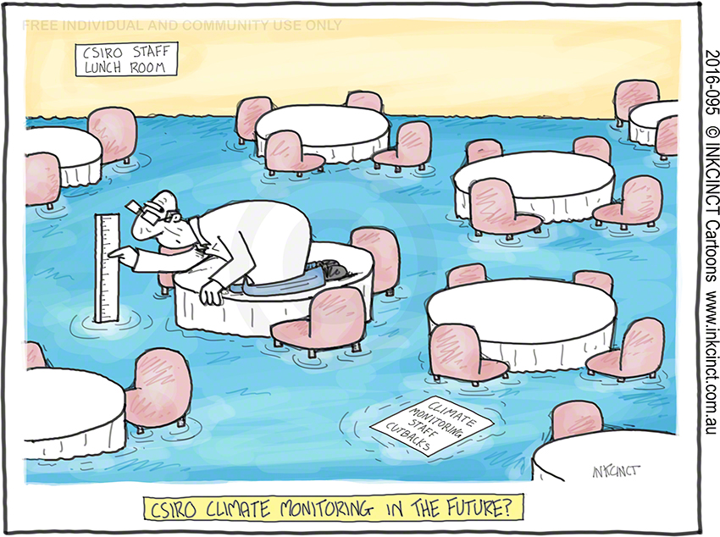
OCG103g - Impact of Global Change on Coastal New England
Course Logistics
syllabus
class dynamics
Content Overview
global env. change
past/present/future
Facebook Activity
perceptions
January 23, 2018

Slide 2
OCG103g - Impact of Global Change on Coastal New England
Course Logistics
syllabus
Instructors: John King Rob Pockalny
Teaching Asst: Sean Scannell
Grading:
2 online exams (20%, example questions on Sakai syllabus)
Assignments (20%, online surveys, activity reports)
Participation (20%)
Attendance (20%)
Final Project (20%, group presentation)
Field Trip: Southern RI Beaches, Saturday after Spring Break
Notes:
presentation

Slide 3
OCG103g - Impact of Global Change on Coastal New England
Course Logistics
syllabus
Course Logistics
syllabus
class dynamics
Pre-Class Surveys
  on-line readings
  on-line questionnaire
  due by midnight before class
In-Class Activities
  lectures (50%)
  activities (25%)
  discussion (25%)
Assignments (1 to 2 page summaries)
  what we did
  why we did it
  implications or perceptions
Notes:
presentation

Slide 4
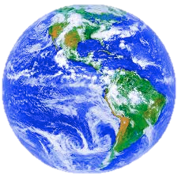
OCG103g - Impact of Global Change on Coastal New England
Content Overview
Global Environmental Change
Potential Solutions
Nature
Biological
Chemical
Physical
Changes
Atmosphere
Ocean
Societal
Institutions
Land
Quality
of Life
Humans
Definition:
The set of biological, chemical and physical changes to land, ocean and atmosphere, which are driven by an interwoven system of human and natural processes.
These changes are intimately connected with processes
of socio-economic and cultural globalization.

Slide 5
OCG103g - Impact of Global Change on Coastal New England
Content Overview
global env. change
past/present/future
Past (natural)
climate change history
geologic record
tribal history
Present (humans?)
recent history
potential causes
examples
Future (solutions)
models/predictions
mitigations
societal impacts

Slide 6
OCG103g - Impact of Global Change on Coastal New England
Facebook Activity
perceptions
Go to the Facebook page of someone you know pretty well.
Pretend you don’t know this person well and write down 3 perceptions you get of this person from the Facebook page.

Slide 7
OCG103g - Impact of Global Change on Coastal New England
Facebook Activity
perceptions
Go to the Facebook page of someone you know pretty well.
Pretend you don’t know this person well and write down 3 perceptions you get of this person from the Facebook page.
Now look at these 3 perceptions and think about how accurate these perceptions are based on your knowledge of this person.

