Slide 1
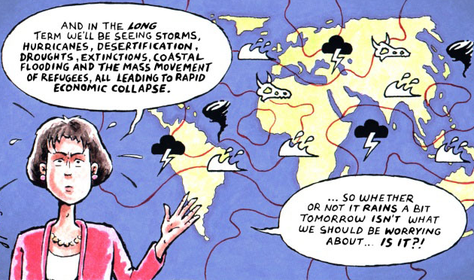
OCG103g - Impact of Global Change on NE’s Coastal Environment
Weather vs Climate

Slide 2
Weather & Climate
Weather vs Climate
Weather
- day-to-day state of the atmosphere in a region
(e.g., sunny, cloudy, rain, snow, hot, cold)
- short-term
Climate
- average weather pattern(s) in a region
(e.g., tropical, temperate, polar, dry, wet)
- longer-term (~30 years of observations)

Slide 3
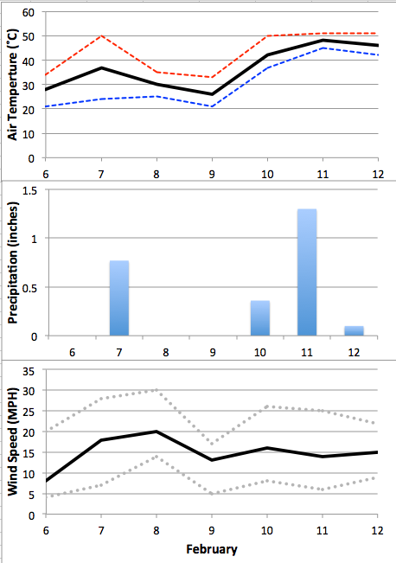
Weather & Climate – Local Examples
Weather or Climate

Slide 4
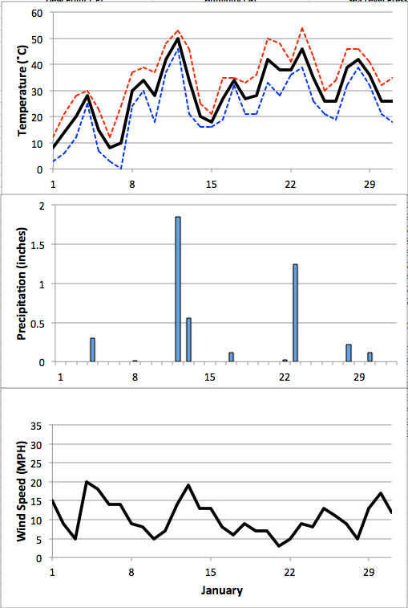
Weather & Climate – Local Examples

Slide 5
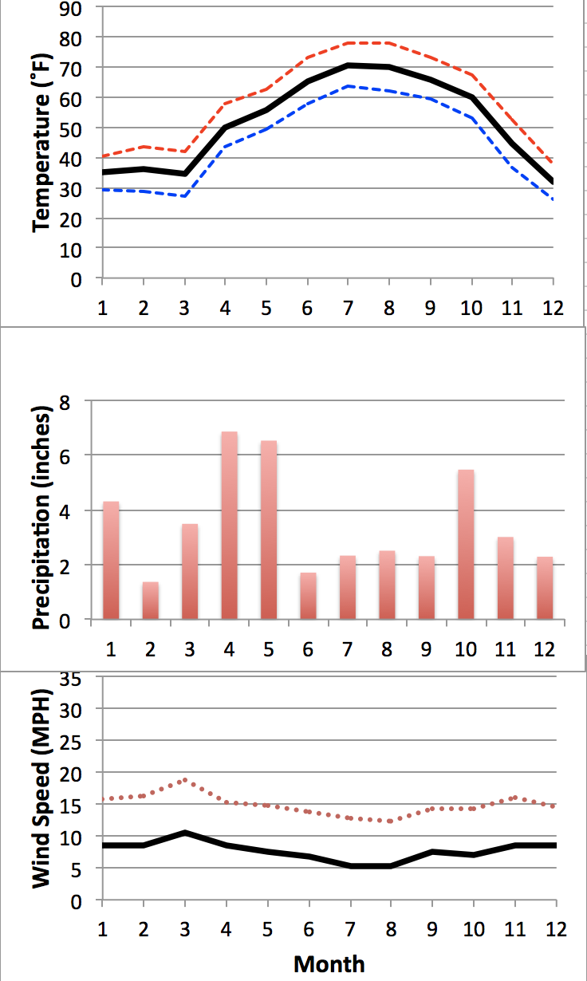
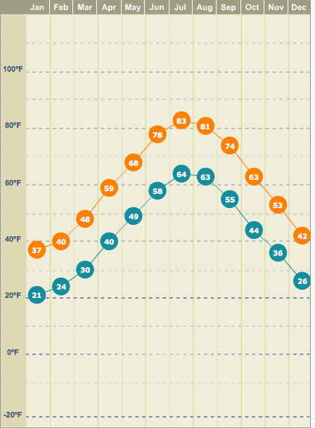
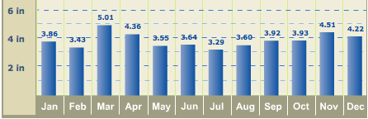
Weather & Climate – Local Examples
Local RI Climate
Winds
NW
SW
NW

Slide 6
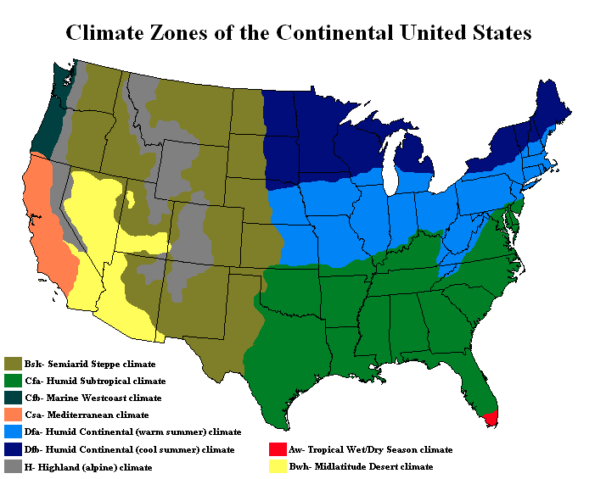
Weather & Climate – U.S. Climate Zones
Think-Pair-Share
What patterns do you notice?
What are the cause(s) of these patterns?

Slide 7
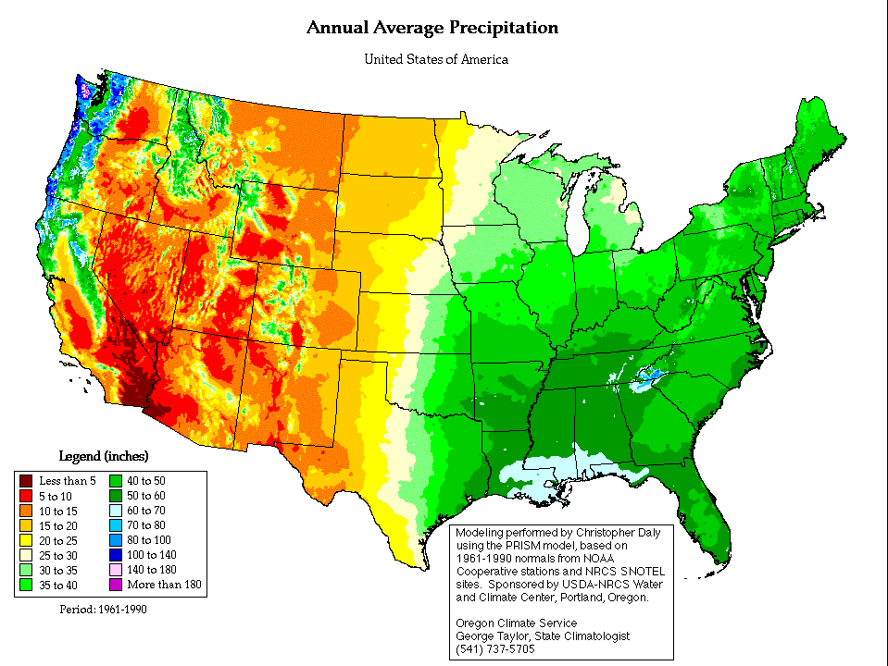
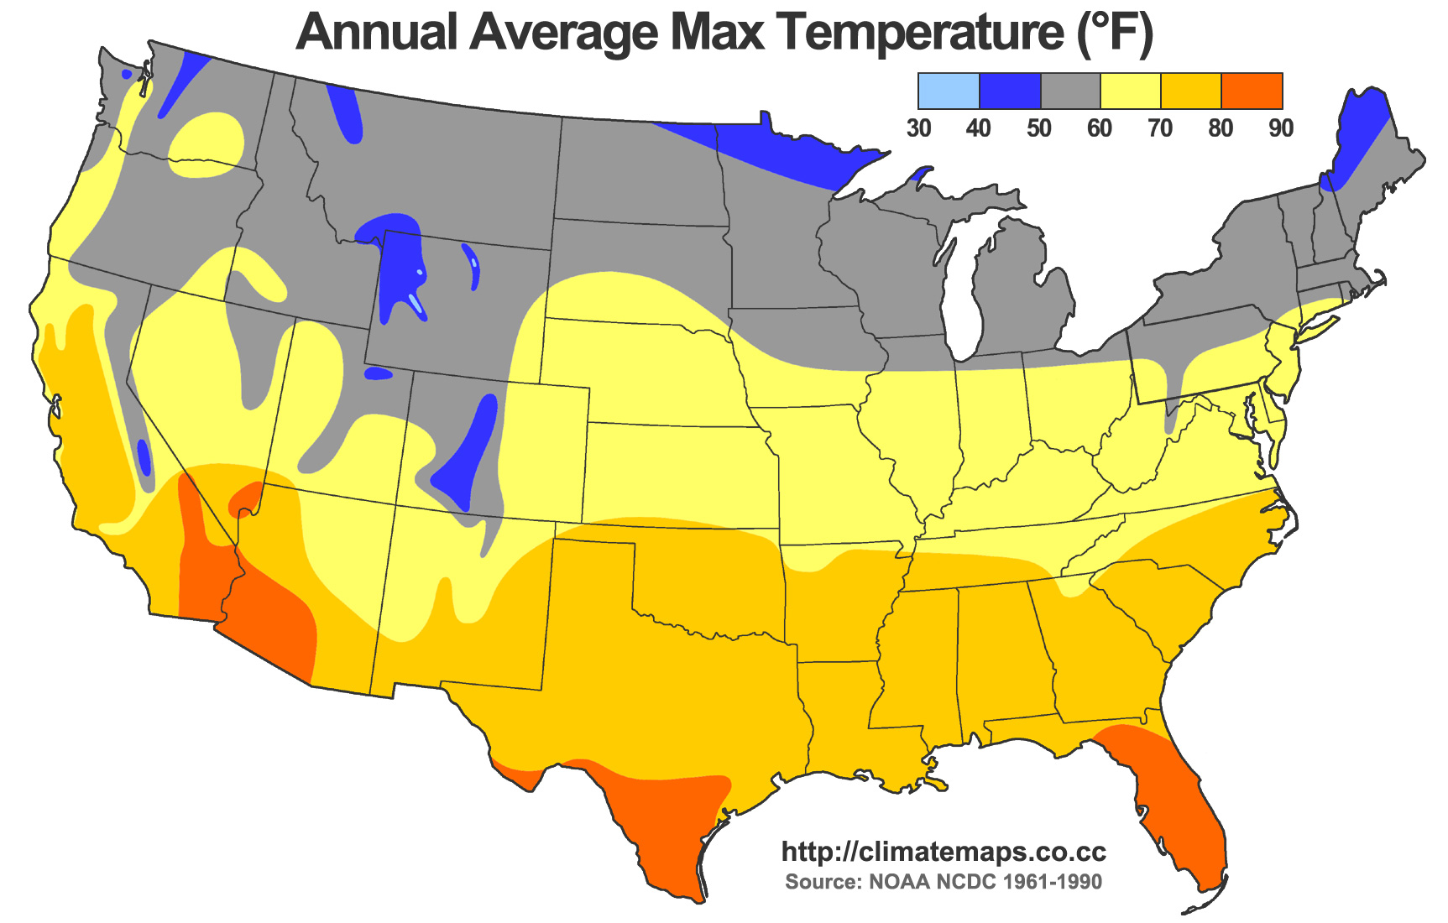
Weather & Climate – U.S. Climate Zones
Very
Wet
Annual Average Precipitation
Cool
Dry
Wet
Warm

Slide 8
Weather & Climate – U.S. Climate Zones
Alpine
Humid Continental (cool)
Marine West Coast
Humid Continental (warm)
Mediterranean
Humid Subtropical
Mid-latitude Desert
Semi-arid Steppe
Tropical Wet/Dry Season

Slide 9
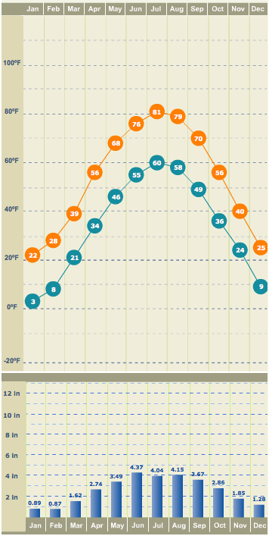
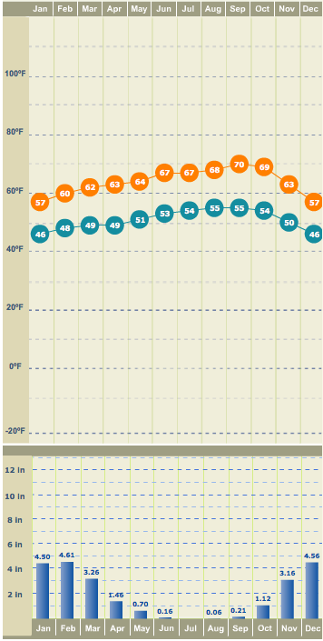
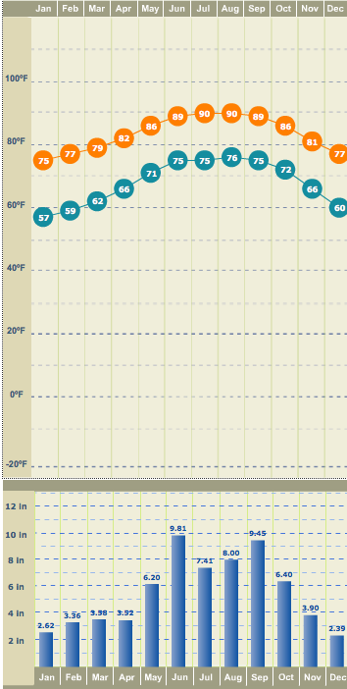
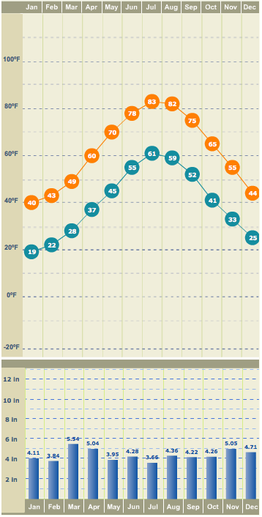
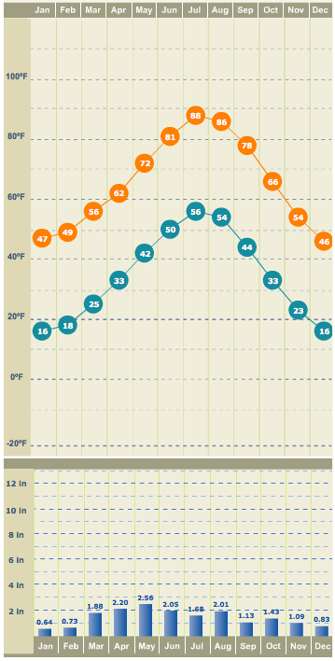
Weather & Climate – Climate Comparisons
San Francisco, CA
Ft. Lauderdale, FL
Kingston, RI
Denver, CO

Slide 10
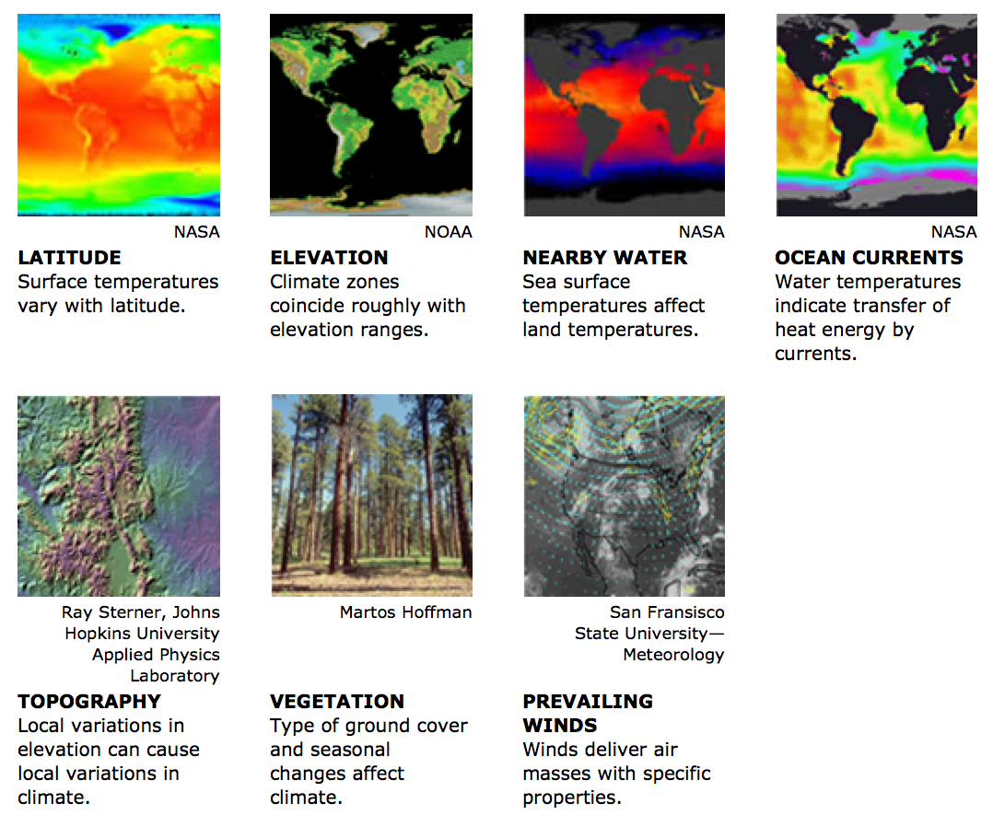
Other Factors

Slide 11
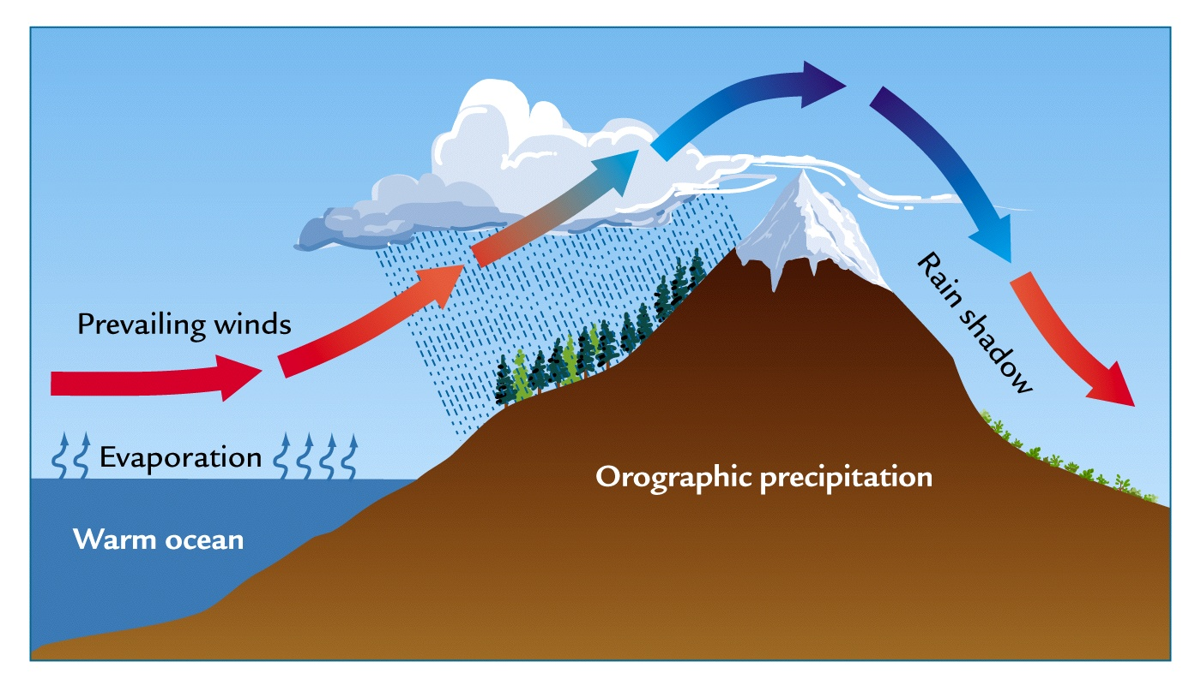
Other Factors – Orographic (Mountain) Effect

Slide 12
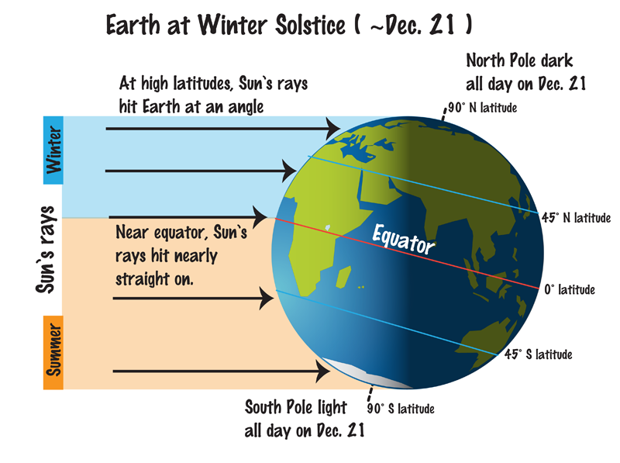
Other Factors – Latitude

Slide 13
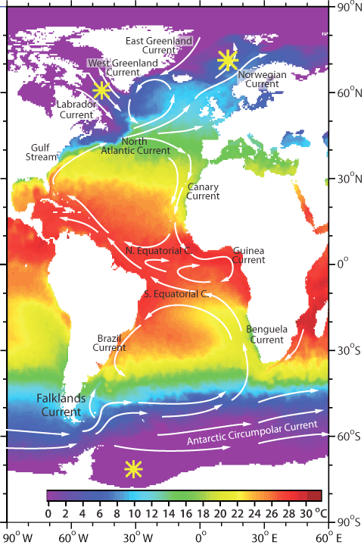
Other Factors – Ocean Currents
Impact of Ocean Currents
Do you think England would be
1) warmer
2) colder
3) about the same
without ocean currents?

Slide 14
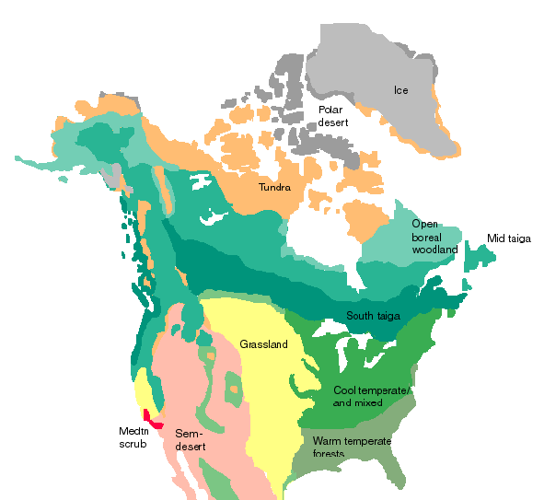
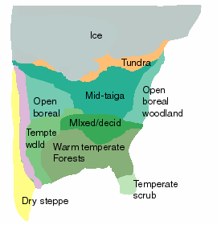
Other Factors - Vegetation
Today, if no agriculture
~25, kybp

Slide 15
Summary
Weather vs Climate
- Weather is short term conditions
  - Climate is longer term (~30 years)
For more information
Weather and Climate Basics
http://www.eo.ucar.edu/basics/
Indicators of Climate
- Primarily Temperature & Precipitation
U.S. Climate Zones
- Eastern Half => temperature gradient from N to S
- Western Half => amount of precipitation & elevation
Factors Controlling Climate
- Latitude - Elevation/Topography
- Vegetation - Nearby Water/Currents
- Prevailing Winds

