Slide 1
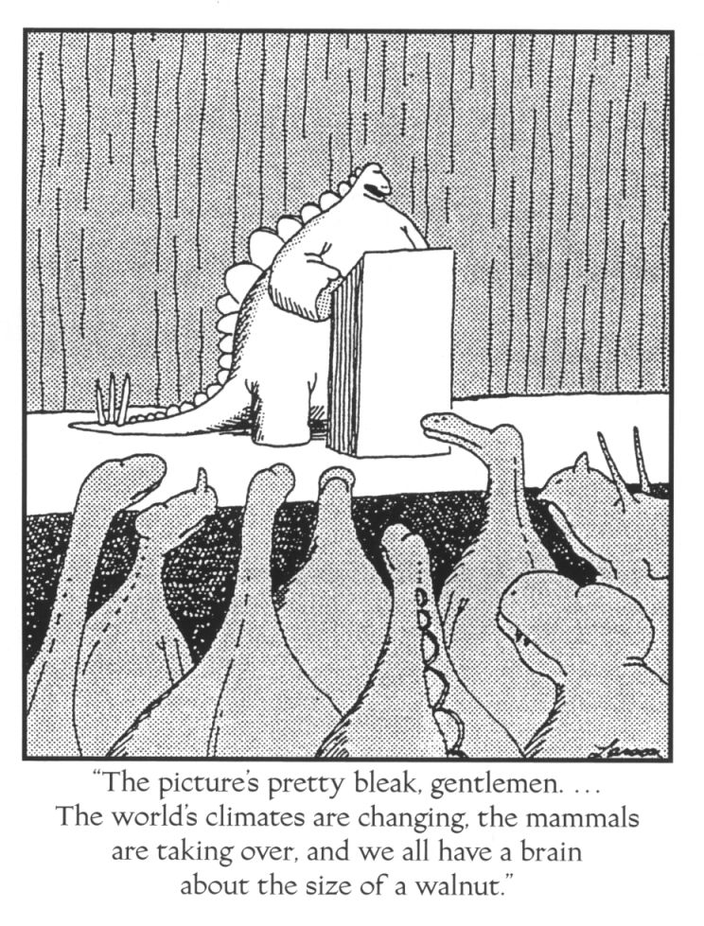
Earth’s Climate System
Complexity
Causes of Climate Change (Factors)
Recent Changes?

Slide 2
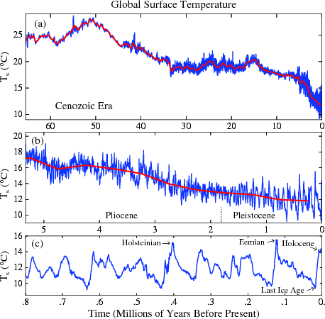
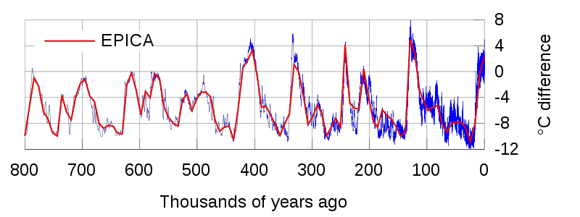
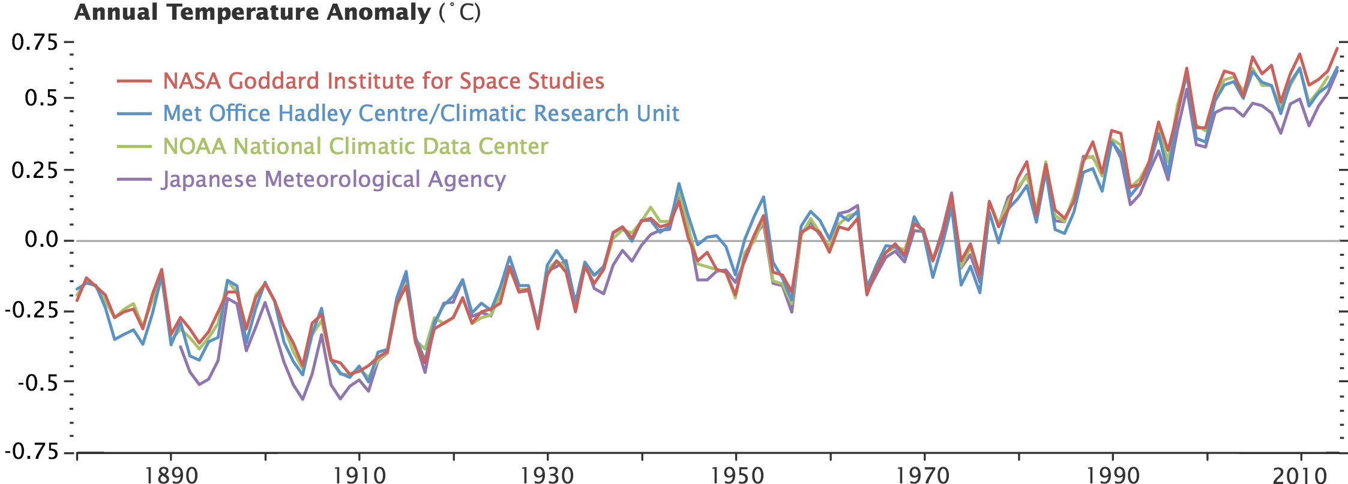
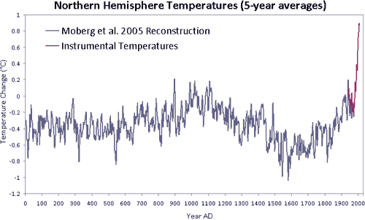
Time Scales of Temperature Change
Millions of Years
Thousands of Years
Hundreds of Years
Tens of Years
15
14
13

Slide 3
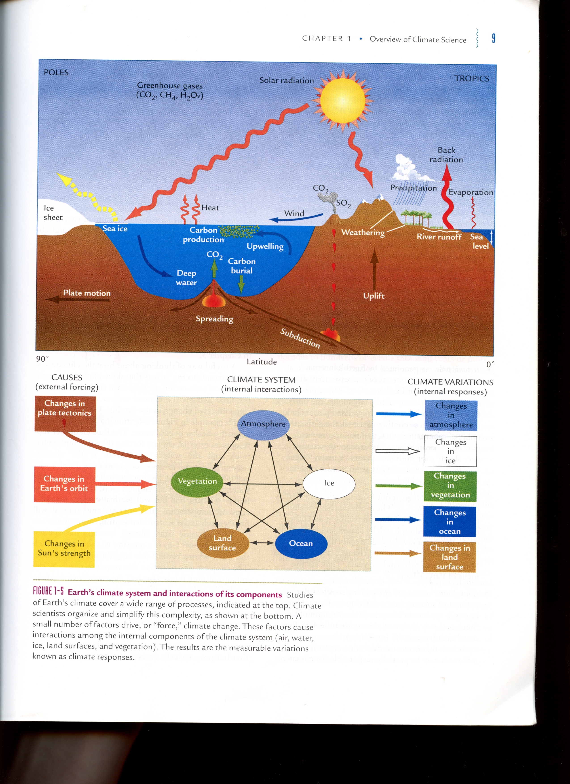
Climate System
A Very Complex System

Slide 4
Climate System
Complex System
internal interactions

Slide 5
Climate System
Complex System
internal interactions
external forcings (causes of change)

Slide 6
Climate System
Complex System
internal interactions
external forcings (causes of change)
internal response (climate change)

Slide 7
Climate System
What happens if Greenhouse Gases Increase
Atmosphere?
Ice?
Ocean?
Land?
Vegetation?

Slide 8
Climate System
Pick one and generate a “Causal Chain”
Remove paved roads?
Plant a trillion trees?
Move continents to poles?
Stop Gulf Stream?

Slide 9
Climate Change Factors
100
10
Temperature Change (˚C)
Orbital Patterns
Plate Tectonics
Albedo
Green House Gases
1
Volcanoes
Sunspots
0.1
1
10
10²
10³
10⁶
10⁹
Time Span (Years)

Slide 10
Heavenly Bodies Demonstration

Slide 11
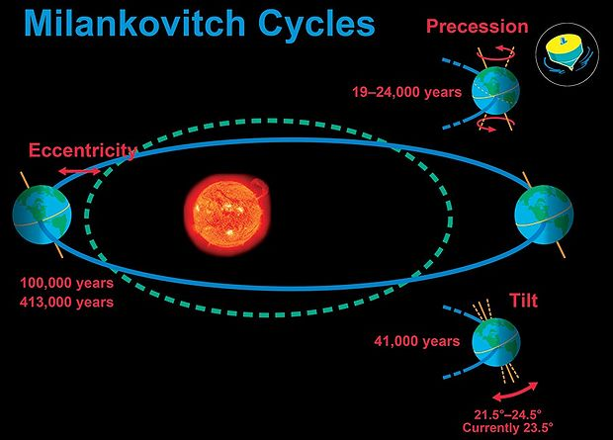
External Forcings – Changes in Earth’s Orbit
Orbital Patterns
Eccentricity – elliptical orbit (100,000 & 400,000 years)
Obliquity – variable tilt (~40,000 years)
Precessions – wobbly top (~20,000 years)

Slide 12
External Forcings – Changes in Earth’s Orbit
Eccentricity – elliptical orbit (100,000 & 400,000 years)
Cause = proximity to Jupiter and Saturn
Elliptical vs Circular Orbits
Sun-centered vs Shifted Orbits
Where is solar input
greatest
lowest
Where is solar input
greatest
lowest

Slide 13
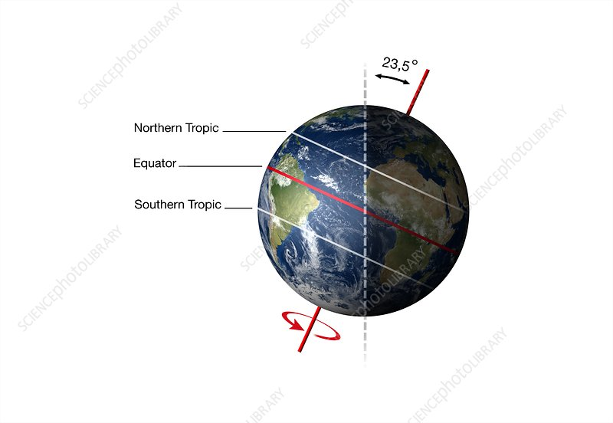
External Forcings – Changes in Earth’s Orbit
Obliquity – variable tilt (~40,000 years)
Cause = proximity to Jupiter and Saturn
20,000 years ago
Today
in 20,000 years
24.5˚
23.5˚
22.1˚
More tilt => more extreme seasons
Less tilt => colder poles, warmer equator

Slide 14
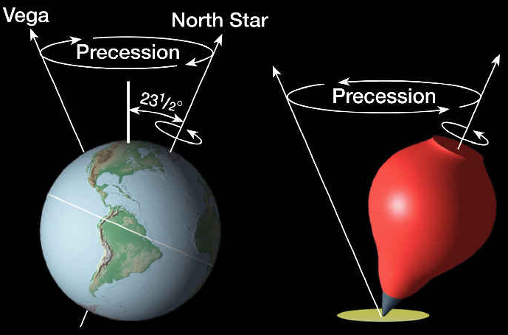
External Forcings – Changes in Earth’s Orbit
Precessions – wobbly top (~20,000 years)
Changes timing of equinox and solstice
(e.g., in 10,000 years, our summer will be in December)

Slide 15
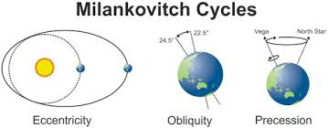
External Forcings – Changes in Earth’s Orbit
Orbital Patterns
Eccentricity – elliptical orbit (100,000 & 400,000 years)
Obliquity – variable tilt (~40,000 years)
Precessions – wobbly top (~20,000 years)
Impacts amount of solar radiation reaching Earth
Impacts distribution
Impacts timing

Slide 16
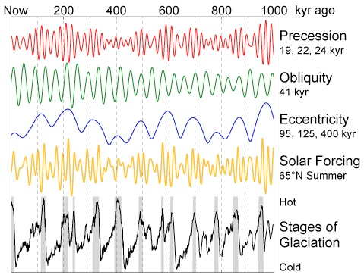
External Forcings – Changes in Earth’s Orbit
Orbital Patterns Through Time
20,000 years
+
40,000 years
+
100,000 years
400,000 years
+
Solar Variability

Slide 17
External Forcings – Changes in Earth’s Orbit
Orbital Patterns Through Time
20,000 years
+
40,000 years
+
100,000 years
400,000 years
+
Solar Variability

Slide 18
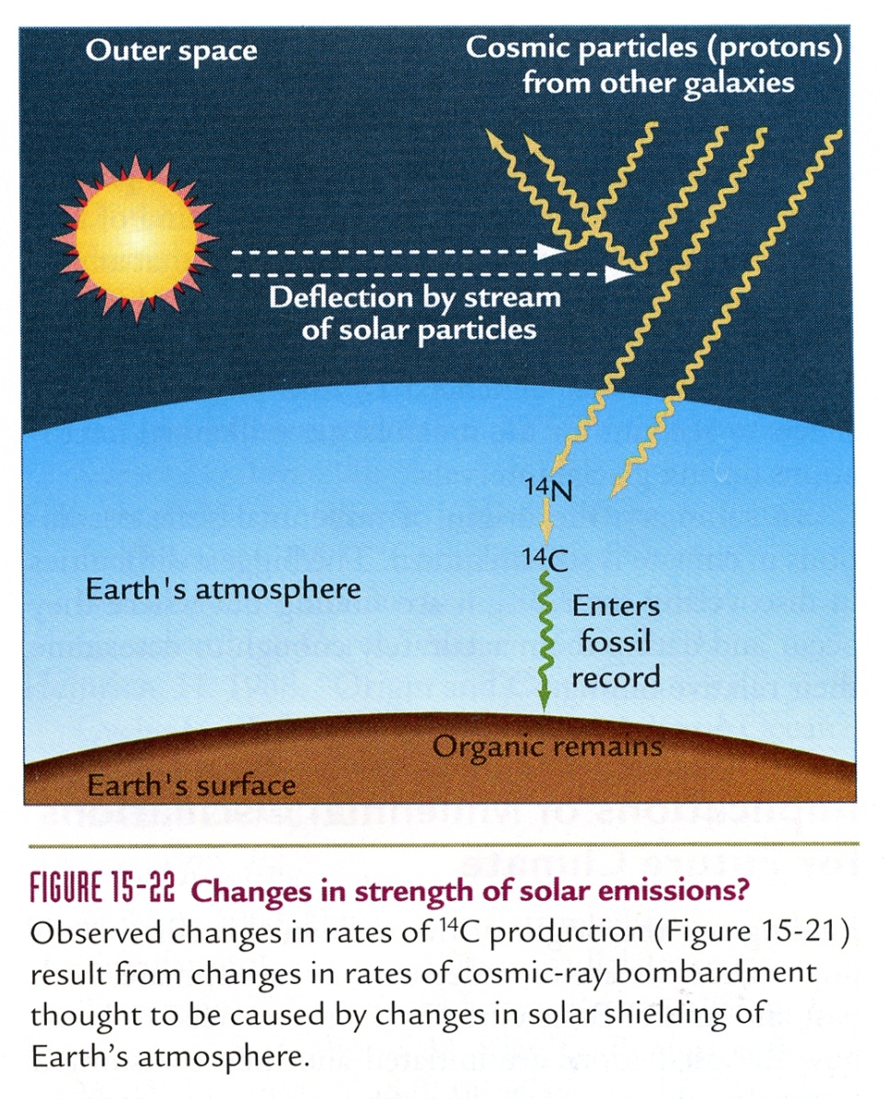

External Forcings – Changes in Sun’s Strength

Slide 19
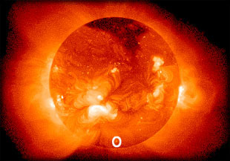
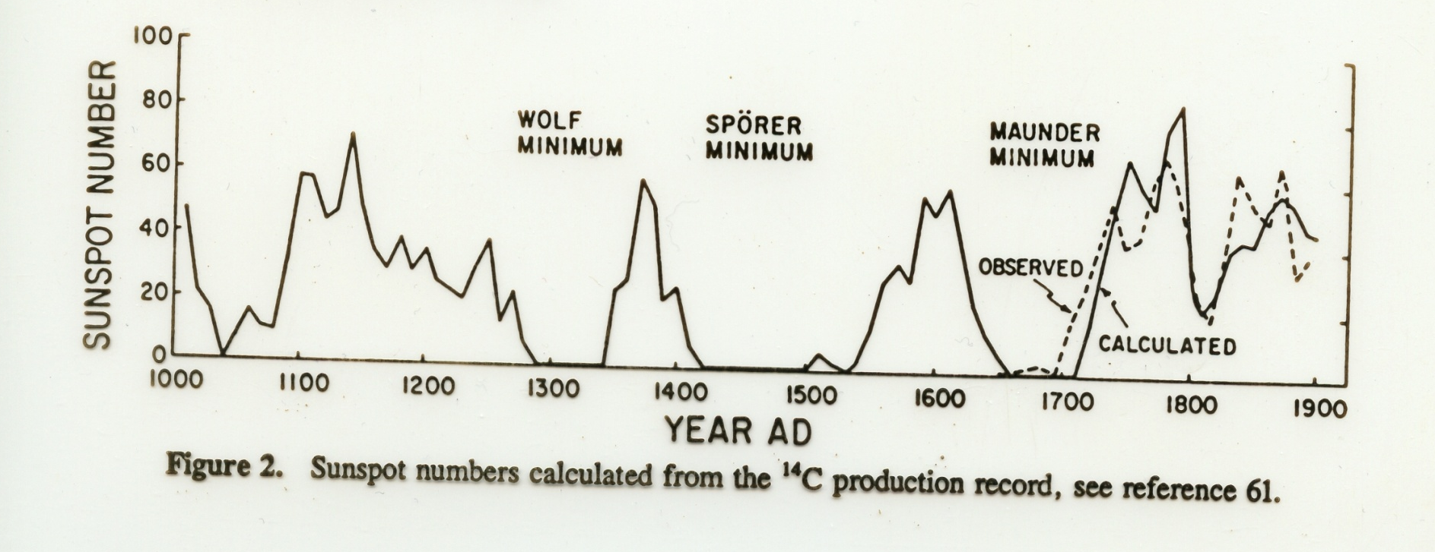
External Forcings – Changes in Sun’s Strength
Sunspot Numbers
- changes in magnetic field of Sun

Slide 20
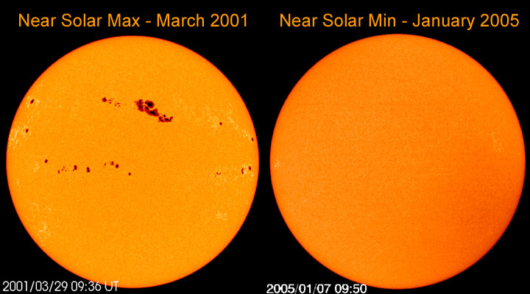
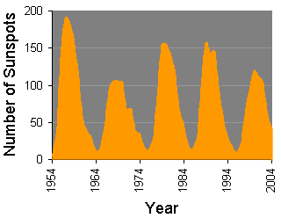
External Forcings – Changes in Sun’s Strength
Sunspot Cycle
changes in magnetic polarity of Sun
11 year cycle

Slide 21
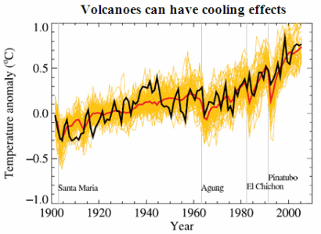
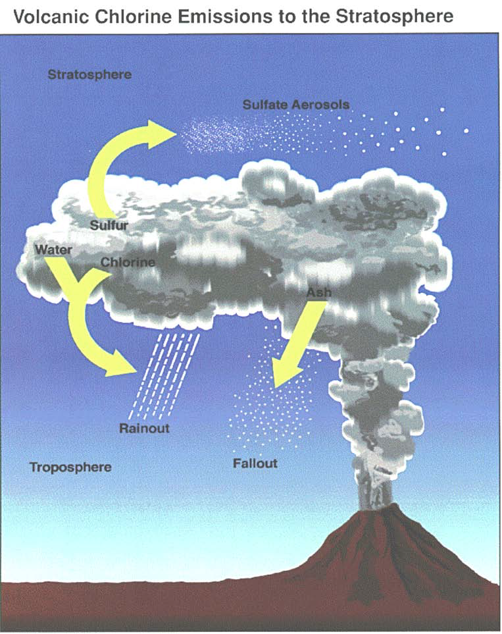
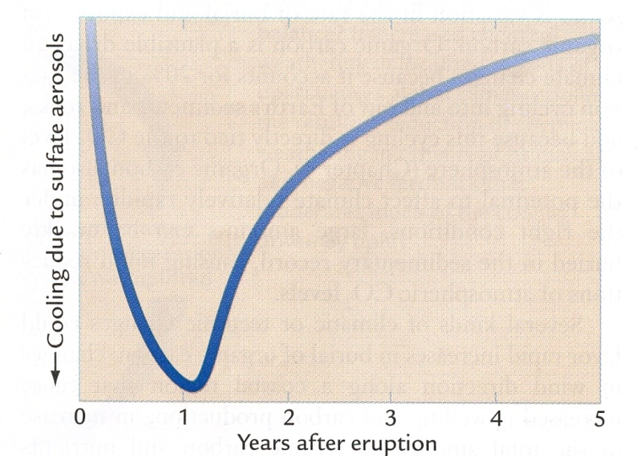
External Forcings – Volcanic Eruptions
Climate Change Factors

Slide 22
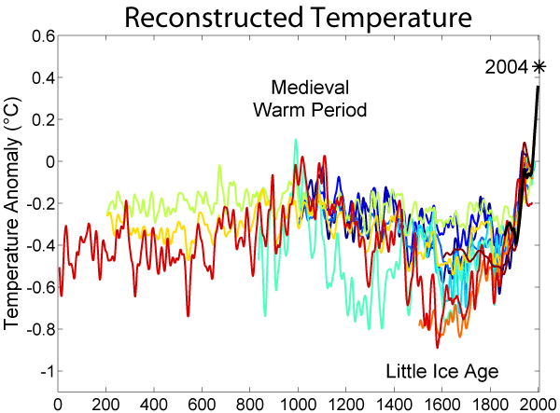
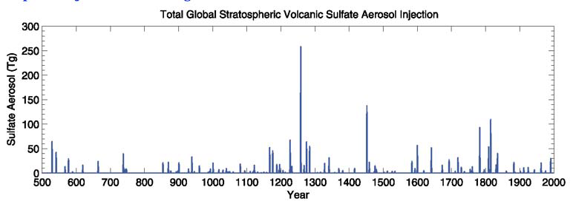
External Forcings – Volcanic Eruptions
Climate Change Factors
Volcanic
Eruptions
Sulfate Aerosol
500
1000
1500
2000
Year

Slide 23
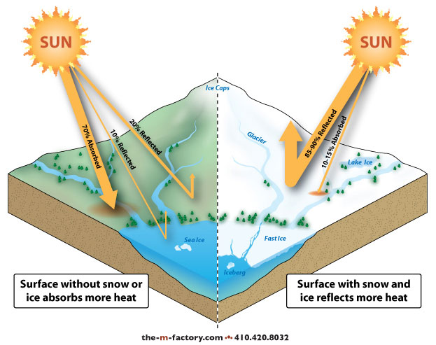
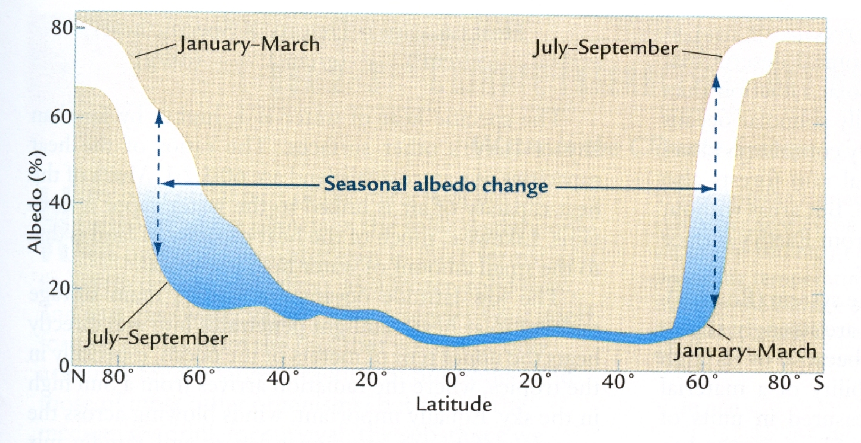
Climate Change Factors - Albedo Effects
Increased ice and snow cover will lead to cooling
Reduced ice and snow cover will lead to warming

Slide 24
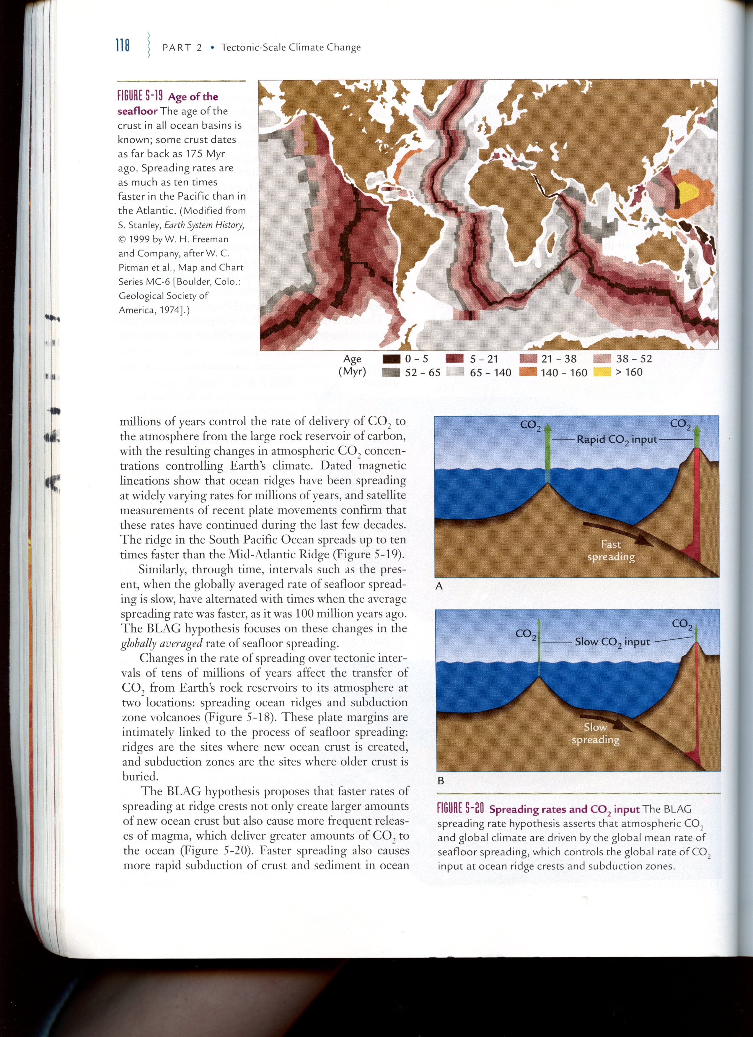
External Forcings - Plate Tectonics
BLAG (Berner, Lasaga & Garrels) Hypothesis
  Faster spreading increases rate of CO₂ input to the atmosphere
  Slower spreading decreases rate of CO₂ input to the atmosphere

Slide 25
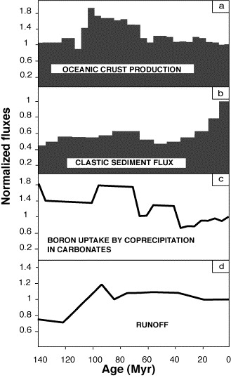
External Forcings - Plate Tectonics
Faster
Slower
Seafloor spreading rates
Think-Pair-Share
Would you predict the atmospheric CO₂ concentration to be higher, lower, or about the same ~100 Million years ago?
Would you expect the climate to be warmer, cooler, or about the same?

Slide 26
Global Warming – What’s Missing?
What do you think is causing this recent change?
15˚C
14˚C

