Slide 1
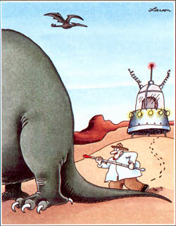
Earth’s Temperature History – How do we know?
Climate System Review
Temperature History Review
Temperature Proxies
Ice Core Activity

Slide 2
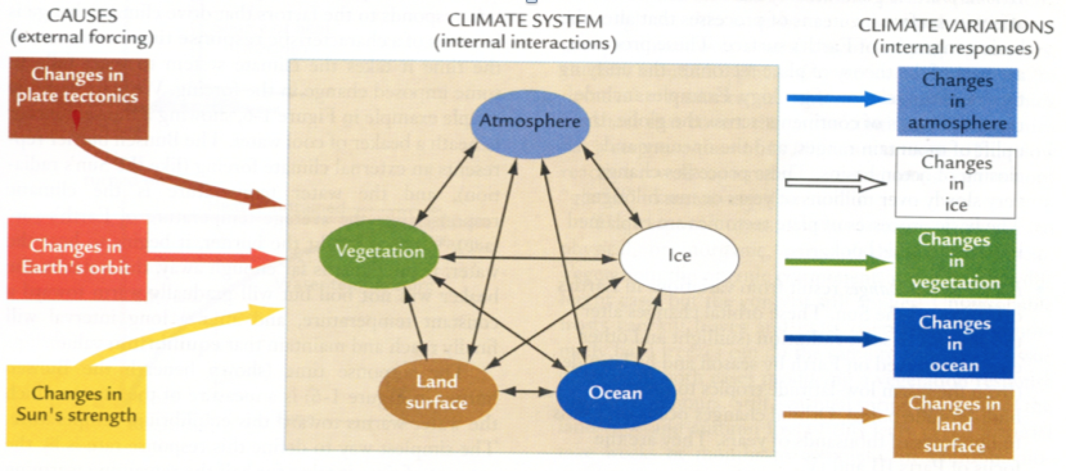
Climate Change
Climate System
- external forcings (plate tectonics, orbit, solar input, volcanoes & man)
- internal interactions (air, sea, land, ice, vegetation)
- internal responses (changes in climate system)
Causal Chains
More sunspots => global warming => melts ice => sea level rises => land area decreases
=> less room for land plants ………

Slide 3
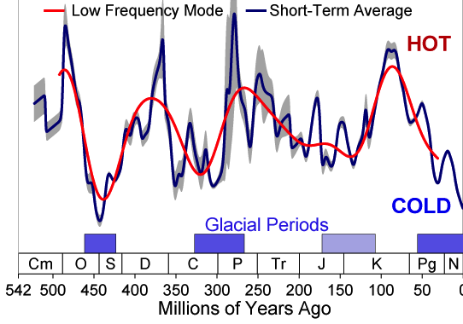
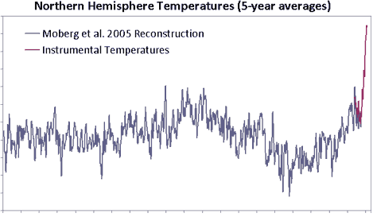
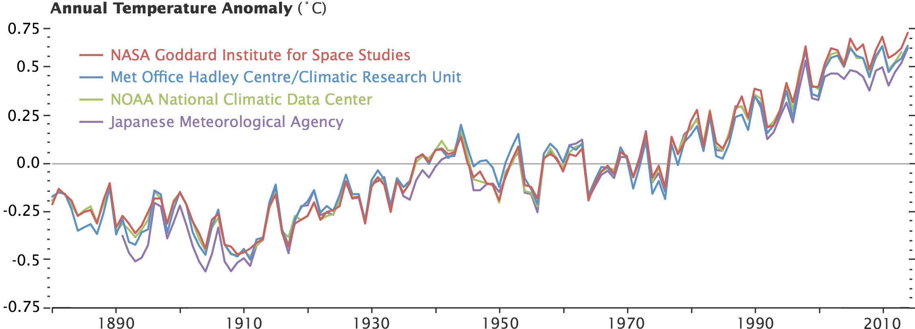
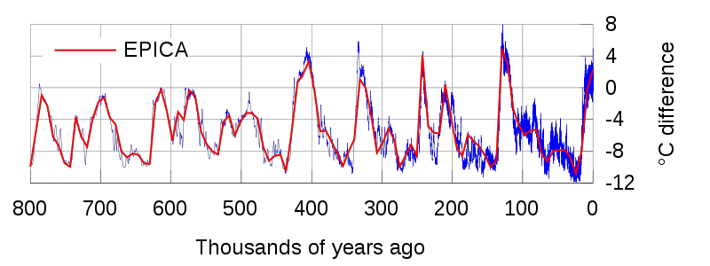
Temperature History Review
Plate Tectonics (Millions of Years)
Sunspots/Volcanoes (10-100s of Years)
0.5
Proxies
Temp. Anomaly (C)
0
Instruments
-0.5
0
Year (AD)
1000
2000
Which time-frame do you believe is the most accurate?
Instrumentation (Decades)
Orbital Patterns (Thousands of Years)
5
0
Temp. Anomaly (C)
-5
Thousands of Years Ago

Slide 4
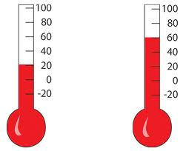
Temperature Proxy
Temperature Proxy –
- preserved physical characteristic (e.g., tree ring)
- that can be used as a measure of past temperature
- if properly calibrated.
4
150
4
3
100
3
Height of Fluid
2
50
2
1
0
1
0
50
100
150
Temperature

Slide 5
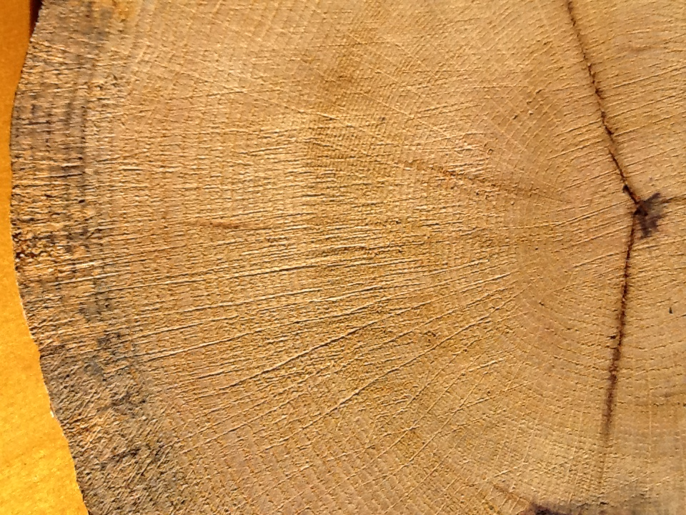
Temperature Proxy – Tree Rings
Tree Ring Age
1937
1942
1947
1952
1957
1962
1967
1972
1977
1982
1987
1992
1997
2002
2007
2012
Growing Conditions?
Wetter
Wider
Rings
Rainfall
Narrower
Rings
Dryer
Colder
Warmer
Temperature

Slide 6
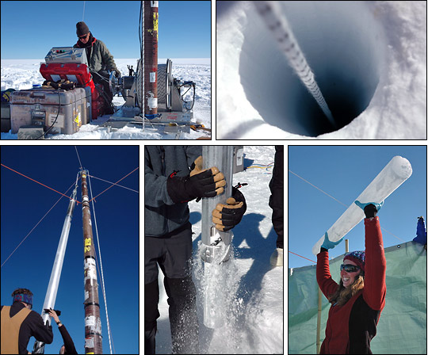
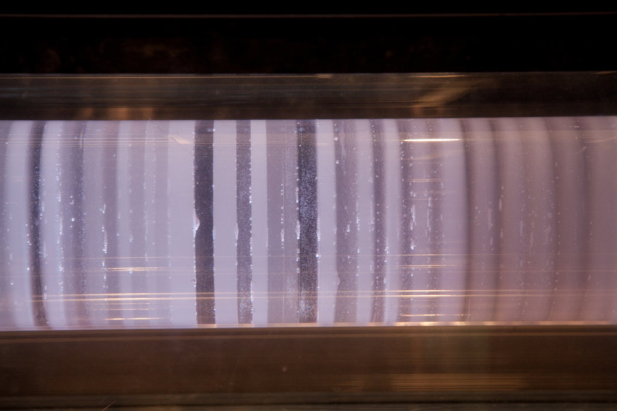
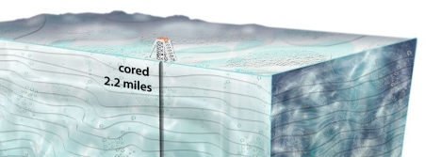
Temperature Proxy – Ice Cores
Annual
Rings

Slide 7
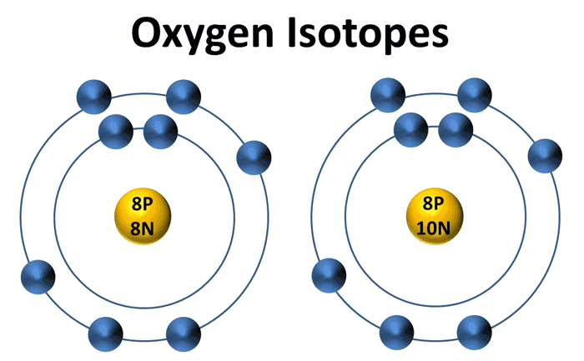
Temperature Proxy – Ice Cores
Warmer Temps.
Ice enriched in ¹⁸O
Ice depleted in ¹⁶O
¹⁸O/¹⁶O increases
¹⁶O
¹⁸O
Lighter
Heavier
Cooler Temps.
Ice depleted in ¹⁸O
Ice enriched in ¹⁶O
¹⁸O/¹⁶O decreases
Water Molecules
¹⁶O
¹⁸O
H
H
H
H
Lighter
Heavier

Slide 8
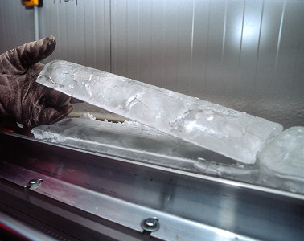
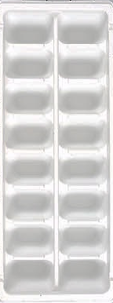
Split Ice Cores
Split Ice Tray
Archive
Working
1
2
3
4
5
6
7
8

Slide 9
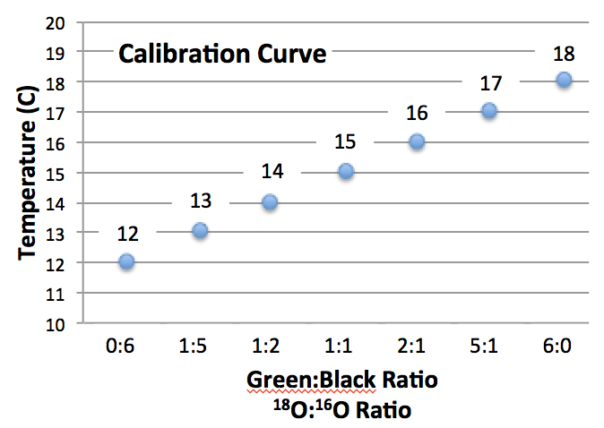
ABCDEFGH
Top
Green Beads (¹⁸O) | Black Beads (¹⁶O) | Green:Black Ratio | Temperature
5 | 1 | 5:1 | 17
Count
Both Cells
A
1) Count Number of Green Beads (¹⁸O)
B
2) Count Number of Black Beads (¹⁶O)
3) Calculate Ratio (Green/Black)
C
4) Use “Look-up Table” to obtain temperature
D
E
F
G
H

Slide 10
ABCDEFGH
Top
1760
1720
A
B
A
B
C
D
E
F
G
H
C
D
E
Volcanic Eruptions
1720
1760
F
G
H

Slide 11
ABCDEFGH
Top
1760
1720
A
B
A
B
C
D
E
F
G
H
C
D
E
F
G
H

Slide 12
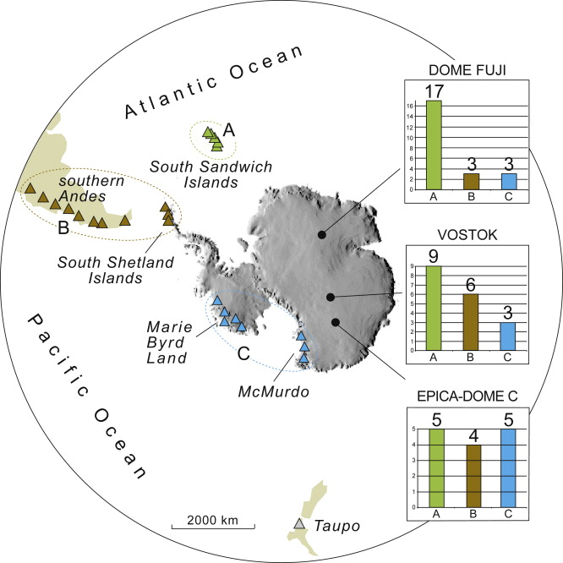
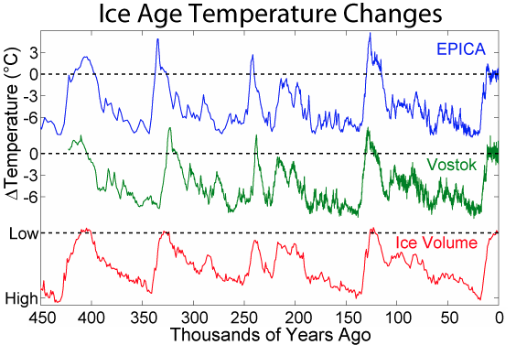
Ice Core Results

