Slide 1
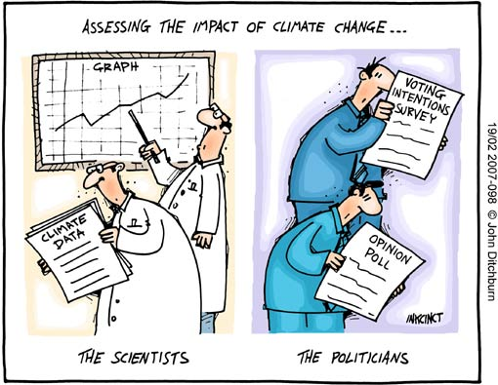
Climate Box Review & Greenhouse Gases
Greenhouse effect?
Greenhouse gases

Slide 2
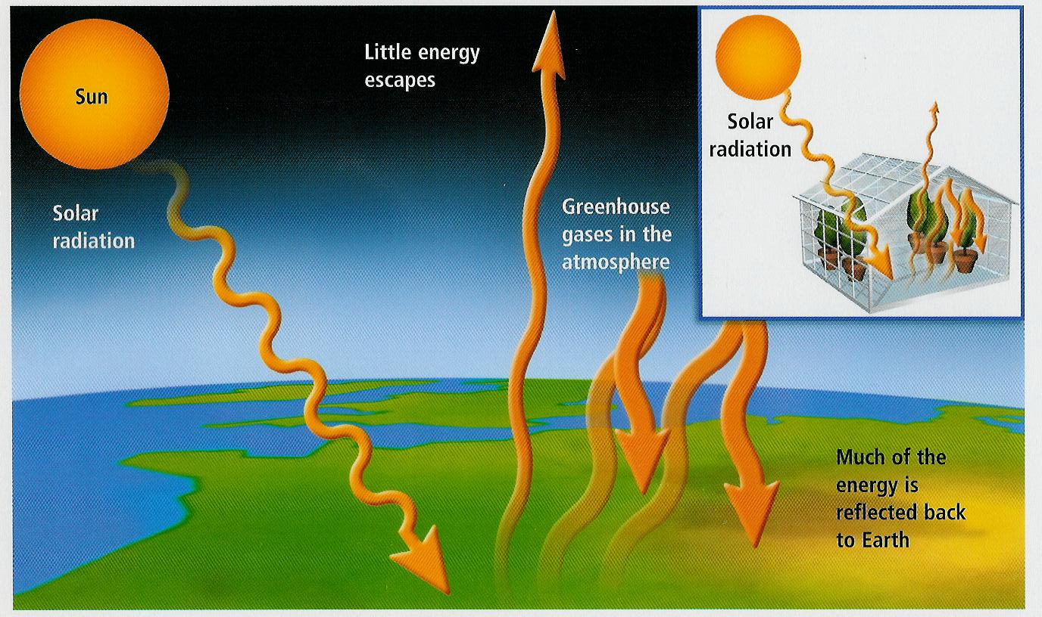
Greenhouse Effect
What is the greenhouse effect?

Slide 3
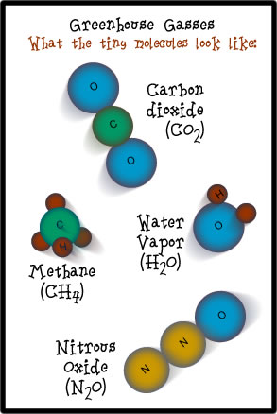
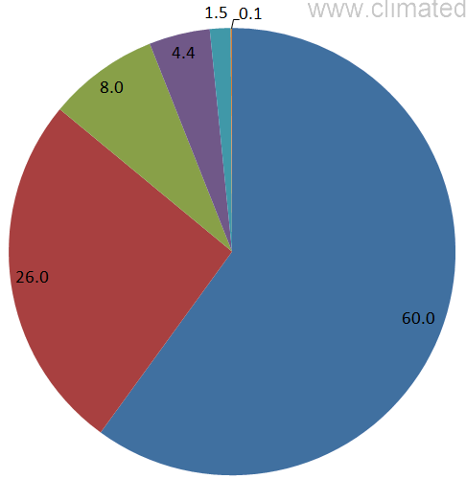
Greenhouse Effect
Greenhouse Gases (GHG)
Water Vapor (H₂O)
Carbon Dioxide (CO₂)
Nitrous Oxide (N₂O)
Methane (CH₄)
Ozone (O₃)
N₂O
CH₄
O₃
CO₂
H₂O
Contribution to Greenhouse Effect

Slide 4
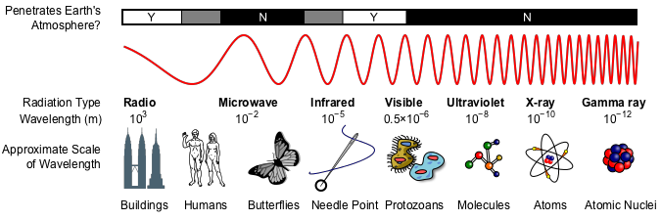
Greenhouse Effect – How does it work?
Electromagnetic Radiation Spectrum
?
?
Radio Waves
Infrared
Visible Light
Ultraviolet
Penetrate Earth’s Atmosphere

Slide 5
Greenhouse Effect
Greenhouse Gases
Visible
IR
UV
IR warms up CO₂
Re-radiates heat
O-C-O
Incoming
Sunlight
O-C-O
O-C-O
UV & Visible
No effect
Heats up Earth
“Converts” UV & Vis to IR

Slide 6
Greenhouse Effect
Greenhouse Gases
Visible
IR
UV
IR warms up CO₂
Re-radiates heat
O-C-O
IR heats up CO₂
Re-radiates heat
Incoming
Sunlight
O-C-O
O-C-O
O-C-O
UV & Visible
No effect
Radiated IR
Heats up Earth
“Converts” UV & Vis to IR

Slide 7
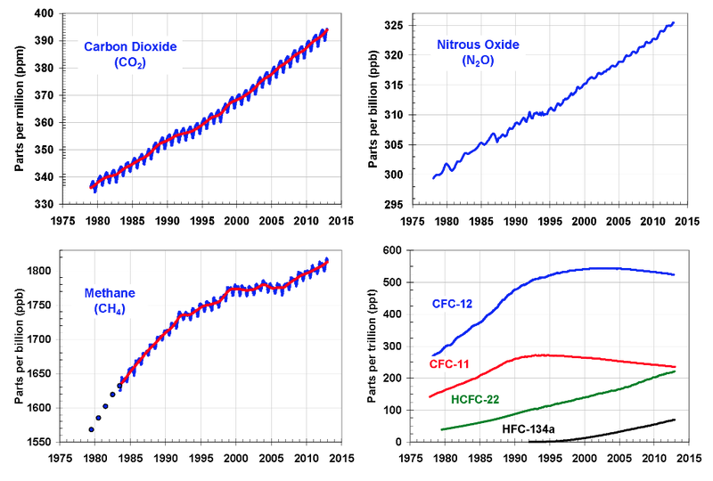
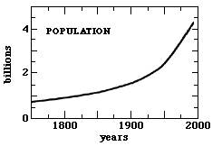
Greenhouse Effect - Trends
Greenhouse Gases (GHG)
Water Vapor (H₂O)
Carbon Dioxide (CO₂)
Nitrous Oxide (N₂O)
Methane (CH₄)
Ozone (O₃)

Slide 8
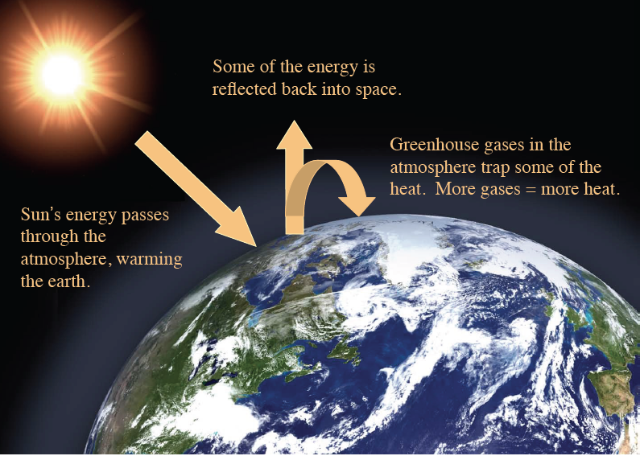
Greenhouse Effect
Greenhouse Gases (GHG)
Water Vapor (H₂O)
Carbon Dioxide (CO₂)
Nitrous Oxide (N₂O)
Methane (CH₄)
Ozone (O₃)
Greenhouse Effect
No Atmosphere
Sun In =>Sun Out
Atmosphere w/ some GHG
Sun In =>warm air =>Sun Out
Atmosphere w/ more GHG
Sun In =>warmer air =>Sun Out

Slide 9
Video – Questions
I still do not understand how CO₂ can create such a temperature change.
One thing that I still don't understand from the greenhouse gas video is how
exactly greenhouse gases trap heat.
If our planet's atmosphere is 99% nitrogen, which said it doesn’t absorb heat well,
how does the carbon dioxide and water vapor contain enough heat to keep the
planet warm?
IR radiation
C
O
O
Carbon Dioxide
Molecule
Incoming energy
“excites” the molecule
Molecule slowly “relaxes”
& releases heat (IR radiation)

Slide 10
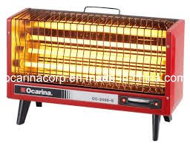
Video – Questions
Why do the radiation wavelengths change from short to long?
Electrical
Current
Electrical heater “converts” electric waves to heat (IR radiation)

Slide 11
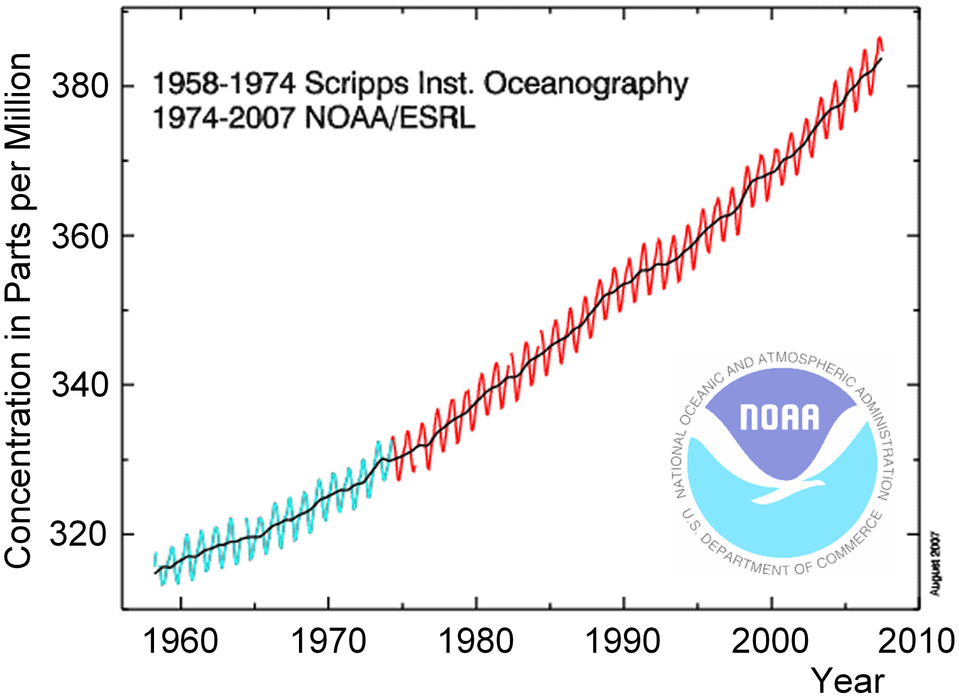
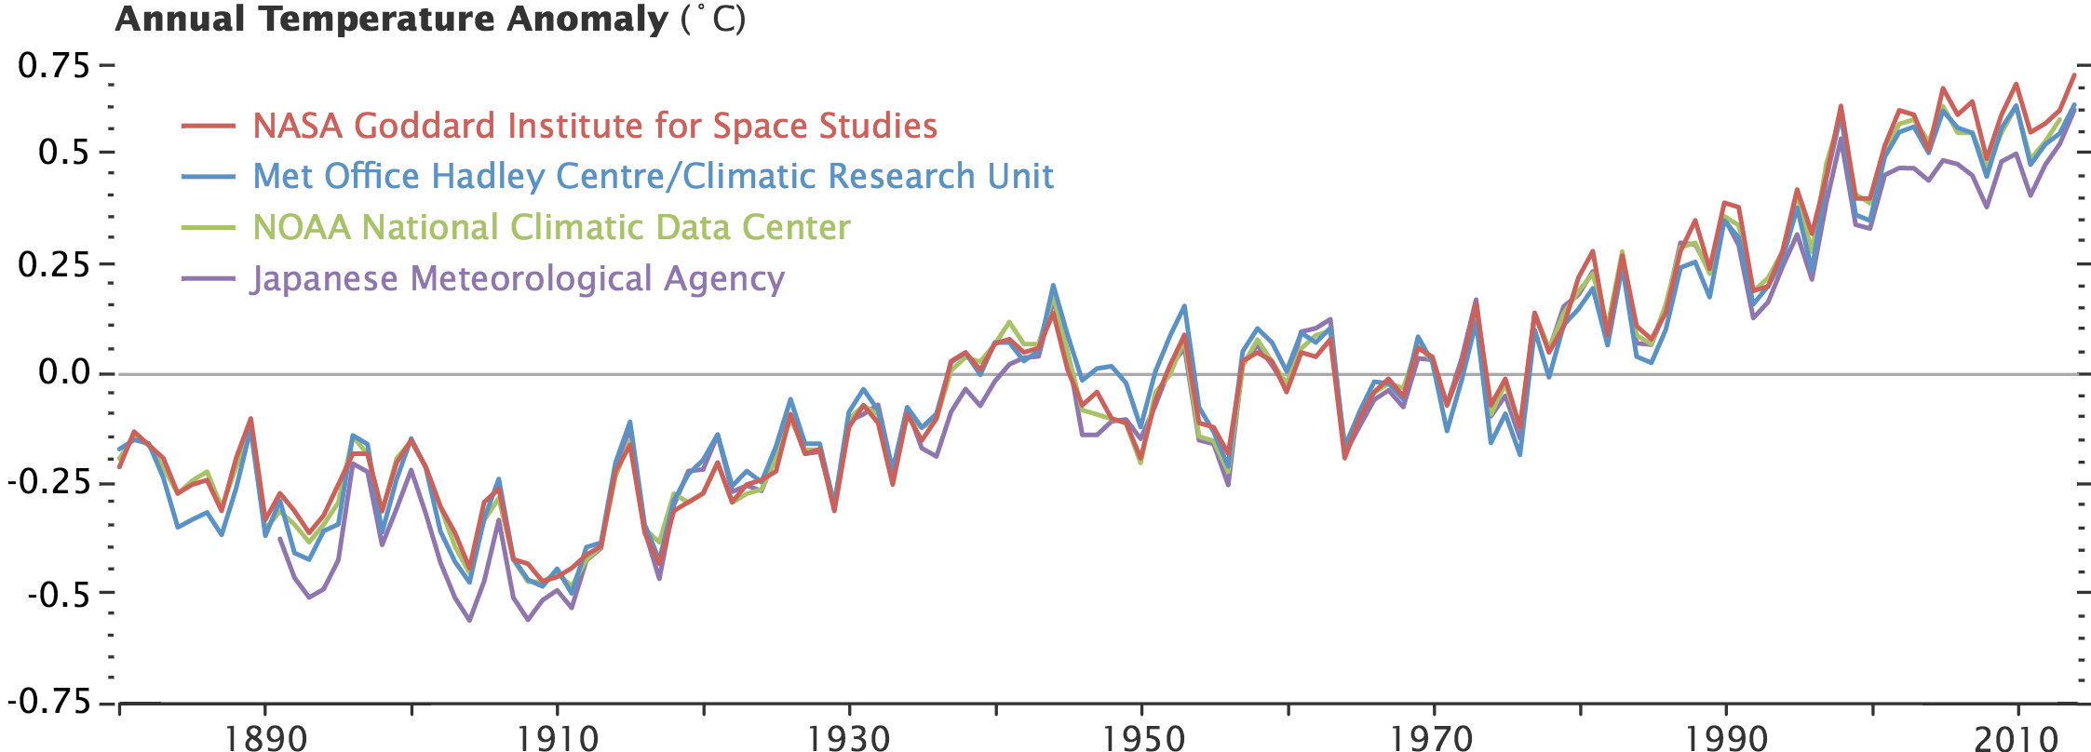
Greenhouse Effect - Trends
Greenhouse Gases (GHG)
Water Vapor (H₂O)
Carbon Dioxide (CO₂)
Nitrous Oxide (N₂O)
Methane (CH₄)
Ozone (O₃)

