Slide 1
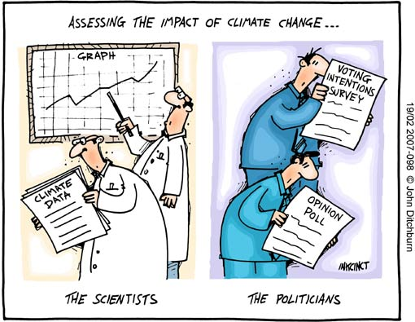
Climate Box Activity
Effect of Albedo and Greenhouse Gases

Slide 2
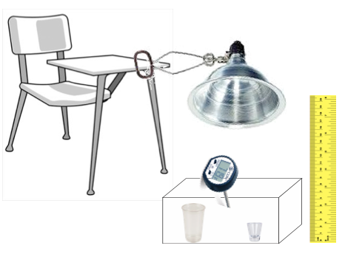
Climate Box - Materials
Materials
Plastic Bin
Thermometer (˚F)
Lamp
Light Bulb (100 W)
Ruler
Plastic Cup
Measuring spoon
Black Foam
White Foam
Vinegar (50 ml)
Baking Soda (1 tsp)

Slide 3
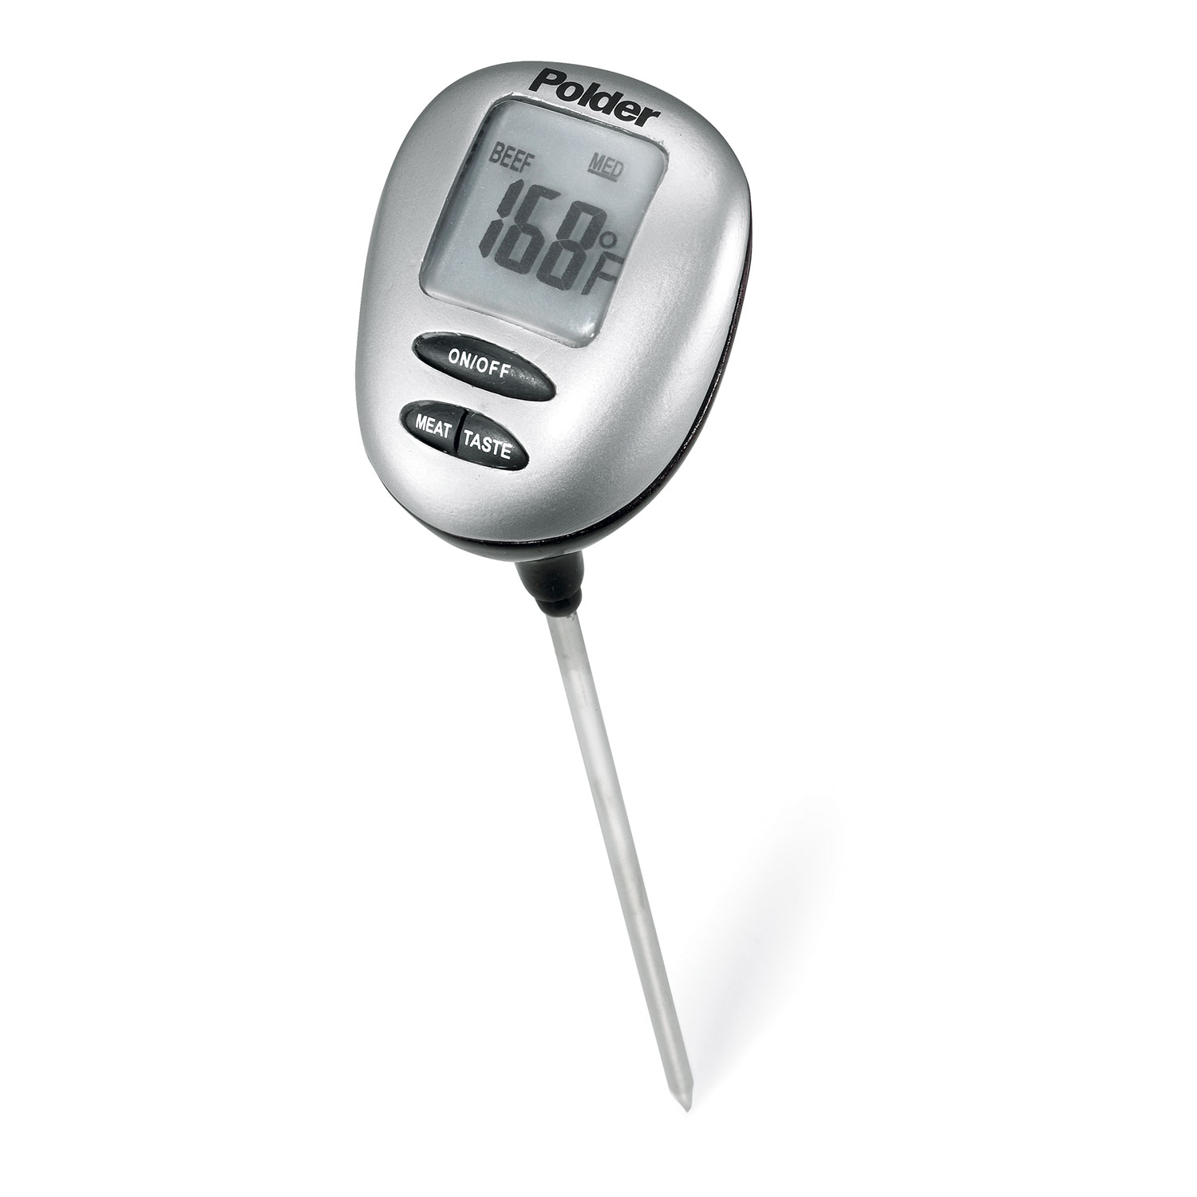
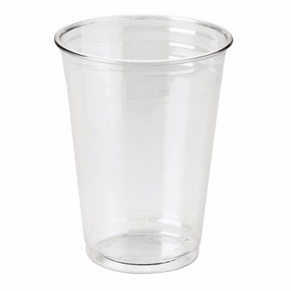
Climate Box - Procedure
Place white foam in plastic bin
Fill cup to line with vinegar
Place vented top on the bin
Place thermometer in vent in the bin top
Position light above bin, 12 inches off the floor
Take initial temperature reading and record on sheet
Turn on lamp and record every minute for 7 minutes
Turn off lamp and let box cool down for 3 minutes
Replace white foam w/ black foam and repeat process
Add 1 tsp baking soda to the vinegar
Replace lid and wait 1 minute before initial reading
Turn on lamp and record every minute for 7 minutes
Turn off lamp and let box cool down for 3 minutes
Replace black foam with white foam
Refill/replace vinegar
Add 1 tsp baking soda to the vinegar
Repeat steps above

Slide 4
Team Members
Time (min.) | White Bottom No mixing | Black Bottom No mixing | White Bottom Add powder | Black Bottom Add powder
0
1
2
3
4
5
6
7

Slide 5

Climate Box Review – Overview
Results
Black + Fizz
Jenna, Joe, Emily, Matt, Alec, Stephanie
Isaiah, Caroline, Betsy, Kara, Z
White + Fizz
Black
White
Stephanie, Matt, Caitlyn, Wesley, Jacqueline, Emily
Luke, Adam, Norm

Slide 6
Climate Box Review – Black & White
Results
Separate
Mixed
What patterns do you see?
Think-Pair-Share

Slide 7
Climate Box Review
Key Relationship
Temperature & Reflectivity
- darker background => increase air temperature
Warm
Air Temperature
Cool
Black
White
Albedo or Surface Reflectivity

Slide 8
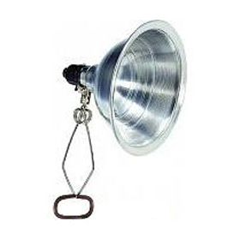
Climate Box Review – Black & White
What’s Happening
Incoming
Energy
Reflected
Energy
Incoming
Energy
Reflected
Energy
More
Energy
Absorbed
Less
Energy
Absorbed
More
Energy
Absorbed
Plastic
Warms
Faster
Adjacent Air
Warmed
Faster & More
Less
Energy
Absorbed
Plastic
Warms
Slower
Adjacent Air
Warmed
Slower & Less

Slide 9
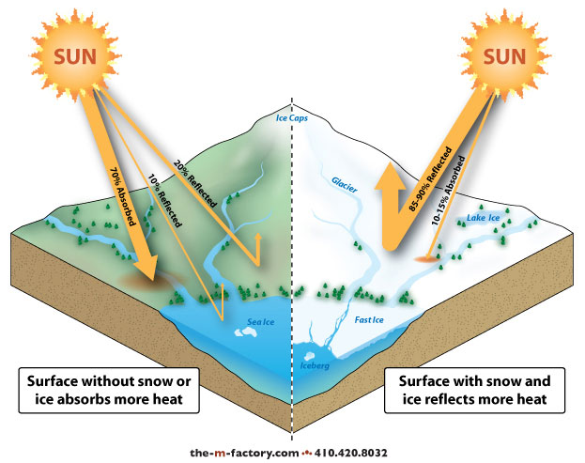
Climate Box Review – Black & White
Implications
Low
Albedo
High
Albedo
Asphalt => Black => Low Albedo
Snow => White => High Albedo

Slide 10
?
Climate Box Review – Pre & Post Fizz
?
Results
White
Black
What patterns do you see?
Think-Pair-Share

Slide 11
Climate Box Review – Pre & Post Fizz
Results
White
Kristen Chelsea Nicolette Emily
Black
What patterns do you see?
Think-Pair-Share

Slide 12
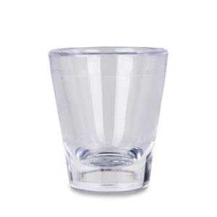

Climate Box Review
What’s Happening ?
Carbon Dioxide
Vinegar
Baking Soda
Antacid
Water
HC₂H₃O₂ + NaHCO₃ ➔ NaC₂H₃O₂ + H₂O + CO₂
Carbon Dioxide (gas)
Water (liquid)
Antacid (solid)

Slide 13
Climate Box Review
Key Relationship
Temperature & CO₂ Correlation
- increase in atmospheric CO₂ => increase air temperature
Warm
Air Temperature
Cool
Low
High
CO₂ Concentration in Air

Slide 14
Climate Box Review – Multiple Factors
Implications
Warm
Factor 1 ➔ Albedo
Factor 2 ➔ Carbon Dioxide (CO₂)
Air Temperature
Cool
Black
White
Albedo or Surface Reflectivity
Warm
Air Temperature
Cool
Low
High
CO₂ Concentration in Air

Slide 15
Climate Box Review – Summary
Key Points
Surface Reflectivity (Albedo) is an important factor in the Earth’s temperature
Carbon Dioxide (CO₂) and other greenhouse gases are also important factor in the Earth’s temperature
High reflectivity and Low CO₂ => cooler temperatures
Low reflectivity and High CO₂ => warmer temperatures

Slide 16
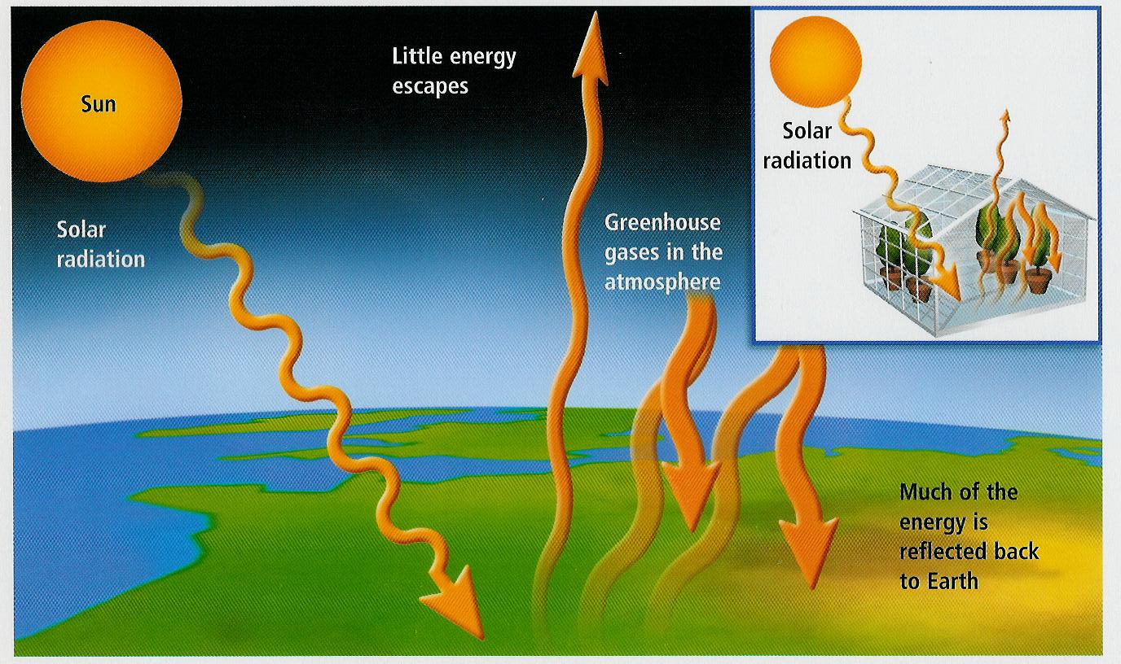
Greenhouse Effect
What is the greenhouse effect?

Slide 17
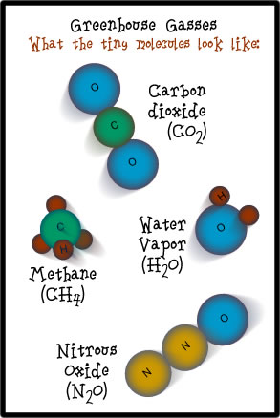
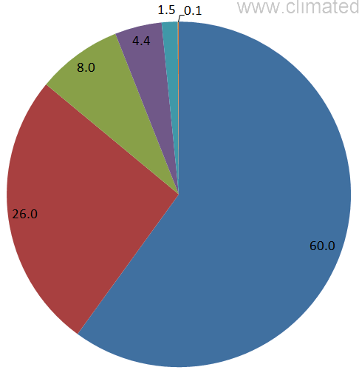
Greenhouse Effect
Greenhouse Gases (GHG)
Water Vapor (H₂O)
Carbon Dioxide (CO₂)
Nitrous Oxide (N₂O)
Methane (CH₄)
Ozone (O₃)
N₂O
CH₄
O₃
CO₂
H₂O
Contribution to Greenhouse Effect

Slide 18
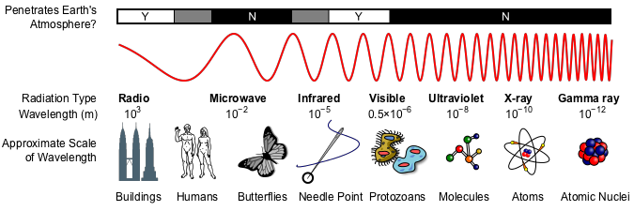
Greenhouse Effect – How does it work?
Electromagnetic Radiation Spectrum
?
?
Radio Waves
Infrared
Visible Light
Ultraviolet
Penetrate Earth’s Atmosphere

Slide 19
Greenhouse Effect
Greenhouse Gases
Visible
IR
UV
IR warms up CO₂
Re-radiates heat
O-C-O
Incoming
Sunlight
O-C-O
O-C-O
UV & Visible
No effect
Heats up Earth
“Converts” UV & Vis to IR

Slide 20
Greenhouse Effect
Greenhouse Gases
Visible
IR
UV
IR warms up CO₂
Re-radiates heat
O-C-O
IR heats up CO₂
Re-radiates heat
Incoming
Sunlight
O-C-O
O-C-O
O-C-O
UV & Visible
No effect
Radiated IR
Heats up Earth
“Converts” UV & Vis to IR

Slide 21
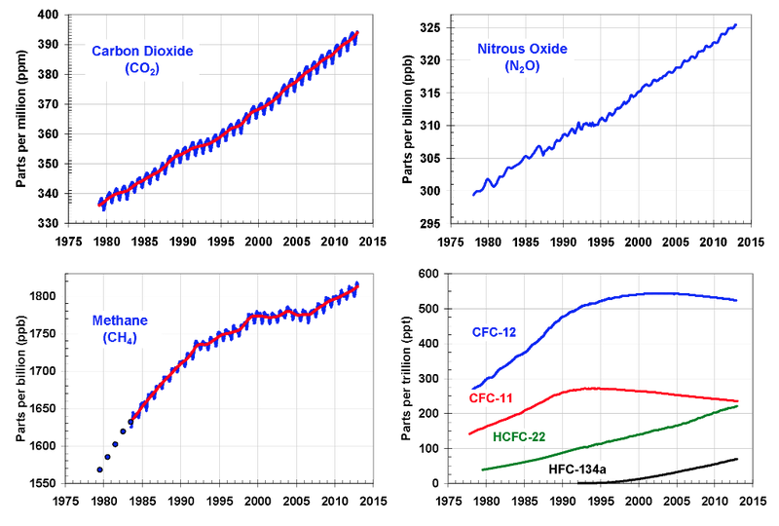
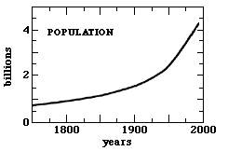
Greenhouse Effect - Trends
Greenhouse Gases (GHG)
Water Vapor (H₂O)
Carbon Dioxide (CO₂)
Nitrous Oxide (N₂O)
Methane (CH₄)
Ozone (O₃)

Slide 22
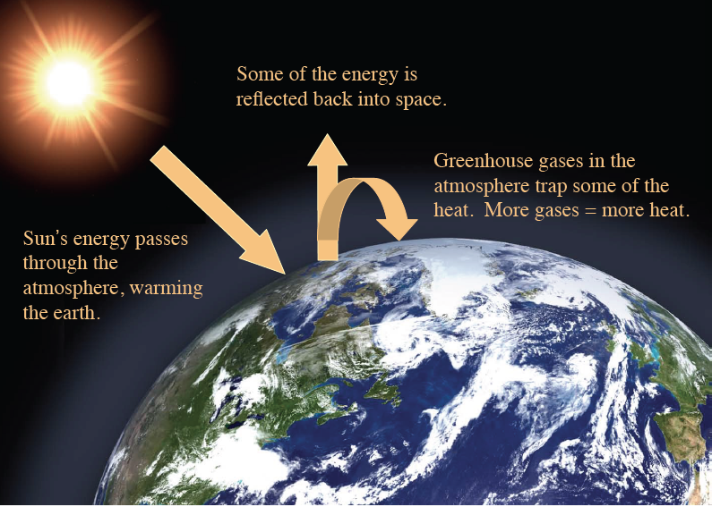
Greenhouse Effect
Greenhouse Gases (GHG)
Water Vapor (H₂O)
Carbon Dioxide (CO₂)
Nitrous Oxide (N₂O)
Methane (CH₄)
Ozone (O₃)
Greenhouse Effect
No Atmosphere
Sun In =>Sun Out
Atmosphere w/ some GHG
Sun In =>warm air =>Sun Out
Atmosphere w/ more GHG
Sun In =>warmer air =>Sun Out

Slide 23
Video – Questions
I still do not understand how CO₂ can create such a temperature change.
One thing that I still don't understand from the greenhouse gas video is how
exactly greenhouse gases trap heat.
If our planet's atmosphere is 99% nitrogen, which said it doesn’t absorb heat well,
how does the carbon dioxide and water vapor contain enough heat to keep the
planet warm?
IR radiation
C
O
O
Carbon Dioxide
Molecule
Incoming energy
“excites” the molecule
Molecule slowly “relaxes”
& releases heat (IR radiation)

Slide 24
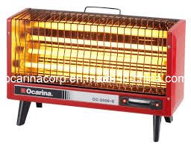
Video – Questions
Why do the radiation wavelengths change from short to long?
Electrical
Current
Electrical heater “converts” electric waves to heat (IR radiation)

Slide 25
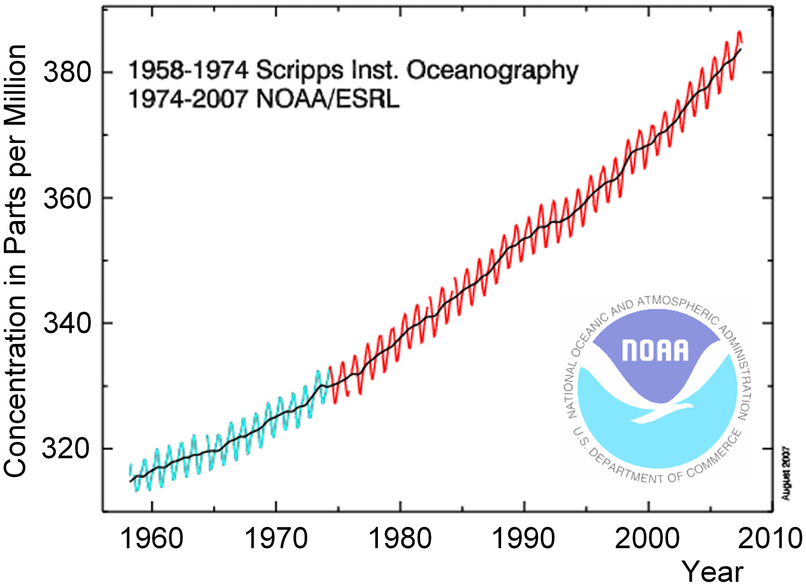
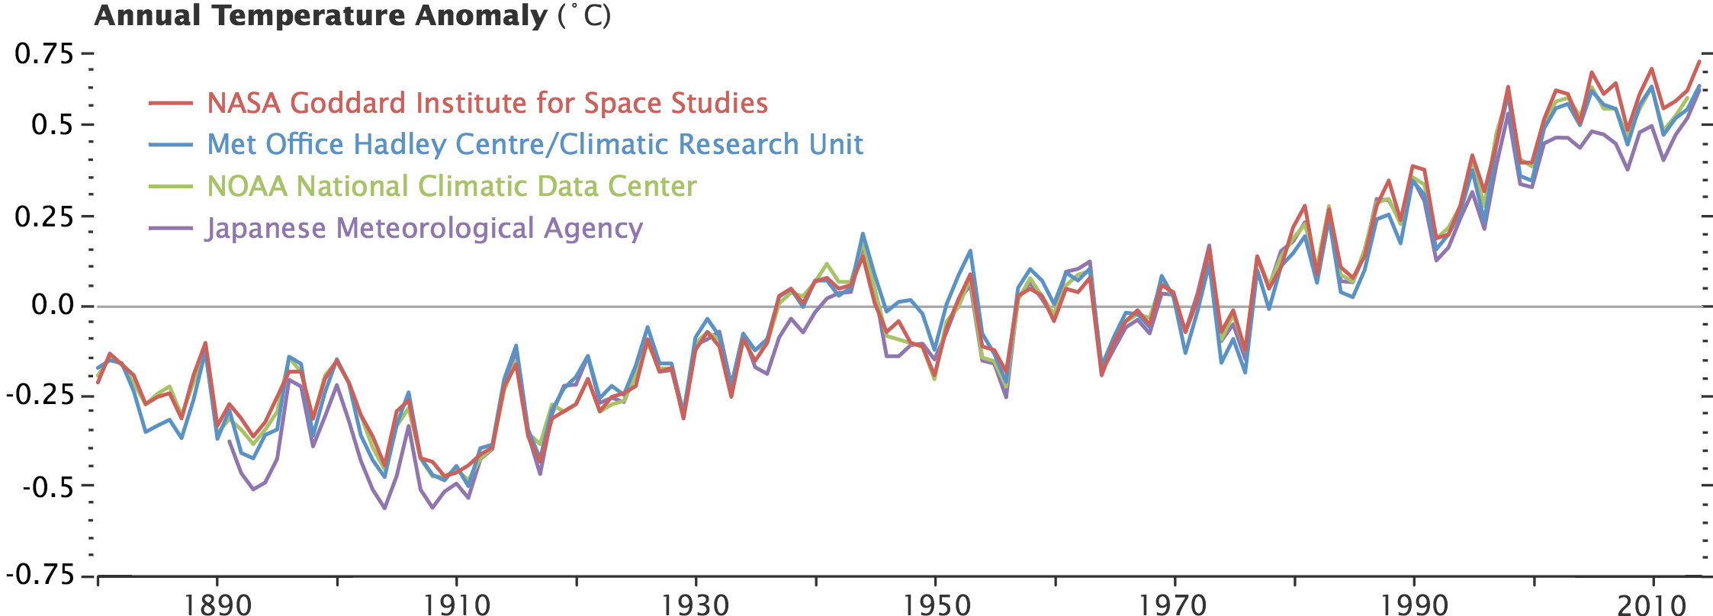
Greenhouse Effect - Trends
Greenhouse Gases (GHG)
Water Vapor (H₂O)
Carbon Dioxide (CO₂)
Nitrous Oxide (N₂O)
Methane (CH₄)
Ozone (O₃)

