Slide 1
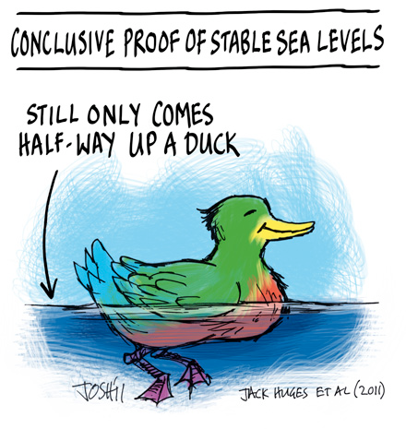
Sea Level Change
Focus Activity
- Hands-on Activity
Sea Level Change
- Examples & Causes
- Classification

Slide 2
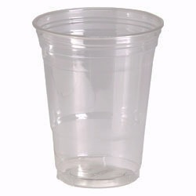
Sea Level Change
Focus Activity
- Hands-on Sea Level Change Activity
The line drawn around the cup represents a reference sea level or “datum”
Fill cup with water to level of the line.
List how many ways can you get the water level to change.
Note direction of water level change
(i.e., up, down, or depends)
3) Note how the new water level departs from the original.
(i.e., same everywhere or variable)
4) Note how long the water level change persists.
(i.e., temporary, maintained, depends)

Slide 3
Sea Level Change
Focus Activity
- Hands-on Sea Level Change Activity
Event or Action (What did you do?) | Water Level Change (above, below, depends) | Region Affected (all-sides, 1-side, middle) | Duration, Timing (maintained, temporary)

Slide 4
Sea Level Change
Focus Activity
- Hands-on Sea Level Change Activity
Event or Action (What did you do?) | Water Level Change (Above, Below, Other) | Region Affected (all-sides, 1-side, middle) | Duration, Timing (maintained, temporary)
Add/Remove water | Up/Down | Whole Cup | Persists until …
Tilt Cup | Variable,depends on tilt | Varies across cup | Persists until …
Squeeze Cup | Up | Whole Cup | Persists until …
Swirl Cup | Variable | Varies round cup | Temporary
Blow Across Cup | Variable, depends on blow direction | Varies round cup | Temporary
Add Rock | Up | Whole Cup | Persists until …
Heat/Cool water | Up/Down | Whole Cup | Persists until …

Slide 5
Sea Level Change - Types
Local
Global/Eustatic
Move Water
Around
Move Land
Up/Down
Change Volume
of Water
Change Volume
of Basins
Tides
Wind
Storms
Tsunami
Mountain Building
Glacial Rebound
Water Withdrawal
Buildings
Glaciers
Precipitation
Thermal Expansion
Spreading Rates
Erosion Rates
Sedimentation
Think-Pair-Share
Which sea level change examples should we be worried about ??
Think Rate of Change
Think Magnitude

Slide 6
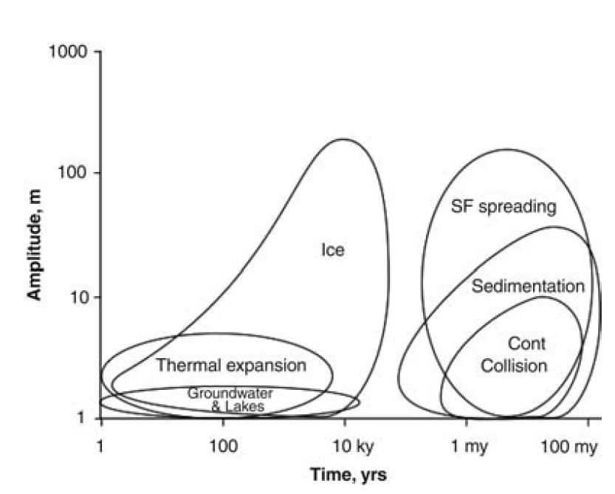
Sea Level Change - Types
Which ones should we be worried about ??
Think Rate of Change
Think Magnitude
What is missing?

Slide 7
Sea Level Change
Focus Activity
- Conceptual examples of sea level change
Sea Level Change
- Examples & Causes
- Classification
- (local vs global)

