Slide 1
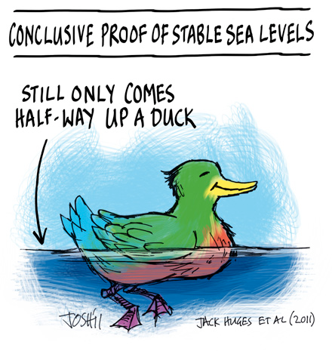
Sea Level Change - History
Recent History
Spatial Variability (i.e. geographically)
- Satellite Evidence
Impacts of Sea Level Change on Humans

Slide 2
Sea Level Change - History

Slide 3
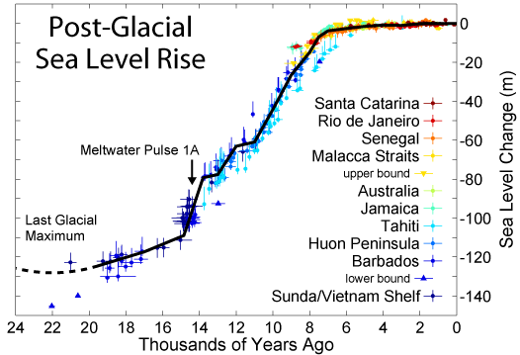
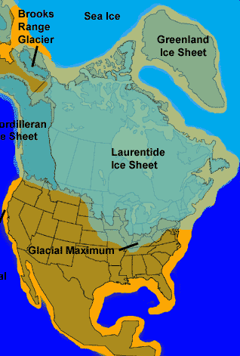
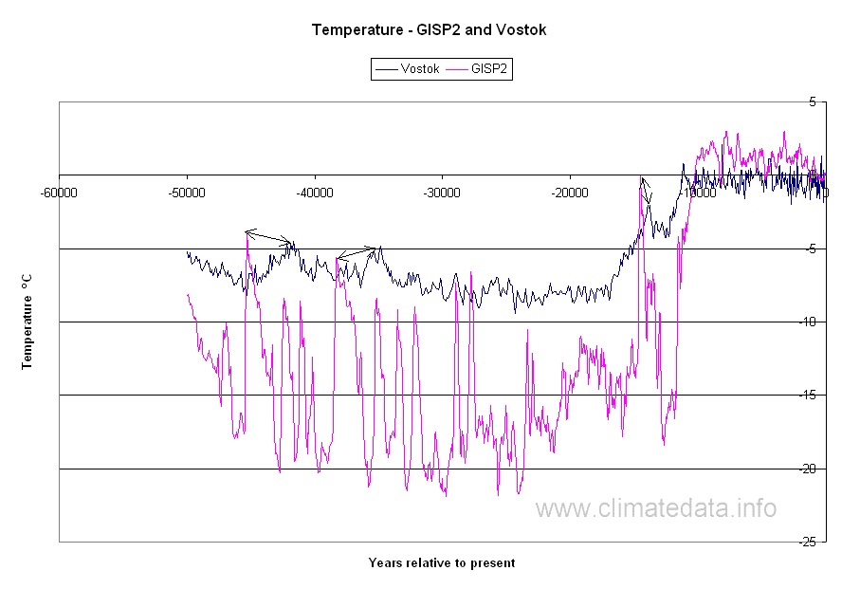
Sea Level Change - History
Temperature (C˚)

Slide 4
Sea Level Change - History
Extent of Ice Sheet
Exposed Land
Coastline ~20,000 years ago
Last Glacial Maximum

Slide 5
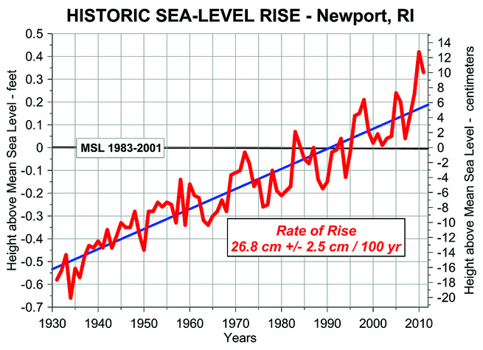
Sea Level Change - History
1 inch / decade

Slide 6
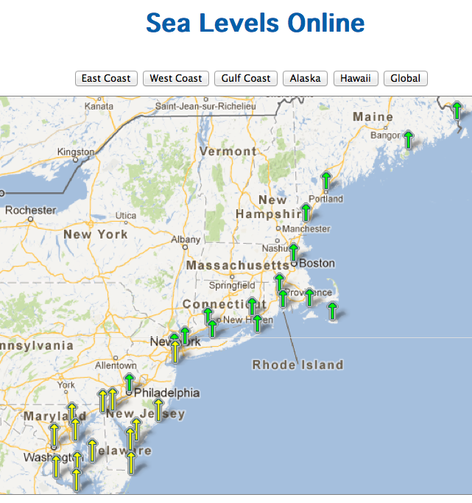

Sea Level Change – Regional View
http://tidesandcurrents.noaa.gov/sltrends/sltrends.shtml
Portland, ME => 1.82 mm/yr
Boston, MA => 2.63 mm/yr
Providence, RI=> 1.95 mm/yr
Newport, RI=> 2.58 mm/yr
New York => 2.35 mm/yr
Atlantic City, NJ=> 3.99 mm/yr

Slide 7
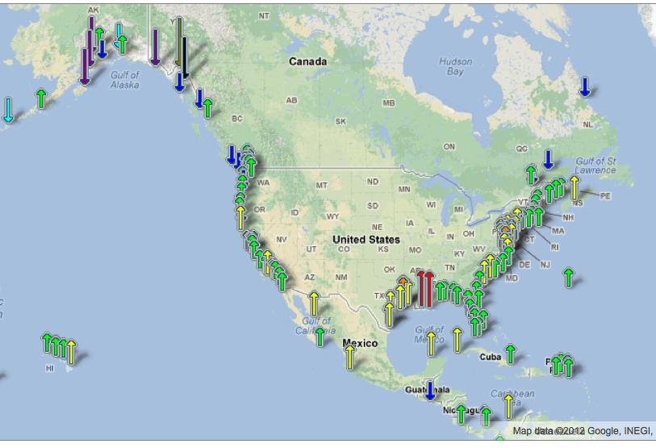
Sea Level Change – Regional View

Slide 8
Sea Level Change – Regional View
Think-Pair-Share
Why does it appear that sea level rising in some regions and falling in others?

Slide 9
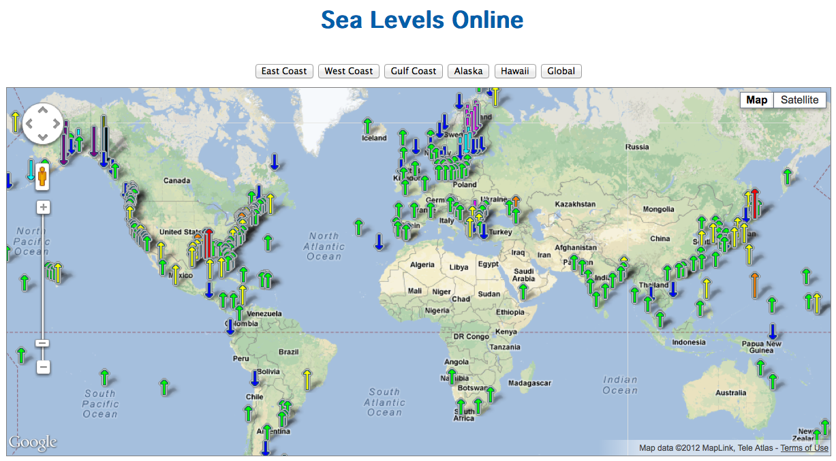
Sea Level Change – Regional View
http://tidesandcurrents.noaa.gov/sltrends/sltrends.shtml

Slide 10
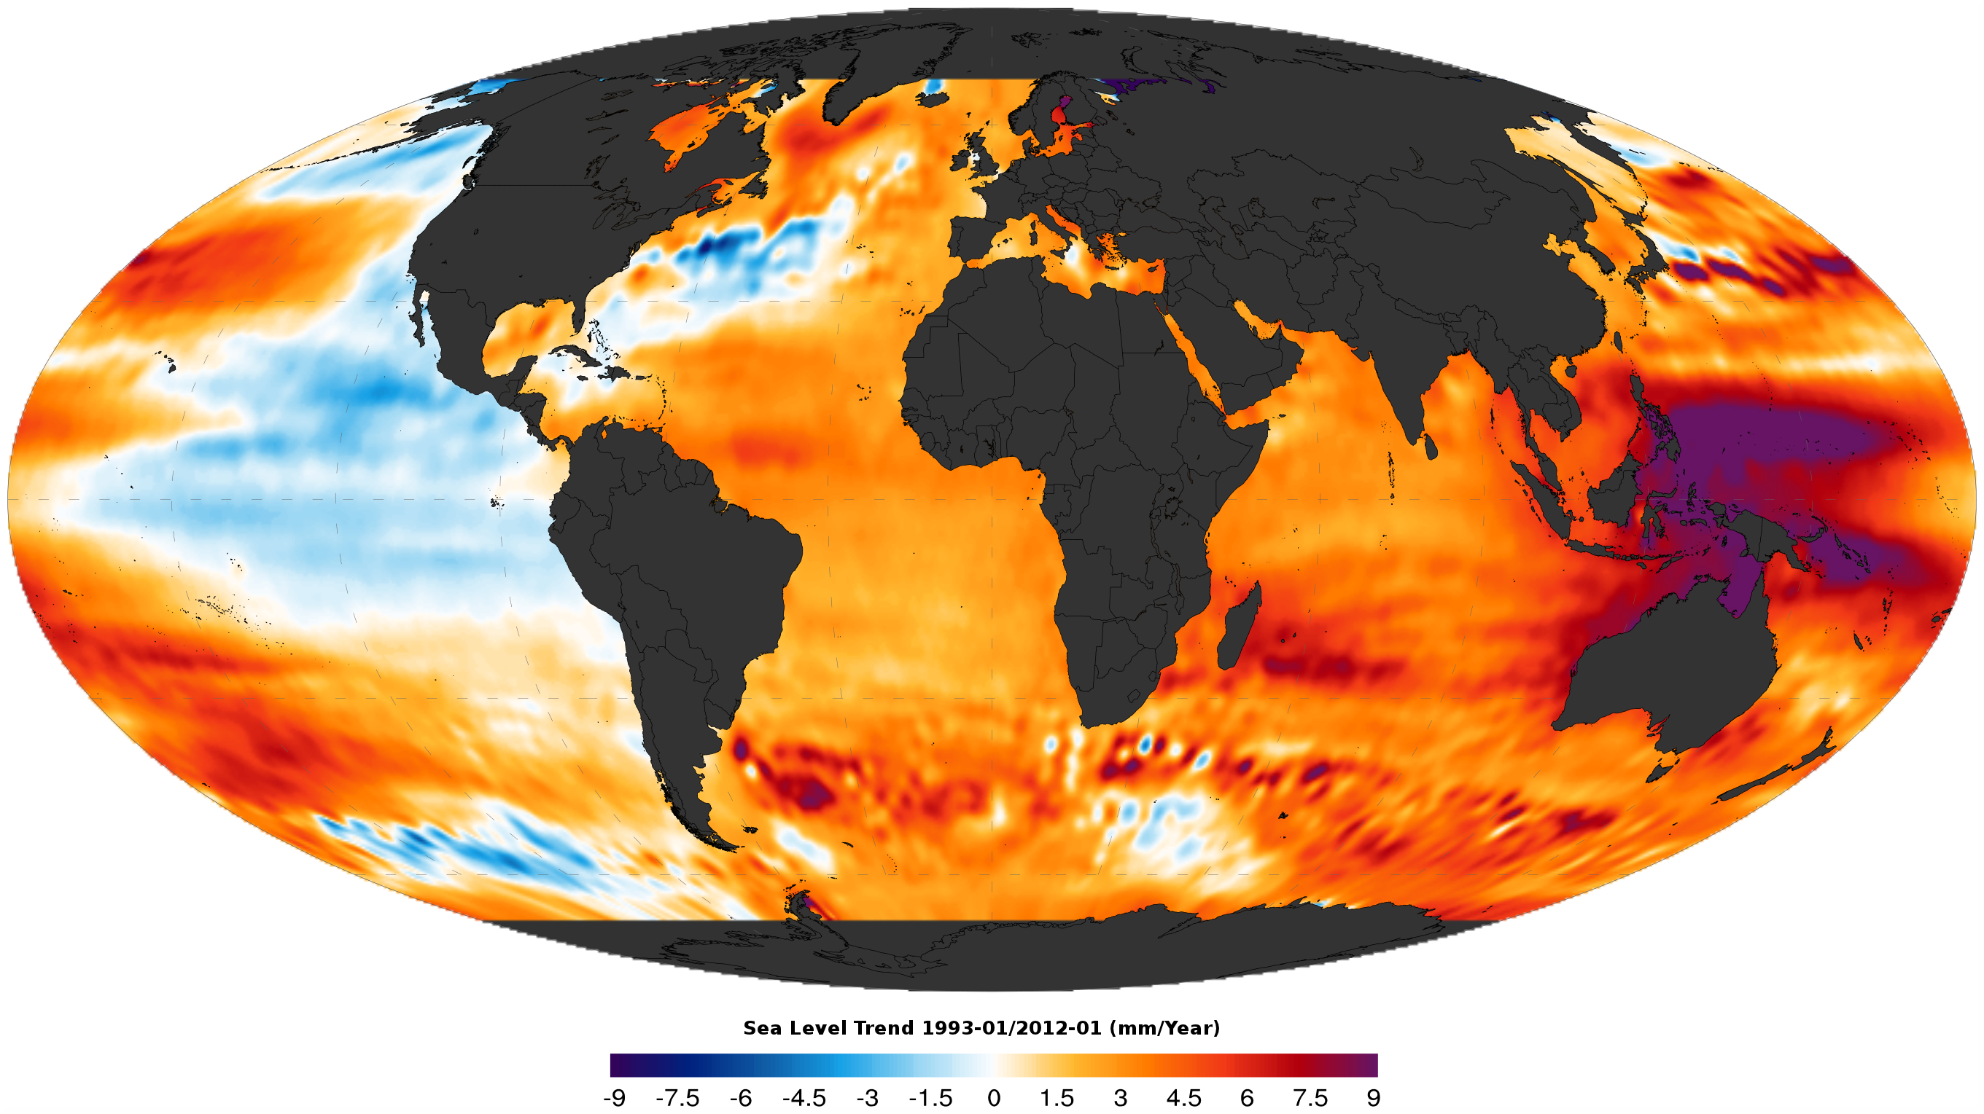
Sea Level Change – Regional View

Slide 11
Sea Level Change – And You
Elevation (m)

Slide 12
Sea Level Change – And You
Elevation (m)
50,000
10,000
1,000 years

Slide 13
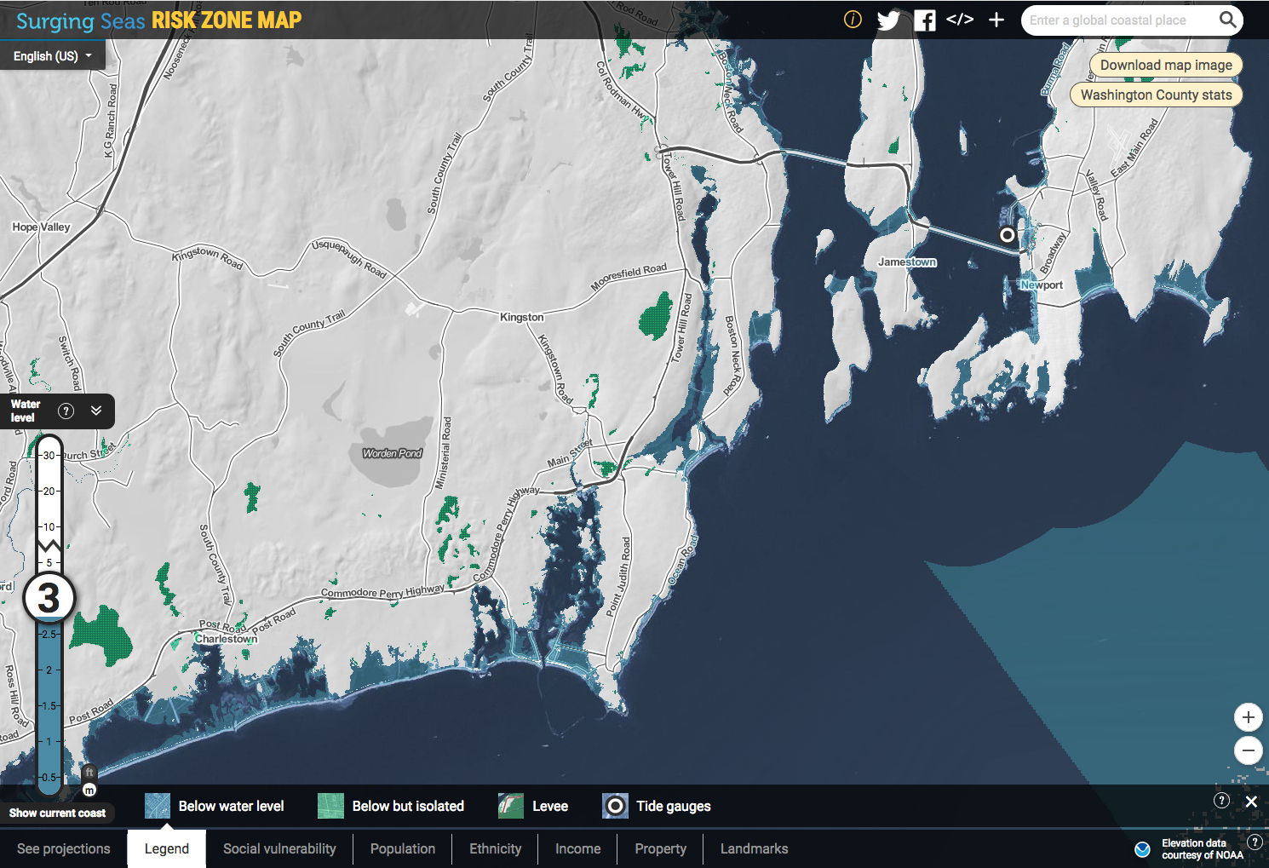
Surging Seas: Risk Finder
http://sealevel.climatecentral.org/

Slide 14
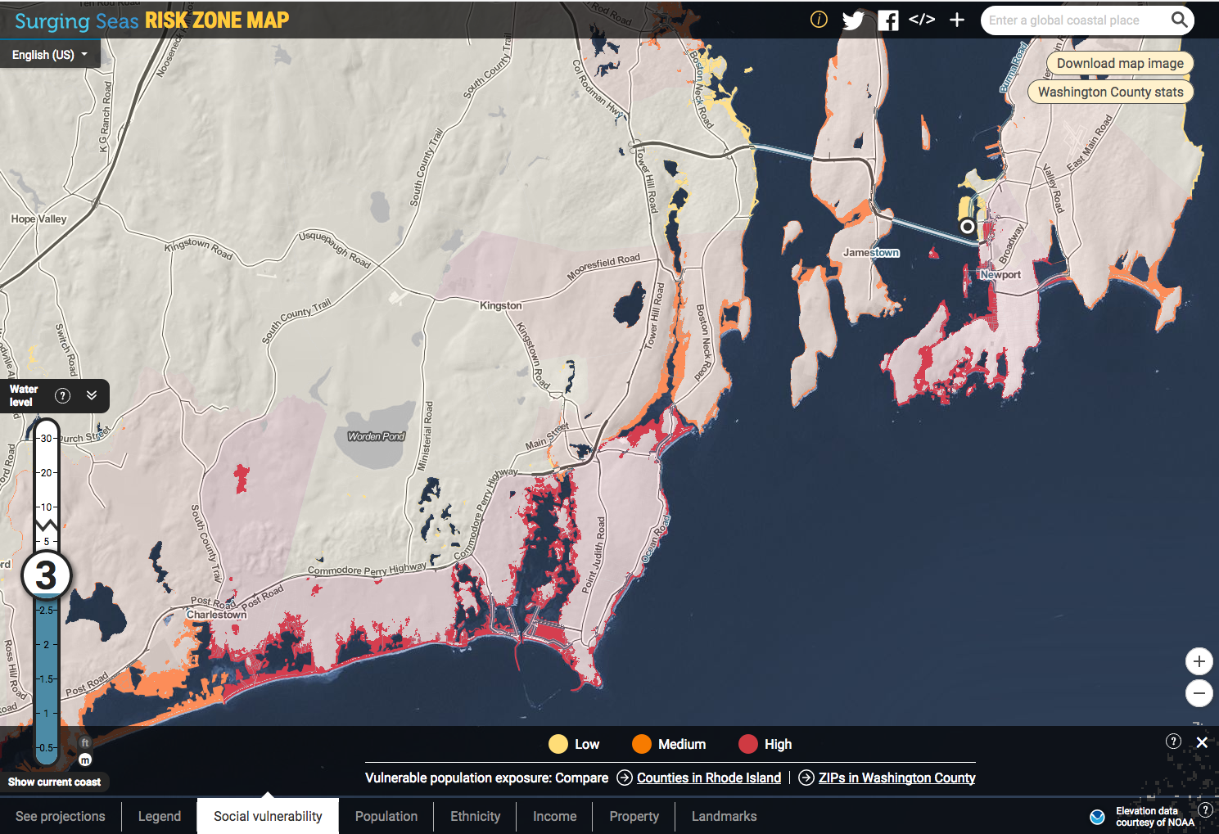

Slide 15
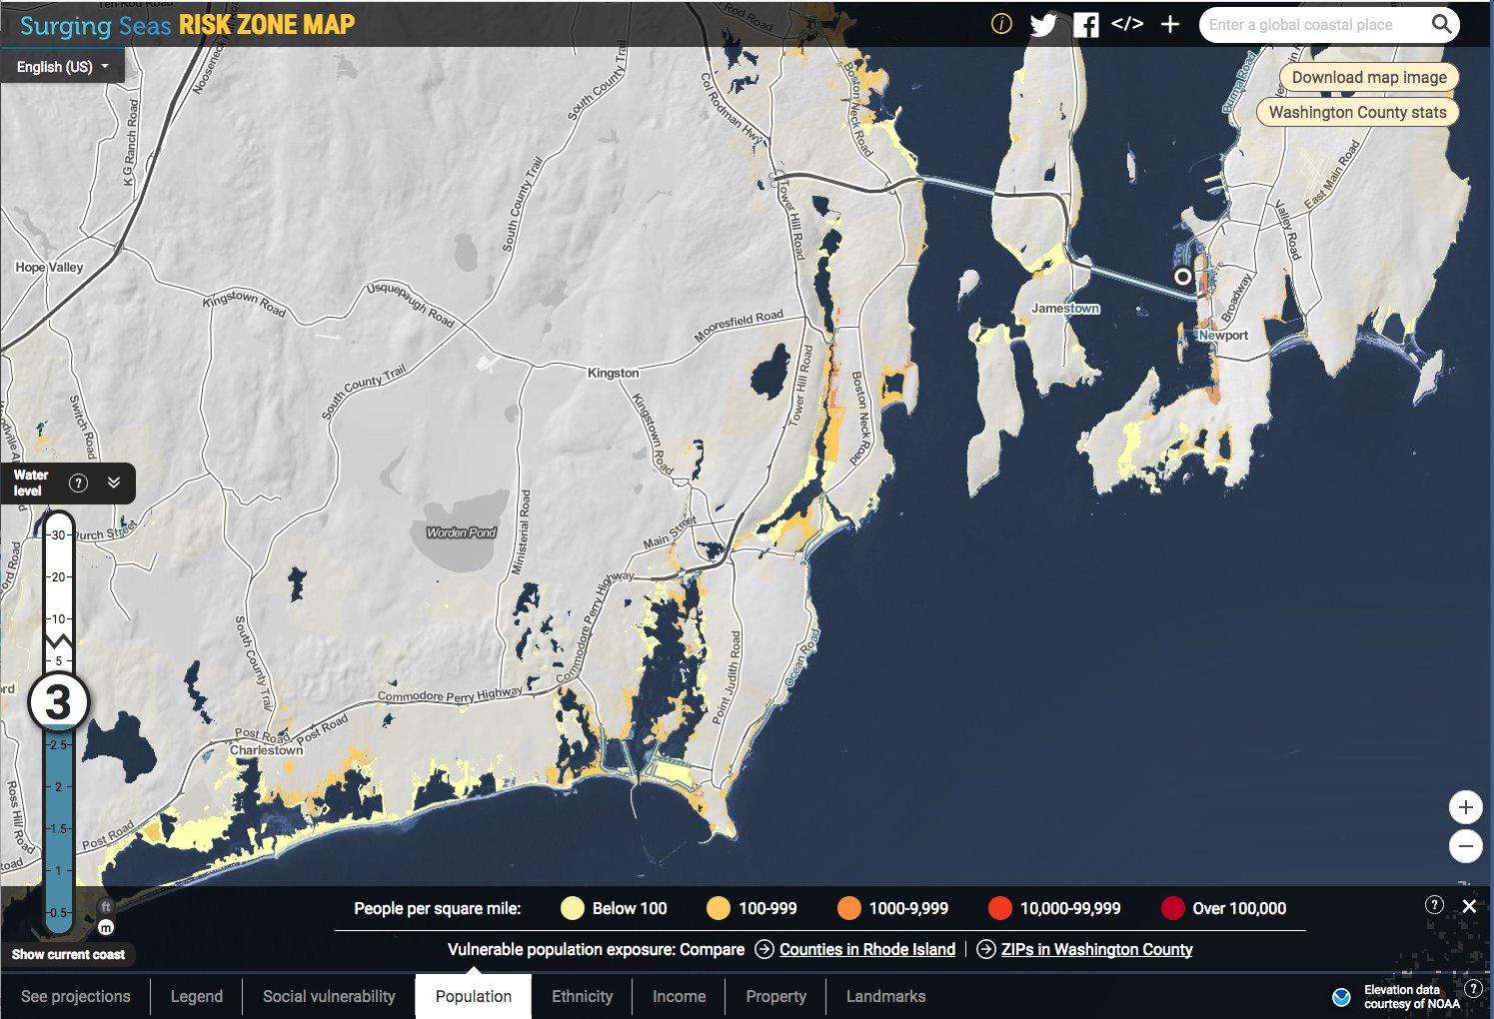

Slide 16
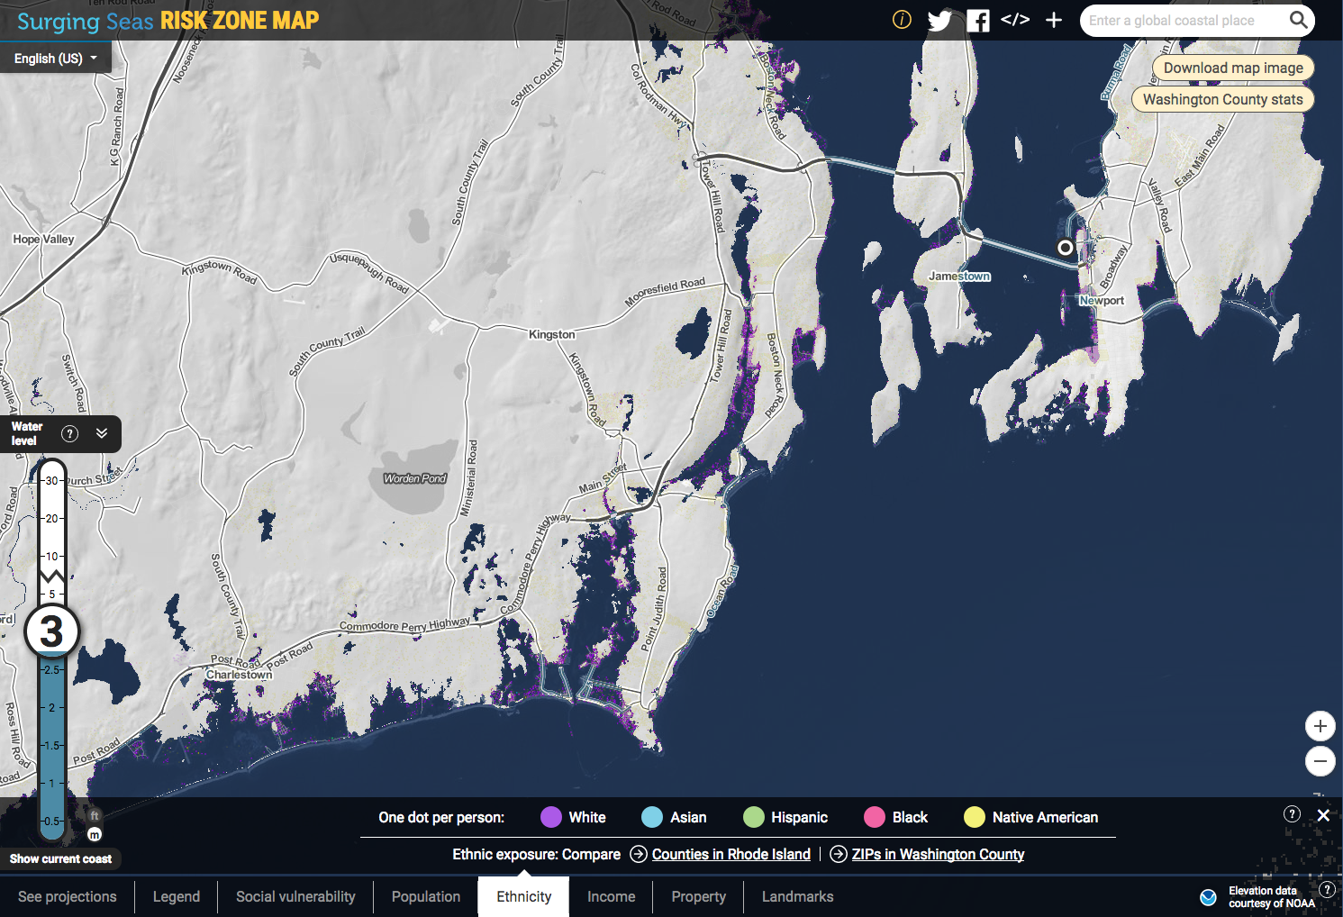

Slide 17
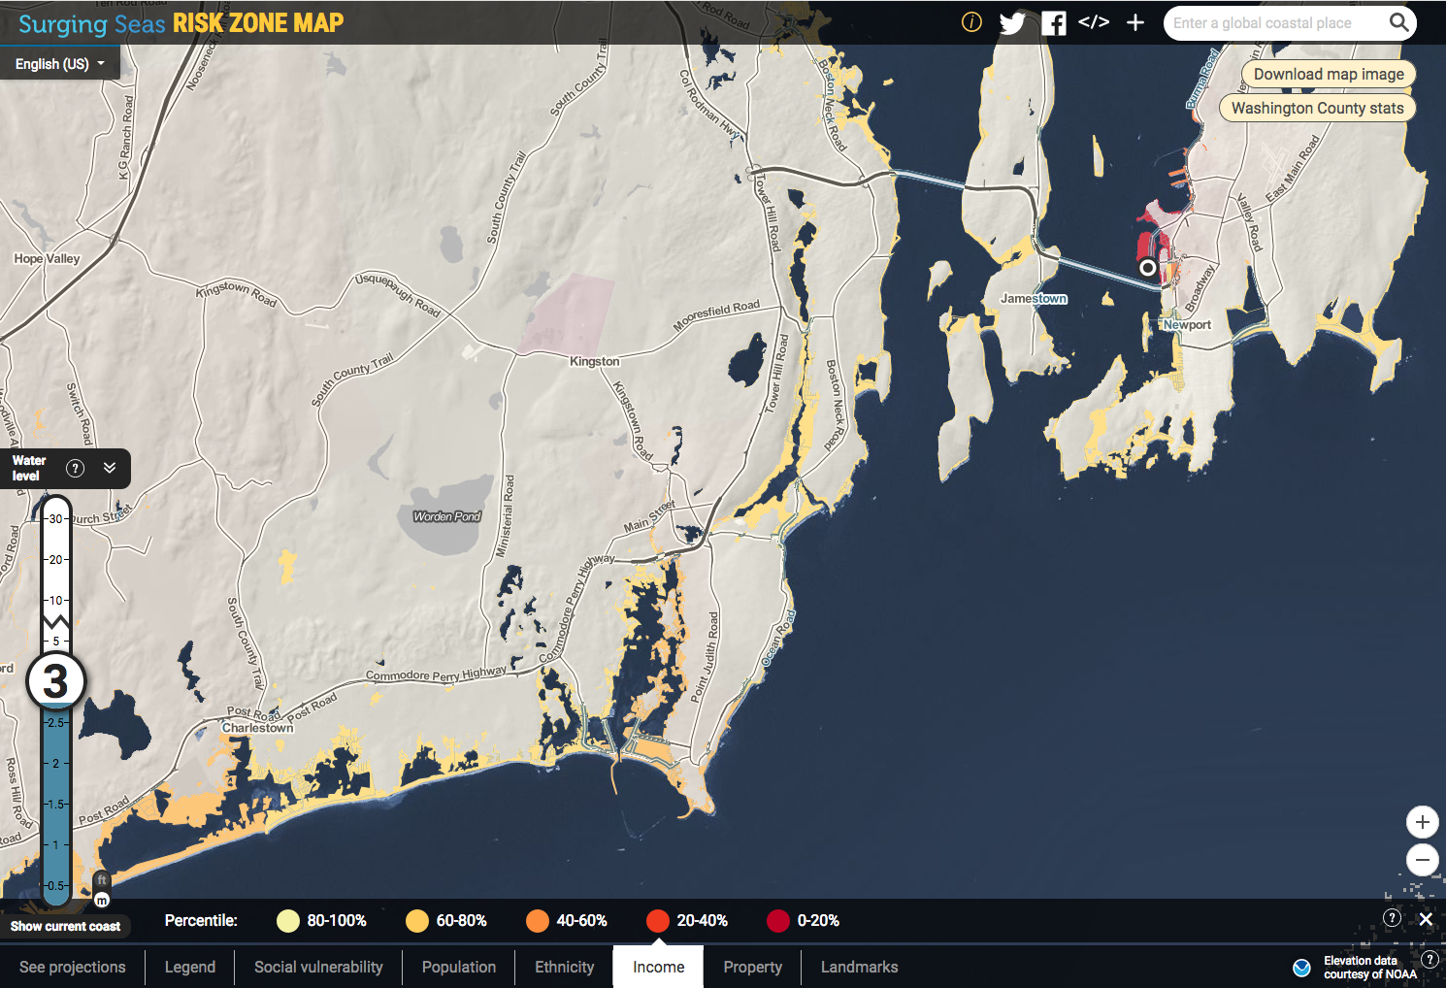

Slide 18
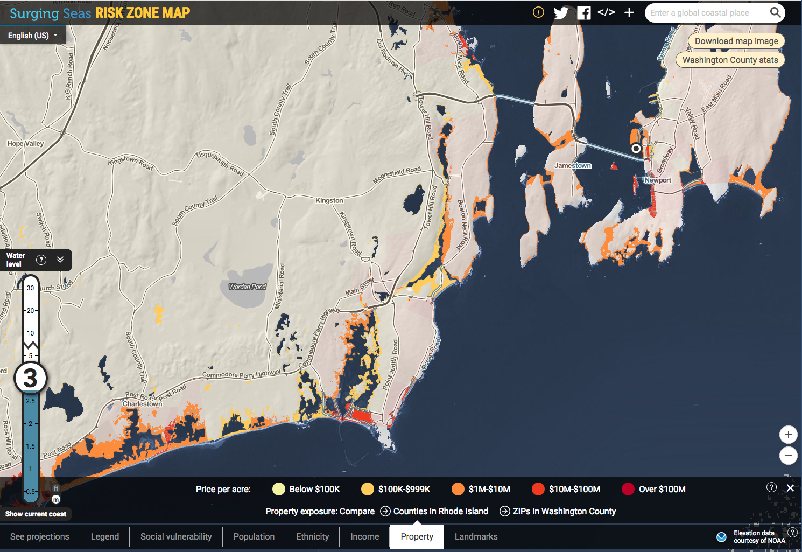

Slide 19
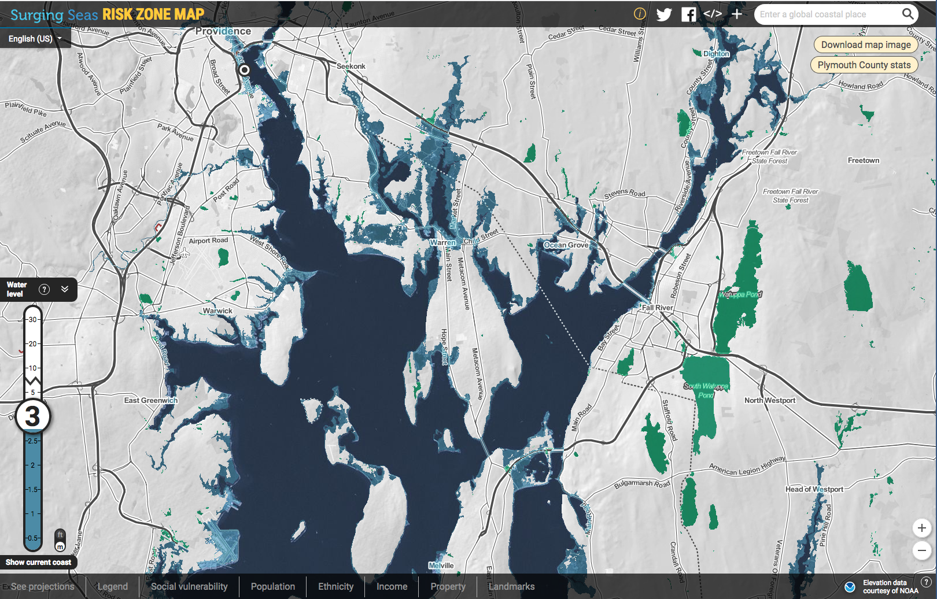

Slide 20
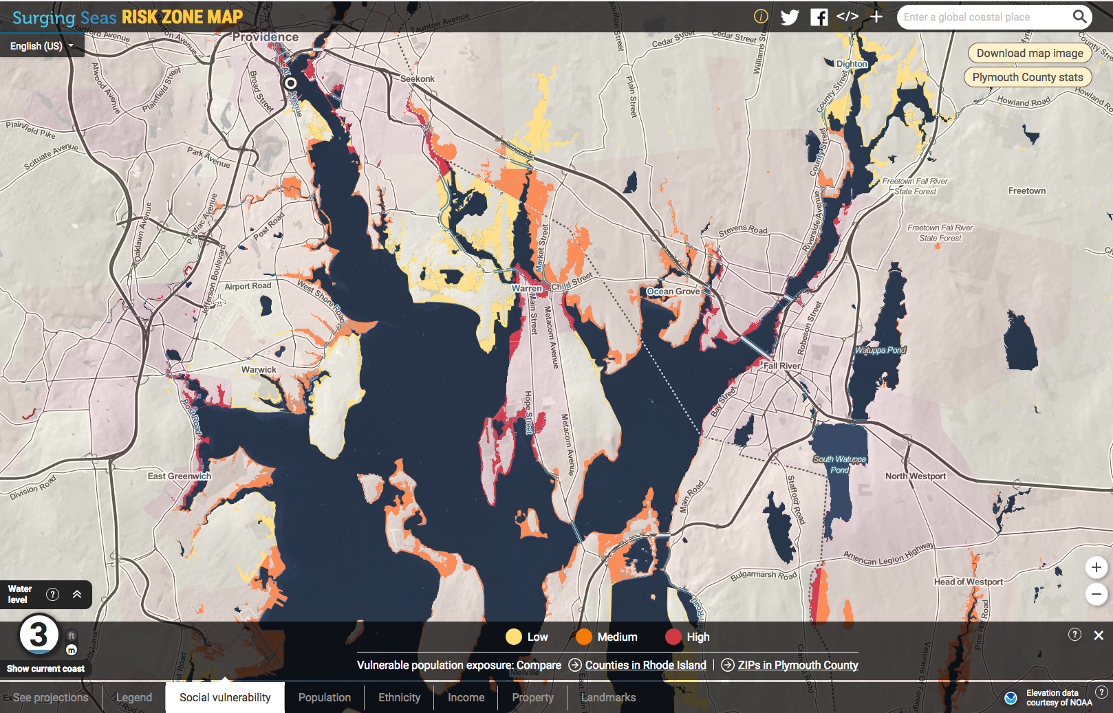

Slide 21
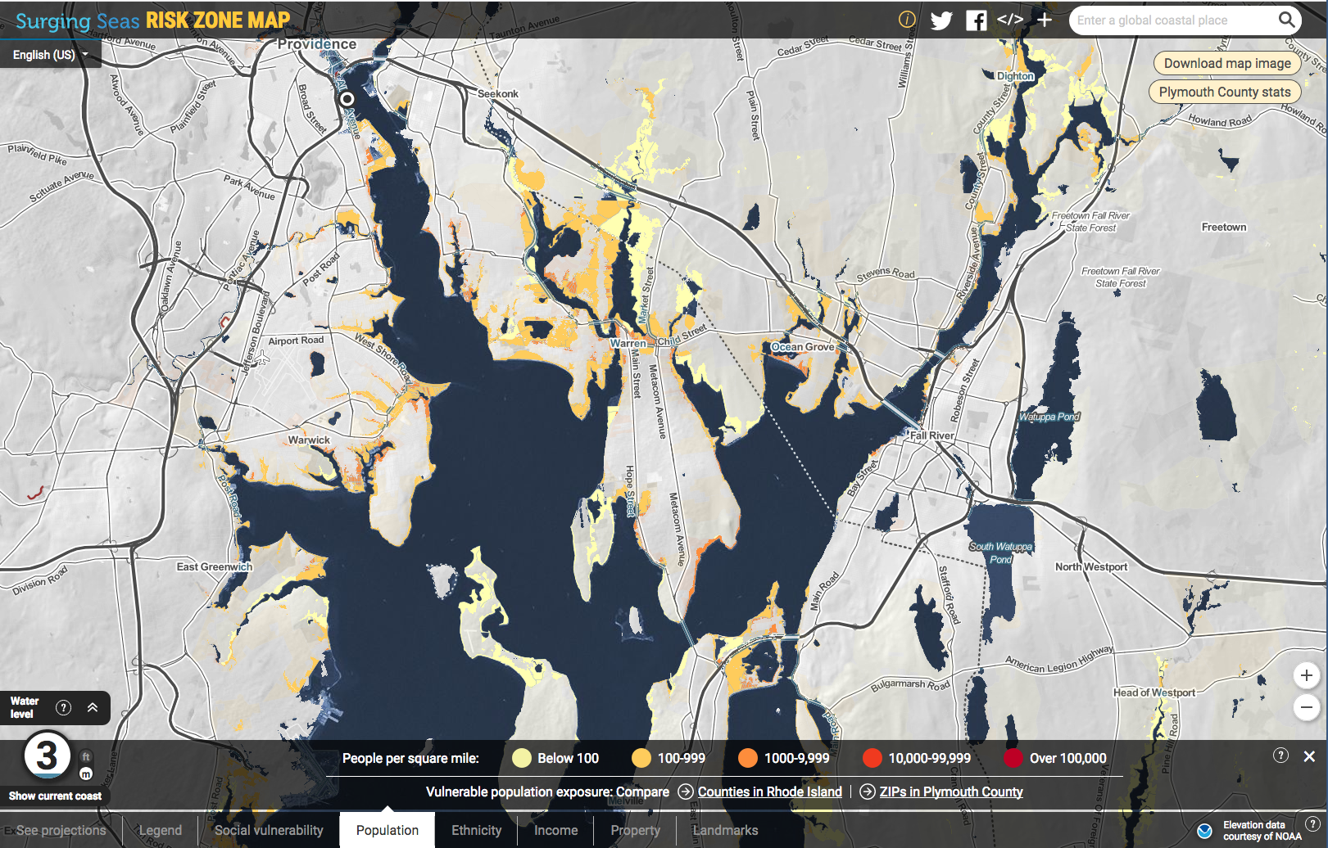

Slide 22
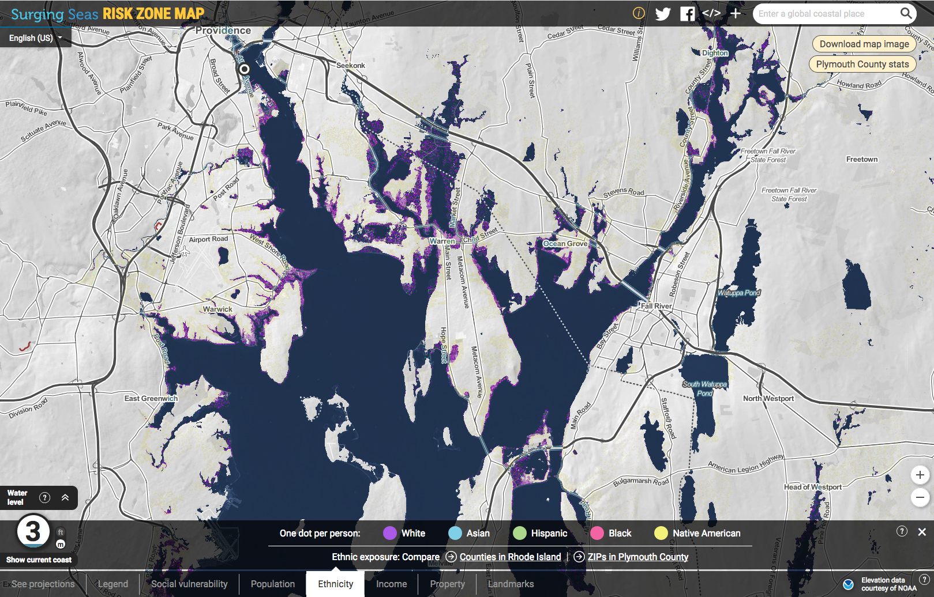

Slide 23
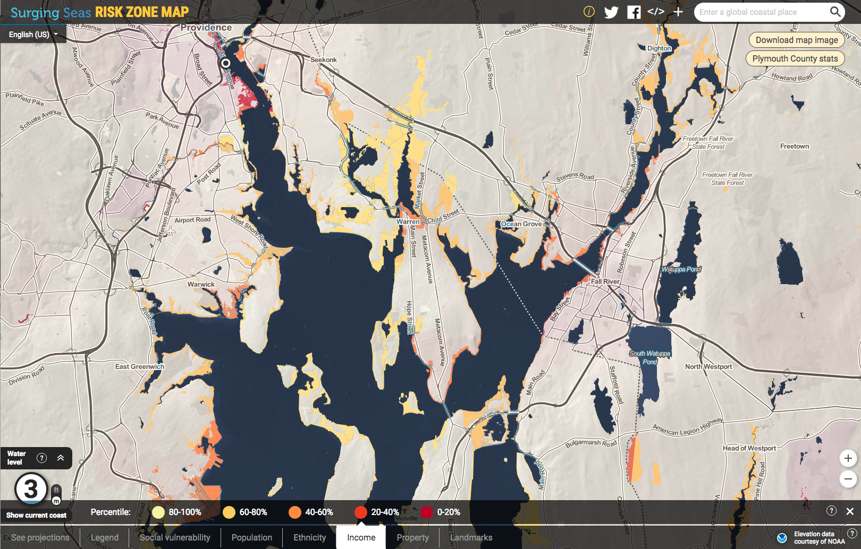

Slide 24
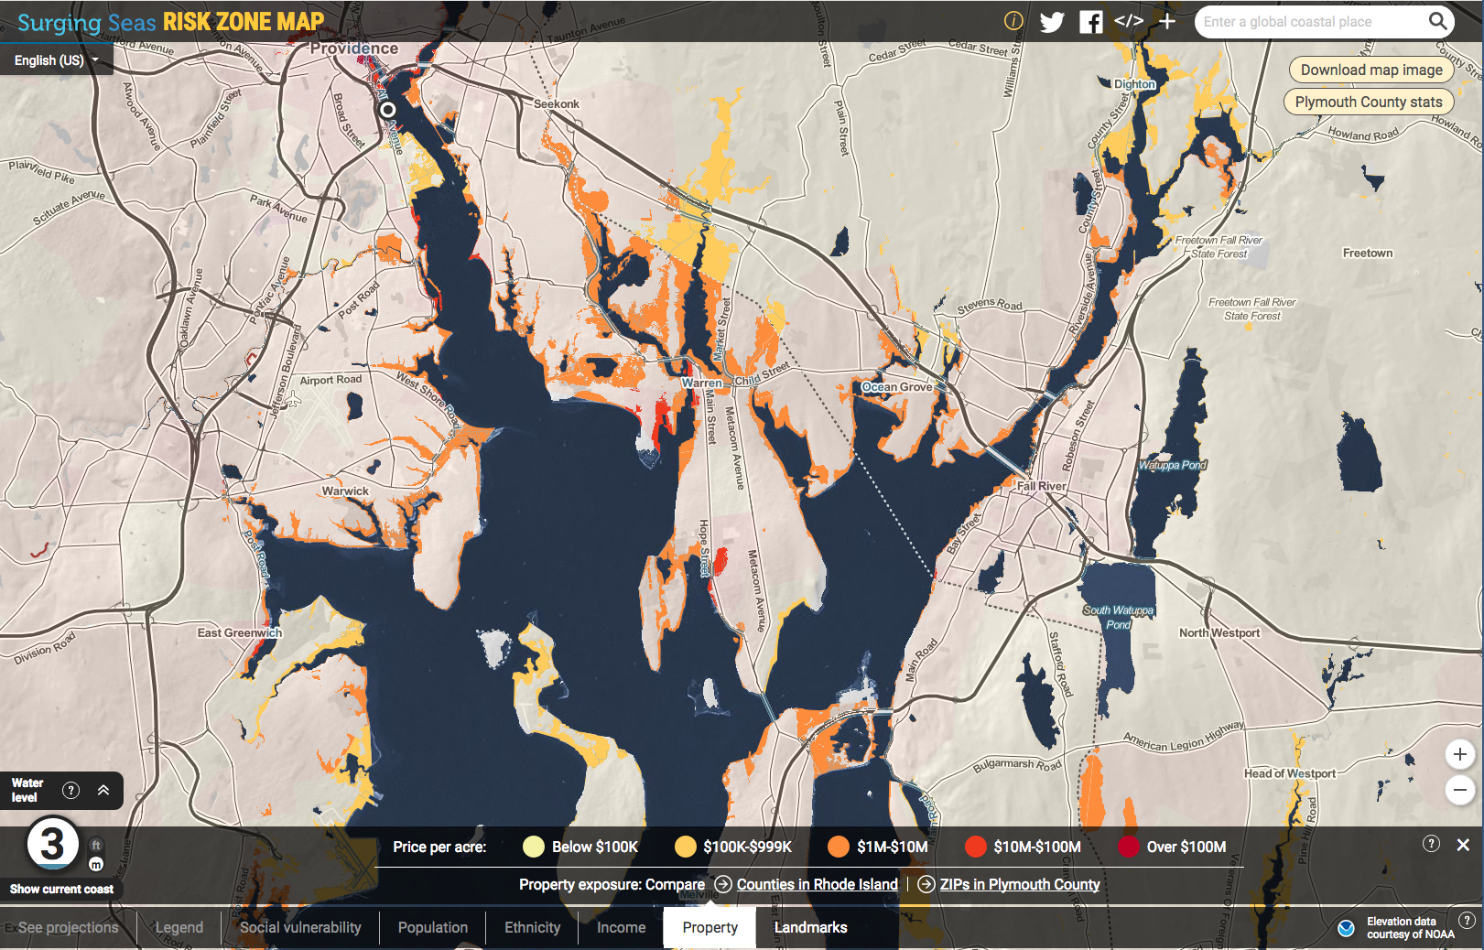

Slide 25
Sea Level Change
Focus Activity
- Conceptual examples of sea level change
Sea Level Change
- Examples & Causes
- Classification
- (local vs global)
Sea Level Change Temporal Variability (i.e., history)
- Geologic – varies by about 300 meters
- Glacial – sea level 120 m lower ~ 20,000 years ago.
- Recent – mostly rising, but variable
Sea Level Change Spatial Variability
- local examples (rising 2-3 mm/yr)
- satellite evidence (overall rising, but quite variable)

