Slide 1
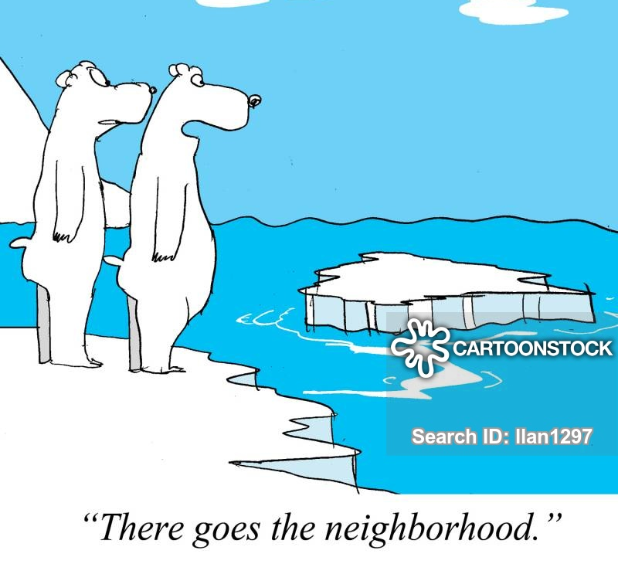
Climate, Glaciers, Sea Level & Paleocultures
Glacier Primer
Climate, Glaciers & Sea Level Change
Regional/Local Impacts

Slide 2
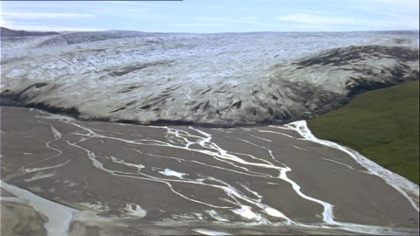
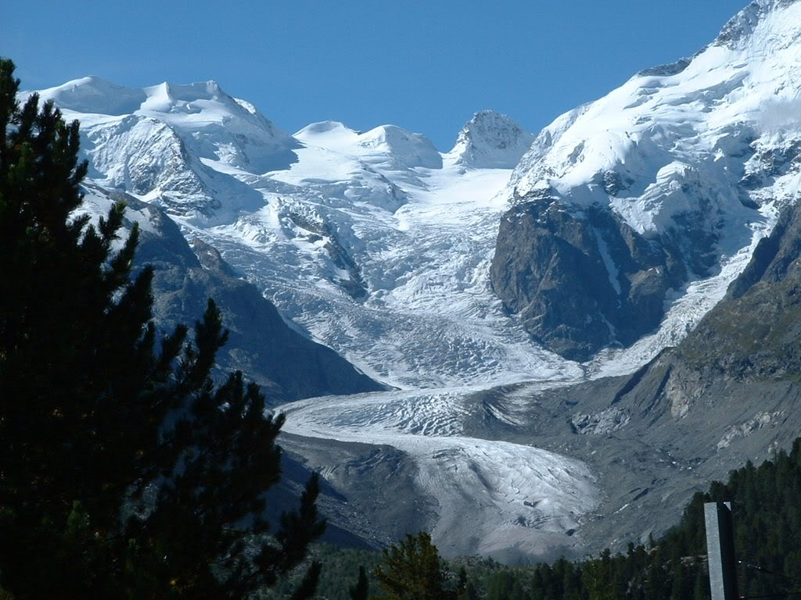
Glacier Primer
2 Types of Glaciers
Mountain or
Alpine Glaciers
Continental Glaciers
or Ice Sheets

Slide 3
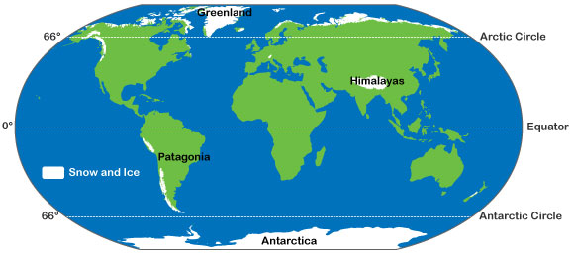
Glacier Primer
Mountain or
Alpine Glaciers
Continental Glaciers
or Ice Sheets
High Altitudes
High Latitudes

Slide 4
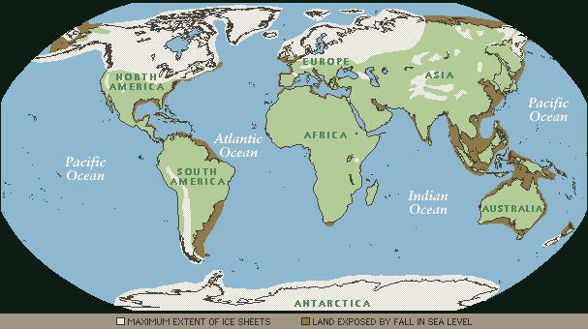
Glaciers Today
3.1 % of Earth’s surface,
10.7 % of Earth’s land area
Glaciers 20 kybp
8 % of Earth’s surface
25 % of Earth’s land area

Slide 5
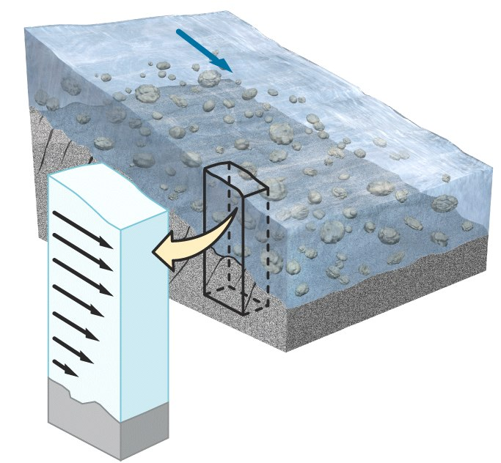
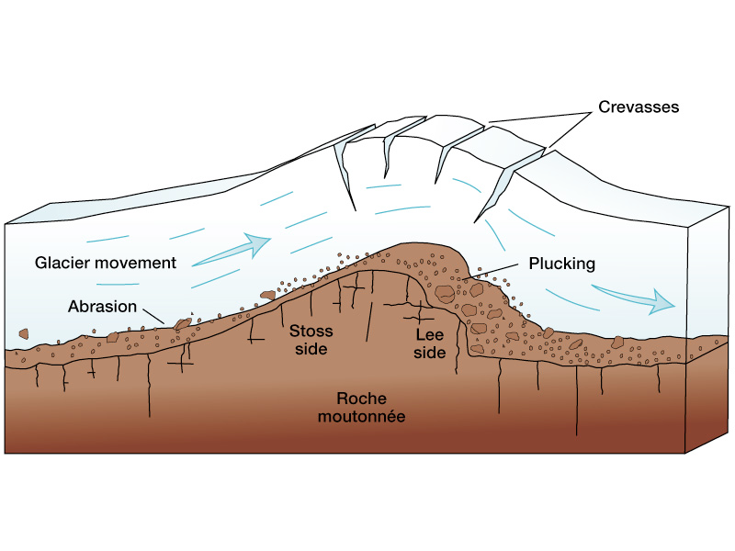
Glacier Primer
Movement of a Glacier
- typically 1 to 2 meters/day
- up to 50 meters/day
Glacial Erosion
- think potholes gone crazy

Slide 6
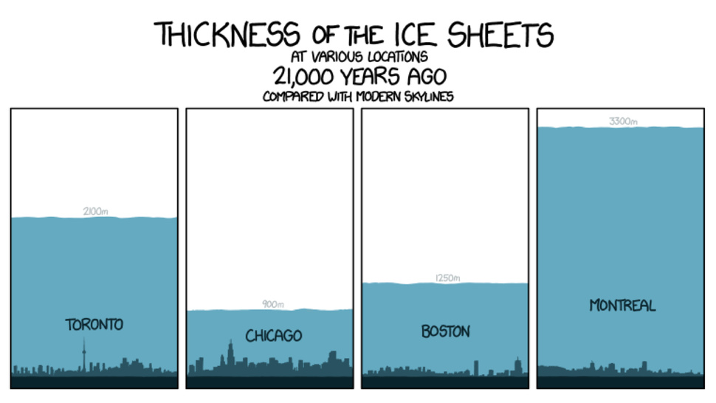
Glacier Primer
3300 m
2000 m
1200 m
900 m

Slide 7

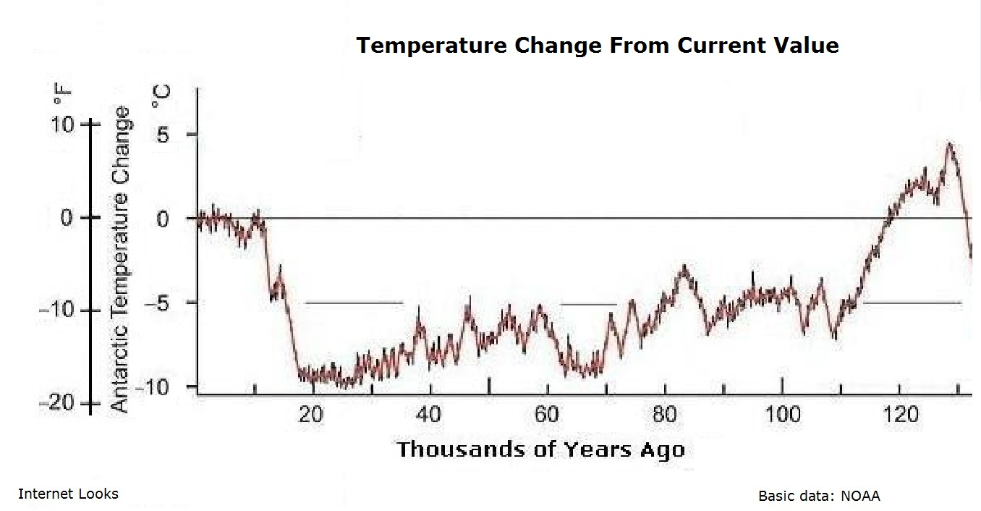
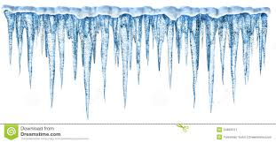
Paleo-Temperature Record
Today
Glacial
Retreat
Last
Glacial
Maximum
5˚C
0˚
Glaciers Form & Advance
Temperature Change
-5˚
-10˚
100
50
0
Thousands of Years Before Present (KYBP)
8˚C increase in 10,000 years
0.5˚C increase in 100 years

Slide 8
“Cliff” Notes
1
Warmer
Present Temperature
Temperature
3
2
Colder
In the Past
Today
Snowfall
Evaporation
Melt Water
Glacier
Land
Ocean
1
2
Sea Level
Falls
3
Sea Level
Rises

Slide 9
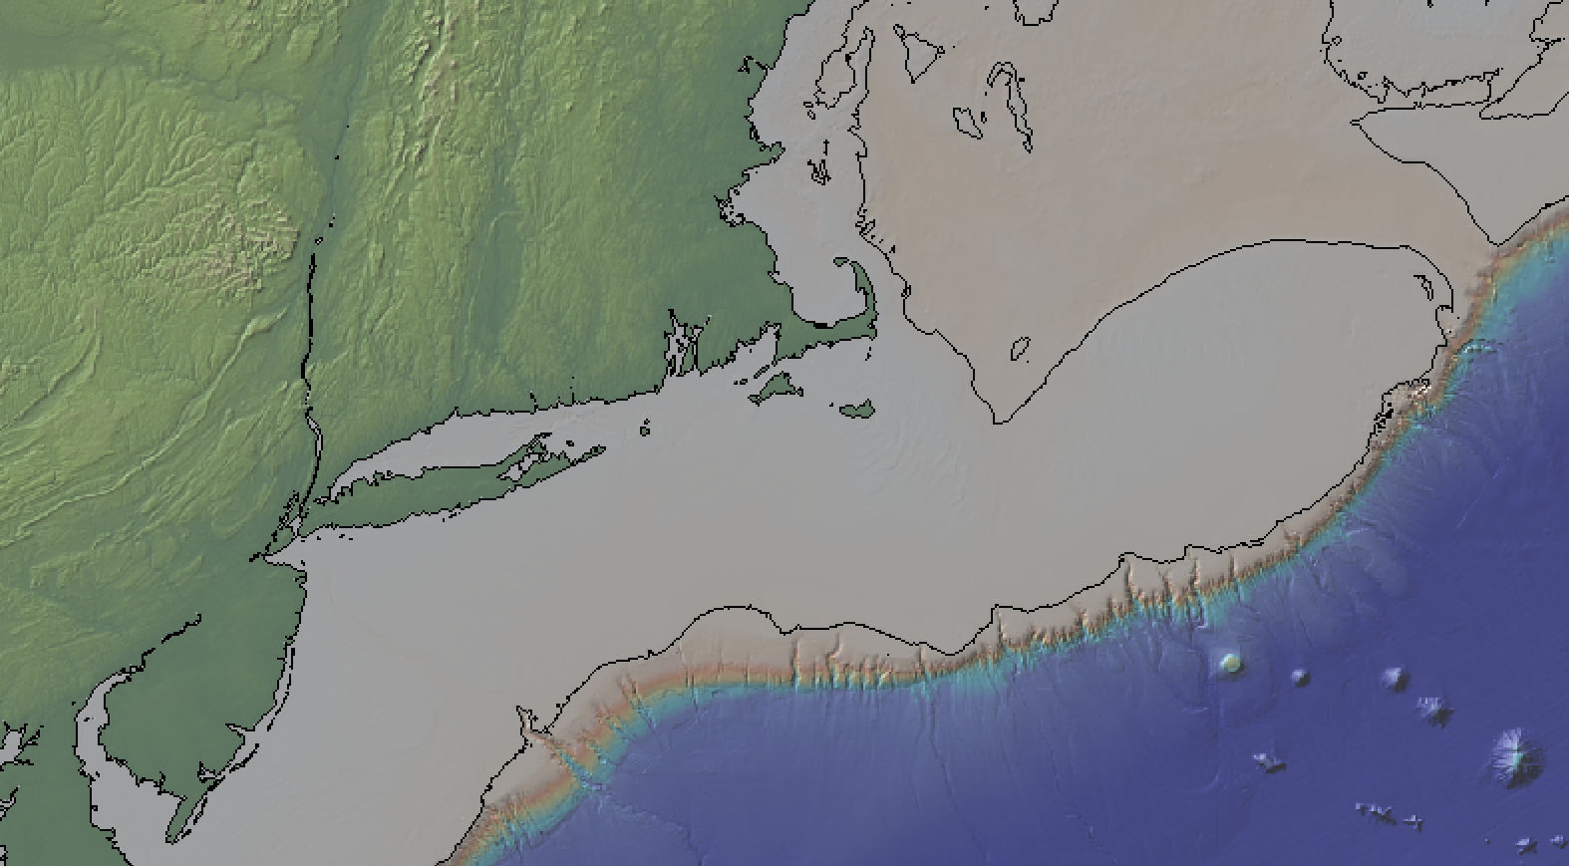
Sooooo………..
How do climate, glaciers, and sea level change
impact paleocultures in “coastal New England?”
20,000 years ago
Ice Sheet
Exposed Land
Shoreline
Where do you think people lived ?
Over what time span?

Slide 10
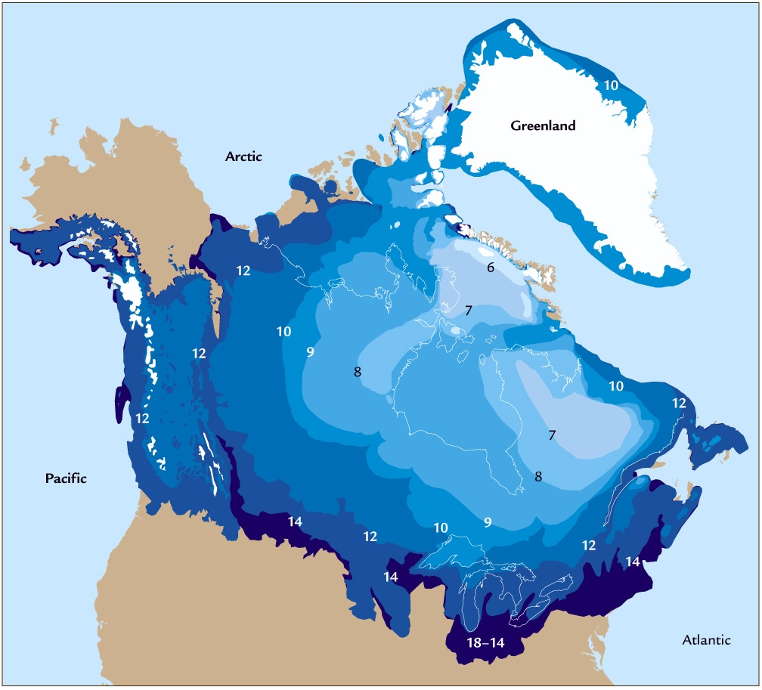
Laurentide Ice Sheet

Slide 11

East Coast Sea Level Rise Movie
http://cdebi.gso.uri.edu/GCH103/videos/east_coast.mp4

Slide 12
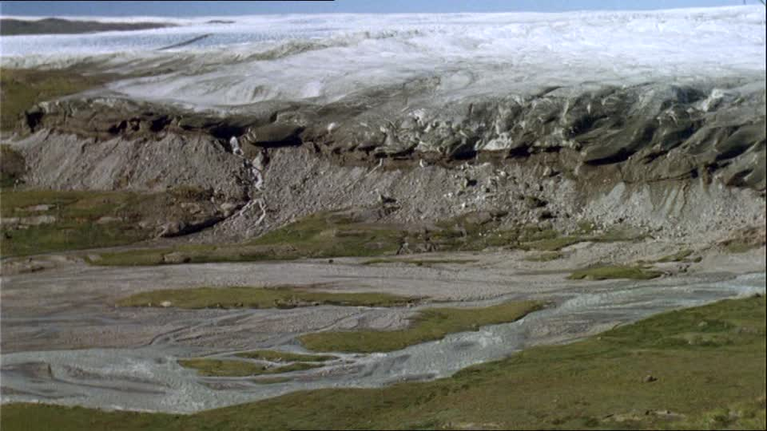
East Coast Sea Level Rise Movie
Glacial Outwash Plain

Slide 13
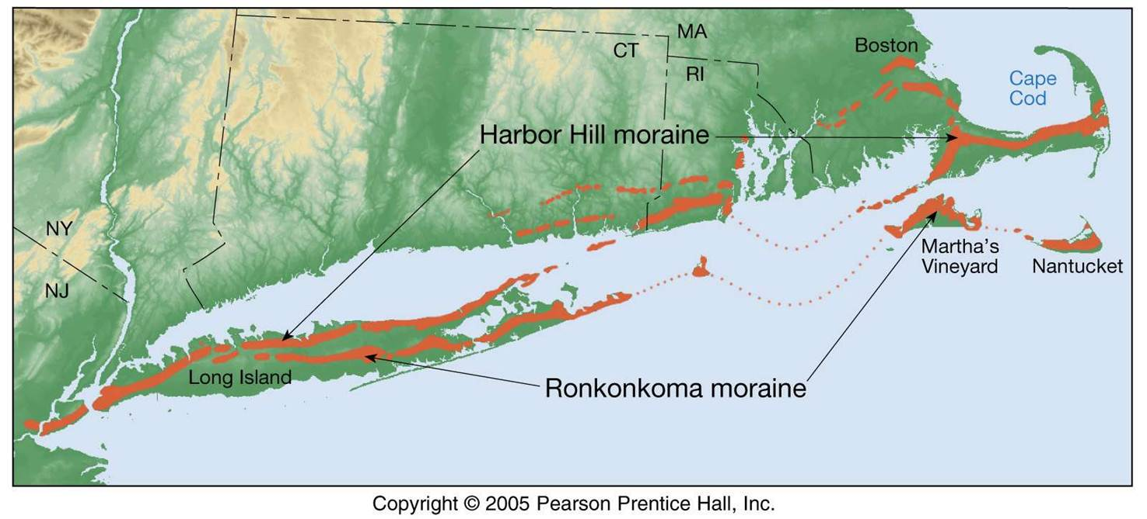
Southern New England Glacial Features
BI

Slide 14
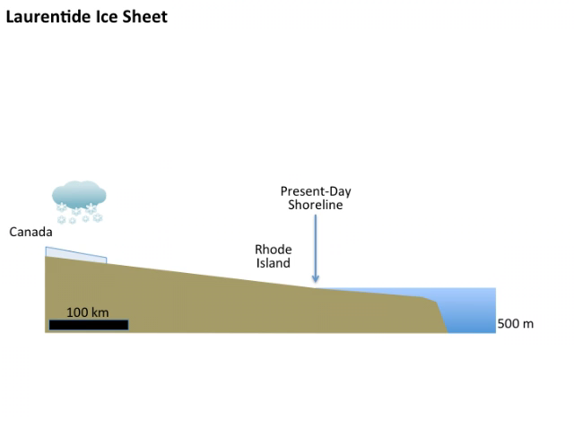
History of Laurentide Ice Sheet in New England
http://cdebi.gso.uri.edu/GCH103/videos/glaciers.mov

Slide 15
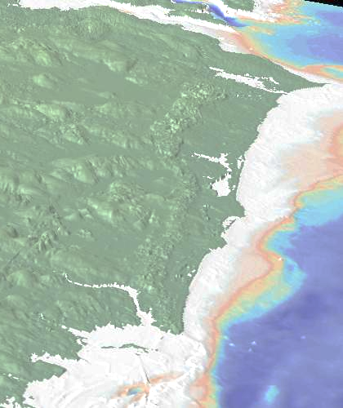
Southern New England Glacial Features
URI
Charlestown
Moraine
Route 1

Slide 16
Sea Level Change in Coastal Rhode Island
http://cdebi.gso.uri.edu/GCH103/videos/movie_nbay2.mp4

Slide 17
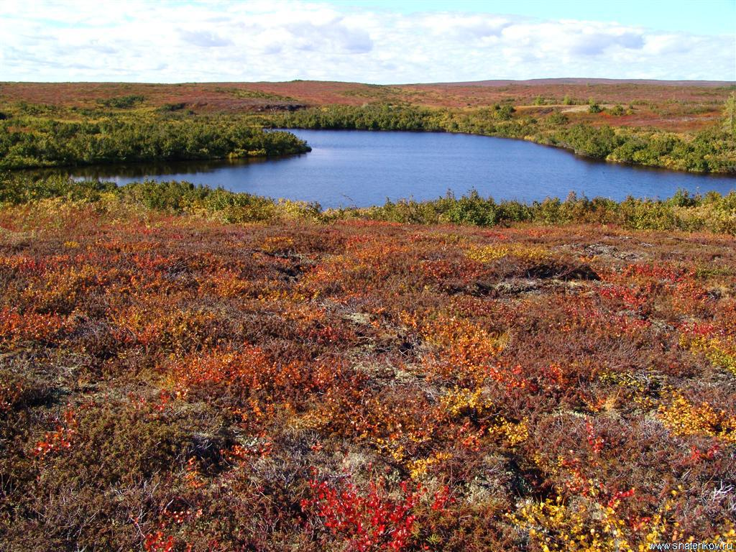
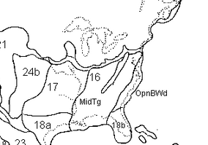
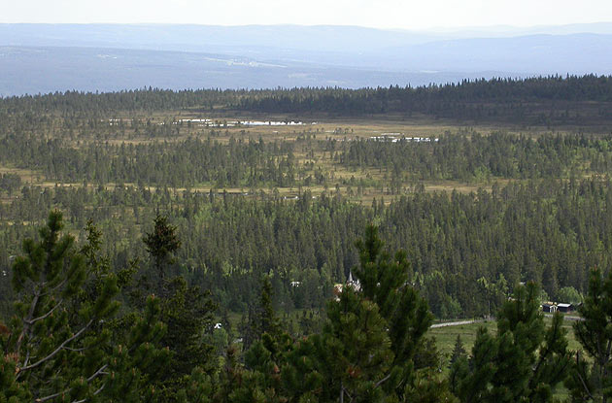
Paleo-Landscapes
Tundra
18,000 to 13,000 years ago
Ice
Open Boreal Woodland
http://www.esd.ornl.gov/projects/qen/new_na.html

Slide 18
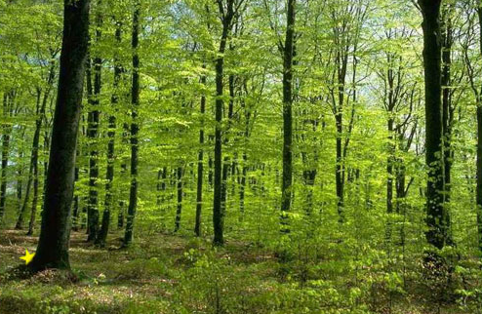
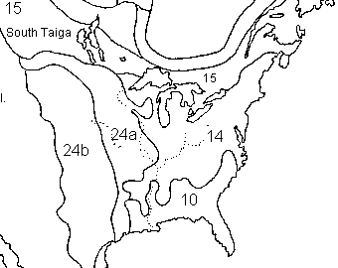
Paleo-Landscapes
8,000 years ago
Temperate Forest
Ice

Slide 19
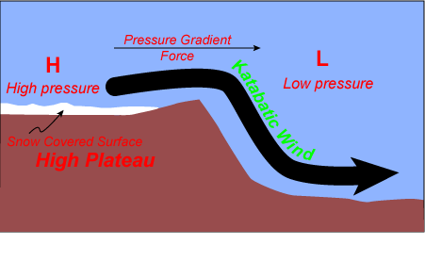
Paleo-Weather
Katabatic WInds
Continental
Margin
Ice Sheet
Cold/Dry
Air
Warm/Dry
Air
Antarctica &
Greenland
> 100 mph

Slide 20
Where do you think people lived ?
Over what time span?
20,000 years ago
Ice Sheet
Exposed Land
Shoreline
No mention of glaciers in Narragansett history

Slide 21
Sea Level and You
1 m tide
3 m sea level rise 2100
5 m storm surge
4 m waves
13 m total

Slide 22
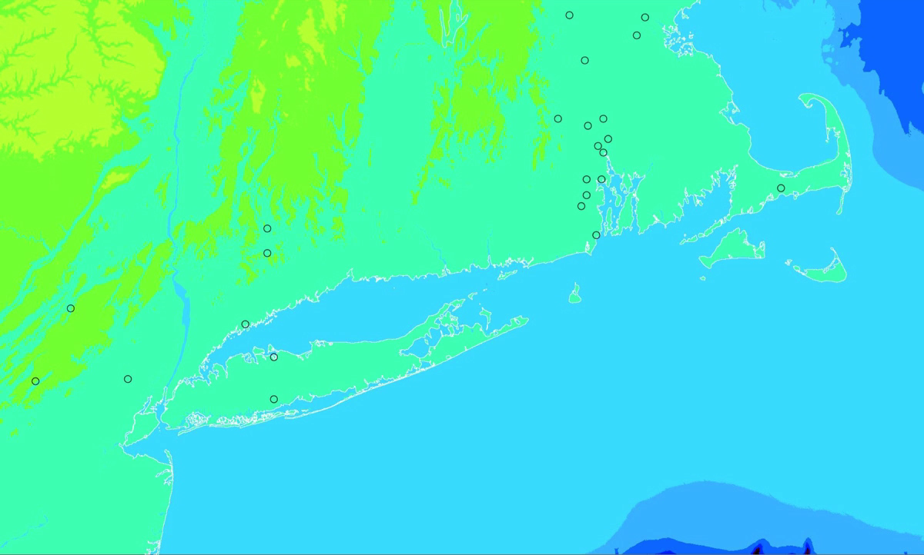
Sea Level and You

