Slide 1

Global Warming:
Hurricanes

Slide 2
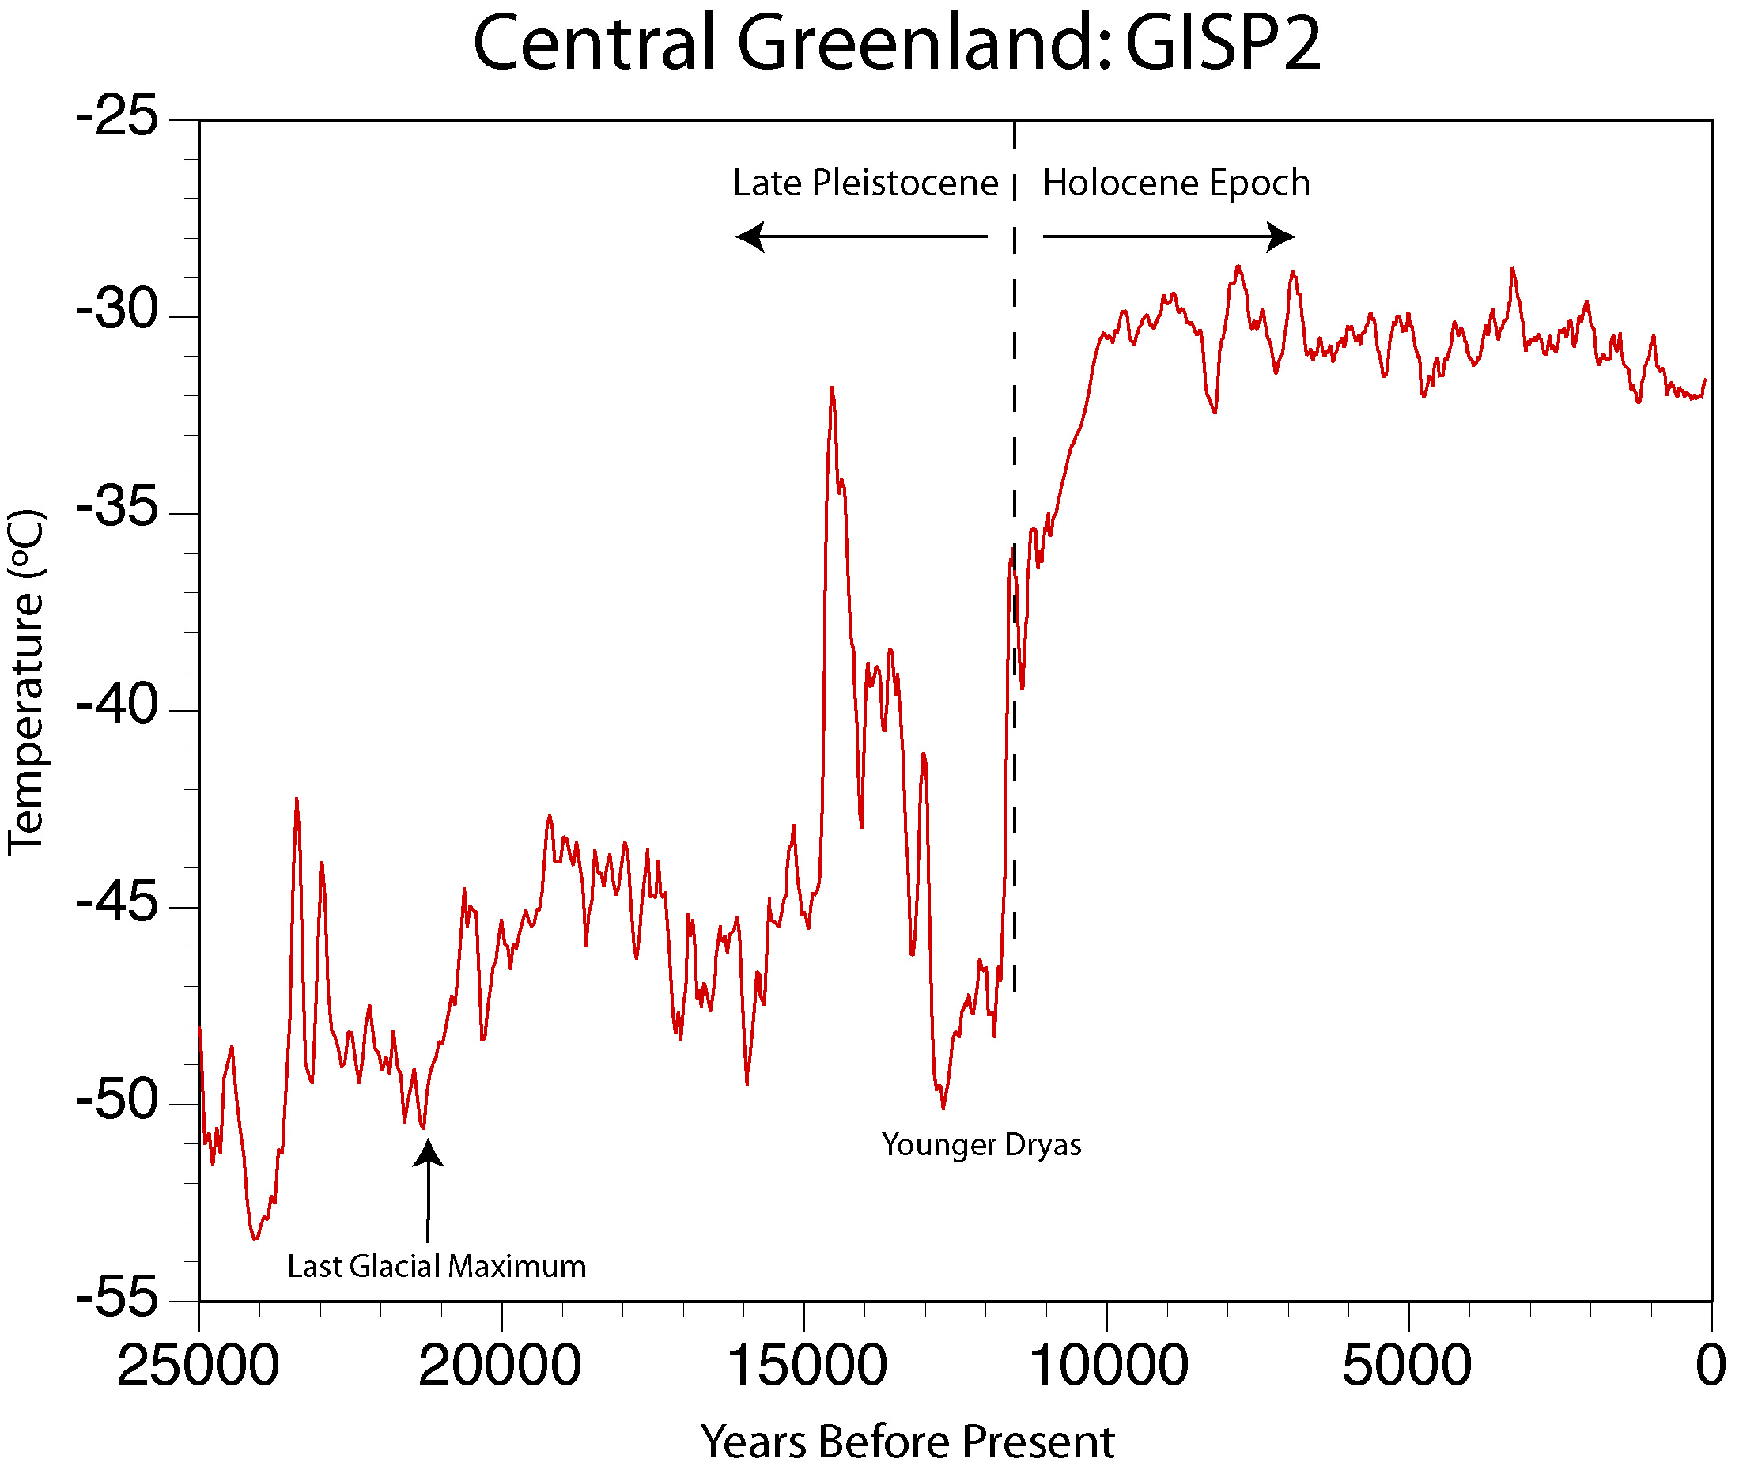
Holocene Paleoclimate
After: Alley, 2000 (Quaternary Science Reviews v.19)
Notes:
2

Slide 3
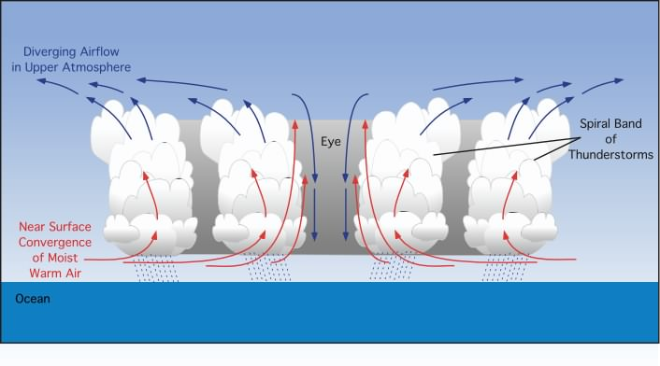
What is a tropical cyclone?
A “heat engine”
Image: Dr. Michael Pidwirny, University of British Columbia
Hurricane FAQ: http://www.aoml.noaa.gov/hrd/tcfaq/tcfaqHED.html
Notes:
3

Slide 4
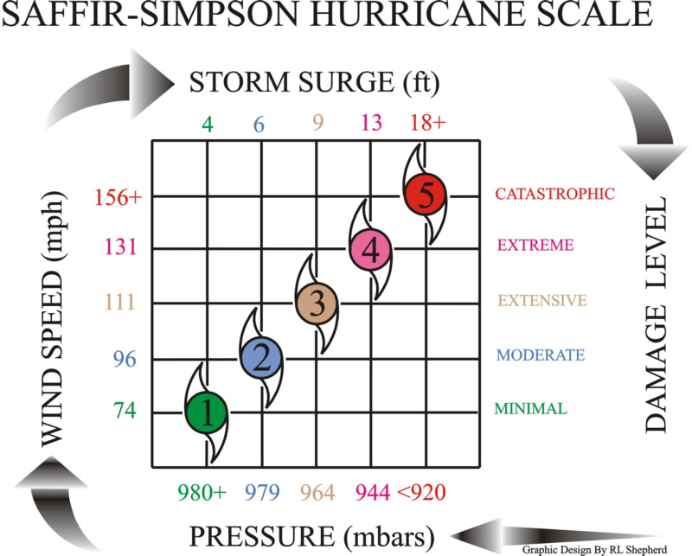
Understanding and attributing hurricane variability
Storm Energy
Notes:
4
Saffir-Simpson hurricane intensity scale for the Atlantic and Northeast Pacific basins to give an estimate of the potential flooding and damage to property given a hurricane's estimated intensity

Slide 5
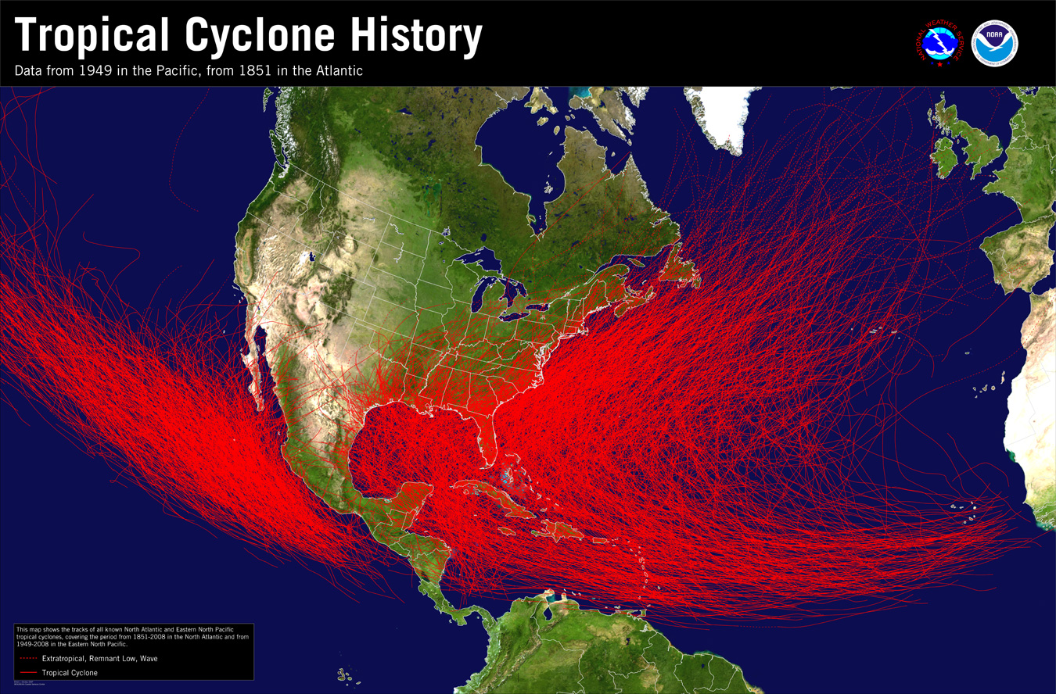
Notes:
5

Slide 6
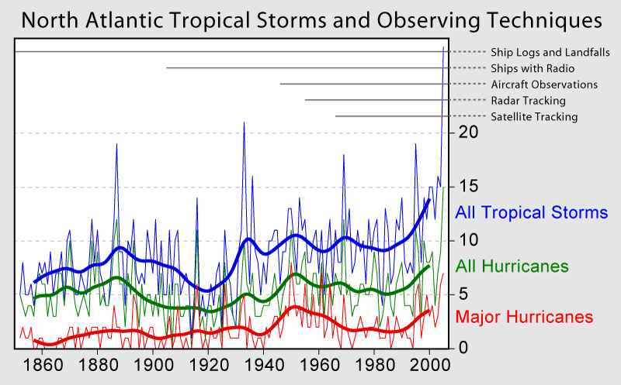
Atlantic Hurricane Database since 1851
Image: Robert A. Rohde / Global Warming Art
Notes:
6

Slide 7
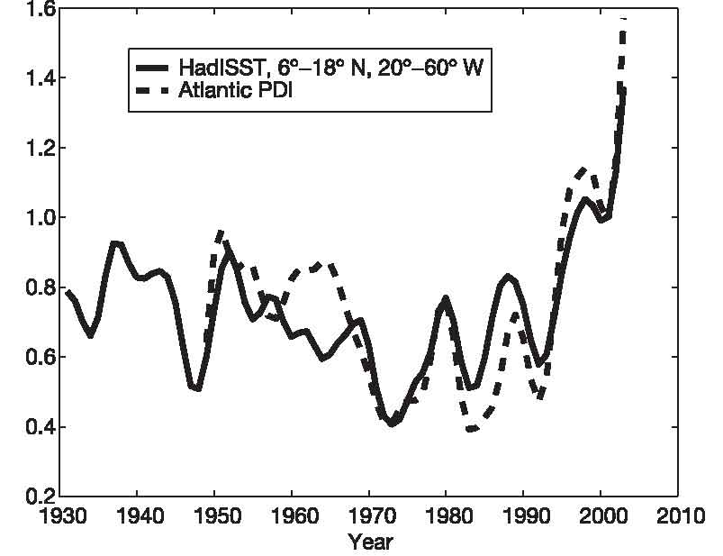
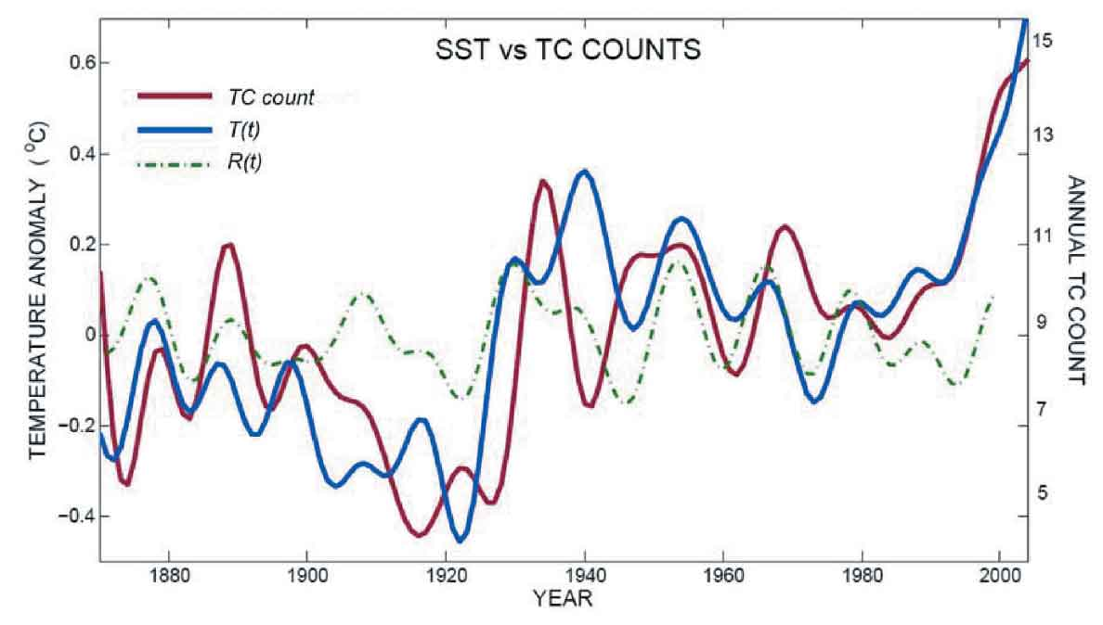
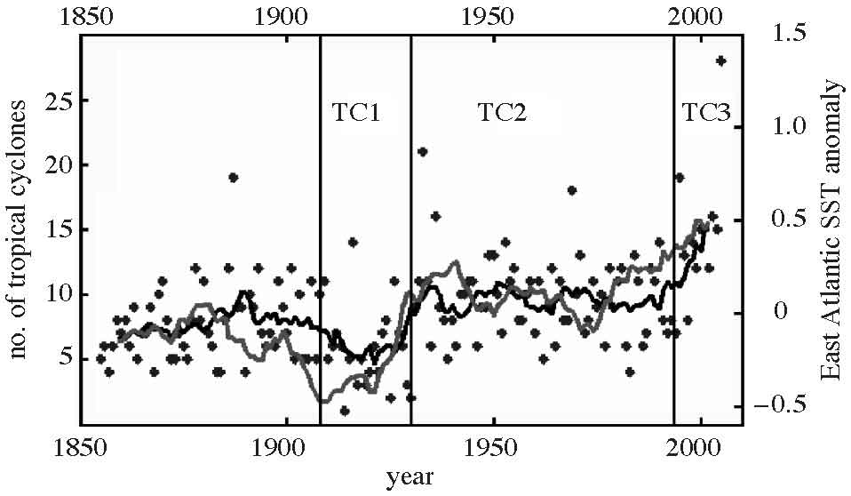
Is recent variability due to GCC…….
Increasing Intensity
Increasing Frequency
Emanuel, 2005 (Nature v.436)
Mann & Emanuel, 2006 (Eos v.87)
Holland and Webster, 2007 (Phil. Trans. R. Soc. doi:10.1098))
Notes:
7
Emanuel correlated increased SSTs over the later part of the 20th century with an increase in the intensity (PDI) of storms in the North Atlantic. PDI: an index of the potential destructiveness of hurricanes based on the total dissipation of power, integrated over the lifetime of the cyclone this index has increased markedly since the mid-1970s jointly with changes in SSTs
SSTs are strongly linked to incresed frequency of TCs…..in this case, a doubling of the number of tropical cyclones over the past 100 years
Holand and webster - past 150 years, 0.7 degree increase, and nearly double the number of storms concluding that the overall trend in SSTs, and tropical cyclone and hurricane numbers is substantially inﬂuenced by greenhouse warming.

Slide 8
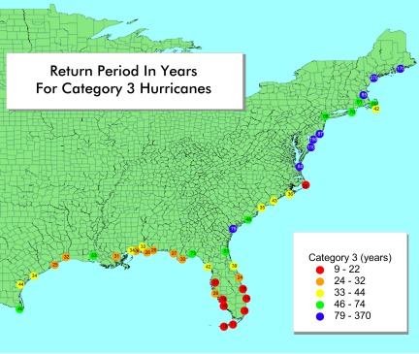
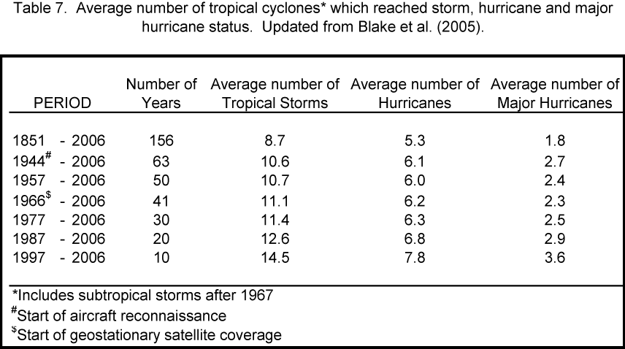
Landfall Return Periods: The frequency at which a certain category of hurricane is expected within 75 nm (86 miles) of a given location.
Source: National Hurricane Center
Notes:
8

Slide 9
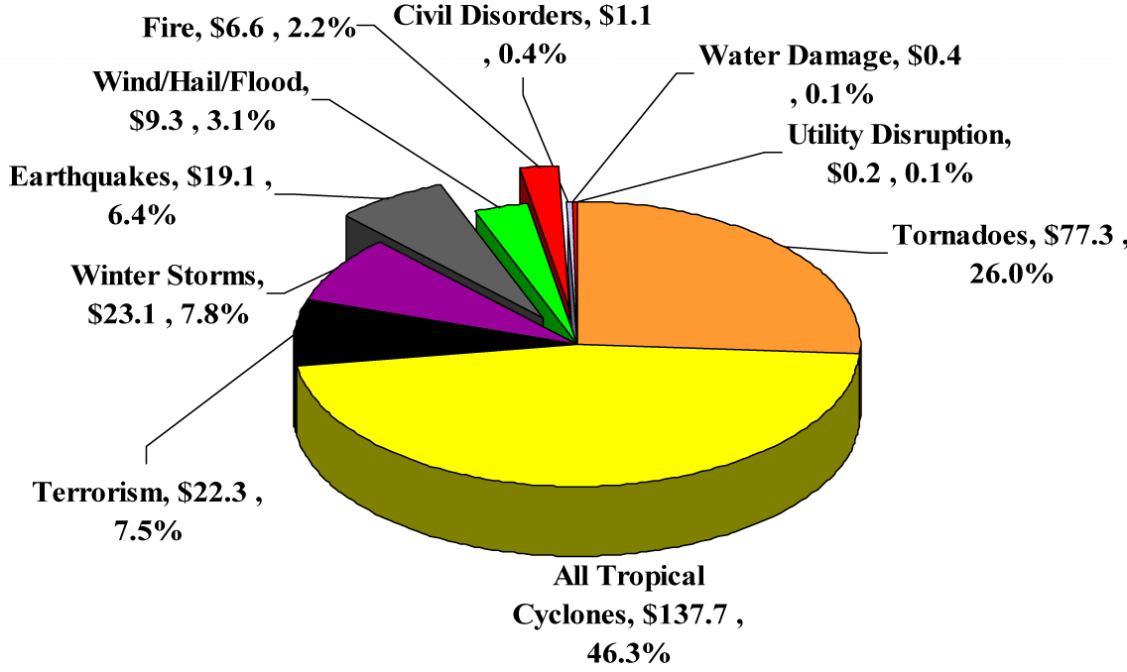
Assessment of Hurricane Risk
Inflation-Adjusted U.S. Insured Catastrophe Losses By Cause of Loss, 1987-2006 ($US billions)
Notes:
9
9

Slide 10
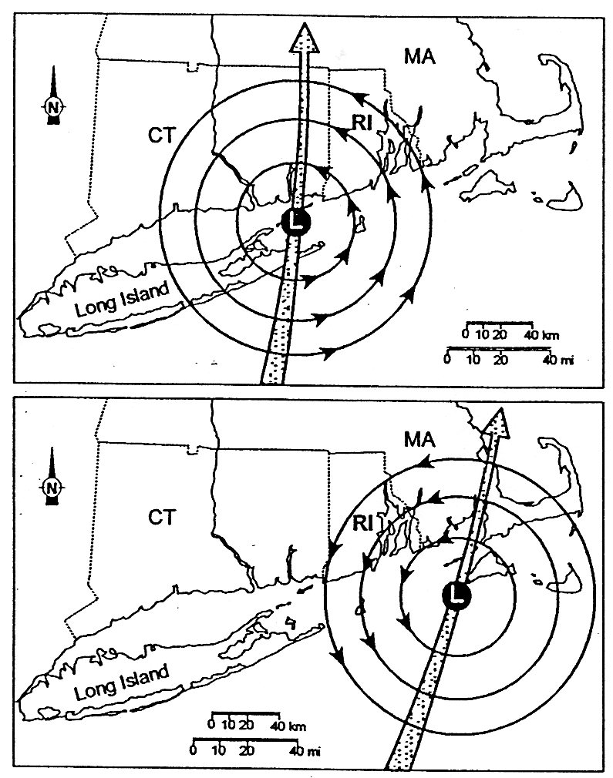
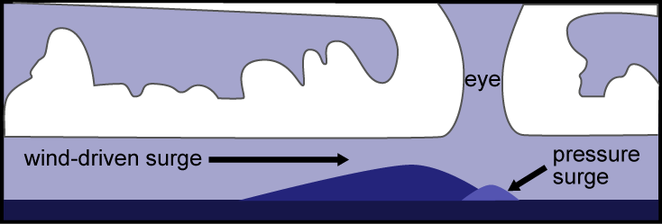
Impacts of Landfalling Storms
Strong winds
Coastal flooding
  Large waves and swells
  Storm surge
Inland flooding
  Heavy precipitation
  Severe thunderstorms
Tornados
Wright & Sullivan, 1980
Image: NASA Earth Observatory
Notes:
10

Slide 11
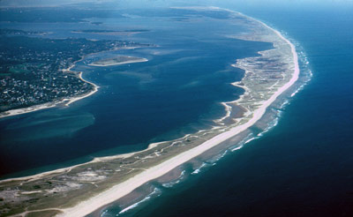
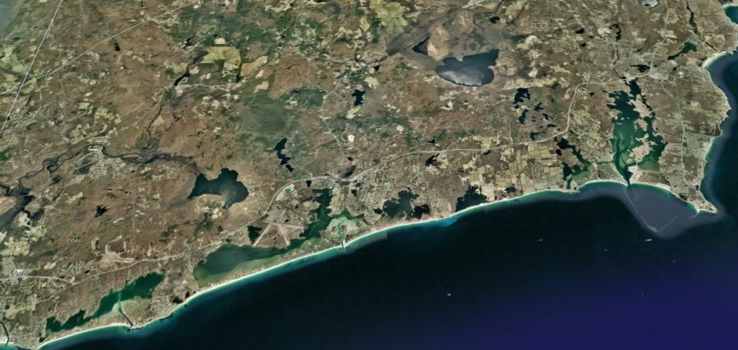
Records of coastal flooding
Barrier beach
Rhode Island South Shore (Google Earth)
Notes:
11

Slide 12
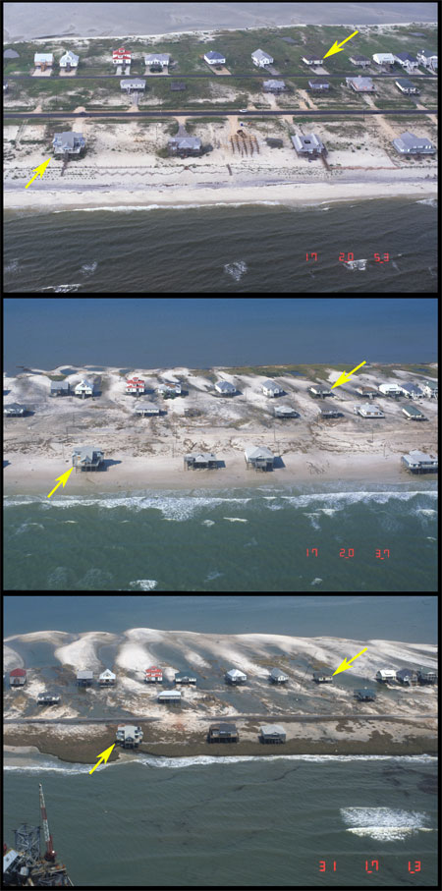
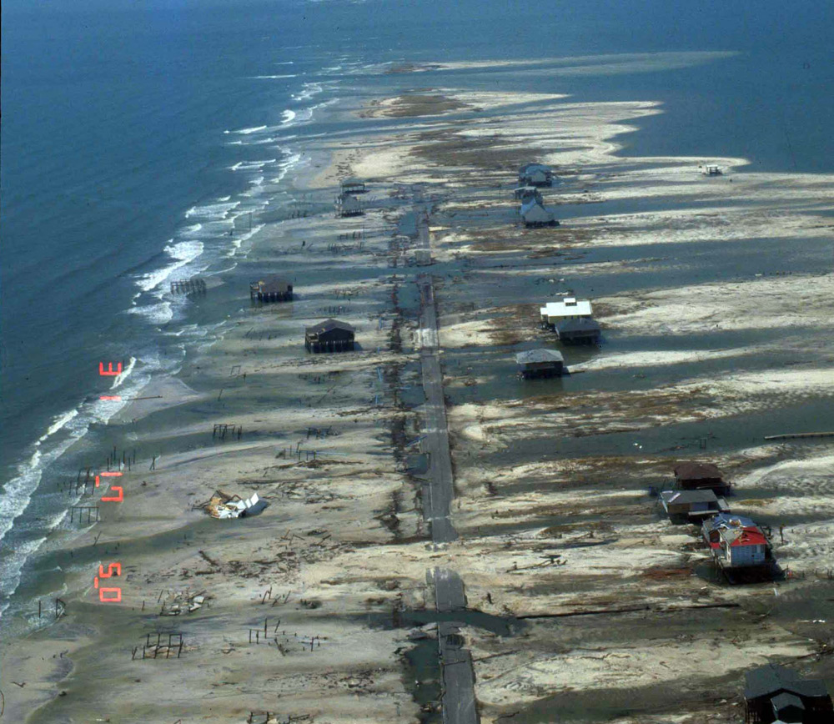
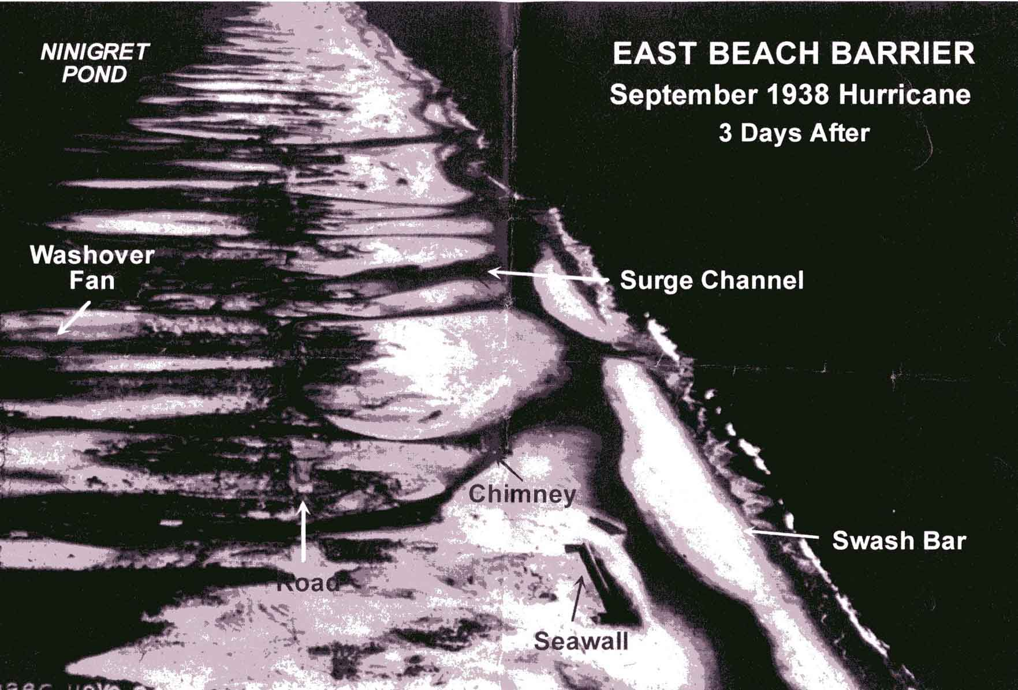
Overwash of barrier beaches
Notes:
12

Slide 13
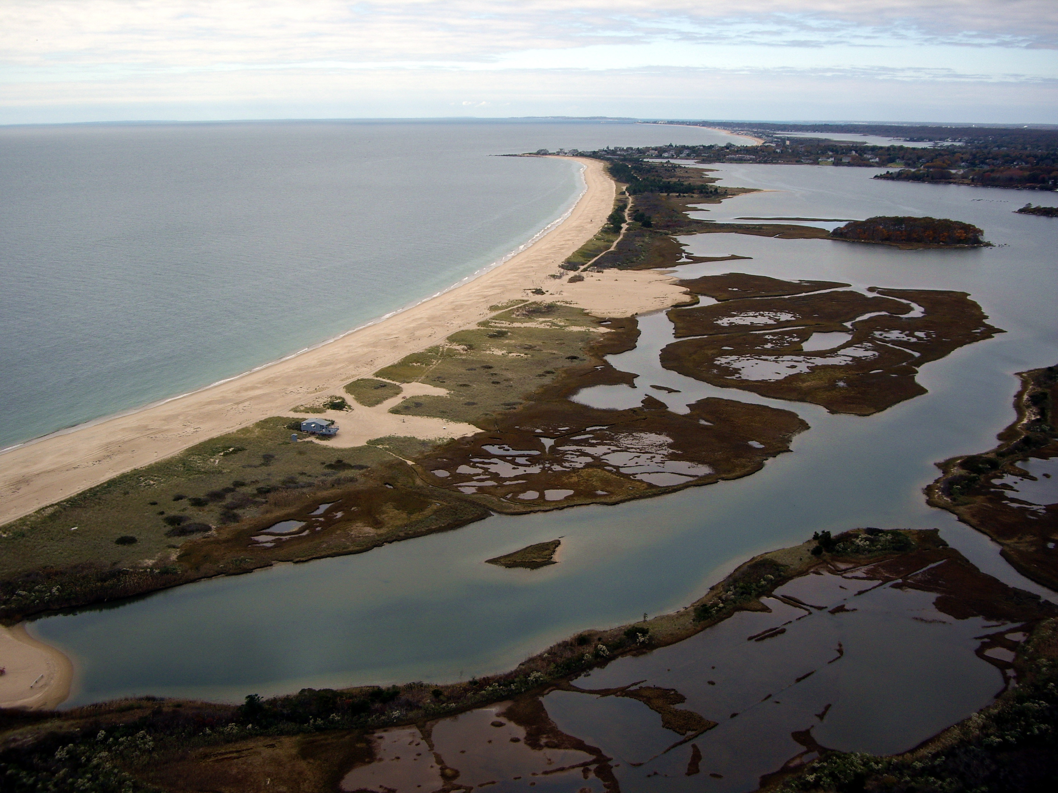
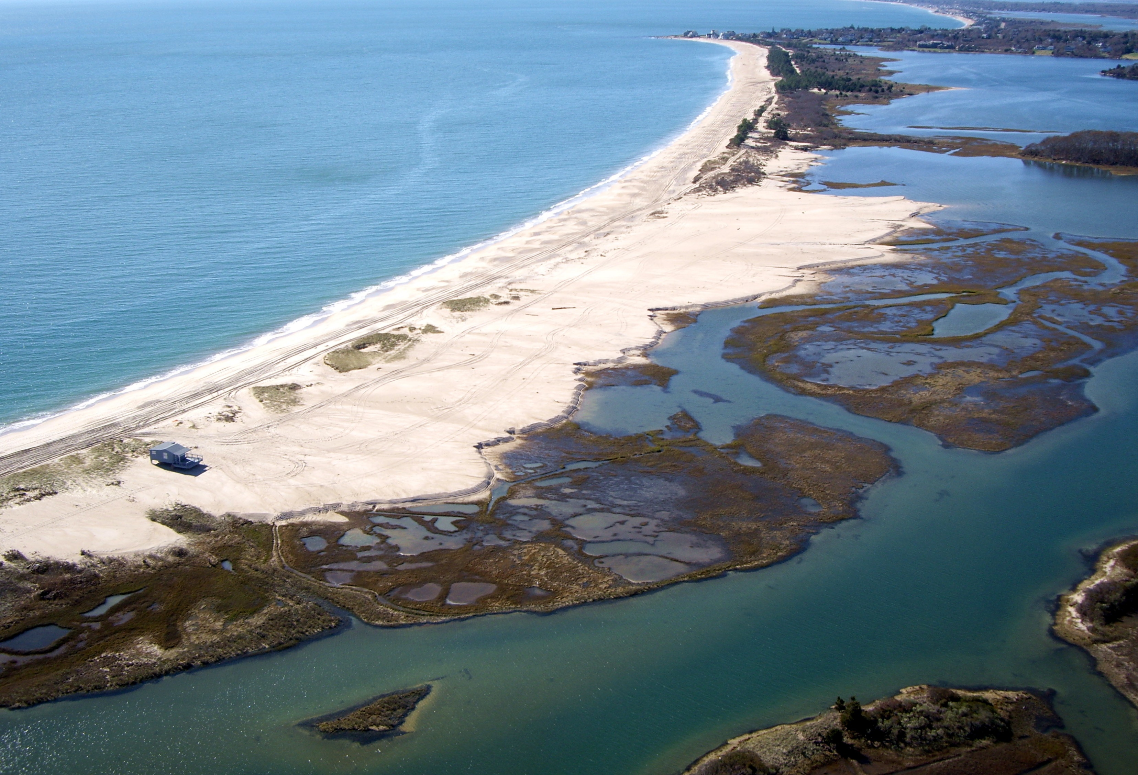
Before
After

Slide 14
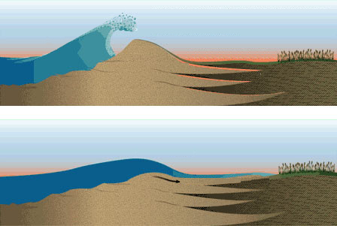
Overwash of barrier beaches
LSU Paleotempestology Group
Notes:
14
“

Slide 15
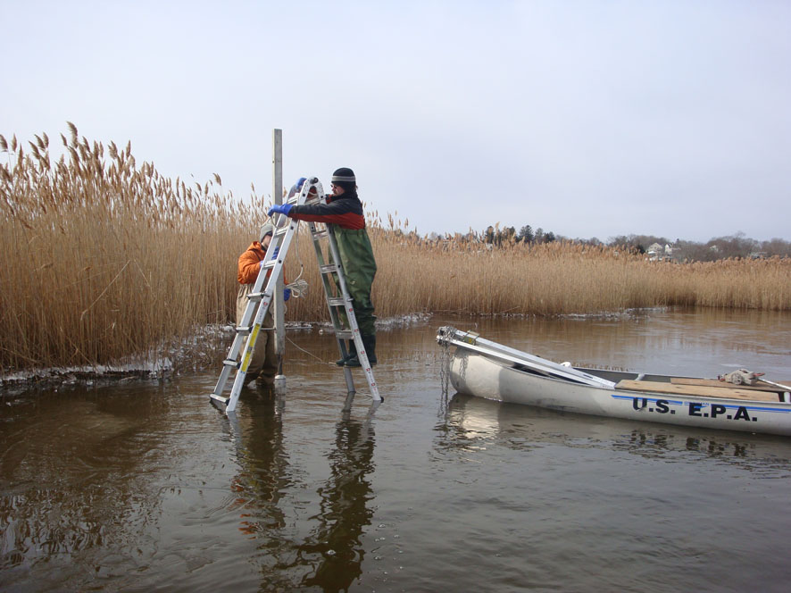
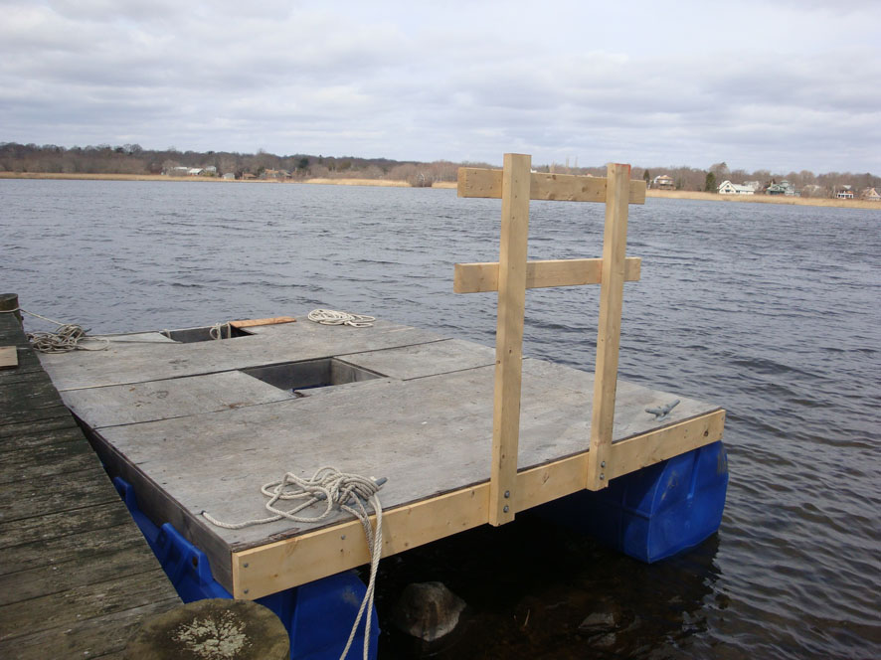
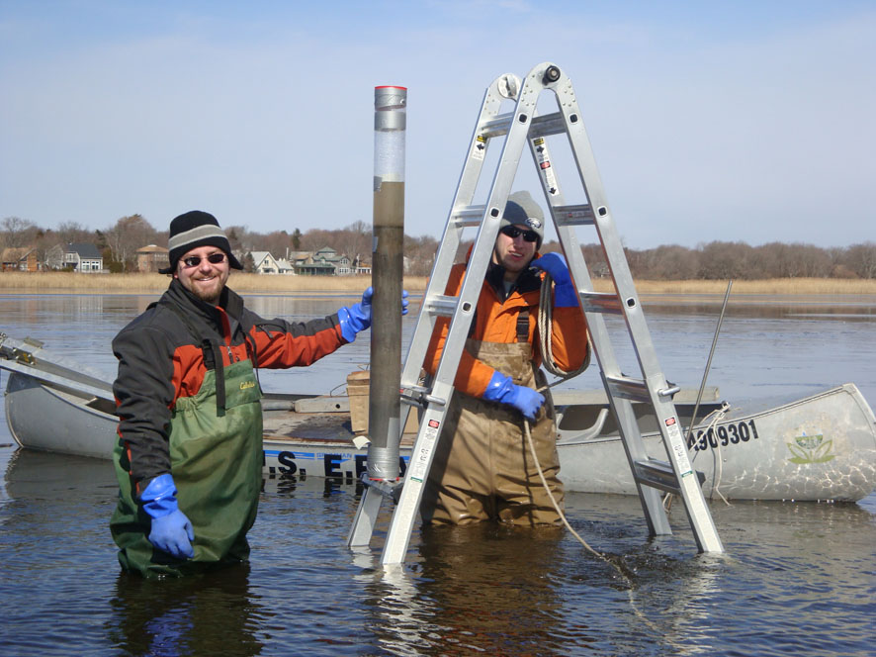
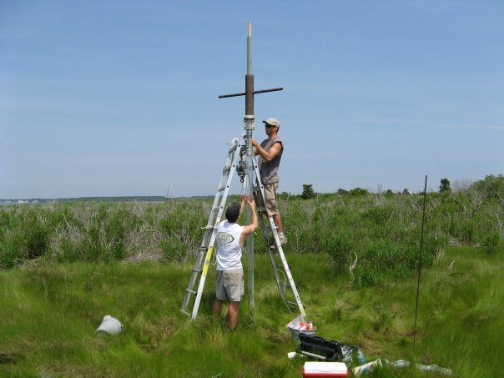
Shallow Water Coring
Fixed piston push core
Coring platform
Hammer core in marsh
Geologists excited to find storm deposits
Notes:
15

Slide 16
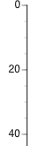
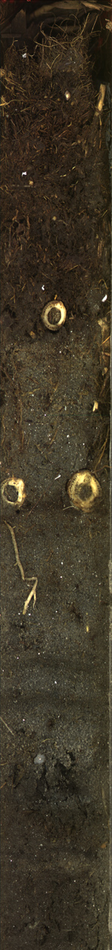
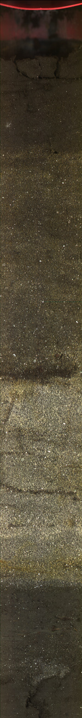
Identification of storm deposits
Marsh Core
Pond Core
Marsh
Peat
lagoon mud (silt & clay)
Depth below seafloor (cm)
laminated
sands
Marsh
Peat
Notes:
16

Slide 17
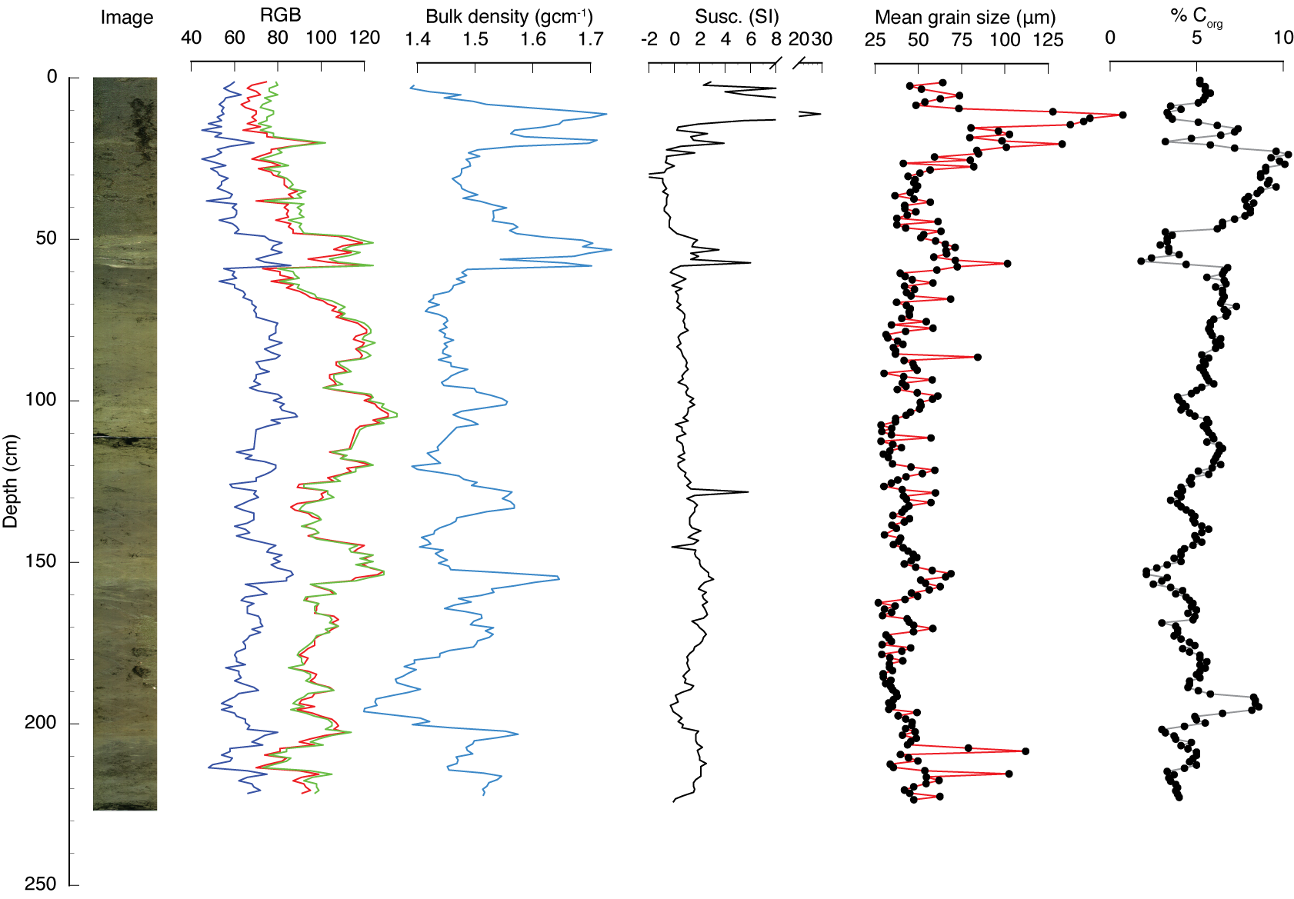
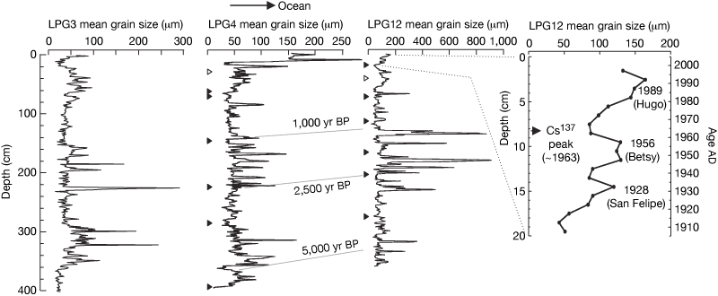
Sedimentary record of hurricane strikes
1. Overwash layers identified
  physical properties (density, color)
  grain size
  organic carbon content
  microfossils
2. Layers correlated between cores
3. Sediments are dated
  radiocarbon
  210Pb, 137Cs
4. Record compared to period of instrumental and historical overlap
Donnelly and Woodruff (2007)
Notes:
17

Slide 18
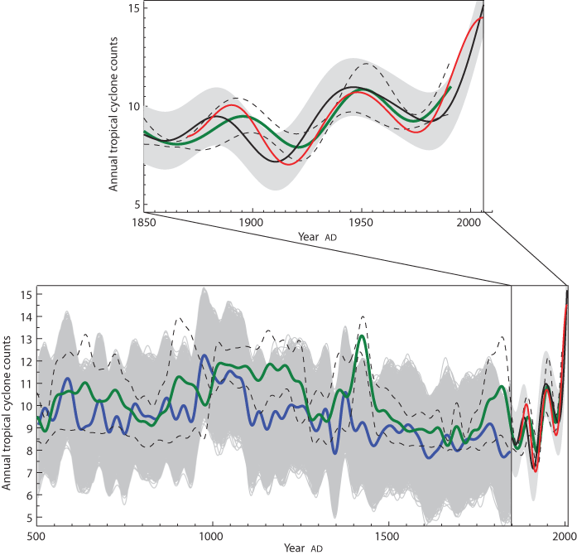
Atlantic hurricanes and climate over the past 1,500 years
Mann et al. (2009)
Notes:
18
Figure 3 | Long-term Atlantic tropical cyclone counts. Modern Atlantic tropical cyclone counts (red) compared both with statistical model estimates of tropical cyclone activity based on modern instrumental (AD 1851–2006; black) and proxy-reconstructed (AD 500–1850; blue) climate indices and an estimate of basin-wide landfalling Atlantic hurricane activity (AD 500–1991) derived from regional composites of overwash sediments (green).
Uncertainties for the statistical model estimates (grey shading, indicating 95% confidence intervals) take into account the uncertainty in the statistical model itself (grey shading), and—in the case of the proxy-reconstructed indices (grey shading), the additional uncertainty due to the uncertainties in the proxy-reconstructed climate indices. Uncertainties for the sediment composite record (thin dashed black curves indicating upper and lower limits of the 95% confidence interval) are derived from jackknifing of the full composite with respect to each of the five contributing regional estimates, as discussed in the text.

Slide 19
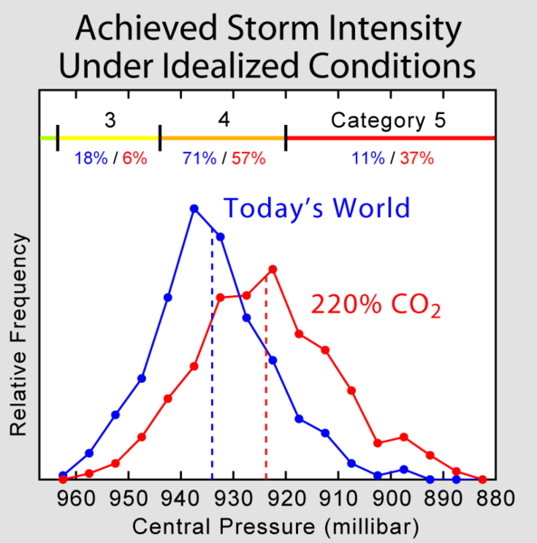
Knutson & Tuleya (2004))
Notes:
19
Knutson & Tuleya (2004), shows a prediction for how hurricanes and other tropical cyclones may intensify as a result of global warming. Specifically, Knutson & Tuleya performed an experiment using climate models to estimate the strength achieved by cyclones allowed to intensify over either a modern summer ocean or over an ocean warmed by carbon dioxide concentrations 220% higher than present day. A number of different climate models were considered as well as conditions over all the major cyclone forming ocean basins. Depending on site and model, the ocean warming involved ranged from 0.8 to 2.4 ｰC.Results, which were found to be robust across different models, showed that storms intensified by a about one half category (on the Saffir-Simpson Hurricane Scale) as a result of the warmer oceans. This is accomplished with a ~6% increase in wind speed or equivalently a ~20% increase in energy (for a storm of fixed size). Most significantly these result suggest that global warming may lead to a gradually increase in the probability of highly destructive category 5 hurricanes.

