Slide 1
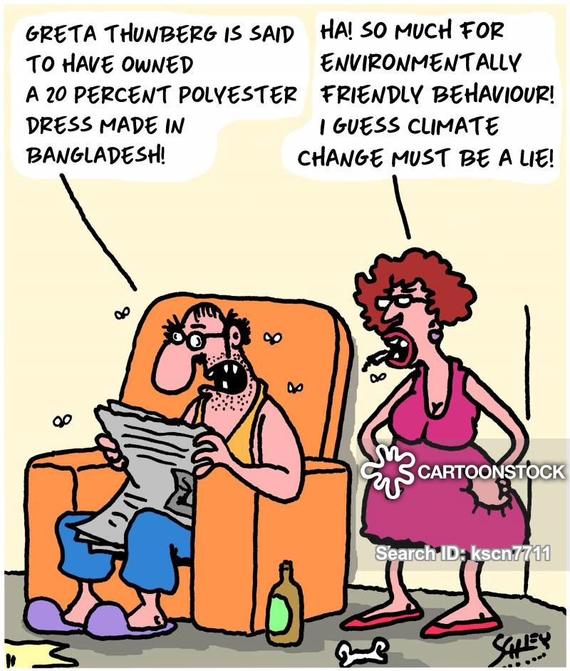
Climate Summary – Effects on People
Focus Activity
- Hands-on Activity
Sea Level Change
- Examples & Causes
- Classification

