Slide 1
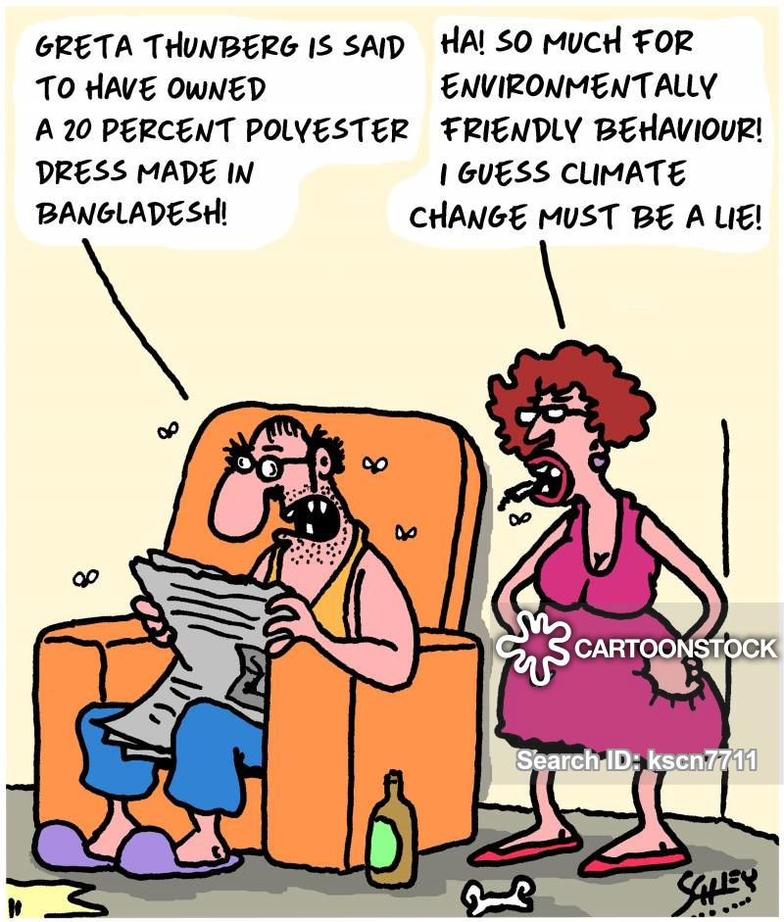
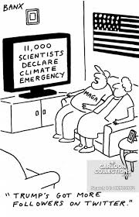
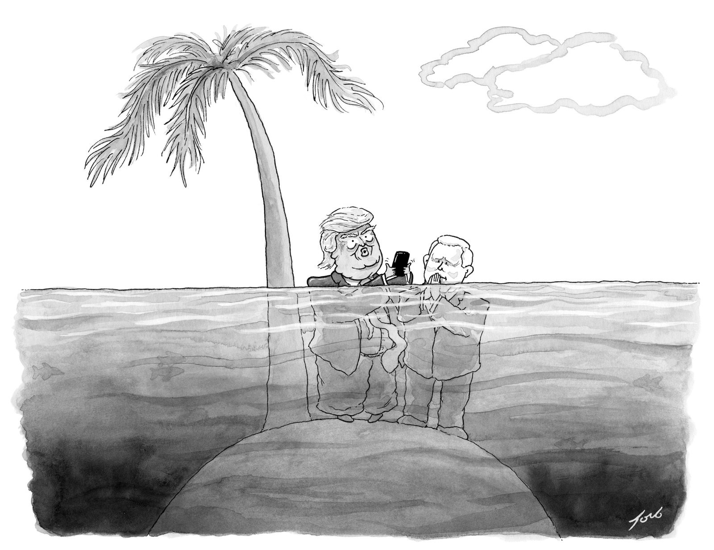
Role of Social Media
Focus Activity
- Hands-on Activity
Sea Level Change
- Examples & Causes
- Classification

