Slide 1
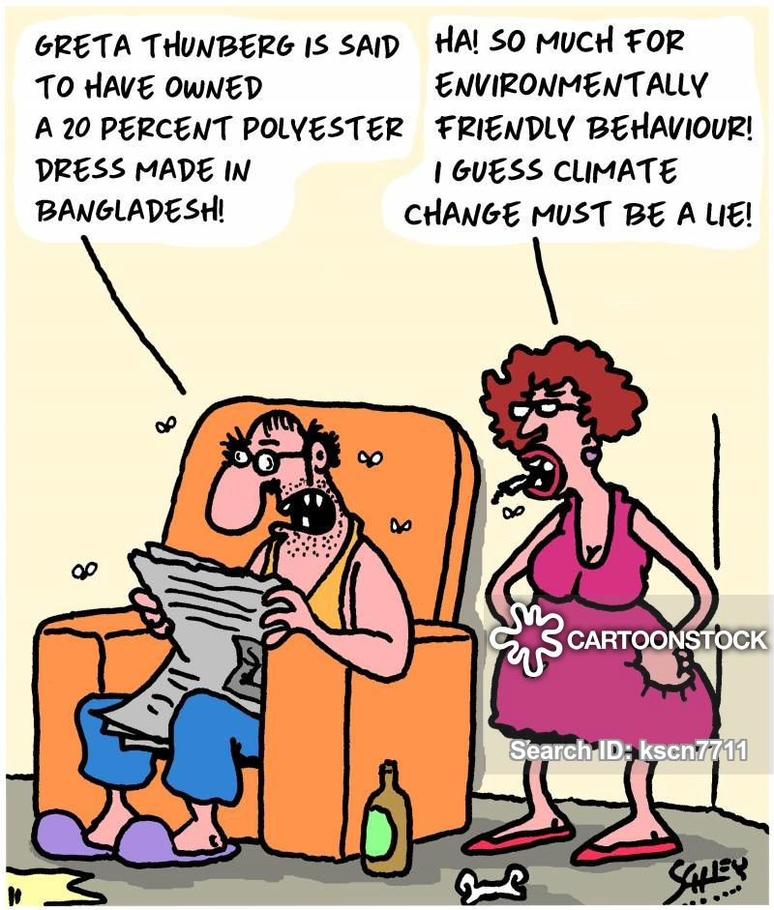
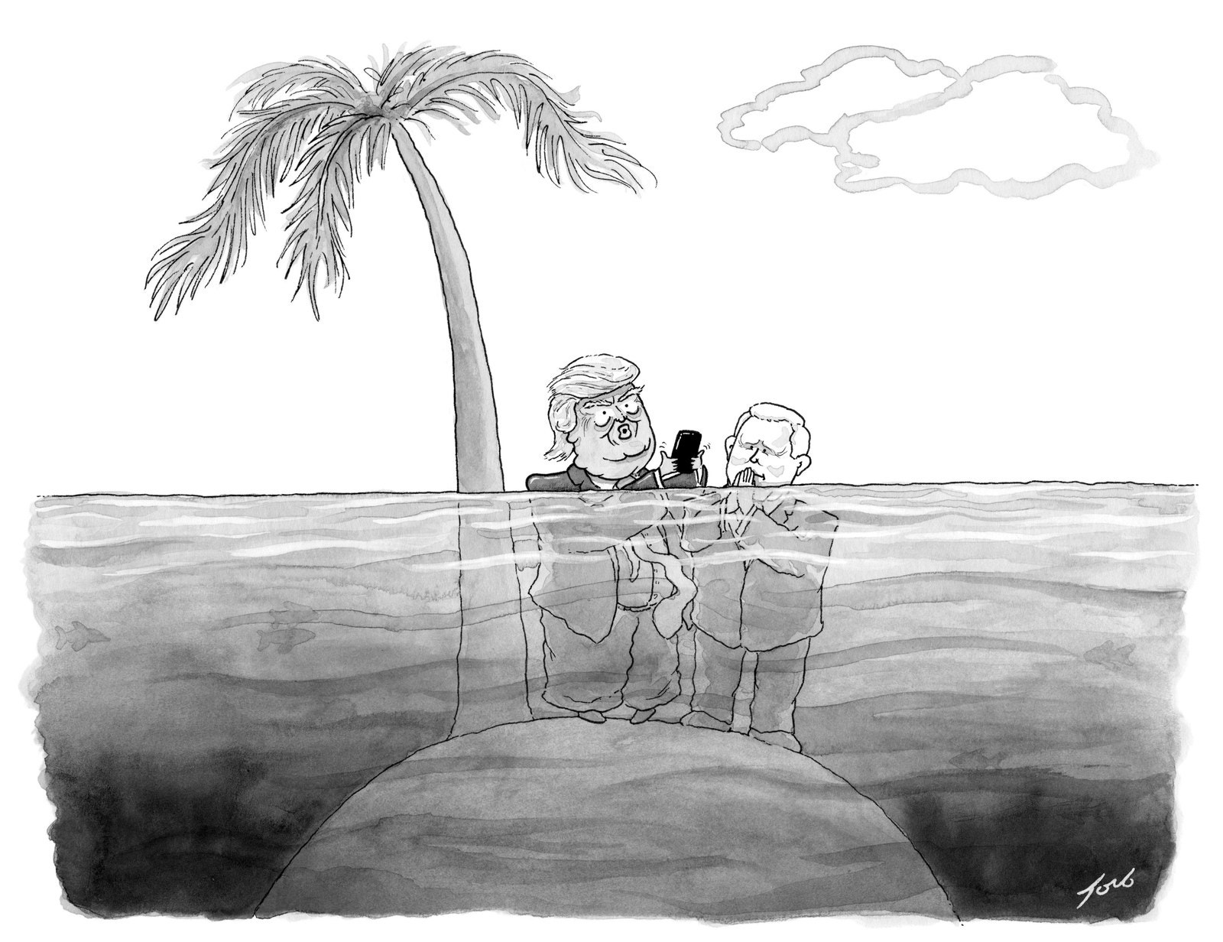
Where were we????
Focus Activity
- Hands-on Activity
Sea Level Change
- Examples & Causes
- Classification

