Slide 1
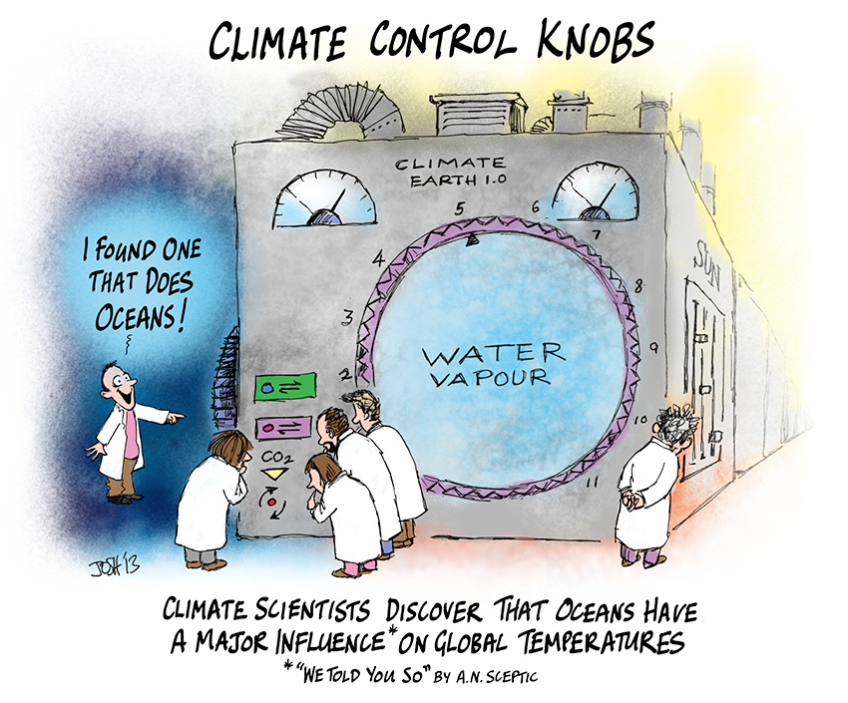
Climate Models
Simulation Review
Climate Models

Slide 2
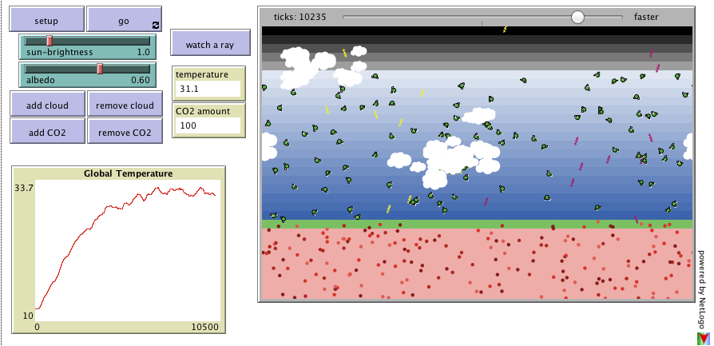
Simulation Review
http://netlogoweb.org/launch#http://netlogoweb.org/assets/modelslib/Sample Models/Earth Science/Climate Change.nlogo

Slide 3
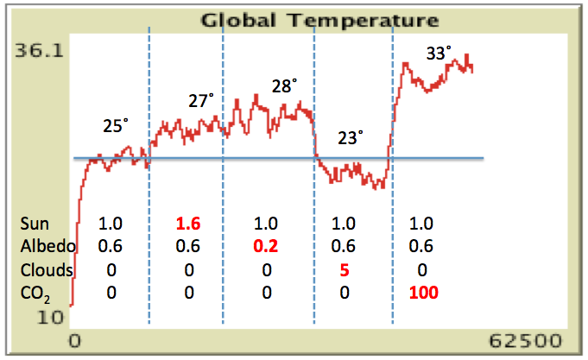
Simulation Review
Temperature = Suns’ Rays + Albedo + Clouds + CO₂
More Red Balls
Higher Temp
More Sun
Higher Temp
Reduce Albedo
Higher Temp
More Clouds
More Reflection Out
Lower Temp
More CO₂
Higher Temp
More Clouds
More Reflection In
Higher Temp

Slide 4
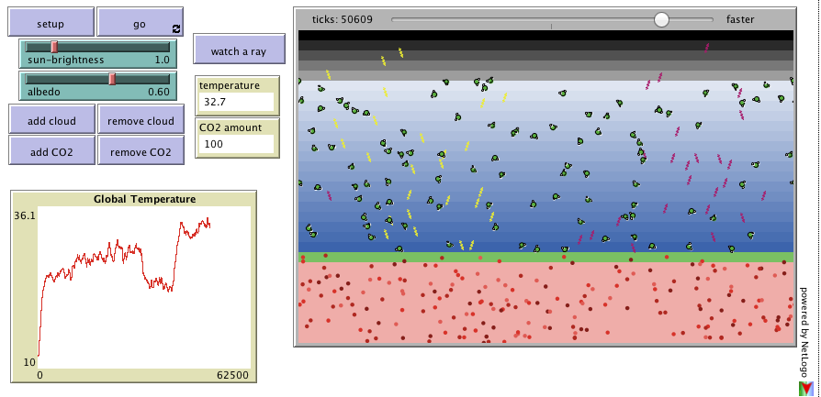
Simulation Review
Group Discussion:
1) Strengths of simulation ??
2) Weaknesses ??
33˚
28˚
27˚
25˚
23˚
Sun 1.0 1.6 1.0 1.0 1.0
Albedo 0.6 0.6 0.2 0.6 0.6
Clouds 0 0 0 5 0
CO₂ 0 0 0 0 100

Slide 5
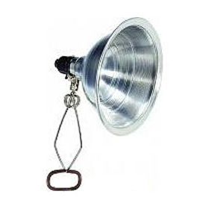
Climate Box Review – Black & White
What’s Happening
Incoming
Energy
Reflected
Energy
Incoming
Energy
Reflected
Energy
More
Energy
Absorbed
Less
Energy
Absorbed
More
Energy
Absorbed
Plastic
Warms
Faster
Adjacent Air
Warmed
Faster & More
Less
Energy
Absorbed
Plastic
Warms
Slower
Adjacent Air
Warmed
Slower & Less

Slide 6
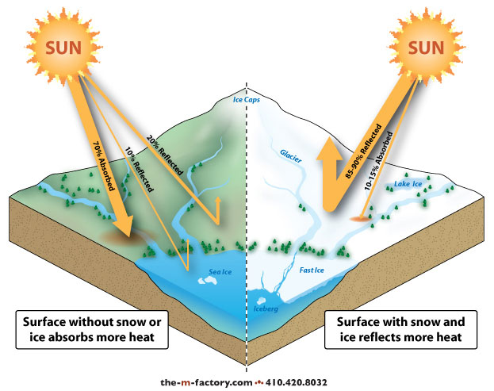
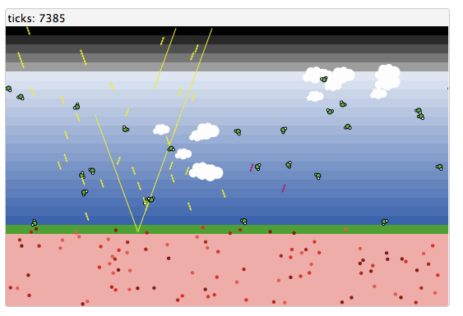
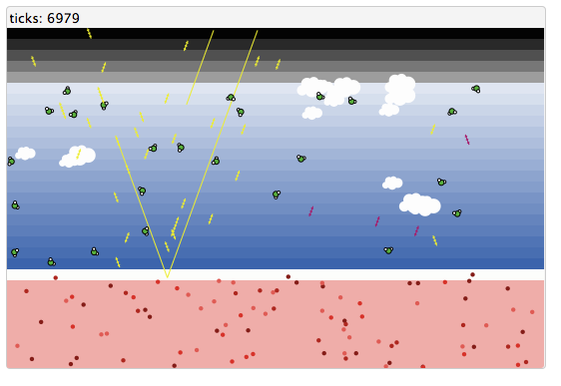
Simulation Review - Albedo

Slide 7
Greenhouse Effect
Greenhouse Gases
Visible
IR
UV
IR warms up CO₂
Re-radiates heat
O-C-O
Incoming
Sunlight
O-C-O
O-C-O
UV & Visible
No effect
Heats up Earth
“Converts” UV & Vis to IR

Slide 8
Greenhouse Effect
Greenhouse Gases
Visible
IR
UV
IR warms up CO₂
Re-radiates heat
O-C-O
IR heats up CO₂
Re-radiates heat
Incoming
Sunlight
O-C-O
O-C-O
O-C-O
UV & Visible
No effect
Radiated IR
Heats up Earth
“Converts” UV & Vis to IR

Slide 9
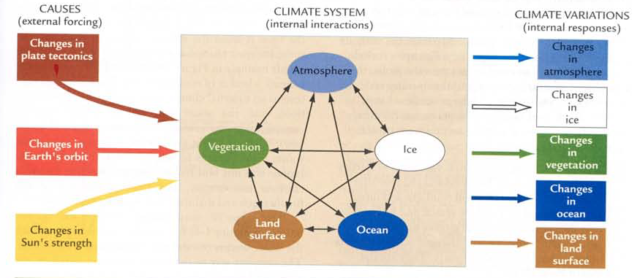
Climate Prediction
Global Circulation Models - Conceptual
Suped-Up Weather Forecasts
Human Impacts ??

Slide 10
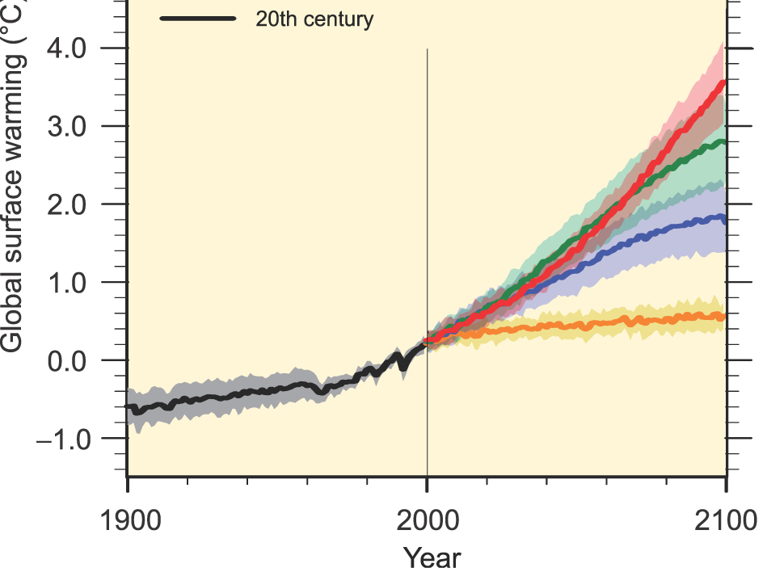
Climate Prediction
Global Circulation/Climate Models
➔
Suped-Up Weather Forecasts
Step 1 - Calibrate Models
Reproduce Past
Prediction
Best Guess
Uncertainty

Slide 11
Climate Prediction
Global Circulation/Climate Models
Step 1 - Calibrate Model
Step 2 – Apply Model
Reproduce Past
Prediction
Predict the Future
High Growth
Moderate Growth
Low Growth
Best Guess
Uncertainty
Constant CO₂

Slide 12
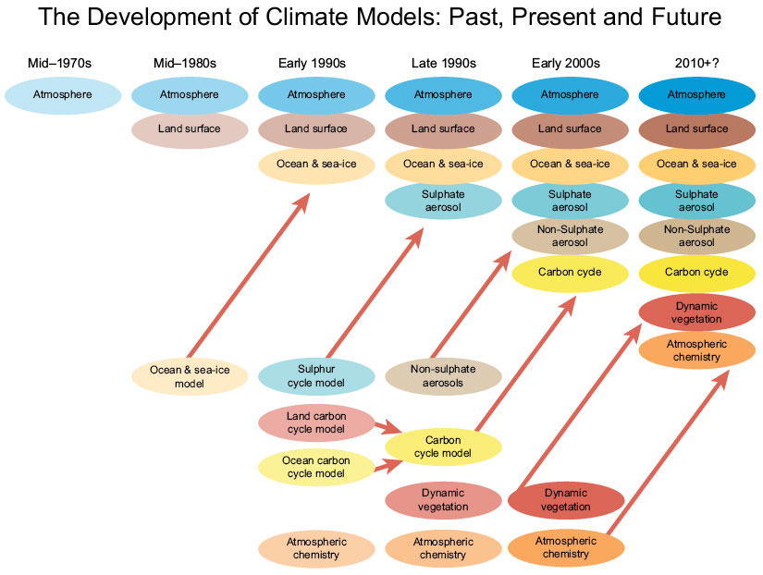
Climate Prediction

Slide 13
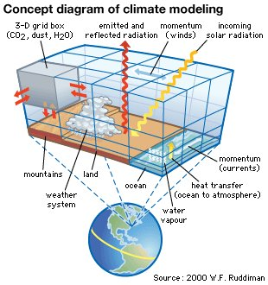
Climate Prediction

Slide 14
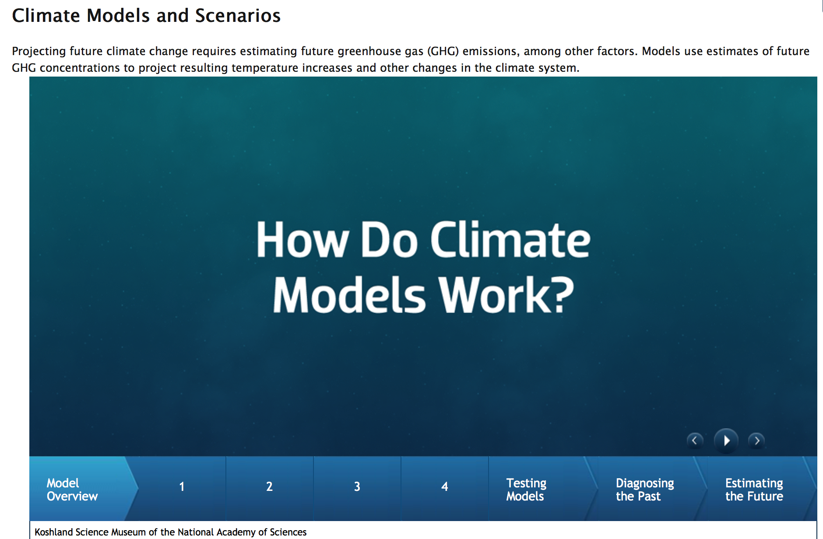
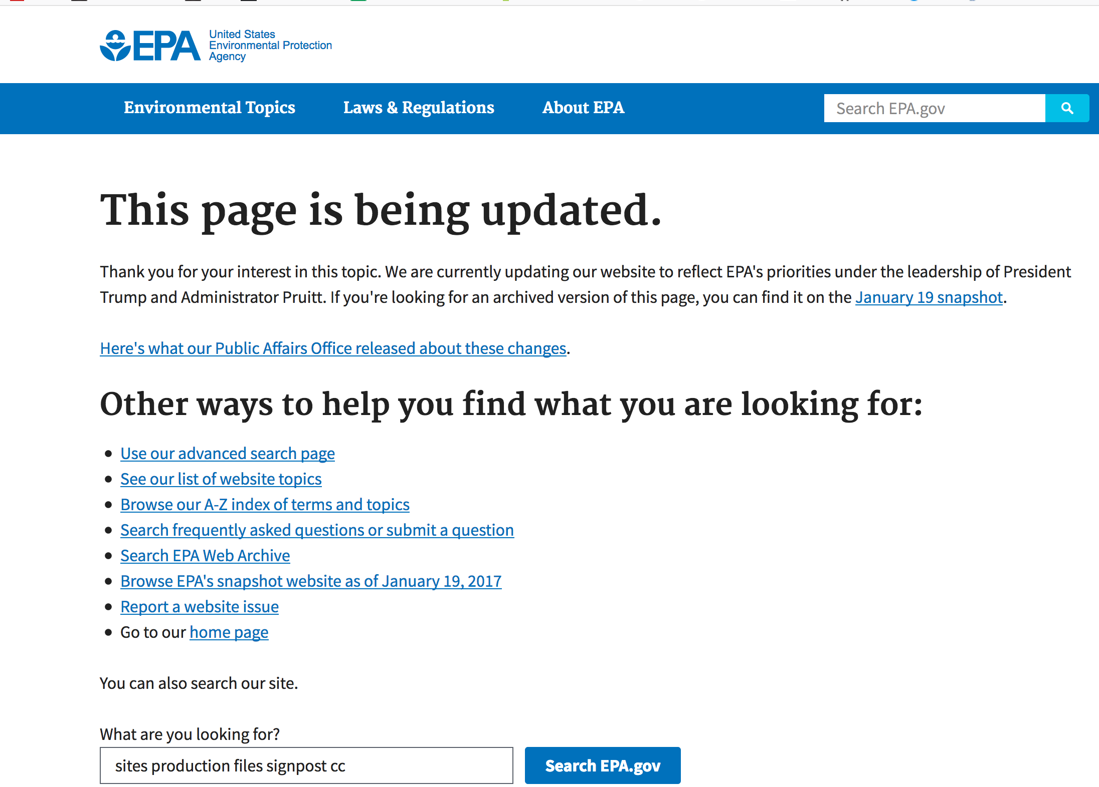
Climate Prediction
https://www3.epa.gov/climatechange/science/future.html#

Slide 15
Climate Prediction
Extra Reading – About Climate Models
www.carbonbrief.org/qa-how-do-climate-models-work
www.skepticalscience.com/climate-models-basic.htm
www.skepticalscience.com/climate-models-intermediate.htm
www.climate.gov/maps-data/primer/climate-models

Slide 16
Climate Prediction
Extra Reading – Climate Model Skeptics
www.realclearscience.com/blog/2017/01/23/a_skeptical_journalists_view_on_climate_models.html
wattsupwiththat.com/2017/07/06/bombshell-study-temperature-adjustments-account-for-nearly-all-of-the-warming-in-government-climate-data/
https://www.theblaze.com/news/2017/07/23/commentary-the-6-biggest-reasons-im-a-climate-change-skeptic-and-why-you-should-be-a-skeptic-too

Slide 17
The Gloom & Doom of Climate Change / Global Warming
What aspect(s) of Climate Change concerns you the most?

Slide 18
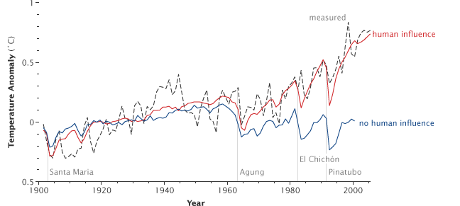
Climate Prediction
Model Predictions - Temperature

Slide 19
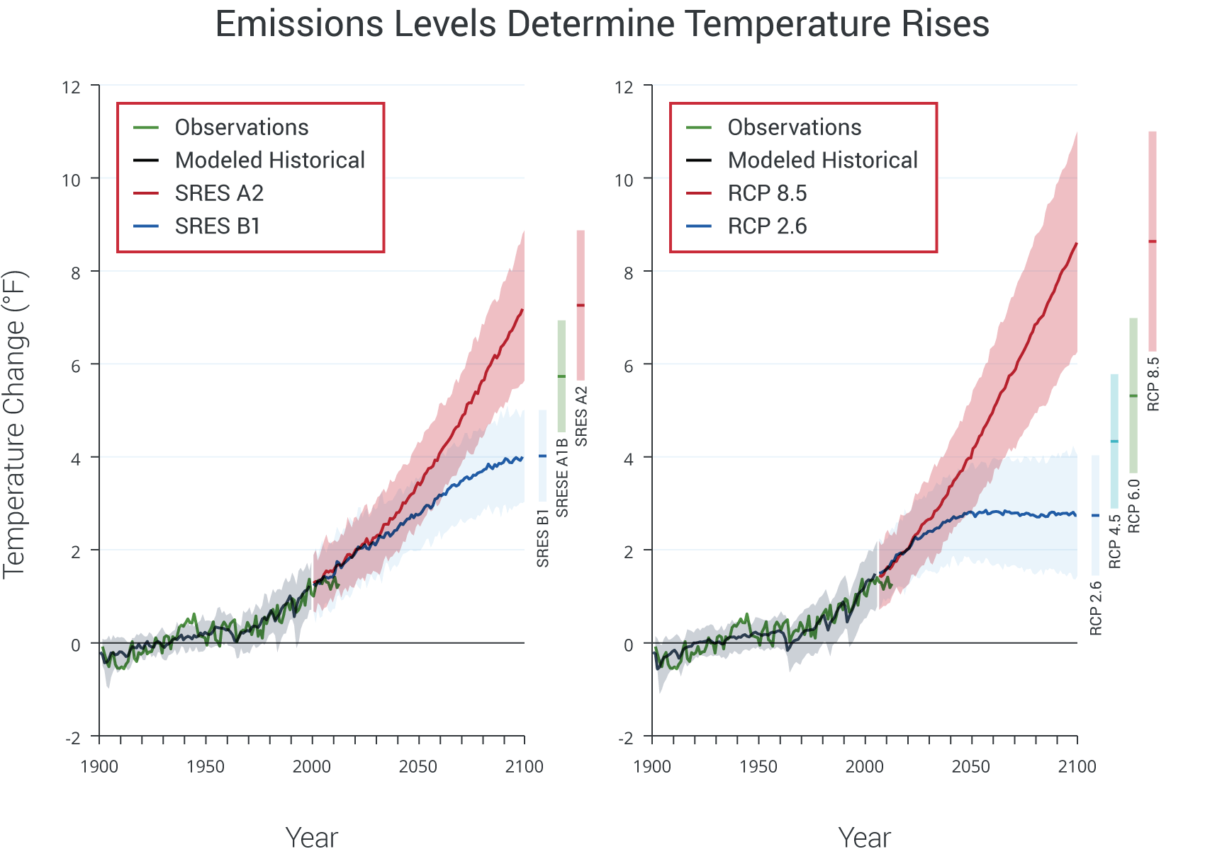
Climate Prediction
Model Predictions - Temperature
continued increases in emissions
(8 ˚F increase)
immediate & rapid reductions in emissions
(2.5 ˚F increase)
http://nca2014.globalchange.gov/report/our-changing-climate

Slide 20
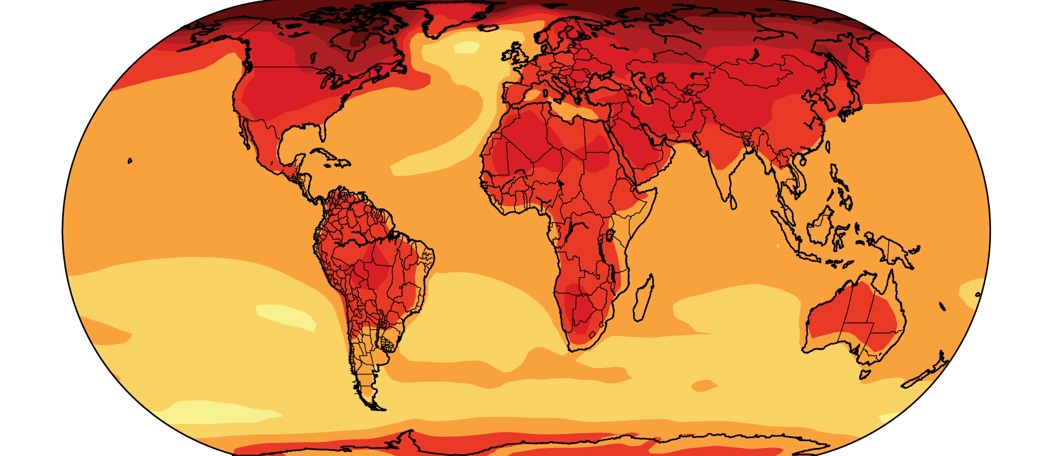
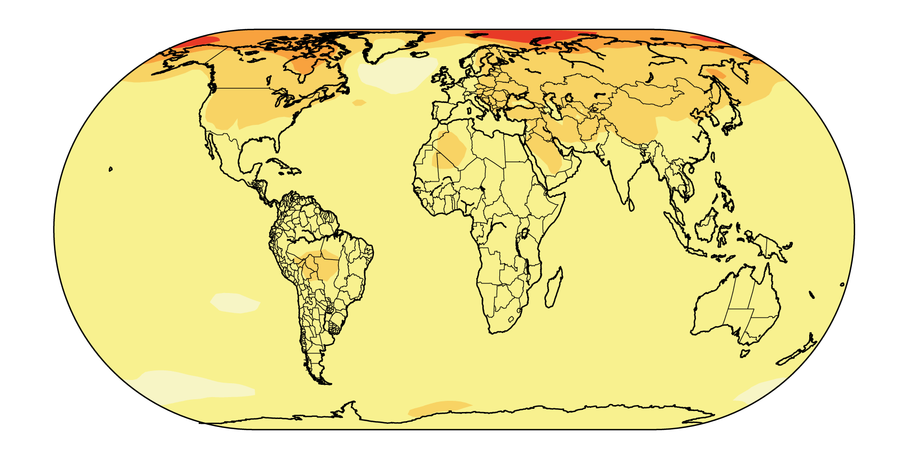

Climate Prediction
Model Predictions - Temperature
continued increases in emissions
(8 ˚F increase)
Where are the biggest changes?
immediate & rapid reductions in emissions
(2.5 ˚F increase)

Slide 21
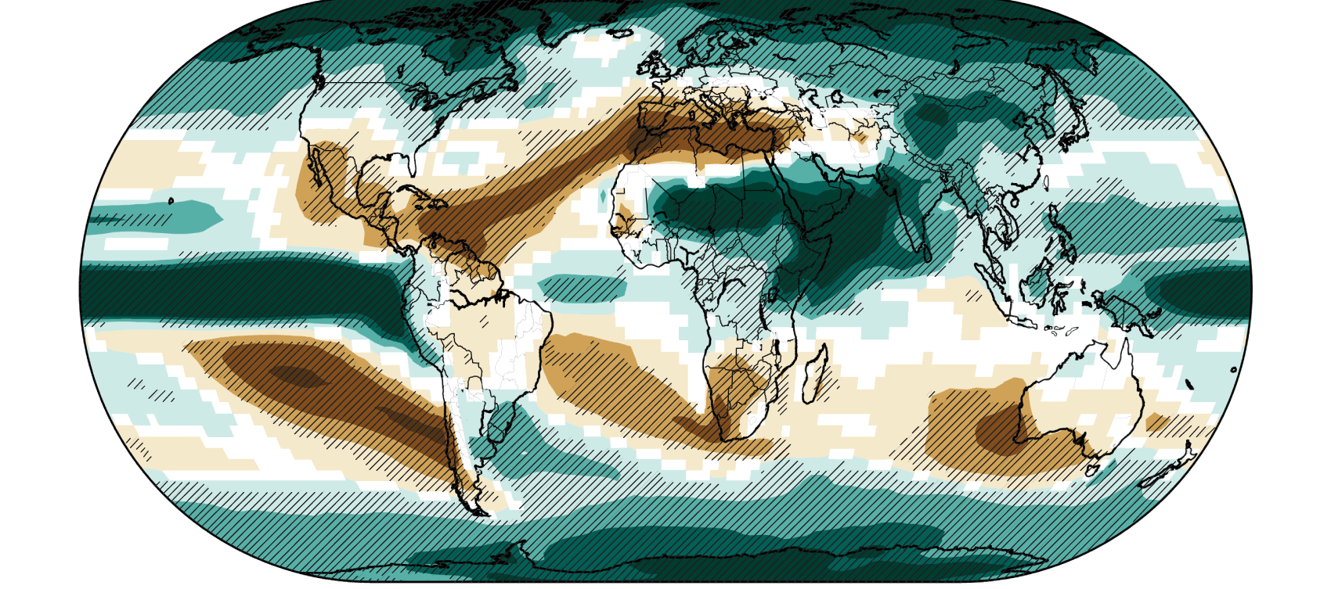
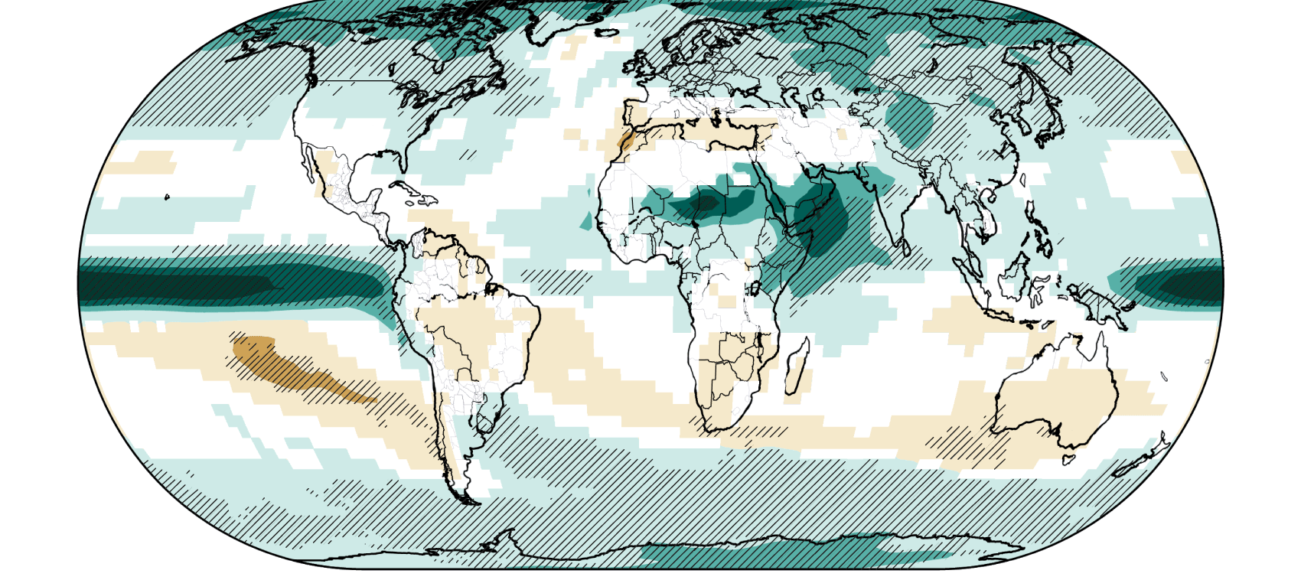
Climate Prediction
Model Predictions - Precipitation
continued increases in emissions
(8 ˚F increase)
immediate & rapid reductions in emissions
(2.5 ˚F increase)

Slide 22
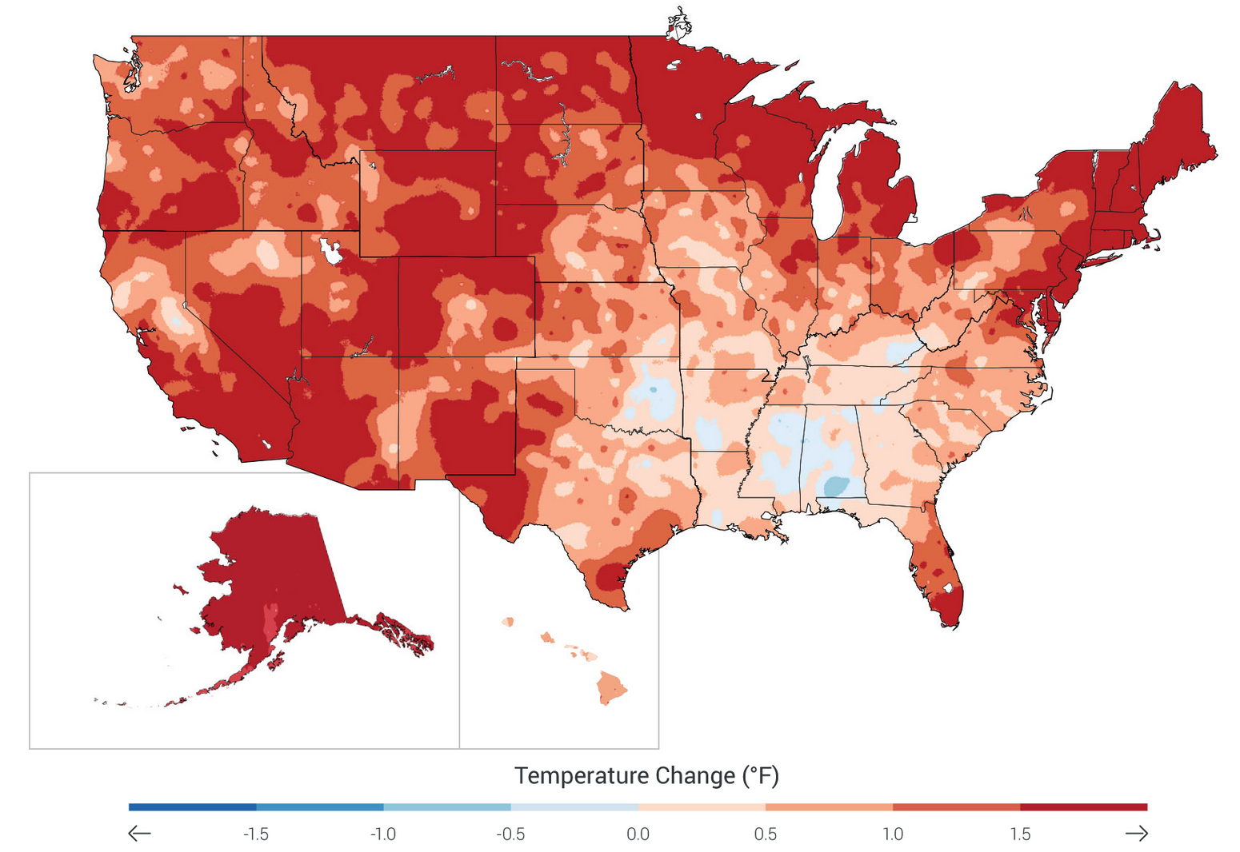
Climate Prediction
Recent Temperature Trends (past 22 years)

Slide 23
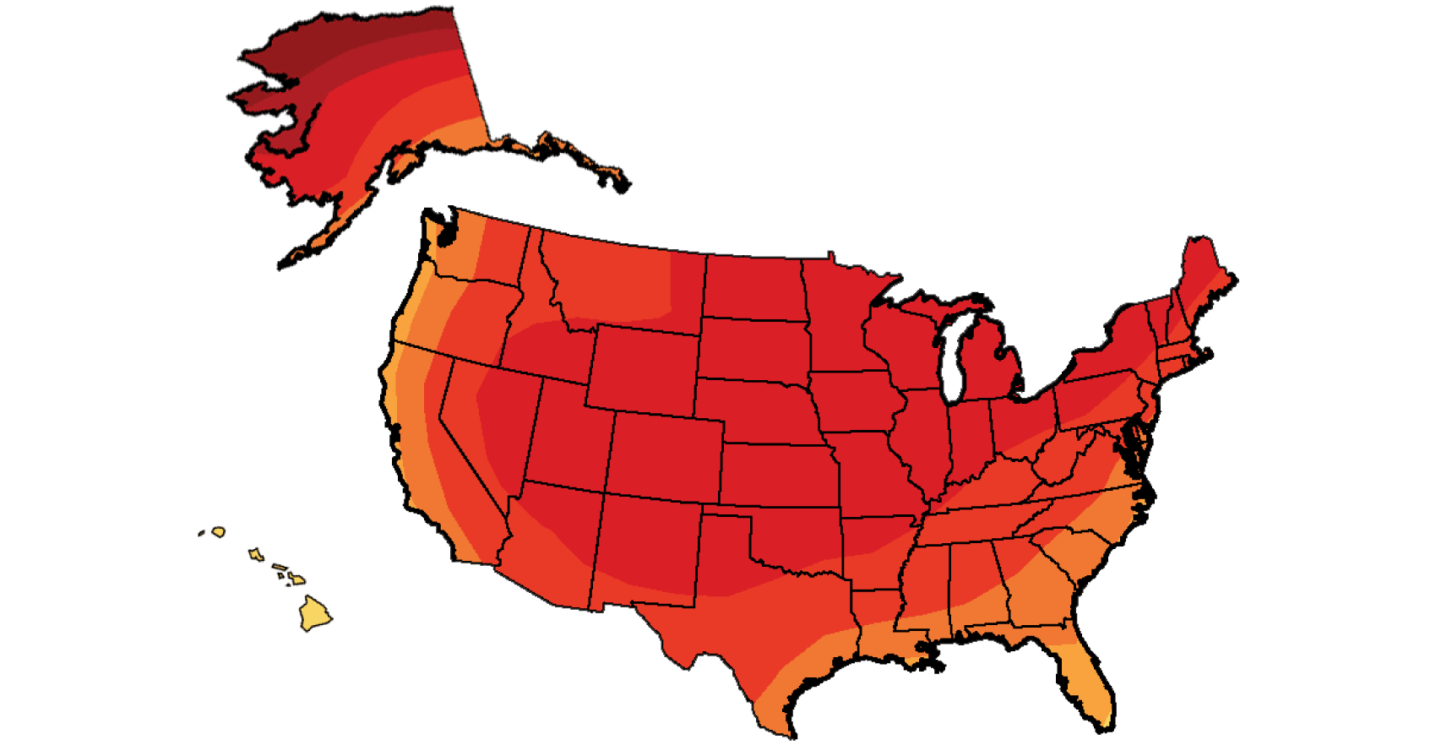
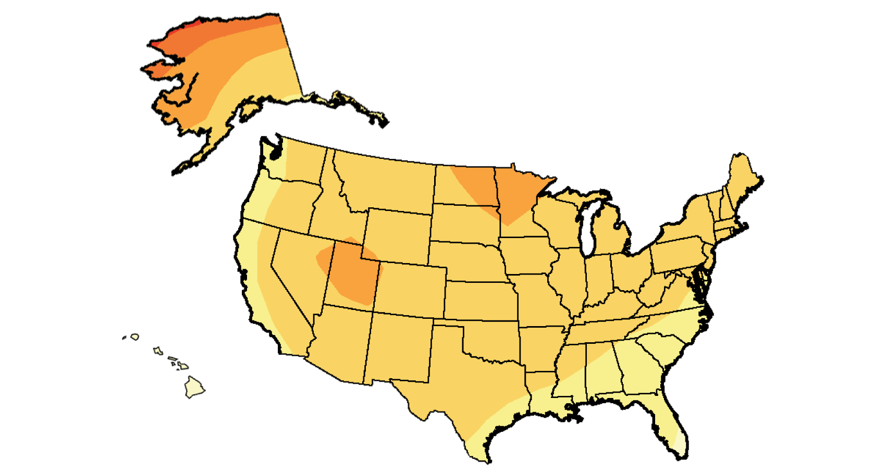

Climate Prediction
Model Predictions - Temperature
continued increases in emissions
(8 ˚F increase)
immediate & rapid reductions in emissions
(2.5 ˚F increase)

Slide 24
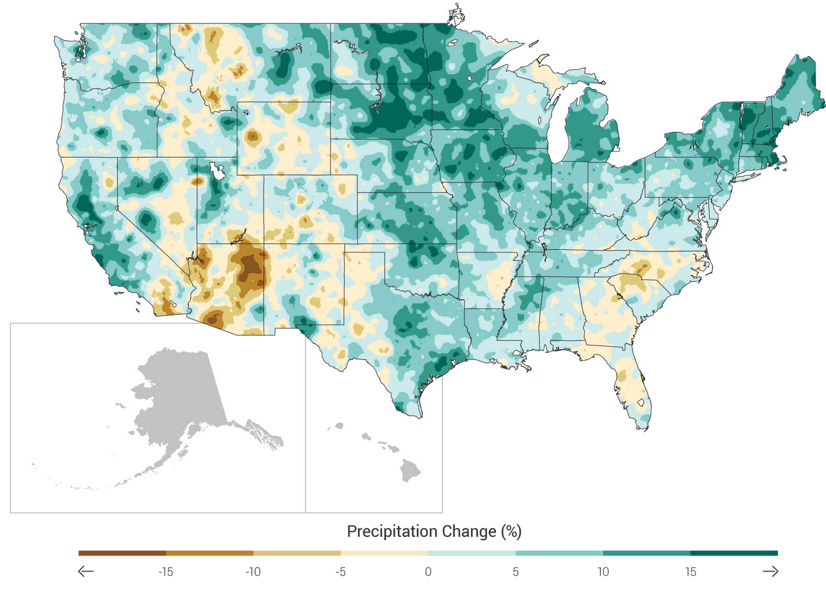
Climate Prediction
Recent Precipitation Trends
1991-2012 compared to 1901-1960

Slide 25
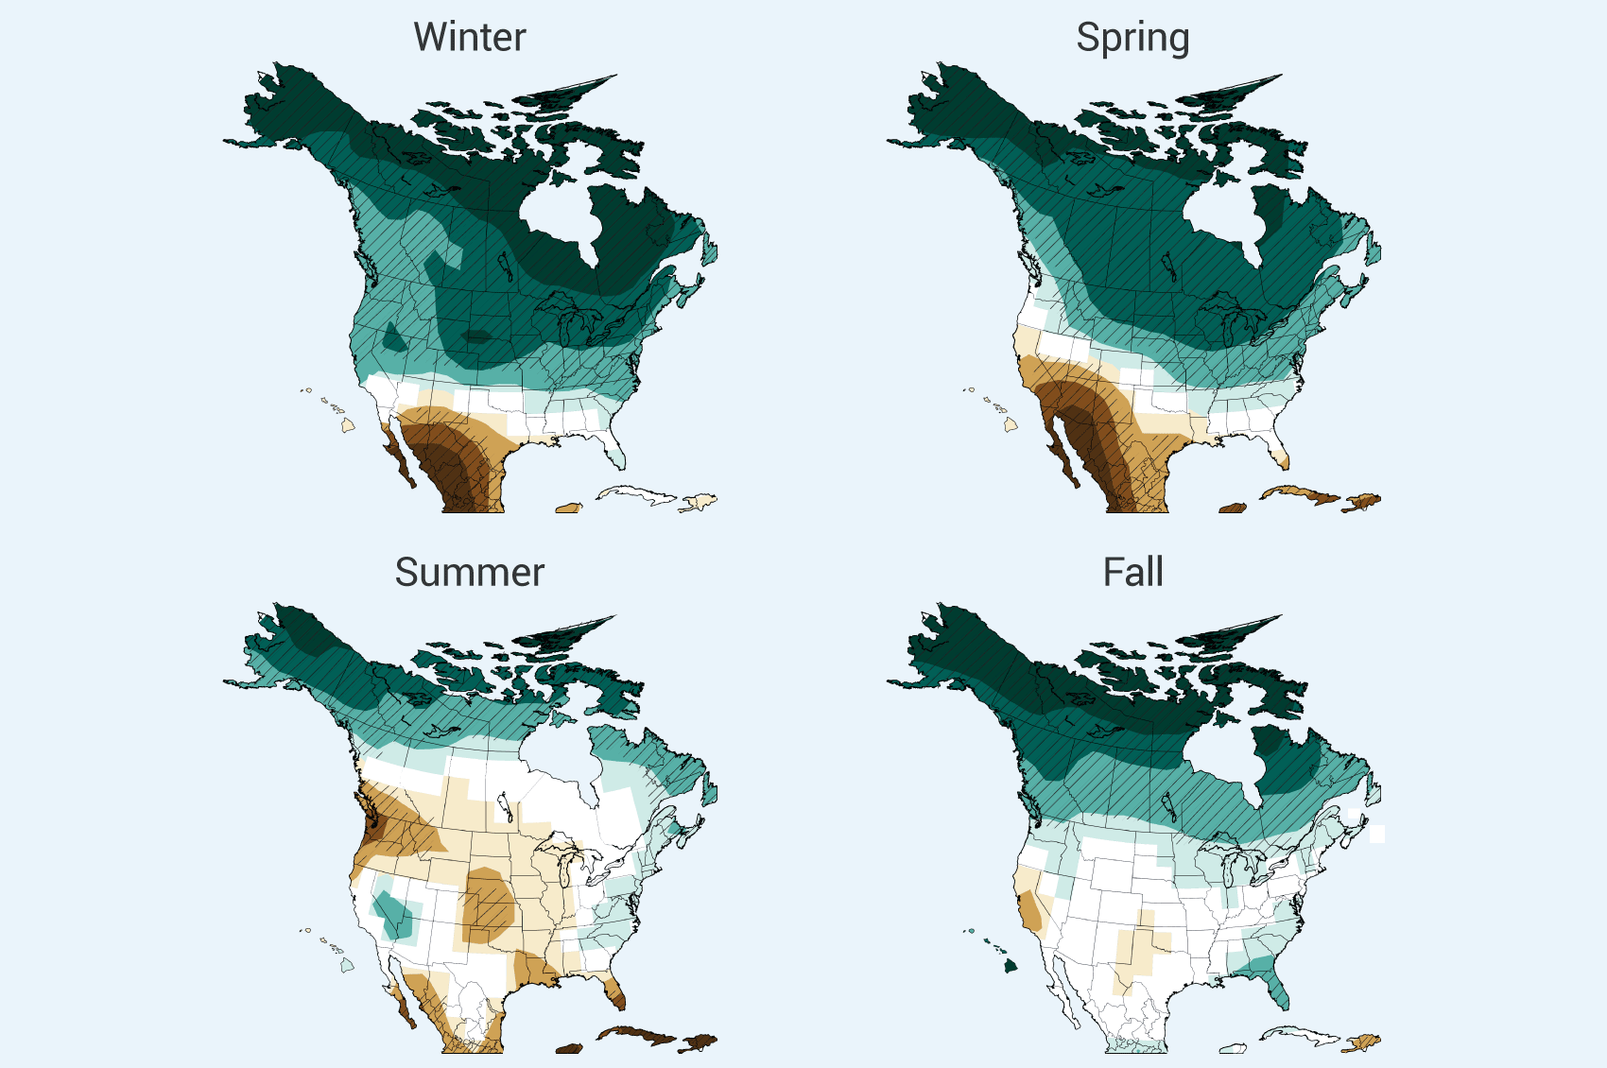
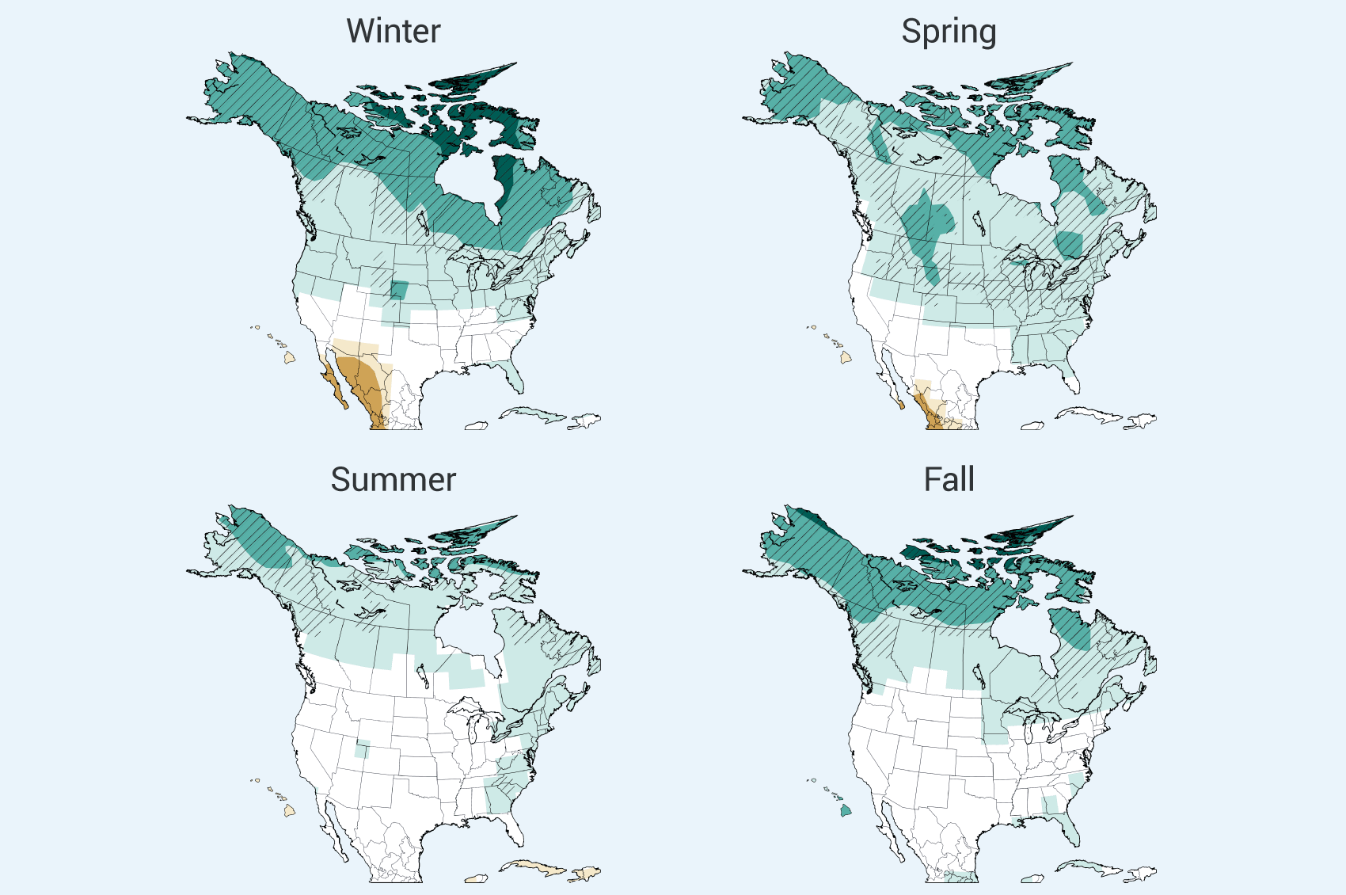
Climate Prediction
Model Predictions – Seasonal Precipitation
continued increases in emissions
(8 ˚F increase)
immediate & rapid reductions in emissions
(2.5 ˚F increase)

Slide 26
Climate Prediction
Model Predictions – Seasonal Precipitation
continued increases in emissions
(8 ˚F increase)
immediate & rapid reductions in emissions
(2.5 ˚F increase)

Slide 27
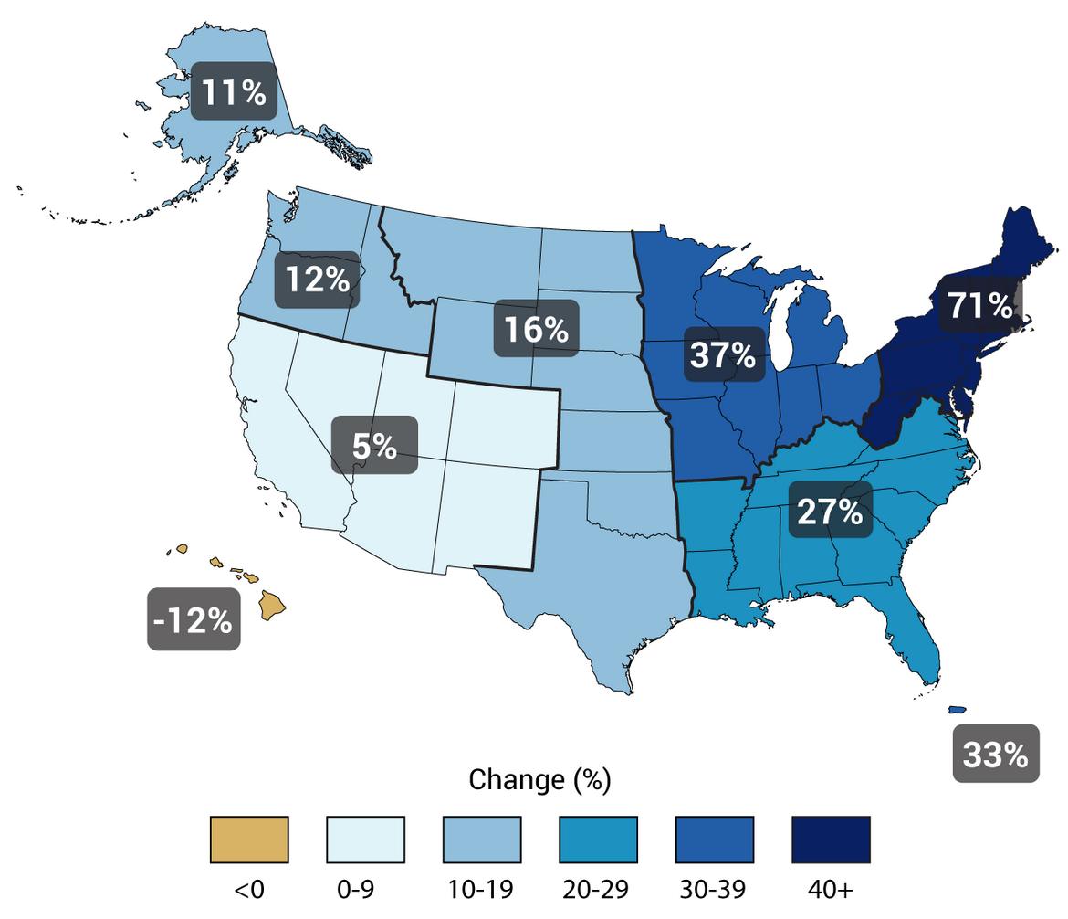
Climate Prediction
Extreme Precipitation Events (change from 1958 to 2012)

Slide 28
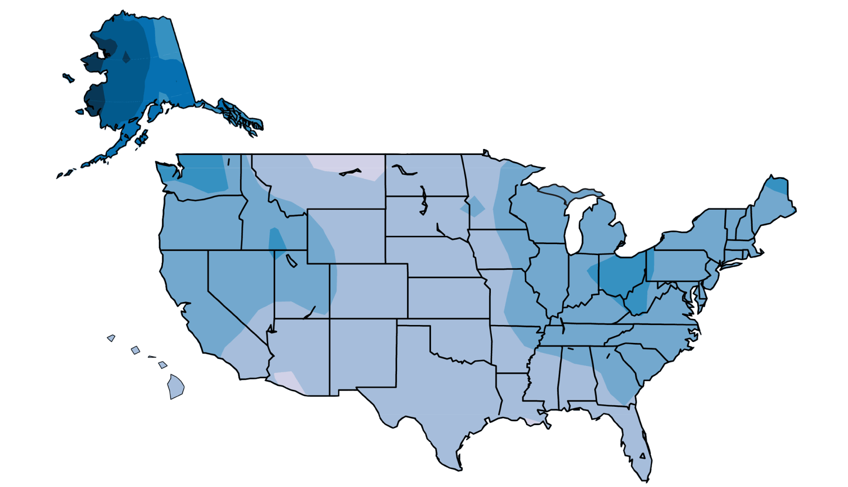
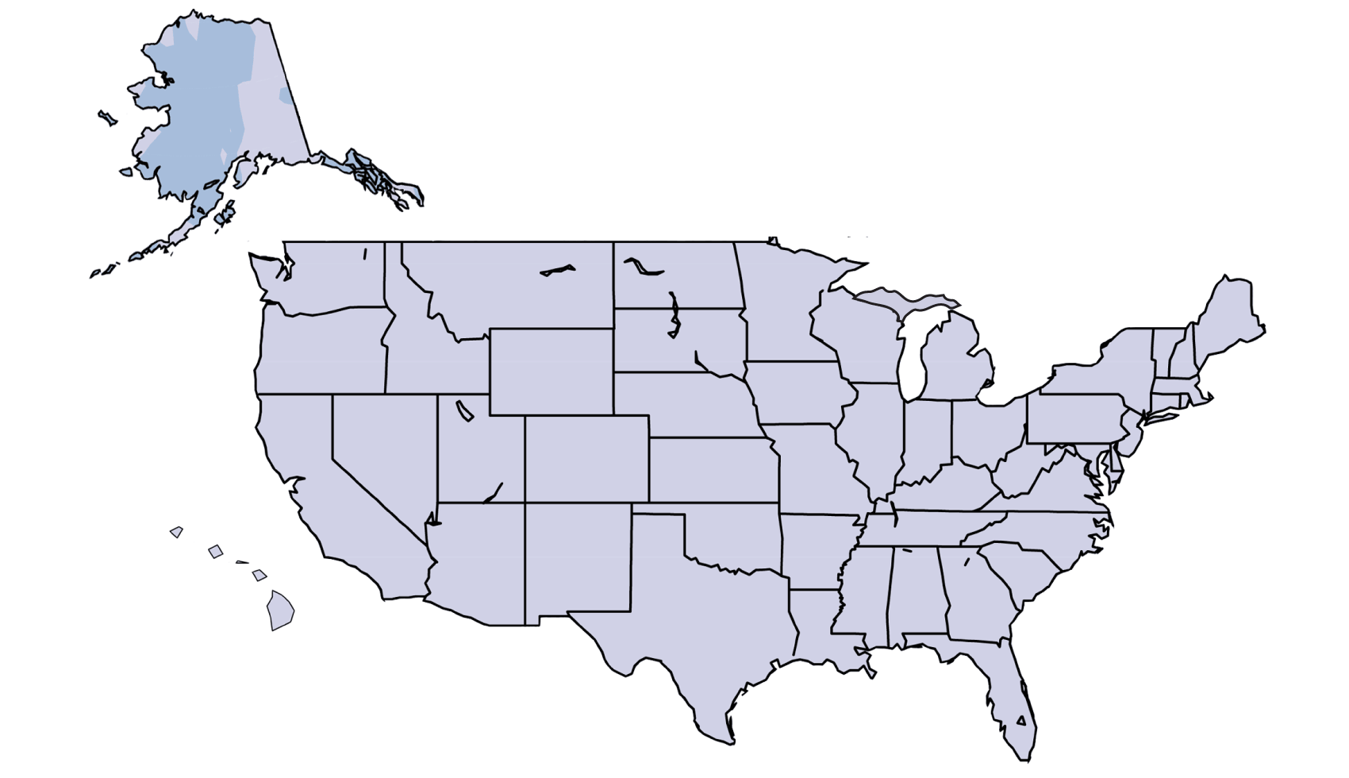
Climate Prediction
Extreme Precipitation Events
continued increases in emissions
(8 ˚F increase)
immediate & rapid reductions in emissions
(2.5 ˚F increase)

Slide 29
Climate Prediction
Climate Change Factors
- External (solar radiation, plate tectonics, human factors)
- Internal (atmosphere, ocean & land interactions)
Climate Simulations
- Simple, conceptual examples
Climate Models
- Simulate past & predict future climate
- Only as good as data and knowledge of system
Climate Predictions
- Temperature (overall warming, but greatest change at high latitudes)
- Precipitation (wetter high latitudes, drier low latitudes)

