Slide 1
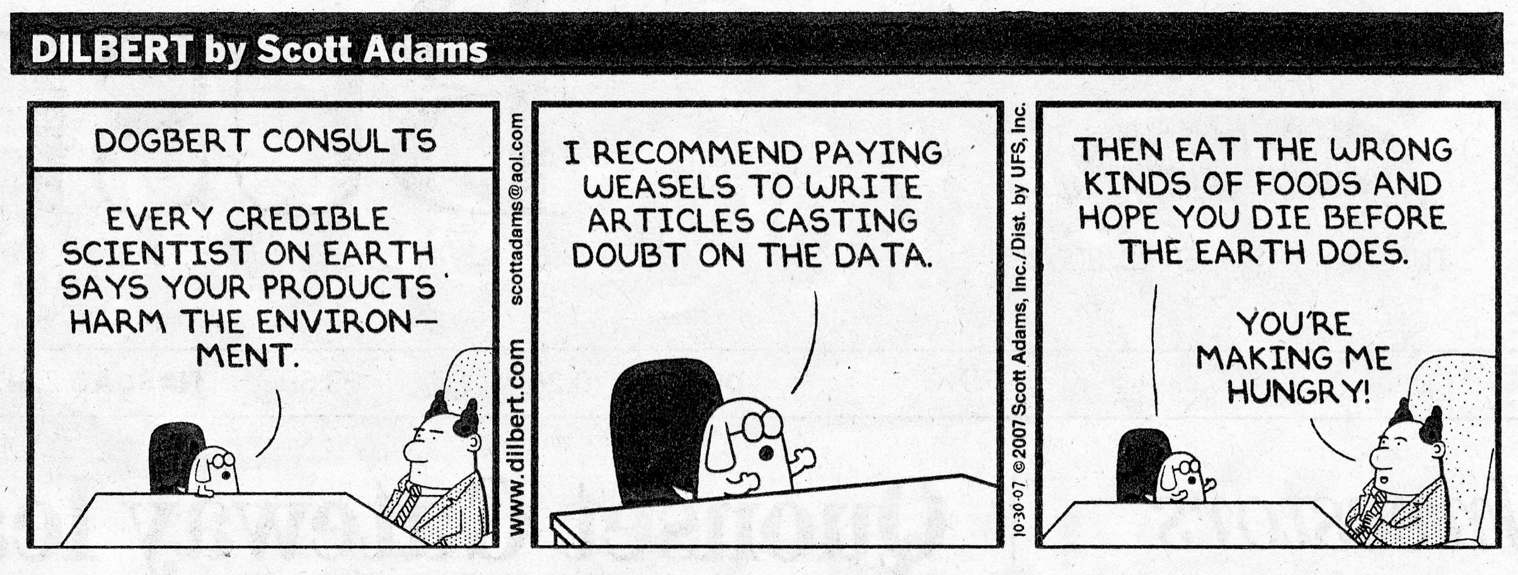
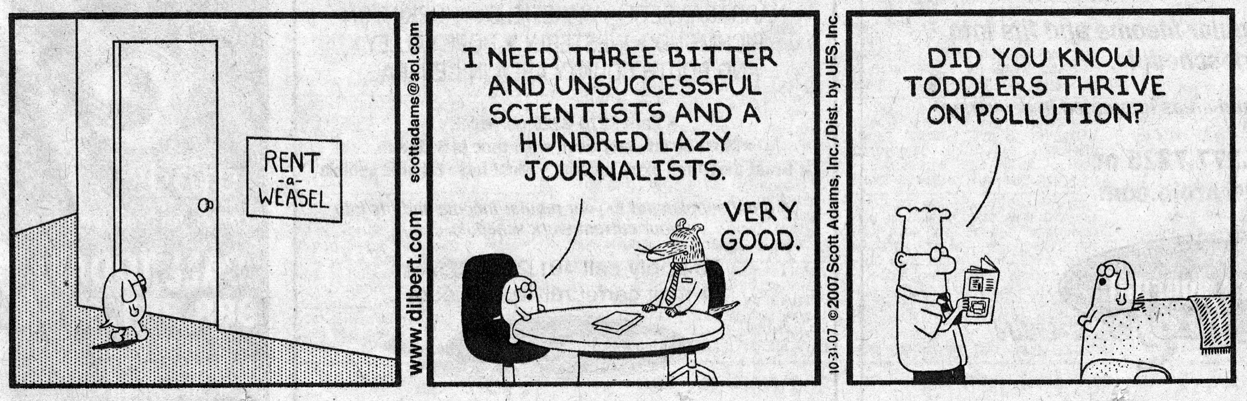
Reason for changes between 2001 & 2007 IPCC climate report?

Slide 2
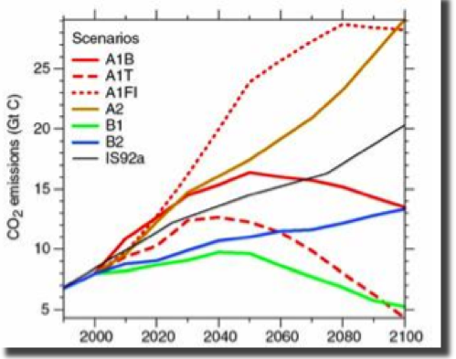
Increased carbon emissions = climate change
Factors
- Economic growth
  (global vs local)
  (service vs material intensive)
- Global populations
(mid-century peak vs steady growth)
- Introduction of new/efficient technologies
- Energy sources
(fossil vs clean vs combo)
Rising Temperatures
  Rising Sea Level
Increased Carbon Emissions

Slide 3
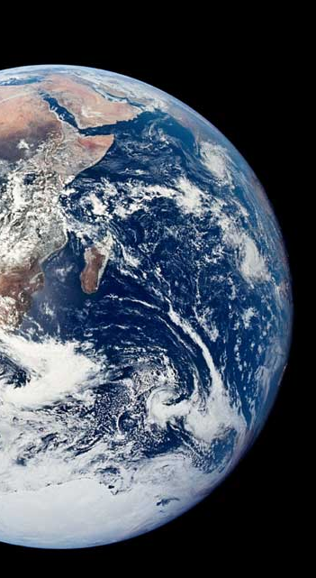
Rising Temperatures

Slide 4
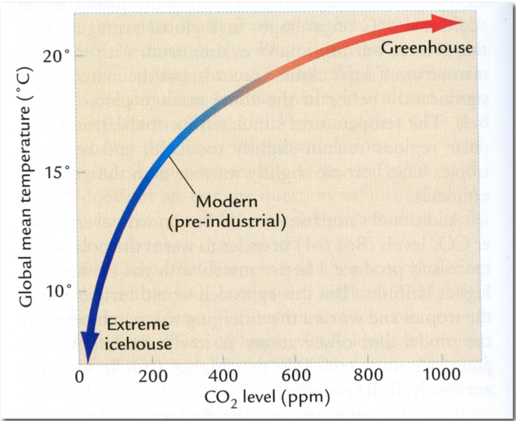
Effect of CO₂ on Climate
Higher CO₂ levels leads to higher global temperatures.
Climate temperature is more sensitive at lower CO₂ concentrations.

Slide 5
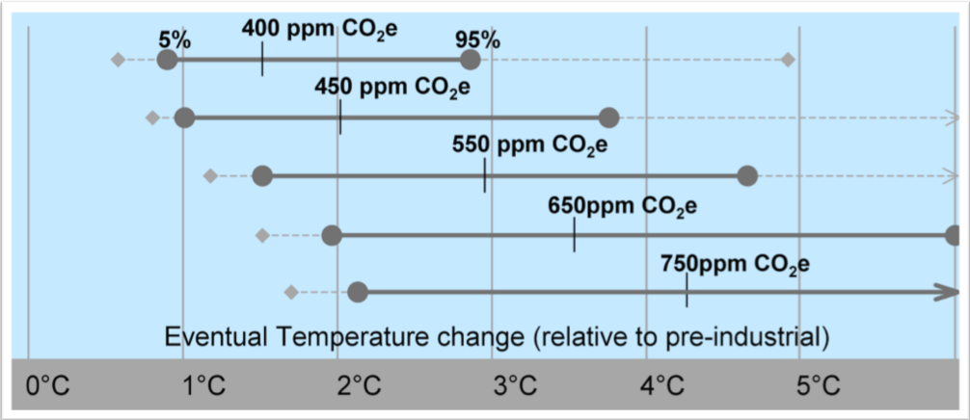
Relationship between CO₂ concentration and global warming

Slide 6
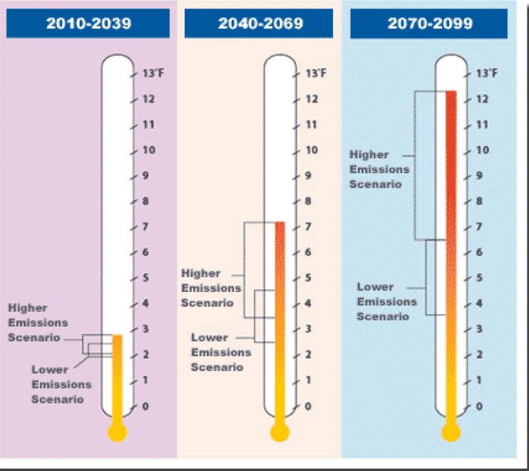
Rising Temperatures
Courtesy of the Union of Concerned Scientists

Slide 7
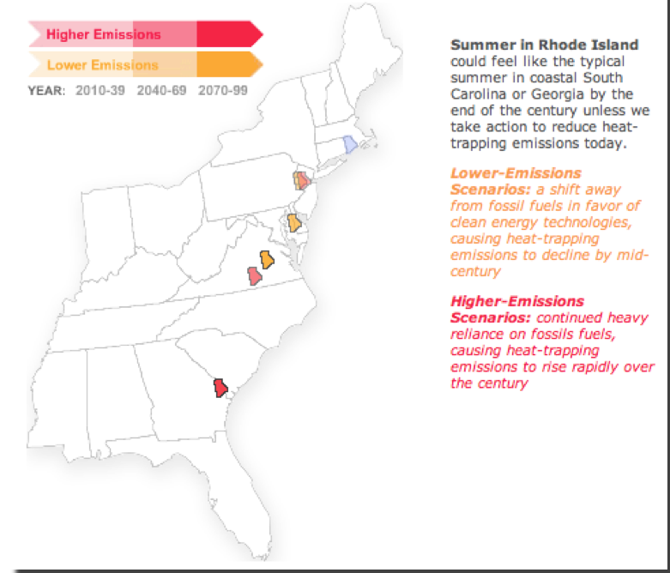
Rhode Island climate “migration”
Courtesy of the Union of Concerned Scientists

Slide 8
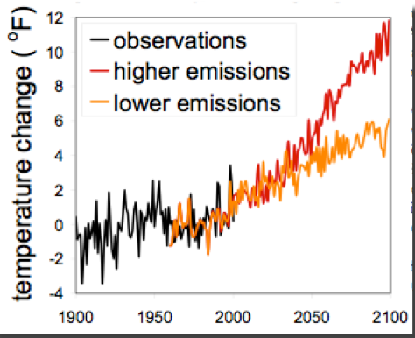
Changes in annual average temperature - Northeast US

Slide 9
Rising Sea Level

Slide 10
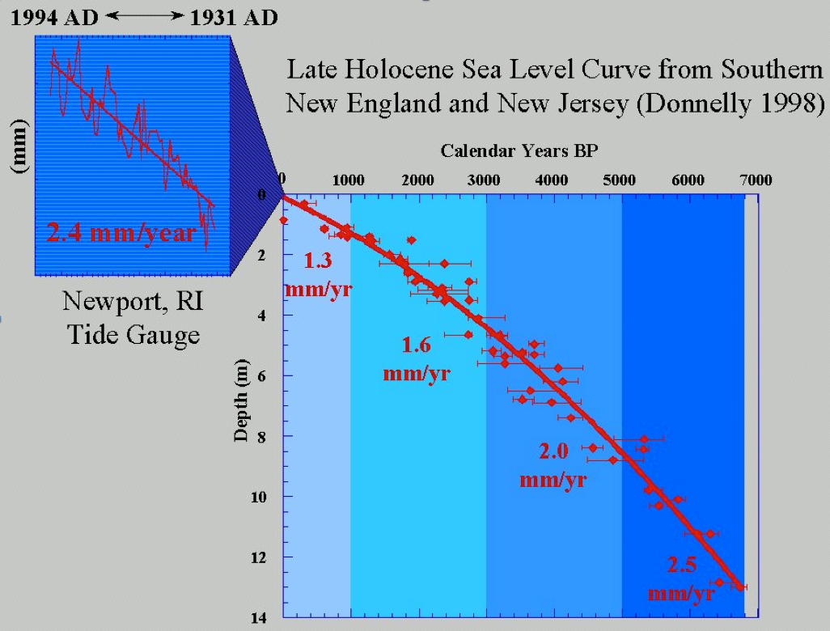

Slide 11
Four contributions to sea level rise
Thermal expansion of seawater
Melting of glaciers and ice caps
Ice sheet surface mass balance
      snowfall - melting
Ice sheet surface dynamical imbalance
      increased flow rate

Slide 12
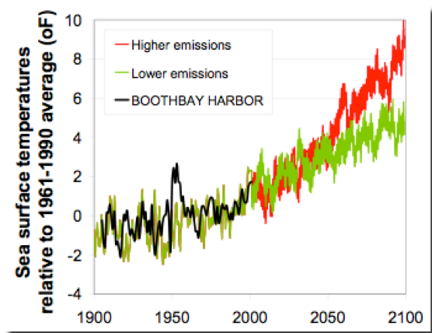
Changes in sea surface temperature - Maine

Slide 13
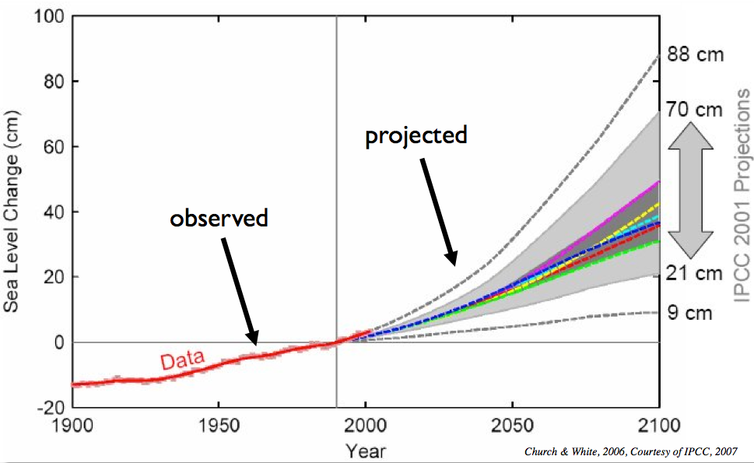
Observed and Projected Sea Level Rise by 2100
Church & White, 2006, Courtesy of IPCC, 2007

Slide 14
Sea Level Rise: Observed vs. Projected
Interval Model Prediction Observed
mm/year
mm/year
1993 - 2003 2.6 3.1
1961 - 2003 1.2 1.8

Slide 15
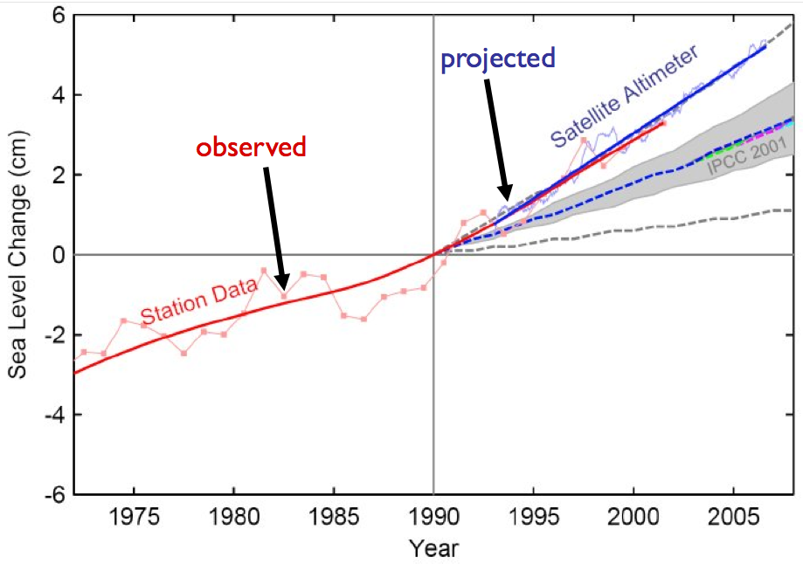
Sea Level Rise: Observed = Projected

Slide 16
Sea Level Rise: New Estimates
Reference | By 2100 (feet) | Total Rise (feet)
Overpeck, et al., 2006 | > 3 | 13 - 20
Rahmsorf, 2007 | 1.6 - 4.6 | - - -
Pfeffer, et al., 2008 | 2.6 - 6.6 | - - -

Slide 17
Increased sea level rise estimates for New England
Reference | Additions to global rise predictions
Yin, et al., 2009 | + 8 inches
Hu, et al., 2009 | + 12 - 20 inches
Total global + regional | 2.3 - 8.3 feet

Slide 18
Rising Sea Level:
Rhode Island

Slide 19


Slide 20
Rising Sea Level:
Northeast

Slide 22
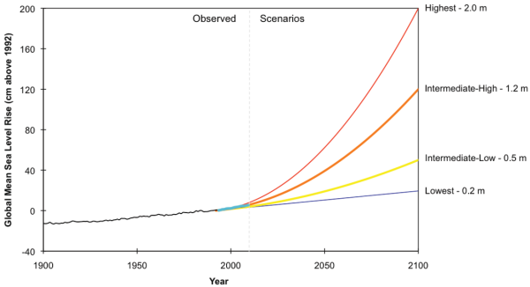
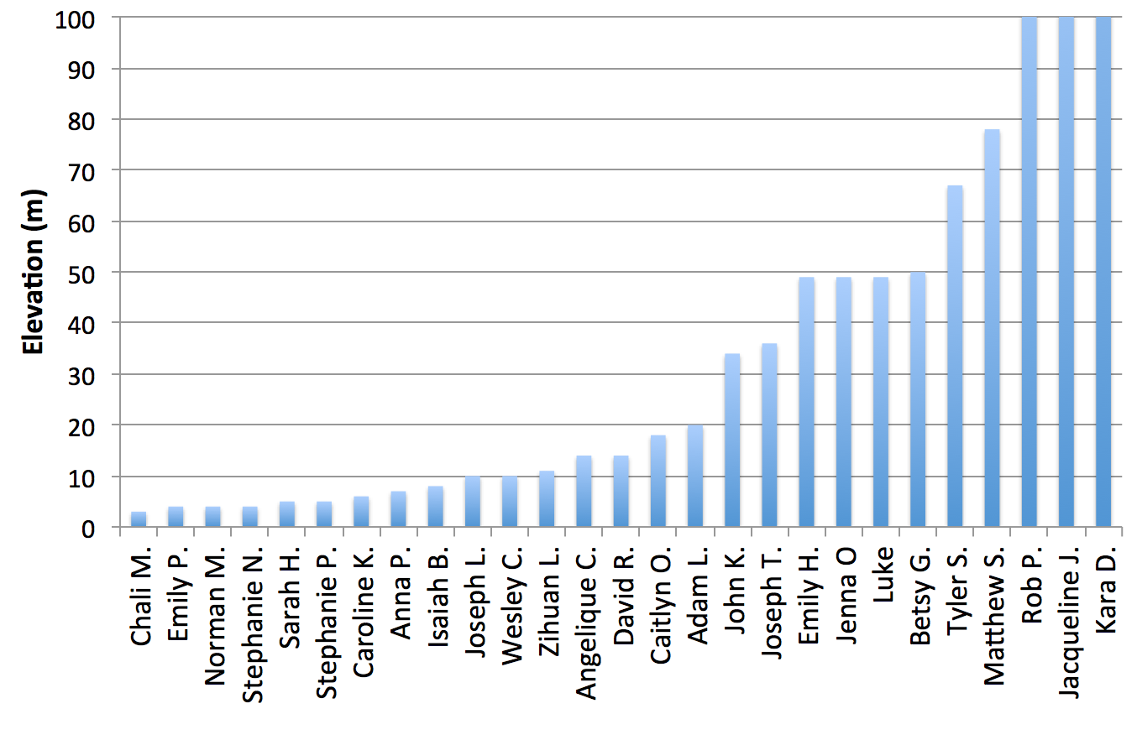
NOAA (2012)
2100

Slide 23
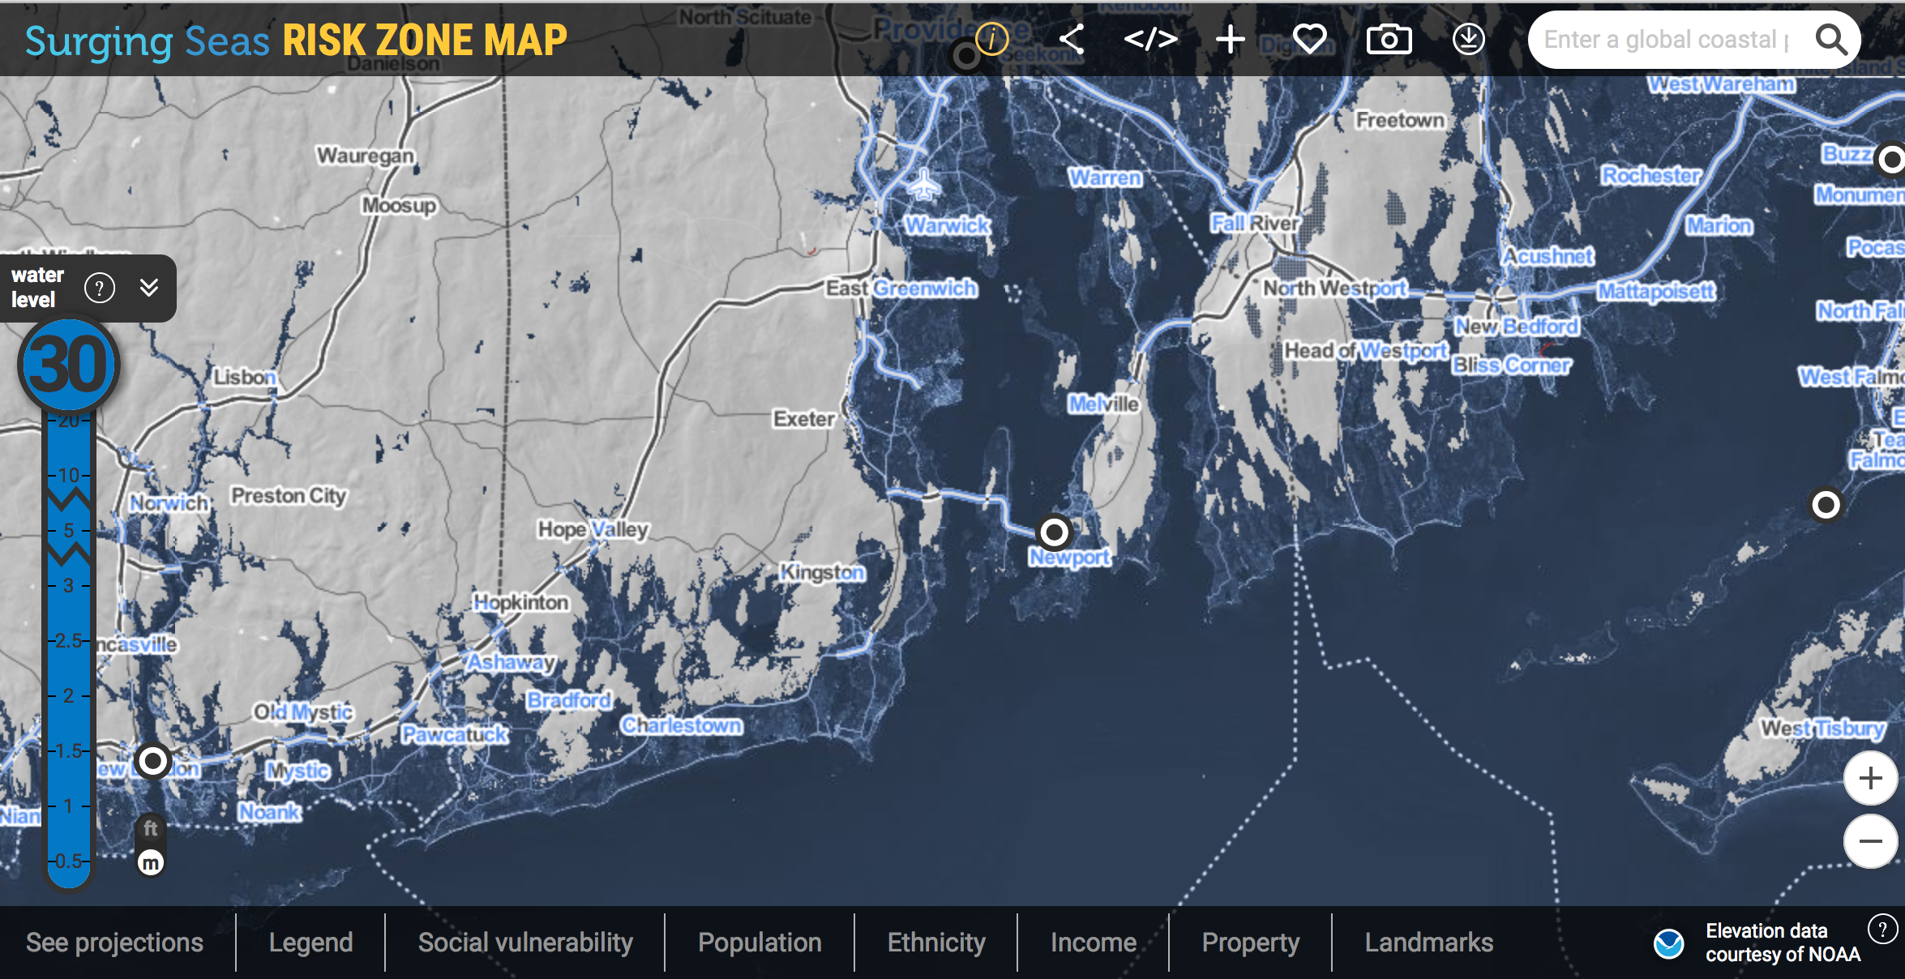
http://sealevel.climatecentral.org/ssrf/rhode-island
Hong Kong
http://ss2.climatecentral.org/#10/22.2929/114.2331?show=satellite&projections=0-RCP85-SLR&level=0.5&unit=meters&pois=hide
Beijing
http://ss2.climatecentral.org/#9/39.4892/117.3120?show=satellite&projections=0-RCP85-SLR&level=0.5&unit=meters&pois=hide

Slide 24
Rising Sea Level in
Rhode Island ~
Southern Coastal Ponds

Slide 25
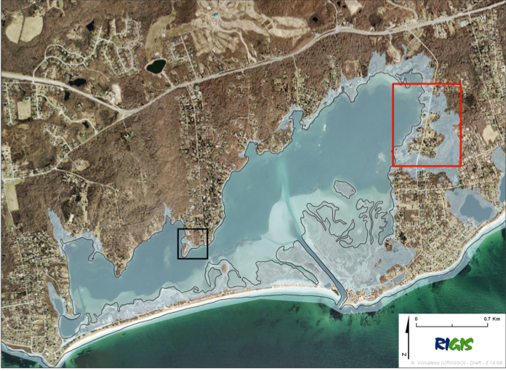
Quonochontaug Pond 5’ sea level rise:
Model by Nathan Vinhateiro, GSO-URI
Flooded areas shown with light blue shading

Slide 26
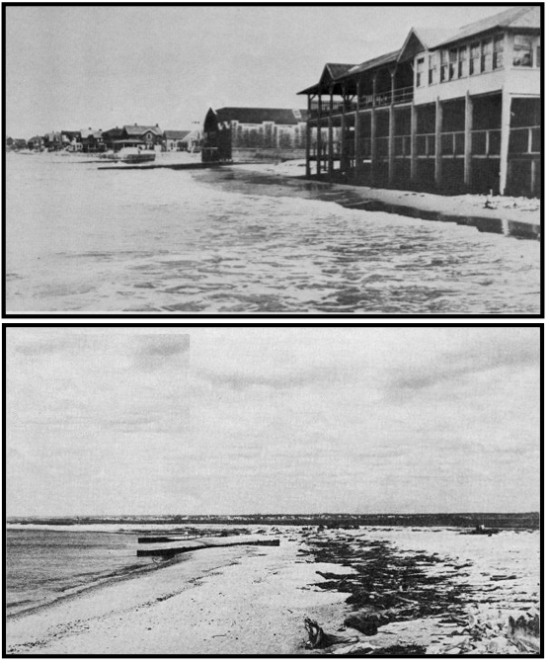
The 1938 Hurricane: Napatree Point
Before:
After:

Slide 27
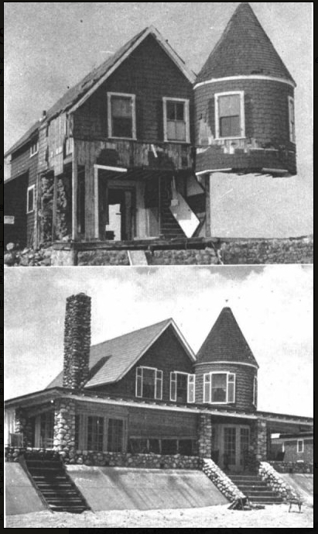
The 1938 Hurricane: Misquamicut Beach
Before:
After:

Slide 28
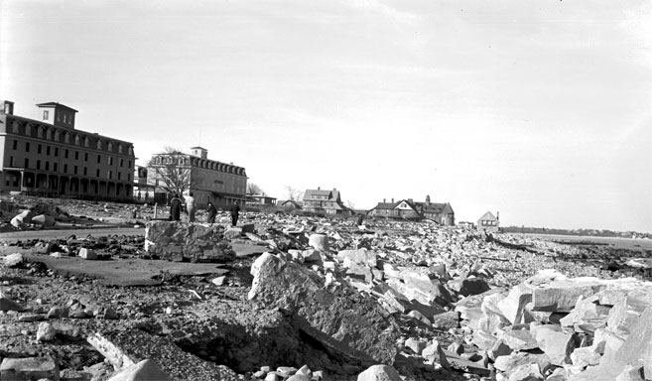
The 1938 Hurricane: Narragansett Sea Wall
“ The Towers”

Slide 29
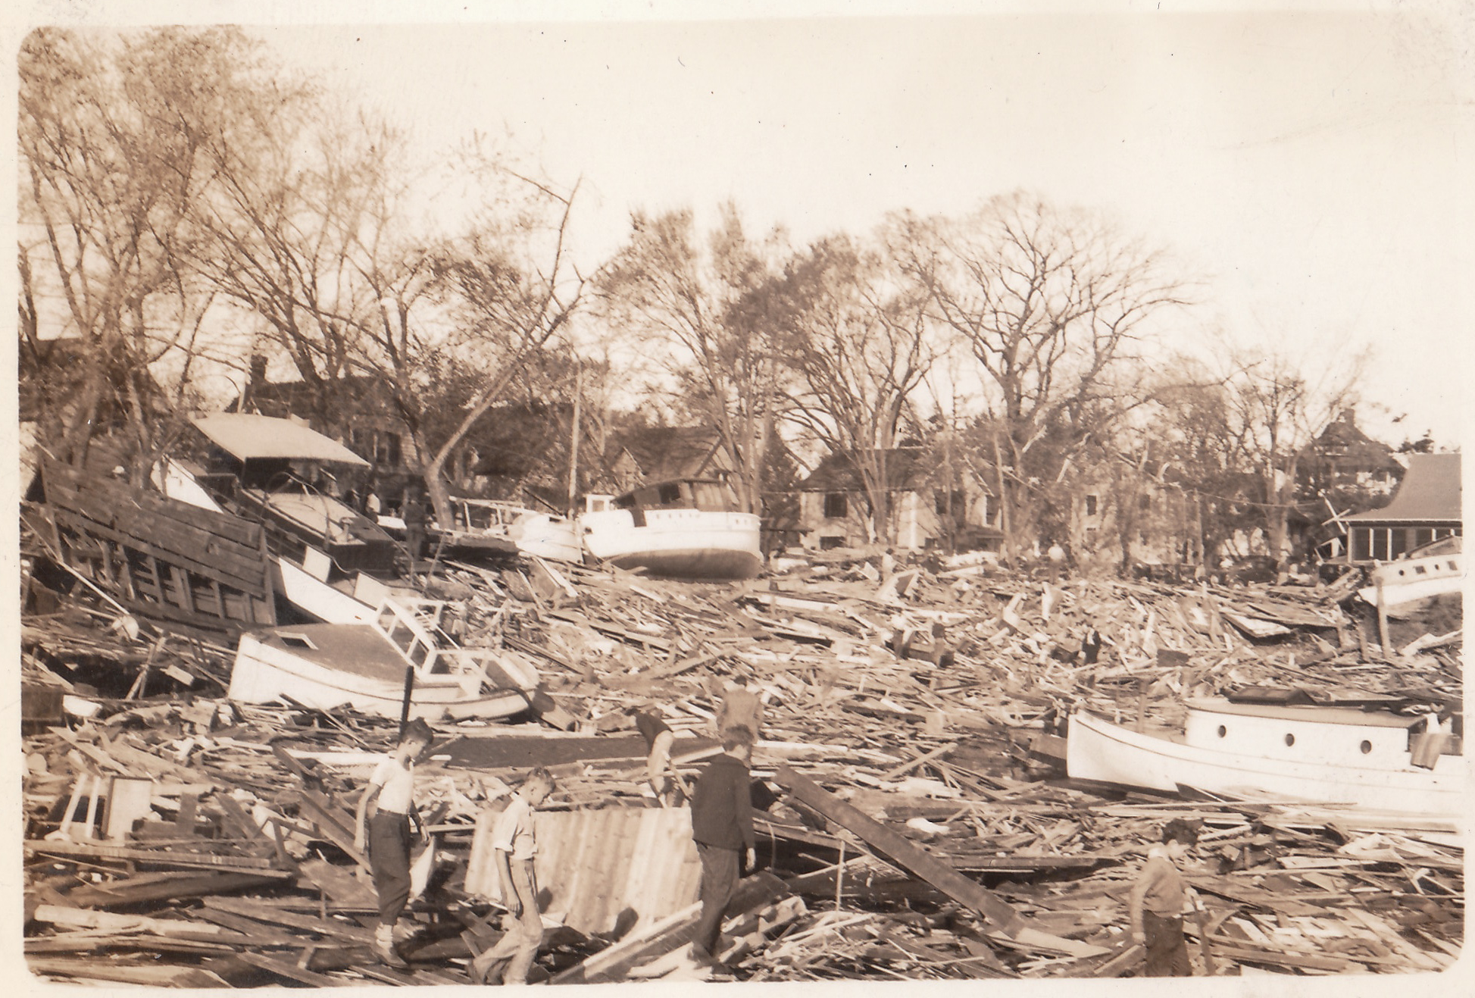
The 1938 Hurricane: Pawtuxet Village

Slide 30
Assessing the Impact of Climate Change:
An Alternative Approach to IPCC

Slide 31
The Stern Review
Sir Nicholas Stern
• Ph.D. Economics,
Oxford University
• Academic, 1970-1999
• Chief economist, World Bank, 2000 - 2003
• Knighted, 2004
• Member, House of Lords, 2007

Slide 32
The Stern Review:
The Economics of Climate Change
• 670 page independent review commissioned by the British government to better understand the economics of climate change
• Uses risk-management approach to assess the impact of climate change
• The risk- management approach focuses on worst case scenarios and how to prevent them
• Stern Review tends to be more definitive than the IPCC report

Slide 33
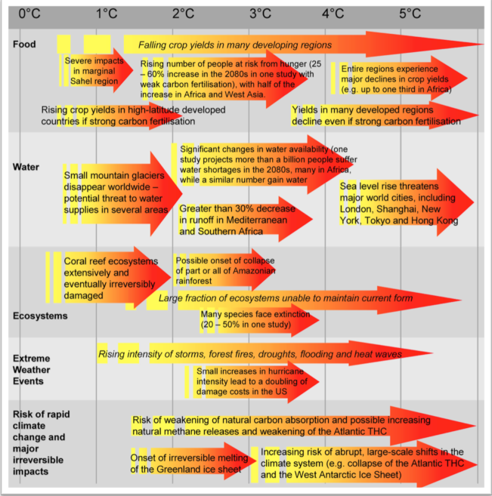
Impacts of increased greenhouse gases

Slide 34
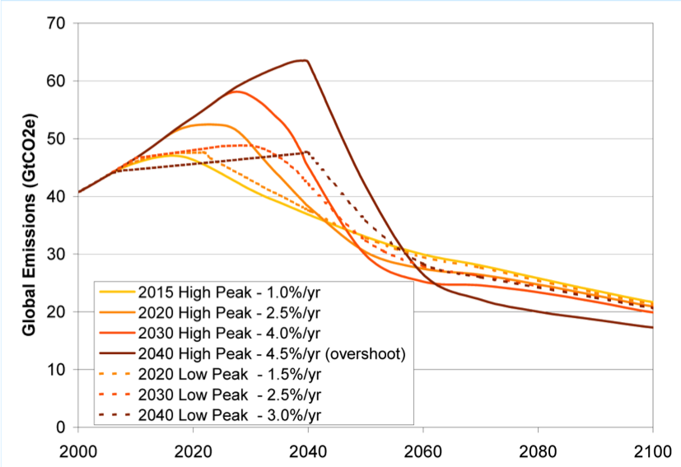
Scenarios to stabilize at 550 ppm CO2

Slide 35
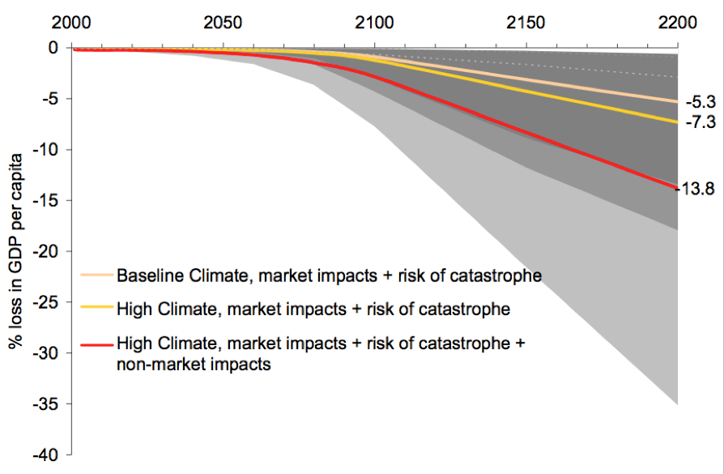
Losses in per capita income due to climate change

Slide 36
Conclusions:
The scientific community has reached a consensus that current climate change is human-induced, and will produce devastating environmental and societal impacts during the next century.
The benefits of strong early action to mitigate climate change clearly outweigh the costs.
The US should aim for moral, scientific and industrial leadership to mitigate climate change, rather than vying to be the head weasel.

Slide 37
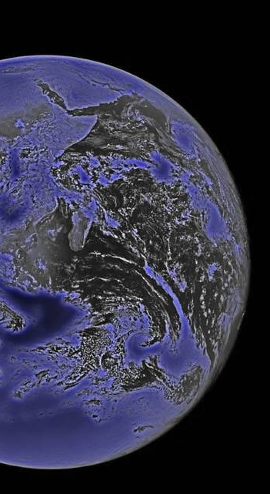
“Perhaps our epitaph will be:
The good Earth. We could have saved it, but we were too damn cheap and lazy.”
~ Kurt Vonnegut

