Slide 1
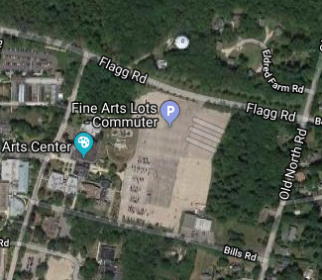
Field Trip Preparation – people who need rides
When: Saturday, April 14th
Wave 1
- Depart at 10 AM (be there by 9:55 AM)
- Return to URI by 12 Noon
Wave 2
- Depart at 1 PM (be there by 12:55 PM)
- Return to URI by 3 PM
Where: URI Flagg Commuters Lot (NE corner)
Car Pool to Carpenter’s Beach (SK)
Weather Forecast:
Partly Cloudy. High 56F.
Winds ESE at 10 to 20 mph.
Dress appropriately, it will feel cooler on the beach than you think.
Meet Here

Slide 2
Field Trip Preparation – people driving themselves
When: Saturday, April 14th
Wave 1
- Arrive by 10:20-10:30 AM
Wave 2
- Arrive by 1:20-1:30 PM
Where: Carpenter’s Beach Pavilion (see maps on next page)
Weather Forecast:
Partly Cloudy. High 56F.
Winds ESE at 10 to 20 mph.
Dress appropriately, it will feel cooler on the beach than you think.

Slide 3
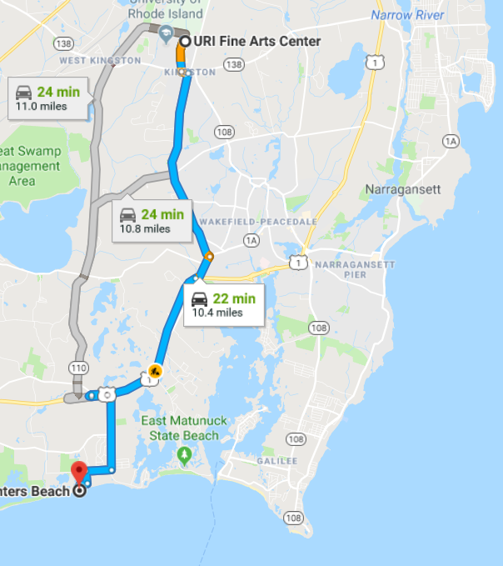
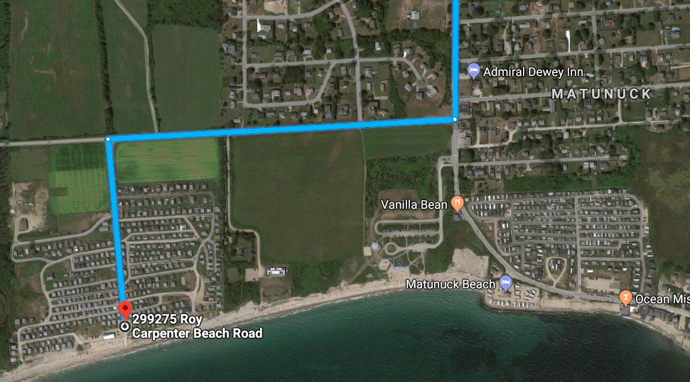
Field Trip Preparation – people driving themselves

Slide 4
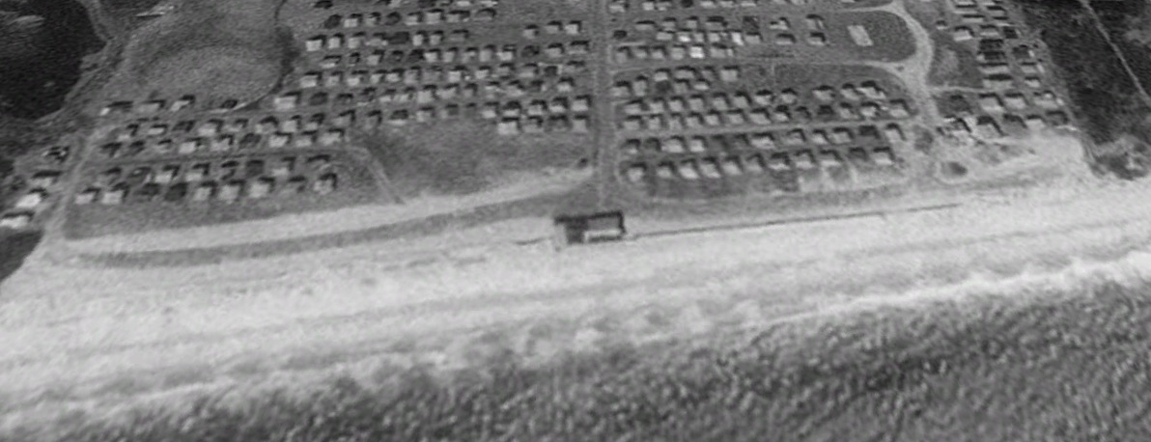
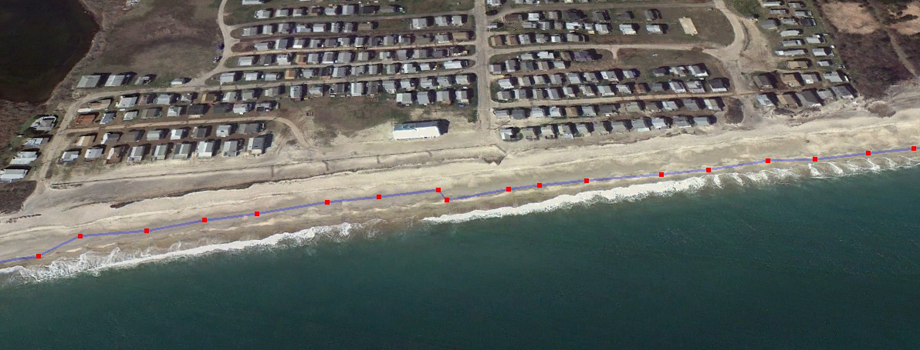
Field Trip Review
Time Scales of Change
- annual patterns
- coastal changes in your lifetime
3/28/1995
4/2/2012

Slide 5
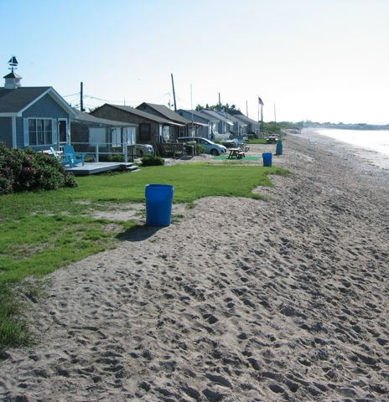
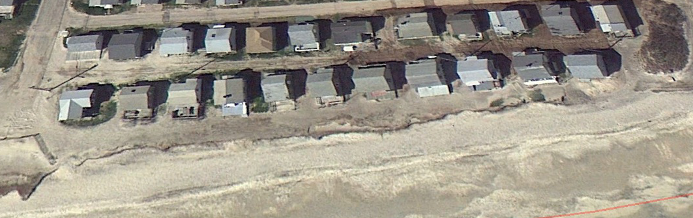
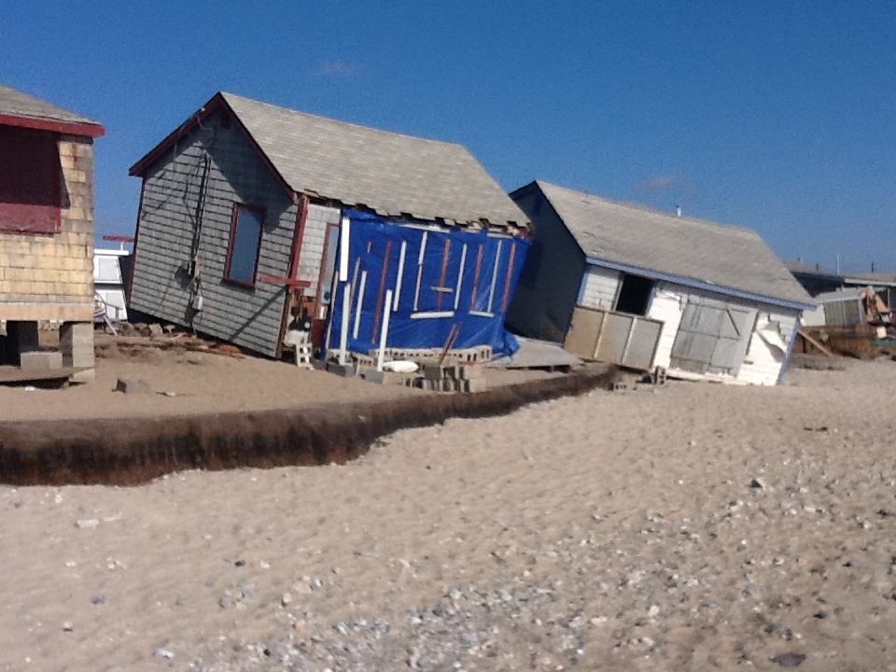
Field Trip Review
pre-Sandy
post-Sandy
4/2/2012

