Slide 1
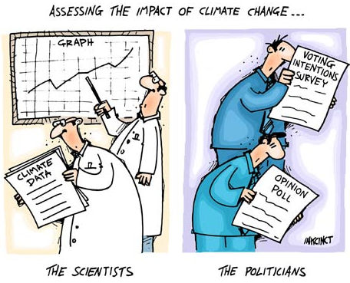
Responding to Climate Change
Gloom & Doom of Climate Change
What Can Be Done?
Final Project Stuff.

Slide 2
Global Warming – What Can Be Done?
Hypothetical….
Rob could lose a few pounds.
Possible Solutions? (good points & bad points)
Change Habits
- no more NYS Wieners
Medical Procedures
- Lipo-suck 4000
What can we do about Global Environmental Change?
Change Habits
- Reduce emissions
Geo-Engineering
- Human ingenuity

Slide 3
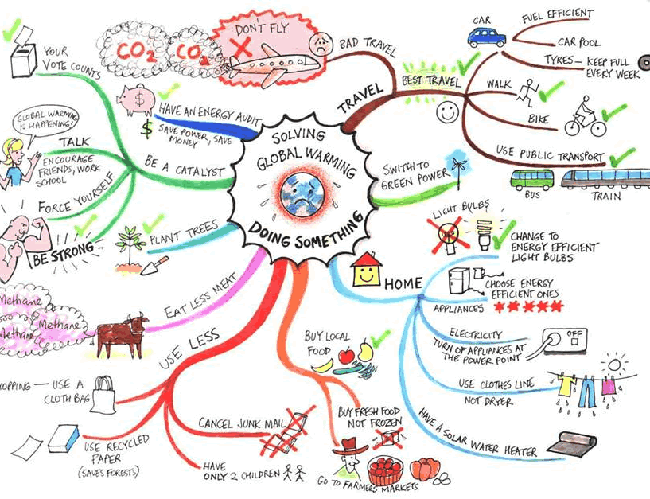
Global Warming – What Can Be Done?
Change Habits

Slide 4
Global Warming – What Can Be Done?
Geo-Engineering

Slide 5
Global Warming – What Can Be Done?

Slide 6
Global Warming – What Can Be Done?

Slide 7
Global Warming – What Can Be Done?

Slide 8
Global Warming – What Can Be Done?

Slide 9
Modeling & Responding to Climate Change
Gloom & Doom of Climate Change
- sea level rise, drought, floods, severe weather, disease
What Can Be Done?
- change behavior
- geo-engineering

Slide 10
Modeling & Responding to Climate Change
Gloom & Doom of Climate Change
- sea level rise, drought, floods, severe weather, disease
What Can Be Done?
- change behavior
- geo-engineering

Slide 11
Tarczuk, Garrett
Spentzos, Niko
Ragosta, Alyssa
Rowe, Brenny
Ryng, Maggie
Murphy, Elizabeth
Butler, Bill
Williams, Mike
Samuel, Kufre
Duong, Jasmine
Schram, Emma
Coppola, Domenic
Goldthwaite, Leo
Messier, Chris
Riel, Hannah
Fordham, Taylor
Pinkrah, Michael
Tissiere, Sean
Brocks, Alexandra
Bayne, Patrick
Porreca, Nicholas
MacDonald, Madison
Boden, Bryan
Fernandes, Dominic
Wilner, Jeremy
Marriott, Jacq
Chen, Vince
Gonzalez, Jescenia
Yanaros, Michelle
Richard, Gavin
Punsalan, Christopher
Courage, Sean
Smith, Joe
Sylvia, Lindsay
Grande, Payton
Smith, Juliette
Bademosi, O.J
Okokon, Itoro
Marriott, Rachel
Tessier, Curtis
Filippini, Joe
Garvey, James
Olowoporoku, Elizabeth
Schuelke, Dylan
Delisle, Jordan
Peccia, Joe
Gorman, Jessie
Sanchez, Andrew
Johanning, Nathan
Blais, Abby
Corbin, Rich
DeCastro, Michael
Smith, Jess
Phomsouvan, Howie
Palmer, Ben
Day, Jack
Adutwum, Kwa
1
6
11
7
12
2
8
13
3
4
9
14
5
10

Slide 12
Global Warming
- recreation (no skiing projects)
- heat waves
- shifting ecosystems
Sea Level Rise Impacts
- U.S. military
- Pacific Islands
- Florida, Virginia, Rhode Island
- recreation
Extreme Weather Occurrence
- lake effect storms
- nor’easters
- hurricanes
- blizzards
- droughts
Corporate Globalization
- environmental protection differences between countries
- cheap labor and affordability of goods
- likelihood of armed conflicts
- cultural differences
- sharing of information
- growth of developing countries
Ecosystem Disruption
- plants (kudzu, Japanese barberry)
- animals (zebra mussels, lionfish, snakehead, pythons, feral hogs)
- insects (emerald ash borers, nutria, stink bugs
Expanding Disease Range/Occurrence
- Mosquito-borne (Zika, Malaria,
West Nile, Dengue Fever)
- Anthrax
- Tick-borne diseases (Babesia, Lyme)
- Cholera

