Slide 2
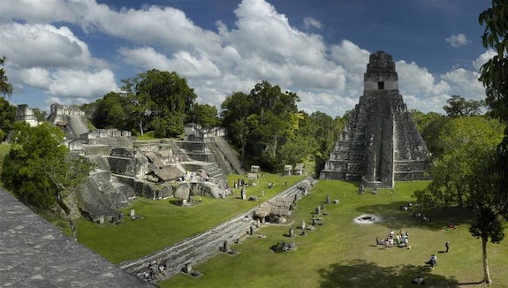
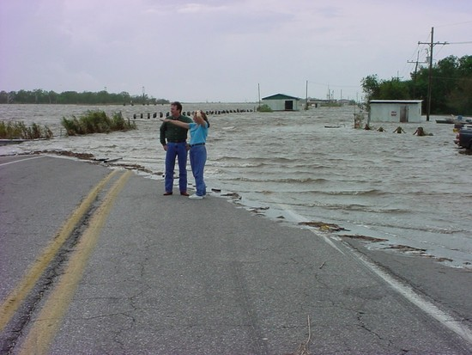
CLIMATE CHANGE’S EFFECT ON PEOPLE:
PAST & PRESENT
Topics for Discussion
How Does Climate Change Effect Us?
Climate Change in the Past:
  Impact on the Mayan Civilization
Climate Change in the Present:
  Impacts on Louisiana’s Isle de Jean Charles Band of Biloxi-Chitimacha Indians
  – America’s First ‘Climate Change Refugees’

Slide 3
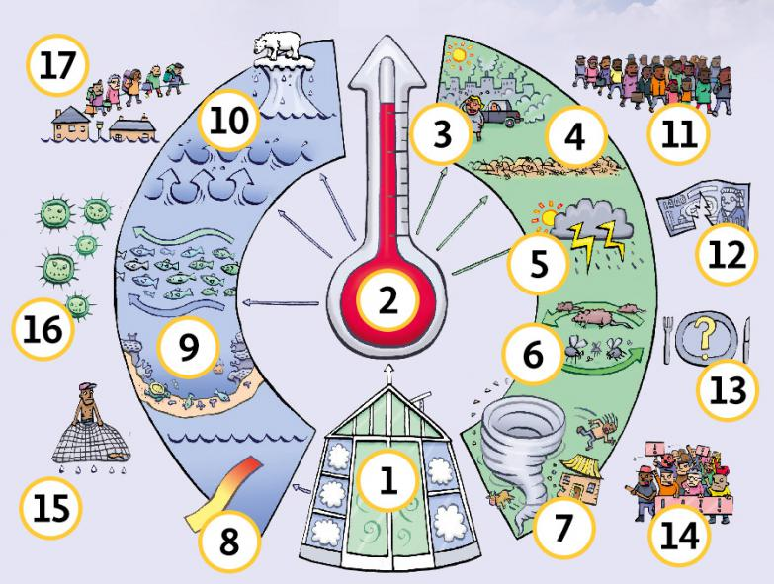
CLIMATE CHANGE’S EFFECT ON PEOPLE
How Does Climate Change Effect People?
(think-pair-share)

Slide 4
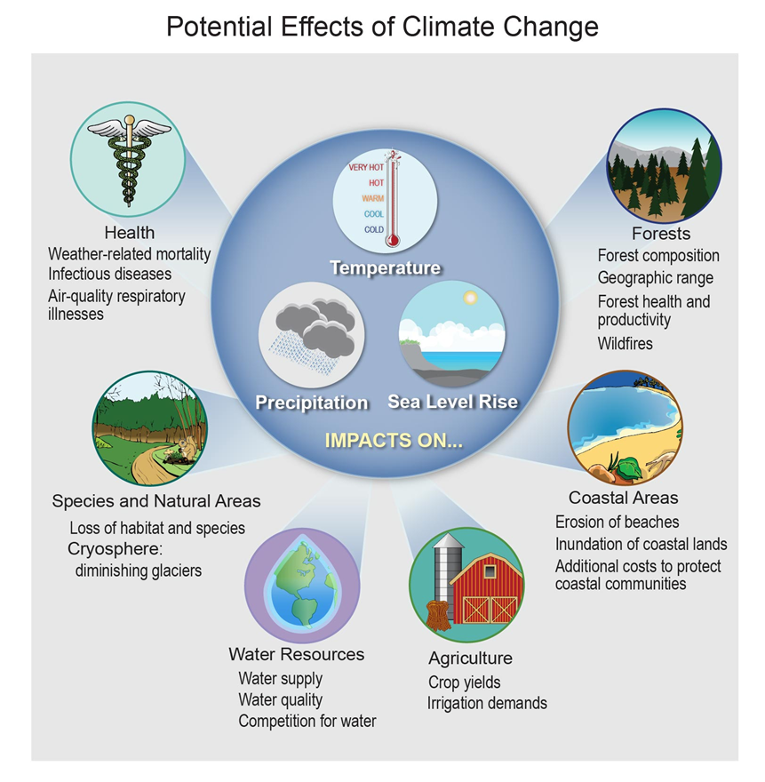
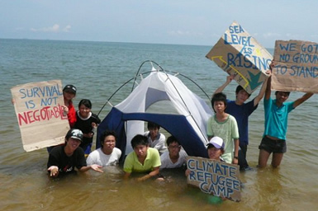
CLIMATE CHANGE’S EFFECT ON PEOPLE
How Does Climate Change Effect People?
  Health
  Agriculture/Fisheries
  Energy
  Water
  Ecosystems
  Forests
  Coastal Areas
  Recreation

Slide 5
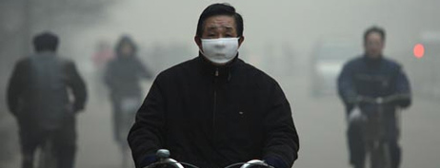
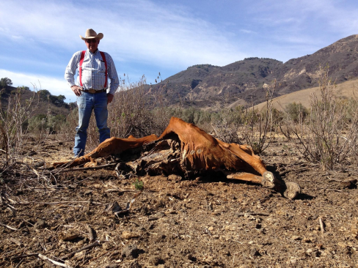
CLIMATE CHANGE’S EFFECT ON PEOPLE
How Does Climate Change Effect People?
  Health
    Temperature-Related Illnesses
    Air Quality-Related Illnesses
    Spreading Diseases
  Agriculture/Fisheries
    Crop & Species Losses = Food Shortages
  Energy
    Increased Demand = Energy Shortages
  Water
    Low or Dried-Out Streams, Rivers, Ponds, Lakes (reservoirs)
    Public Water Supply Shortages, Irrigation Restrictions, Reduced Hydropower, Transportation Disruptions

Slide 6
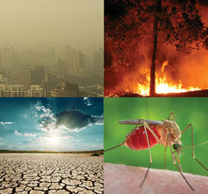
CLIMATE CHANGE’S EFFECT ON PEOPLE
How Does Climate Change Effect People?
  Ecosystems (plants and animals)
    Altered/Diminished Habitat
  Forests
    Spread of Pests
    Increased Wildfires
  Coastal Areas
    Coastal Cities Flooded
    Coastal Wetlands Destroyed
  Recreation
    No Snow = No Skiing/Snowboarding
    Beach Erosion = No Beach

Slide 7
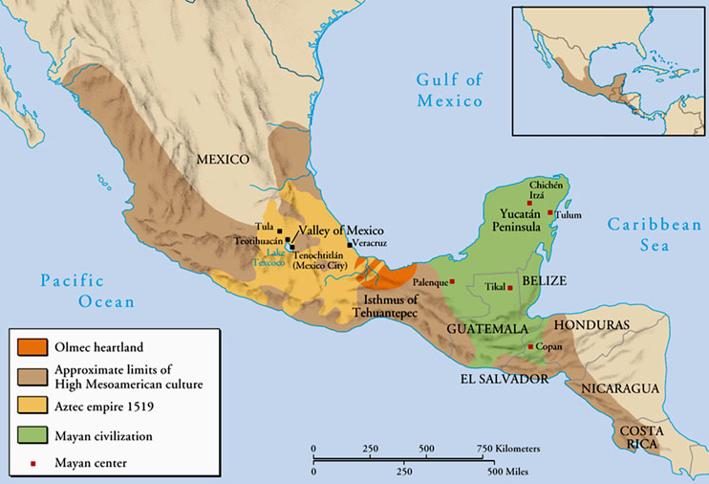
CLIMATE CHANGE’S EFFECT ON PEOPLE
Impact of Climate Change on the Maya Civilization
Maya civilization – one of the most dominant indigenous societies of Mesoamerica (Mexico and Central America) before the 16th-century Spanish invasion. Experienced growth over 2,700 years between 3,800-1,100 years before present (B.P.), followed by collapse @ 1,100 B.P., and a 600-yr transition to villages
Maya culture centered in one area (shown in green) – Yucatan Peninsula (in modern-day Guatemala, Belize, parts of Mexican states Tabasco and Chiapas, and western parts of Honduras and El Salvador)
Tikal (classical Mayan capital city)

Slide 8
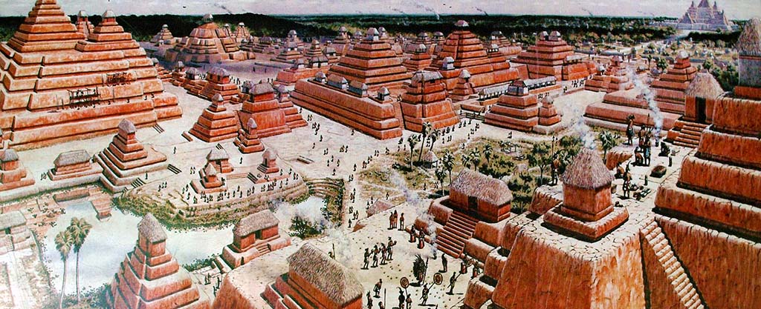
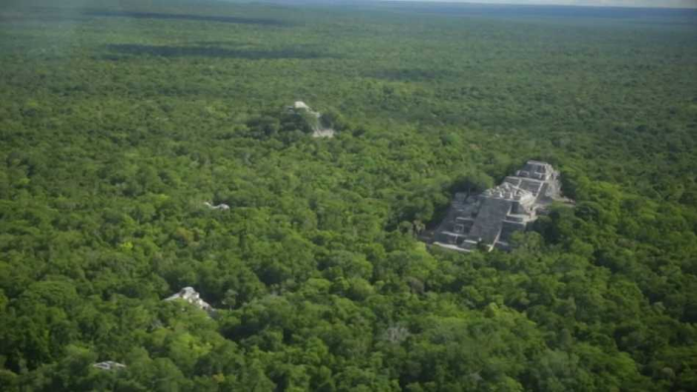
CLIMATE CHANGE’S EFFECT ON PEOPLE
EARLY MAYA PERIOD (3,800-2,250 B.P.)
  Agricultural culture (corn [maize], beans, squash and cassava [manioc])
  City and pyramid-builders - Mirador – one of the greatest cities ever built
CLASSIC MAYA PERIOD (2,250-1,100 B.P.)
  40 cities with plazas, palaces, temples and pyramids, and ball-courts
  Each city @ 5-50,000 people; total est. population ca. 2 million
  Cities surrounded/supported by large population of farmers
  Farming = primitive “slash-and-burn” agriculture; also irrigation, and terracing
  “Collapse” @ ca. 1,100 B.P. – Why?!?
    Possible causes: 1) exhausted environment; 2) constant warfare - led to
    broken trade alliances, politics, and religion; or 3) climate change (drought)
Early Maya city of Mirador

