Slide 1
Topics for Today’s Discussion
Archaeology as a “lens” for viewing the past
What do we think we know and why?
Who’s past is it and who gets to write its history?

Slide 2
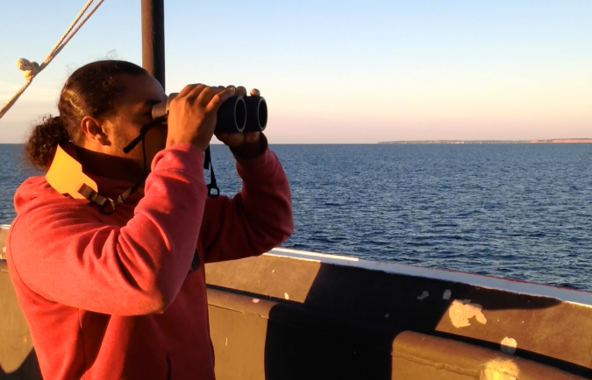
Archaeology as a “Lens” for Viewing the Past
Primary source of information for 99% of our human history (writing 5KYBP of >2.5MY)
Unique among western sciences – able to study human history & culture change over “deep time” (entirety of human history)
Provides uniquely powerful human experience – physical contact with the past (closest we can come to time-travel)
Primary goals: preservation/stewardship and increasing our knowledge about the past
Provides an “unvarnished” record of the past (very different from historic accounts)
Archaeology’s Downsides: inherently destructive; western-culture bias; accessibility bias (land v. underwater); preservation bias (inorganic v. organic); de-emphasis on humanity; difficult to integrate with Tribal oral history; provides a limited record from which to interpret the totality of human activity

Slide 3
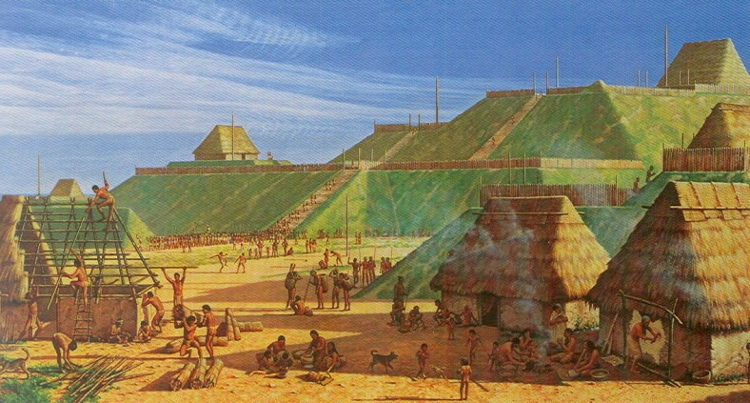
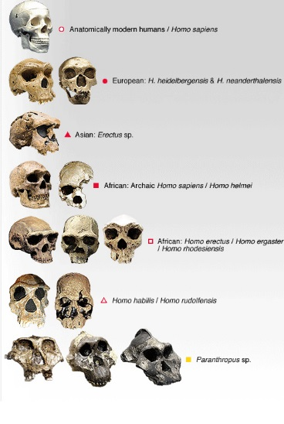
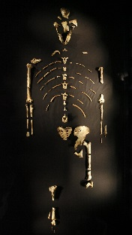
What is Archaeology?
Archaeology or Archeology (archaeo = “ancient” and logy = “the study of”)
Study of past human society through the examination of artifacts, features, ecofacts, and environmental data. Archaeology is empirically based and is often the only way to learn about peoples who left no written record.
Anthropology
(Anthro=man)
Cultural
Archaeology
Linguistic
Biological

Slide 4
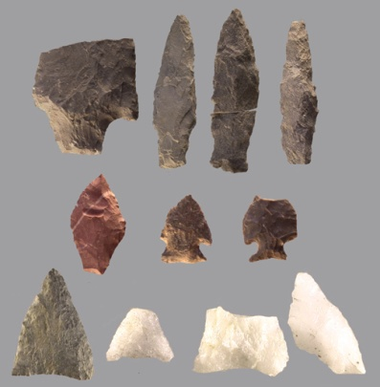
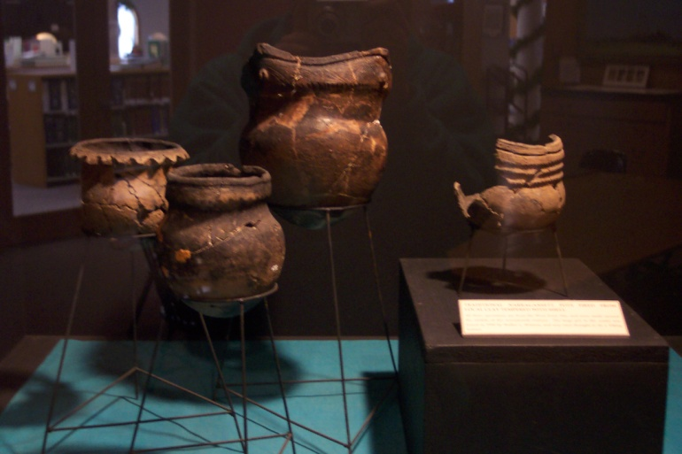
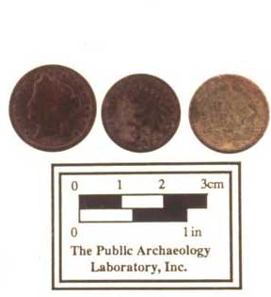
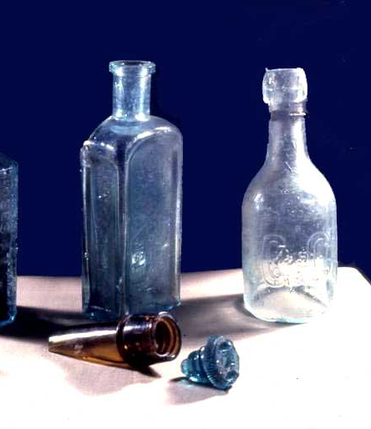
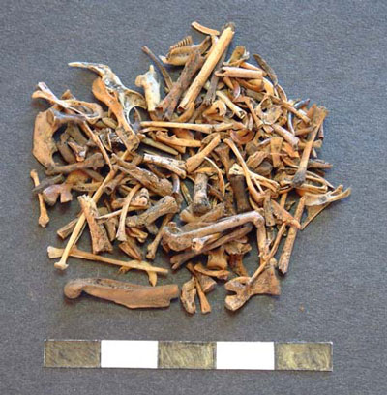
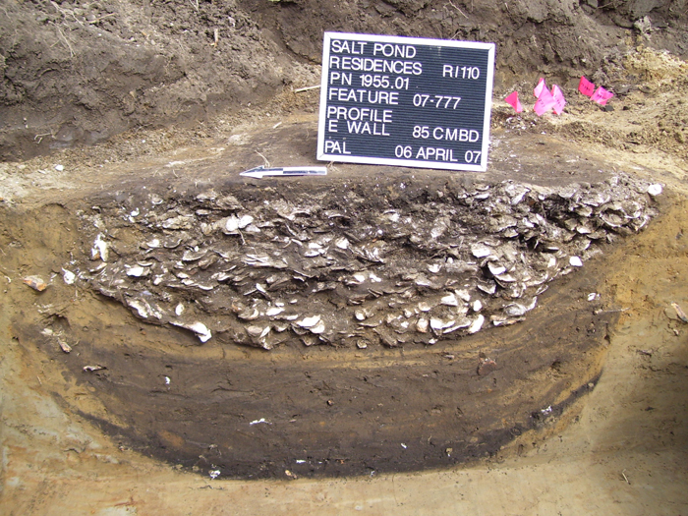
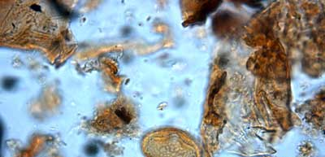
Archaeological Terms (continued)
Artifact: Any “thing” made or modified by humans.
Ecofacts: Non-artifactual remains found in archaeological sites that are part of the cultural record - such as bones, seeds, and plant pollen.

Slide 5
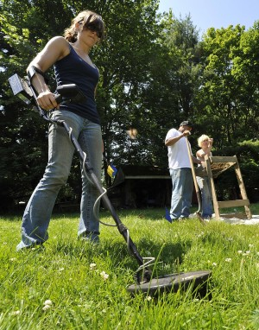
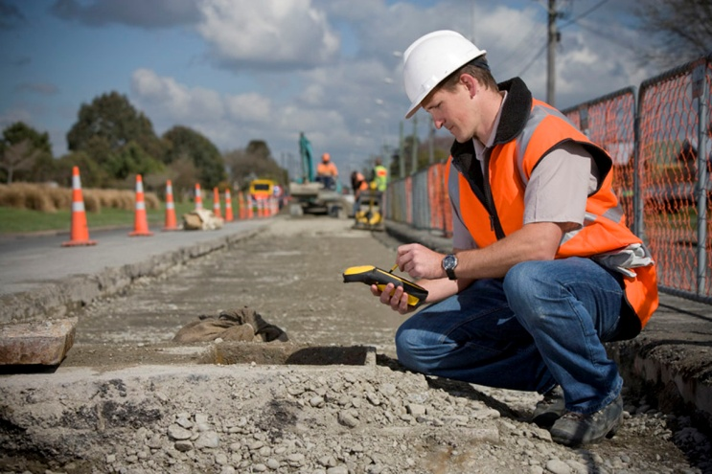
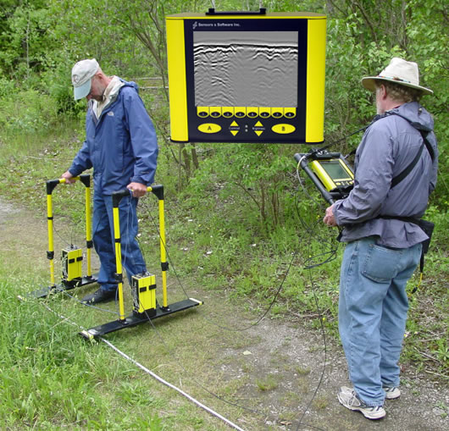
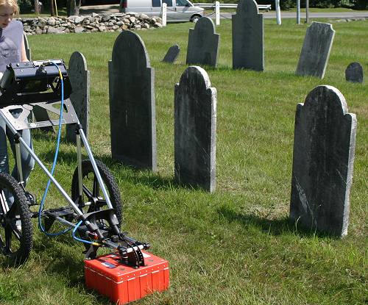
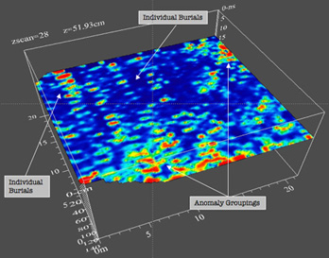
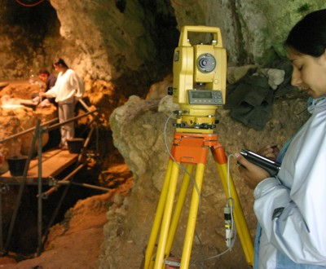
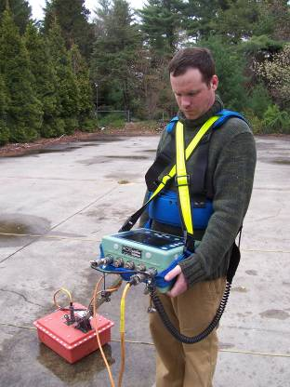
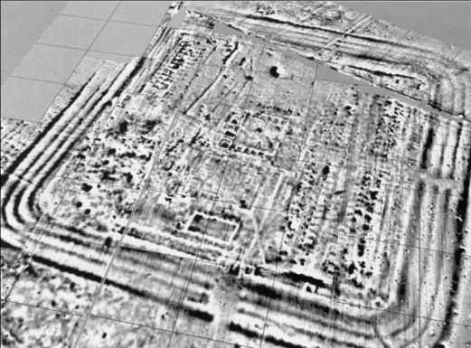
Modern Tools: Remote Sensing

Slide 6
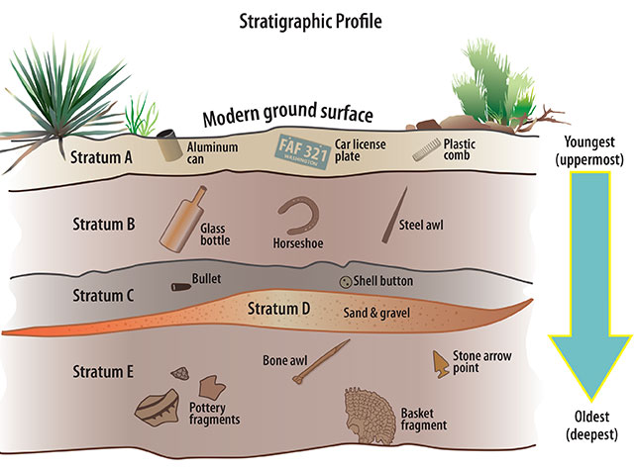
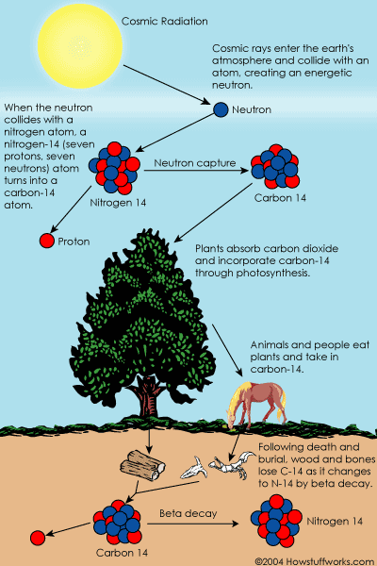
Keys to Archaeological Investigation: Temporal Context
Relative Dating
Absolute Dating
(radiocarbon)

Slide 7
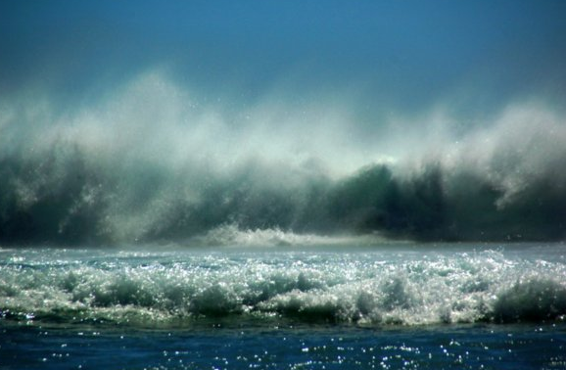
What about the Submerged Environment?

Slide 8
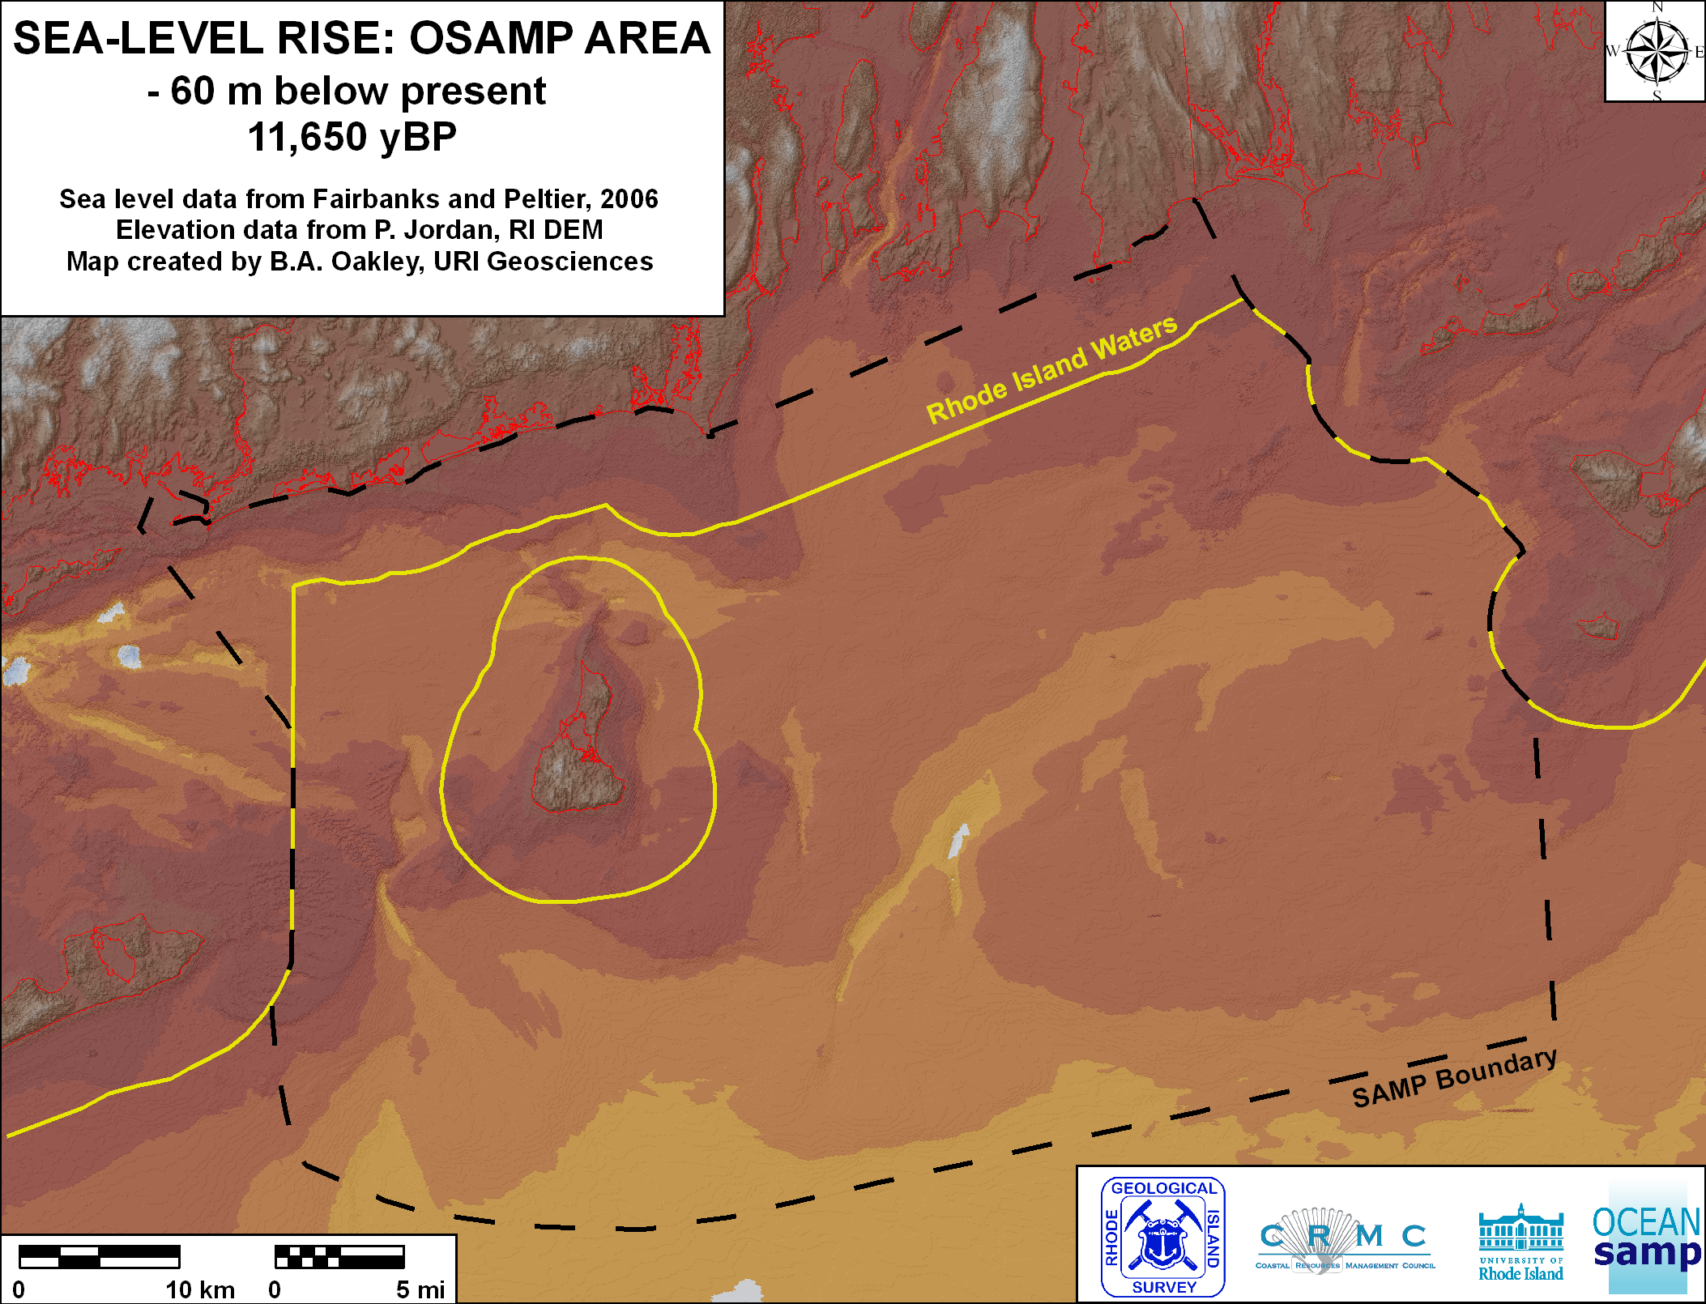
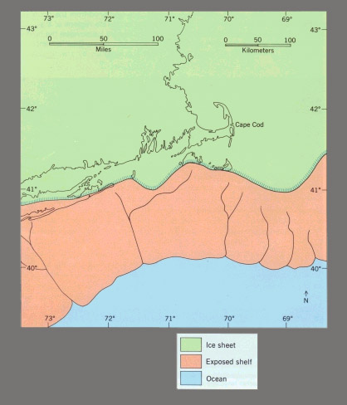

Slide 9
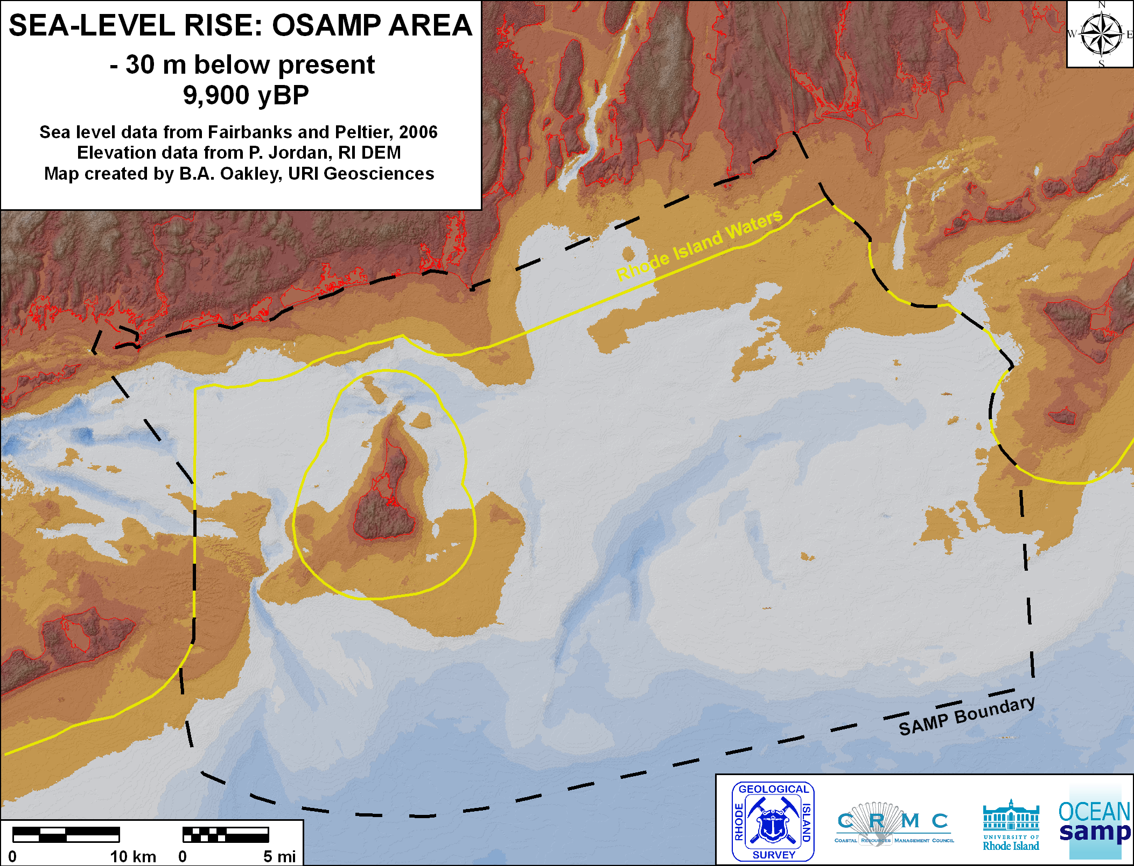

Slide 10
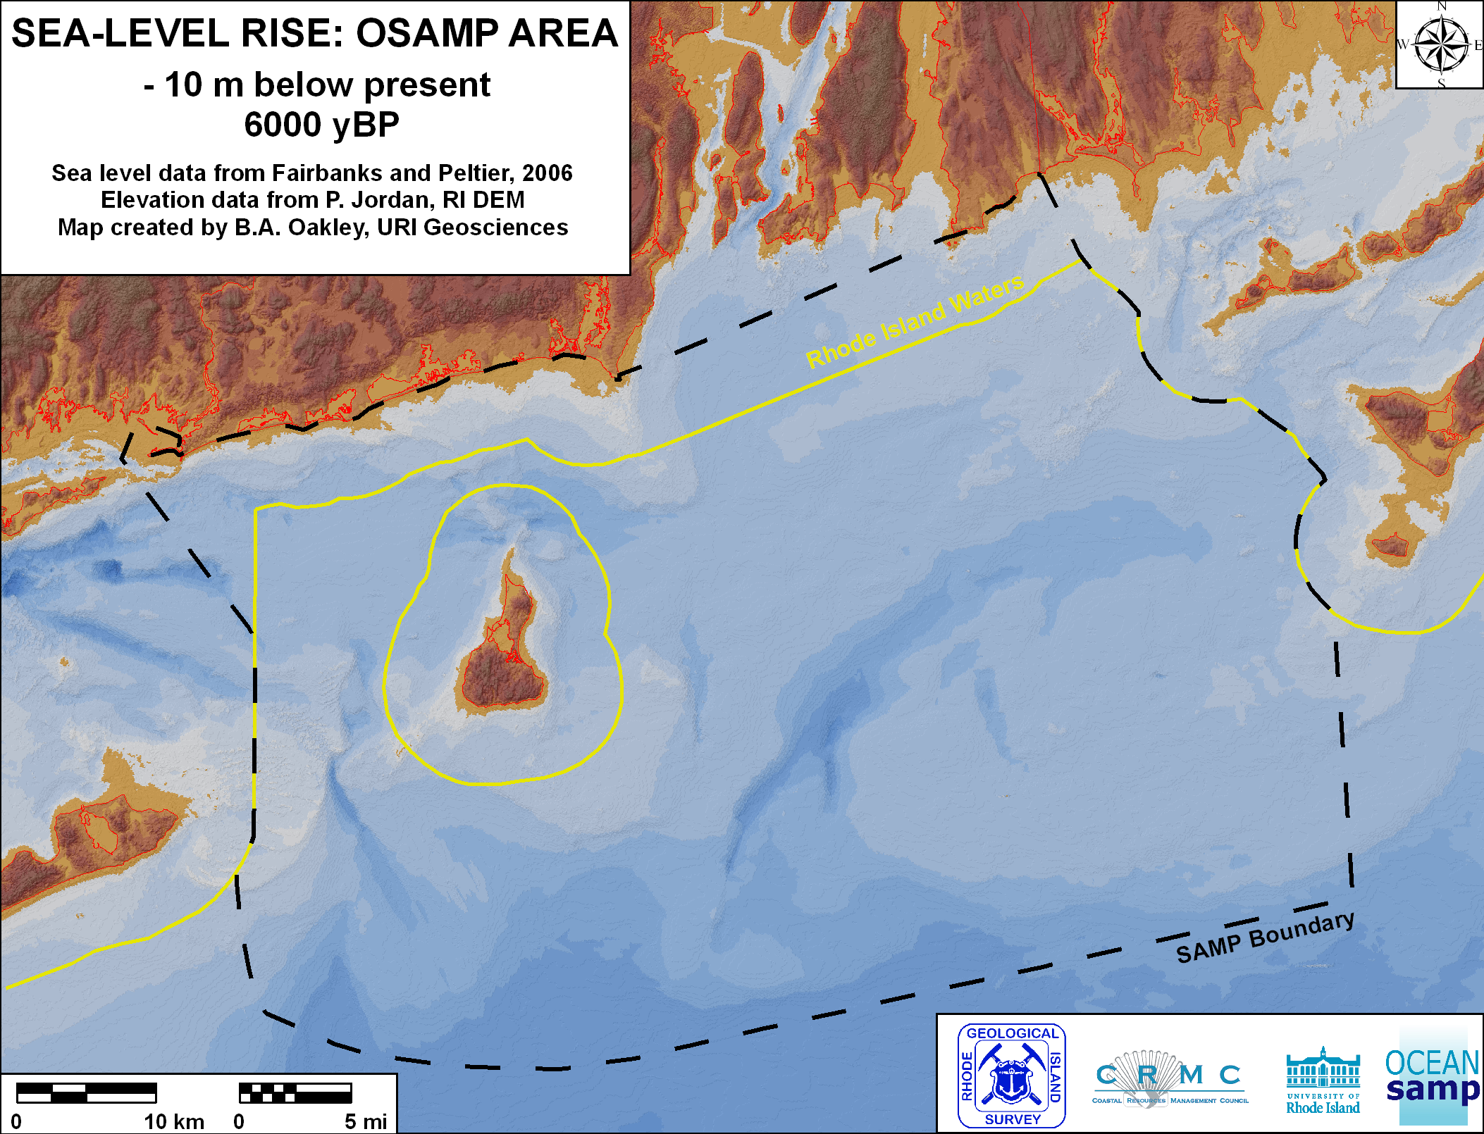

Slide 11
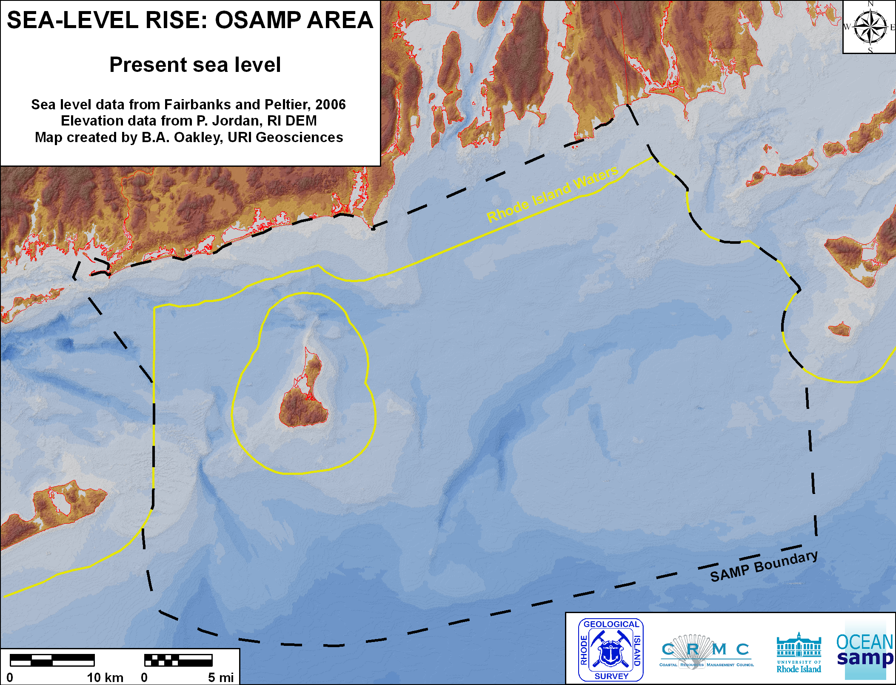

Slide 12
east coast movie

Slide 13
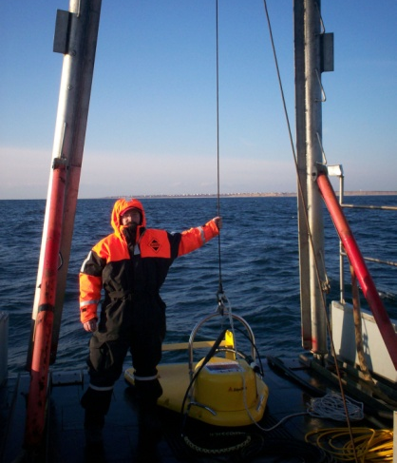
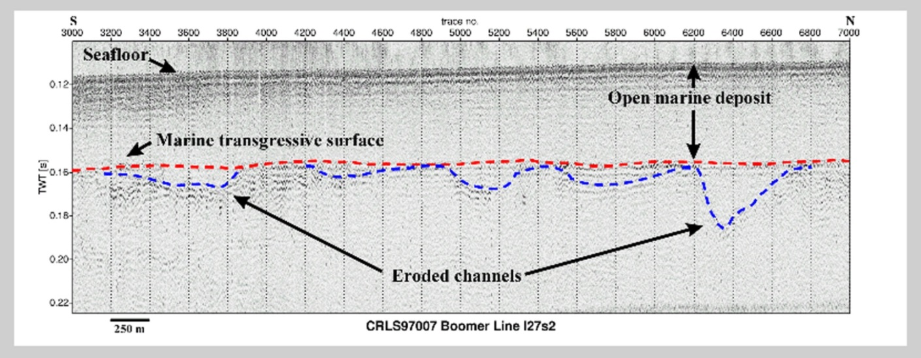
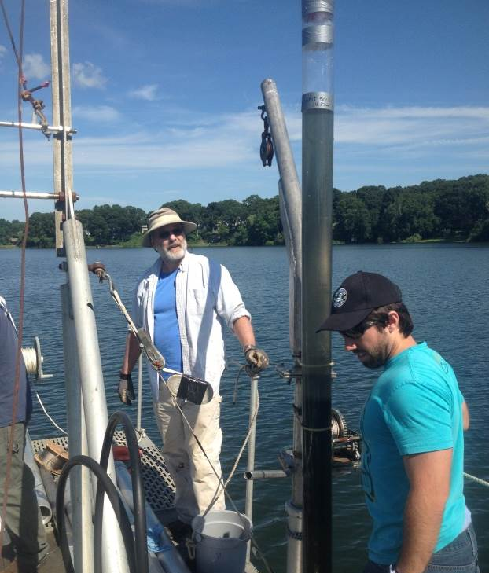
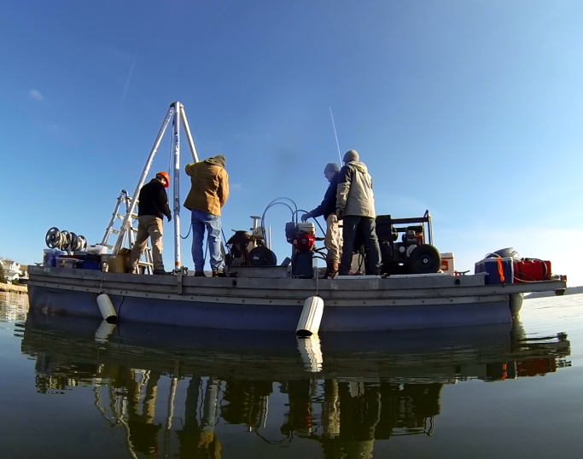
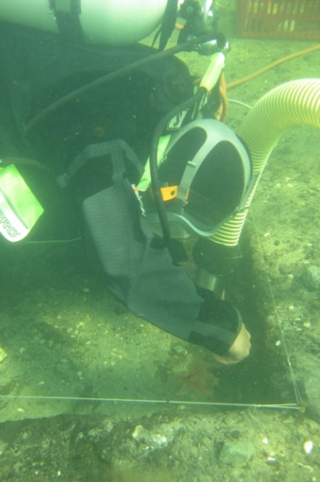
Finding Submerged Paleocultural Landscapes:
Marine Remote Sensing & Sediment Sampling
(sidescan sonar, subbottom profiler, multi-beam depth sounder)
(sediment coring and underwater excavation)

Slide 14
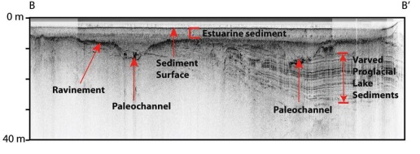
Submerged Paleocultural Landscape Reconstruction
Image courtesy of U.S. Geological Survey

Slide 15
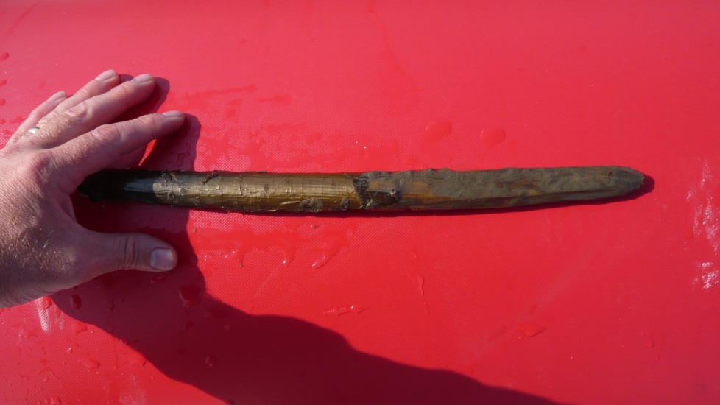
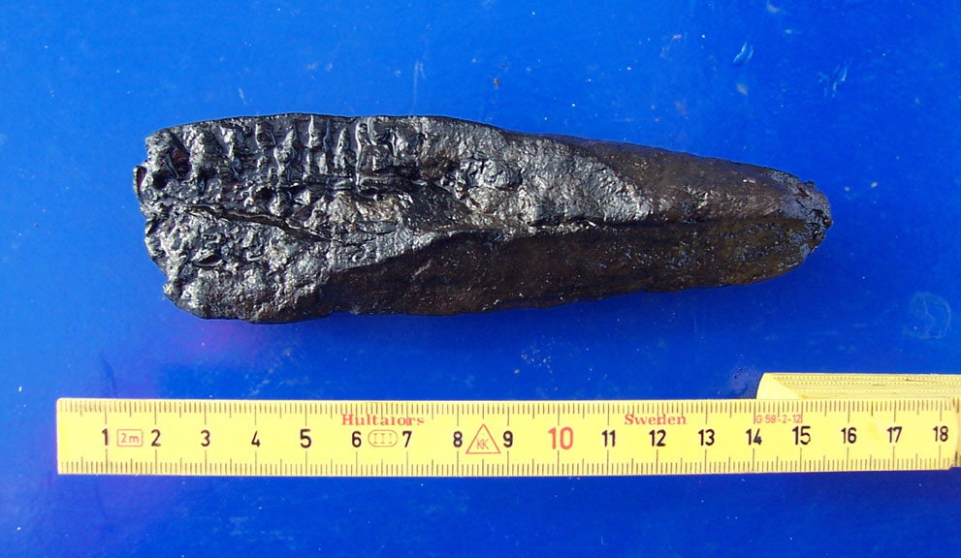
Organic Preservation in the Submerged Environment
Wooden artifacts and ecofacts excavated from a ca. 6,000 year old submerged site in Tudsehage, Denmark.
Require conservation treatment to preserve them.
Sharpened Wooden Stake
(part of a fish weir or dwelling)
Charred Cut Firewood
Hazelnuts & Acorns

Slide 16
When did people arrive in North America?
- the first climate refugees?

Slide 17
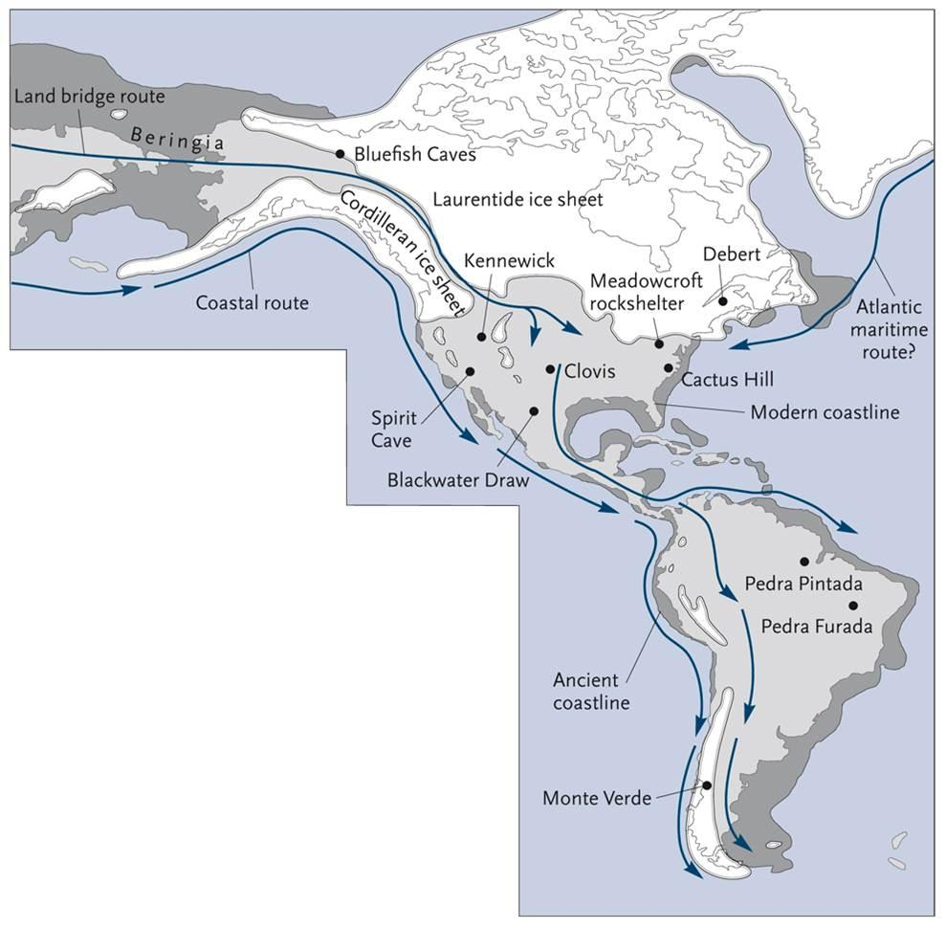
Archaeological Evidence Suggests Population of the Americans was Complicated
Solutrean Hypothesis
20,000+ years ago
Land Bridge Hypothesis
13,000-14,000 years ago
Coastal Migration Hypothesis
15,000-16,000 years ago

Slide 18
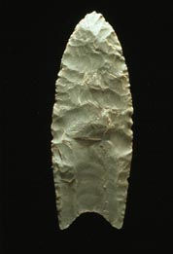
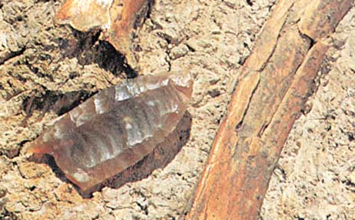
Clovis Site, New Mexico 1920-30s
Dates to ca. 13,200 to 12,900 calendar years ago. “Clovis people” were once believed to be the earliest human inhabitants of the Americas and the ancestral relative of most contemporary Native Americans.

Slide 19
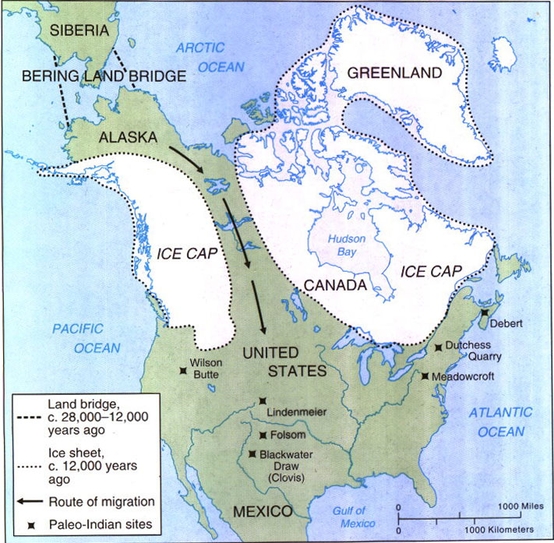
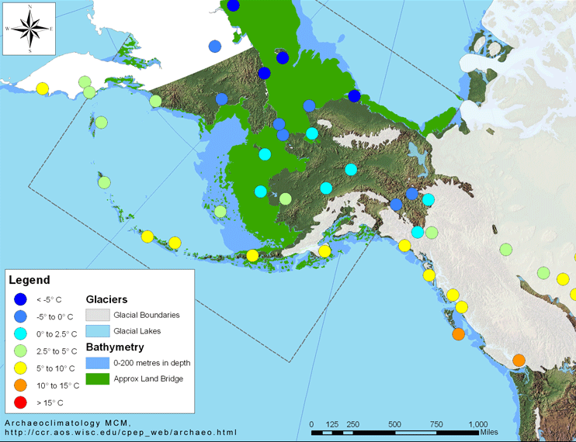
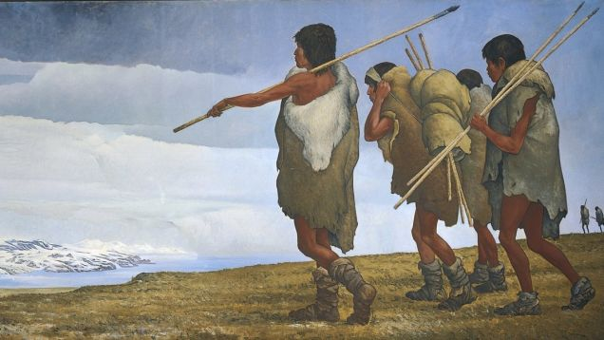
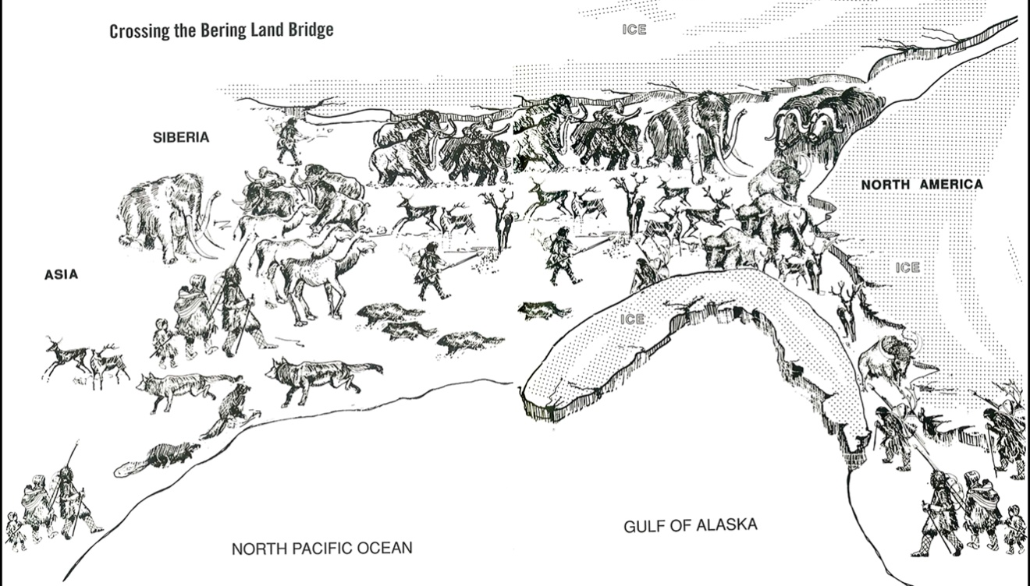
Native American Origins (archaeological theory)
Ca. 15,500 B.P.

Slide 20
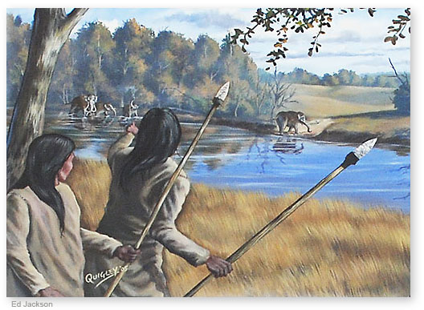
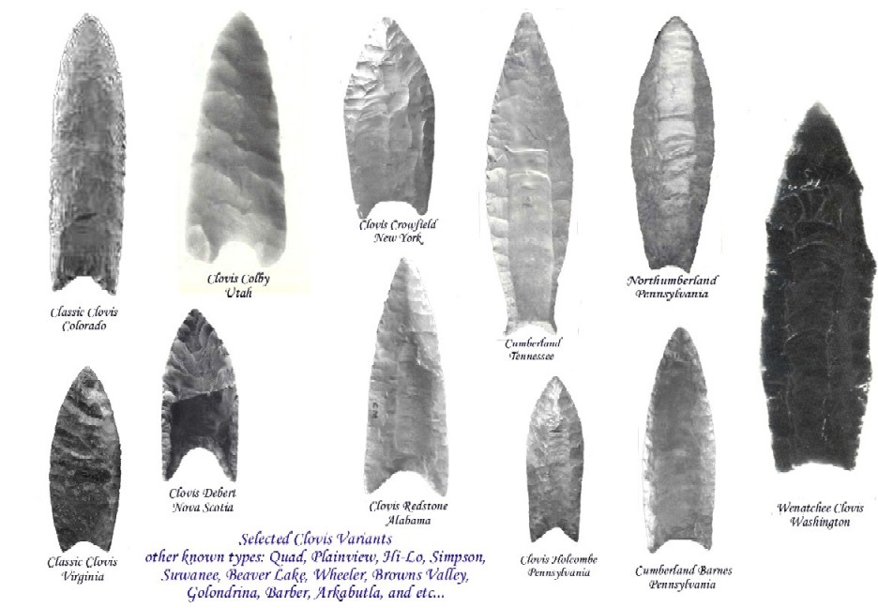
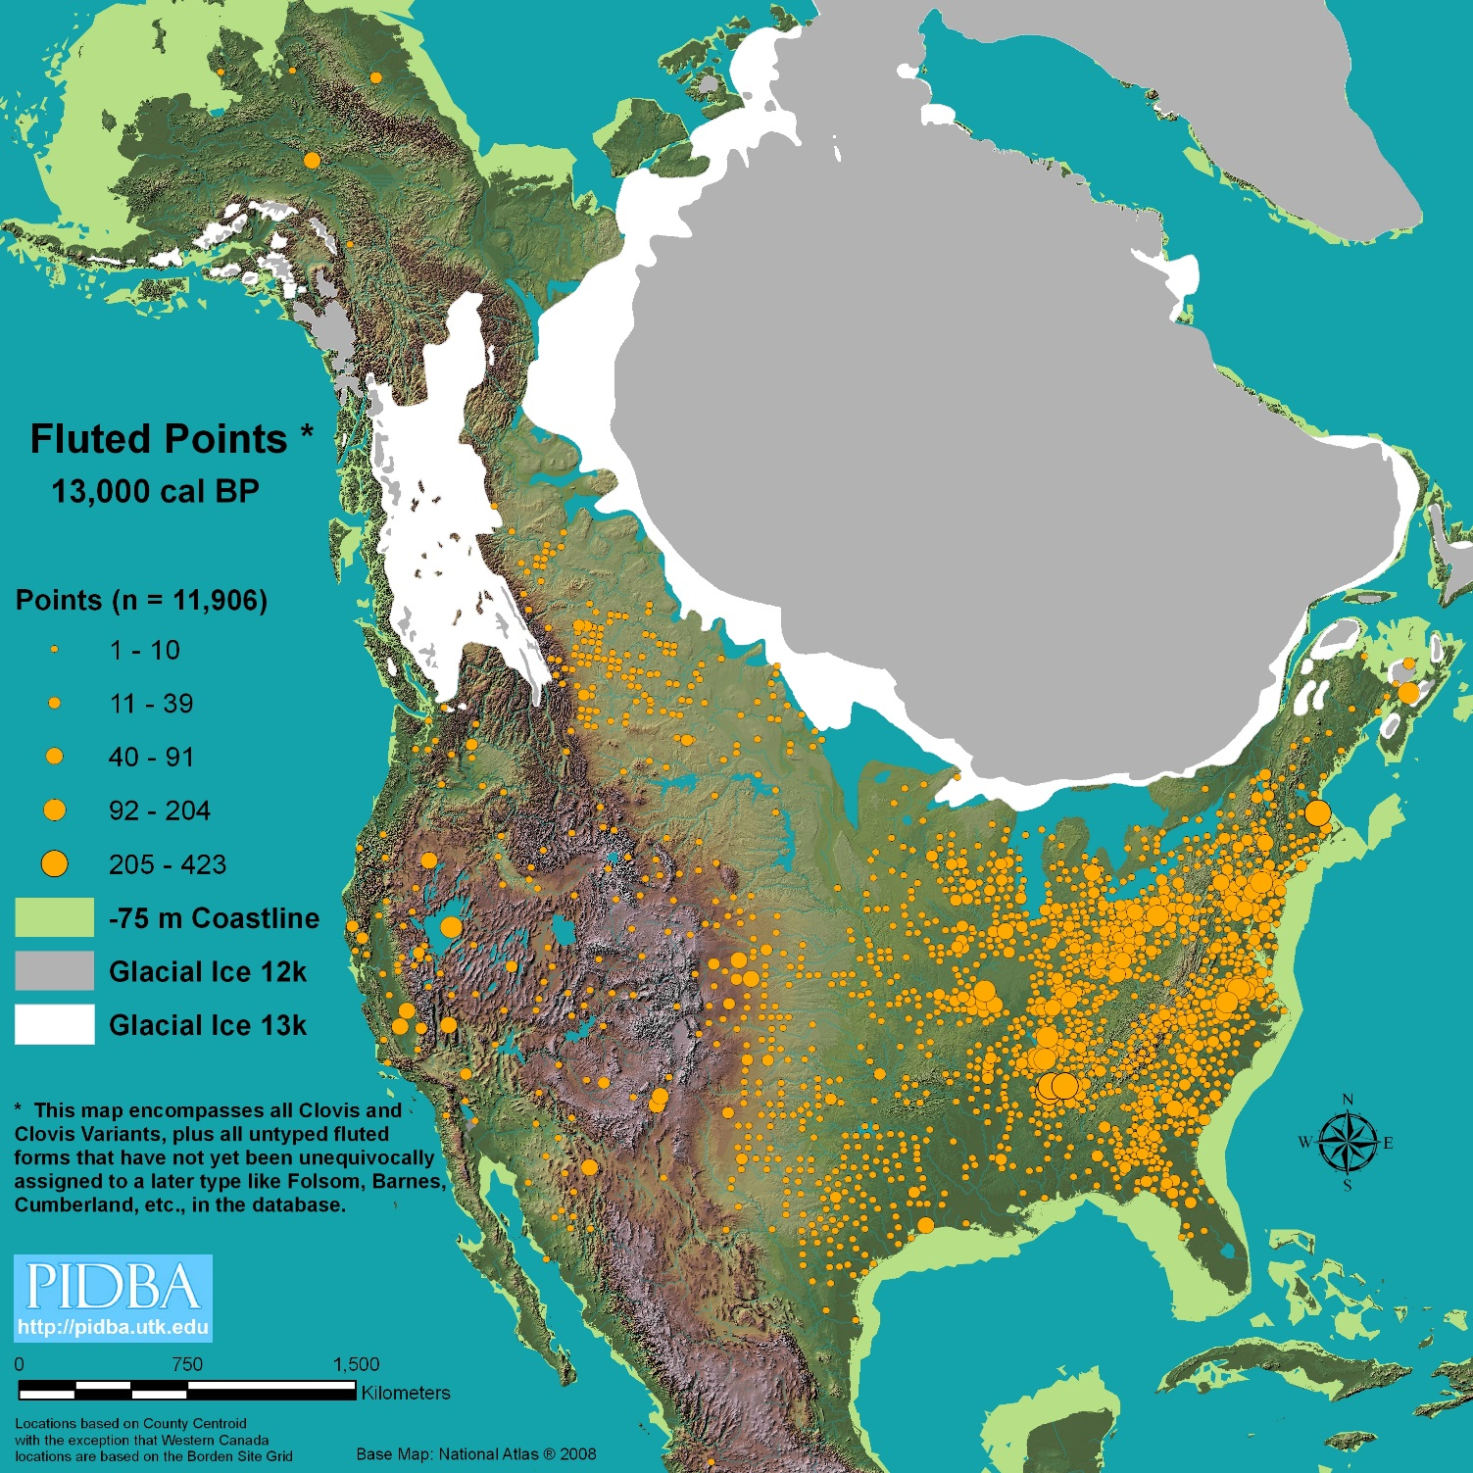
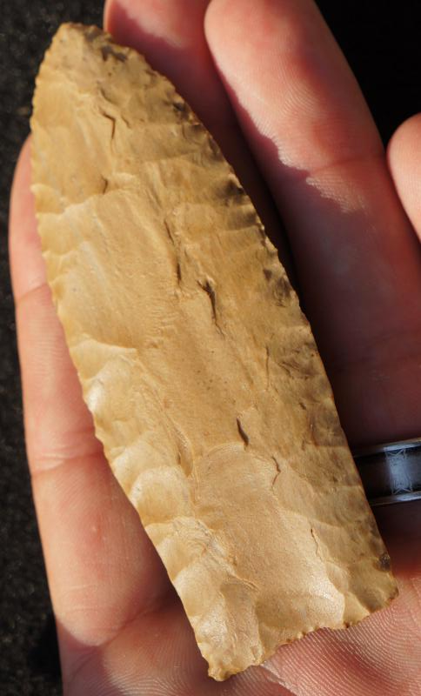

Slide 21
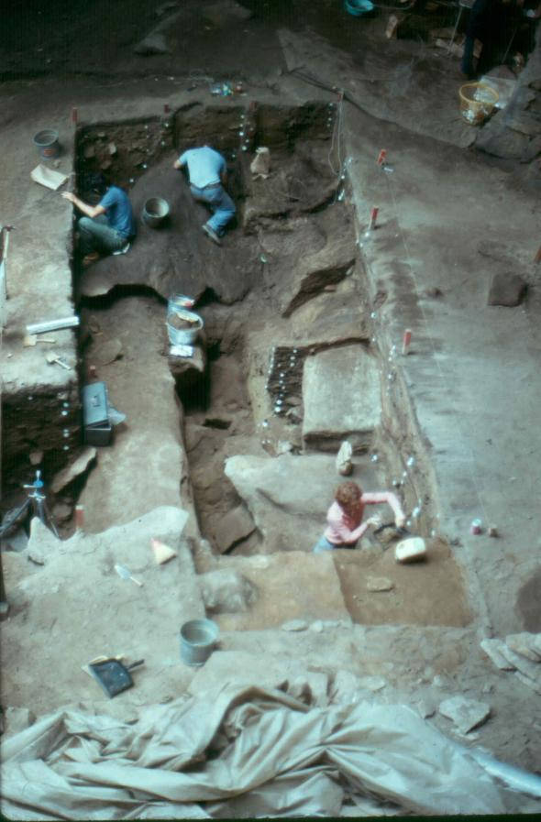
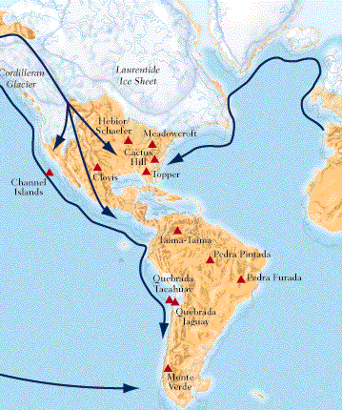
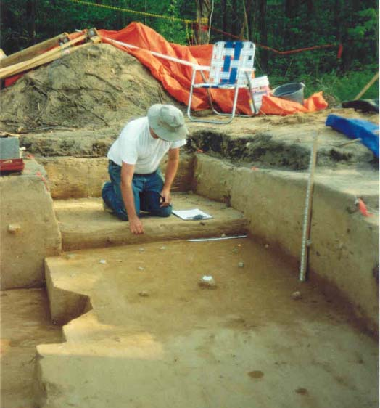
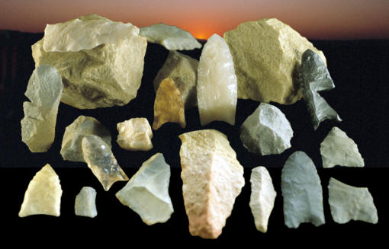
Could Someone Have Met Clovis?
Meadowcroft Rockshelter, PA
19,000 to 13,000 y.a.
Cactus Hill, VA 22,000 to 18,200 y.a.
Topper, SC 20,000 to 16,000 y.a.

Slide 22
Pre-Clovis in RI? Maybe - Late Glacial Maximum Glaciation ca. 26,000 ya.

Slide 23
At least not on land
100 km (62 mi) off shore in 75 m (246ft) of water.
Collagen C14 date of mastodon ca. 23,000 y.a.

Slide 25
Who’s Past is it and Who Gets to Write its History?
Narragansett Tribal Oral History
Informs us that more than 15,000 years ago, the ancient villages of the ancestral Narragansett were out where the ocean is now, and that overnight the ocean’s waters began to rise and their people had to evacuate their ancient homes.

