Slide 1
CLIMATE CHANGE’S EFFECT ON PEOPLE
Collapse of Maya Civilization (ca. 1,300-1,100 B.P.)
  Evidence of climate change (ca. 200 yr-long period of intense drought) found in
  sediment samples taken from two lakes (north and south)
  Examined ratio of heavy & light oxygen isotopes found in fossilized shell and
  sedimentary rock, and hydrogen isotopes in the acid found in the waxy coatings of
  Land plants
  Lighter isotopes of oxygen evaporate more readily – times of greater evaporation
  and lower precipitation = a greater amount of heavy isotopes in the water, which
  end up in the fossilized shell and sedimentary rock
  Also looked at growth rates of stalagmites – they grow quicker during wet months
  Mayan culture founded on anomalous high rainfall patterns. Drought found to be
  worse in the southern region –where the civilization’s collapse was more rapid)
  Possible result of shift in the Intertropical Convergence Zone or El Nino – similar
  effect on several ancient societies (e.g., Teotihuacan and Akkadian Empires)

Slide 2
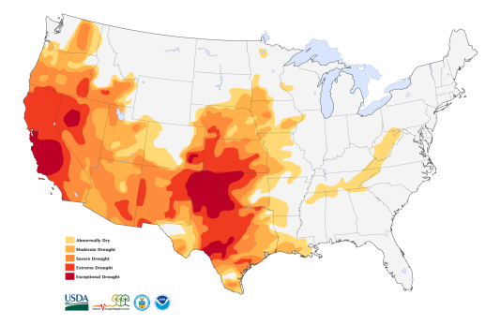
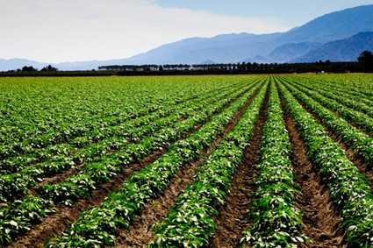
CLIMATE CHANGE’S EFFECT ON PEOPLE
Extreme drought conditions in California and the Midwest since 2000
The chances of a 35-year or longer "megadrought" striking the Southwest and central Great Plains by 2100 are above 80 percent if the world stays on its current trajectory of greenhouse gas emissions, according to scientists from NASA, Columbia University, and Cornell University.
California has been the #1 food & agricultural producer in the United States for more than 50 consecutive years.
A nearly $44 billion dollar industry that generates over $100 billion in related economic activity in the United States every year.
Any similarities between Ancient Mayan situation and ours Today?
(think-pair-share)

Slide 3
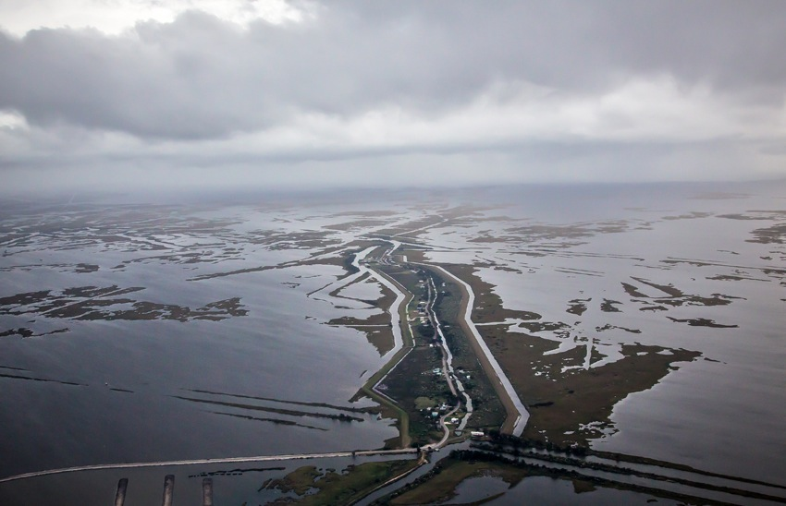
CLIMATE CHANGE’S EFFECT ON PEOPLE
Impact of sea level rise on the islands and wetlands of South Louisiana
Since 1930, the Louisiana coast has lost about 190,000 square miles of land = an area the size of Rhode Island
USGS: Over the last 25 yrs – losing 16.57 sq mi/year
= football field of coast every hour
Isle de Jean Charles Band of the Biloxi-Chitimacha Indians will be America’s First “Climate Change Refugees”
Island population is about 70 people, down from a peak of about 350, with only 25 homes full-time residences.
Rising waters are now threatening the very existence of the Tribe and its homeland
“It ain’t they-uh no maw.”

Slide 4
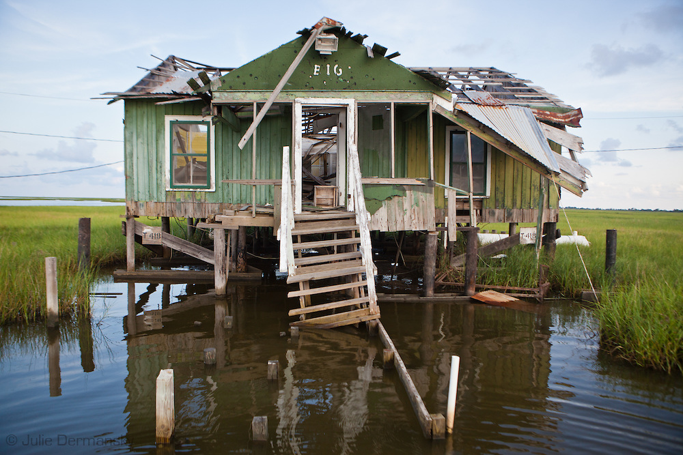
CLIMATE CHANGE’S EFFECT ON PEOPLE
Impact of sea level rise on the islands and wetlands of South Louisiana
50 yrs ago, Isle de Jean Charles was 11 miles long-x-5 miles wide. It is now 2 miles long-x-0.5 miles wide and shrinking rapidly
Louisiana’s $50-billion “Comprehensive Master Plan for a Sustainable Coast” released in 2012 does not include any measure to rebuild or protect the Isle de Jean Charles
Chief Albert Naquin hoped to relocate the Tribe, but dropped idea because some determined to stay
Tribe faces not only the disappearing land of their ancestors, but also the disappearance of their island-based culture

Slide 5
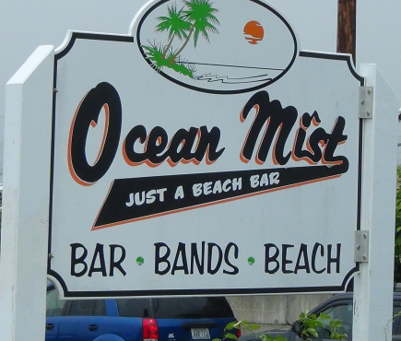
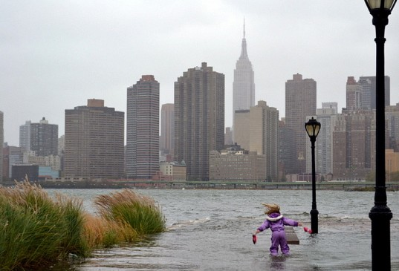
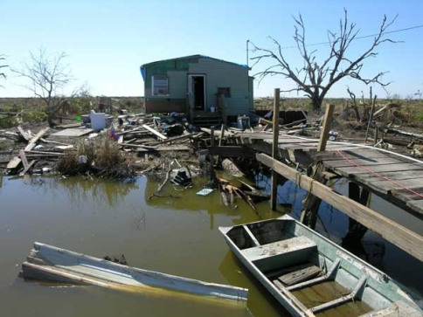
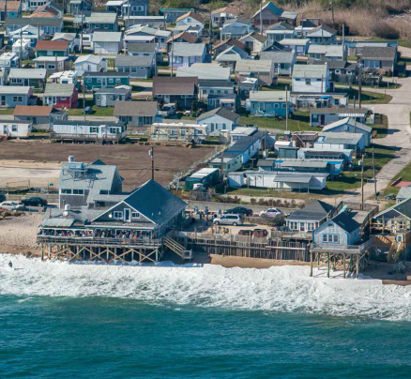
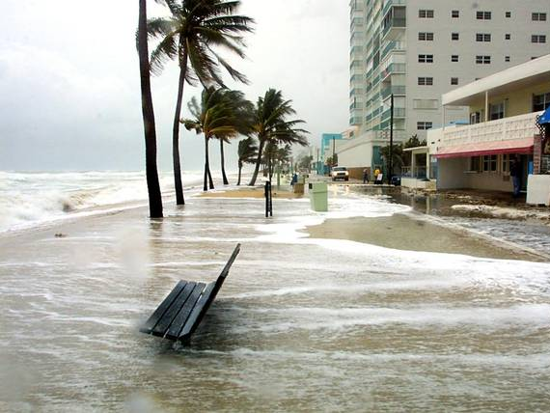
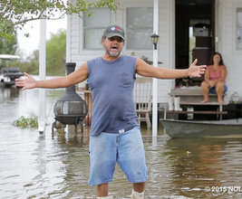
CLIMATE CHANGE’S EFFECT ON PEOPLE
Social Justice Question: Who will be the “Winners” and “Losers”? Why?
(think-pair-share)
E. Matunuck, RI
Manhattan, NY &
Miami Beach, FL
Isle de Jean Charles
Southeastern ,LA

Slide 6
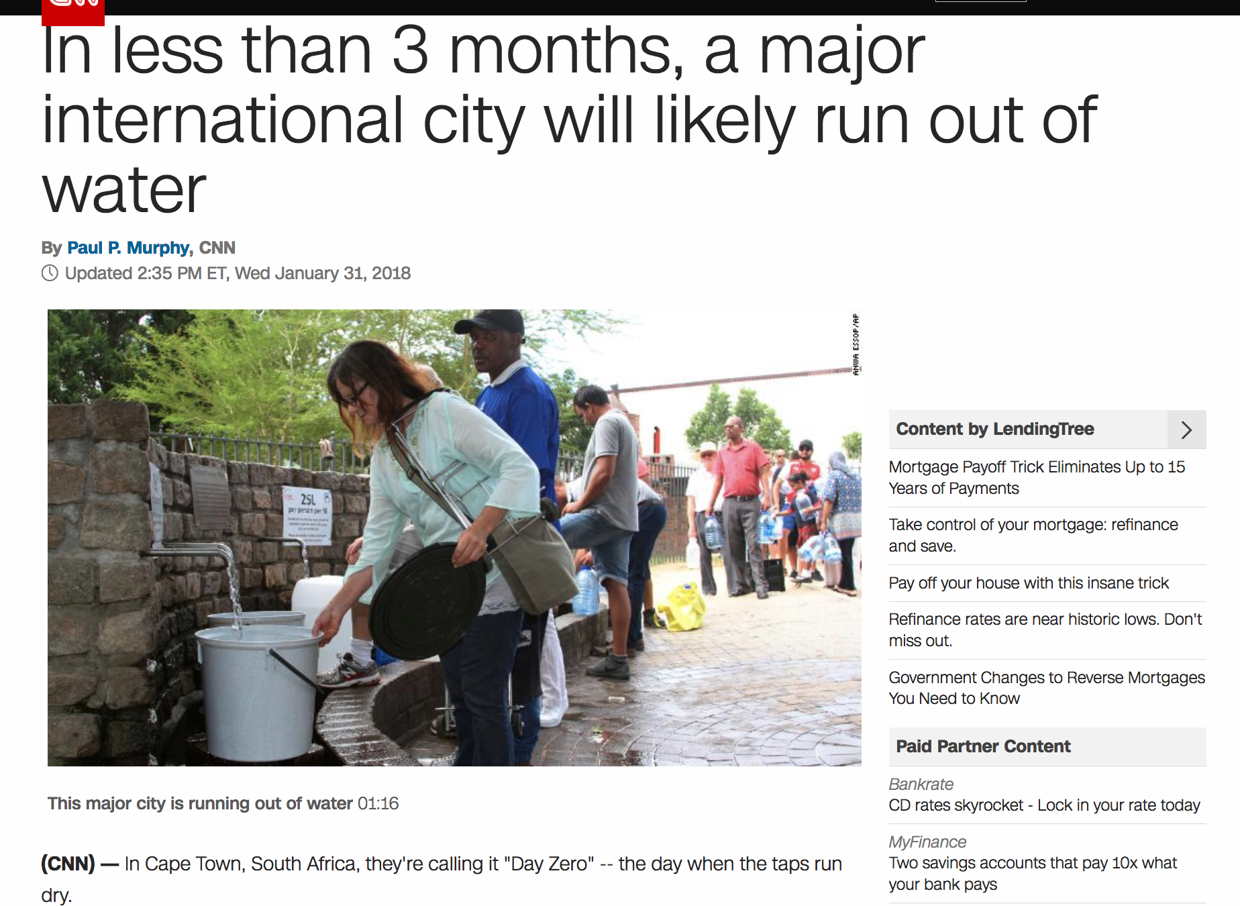

Slide 7
Accuracy?
Factor

