Slide 1
Topics for Today’s Discussion
Archaeology as a “lens” for viewing the past
What do we think we know and why?
Underwater archaeology
Glacier primer
Climate, glaciers and sea level change
Regional/local impacts

Slide 2
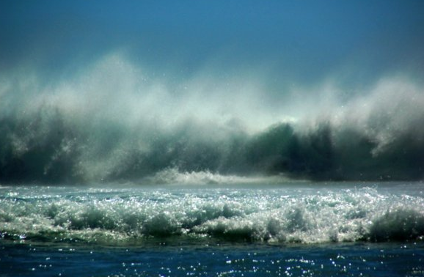
What about the Submerged Environment?

Slide 3
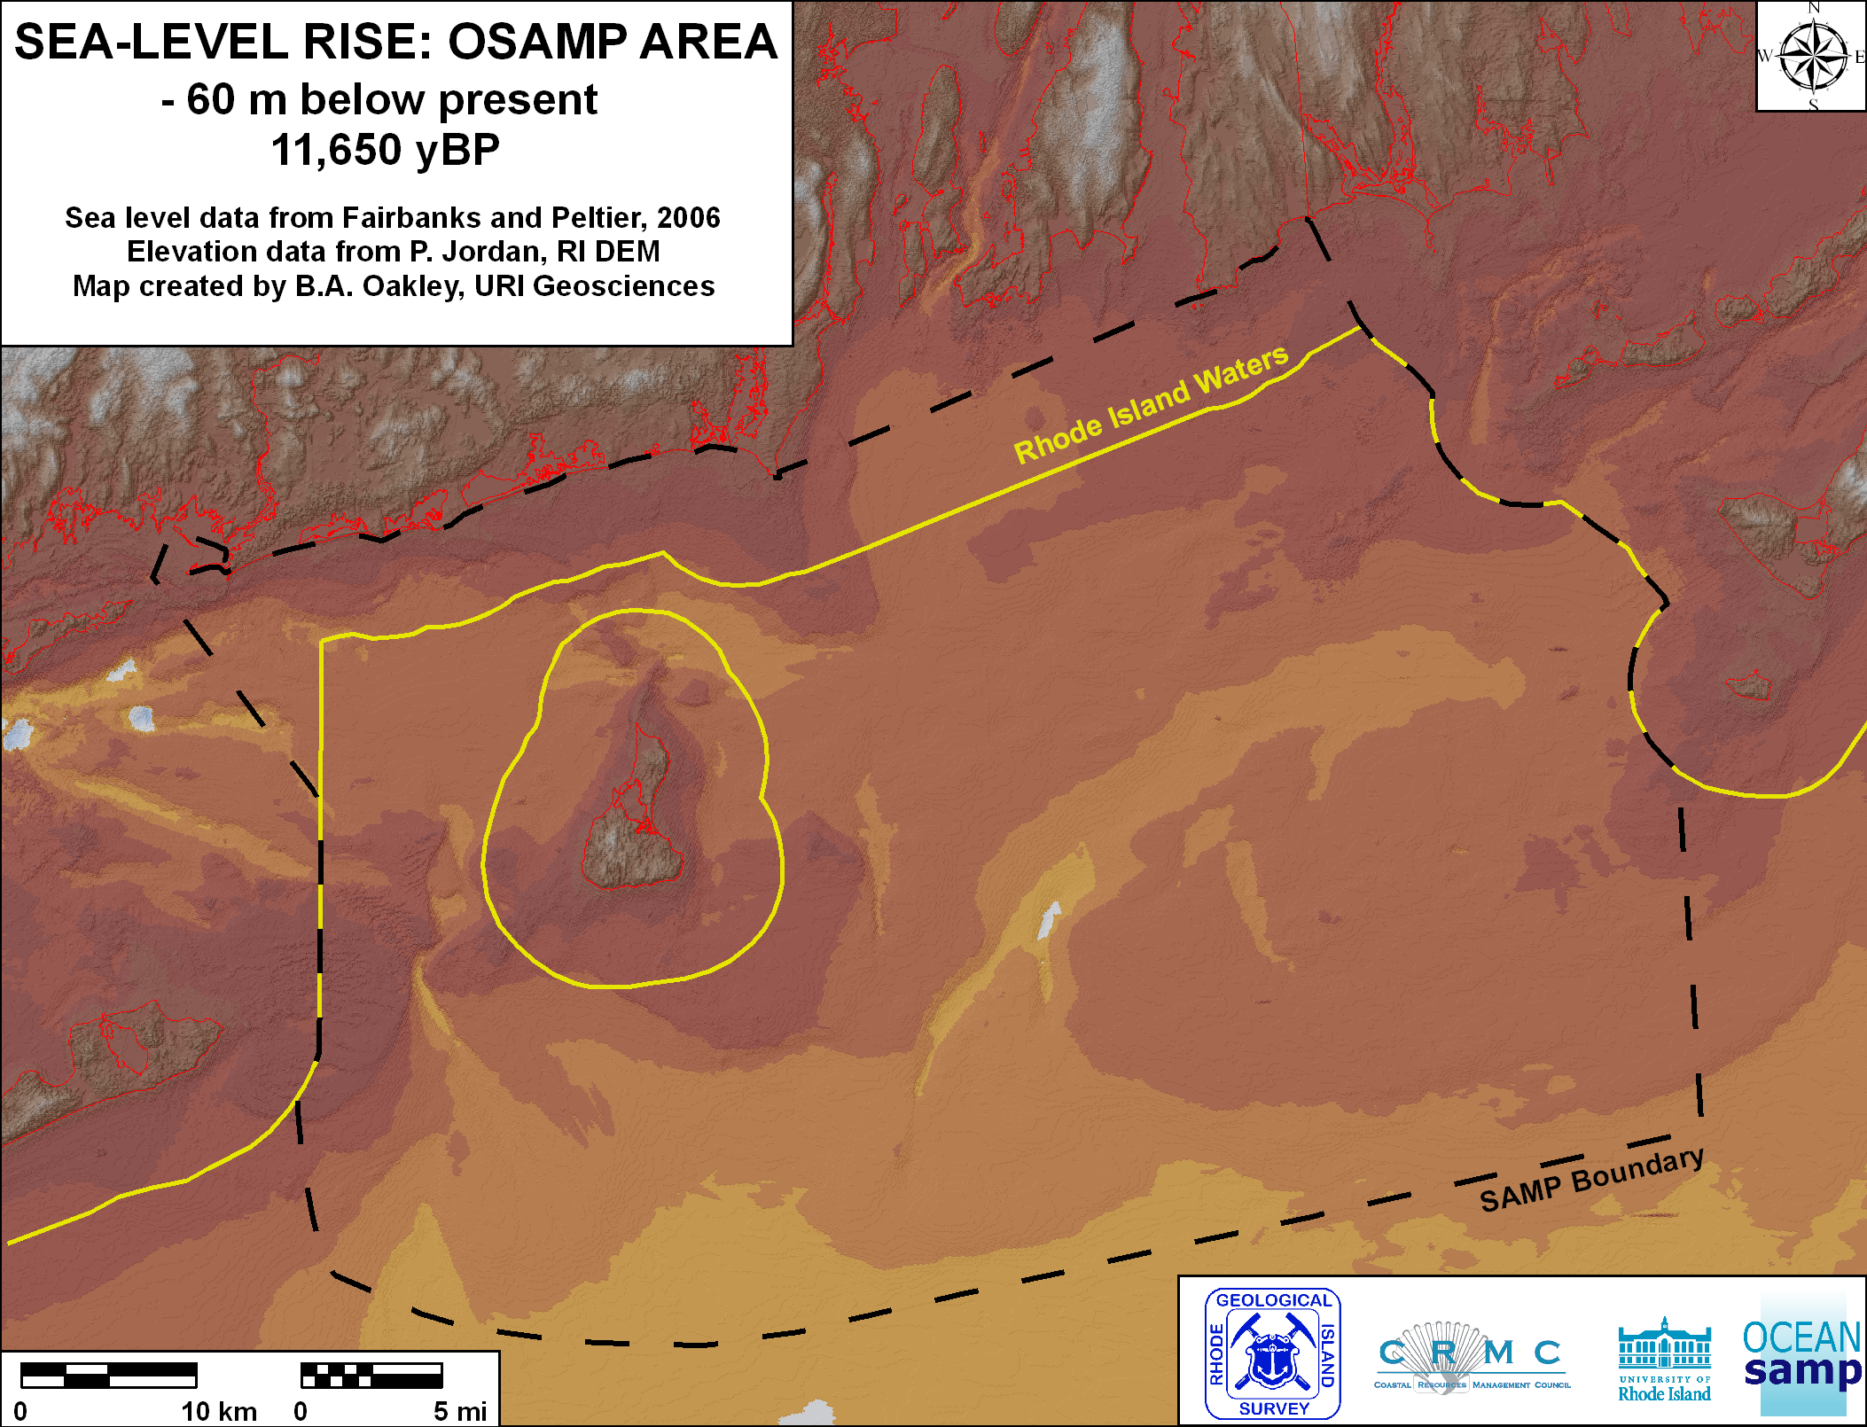
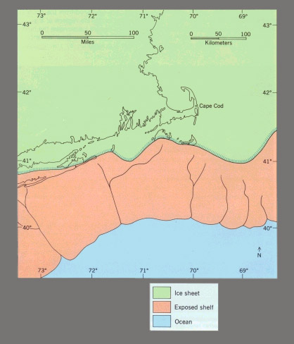

Slide 4
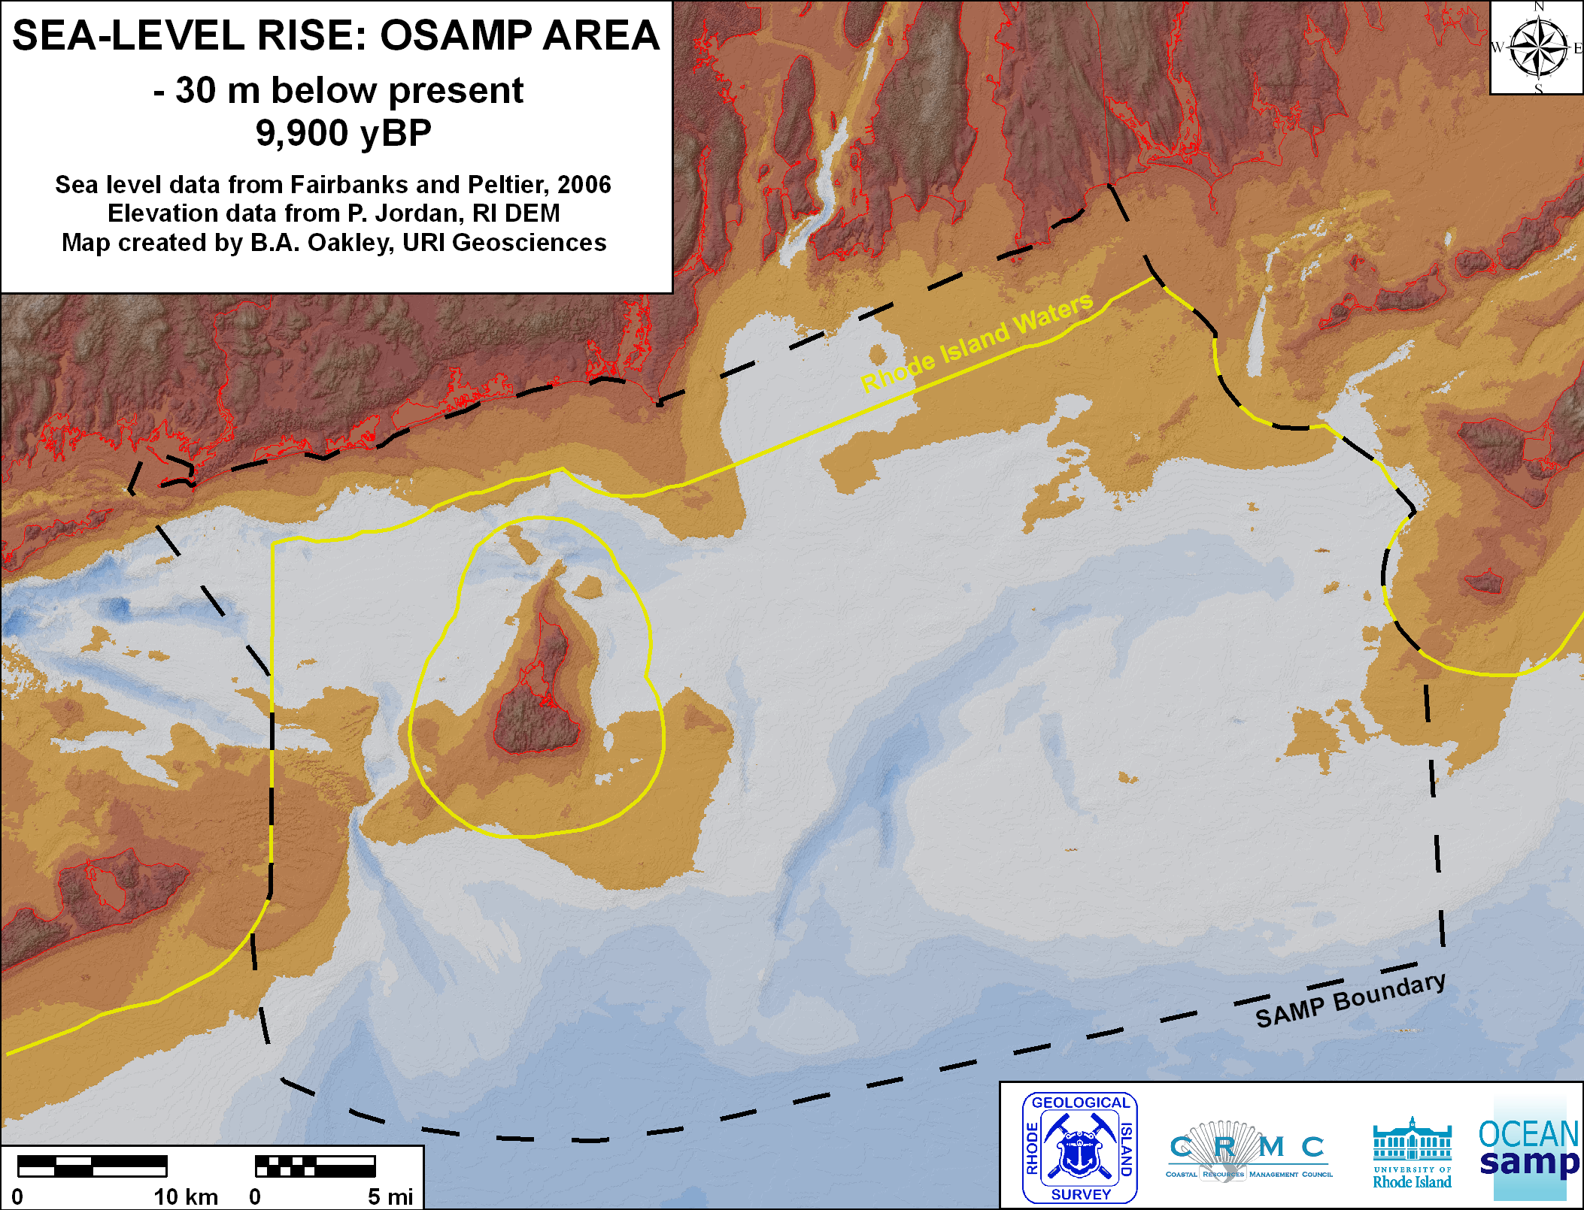

Slide 5
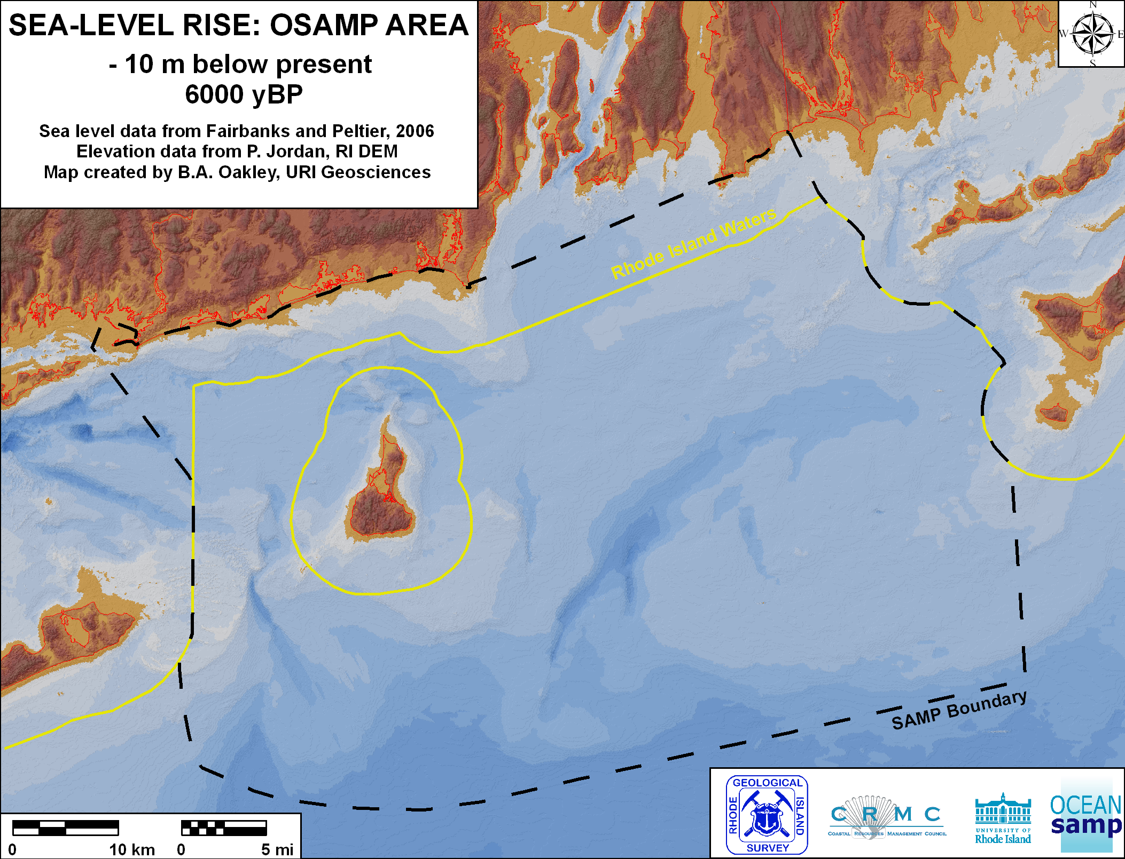

Slide 6
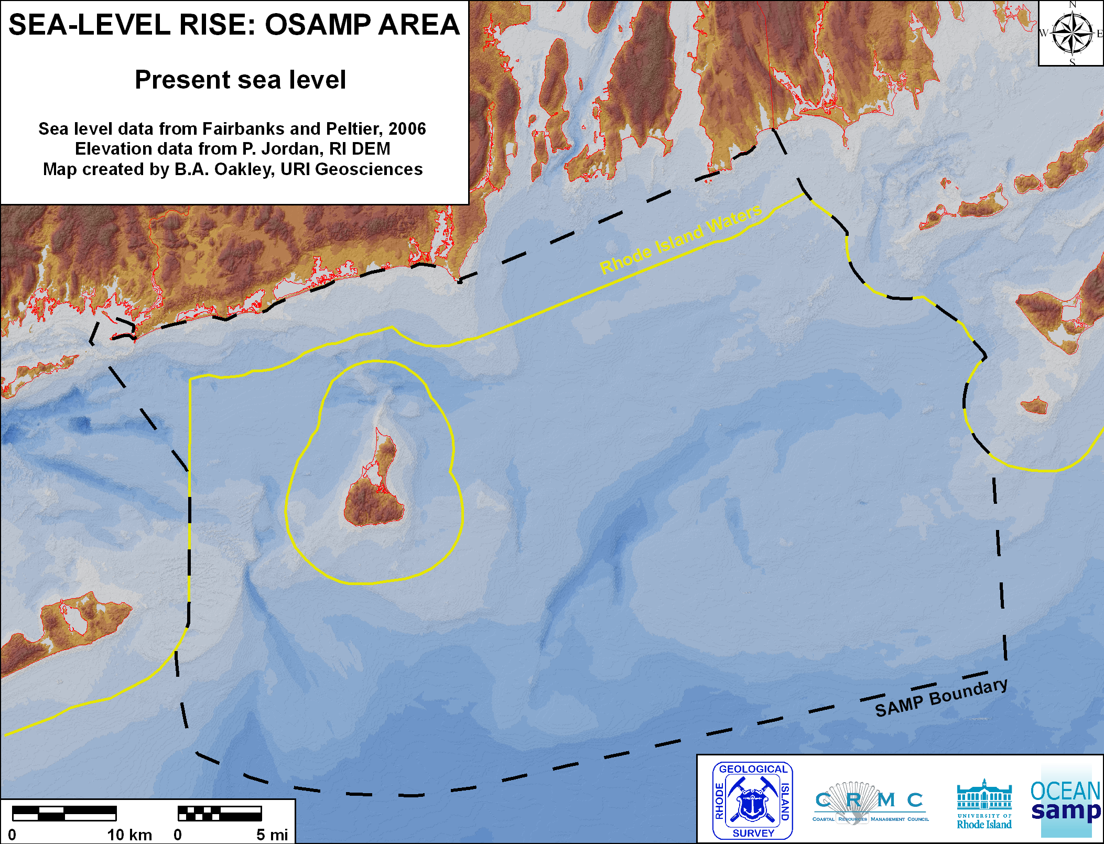

Slide 8
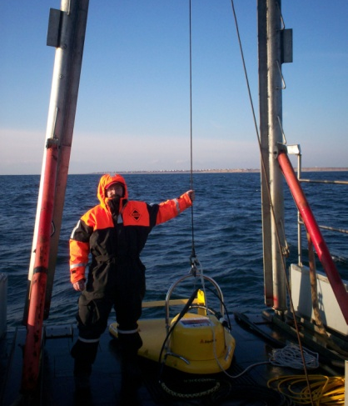
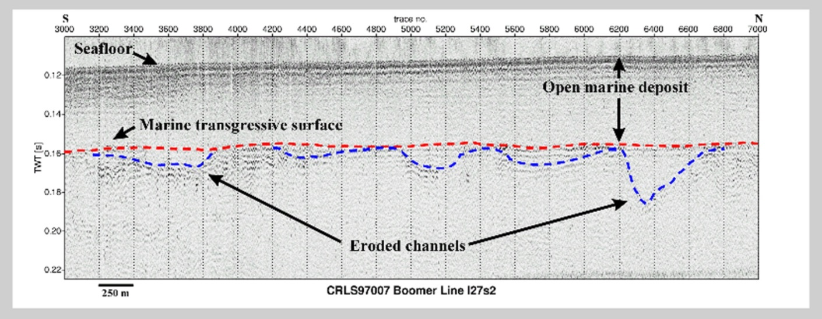
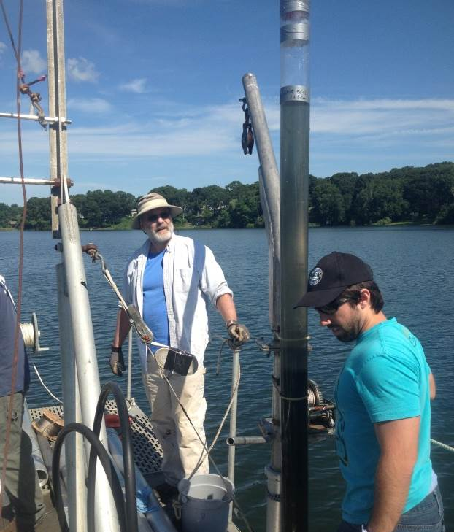
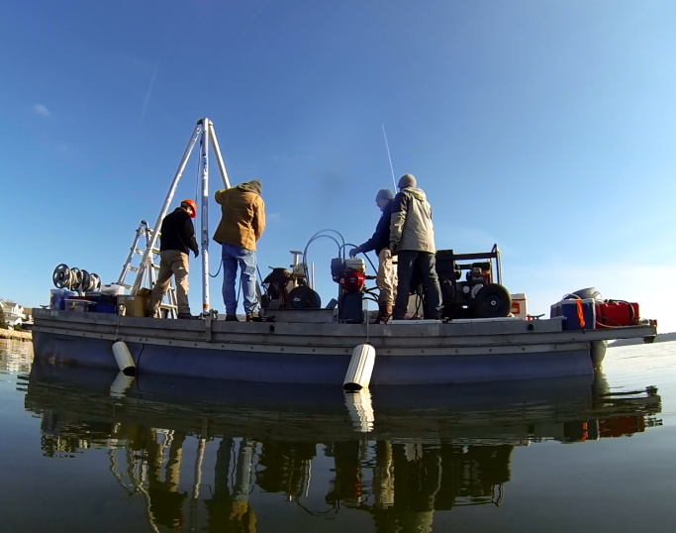
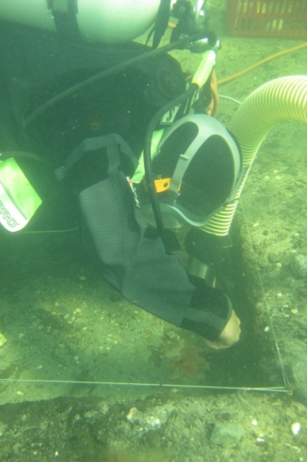
Finding Submerged Paleocultural Landscapes:
Marine Remote Sensing & Sediment Sampling
(sidescan sonar, subbottom profiler, multi-beam depth sounder)
(sediment coring and underwater excavation)

Slide 9
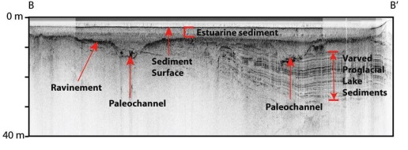
Submerged Paleocultural Landscape Reconstruction
Image courtesy of U.S. Geological Survey

Slide 10
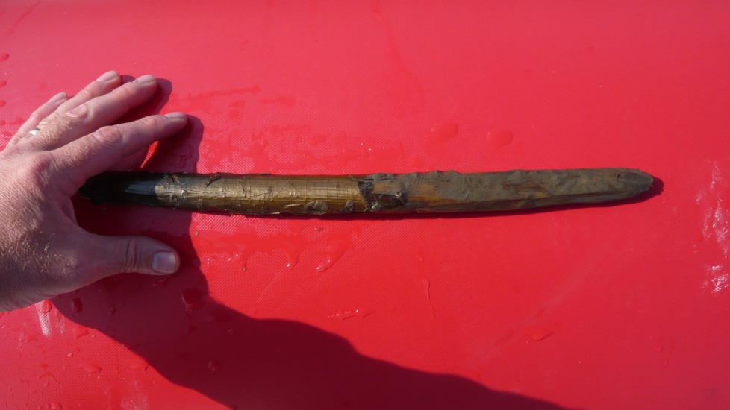
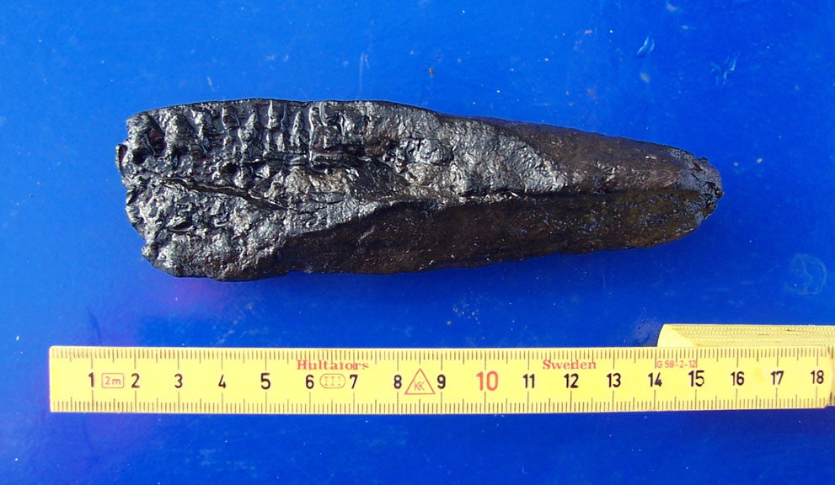
Organic Preservation in the Submerged Environment
Wooden artifacts and ecofacts excavated from a ca. 6,000 year old submerged site in Tudsehage, Denmark.
Require conservation treatment to preserve them.
Sharpened Wooden Stake
(part of a fish weir or dwelling)
Charred Cut Firewood
Hazelnuts & Acorns

Slide 11
When did people arrive in North America?

Slide 12
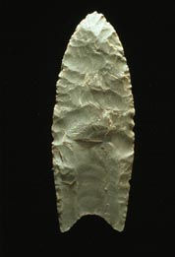
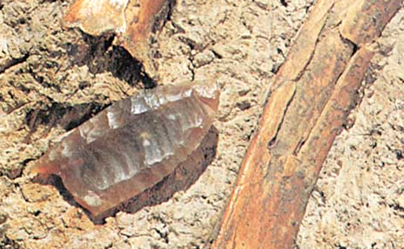
Clovis Site, New Mexico 1920-30s
Dates to ca. 13,200 to 12,900 calendar years ago. “Clovis people” were once believed to be the earliest human inhabitants of the Americas and the ancestral relative of most contemporary Native Americans.

Slide 13
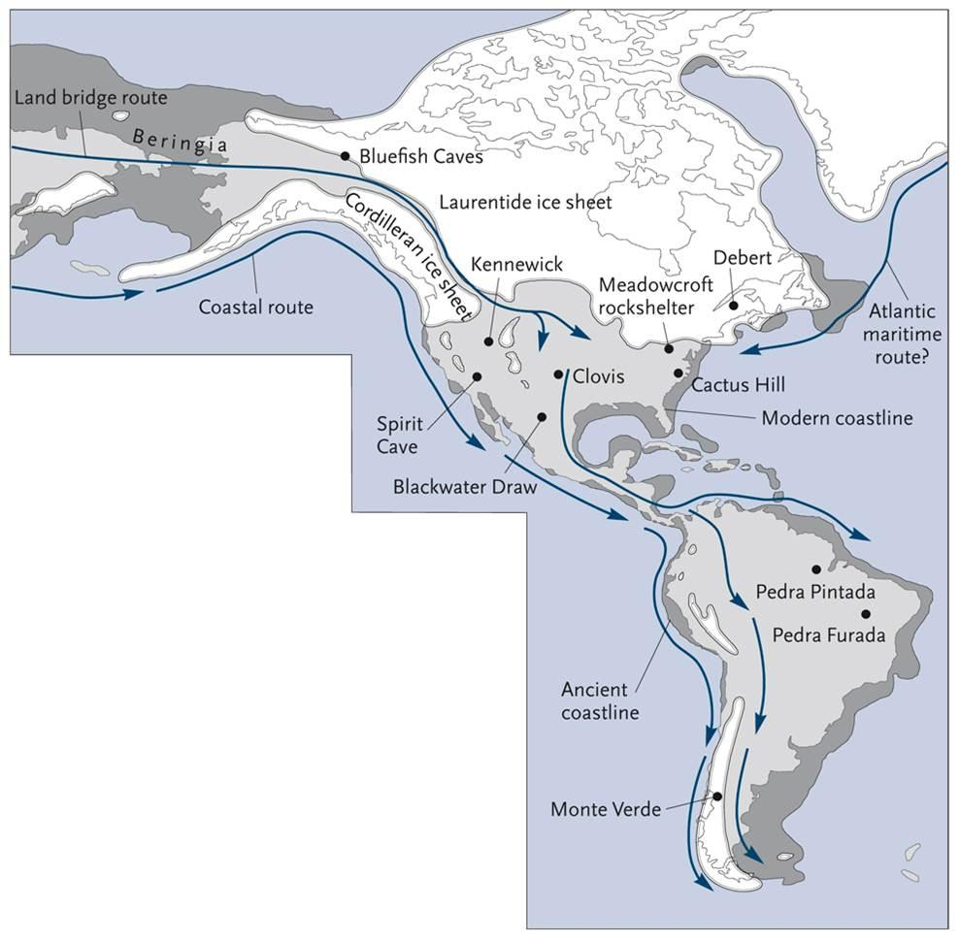
Archaeological Evidence Suggests Population of the Americans was Complicated
Solutrean Hypothesis
20,000+ years ago
Land Bridge Hypothesis
13,000-14,000 years ago
Coastal Migration Hypothesis
15,000-16,000 years ago

Slide 14
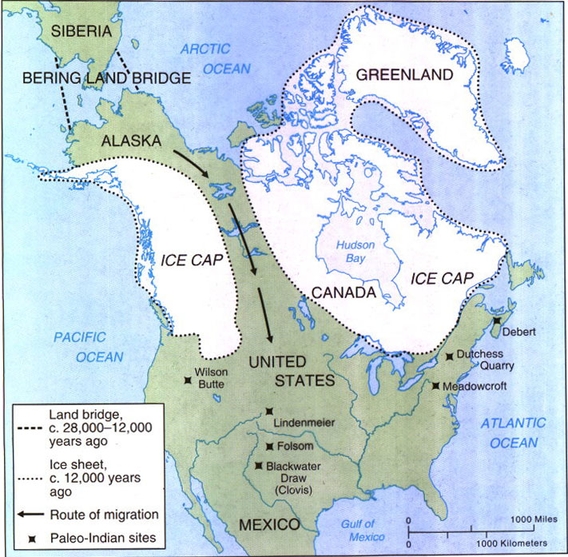
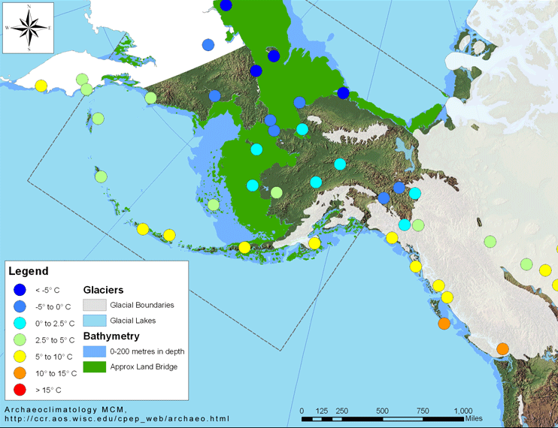
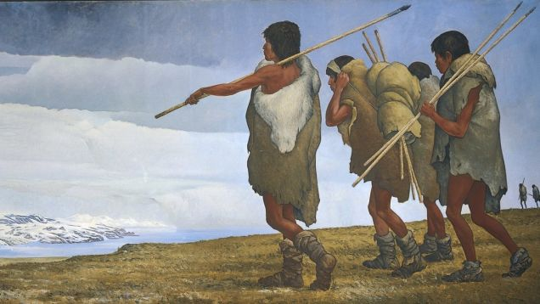
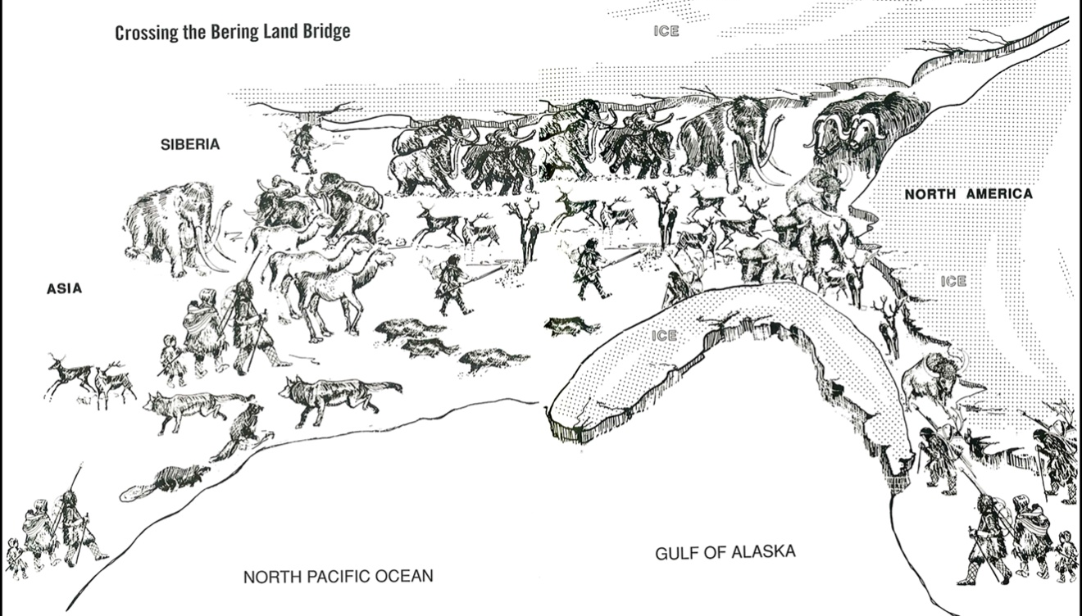
Native American Origins (archaeological theory)
Ca. 15,500 B.P.

Slide 15
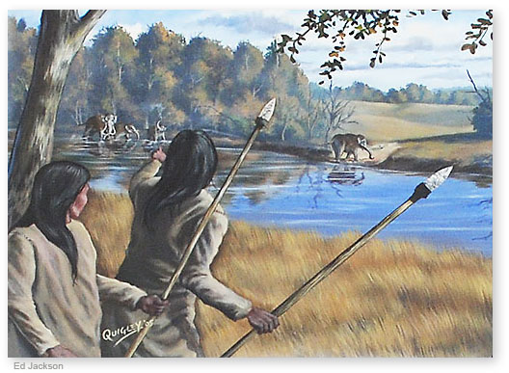
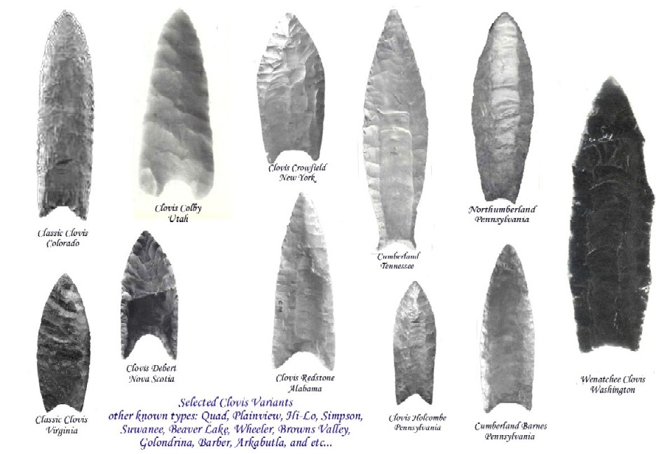
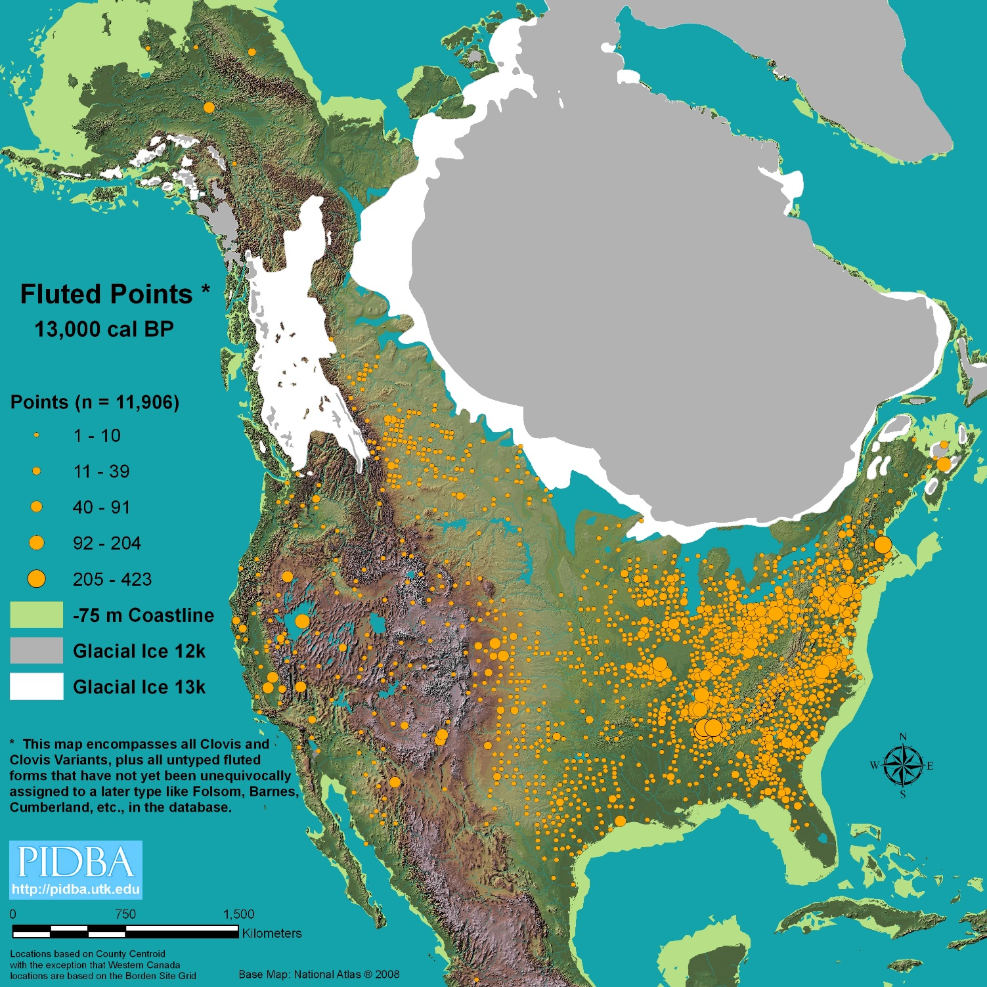
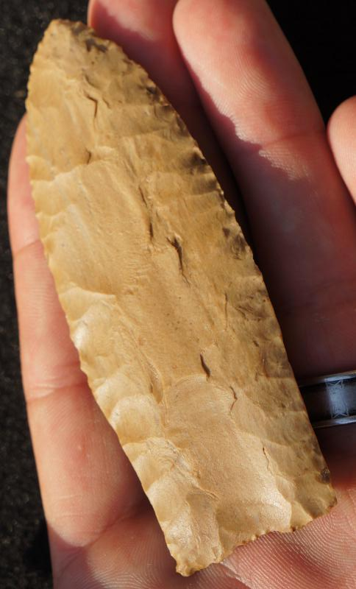

Slide 16
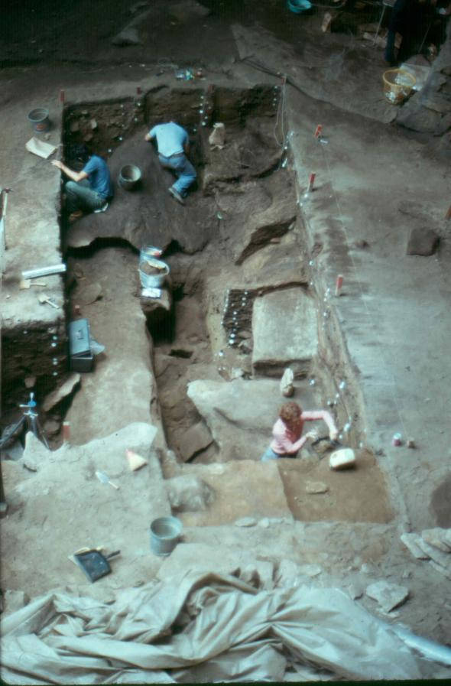
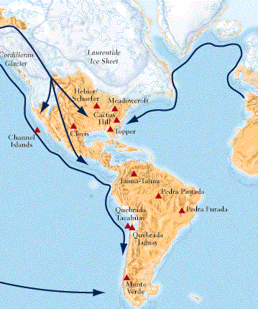
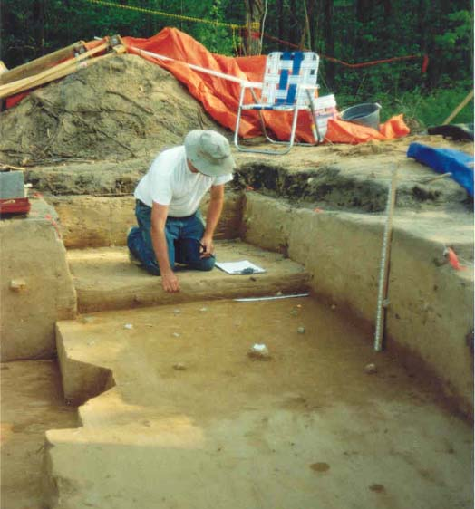
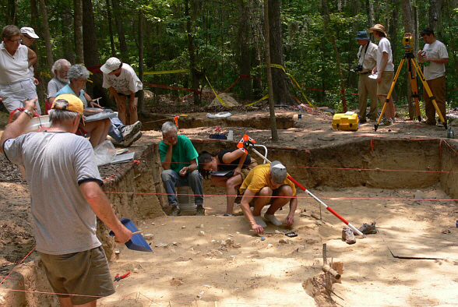
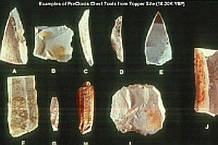
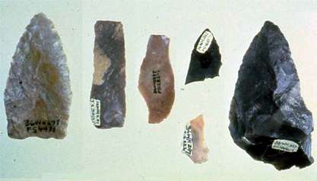
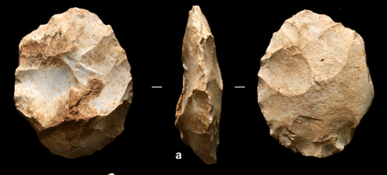
Could Someone Have Met Clovis?
Meadowcroft Rockshelter, PA
19,000 to 13,000 y.a.
Cactus Hill, VA 22,000 to 18,200 y.a.
Topper, SC 20,000 to 16,000 y.a.

Slide 17
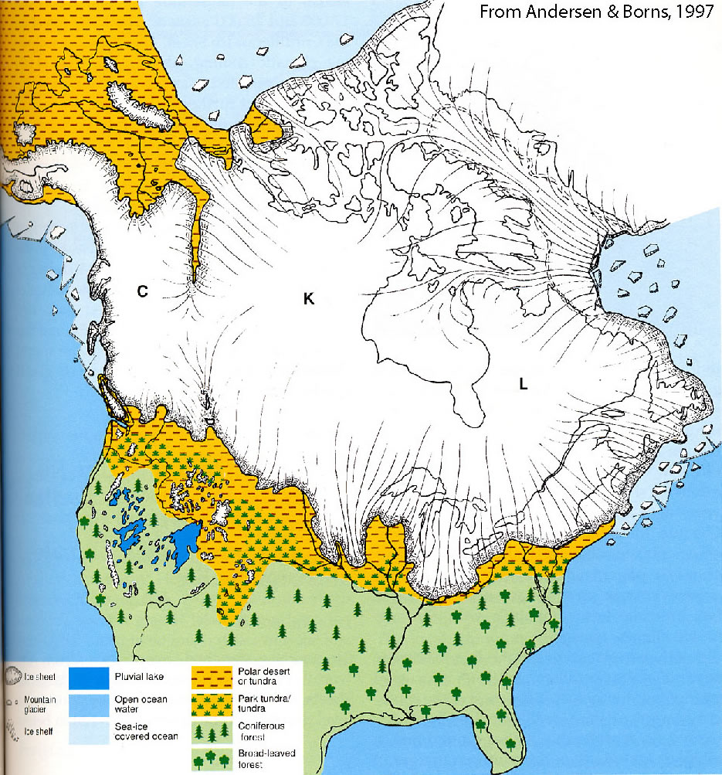
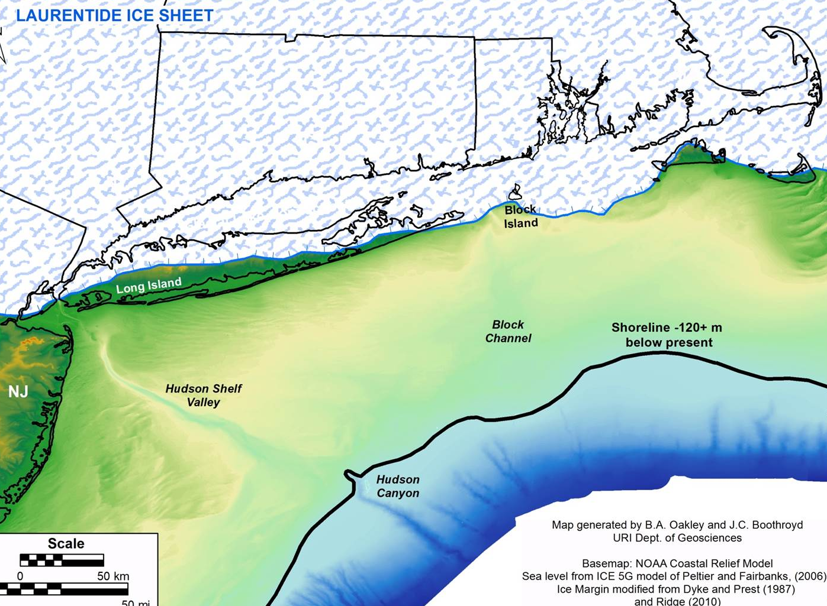
Pre-Clovis in RI? Maybe - Late Glacial Maximum Glaciation ca. 26,000 ya.

Slide 18
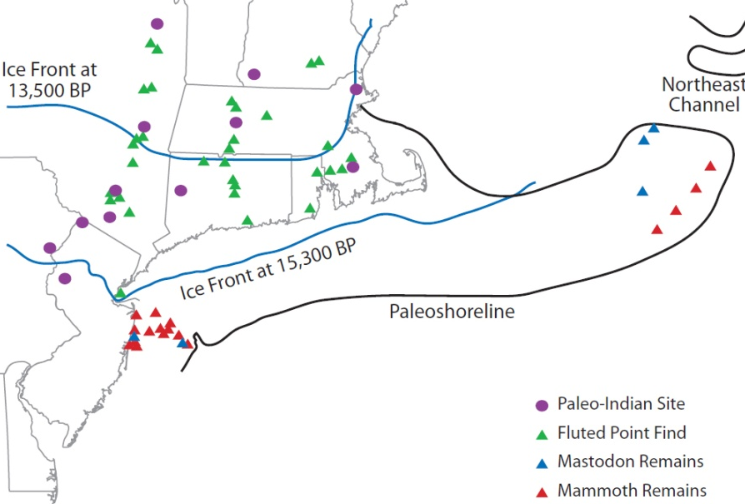
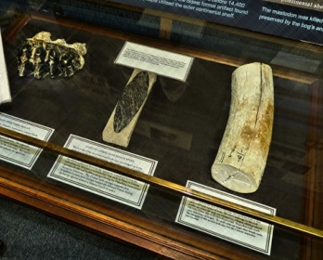
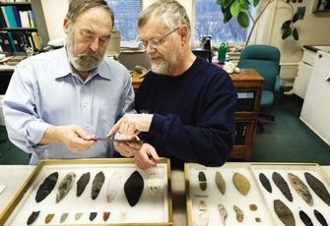
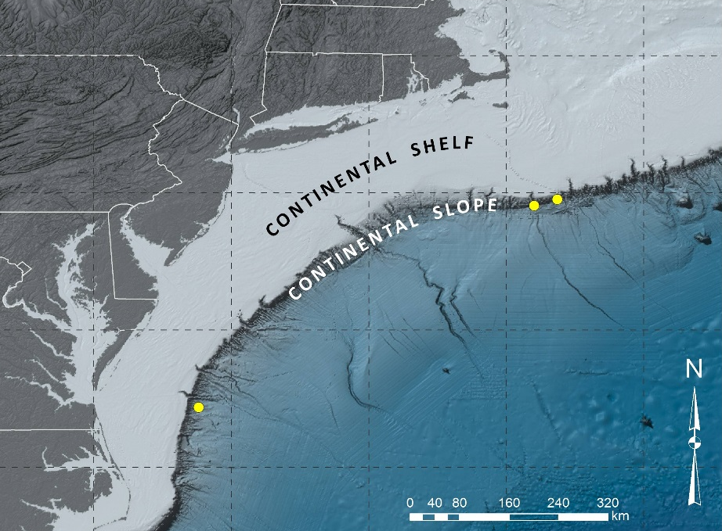
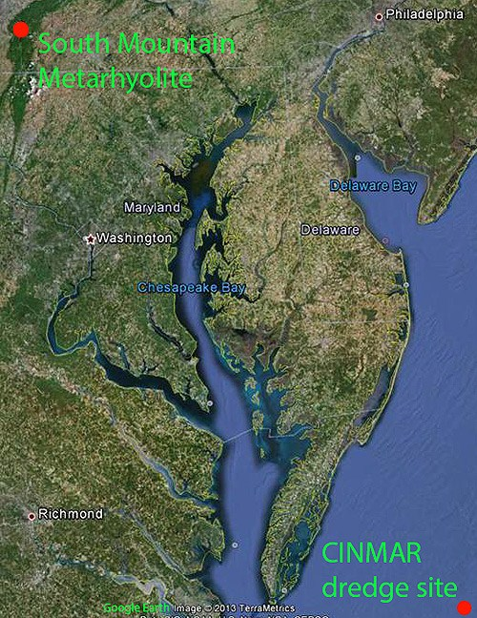
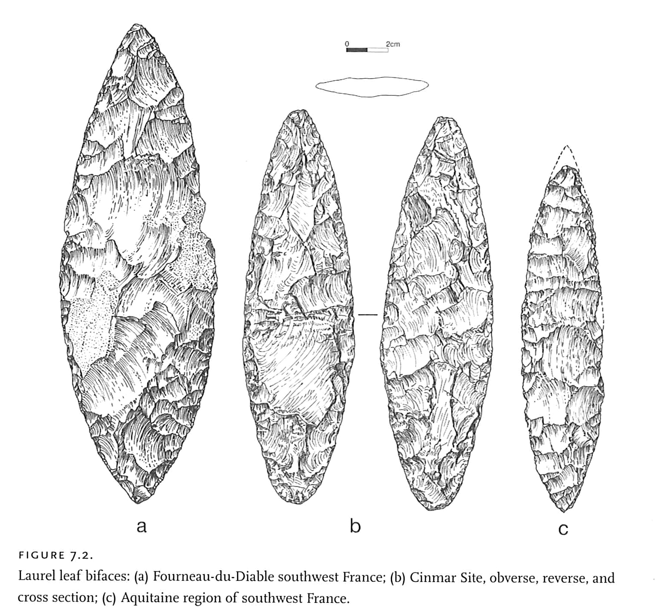
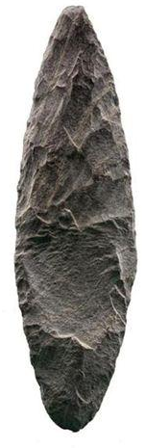
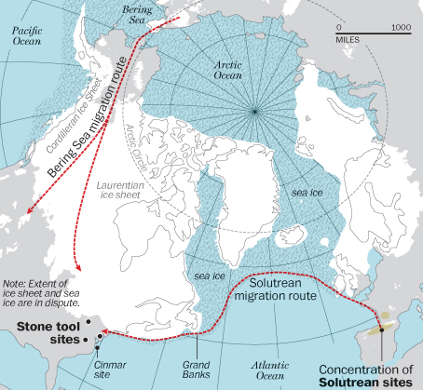
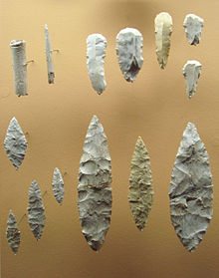
At least not on land
100 km (62 mi) off shore in 75 m (246ft) of water.
Collagen C14 date of mastodon ca. 23,000 y.a.

Slide 19
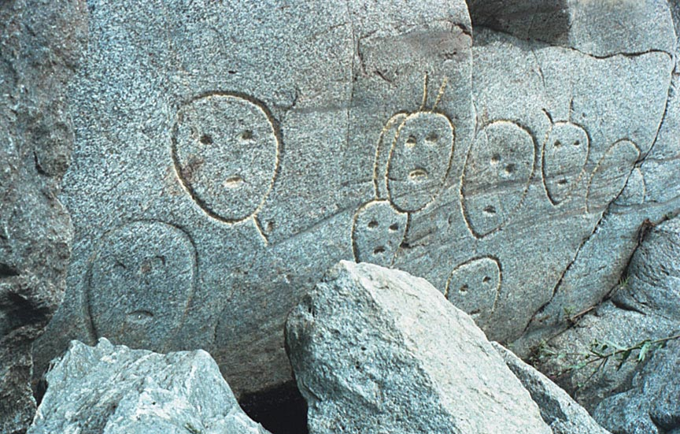
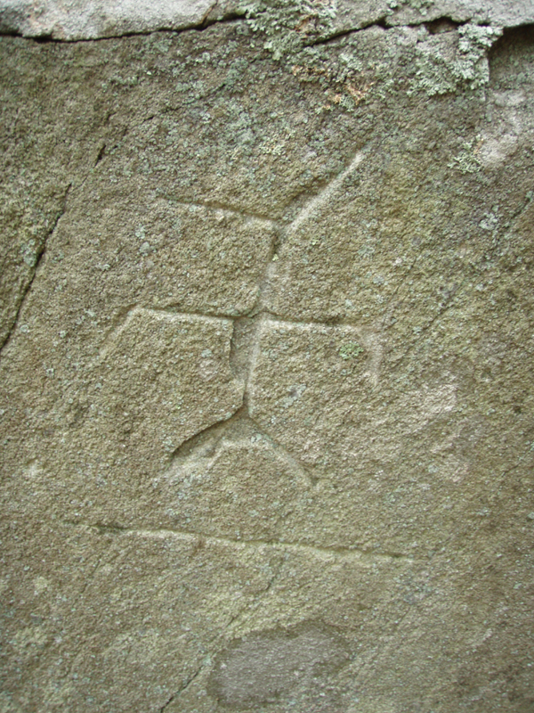
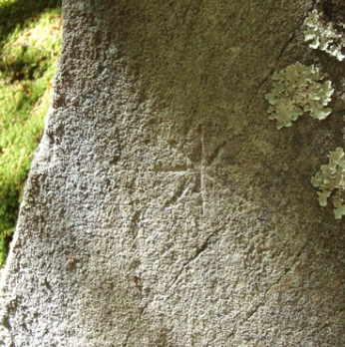
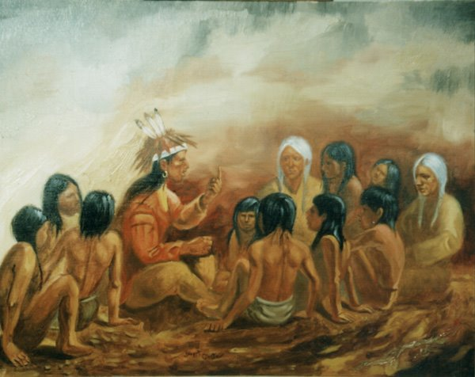

Slide 20
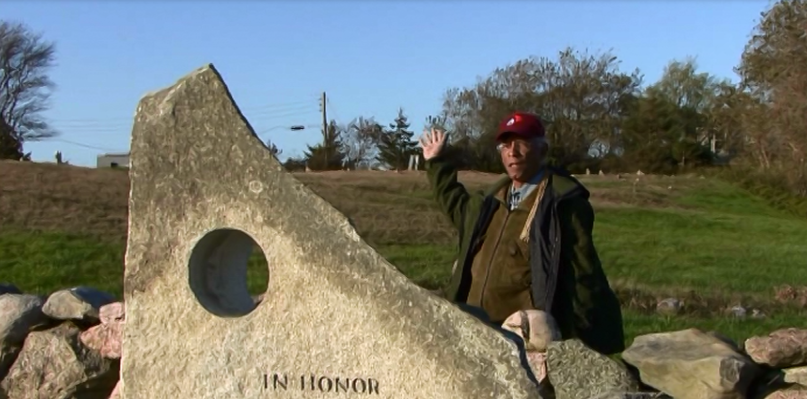
Who’s Past is it and Who Gets to Write its History?
Narragansett Tribal Oral History
Informs us that more than 15,000 years ago, the ancient villages of the ancestral Narragansett were out where the ocean is now, and that overnight the ocean’s waters began to rise and their people had to evacuate their ancient homes.

