Slide 1
El Niño Southern Oscillation
Description (El Nino vs La Nina)
Global Weather Impacts
History/Frequency
North Atlantic Version
http://cdebi.gso.uri.edu/GCH103/videos/El_Nino_1.mov

Slide 2
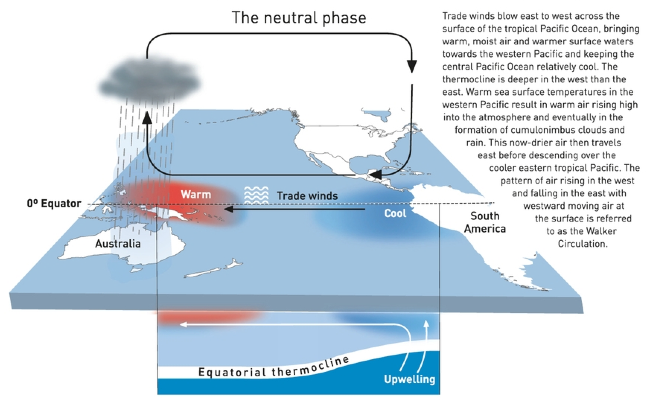
El Nino Southern Oscillation (ENSO)
Trade Winds Strength
- ”normal”

Slide 3
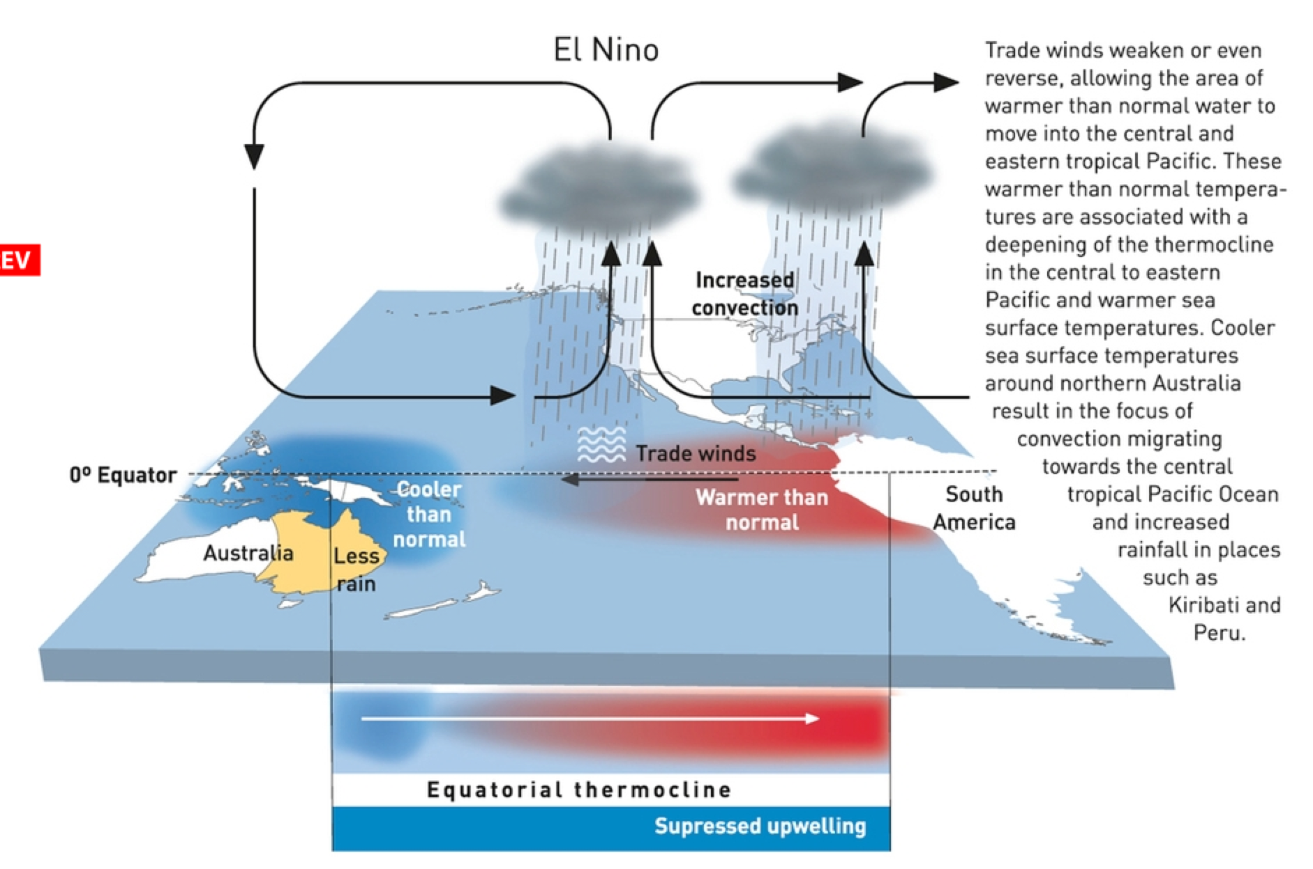
El Nino Southern Oscillation (ENSO)
Trade Winds Strength
- ”weaker”

Slide 4
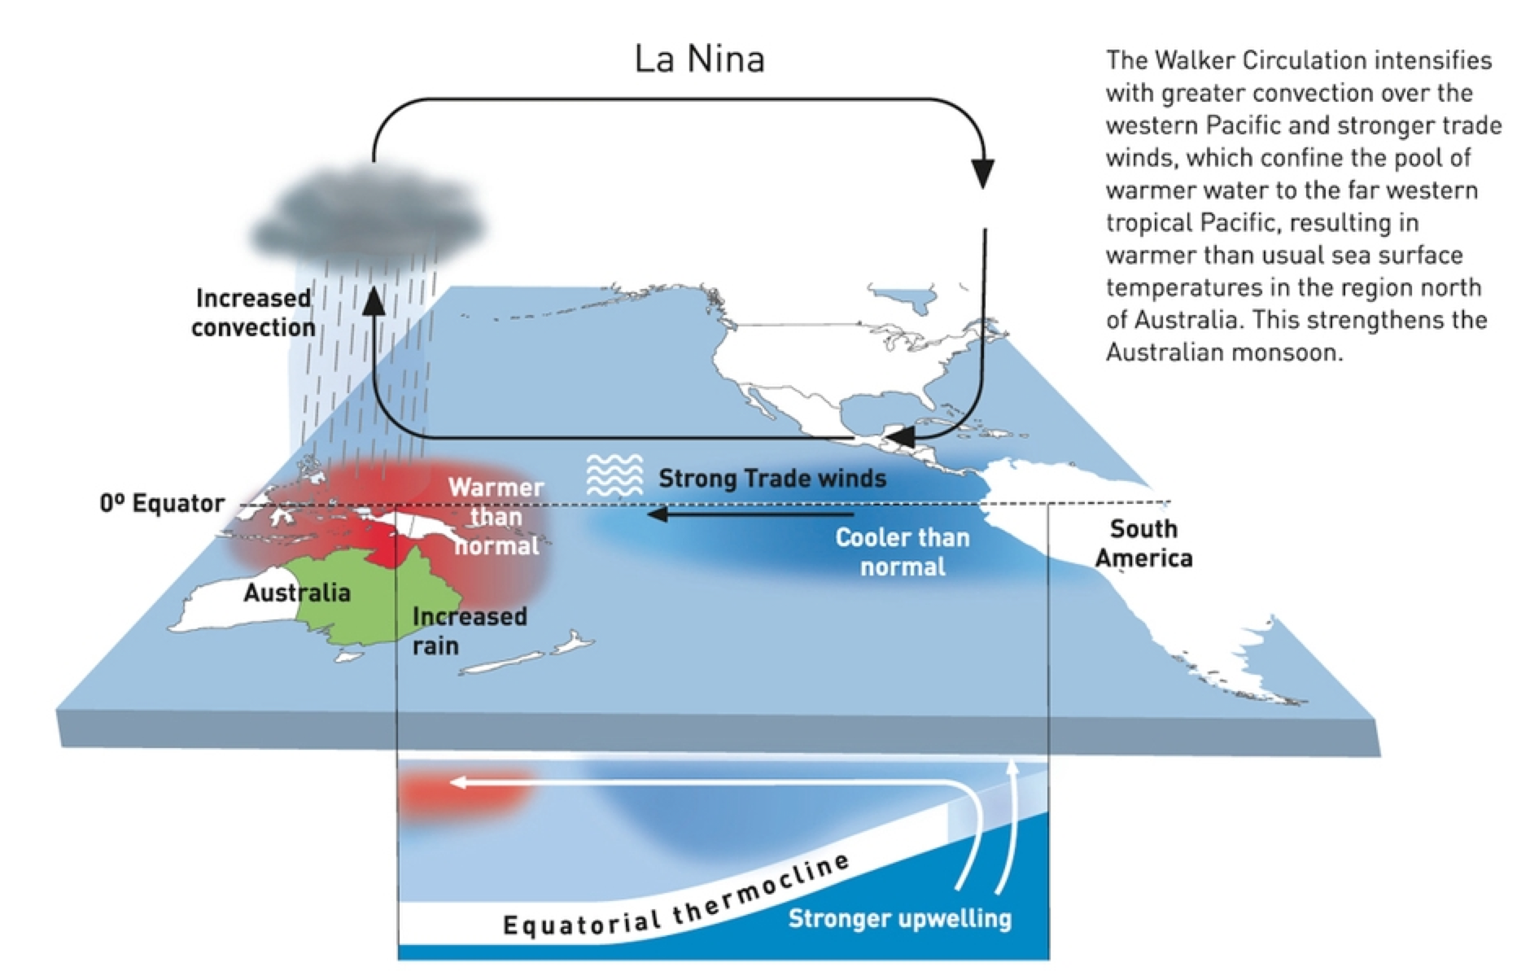
El Nino Southern Oscillation (ENSO)
Trade Winds Strength
- ”strongerl”

Slide 5
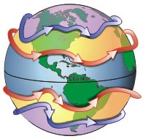
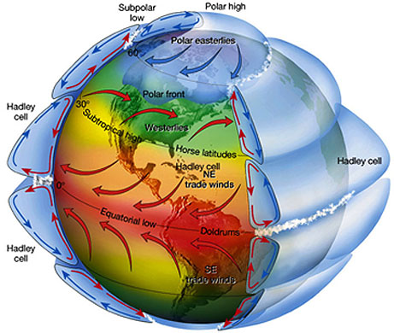
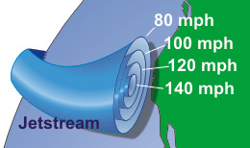
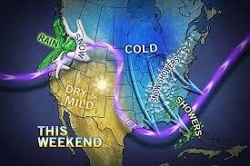
Jet Streams
Polar
Sub-Tropical
H
L

Slide 6
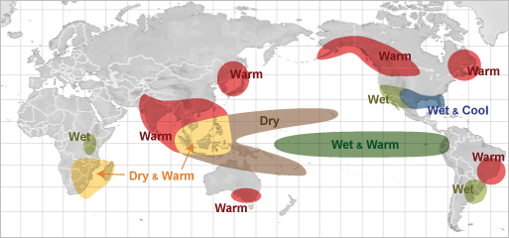
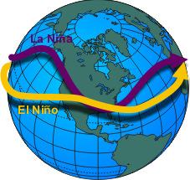
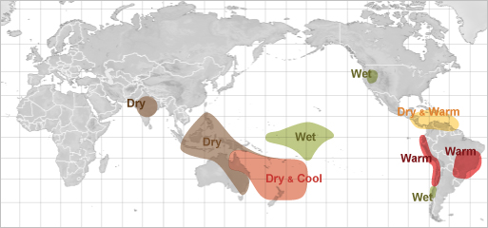
ENSO Weather Impacts
El Nino
Winter
Jetstream
Path
Summer

Slide 7
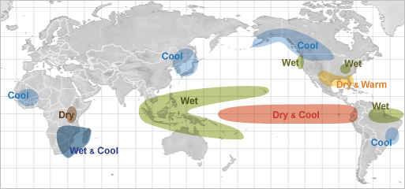
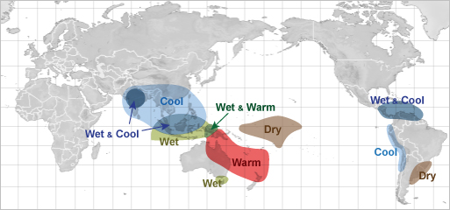
ENSO Weather Impacts
La Nina
Winter
Jetstream
Path
Summer

Slide 8
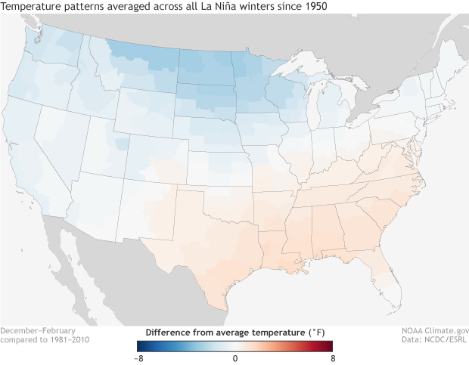
ENSO Weather Impacts
La Nina

Slide 9
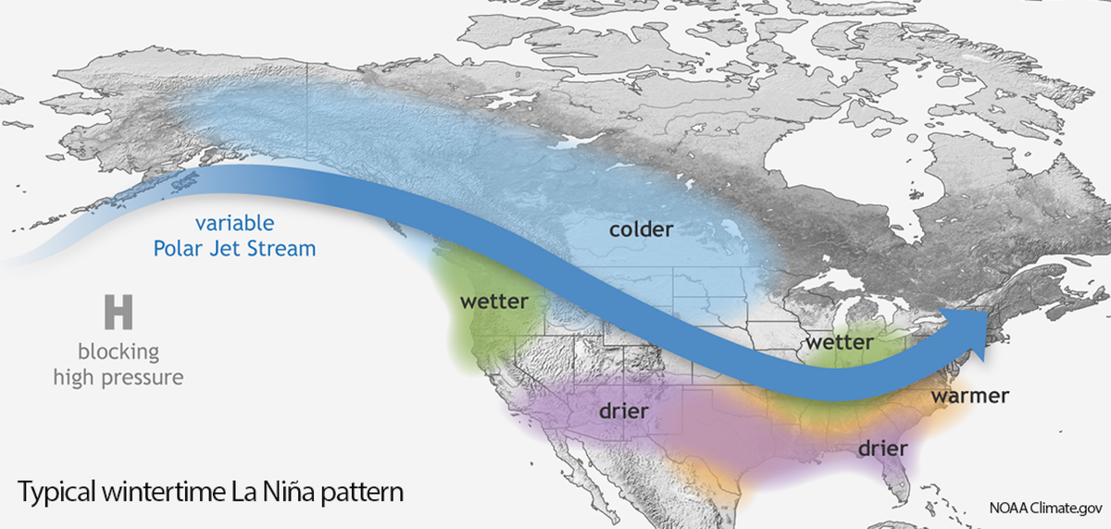
ENSO Weather Impacts
La Nina

Slide 10
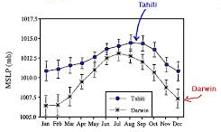
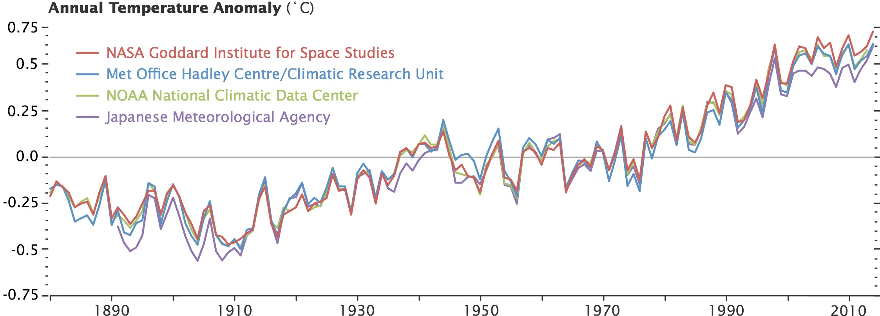
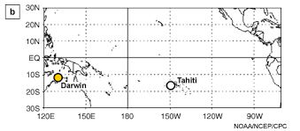
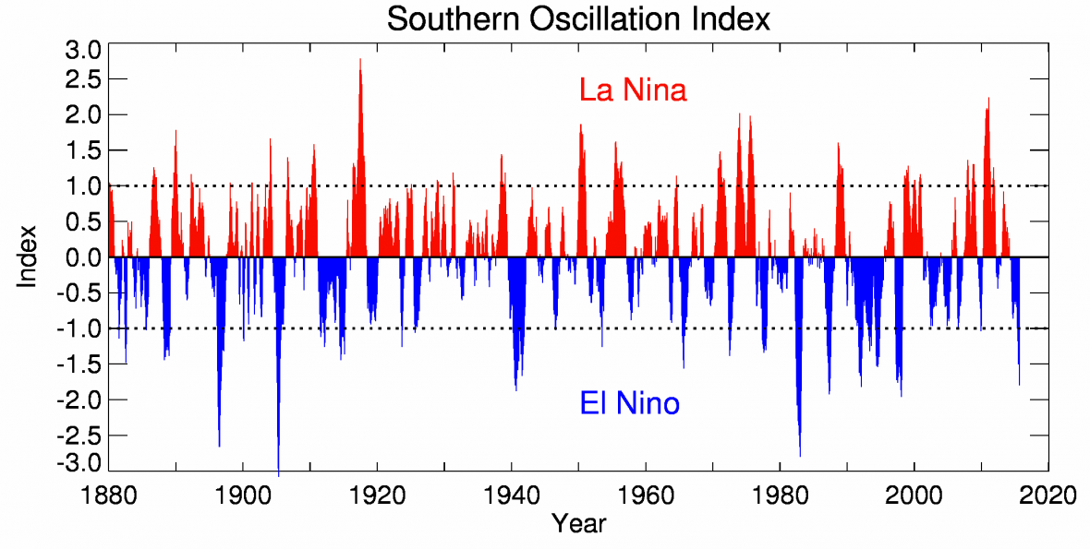
ENSO Recent History
2 to 7 year frequency

Slide 11
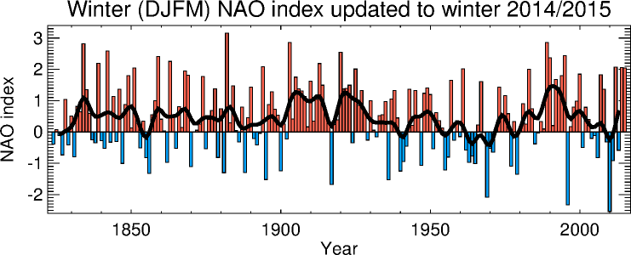
North Atlantic Oscillation (NAO)
Positive Mode
Negative Mode
Strong pressure systems (H & L) over Atlantic
- “Guide” Jetstream between systems
Weak pressure systems (H & L) over Atlantic
- Allow Jetstream to meander

Slide 12
ENSO NAO Comparison
2 to 7 year frequency

