Slide 1
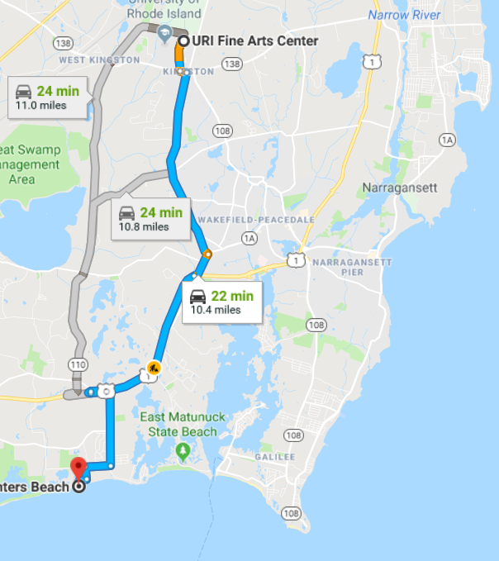
OCG103g - Impact of Global Change on NE’s Coastal Environment
Field Trip Review
Group Projects

Slide 2
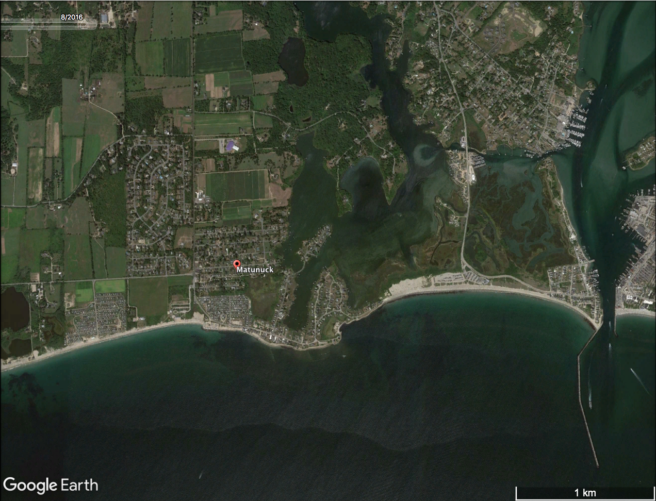
Field Trip Review
Ocean Mist
Roy Carpenter’s
Beach

Slide 3
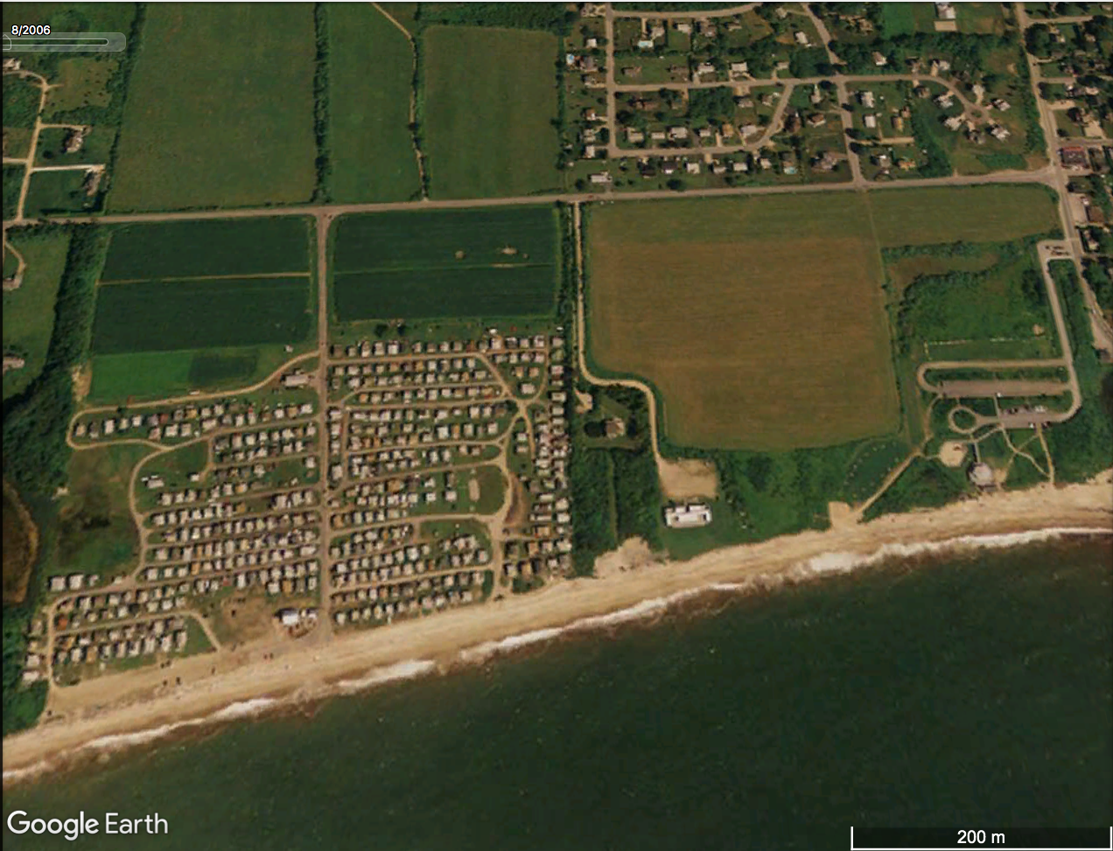
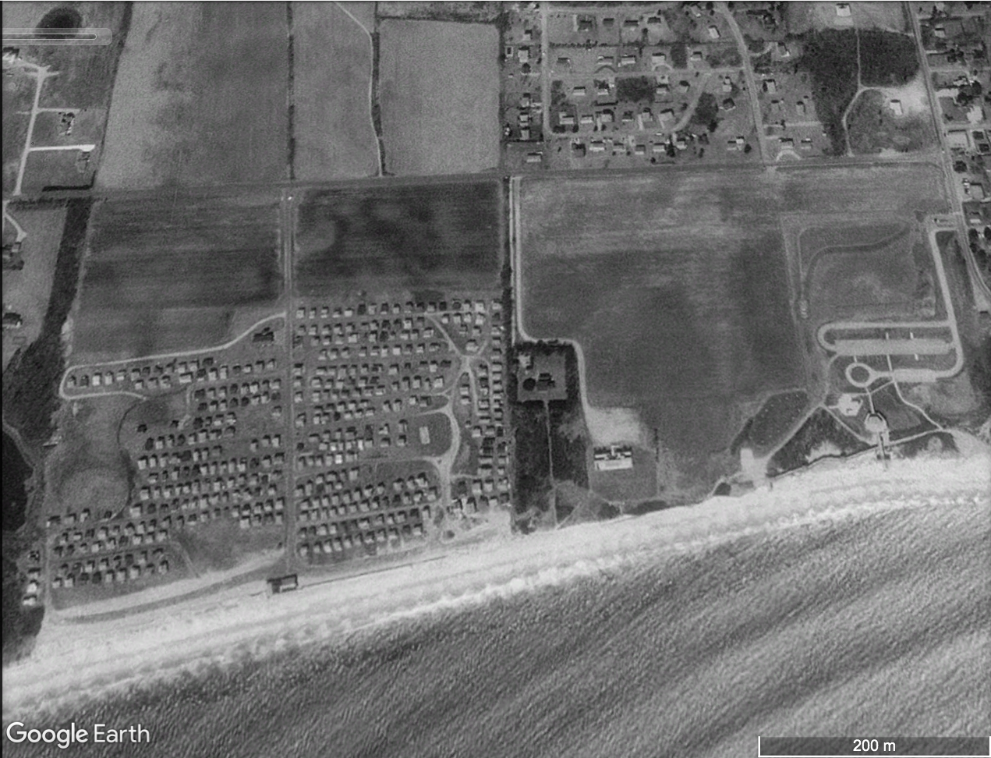
Field Trip Review
2006
Pavilion
Pavilion
1995
Pavilion
Pavilion

Slide 4
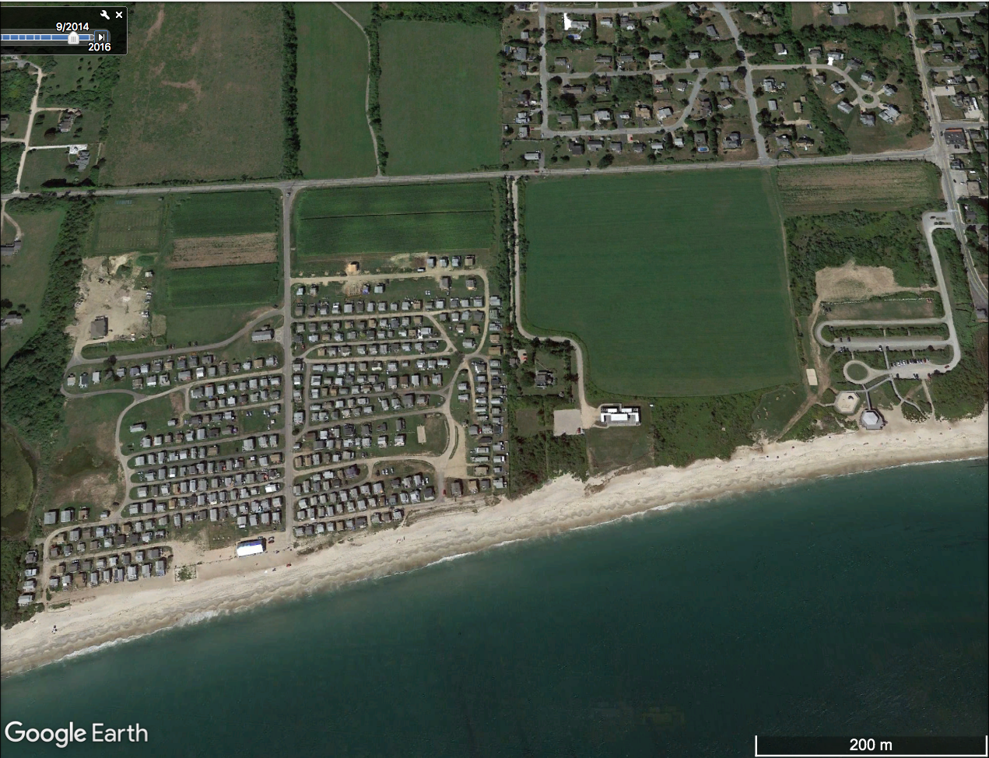
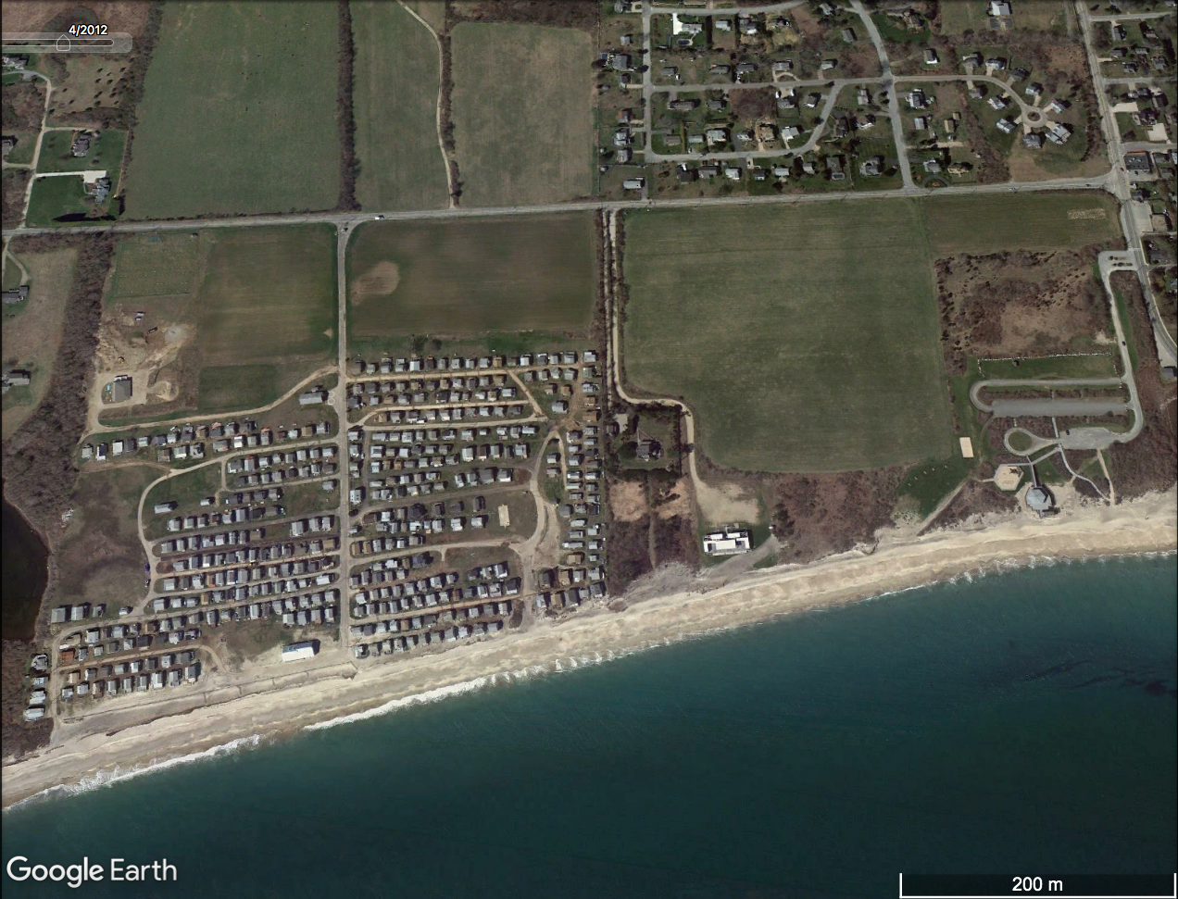
Field Trip Review
2012
post-Sandy
Pavilion
Pavilion
2012
pre-Sandy
Pavilion
Pavilion

Slide 5
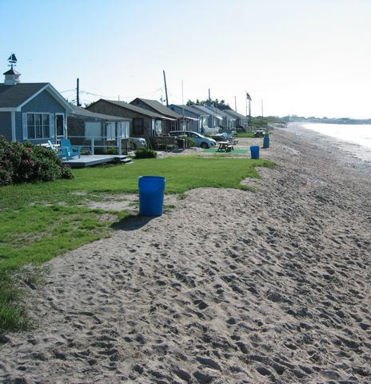
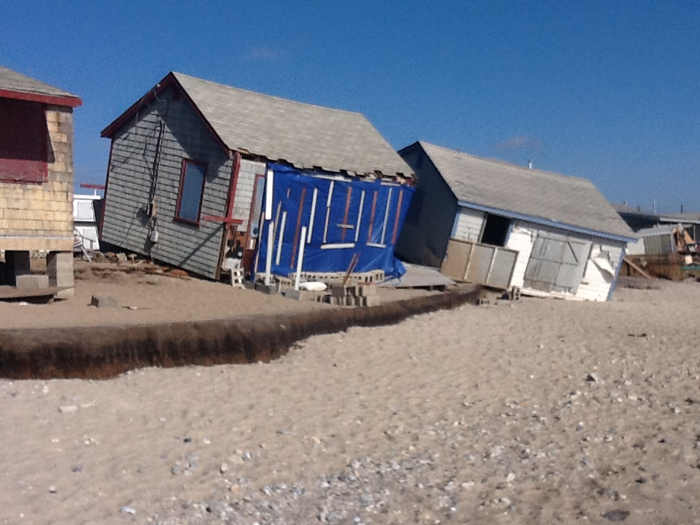
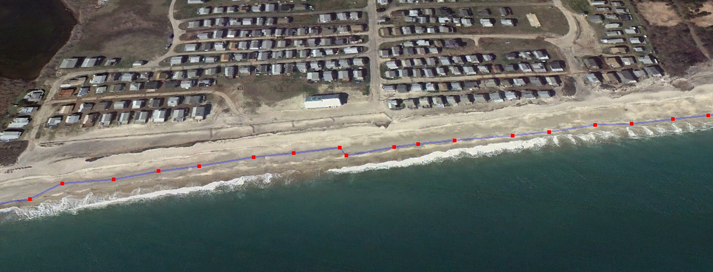
Field Trip Review
pre-Sandy
post-Sandy
4/2/2012

Slide 6
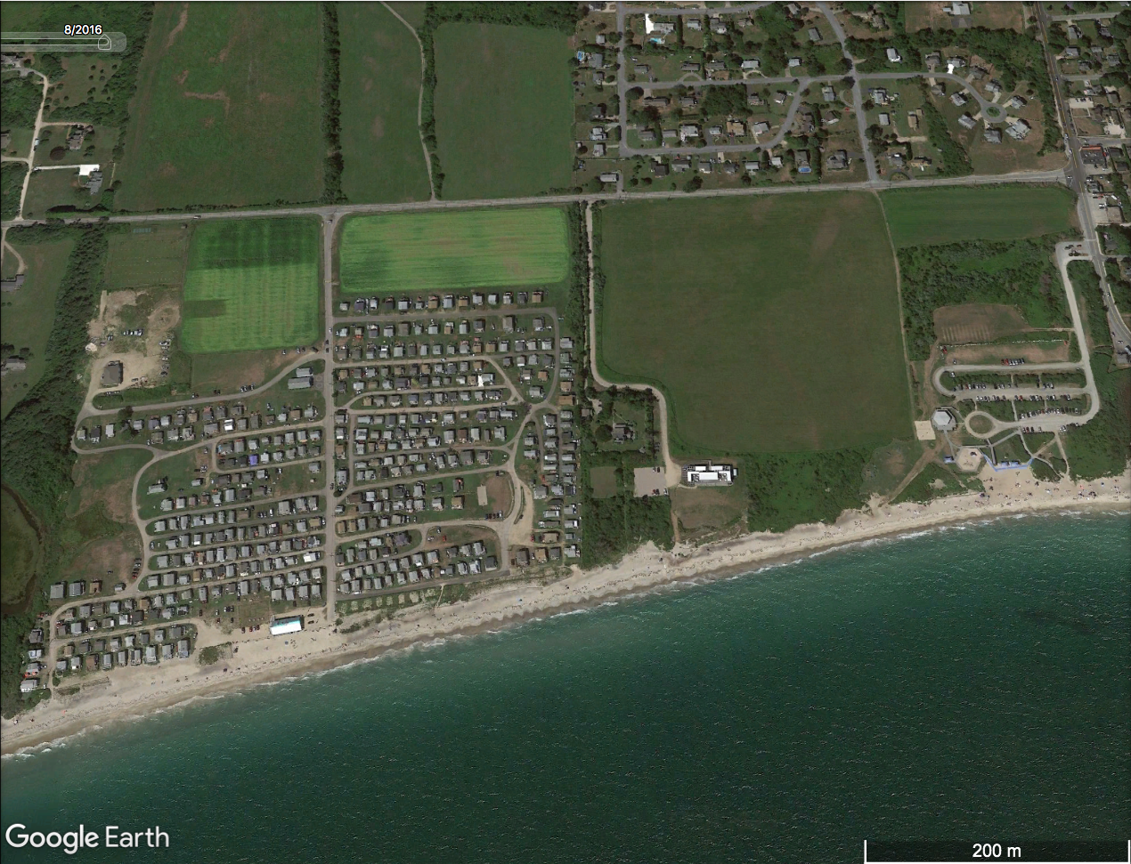
Field Trip Review
2016
Pavilion
Pavilion
2014
Pavilion
Pavilion

Slide 7
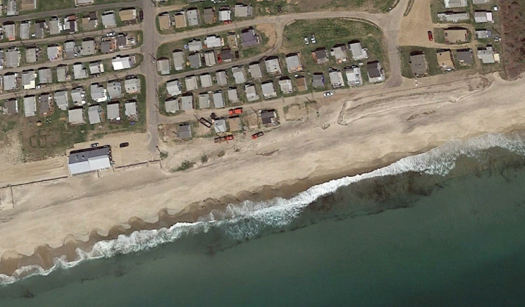
Field Trip Review
2015

Slide 8
Field Trip Review
Ocean Mist

Slide 9
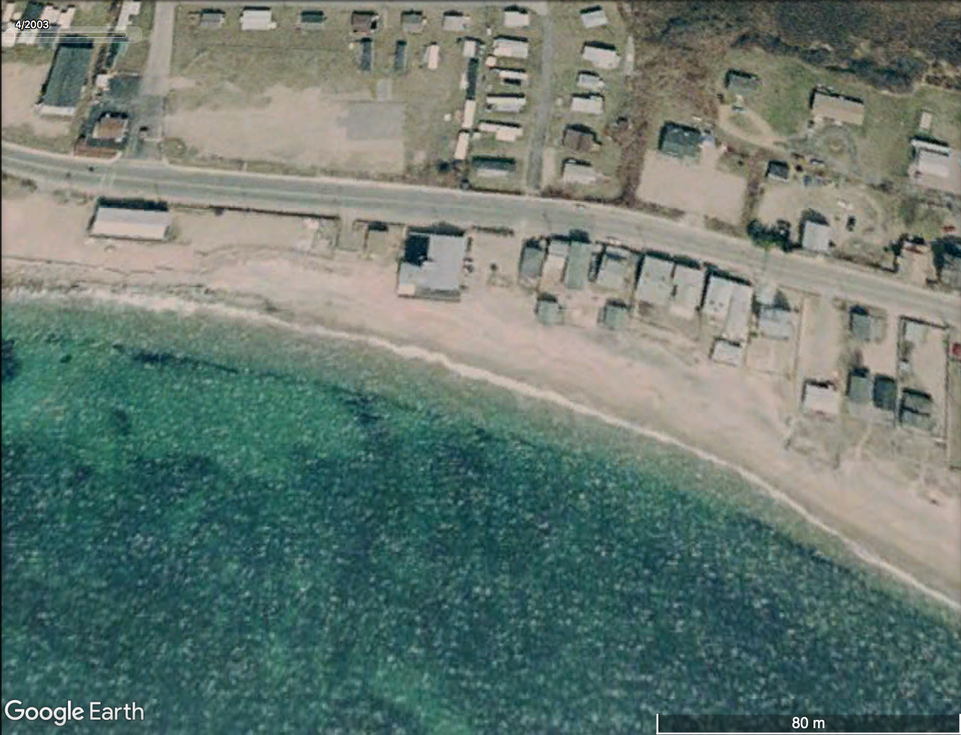
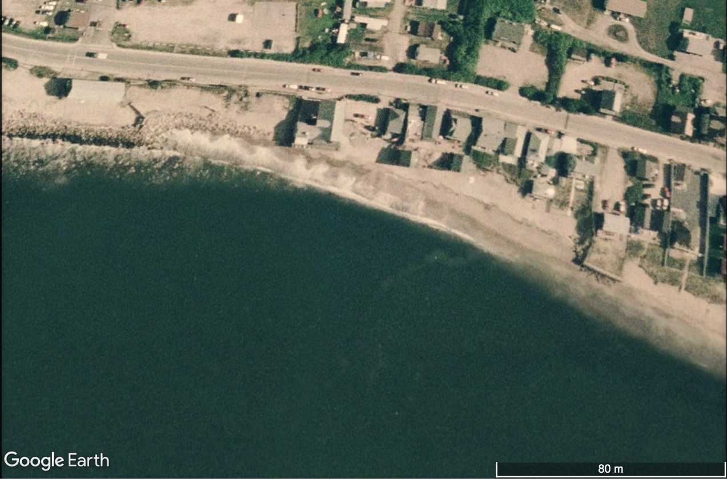
Field Trip Review
Ocean Mist
2003
2007

Slide 10
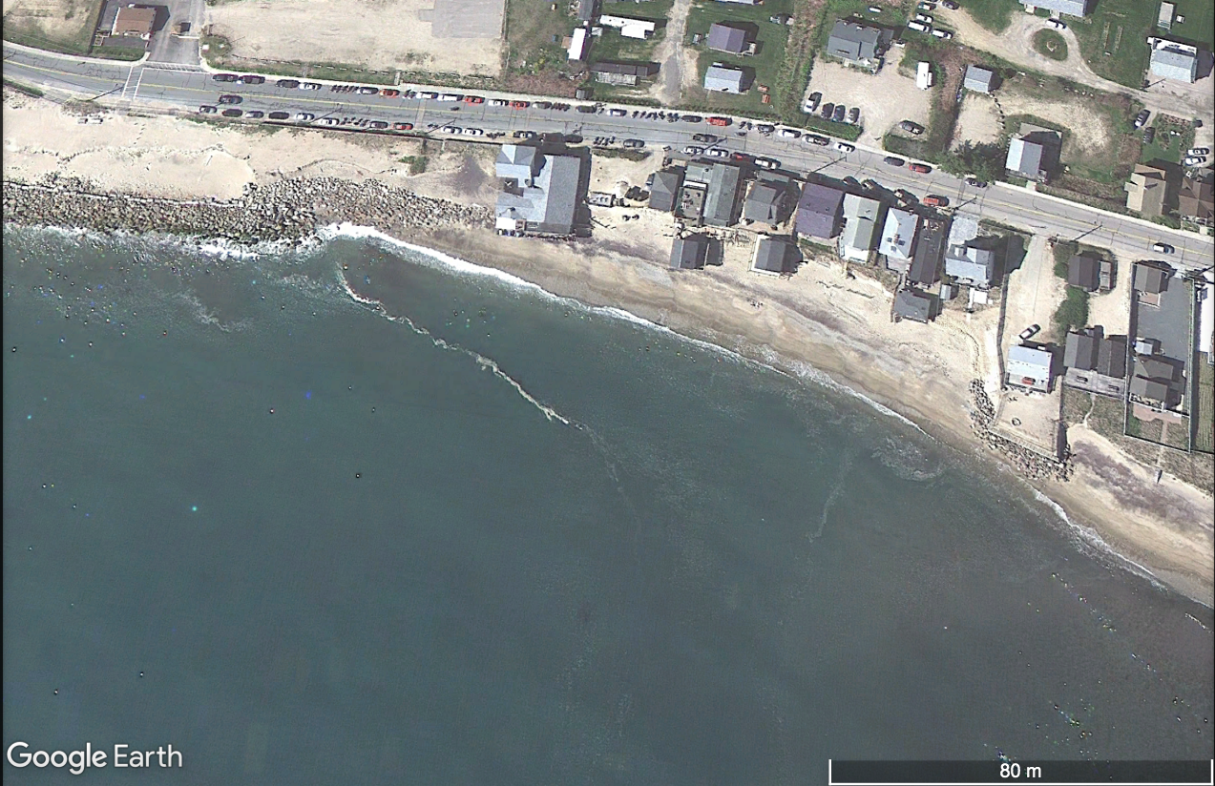
Field Trip Review
Ocean Mist
2007
2010

Slide 11
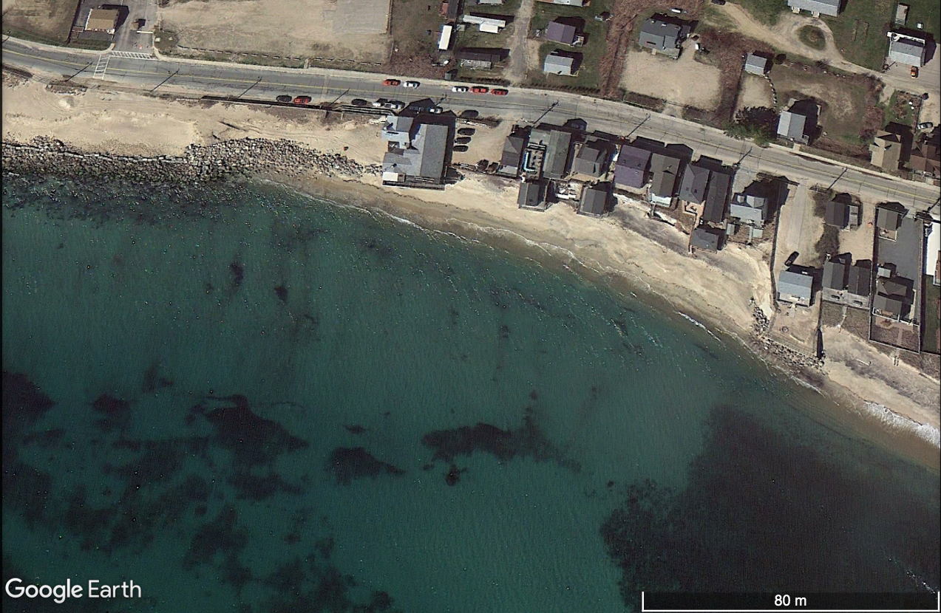
Field Trip Review
Ocean Mist
2010
2012
pre-Sandy

Slide 12
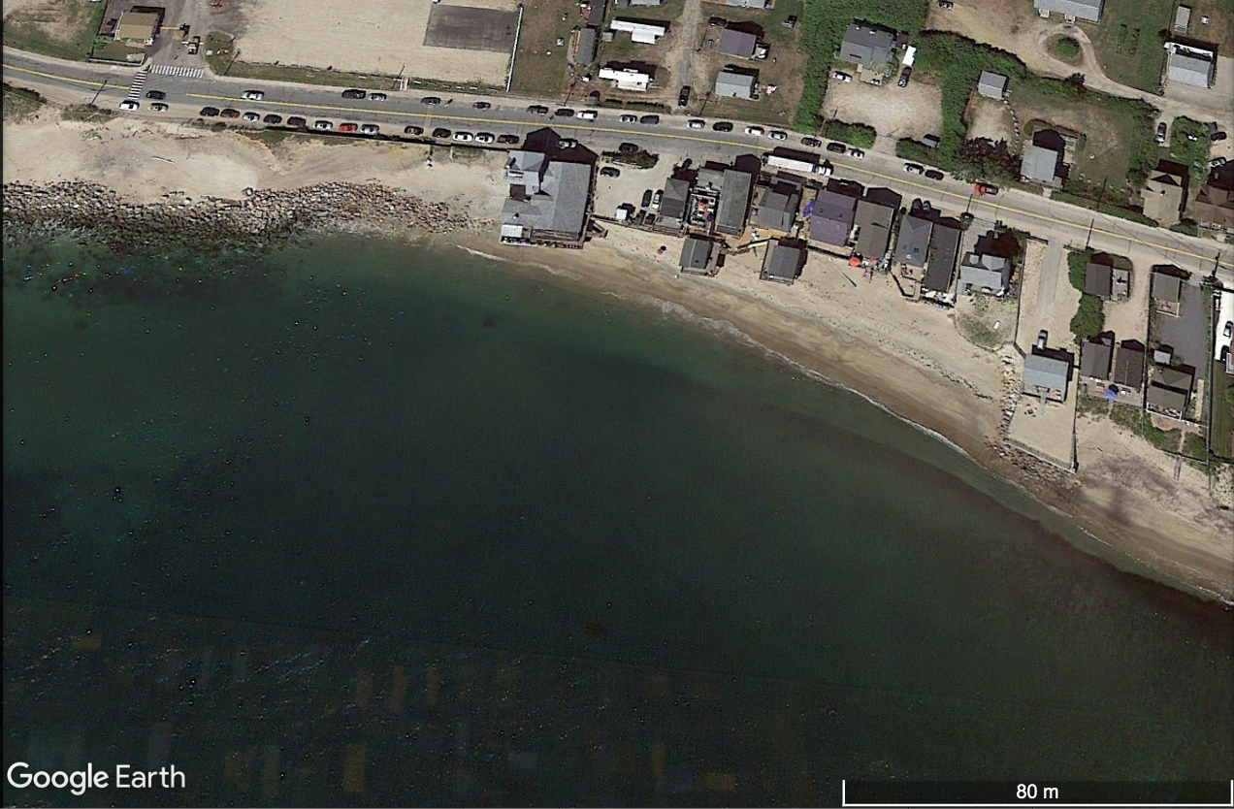
Field Trip Review
Ocean Mist
2012
pre-Sandy
2014

Slide 13
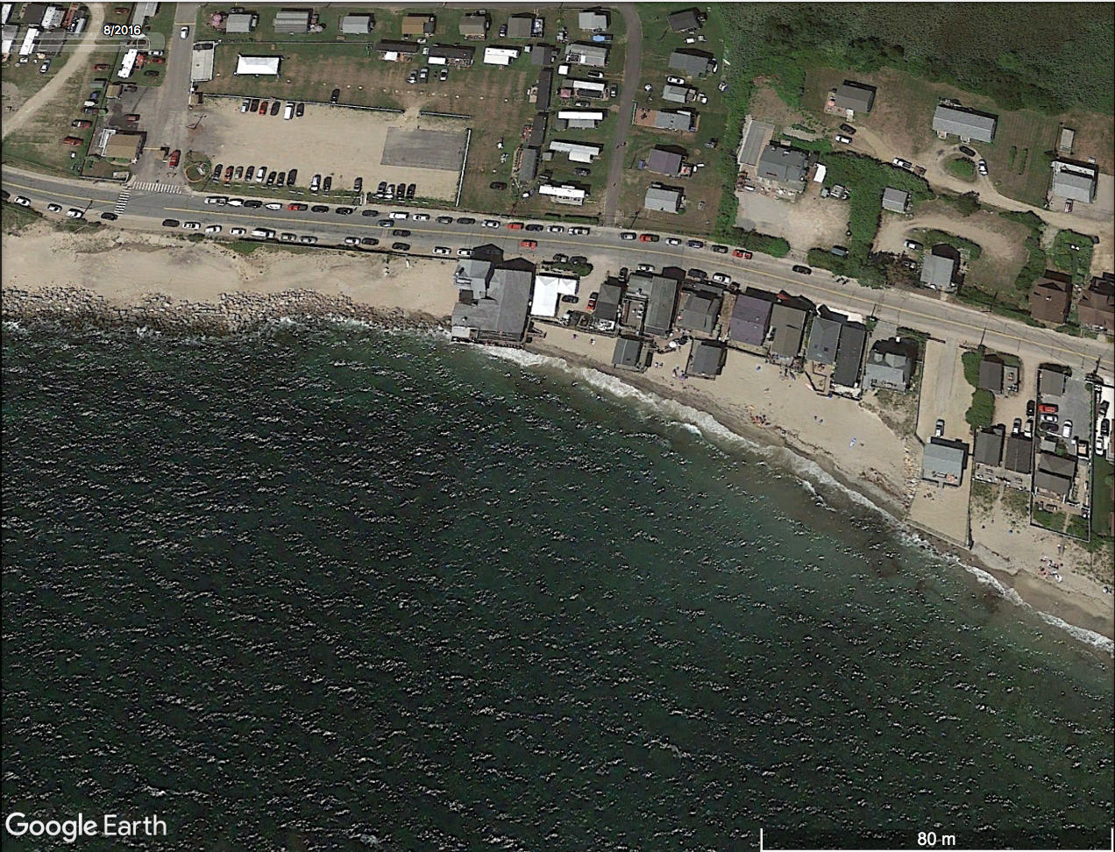
Field Trip Review
Ocean Mist
2014
2016

Slide 14
Field Trip Review
Ocean Mist
2003
2016

Slide 15
Group Presentations
Impact of Global Change on New England’s Coastal Environment
Global Change Topic Societal Institutions
- global warming - economy
- sea level rise - education
- extreme weather - family
- corporate globalization - politics
- ecosystem disruption - religion
- expanding disease range
Demonstrates Critical Thinking
4-person groups (TBD)
2 minutes each (10 minutes total, 2 minutes fo questions)
May 10th, 8-11 AM (during scheduled finals)

Slide 16
Levels of Critical Thinking (Spectrum)
1) Uninformed
- never heard of it before
2) Hear-Say
- information from parents, friends, media?
3) Initial Fact Checking
- check source of information without
regard to quality of reference
4) Advanced Fact Checking
- use high-quality references or collect data
5) Discrimination
- able to ID good and bad arguments
- see alternative interpretations
6) Critical Thinker
- ID issue,
- gathers relevant info,
- reasoned interpretations
- possible alternatives
- communicate results

Slide 17
Group Projects
6) Critical Thinker
- ID issue,
- gathers relevant info,
- reasoned interpretations
- possible alternatives
- communicate results
Accepter vs Deny-er
Accepter vs So-What-er
Person #1
Introduction
- identify the Issue
- set the stage
Person #2
Person #3
Interpretation #1
- gather data/info
- reasoned interpretation
Interpretation #2
- gather data/info
- reasoned interpretation
Societal Implications
- One or more societal institutions
- Related to interpretations
- What could/should be done
Person #4

Slide 18
Content | Did the presentation provide useful information? Were appropriate graphics/data used and referenced?
3 | Presentation had significant useful information and appropriate graphics/references.
2 | Presentation had modest useful information and/or appropriate graphics/references.
1 | Presentation was lacking in useful information and appropriate graphics/references.
Organization | Was the presentation well organized and easy to follow? Were transitions and proposed format followed?
3 | The presentation was well organized and followed proposed format
2 | The presentation was sufficiently organized and somewhat followed the proposed format.
1 | The presentation was poorly organized and did not follow the proposed format.
Discussion | How well did the group handle the questions and discussion period ?
3 | The questions and discussion period were handled very well.
2 | The questions and discussion period were handled adequately.
1 | The questions and discussion period were handled “not so good.”
Collaboration | Did everyone contribute to the presentation? Did everyone seem well versed in the material?
3 | Everyone contributed and were knowledgeable of the material.
2 | Only some of the group contributed and were knowledgeable of the material.
1 | Group had poor coordination and lacked sufficient knowledge of the material.

Slide 19
Contribution | How much did each partner contribute to the group project | You __________ | Name _________ | Name ________ | Name ________
3 | Above Expectations – Did most of the work
2 | Met Expectations – Did their fair share
1 | Below Expectations - Slacker

Slide 20
Group Projects
Story Board
Introduction
Interpretation #1
Interpretation #2
Summary
ID Key Issue
Background Info
5 W’s
Interpretations
Possible Option
Supporting Data
Interpretation
Strength/weakness
Possible Option
Supporting Data
Interpretation
Strength/weakness
Summarize Causes
Societal Implications
Mitigation Options
What to do?
Cause of Global Warming
Temps rising
where => globally
when => since XXXX
how much => X˚C
why – GHG, sunspots
Interpretation
not rising (faulty data)
rising (natural)
rising (GHG & man)
Not Rising
Supporting Data
errors in data collection
data fudging
Summarize Arguments
key parts of arguments
select an interpretation
Societal Implications
- economic, political
(people avoid him)
Mitigation Options
- curb fossil fuels ($$)
- green energies ($)
Rising & Natural
Supporting Data
correlation w/
natural cycles
Rising & Human
Supporting Data
CO2 & Temp correlation

Slide 21
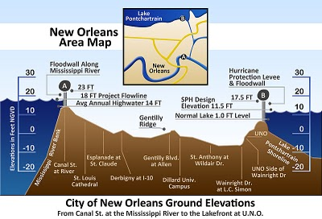
City of New Orleans (Example)

Slide 22
Group Projects
Story Board – New Orleans
Introduction
Interpretation #1
Interpretation #2
Summary
ID Key Issue
Background Info
5 W’s
Interpretations
Possible Option
Supporting Data
Interpretation
Caveats?
Possible Option
Supporting Data
Interpretation
Caveats?
Summarize Causes
Societal Implications
Mitigation Options
What to do?

Slide 24
IDENTIFY THE ISSUE

Slide 28
INTERPRETATION #1

Slide 31
INTERPRETATION #2
Infestations every 20 years (e.g., Cicadas, 17 years)
Recent increase in affected areas is an artifact of better observation tools

Slide 32
will end up costing an estimated 11,000 jobs over the next 14 years.
Winters are actually getting colder

Slide 33
INTERPRETATION #3

Slide 34
Societal IMPLICATIONS
will end up costing an estimated 11,000 jobs over the next 14 years.
Economic Impacts
- Loss of Timber
U.S. Forest Service committed $40 million for cleanup efforts in 2009
Cost an estimated 11,000 jobs in Canada over the next 14 years.
- Fire Hazard
- Loss of Tourism

Slide 35
will end up costing an estimated 11,000 jobs over the next 14 years.
What Could/Should be Done ?
- If Global Warming
Treat Forests – costly, but provides jobs
Not sure if reducing atmospheric CO2 will help
Positive Feedback of dying trees
- If Natural Cycle
Wait for nature to take its course
Not worth spending money to treat forests
No need to change our habits
- If Forest Service Practices
Change forestry practices
Wait to see if it is a climate issue

Slide 36
Group Presentations
Impact of Global Change on New England’s Coastal Environment
Global Change Topic Societal Institutions
- global warming - economy
- sea level rise - education
- extreme weather - family
- corporate globalization - politics
- ecosystem disruption - religion
- expanding disease range
Demonstrates Critical Thinking
4-person groups (TBD)
2 minutes each (10 minutes total, 2 minutes fo questions)
May 10th, 8-11 AM (during scheduled finals)

