Slide 1
Field Trip Preparation
When: Saturday, April 2nd
Depart at 10 AM (be there by 9:45 AM)
Return to URI by 12 Noon
Where: Meet at URI Visitors Center
Car Pool to Carpenter’s Beach (SK)
Weather Forecast:
High of 50 ˚F
50% chance of rain
Wind < 10 mph from the South
Dress appropriately, it will feel cooler on the beach than you think.

Slide 2
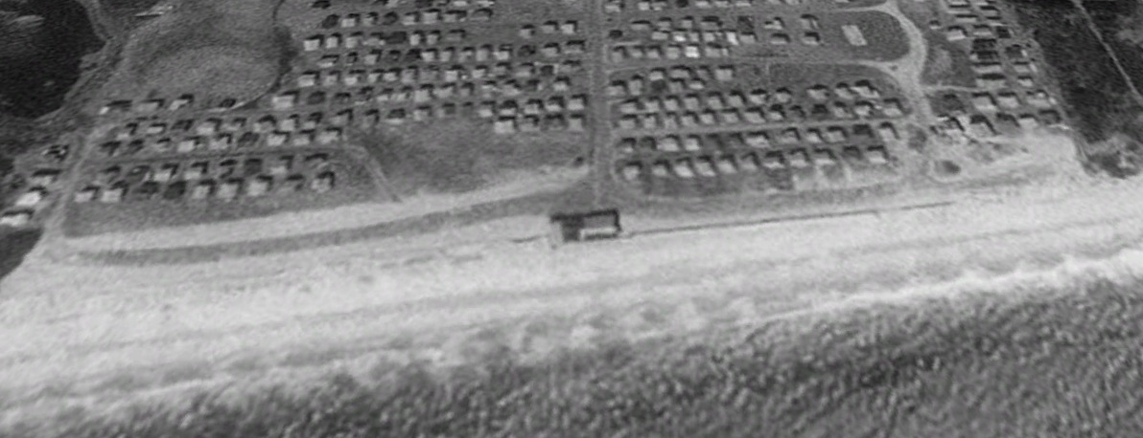
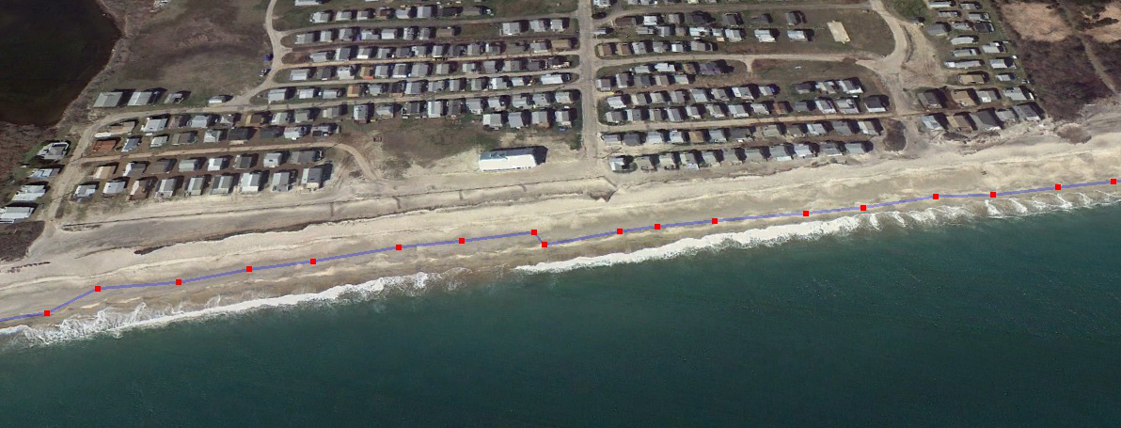
Field Trip Review
Time Scales of Change
- annual patterns
- coastal changes in your lifetime
3/28/1995
4/2/2012

Slide 3
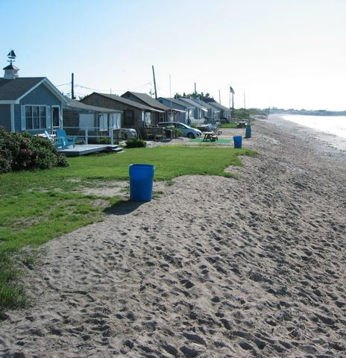
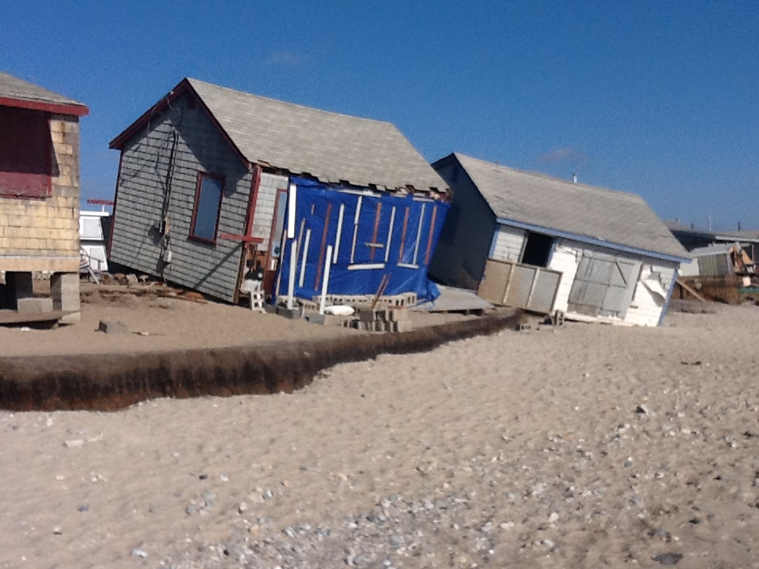
Field Trip Review
pre-Sandy
post-Sandy
4/2/2012

