Slide 1
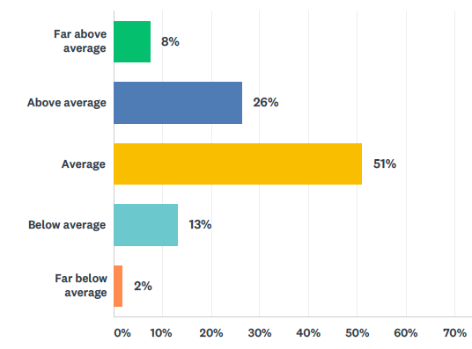
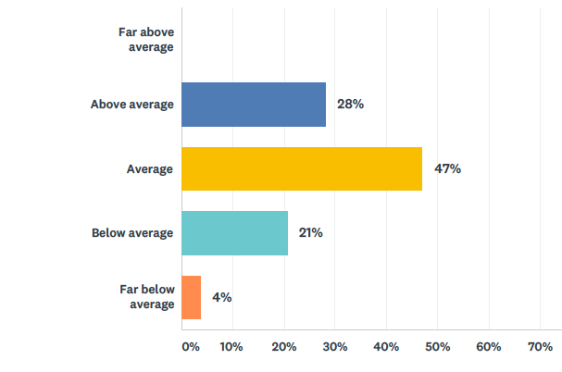
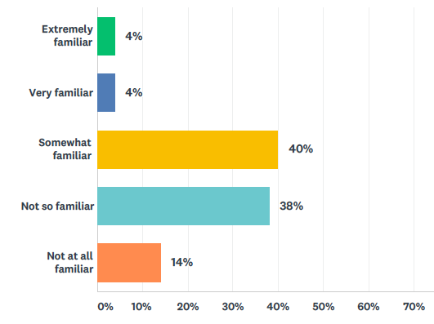
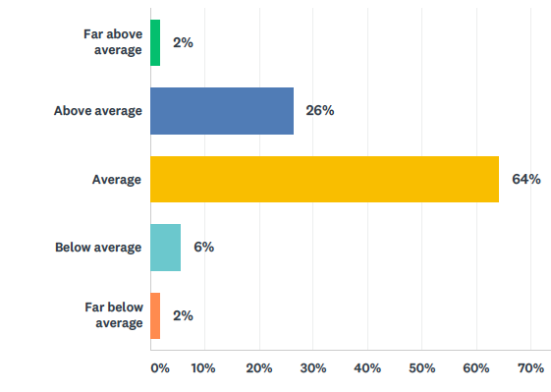
General Science Knowledge
Climate & Climate Change Knowledge
53 of 106 students responded
Natural Cycles Related to Climate
Graph Interpretation
Notes:
Basic characterization of the student prior knowledge for various science- and climate-related topics.
General science – slightly above average (3.25 rating with 3 as expected average)…std 0.84
Climate knowledge – average (3 rating with with 3 as expected average)…std 0.80
Natural cycles – below average (2.46 rating with 3 as expected average)…std 0.64
Graph Interpretation - slightly above average (3.2 rating with 3 as expected average)…std 0.92

Slide 2
Student responses to examples of a natural cycle that impacts climate change
53 of 106 students
responded
17 of 106 students
responded
Notes:
Not sure we have enough to interpret these wordclouds

Slide 3
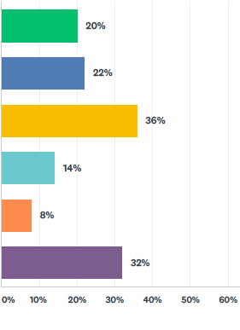
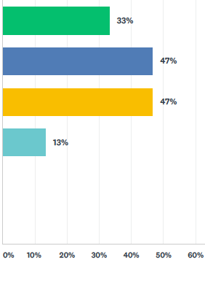
Which answers describe the relationship between the sunspots and global temperature?
(Select all that apply)
Pre-Sounds
Post-Sounds
Sunspots occur on an 11-year cycle, and are likely causes of periodic changes in global temperature.
Sunspots occur on an 11-year cycle, but are not likely causes of periodic changes in global temperature.
An increase in sunspots frequency correlates with an increase in global temperature.
An increase in sunspots frequency does not correlate with an increase in global temperature.
What are sunspots?
Don't know.
50 respondents
15 respondents
Notes:
Potentially some misleading or contradictory aspects with respect to sunspots.
I would normally accept answer #1 (green) and #3 (orange?) as correct answers.
Sunspots and sunspot frequency both impact global temperatures by less than a degree over time scales of 10-1000 years, but sunspots are not the cause for changes in global temperatures over the past century.
At least the 15 respondents in the post survey knew about sunspots.

Slide 4
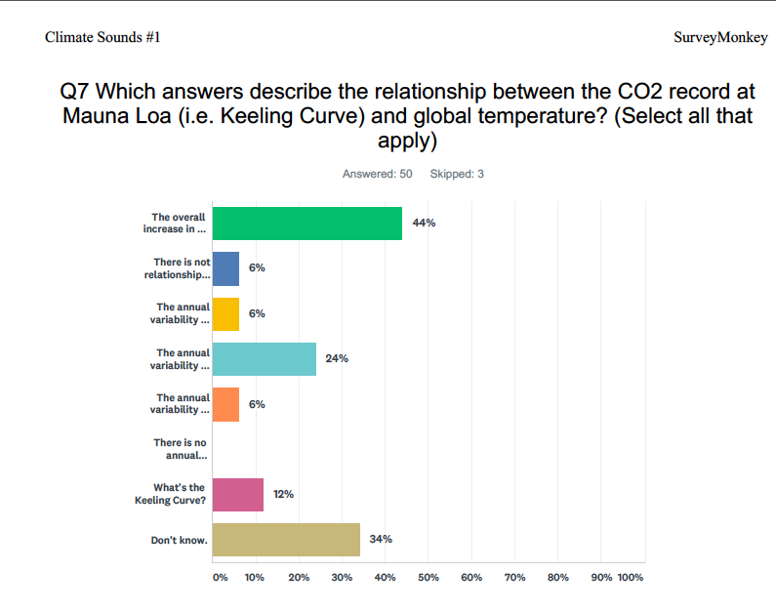
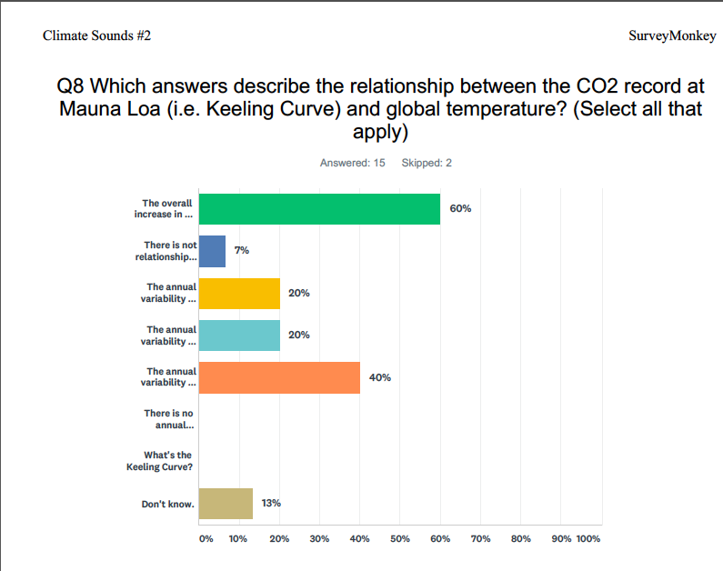
Which answers describe the relationship between the CO2 record at Mauna Loa
(i.e. Keeling Curve) and global temperature?
(Select all that apply)
Pre-Sounds
Post-Sounds
The overall increase in the CO2 trend follows the global temperature record.
There is no relationship between the CO2 trend and global temperature record.
The annual variability in CO2 is due to seasonal differences in wind patterns.
The annual variability in CO2 is due to seasonal differences photosynthesis.
The annual variability in CO2 is due to seasonal differences in temperature.
There is no annual variability in CO2.
What's the Keeling Curve?
Don't know.
50 respondents
15 respondents
Notes:
The most correct answers her are #1 (green) and #4 (turquoise?).
Increase in correct choices of #1 (44% to 60%)
Slight decrease incorrect choice of #4 (24% to 20%)
Oddly enough a big increase in the incorrect answer #5 (orange)
Improvement in knowledge of Keeling Curve and relationships, but sill an I don’t know response.

Slide 5
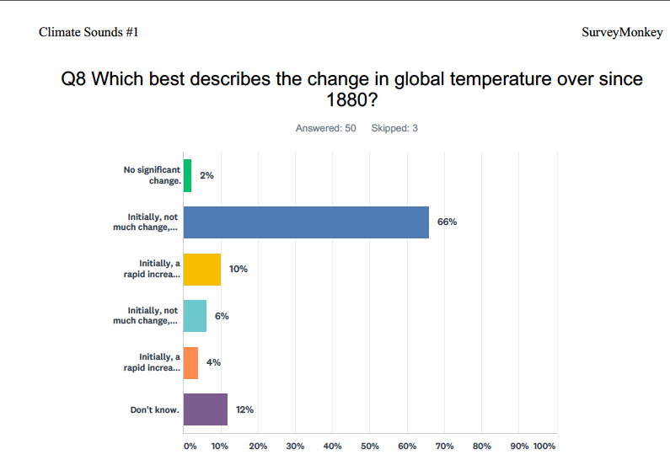
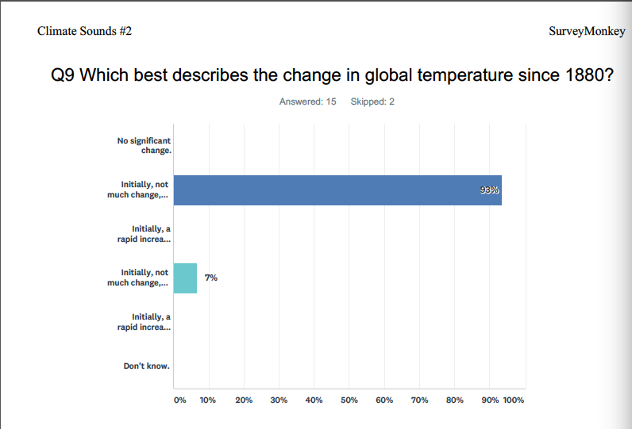
Which best describes the change in global temperature since 1880?
Pre-Sounds
Post-Sounds
No significant change.
Initially, not much change, but a more rapid increase recently.
Initially, a rapid increase, but not much change recently.
Initially, not much change, but a more rapid decrease recently.
Initially, a rapid increase, but not much change recently.
Don't know.
50 respondents
15 respondents
50 respondents
15 respondents
Notes:
Best Improvement in correct answer.

