Slide 1
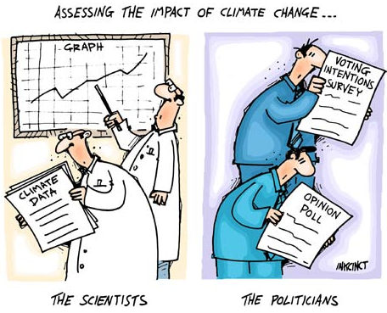
Global Change
Greenhouse Effect
Greenhouse Effect
Temperature Proxies
Example Proxies
History of Measurements (100 Myrs to 100 yrs)

Slide 2
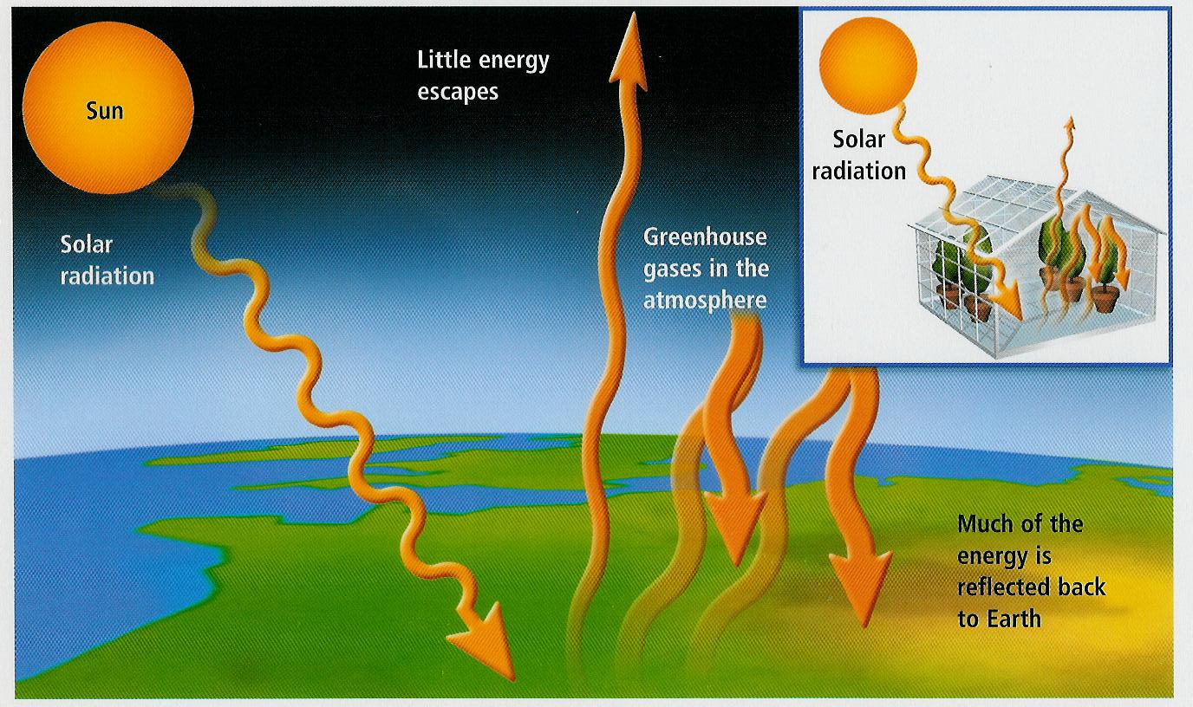
Global Change
Greenhouse Effect
- incoming solar radiation “trapped” by lower atmosphere

Slide 3
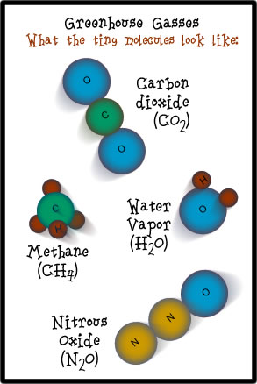
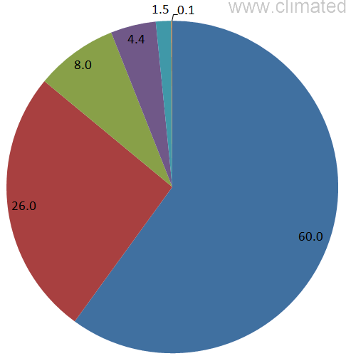
Global Change
Greenhouse Effect
Greenhouse Gases (GHG)
Water Vapor (H₂O)
Carbon Dioxide (CO₂)
Nitrous Oxide (N₂O)
Methane (CH₄)
Ozone (O₃)
N₂O
CH₄
O₃
CO₂
H₂O
Contribution to Greenhouse Effect

Slide 4
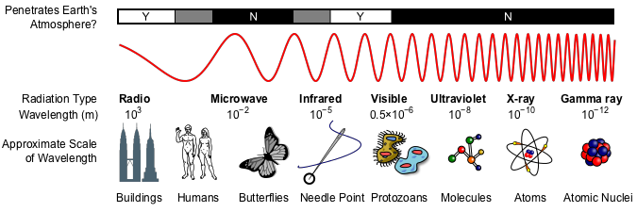
Global Change
Greenhouse Effect
Electromagnetic Radiation Spectrum
?
?
Radio Waves
Infrared
Visible Light
Ultraviolet
Penetrate Earth’s Atmosphere

Slide 5
Global Change
Greenhouse Effect
How can Greenhouse Gases create a temperature change.
IR radiation
C
O
O
Carbon Dioxide
Molecule
Incoming energy
“excites” the molecule
Molecule slowly “relaxes”
& releases heat (IR radiation)

Slide 6
Global Change
Greenhouse Effect
Visible
IR
UV
IR warms up CO₂
Re-radiates heat
O-C-O
Incoming
Sunlight
O-C-O
O-C-O
UV & Visible
No effect
Heats up Earth
“Converts” UV & Vis to IR

Slide 7
Global Change
Greenhouse Effect
Visible
IR
UV
IR warms up CO₂
Re-radiates heat
O-C-O
IR heats up CO₂
Re-radiates heat
Incoming
Sunlight
O-C-O
O-C-O
O-C-O
UV & Visible
No effect
Radiated IR
Heats up Earth
“Converts” UV & Vis to IR

Slide 8
Global Change
Greenhouse Effect
Keeling Curve
Sawtooth seasonal change
- decrease during growing season
CO₂ taken up by plants
- increase during “rotting” season
decaying plants release CO₂

Slide 9
Global Change
Greenhouse Effect
History
Joseph Fourier in the 1820s => atmospheric gases “trap” heat
John Tyndall (1859) => identified greenhouse gases H₂0, CO₂, CH₄
Svante Arrhenius & Arvid Högbom (1869) => human activities increase CO₂
climate self-regulation (1900 – 1950) – carbon cycle & oceans
Guy Stewart Callendar (1938) – revived CO₂ as important greenhouse gas
1950’s – computational studies supported greenhouse gas role in temperature
1958 – Keeling established CO₂ monitoring site at Moana Loa (and Antartica)
1960’s & 70’s – debated role of CO₂
1980’s – ice cores turned the debate

Slide 10
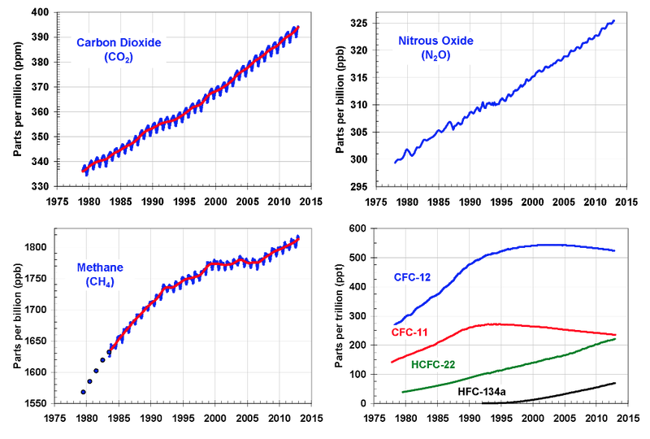
Global Change
Greenhouse Effect
Greenhouse Gases (GHG)

Slide 11
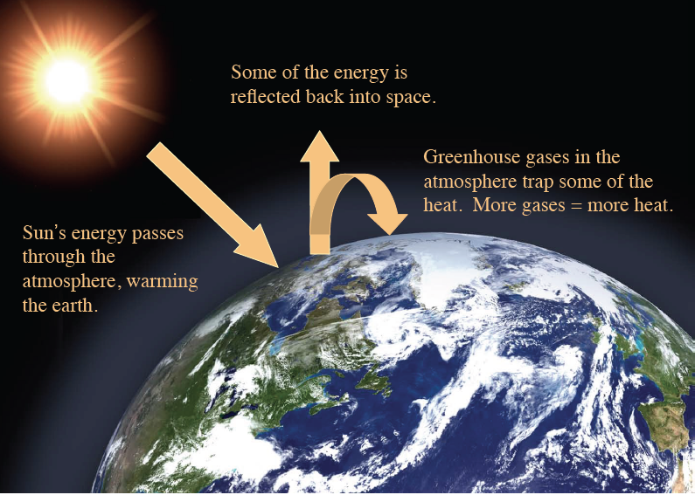
Global Change
Greenhouse Effect
Greenhouse Effect
No Atmosphere
Sun In =>Sun Out
Atmosphere w/ some GHG
Sun In =>warm air =>Sun Out
Atmosphere w/ more GHG
Sun In =>warmer air =>Sun Out

Slide 12
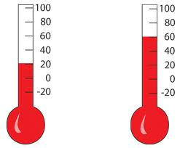
Global Change
Climate Proxies
Temperature Proxy –
- preserved physical characteristic (e.g., tree ring)
- that can be used as a measure of past temperature
- if properly calibrated.
4
150
4
3
100
3
Height of Fluid
2
50
2
1
0
1
0
50
100
150
Temperature

Slide 13
Global Change
Climate Proxies – Tree Rings
Dendochronology: the study of tree rings
● Measurement is thickness of the ring
– Temperature, CO2 content, precipitation
● Pretty well calibrated over the last 100 or so years
● Bristlecone pine – 5000 years old

Slide 14
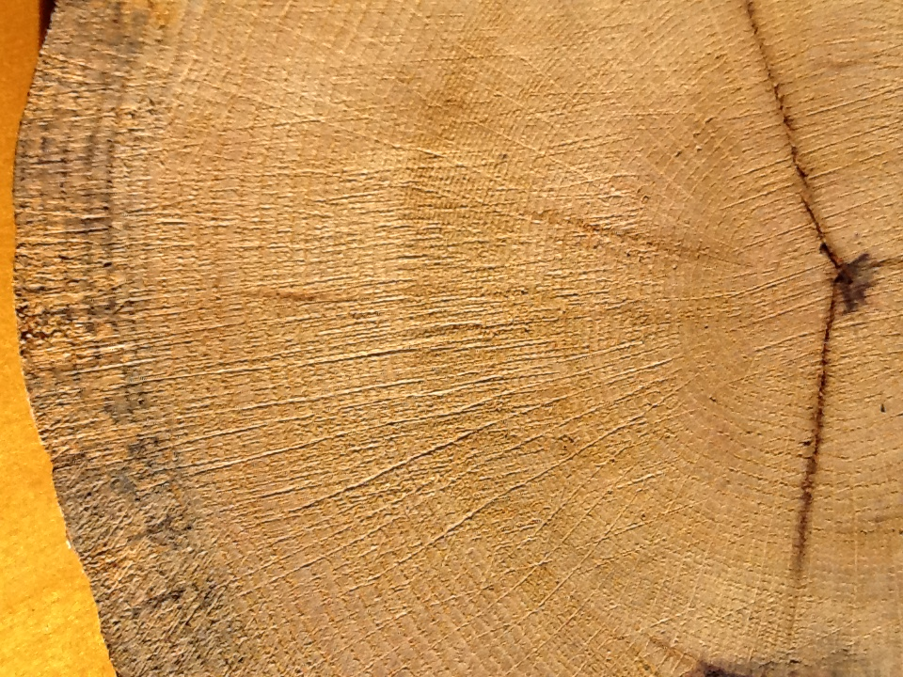
Global Change
Climate Proxies – Tree Rings
Tree Ring Age
1937
1942
1947
1952
1957
1962
1967
1972
1977
1982
1987
1992
1997
2002
2007
2012
Growing Conditions?
Wetter
Wider
Rings
Rainfall
Narrower
Rings
Dryer
Colder
Warmer
Temperature

Slide 15
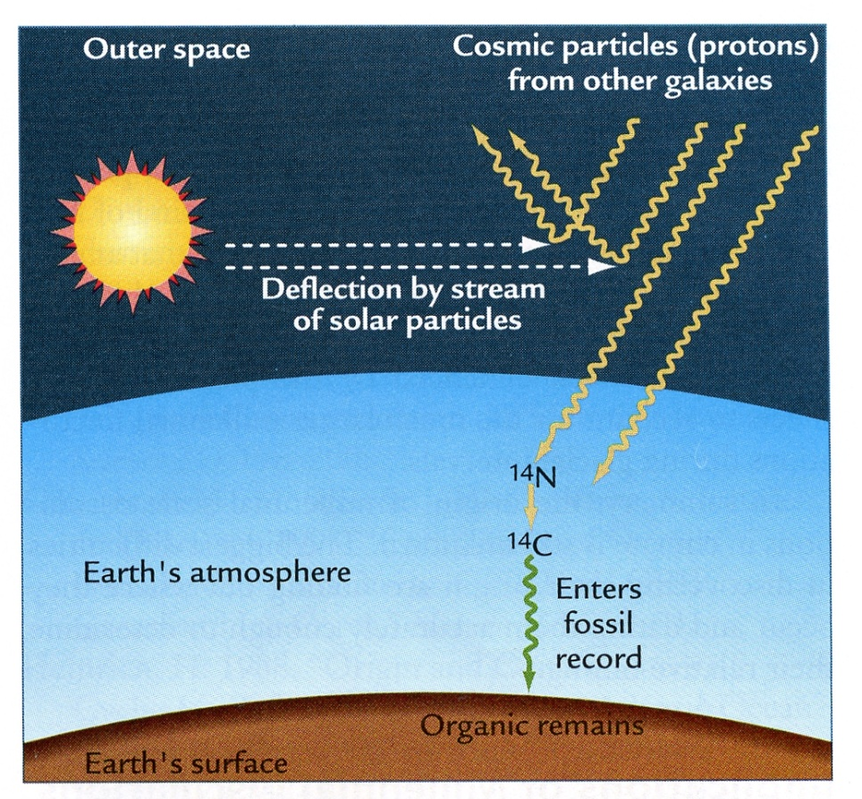

Global Change
Climate Proxies – Tree Rings
Tree Ring Age
1937
1942
1947
1952
1957
1962
1967
1972
1977
1982
1987
1992
1997
2002
2007
2012

Slide 16
Global Change
Climate Proxies – Corals
Coral growth
● Coral skeleton are made of calcium carbonate, CaCO₃
● Trace amounts of strontium, Sr, get included in place of the Ca
● Ratio of Sr/Ca depends on temperature (colder => more Sr)

Slide 17
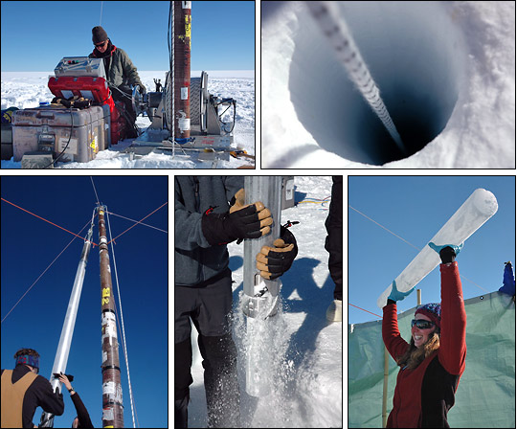
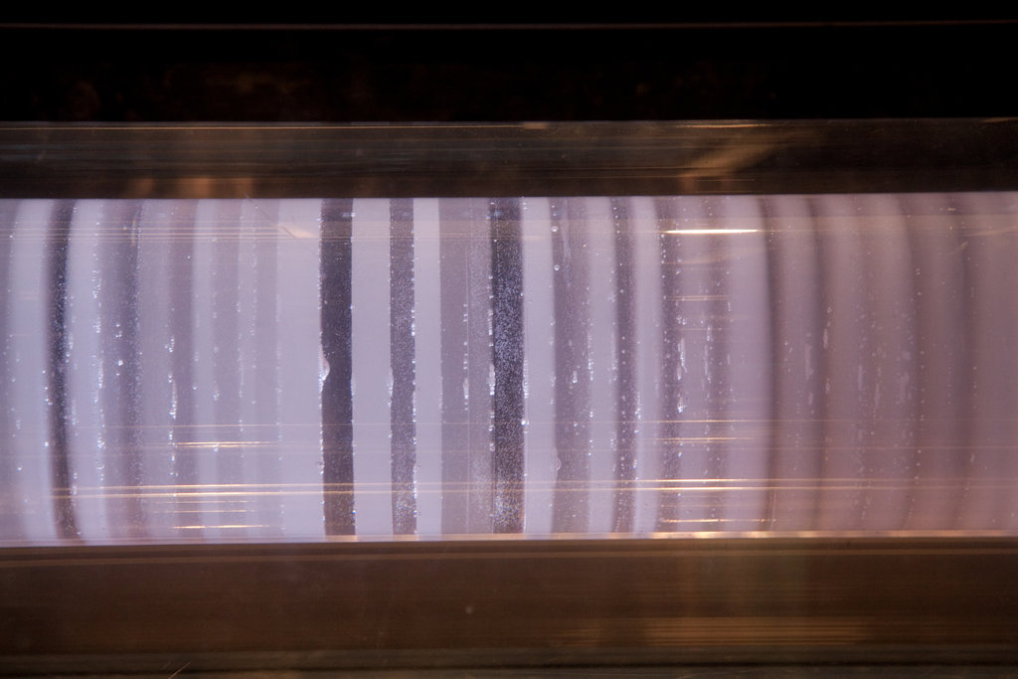
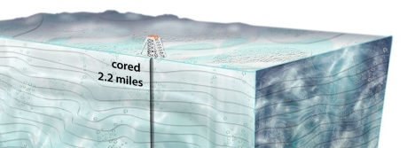
Global Change
Climate Proxies – Ice Cores
Air Bubble in Cores
trapped atmosphere
past CO₂ concentrations
past CH₄ concentrations
Younger
Annual Ring
Melted Ice
past global ice volume
oxygen isotopes
Pollen
plant types
Dust
aridity
Older

Slide 18
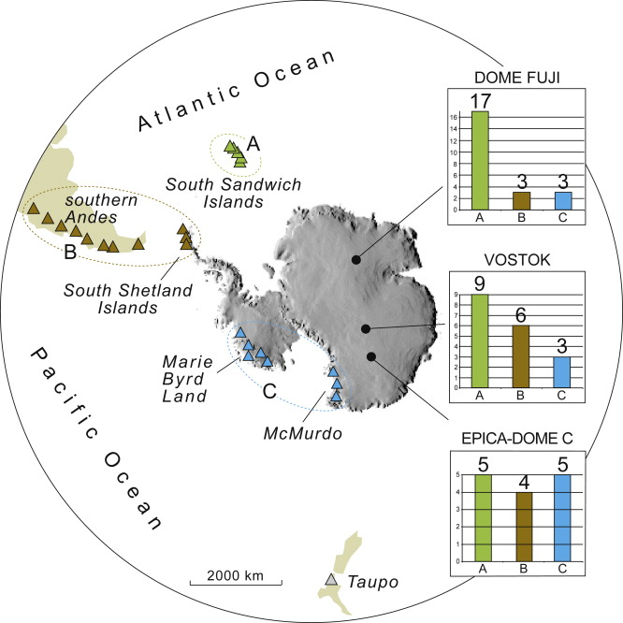
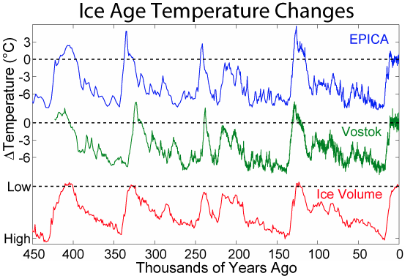
Global Change
Ice Core Results

Slide 19
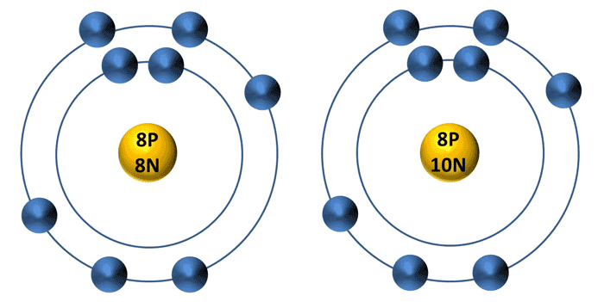
Global Change
Oxygen Isotopes
Types of common oxygen molecules
– Oxygen 16 (8 protons, 8 neutrons) - most oxygen
– Oxygen 18 (8 protons, 10 neutrons) - heavy oxygen
The type of oxygen found is related to precipitation/evaporation
– O16 evaporates more easily
Climate affects precipitation/evaporation
¹⁶O
¹⁸O
Lighter
Heavier
Water Molecules
¹⁶O
¹⁸O
H
H
H
H
Lighter
Heavier

Slide 20
Global Change
Oxygen Isotopes
Warmer Temps.
Ice enriched in ¹⁸O
Ice depleted in ¹⁶O
¹⁸O/¹⁶O increases
¹⁶O
¹⁸O
Lighter
Heavier
Cooler Temps.
Ice depleted in ¹⁸O
Ice enriched in ¹⁶O
¹⁸O/¹⁶O decreases
Water Molecules
¹⁶O
¹⁸O
H
H
H
H
Lighter
Heavier

Slide 21
Global Change
Ice Core Results

Slide 22
Global Change
Ice Core Results
More dust when colder

Slide 23
Global Change
Climate Proxies – Sediment Cores

Slide 24
Global Change
Climate Proxies – Sediment Cores
Deep Sea Drilling Program (1966-1983)
Ocean Drilling Program (1983-2003)
Integrated Ocean Drilling Program (2003-2013)
International Ocean Discovery Program (2013 - ?)
Glomar Challenger
(1966 – 1983)
JOIDES Resolution
(1983 – present)
Chikyu
(2002 – present)
120 m long
90 days
143 m long
75 days
125 people
210 m long
200 people

Slide 25
Global Change
Climate Proxies – Sediment Cores
Dynamic Positioning
– Ship maintains position automatically
Heave compensation
– Removes the drill up/down to cancel rocking motion

Slide 26
Global Change
Climate Proxies – Sediment Cores
Drill String
- Hollow pipe sections, 9.6m long each
- Pipe spins a drill bit on the end
- The “core” in the center of the hole is removed up the pipe
- Tools and sensors can be lowered down inside the pipe on a wire

Slide 27
Global Change
Climate Proxies – Sediment Cores

Slide 28
Global Change
Climate Proxies – Sediment Cores
Drill string sensors (logging the hole)
Can lower sensors inside the drilled hole
– Temperature
– Cameras
– Samplers
● Use a reentry cone
– Can put the drill back in same hole

Slide 29
Global Change
Climate Proxies – Sediment Cores
Piston coring
- Softer sediments
- Plastic tube in a metal pipe

Slide 30
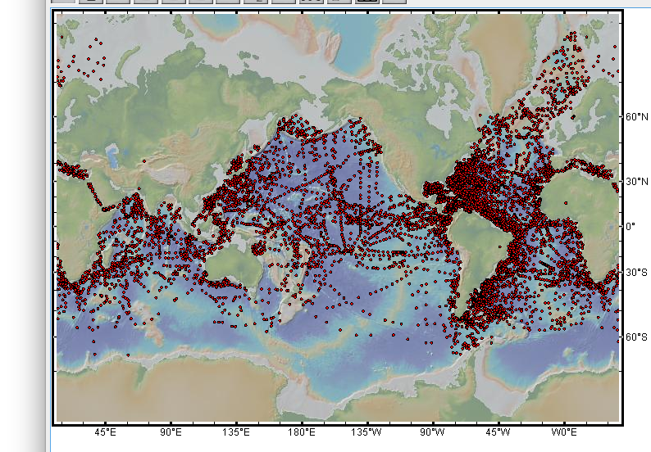
Global Change
Climate Proxies – Sediment Cores
Ocean Drilling
Sediment Cores

Slide 31
Temperature indicator
Age of sample
Global Change
Climate Proxies – Sediment Cores
Past Climate Measurement Needs
- Age of Measurement
- Temperature Indicator/Proxy (e.g., oxygen isotope ratios)

Slide 32
Global Change
Climate Proxies – Sediment Cores
Age Measurements
Proxy
Magnetostratigraphy
(polarity reversals)
Biostratigraphy
(critter range)
Radiometric Dating
(radioactive decay)
0
120 Ma

Slide 33
Global Change
Climate Proxies – Sediment Cores
Age Measurements
Proxy
Magnetostratigraphy
(polarity reversals)
Biostratigraphy
(critter range)
Radiometric Dating
(radioactive decay)
0
120 Ma

Slide 34
Global Change
Geologic Time Scales – Since Dinosaurs

Slide 35
Global Change
Climate Proxies – Sediment Cores
Foraminifera (single cell protozoa) shells are made
of calcium carbonate, CaCO3
Can use the ¹⁸O/¹⁶O ratio in their shells as a proxy
for past temperature
Calcium Carbonate (CaCO₃) “shell”

Slide 36
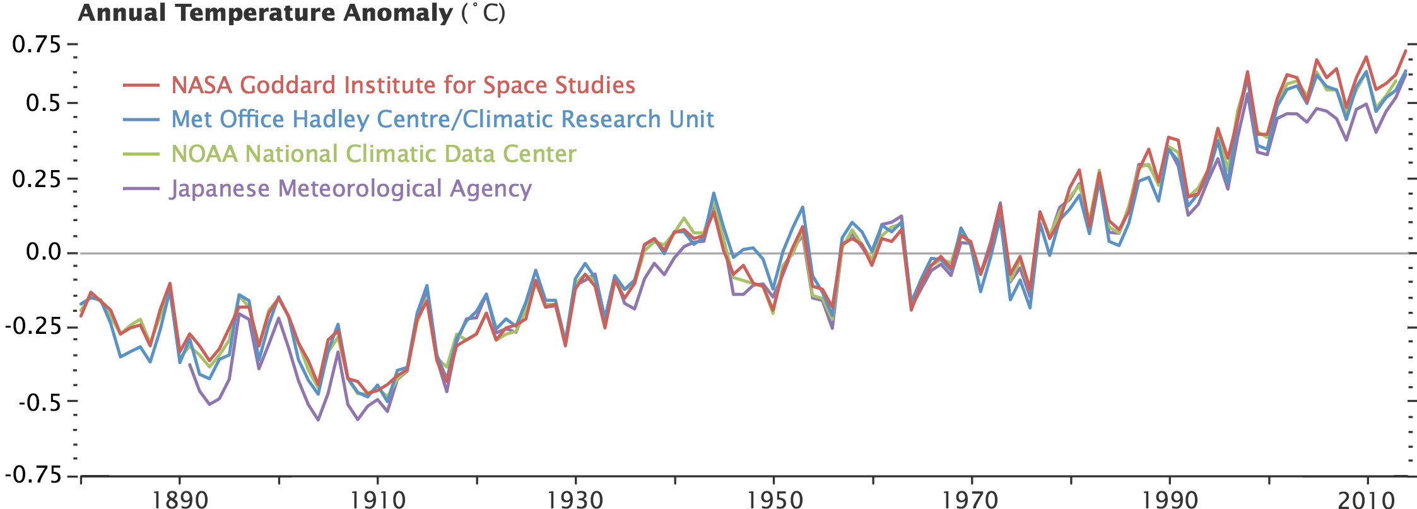
Global Change
History of Temperature
Instrumental Measurements (1850 to present)
15˚C
14˚C

Slide 37
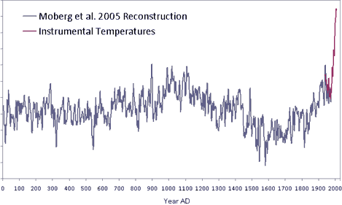
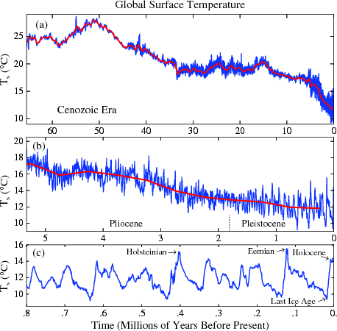
Global Change
History of Temperature
Instrumental Measurements (1850 to present)
Proxy Measurements
- tree rings (past 2000 years or so)
15
Medieval
Warm
Period
14
Little
Ice Age
13

Slide 38
Global Change
History of Temperature
Instrumental Measurements (1850 to present)
Proxy Measurements
- tree rings (past 2000 years or so)
- corals (past 500 years)
- ice cores (past 500 thousand years)

Slide 39
Global Change
History of Temperature
Instrumental Measurements (1850 to present)
Proxy Measurements
- tree rings (past 2000 years or so)
- corals (past 500 years)
- ice cores (past 500 thousand years)
- deep-sea sediments (past 100,Million years)

Slide 40
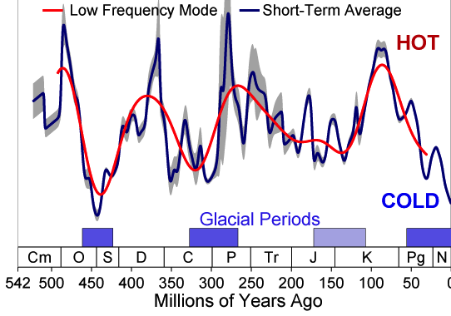
Global Change
History of Temperature
Instrumental Measurements (1850 to present)
Proxy Measurements
- tree rings (past 2000 years or so)
- corals (past 500 years)
- ice cores (past 500 thousand years)
- deep-sea sediments (past 100 Million years)
- on land, formerly deep sea sediments (past 500 Million years)
40
30
Temperature (˚C)
20
10

Slide 41
Global Change
History of Temperature
Greenhouse Effect
Proxies defined
Examples
ice cores
sediment cores
tree rings
History of Measurements (100 Myrs to 100 yrs)
Temp
CO₂
Time & Space Biases
hurricane example (ship logs vs satellites)
instrument location

Slide 42
Global Change
Greenhouse Effect
Greenhouse Effect
- greenhouse gases
Temperature Proxies
Example Proxies
tree rings
corals
ice cores
sediment cores
History of Measurements (100 Myrs to 100 yrs)

